Slide 1
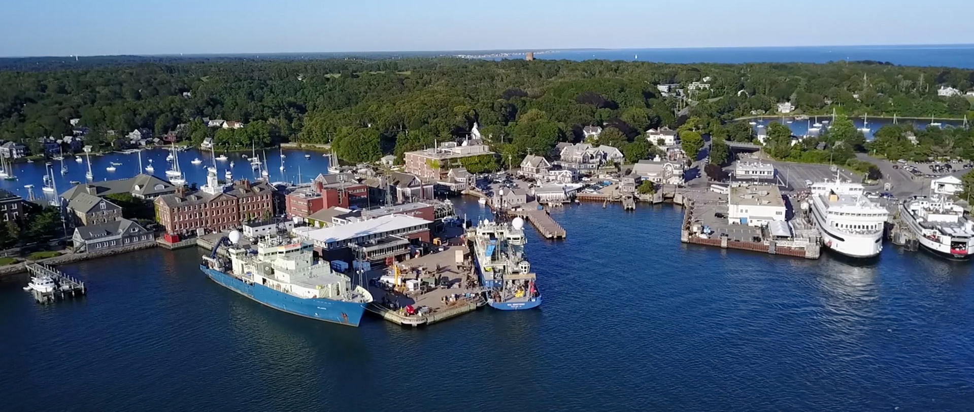
TIOGA 2025 Users Meeting
Presented by WHOI Ship Operations

Slide 2
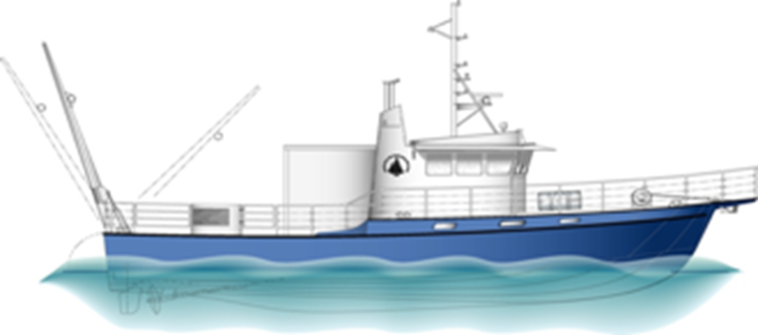
Meeting Agenda for January 29, 2025
    2024 Review
    2025 Day Rates & Fuel Rates
    Scheduling
    Standby Days
    MVCO
    Dive Ops
    Extended Days
    SSSG Update
    Improvements

Slide 3
2024 Review
2024 86 total days*
2023 91 total days
2022 95 total days
2021 115 total days
2020 77 total days (COVID)
2019 55 total days (COVID)
*2024 Tioga Ops began April 1 (MLR), 9 months of operations
Averaging 87 days / year since 2019.
Operations were regional. MVCO, Outer Cape, Mass Bay, SE New England and Pt Judith, Wind Leases, Gulf Maine
Outside users included Battelle, USGS, BAE, WHG, Vineyard Wind and ONR
2024 | Full | Half | Extended | Standby
WHOI | 39 | 12 | 0 | 14
Outside | 7 | 7 | 0 | 0
Battelle | 7 | 14 | 0 | 0
Totals | 53 | 33 | 0 | 14

Slide 4
Tioga Day Rates
Minimal increase in 2025
WHOI $75 & $100, Outside Users $110 & $225
Outside users pay full base rate plus 10% Fee
RV TIOGA 2025 Day Rates
Type | WHOI | Non-WHOI
Half Day: 1-6 hrs | $2,650.00 | $3,760.00
Full Day: 6 - 12 hrs | $5,000.00 | $7,525.00
Extended Day: 12-16hrs | $7,475.00 | $10,950.00
Standby Day | $1,200.00 | $1,200.00
Endowment
Half Day: 1-6hrs | $1,110.00 | $ -
Full Day: 6 - 12 hrs | $2,525.00 | $

Slide 5
Tioga Fuel Rate
Each user is charged per gallon based on actual fuel purchase price that is on board. Includes both engines and generator
Fuel cost is calculated daily & completed after each trip/voyage. Vessel has digital flow meters
2024 Fuel Cost Average $3.28 / gallon
Example of fuel cost calculation

Slide 6
Tioga Scheduling
Tioga scheduling is available online via the following methods:
  Ship Time Request (STR) via the link:
    https://whoiforms.whoi.edu/tioga-shiptime-request/
  Google calendar via the link: Date of reservation will be noted in Calendar
    https://www.whoi.edu/what-we-do/explore/ships/ships-tioga/tioga-ship-scheduling/
Tioga schedule is updated in real time and can be viewed via the following:
    https://whoiforms.whoi.edu/tioga-schedule/
Contact Eric Benway, WHOI Port Captain, for scheduling questions

Slide 7
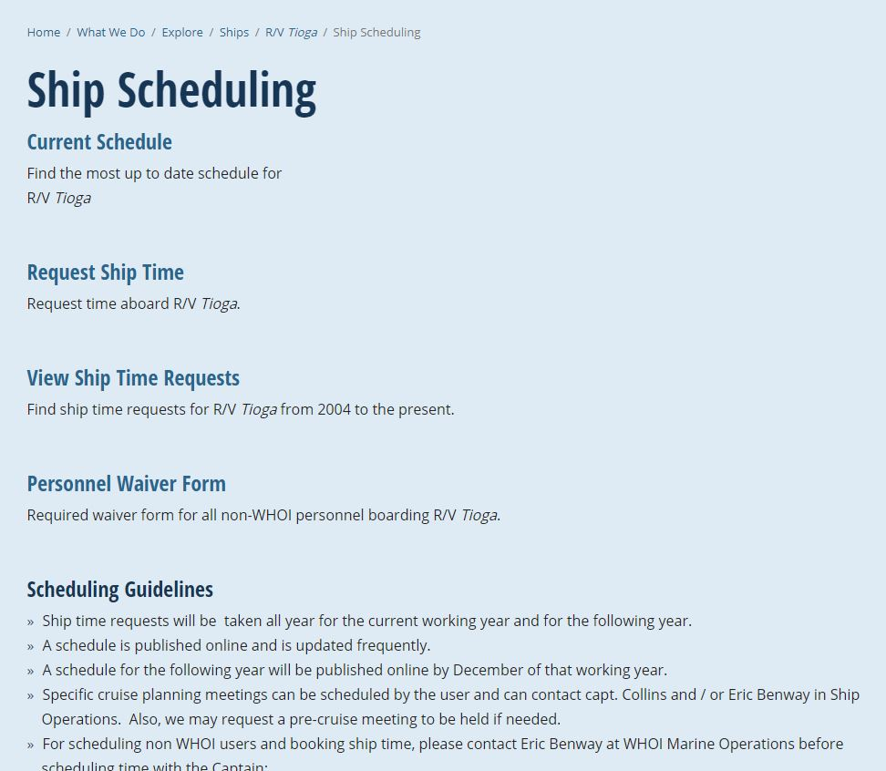
Tioga Scheduling continued
https://www.whoi.edu/what-we-do/explore/ships/ships-tioga/tioga-ship-scheduling/

Slide 8
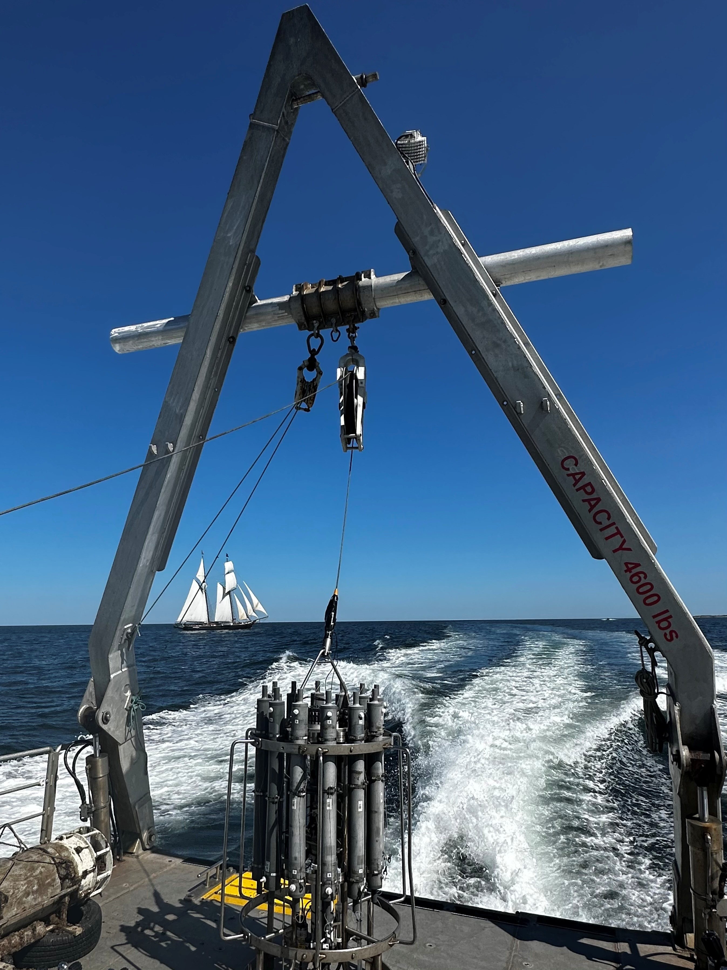
Tioga Scheduling continued
WHOI users receive priority over outside users whenever possible
Flexibility is key for all users and crew – Be willing to work with other projects & adjust schedules
Ship Ops welcomes collaboration of different projects on same trip working in / near same area(s)
Make up days due to wx may occur immediately or may require rescheduling at a later date
Maintenance days will need to be considered/blocked from calendar to assure vessel operational safety

Slide 9

Tioga Standby Days
$1,200 per SB Day
Stand By Days have been created to "lock in“ reservations
Designed to hold the boat during project w/o offloading gear
If a user schedules more days than they really needed, SB days may be charged
Do not automatically schedule in WX days. Discuss with Captain Pete the scope of your project and deadlines etc. If you need more time we will work to schedule you in before deadlines

Slide 10
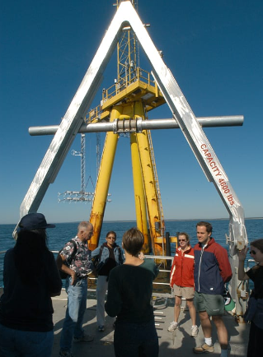
MVCO
  Multiple science teams need to coordinate prior loading and departure and have a common science plan
  One Ch Sci or leader per voyage
  Additional projects/users going out to tower and nearby moorings
  Cost splitting with other projects and users
  Cost splitting with outside users at MVCO

Slide 11
Dive Operations
  Work with WHOI DSO Ed O’Brien and Kim Malkoski prior to loading
  Submit Dive Plan to Captain well in advance of trip
  Dive Plan Approval is required prior to departure
  Scientists and Engineers and other staff can get dive qualified through WHOI Dive Operations
  Ed O’Brien Kim Malkoski
  Dive Operations Manager Dive Safety Officer
  508-289-2239 508-289-3522
  eobrien@whoi.edu kmalkoski@whoi.edu

Slide 12
Tioga Extended Days
Any day over 12 hrs
Additional crew may be required to operate legally
Hourly rate may be charged, estimate $627/hr for 2025 + fuel
Extended days must be planned well in advance
Schedule may need to be changed due to rest requirements and other projects following day(s)
Night Operations are allowed but no day ops during those projects for crew rest

Slide 13
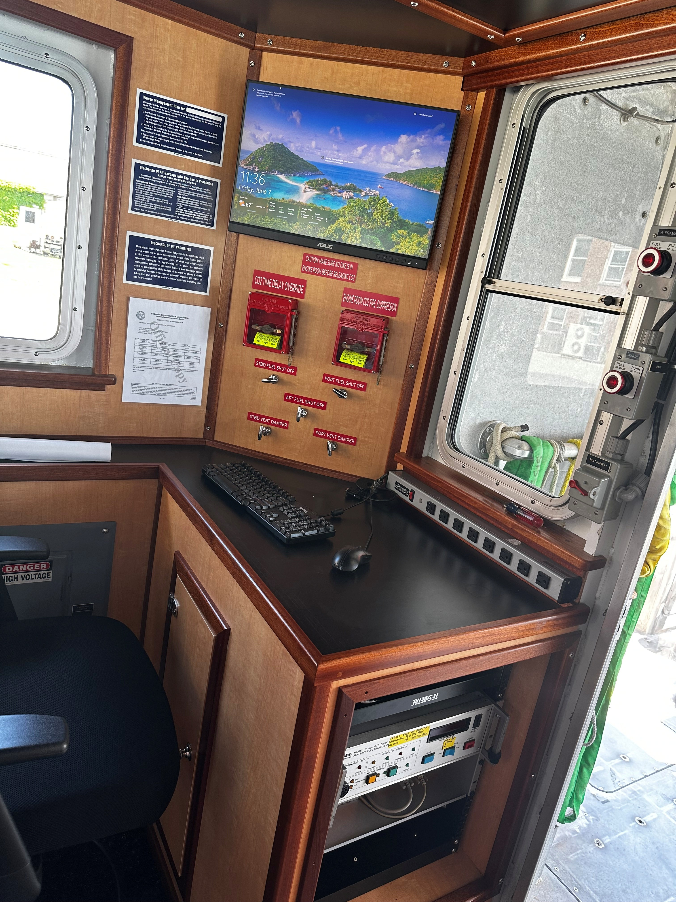
SSSG Support
A major overhaul took place to the Tioga’s science infrastructure
All of Tioga’s science wiring and racks were removed during last springs refit
Two new racks and new data and network wiring have been installed as replacements
Two new data collection computers have been installed, In line with plans for all WHOI vessels to update their data collection systems
A new L1/L5 GPS is presently being installed, which will give small improvement in GPS accuracy
The network is due for an overhaul, with plans to replace the router and add WiFi access
There are tentative plans to add Starlink service for science use
Input on the usefulness of Starlink for science would be helpful

Slide 14
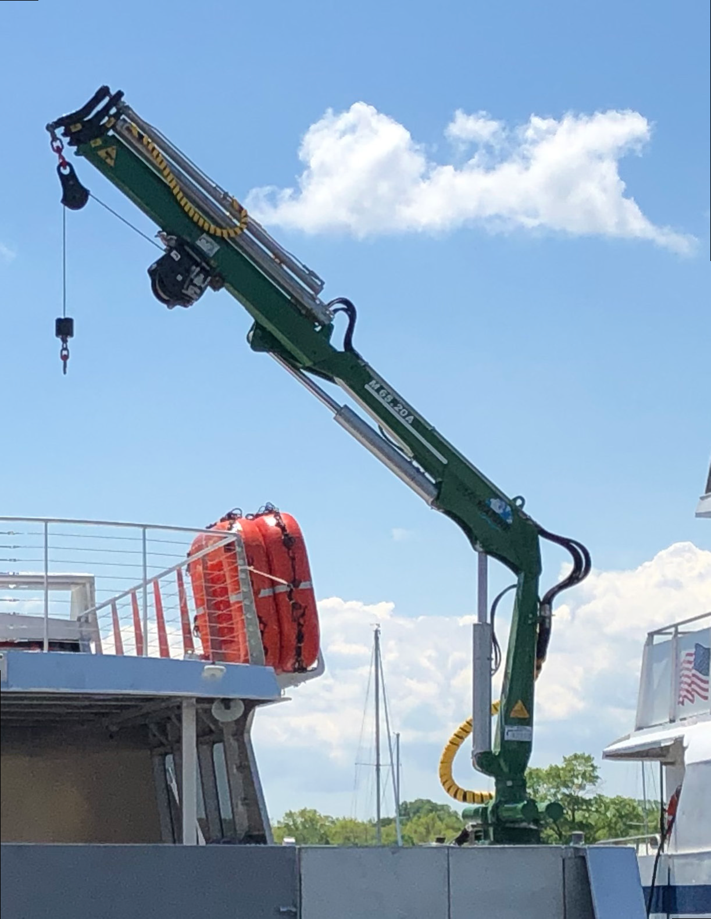
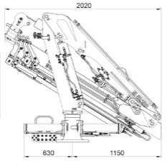
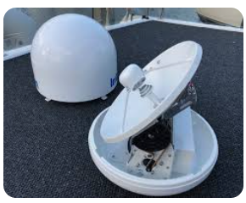
2025 Planned Improvements
Winch drum relocations (swap)
Knuckle Crane – DMW M42.20A
Reach 16.4 ft
hook load rating of 1,200 lbs at full extension
CTD Fluorometer
Starlink

Slide 15

QUESTIONS?

Slide 16
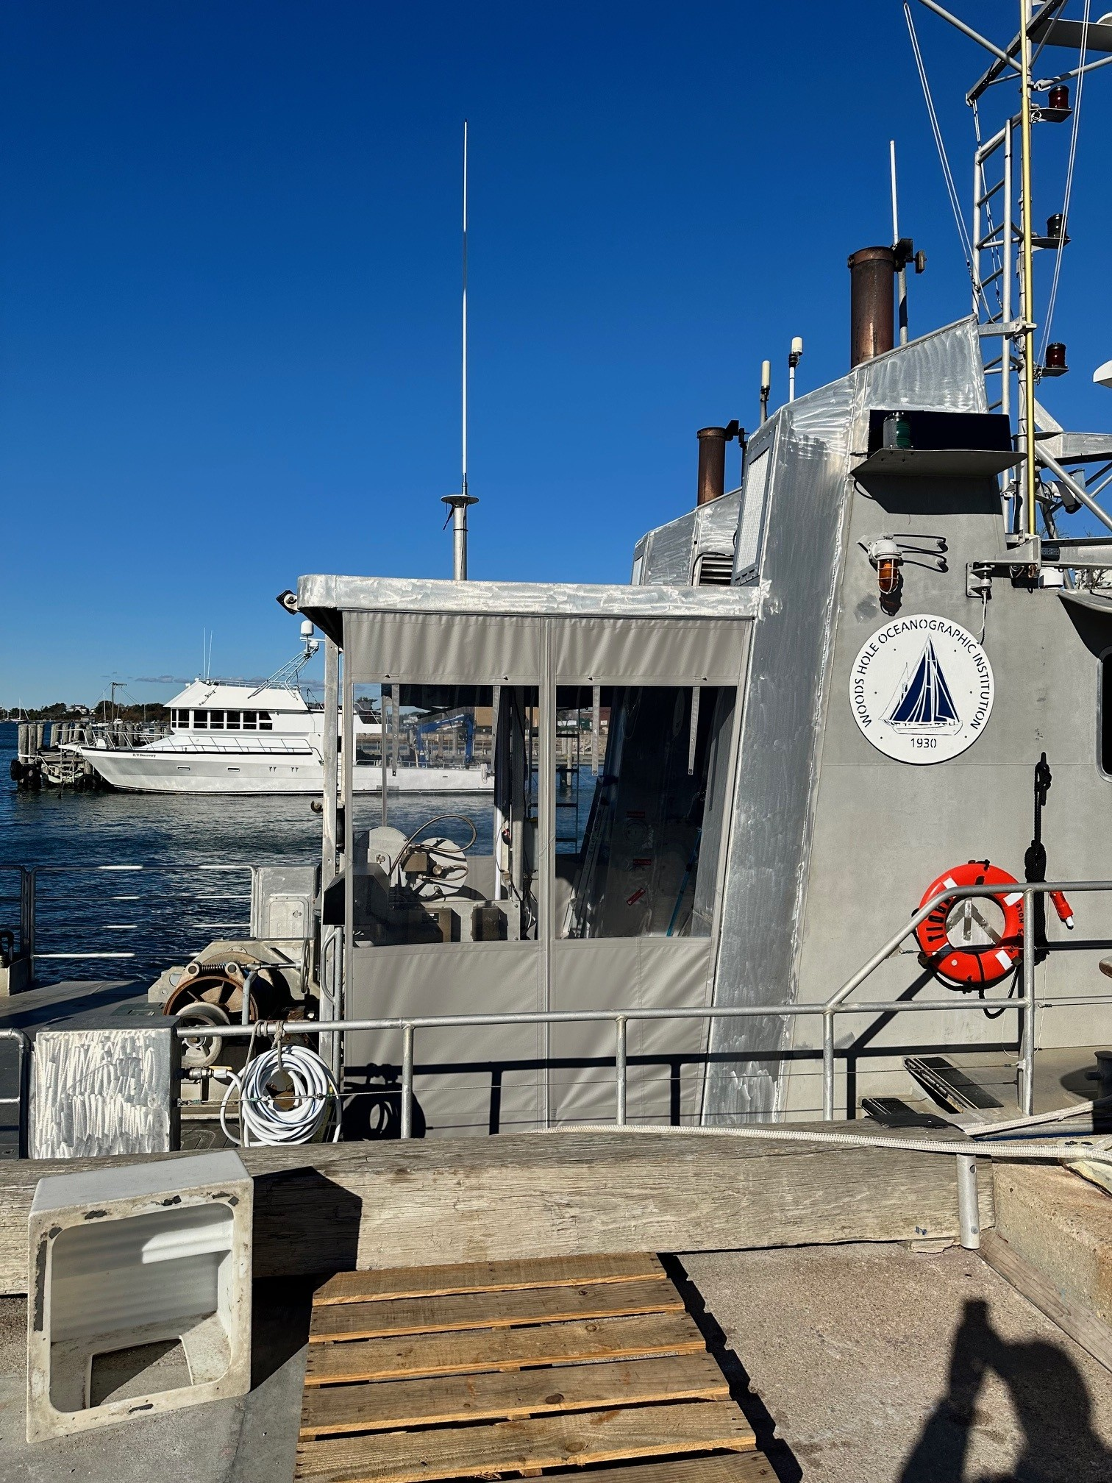
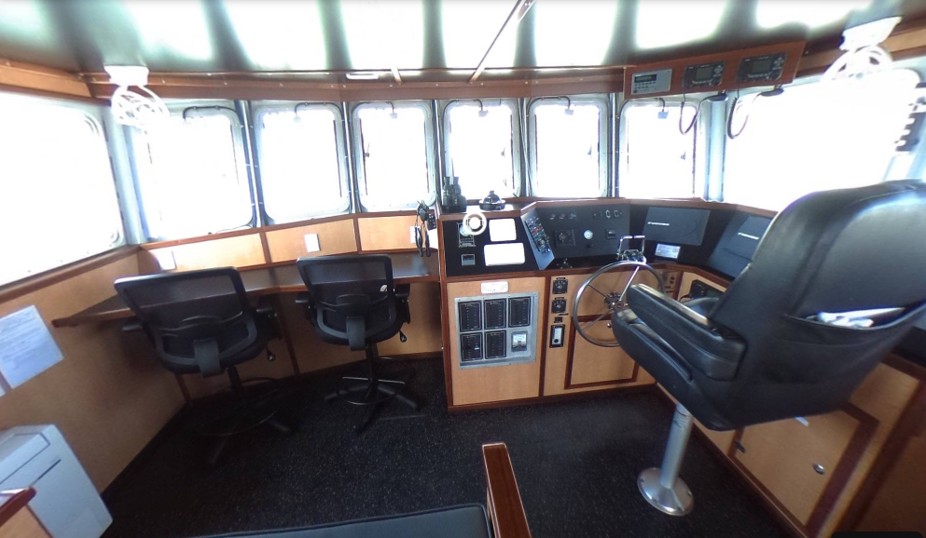
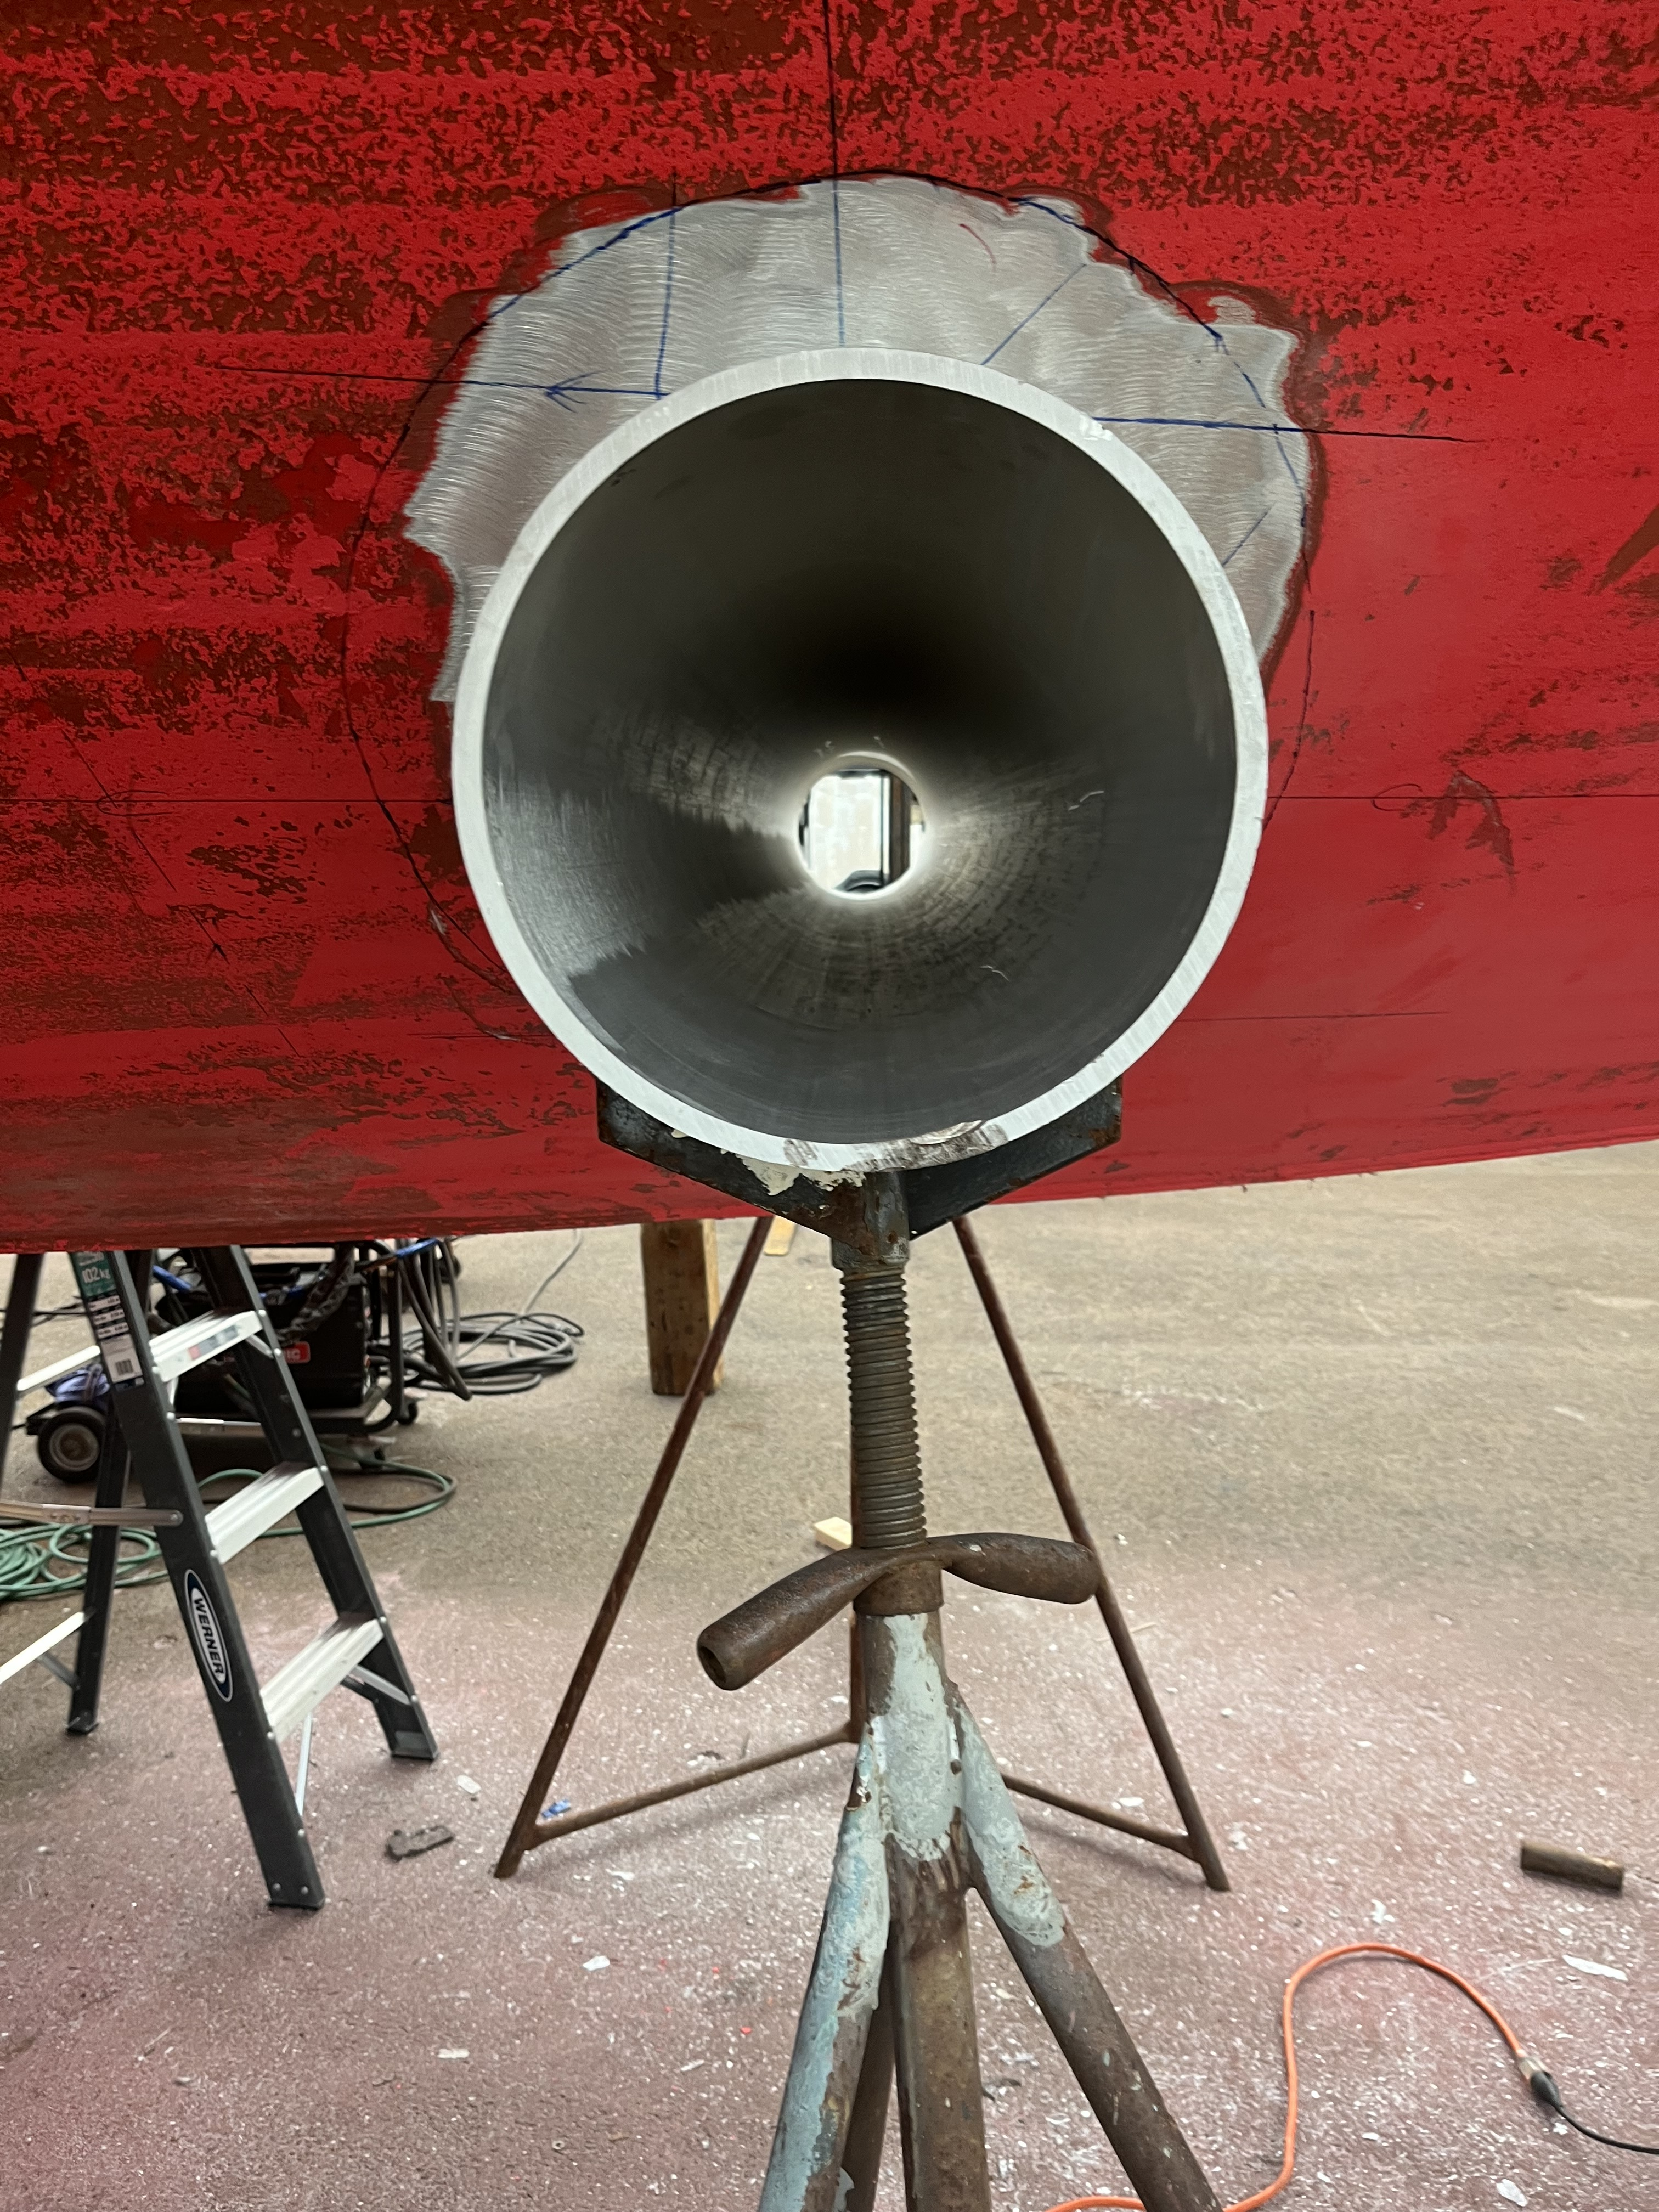
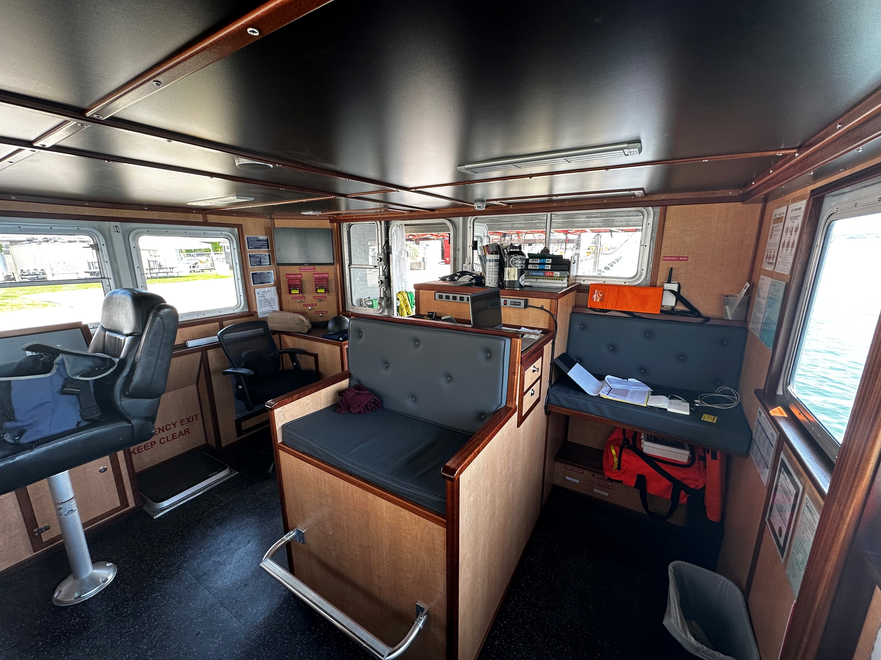
MLR Pictures

