Slide 1
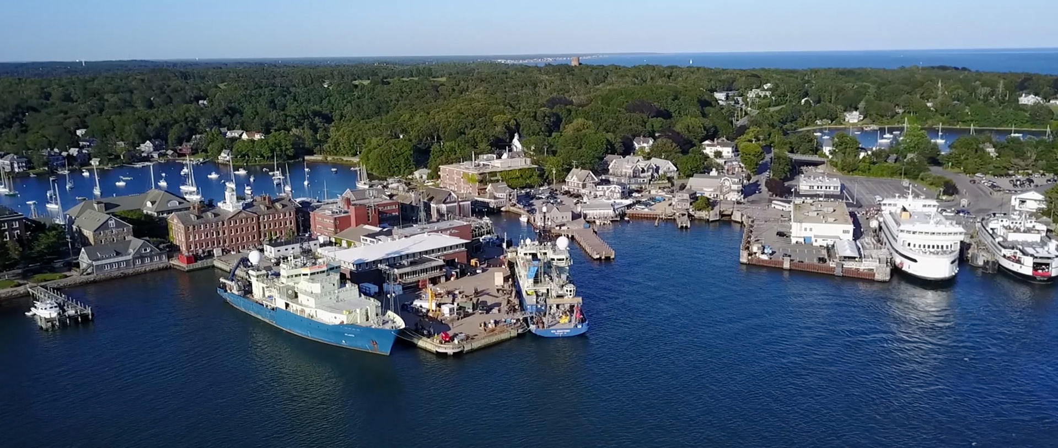
TIOGA 2021 User Meeting
Presented by WHOI Port Operations

Slide 2
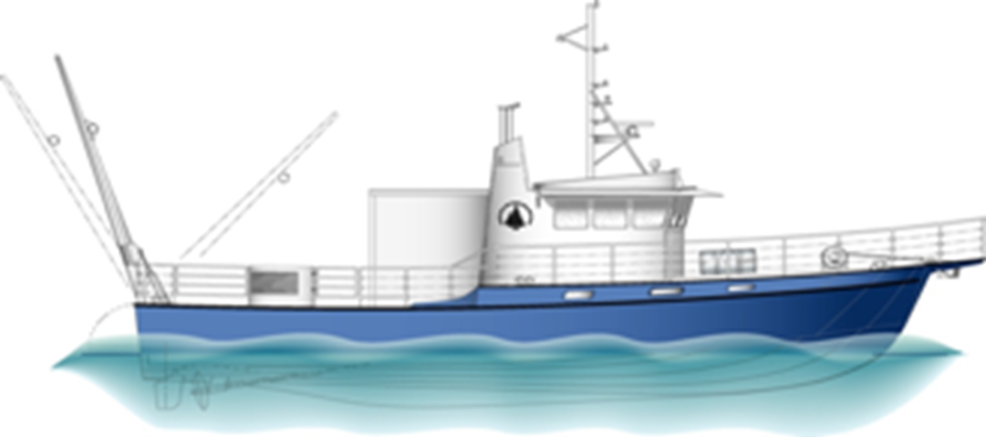
Meeting Agenda for February 3, 2021
    Introductions
    2020 Review
    Tioga COVID-19 Protocols
    2021 Day Rates & Fuel rates
    Scheduling & Cruise Planning 2021
    Vessel Chartering (outside WHOI)

Slide 3
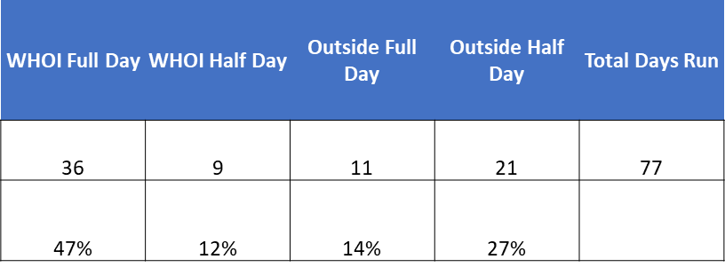
2020 Review
COVID-19 March 17
  Tioga completed 4 missions prior to May 1
May 3 began Re-start of Science Ops post-COVID-19
  With COVID-19 Protocols in place, Tioga averaged 8.1 missions per month (May – December)
2020 improved to 77 days vs 55 days during 2019 (+22 days) despite a pandemic!
Operations were local and included MVCO, Outer Cape, Mass Bay and SE New England areas
Users included WHOI, Battelle, USGS, Klein Marine Systems and Oceantech USA

Slide 4
Tioga COVID-19 PROTOCOLS
Passenger/scientist number allowed on board is limited to 3 (weather-permitting, may increase to 4)
Masks must be worn at all times, particularly when below deck
The wheelhouse is off limits and users are required to set up equipment in the Lab
Social distancing protocols are expected to be maintained at all times
Assignment of specific duties and a well scripted procedure is requested for load out and deck operations prior to departure

Slide 5
Tioga COVID-19 PROTOCOLS
Users are expected to be “self-sufficient” for their MOB/DEMOB and deck operations. Tioga Crewmembers deck responsibilities are restricted to running machinery/cranes.
Staterooms are off limits
Users are asked to remain on Weather decks as much as possible
Food and Beverage are not being provided by crew and Tioga is no longer carrying community stores although the water cooler remains available
“Sanitize-Use-Sanitize” approach is expected by all users when common area surfaces are touched, this includes the water cooler and head

Slide 6
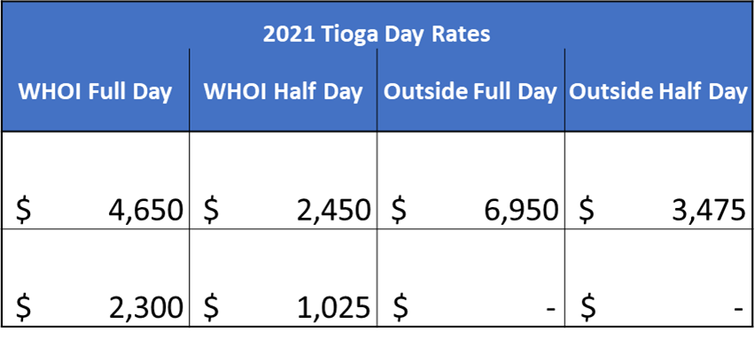
Tioga Day Rates
No increase to the day rate for 2021
In an effort to help reduce higher overall day rates, fuel costs continue to be charged separately from vessel rates for all users
Actual Fuel usage is charged on a per trip basis
Day rate is for vessel, Crew and installed science equipment

Slide 7
Tioga Fuel Rate
Each user is charged the same amount per gallon based on actual fuel purchased
Fuel cost is calculated daily & completed after each trip/voyage, vessel has digital flow meters
2021 use fuel estimate of 28.5 gallons/hour at $2.40/gallon
  Includes both engines and generator
RATES are available at the following internal link: https://www.whoi.edu/page.do?pid=144756

Slide 8
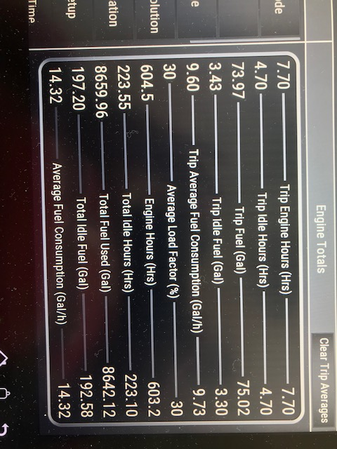
Post Operation Fuel Report
  Example of a typical full day run read-out from digital flow meter

Slide 9
Tioga Scheduling
Contact Eric Benway, WHOI Port Captain, for initial scheduling questions
Tioga scheduling is available online via the following methods:
  Google calendar via the link:
    https://www.whoi.edu/what-we-do/explore/ships/ships-tioga/tioga-ship-scheduling/
  Ship Time Request (STR) via the link:
    https://whoiforms.whoi.edu/tioga-shiptime-request/
Tioga schedule is updated in real time and can be viewed via the following:
    https://whoiforms.whoi.edu/tioga-schedule/

Slide 10
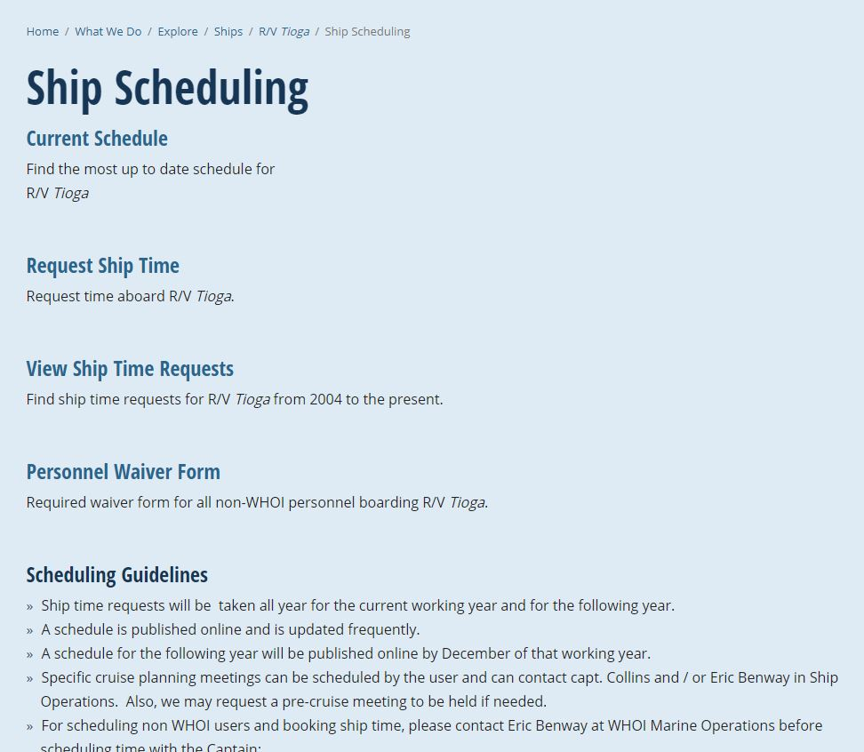
Tioga Scheduling continued
https://www.whoi.edu/what-we-do/explore/ships/ships-tioga/tioga-ship-scheduling/

Slide 11
Tioga Scheduling continued
WHOI users receive priority over outside users whenever possible
Remaining flexible is key for all users and crew
Users may receive one wx (weather cancellation) day per operation day as needed
Make up days due to wx may occur immediately or may require rescheduling at a later date

Slide 12
Tioga Scheduling continued
Maintenance days may need to be considered/blocked from calendar to assure vessel operational safety
Should an extended day (12+ hours) be requested/needed, crew exchange for Captain or Mate is required
ASK about hourly options (beyond 12 hours but not quite to 18 hours)
Marine Operations is working to establish a rate for these unique situations

Slide 13
Tioga Scheduling continued
Dive Operation Scheduling
  Work with WHOI DSO Ed O’Brien and Kim Malkoski prior to loading
  Submit Dive Plan to Captain
  PLEASE NOTE - Approval is required prior to departure
MVCO
  Additional projects/users going out to tower and nearby moorings
  Cost splitting with other projects and users
  Cost splitting with outside users at MVCO
Other large projects on the Horizon?
  Orsted proposal for Tioga use is under review (COVID delay)

Slide 14
Cruise Planning
Please make a PLAN ahead of time with Captain Peter Collins
Science is expected to provide a written procedure of activities including, but not limited to, the following areas:
    Deployments / Recoveries
    Dive Ops / Glider Ops etc.
Providing pictures and/or drawings is recommended, more information is better
Shared science equipment needs, please include at time of scheduling/planning
Prior to departure, define expectations of who will performing the various activities. Science is expected to provide adequate on-board personnel to complete objectives
Prior to departure, communicate with Captain what gear will need to be provided by Tioga operations and what gear/items are being provided by science team

Slide 15
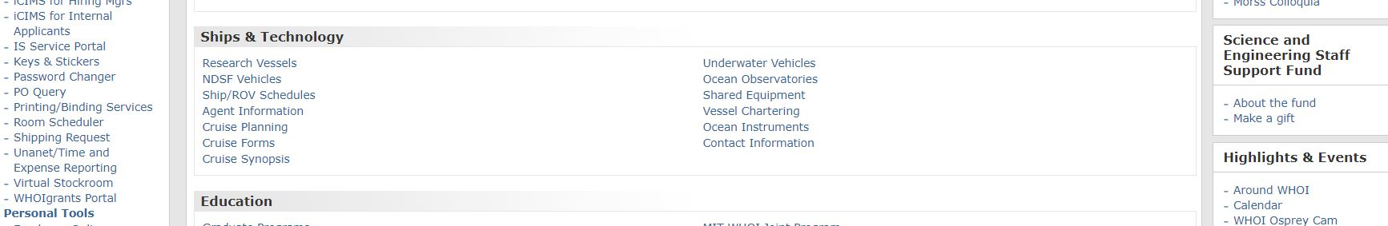
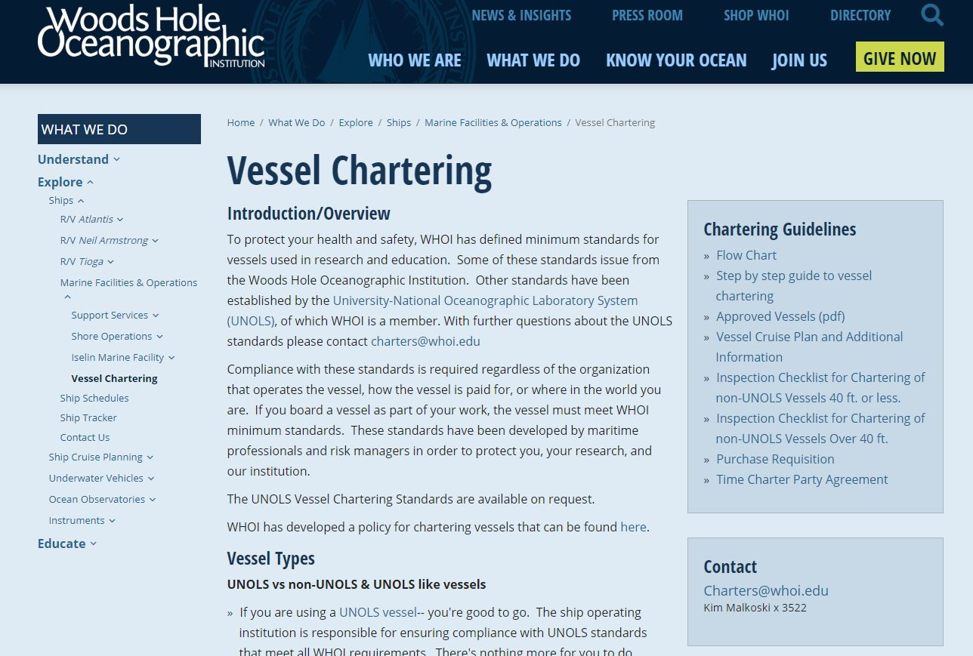
Vessel Chartering

Slide 16
Vessel Chartering continued
NEW in 2020 and in place/expected for operations during 2021
  Every charter must have a new charter agreement for each planned trip
  Even if a vessel was chartered the previous year/month/week, users must prepare a new/separate charter agreement and have in place prior to departure
Kimberly Malkoski is available to help guide users through this process
Contact
Charters@whoi.edu
Kim Malkoski x 3522

Slide 17
Vessel Chartering continued
WHOI “Small Boat Program” is back … in a different way
  Labs that own small boats may provide them for shared use by other WHOI staff or projects
Marine Operations assists in managing this program if small boat owners voluntarily participate
For those participating small boat owners, Marine Operations assists with monetary assistance for insurance premiums of these small vessels
Marine Operations has a 9 ft inflatable with engine available for use

Slide 18
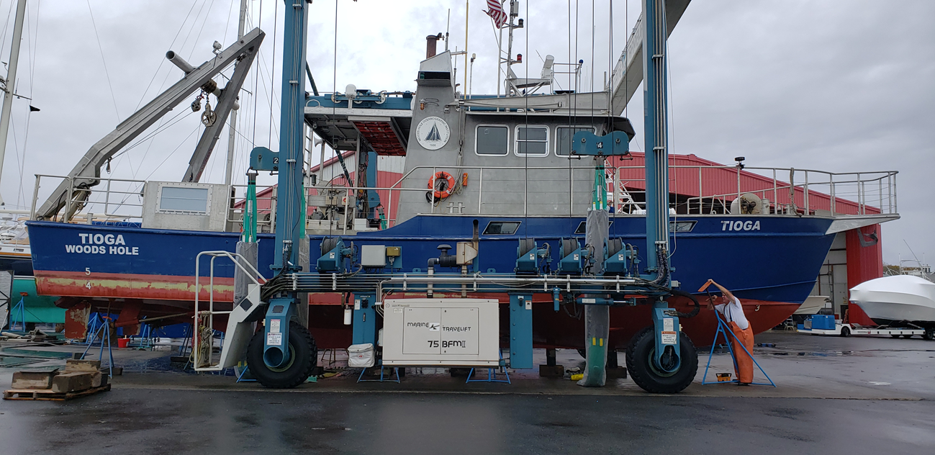
THANK YOU
Providing all TIOGA customers with a safe platform, knowledgeable crew and reliable equipment continues to be the goal of Ship Operations

Slide 19

QUESTIONS?

