Slide 1
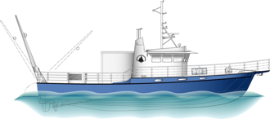
Tioga User Meeting 2020
Presented by WHOI Port Operations

Slide 2
Tioga User Meeting Feb 26, 2020
Agenda
Introductions
2019 Review
2020 Day Rates &
Fuel rates and estimating
Scheduling & Cruise Planning 2020
New Vessel Charter Policy (Kim Malkoski)

Slide 3
2019 Review
Repower completed May 1, 2019 at Gladding Hearn Shipbuilding
Included 2 new CAT C18 engines (715 HP) and Twin Disc gearboxes, new 30kw generator, 2 new electronic chart plotters, radar and sonar. Repeater screen in lab. All internal systems received a careful inspection and condition based maintenance.
Rolled Out New Day Rate Structure
Vessel day rate separates out vessel and fuel.
May 7 began SVC cruises and Science Ops
2019 very slow year with 55 charge days total
Operations were local (MVCO, Outer Cape, Mass Bay and SE New England areas). Users were WHOI, Battelle and USGS

Slide 4
Tioga Day Rates
Tioga’s day rates were increased ~$350/day on average for all users in 2019. Decision was based on:
In 2019 Tioga Operations were directed to begin paying back WHOI endowment deficit of $298,476 over the next 4 years. This adds an additional $75k in the op budget each year
In an effort to help reduce larger day rates overall, we are separating out fuel costs and vessel costs for users

Slide 5
Tioga Vessel Day Rates cont.
Day rate is for vessel, Crew and installed science equipment
Fuel added separately on a per trip basis

Slide 6
Tioga Fuel Rate
Fuel cost is calculated on a trip x trip bases once voyage is completed daily, vessel has digital flow meters
Each user pays same cost / gal to what Tioga paid
2020 use fuel estimate of 28.5 gal / hr. at $2.40 / gal
Includes both engines and generator

Slide 7
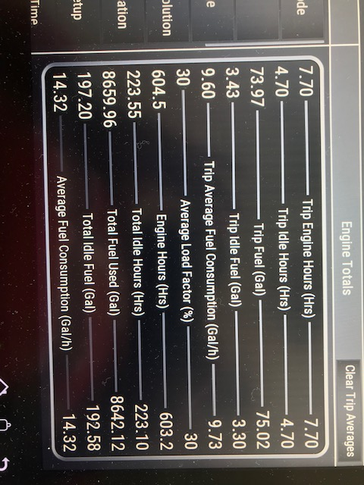
Fuel Report post op
Above is an example of a recent tower trip

Slide 8
Tioga Crew Training
Crew Training
In the field training done in 2019
Basic Life and Safety training 2019 and 2020
Radar endorsement 2020
Diesel Engine training 2020
Marine Electronic training 2020
Medical P.I.C.
Working to schedule more training during least used times in 2020

Slide 9
Tioga Scheduling
WHOI Port Captain, Eric Benway is primary contact for initial scheduling questions
All online Tioga scheduling is online
https://www.whoi.edu/what-we-do/explore/ships/ships-tioga/tioga-ship-scheduling/
Ship Time Request (STR)
https://whoiforms.whoi.edu/tioga-shiptime-request/
Schedule updated in real time
https://whoiforms.whoi.edu/tioga-schedule/

Slide 10
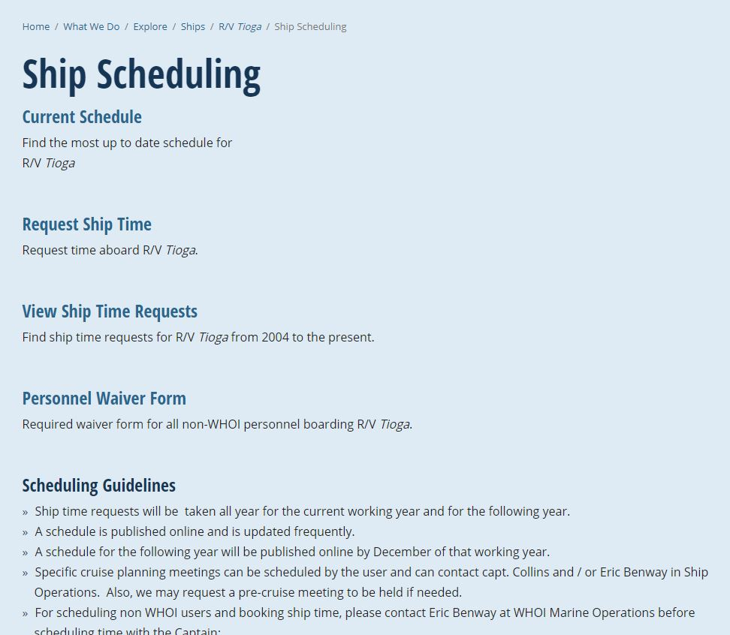
Tioga Scheduling
https://www.whoi.edu/what-we-do/explore/ships/ships-tioga/tioga-ship-scheduling/

Slide 11
Tioga Scheduling continued..
WHOI users will get priority over outside users whenever possible
Flexibility is still key for everyone
Weather days – Users will receive one wx day per op day.
Make up days due to wx may occur immediately or need to be rescheduled at a later date
Tioga may need to block out maintenance days into the schedule if calendar is becoming full
If extended day is needed, extra Captain or Mate are required to do ops beyond 12 hrs.

Slide 12
Tioga Scheduling cont.
Scheduling Dive Operations - Submit a Dive Plan to Captain. WHOI DSO Ed O’Brien and Kim Malkoski are resources. Approval is required prior to departure.
MVCO
Many more projects / users going out to tower and near by moorings
Cost splitting w/ other projects and users
Cost splitting w/ outside users at MVCO
Other large projects on the Horizon?
Orested proposal for Tioga use is under review (Mark Baumgartner)

Slide 13
Cruise Planning
Please make a PLAN ahead of time w/ Captain
Science should provide a written procedure of activities such as;
Deployments, Recoveries, Dive Ops, Glider Ops etc.,
Provide pictures, drawings. More the better

Slide 14
Cruise Planning cont.
Define ahead of time as to who does what. Science needs to provide adequate personnel on board to complete objectives
Communicate ahead of time with Capt. as to what gear needs to be provided by Tioga and what is being provided by science

Slide 15
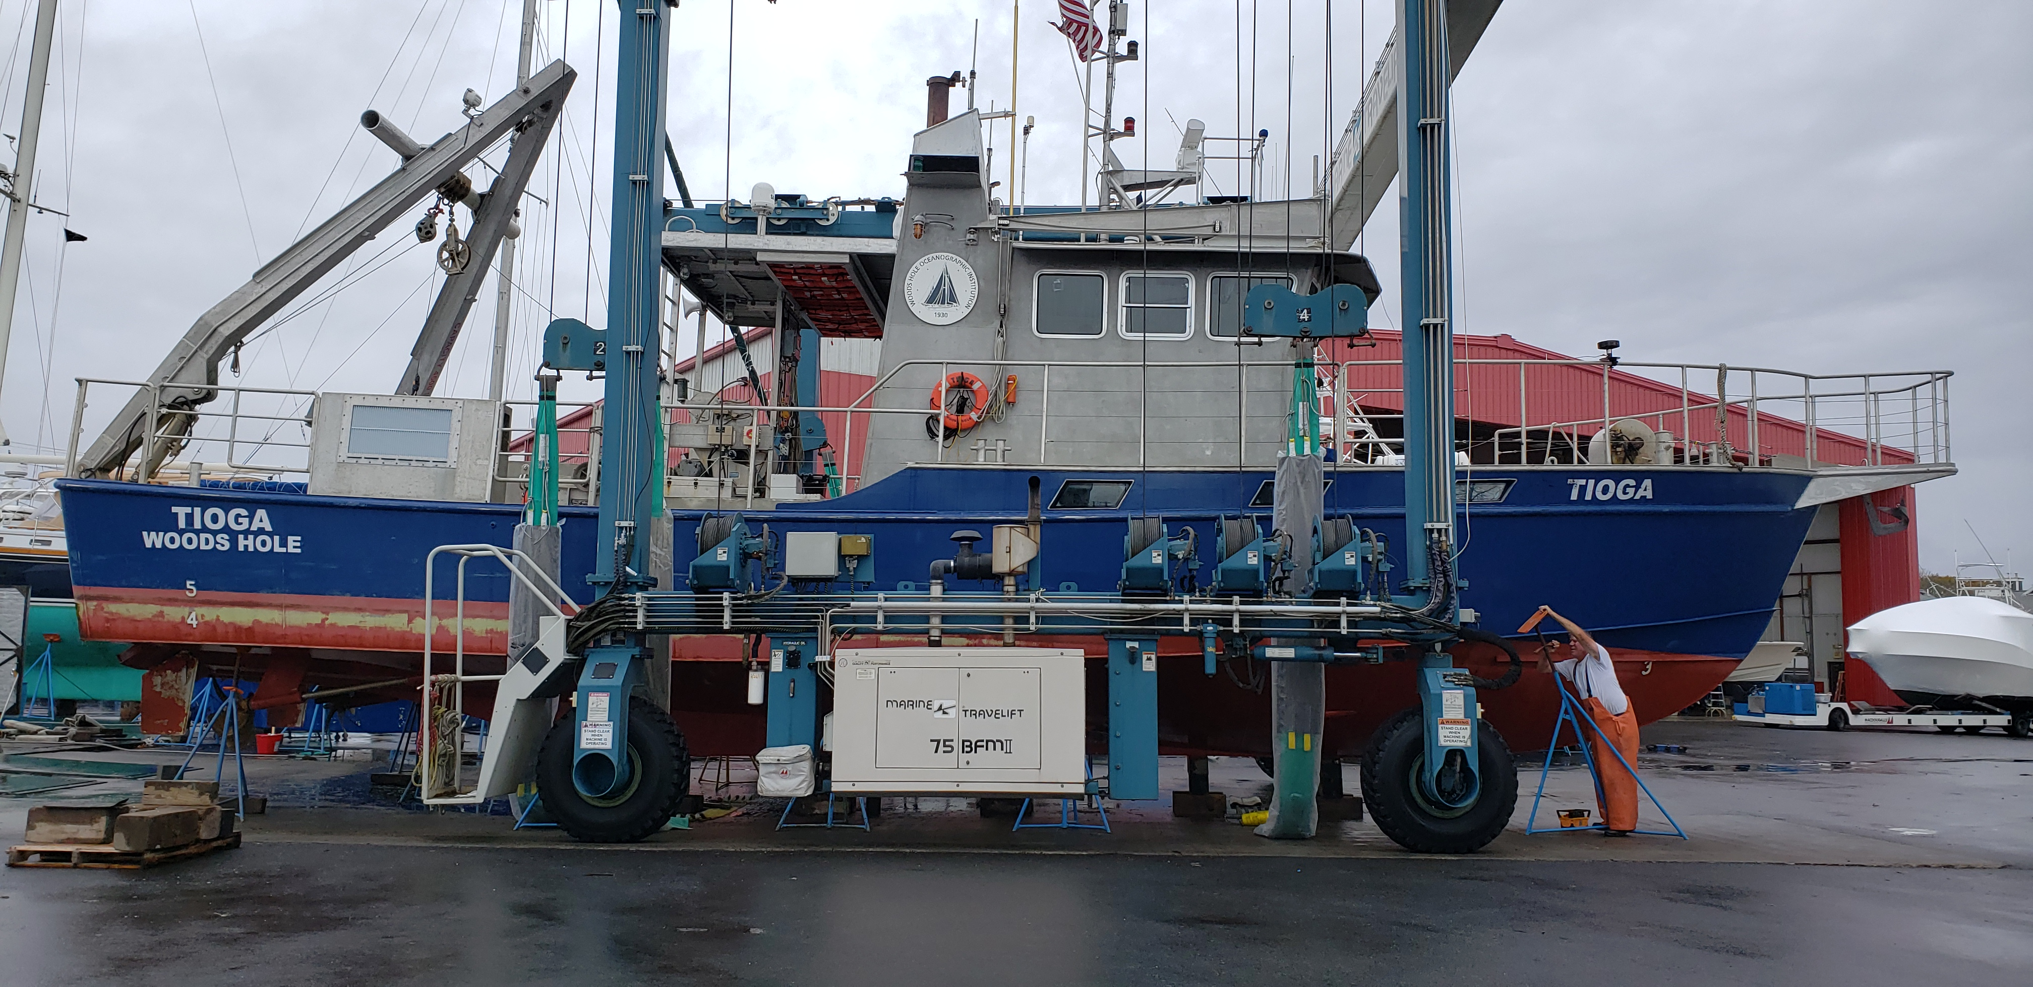
Thank you
Our goal is to provide all TIOGA customers with a safe platform, knowledgeable crew and reliable equipment.

Slide 16
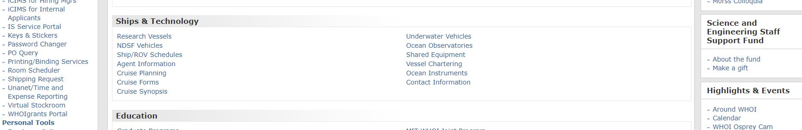
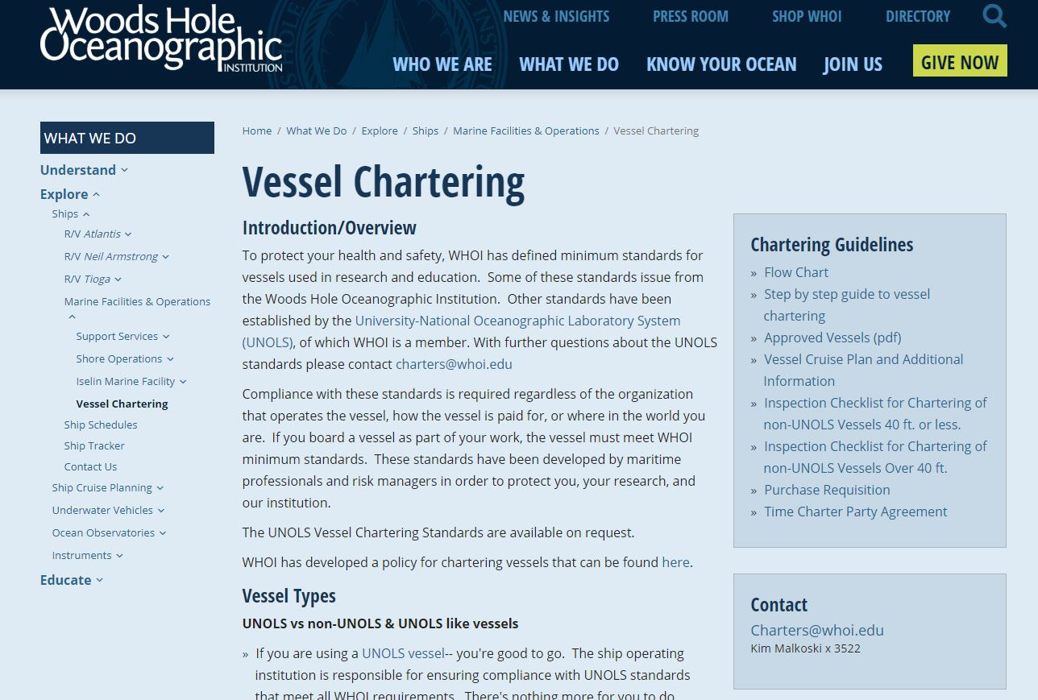
Vessel Chartering

Slide 17
Vessel Chartering cont.
NEW 2020 - Every charter now must have a new charter agreement for every trip planned
Even if you chartered a boat the previous year, month or week, users will still have to get a new / separate charter agreement in place before setting out
Kimberly Malkoski will help guide you through this
Contact
Charters@whoi.edu Kim Malkoski x 3522

Slide 18
Vessel Chartering cont.
WHOI “Small Boat Program” is back … in a different way
Labs who own small boats may provide them for shared use by other WHOI staff or projects
Marine Operations would help manage this if they volunteer to participate in the program
For those labs participating, Marine Ops will help cover insurance costs for those boats
Marine Ops has a 9 ft inflatable w/ engine available for use

Slide 19
Thank you
Questions?

