Slide 1
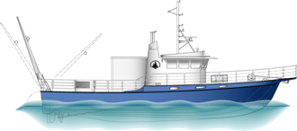
Tioga User Meeting 2019
Presented by WHOI Port Operations

Slide 2
Tioga User Meeting Feb 11, 2019
Agenda
Introductions
Current Status of Tioga
Working Group Report
Port Office Action Items
Maintenance Plan
Scheduling & Cruise Planning 2019
Day Rates

Slide 3
Tioga Vessel Operations Team
Tim Twomey – Director of WHOI Ship Operations
Eric Benway – WHOI Port Captain
Hank Ayers – WHOI Port Engineer
Master, CRV Tioga – Peter Collins, Master 1600 Ton upon Oceans and 2nd Mate unlimited
Mate, CRV Tioga – Leah Saunders, Master 100 ton

Slide 4
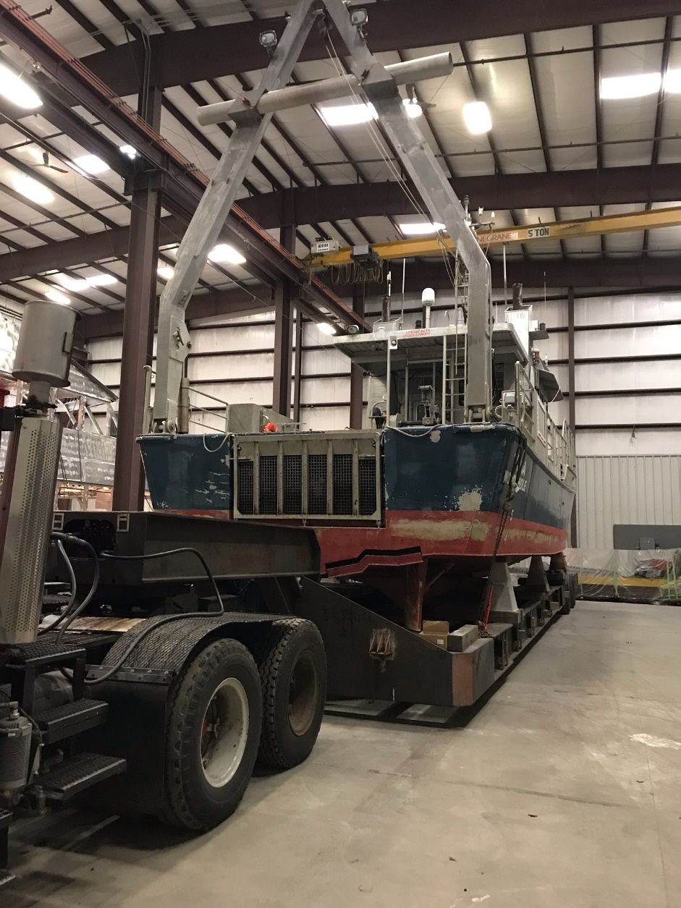
Current Ship Yard Status

Slide 5
Shipyard Status
Both engines removed
Generator removed
Engine room cleaned
Sanitation System repaired
Main exhaust stacks are being serviced / repaired
A/C units (3) being replaced
New Furuno Radar and Chart Plotter
Wireless infrastructure upgrade
New CAT engines to be delivered OOA second week of March
New Generator to be installed OOA by Feb 15
CO2 system being serviced
Life raft being serviced / inspected

Slide 6
Tioga Working Group Report
Report Findings
The Tioga is a highly-valued facility of the institution which is uniquely equipped to support our mission.
Users currently have low confidence in: the vessel’s reliability, administration of the vessel, and crew experience.
The business model for the vessel is not sustainable in its current form.
Report is posted on Tioga’s website
http://www.whoi.edu/main/ships/tioga

Slide 7
Port Office Action Items from TWG Report
Crew Training
Port Office developing a plan for crew to gain more experience
Science Verification Cruises (SVC’s) April/May 2019
Shakedown time for new engines, generator and other equipment
Help crew gain confidence in different overboarding events
Allow science to test their own equipment
No charge to science
Documented Maintenance Plan
Transparent and simplified Scheduling (new STR)
Funding & Revenue
Day rates structure may change in 2019 to repay WHOI endowment
Marketing Tioga to other users to increase use and revenue
Safety and regaining user confidence are our goals

Slide 8
Tioga Maintenance Outline
Tioga will be maintained at highest standards.
Main machinery maintenance schedules will be in accordance with OEM guidelines at all time.
Crew is being trained to perform the routine maintenance, daily checks, oil changes etc. prior to and during upcoming sea trials following the repower.
Any adjustments internal to the engine will be performed by technician from Milton Cat.
All worked will be logged and kept in electronic format.

Slide 9
Tioga Inspection Schedule
USCG – ANNUAL SAFETY INSPECTION
SAFETY EQUIPT: RAFTS, CO2, EPIRB ETC. – ANNUAL INSPECTIONS
CO2 SYSTEM / FFE – ANNUAL INSPECTIONS
HULL DOCKING – 2 YEAR REQUIREMENT
MAIN ENGINES -- CAT C 18 OEM SCHED
GENSET -- NORTHERN LIGHTS 30 KW – OEM SCHED
WINCHES – ANNUAL MAINT
PROPS – POLISHING COND BASED

Slide 10
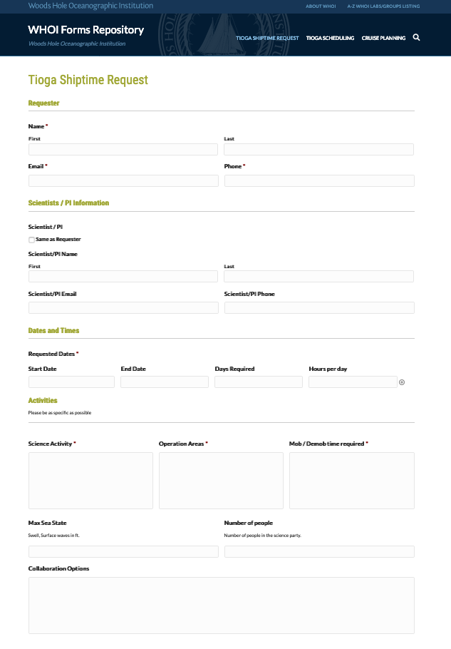
Scheduling
Port Captain, Eric Benway is
primary contact
New one page
Ship Time Request (STR).
Half Day up to 5 hrs.
Full Day 6 – 12 hrs.
12 hr + Extra crew req.
Per USCG COI

Slide 11
Scheduling continued..
WHOI users get priority over outside users
Developing a new calendar / scheduling tool with WHOI IS
Flexibility is still key for everyone
Weather days – will schedule one wx day per op day.
Make up days due to wx may occur immediately or need to be rescheduled at a later date
Tioga may need to schedule maintenance days into the schedule if calendar is becoming full
If extended day is needed, extra Captain or Mate are required.

Slide 12
Cruise Planning
Once the project is scheduled cruise planning will begin.
A Cruise Plan will be the Ch Sci responsibility
Planning will involve Captain Peter Collins and Port Captain Eric Benway
We will bring in SME’s for any specialized requests (techs)
Dive Operations - Formal Dive Plan to go through WHOI DSO Ed O’Brien. Approval is required prior to departure.

Slide 13
Day Rates
Evaluating a new rate structure to help recoup lost revenue and to repay endowment.
“Ala-Cart” structure
Vessel base rate + fuel.
Base + fuel + CTD
Base + fuel + Corer & Technician
Pro rated for those already with funding in 2019
Base rate would include underway sensors and instrumentation (MET / ADCP)

Slide 14
Thank you
Our goal is to provide all TIOGA customers with a safe platform, knowledgeable crew and reliable equipment.
Regaining confidence will take time but we are committed 100% to do so.
Please contact Eric Benway for scheduling 2019 projects

