Slide 1
RV ARMSTRONG, AGOR 27
November 2013 Institution update

Slide 2
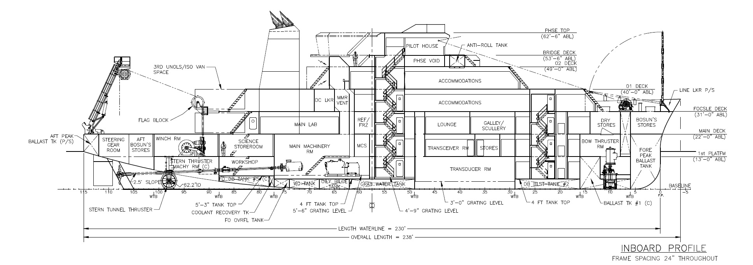
RV ARMSTRONG, AGOR 27
Oceans Class Characteristics
Length OVA = 238’-0” Beam = 50’-0”
Design Speed = 12.0 kts Endurance = 40 days
Crew Size = 20 Science Party Size = 24

Slide 3
RV ARMSTRONG AGOR 27
Delivery date: October 2014
Science verification cruise(s) ~January 2015 – ~ April 2015
Science Mission Equipment
Lab Layouts
Deck handling systems (winches and crane)
A Frame
Deck layouts

Slide 4
AGOR 27 Science Equipment List
Funded In Vessel Construction Budget
Kongsberg EM122 Multibeam
SeaBird TSG
Knudsen 3260 Sub Bottom Profiler
Massa TR109 3.5 kHz transducer Array
12 kHz transducer Array
POS/MV Precision GPS
Satellite Communication System
38 kHz RDI Ocean Surveyor ADCP
Acoustic Monitoring System
Science Seawater Distribution System

Slide 5
AGOR 27 Science Equipment List
DURIP (Navy) Funded Equipment
Kongsberg EM710 Multibeam
Kongsberg Sonar Synchronization System
75 kHz RDI Ocean Surveyor ADCP
300 kHz RDI Workhorse Mariner ADCP
Kongsberg HiPAP Gantry with Sonardyne USBL
Kongsberg EK60 Mid-Water Echo Sounder
RADAR Wave Height Measurement System
OTHER (NSF?) Funded Equipment
AUV High Bandwidth Communications
Plotters

Slide 6
19 inch transducer wells avail for science
Transducer Room Layout
75 kHz ADCP
38 kHz ADCP
EM122
EM122
USBL stem
EM710
Knudsen 3260
EM710
300 kHz ADCP
12 kHz Transducer

Slide 7
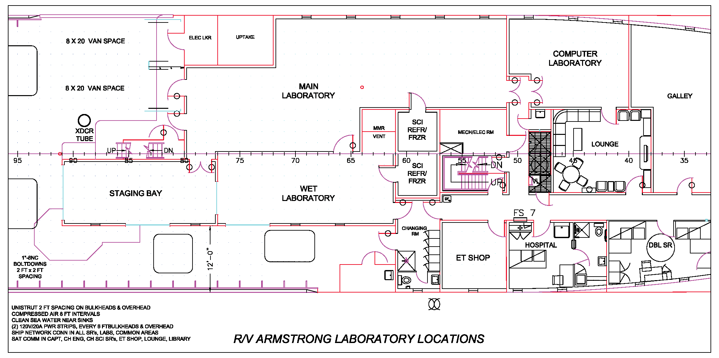
Complete Lab Layout

Slide 8
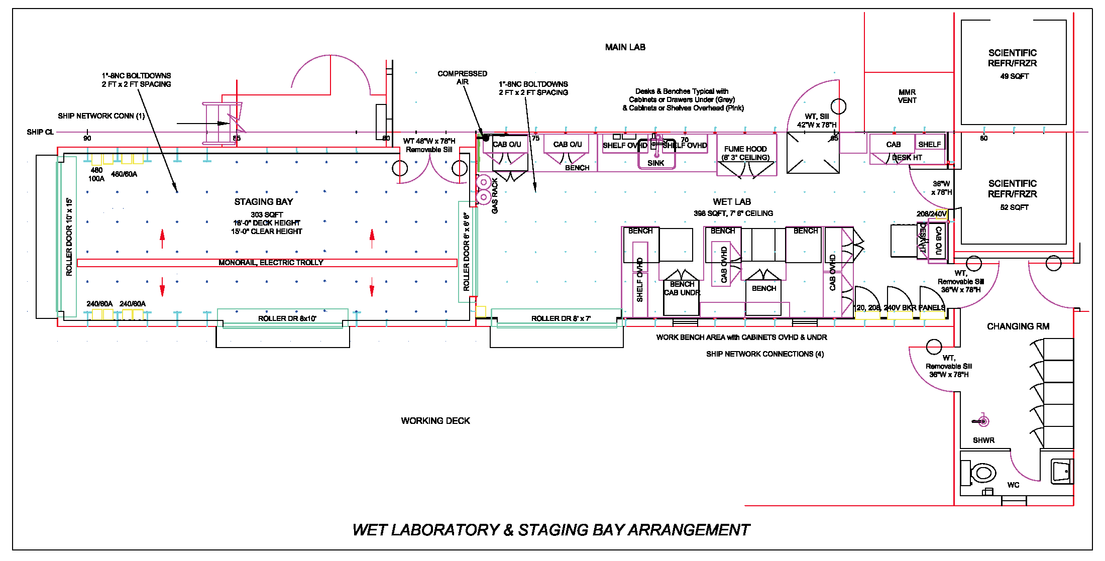
Wet Lab & Staging Bay

Slide 9
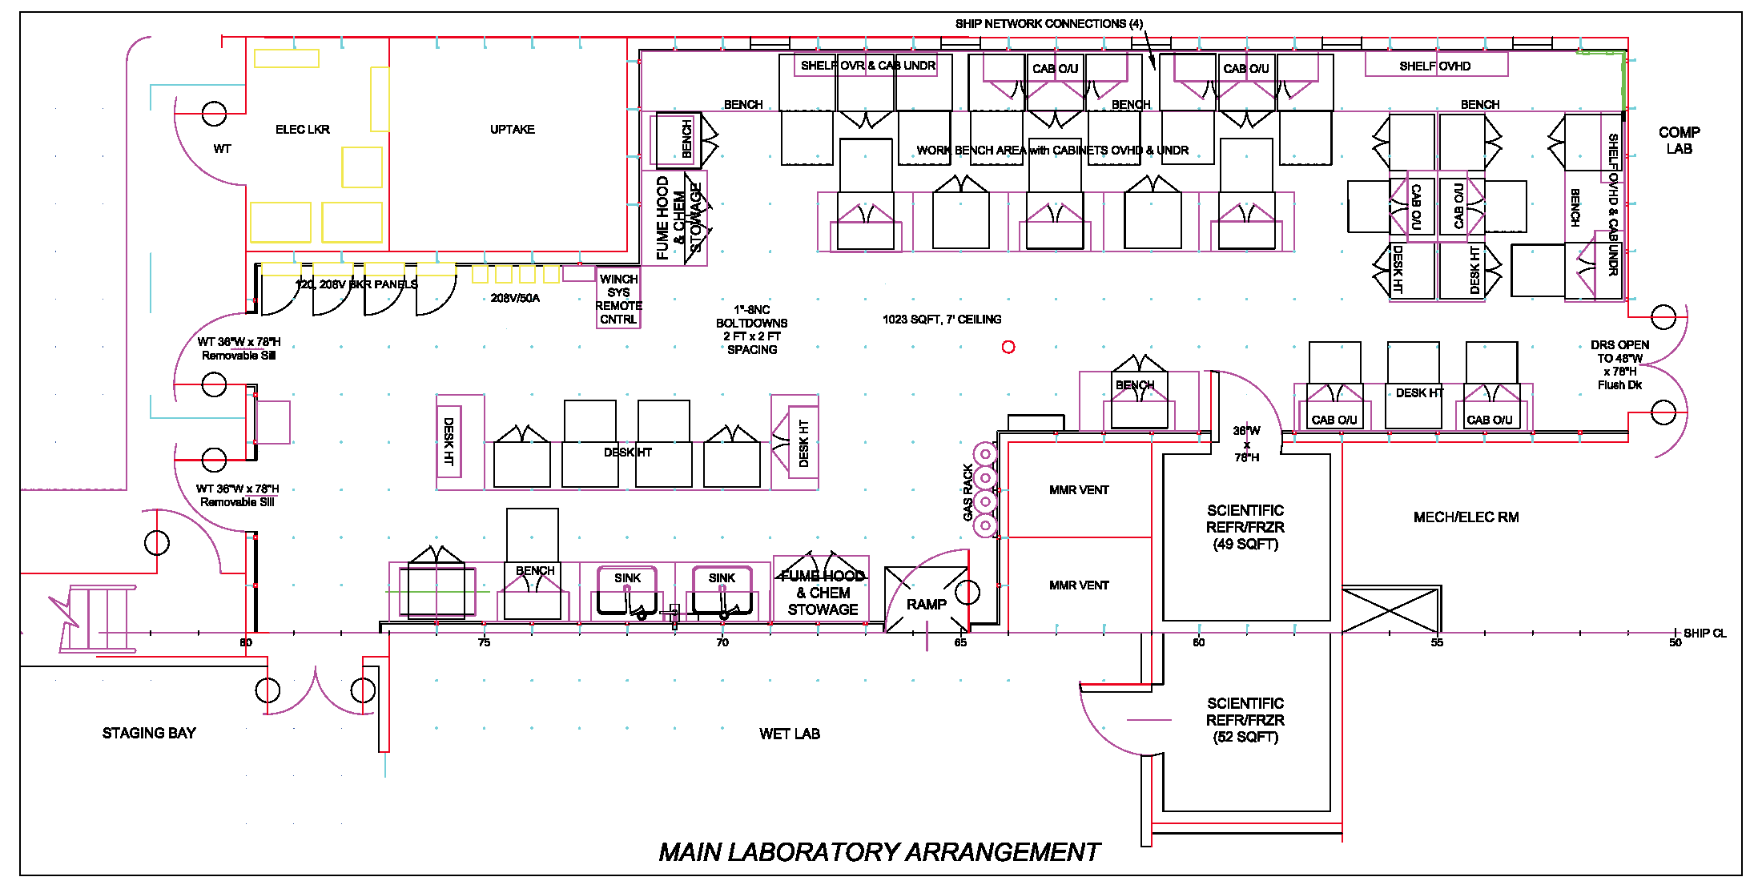
Main Lab

Slide 10
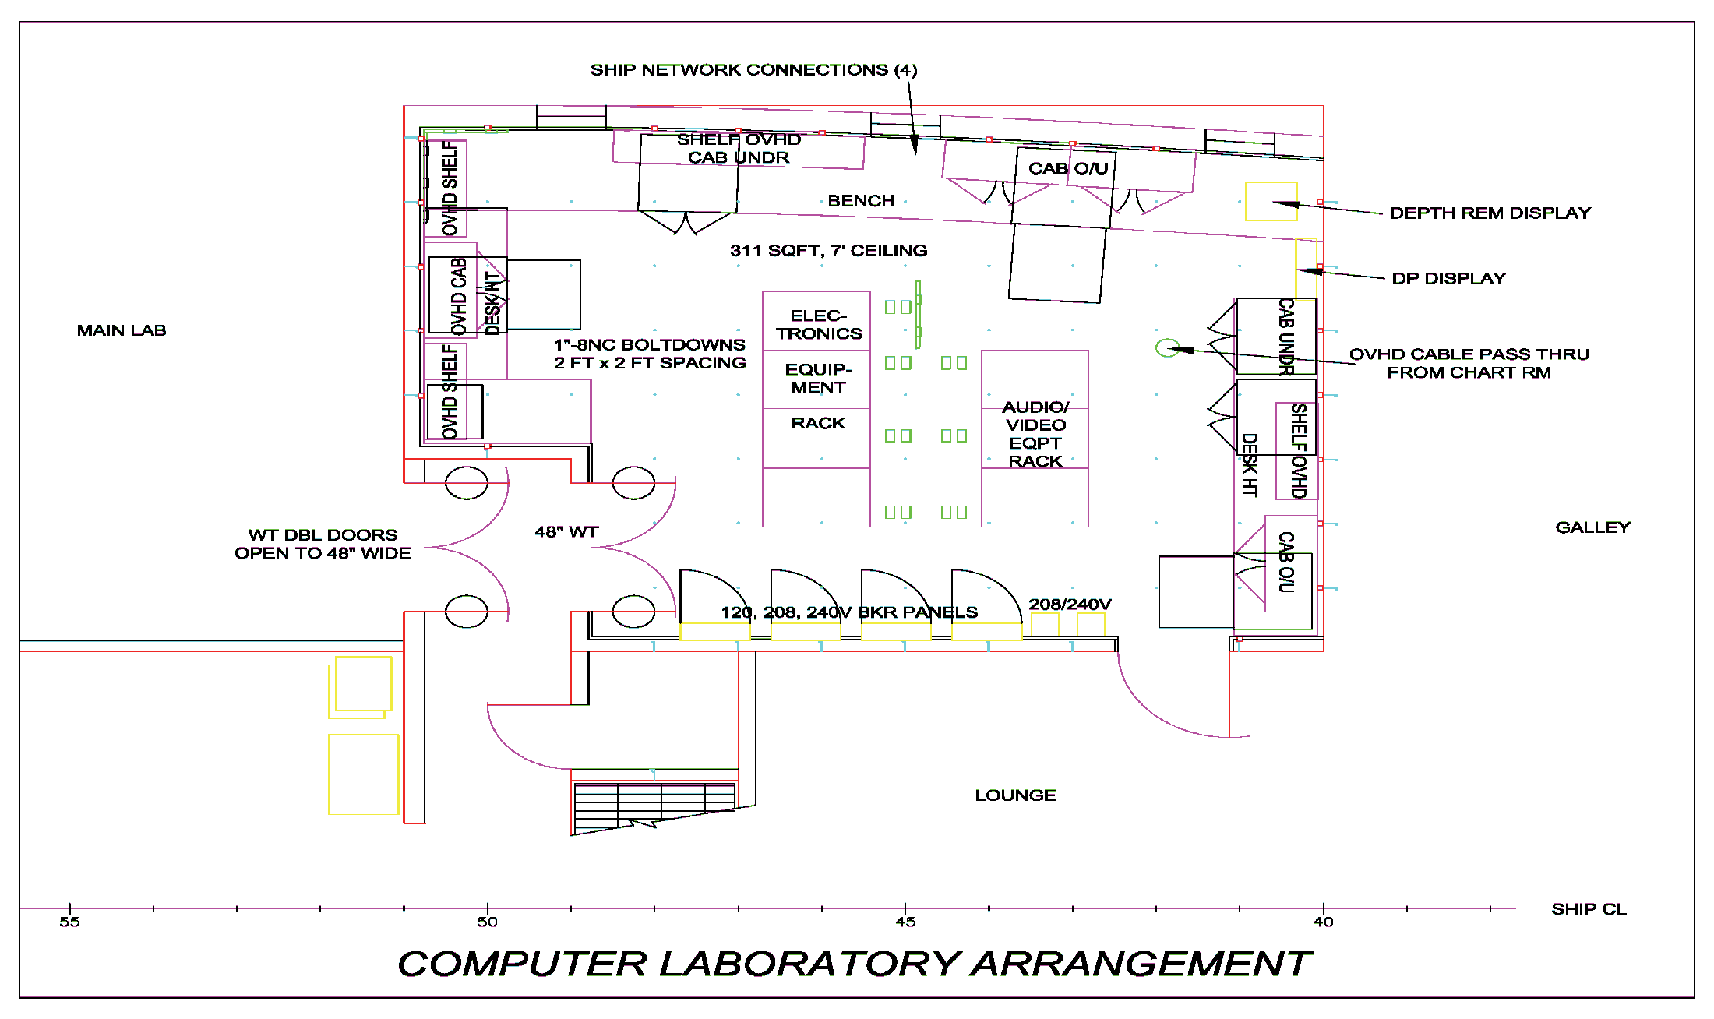
Computer Lab

Slide 11
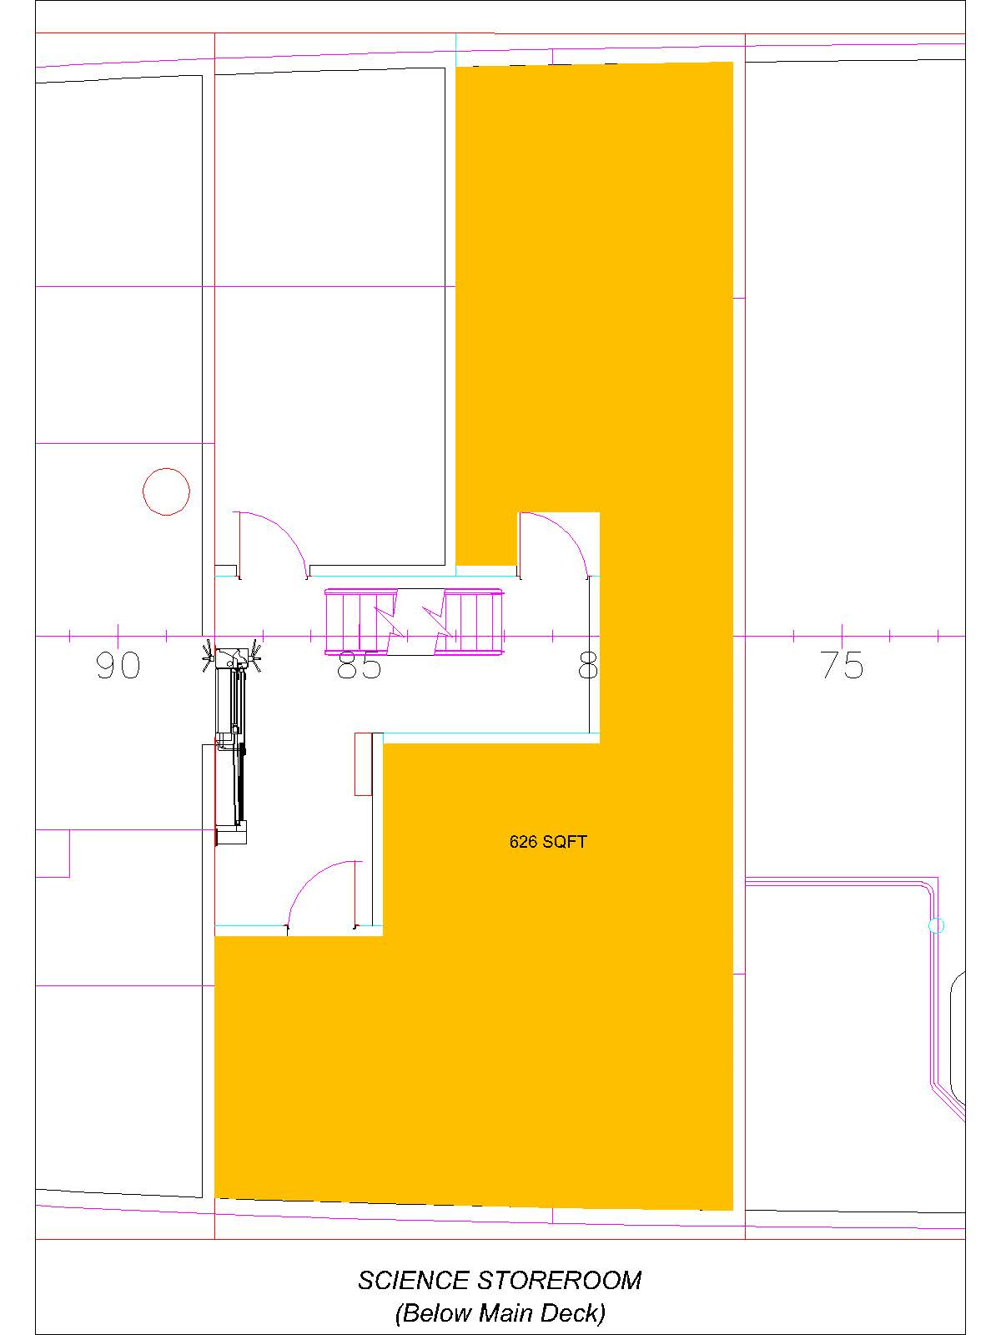
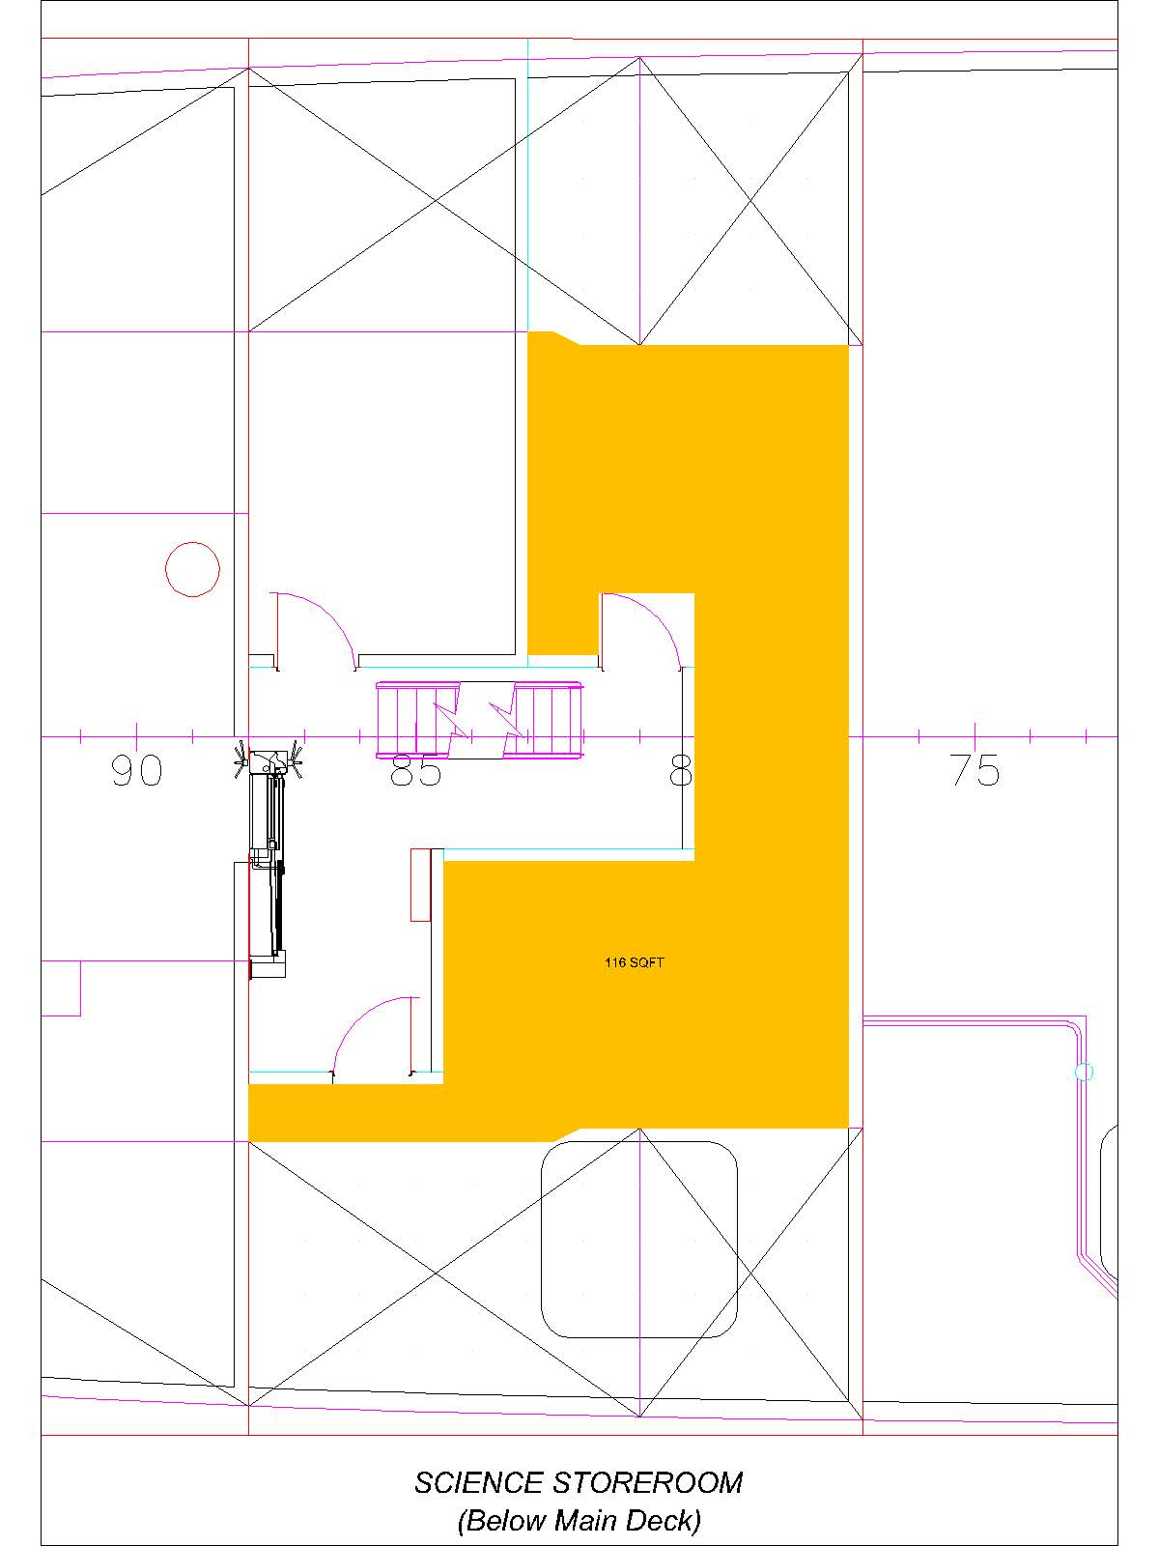
Science Storeroom

Slide 12
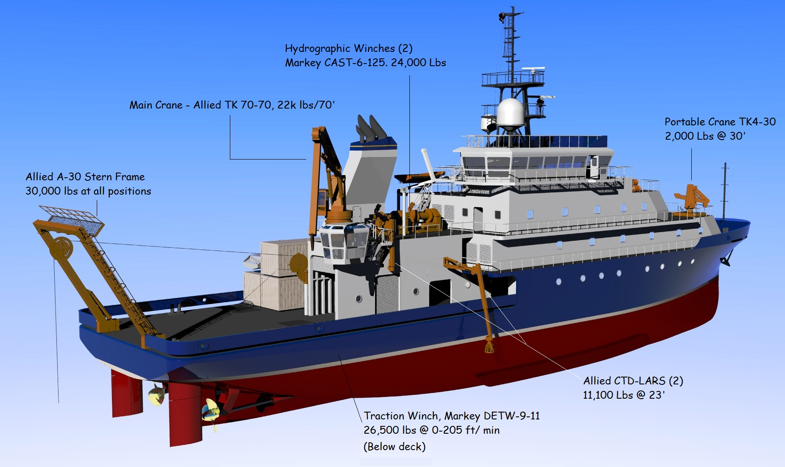
Deck Equipment AGOR 27

Slide 13
Hydrographic Winches (2)
Markey CAST -6-125
Per Design Specification (J-1) Stern Frame Shall be capable of:
Electric Motor Driven
Rated at 24,000 Lbs
A pushbutton operator interface enables the level wind to electronically adjust to any diameter wire, cable or soft-line
The output sheave of the fairlead is mounted in a flagging block which sweeps 360 degrees. This unique design eliminates the need for deck hands to carry and rig intermediate blocks or fairleads, resulting in less time spent rigging, more time for sampling, which reduces overall operational time and expense.
Capable of a line pull test of at least 5,000 pounds with a full drum and at least 11,100 pounds with a bare drum
Capable of variable speeds up to at least 1.5 meters/sec under full load
Capable of handling cable sizes and lengths up to and including 10,000 meters of 0.393 inch EOM cable.
One winch provided with lebus shells sized for .322” EM cable the other with 3/8”, 3x19 torque balanced wire rope

Slide 14
Traction Winch
Markey DETW-9-11
Per Design Specification (J-1) Traction Winch Shall be capable of:
26,500 Lbs @ 0-205 Ft/Min
Electric Motor Driven
AC Variable Frequency Drive System and electric motors giving precise control.
Lebus-grooved drum shells.
Full load line pull of at least 25,000 pounds and continuous speed control to 0.1 meters/min throughout the speed range
Handling 12,000 meters of 9/16” 3x19 wire and 10,000 meters of 0.680 EM cable
Winch and sheave shall be capable of handling 0.681 inch fiber optic cable
Cooling of stowage winch drums to reduce heat build up when transmitting high power levels through the cable to ROV’s

Slide 15
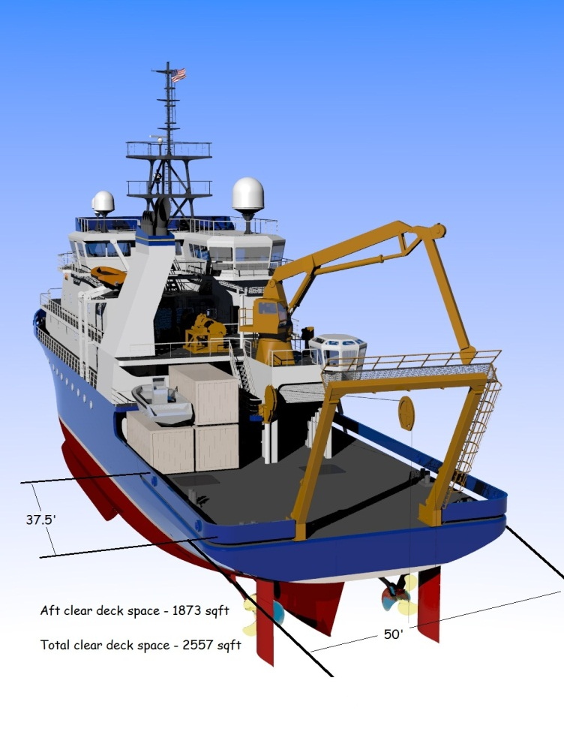
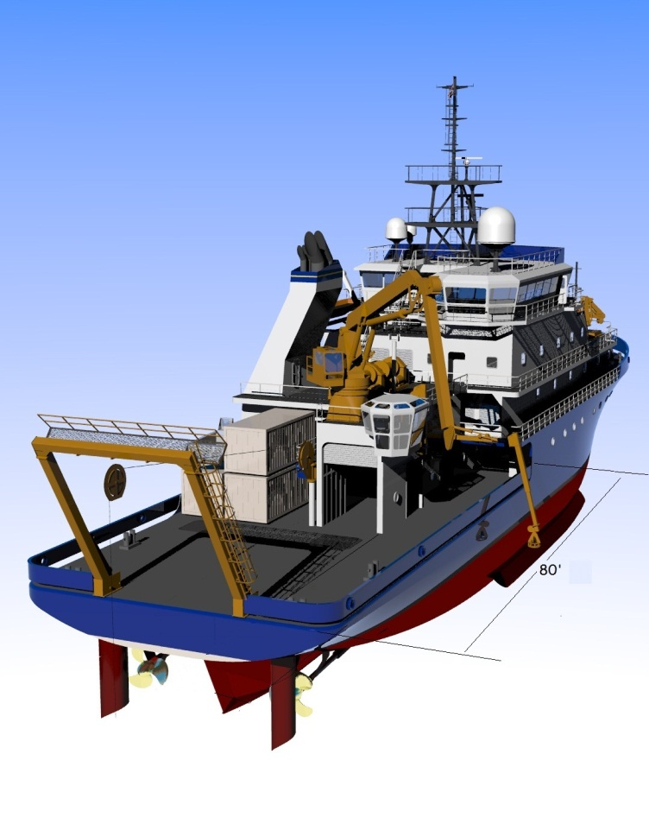
Deck Working Space
Aft clear deck space – 1873 ft²
Total clear deck space – 2557 ft²

Slide 16
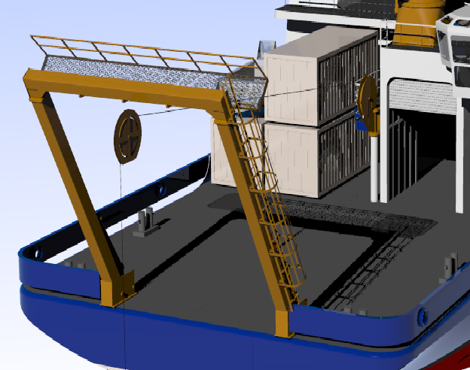
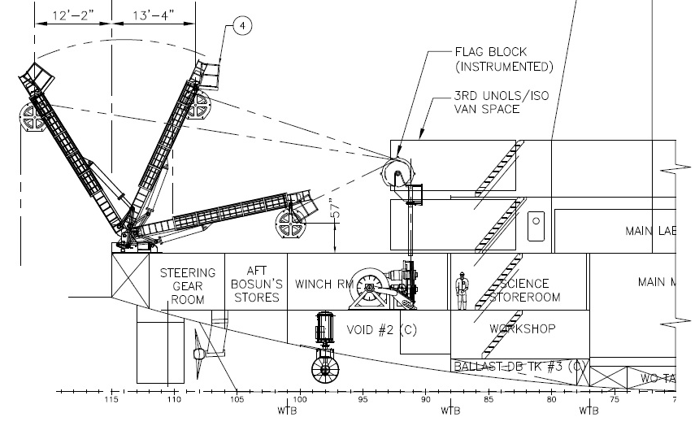
Stern Frame
Allied A-30 (243 x 324”)
Per Design Specification (J-1) Stern Frame Shall be capable of:
Dynamic Safe Working Load of 30,000 Lbs through full range of motions.
Capable of withstanding the 46 CFR 189.35 breaking strength requirements for a wire with a breaking strength of 120,000 in fully extended position
Rotation Period of no more than 35 Seconds from stop to stop
Height from block attachment points to the deck of 27 feet and a clear width between the legs of at least 15 feet above the deck
Minimum 12 foot inboard and outboard reach
Maintenance position rotates top of frame within a safe working height above the main deck (4’9”) to change blocks and cable fairleads.

Slide 17
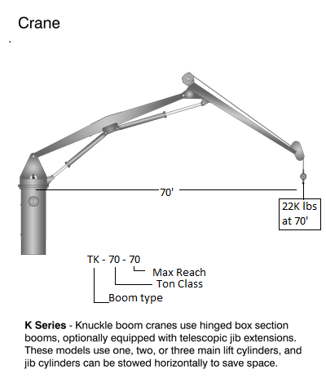
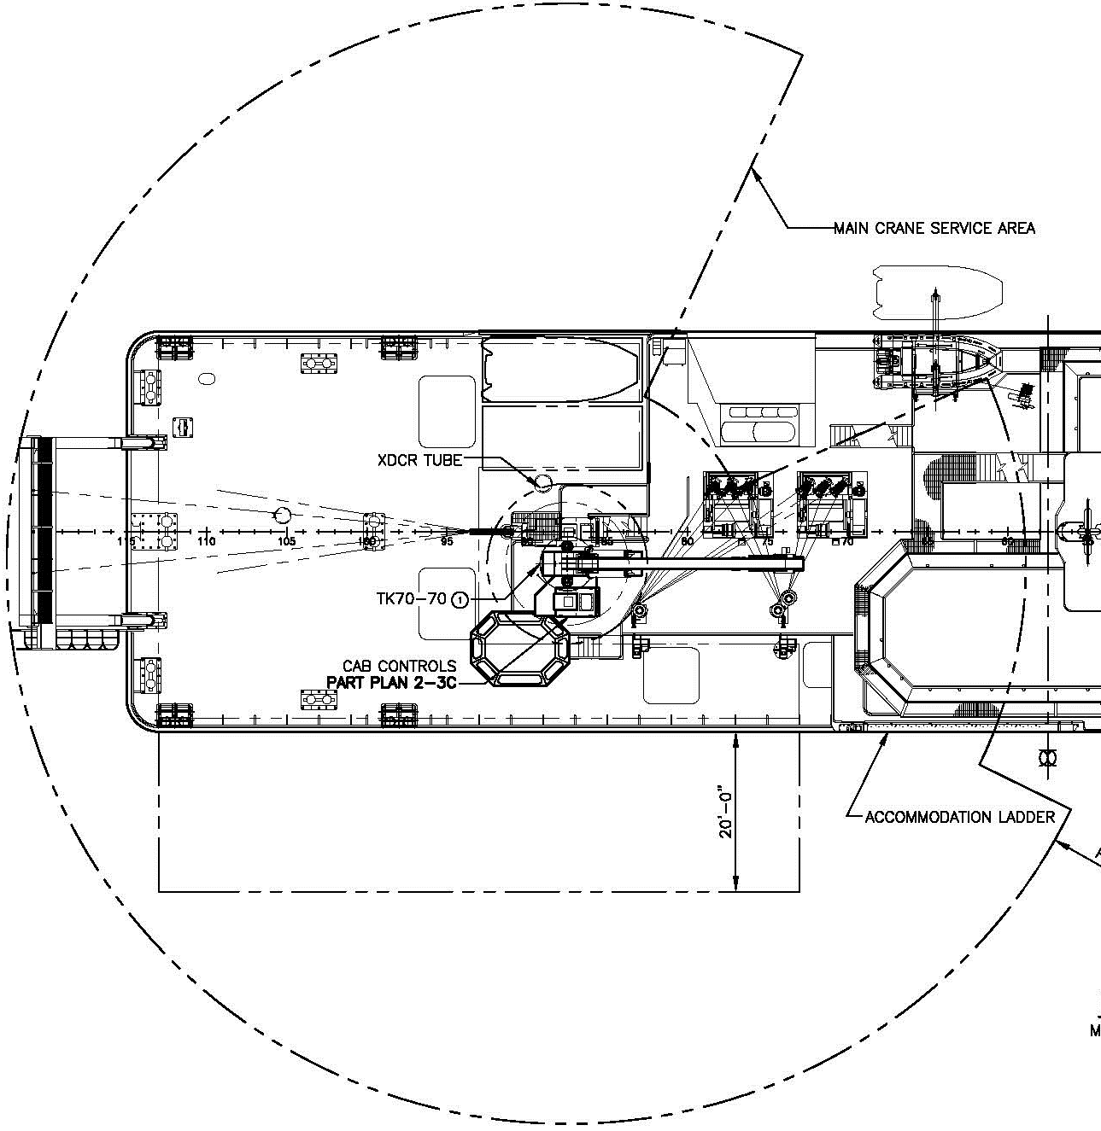
Deck Crane: TK70-70. 01 Deck aft
Per Design Specification (J-1) Cranes Shall be capable of:
Loading and offloading vans and equipment weighing up to 20, 000 pounds 20’ beyond stbd side pier side.
Performing towing and coring operations with wire (including fiber optic) from the trawl/tow traction winch.
Deploying buoys and other heavy equipment weighing up to 10K lbs. up to 12’ over the Stbd. Side in sea state 4
Provided with a load hoist winch capable of providing hook drop at least 50’ below the base of the crane and at least 40’/min hook drop test
Hook speed of at least 40ft/min with a bare drum and at least 60ft/min with a full drum

Slide 18
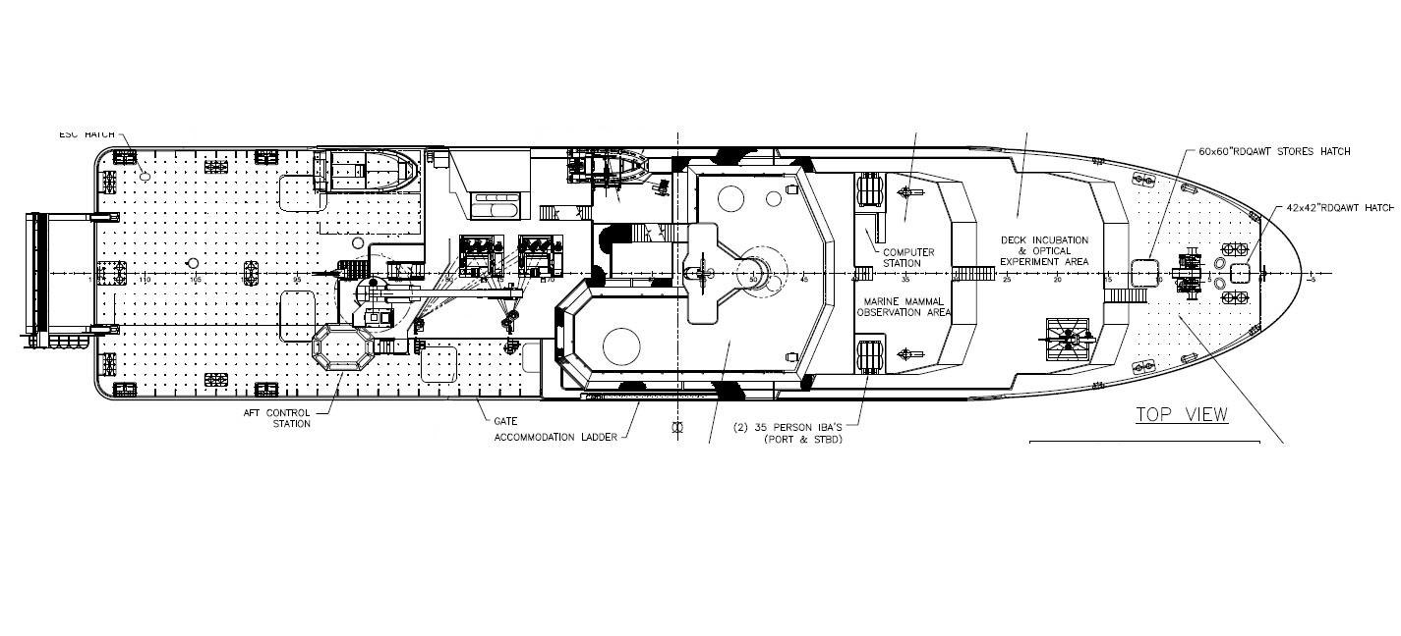
RV ARMSTRONG, AGOR 27
Main Deck (working deck)

Slide 19
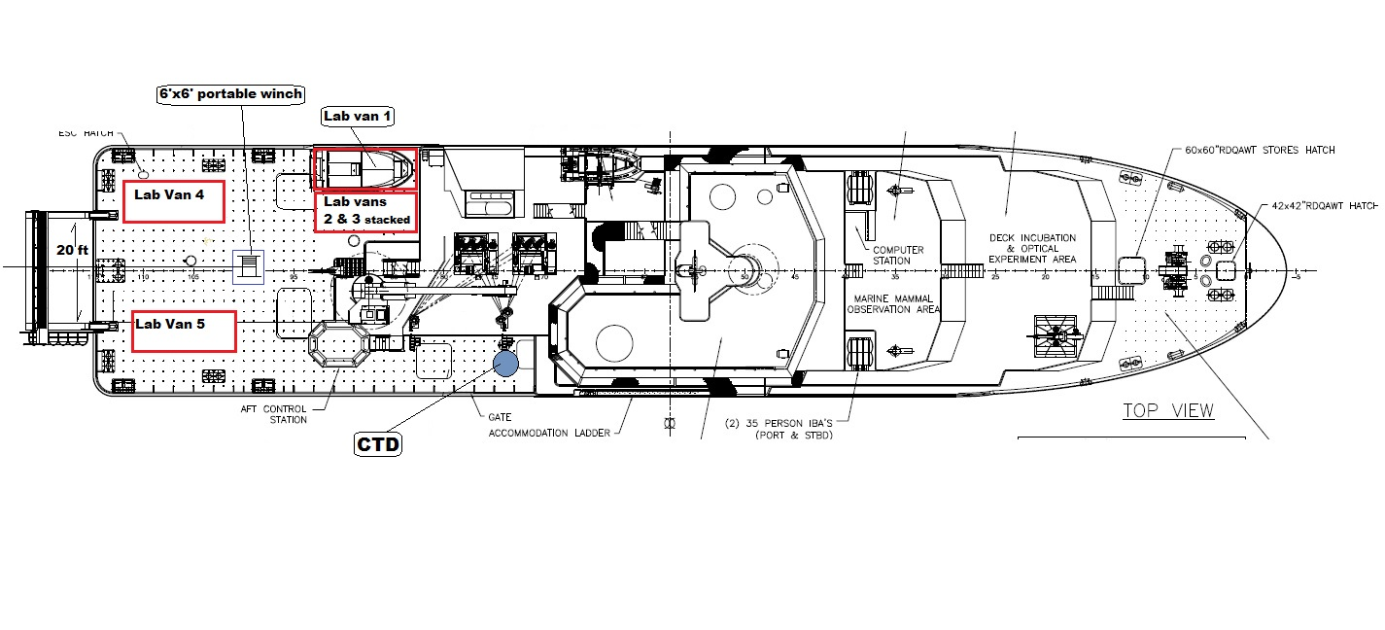
Working Deck Examples with 5 lab vans, portable winch and CTD operation

Slide 20
RV Armstrong with ROV Jason example layout

Slide 21
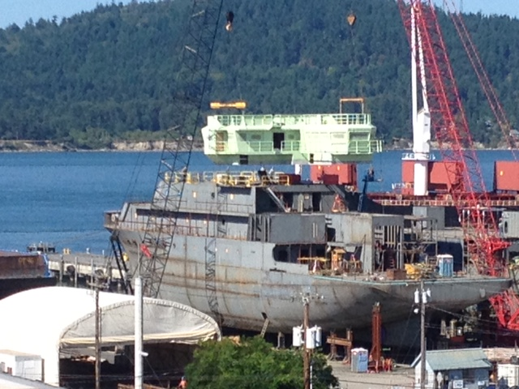
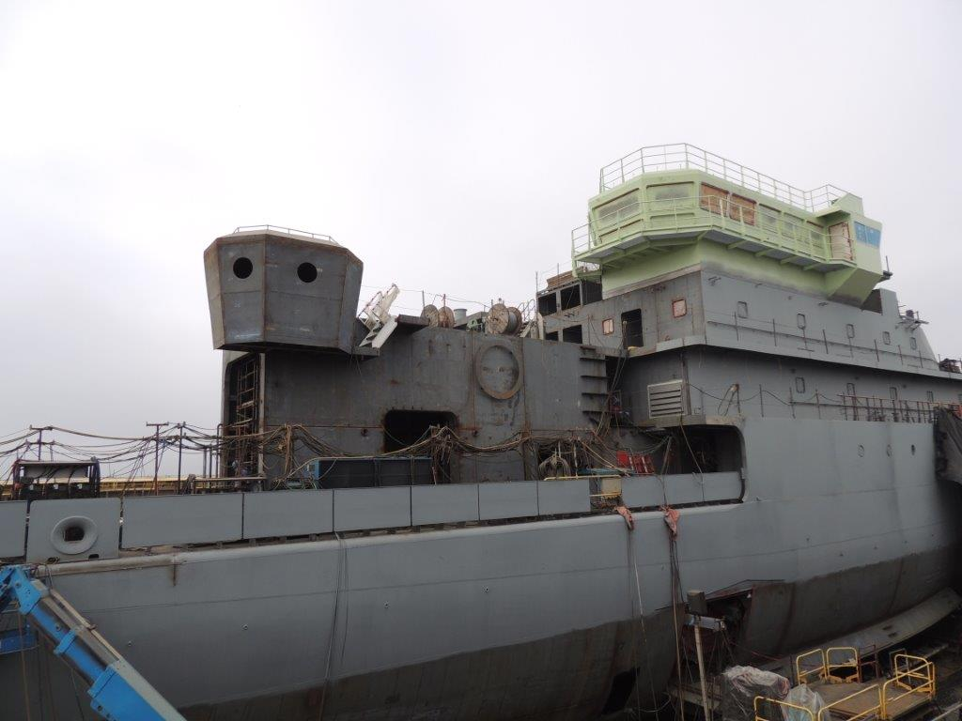
RV ARMSTRONG, AGOR 27
Summer 2013

Slide 22
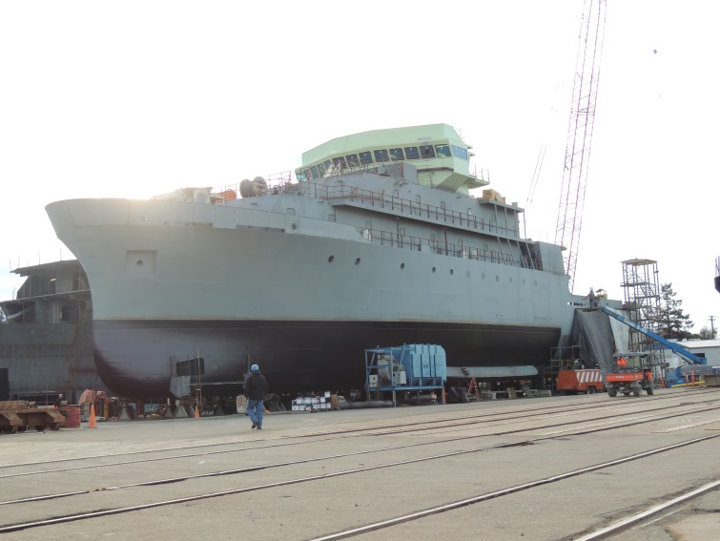
RV ARMSTRONG, fall 2013

Slide 23
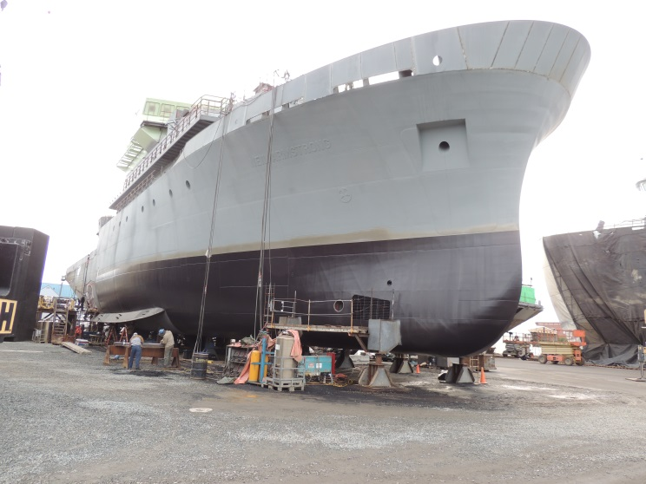
RV Armstrong starboard side fall 2013

