Slide 1
On Vertical Discretization
in the HYCOM/CICE Arctic Ocean Modeling System
Dmitry Dukhovskoy, Eric Chassignet (FSU COAPS)
Pam Posey, Joe Metzger, Alan Wallcraft (NRL SSC)

Slide 2
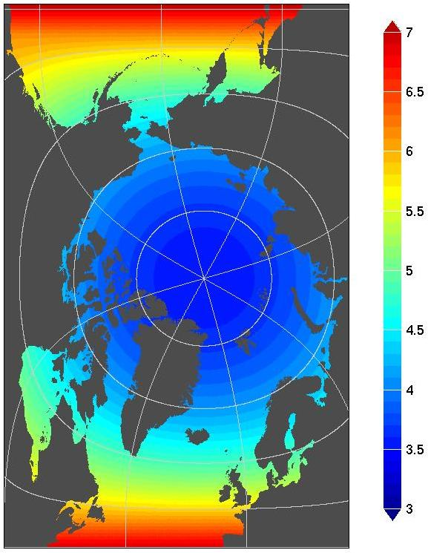
HYCOM/CICE Modeling System of the Arctic Ocean
Coupled HYbrid Coordinate Ocean Model and Los Alamos Sea Ice Model (CICE 4.0)
Arctic-only grid is a sub-region of the tripole grid
32 vertical ocean levels
0.72° ARCc
3hr NOGAPS atmospheric forcing
Atlantic and Pacific boundaries
- Closed (no-ice) in CICE
- Relaxation to climatology in HYCOM
0.08° ARCc
1hr CFSR atmospheric forcing
Atlantic and Pacific boundaries
- Closed (no-ice) in CICE
- Nested into Global HYCOM 1/12°
Sensitivity Runs
Horizontal Resolution (km)
Topography Representation:
Realistic Topography
Closed Bering Strait
Closed CAA
Isolated Kara Sea
Idealized topography (replicated NRL test run)
ARCc0.72
ARCc0.08
Vertical Discretization:
Z-level vs hybrid (isopycnal) grid

Slide 3
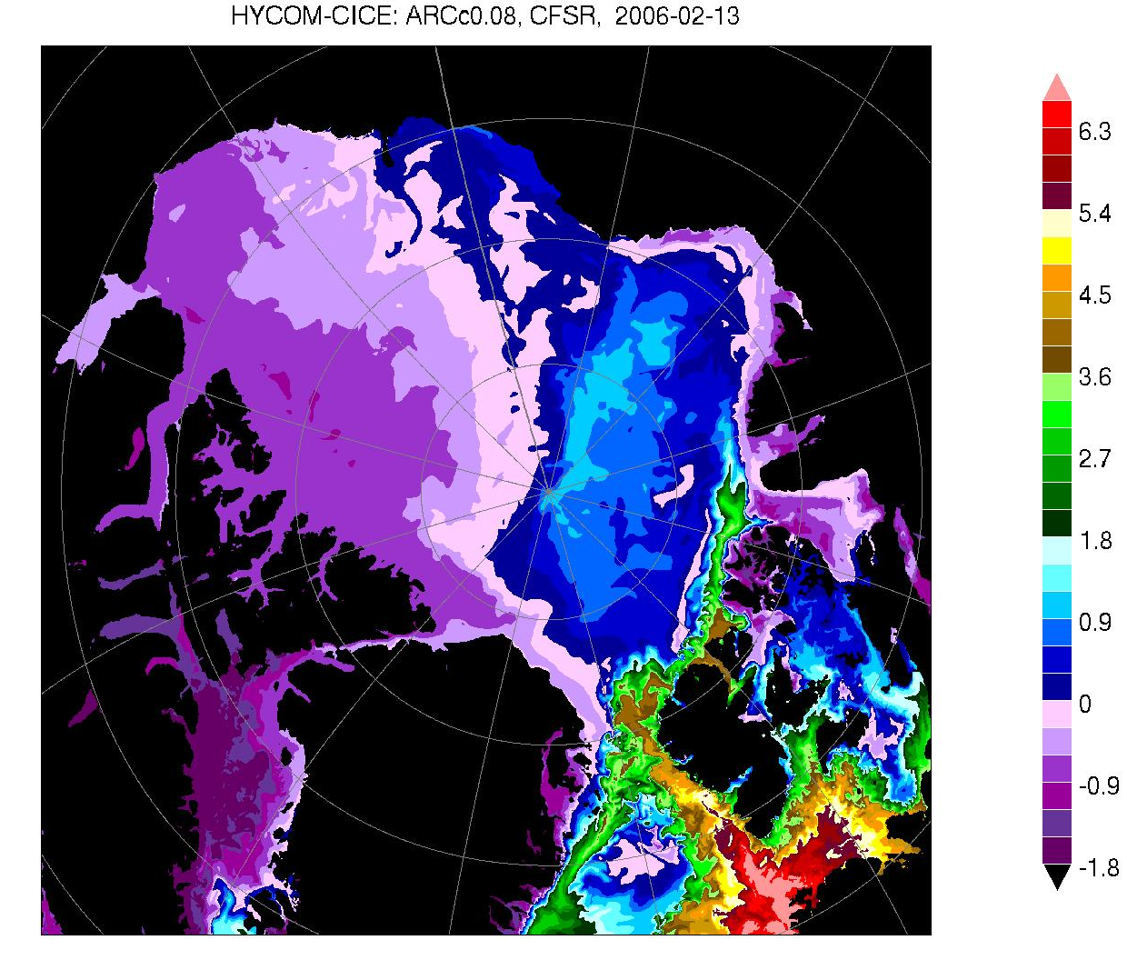
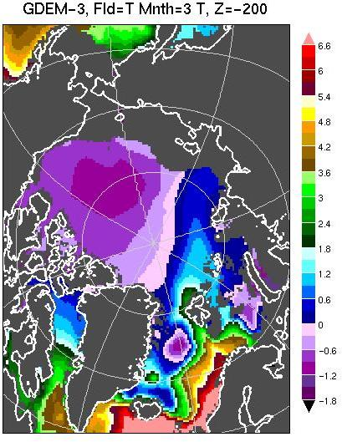
T Fields at 200 m
ARCc0.08 CFSR Forcing 2006/02/13
GDEM

Slide 4
Sensitivity Experiments with ARCc0.72
Effect of Vertical Discretization

Slide 5
Geopotential (“Z-level”) Vertical Coordinates
Pros:
Numerical simplicity and computational efficiency
Accurate calculation of horizontal gradients of depth-dependant quantities (e.g., pressure)
Ease in providing high resolution in unstratified ocean
Cons:
Spurious diapycnal mixing
Shallow areas are poorly resolved
Misrepresentation of bottom slopes
Sensitivity of Topographic Shelf Wave Simulation in a Z-level Model to Vertical Resolution
Double Kelvin Waves
Spurious Diapycnal Mixing in Centered and FCT Vertical Advection Schemes Discretized on a z-level Grid
Bleck, “Hybrid Vertical Coordinates”,2009
Number of Z levels decreases
Shelf Waves (Control Run)
Griffies et al., Mon.Weath.Rev., 2000
Dukhovskoy et al., Ocean Modelling, 2006
Notes:
Traditional vertical grid. Vertical velocity oscillates. After half period of oscillation, the fundamentally dispersive nature of the centered advection scheme is readily apparent. In both cases, thermocline diffuses.

Slide 6
Isopycnal Vertical Coordinates
Pros:
Considered to be the most natural vertical coordinate system because:
Adiabatic flow follows surfaces of potential densities. Water mass transports in the ocean occur mainly along isopycnal surfaces
Mixing of material properties by eddies in the stably stratified ocean occurs predominantly along isopycnal surfaces (Iselin, EOS, 1939; Montgomery, Bull. Amer. Met. Soc., 1940).
Accurate representation of the bottom topography
High vertical resolution of stratified portion of the water column
No spurious diapycnal mixing (diapycnal mixing can be added via mixing coefficients)
Cons:
Lack of vertical resolution in weakly stratified ocean
Sophisticated algorithms for vertical coordinate scheme
Outcropping of isopycnal levels thus “wasting” vertical layers which are less dense than the surface mixed layer
Special treatment of T/S advection across isopycnal interfaces to maintain constant densities in the layers and control cabbeling
Notes:
HYCOM uses the Dewar-McDougall diapycnal mixing algorithm, which treats density as piecewise constant in the vertical. Solved explicitely/implicitely.

Slide 7
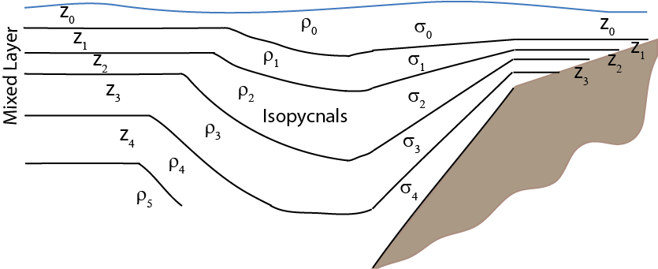
Hybrid Coordinates
R. Bleck: “HYCOM was developed to address known shortcomings of the MICOM vertical coordinate scheme “:
Isopycnal Vertical Grid
Outcropping problem
Lack of resolution in unstratified ocean
HYCOM hybrid scheme is similar to Arbitrary Lagrangian-Eularian technique of Hirt (1974) but major difference: coordinate layers are kept aligned with target densities
Hybrid Vertical Grid
isopycnal in the open stratified ocean
z-levels in unstratified mixed layer and very shallow regions
σ-levels in shallow regions
Notes:
HYCOM remains isopycnal in the open stratified ocean
Smoothly transition to z-levels in unstratified mixed layer to terrain-following in shallow regions and back to z-level in a very shallow regions
ALE – material velocities and velocity of the grid interface (applied for problems with moving boundaries)

Slide 8
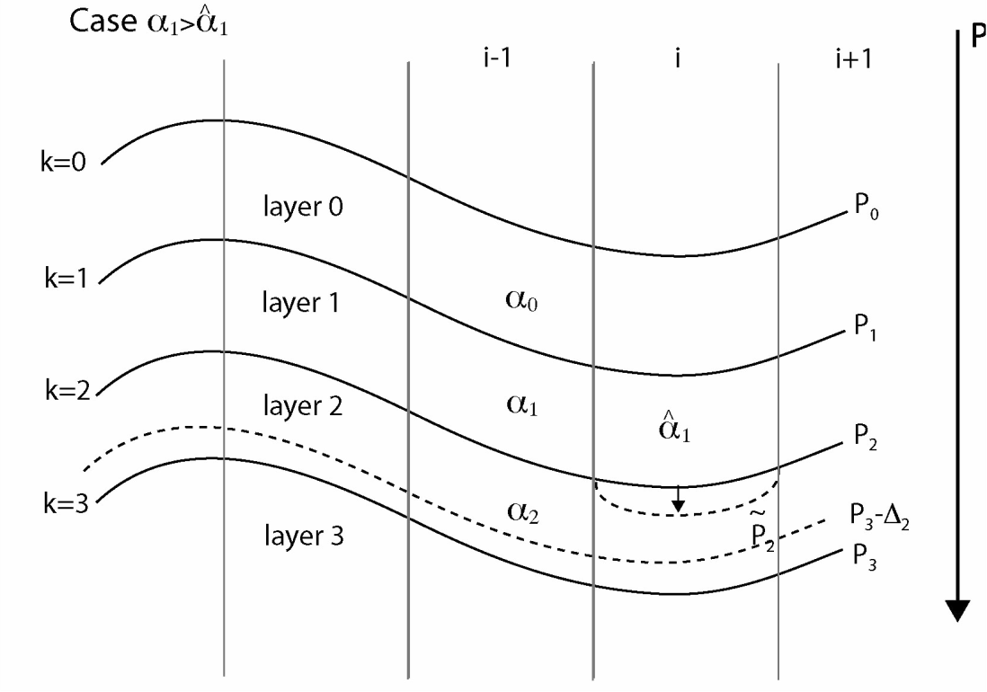
Hybrid Vertical Coordinate Grid Generator
Restores isopycnic conditions in coordinate layers by changing α₁ to in a manner that:
Maintains minimum layer thicknesses in the upper part of the water column
The overall height of the column, represented by the integral is preserved
The upper interface is moved upward to transfer less-dense water from layer 0 to layer 1.
The upper interface is moved downward to transfer denser water from layer 2 to layer 1.
Notes:
The algorithm controlling vertical coordinate adjustment in the open ocean works as follows. Consider 3 isop. Layers.
To restore isopycnic conditions, it is necessary to re-discretize the water column in a manner that preserves the overall height of the column while changing alf1 (specific volume) to target reference. Case 1: the layer is too dense, upper interface moves upward and mass is exchanged between layers 0 and 1.

Slide 9
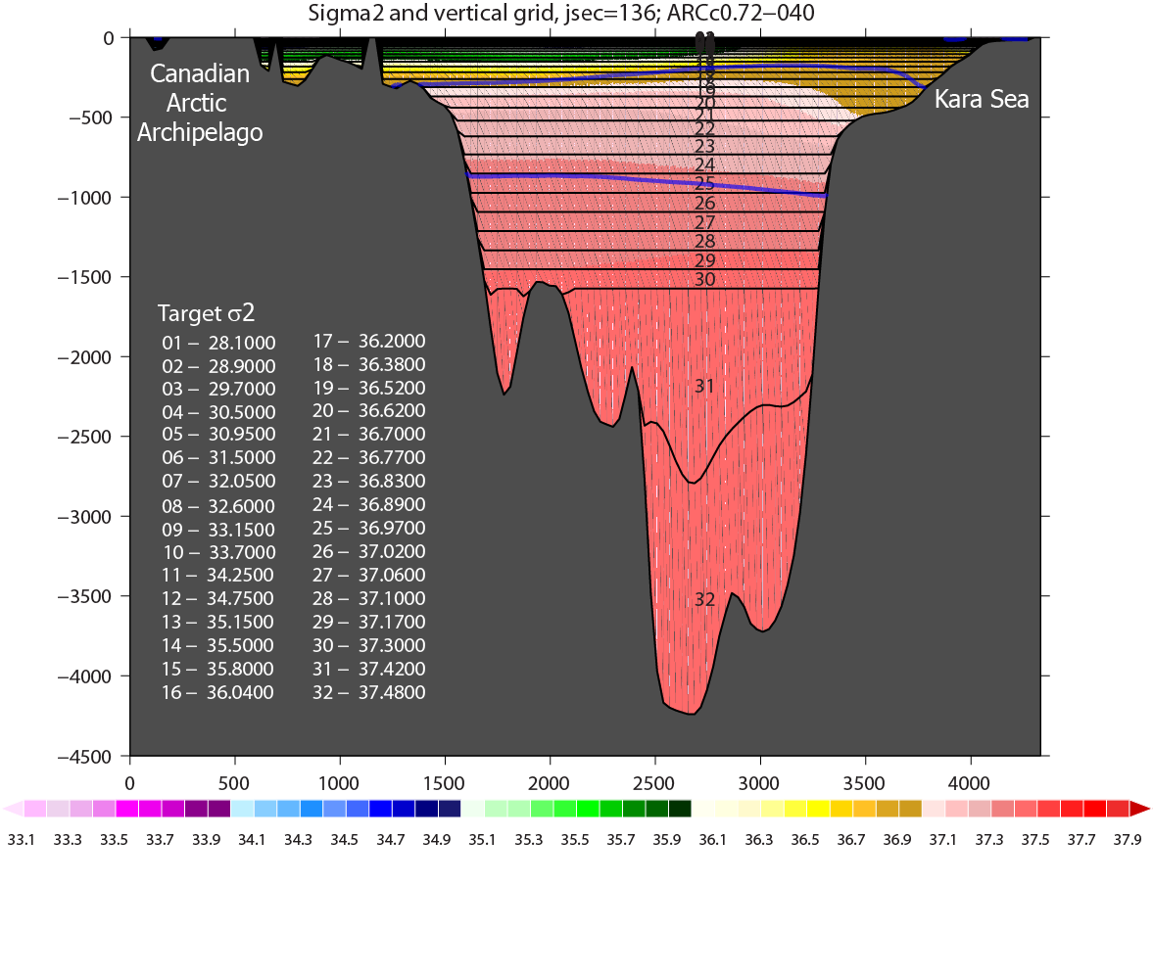
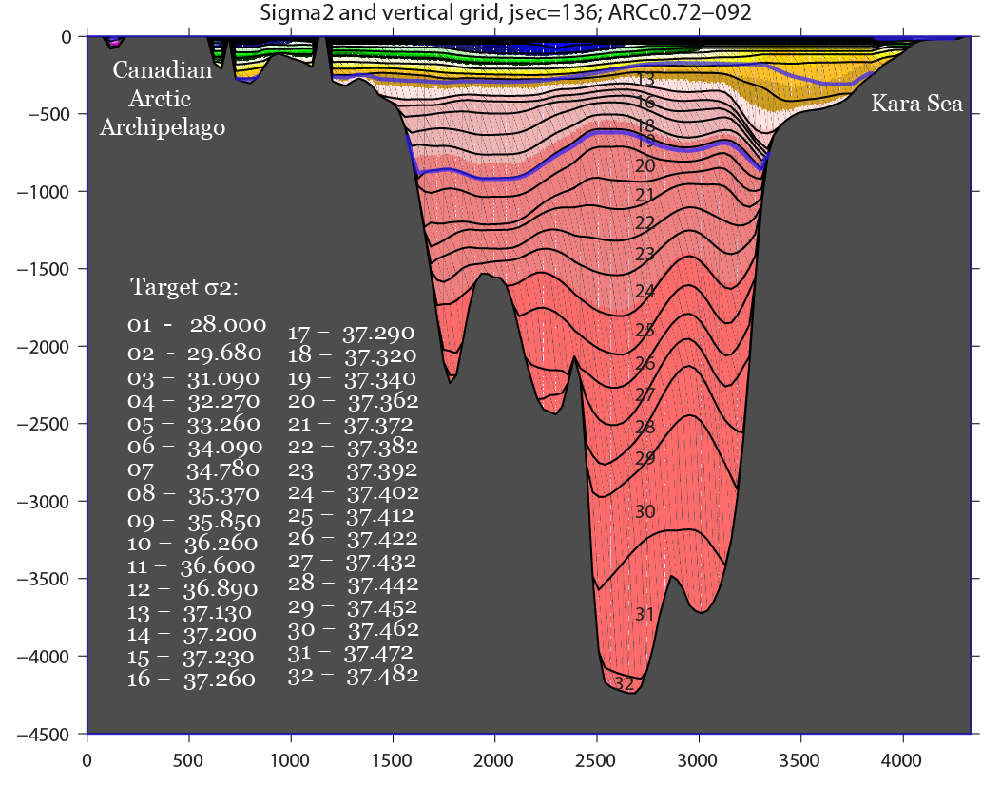
“Z-level” Vertical Grid
Vertical Sections of σ₂
Model Experiments
Atmospheric forcing: 3 hourly NOGAPS 0.5˚ fields
Lateral OBs: relaxation to T/S/P climatology
Rivers: climatology
Barotropic/barocl ∆t: 20 s/360 s
CICE ∆t: 1800 s
“ρ-level” Vertical Grid
HYCOM Initialization:
Climatology
CICE initialization:
3m ice where t < t_{freezing}
HYCOM/CICE Spin-up:
1-year run with climatology
5-year run with 2003 forcing
Notes:
Two vertical grids used in twin model experiments. One model – predominantly z-levels through the water column, second model – isopycnals, except for the mixed layer. Same initial conditions, spin-up, surface and lateral forcing.

Slide 10
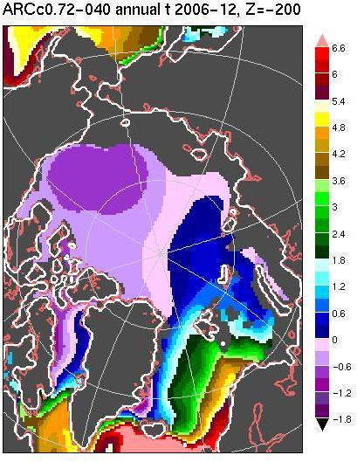
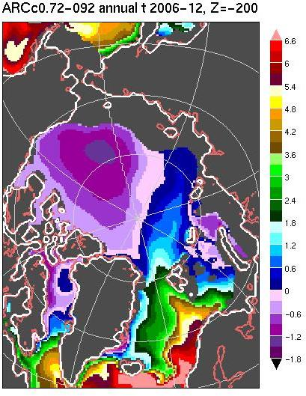
T Fields at 200 m
Z-level Vertical Grid
ρ-level Vertical Grid
GDEM
6.6
5.4
3.6
1.8
0
-1.8

Slide 11
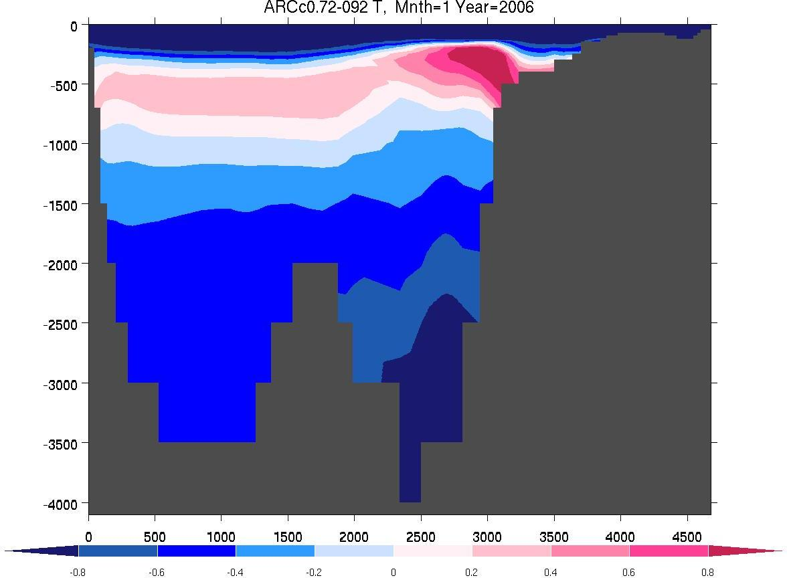
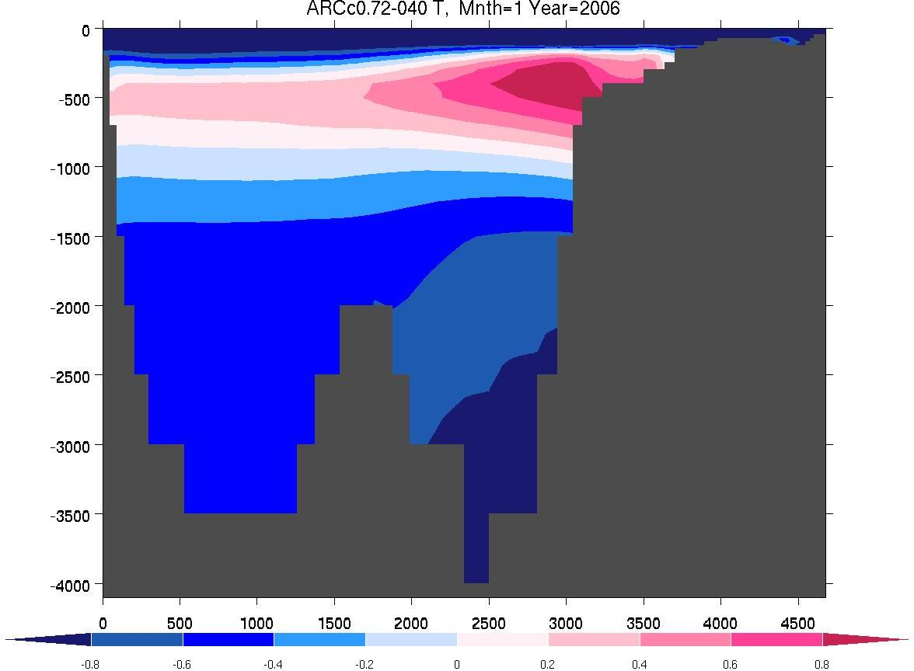
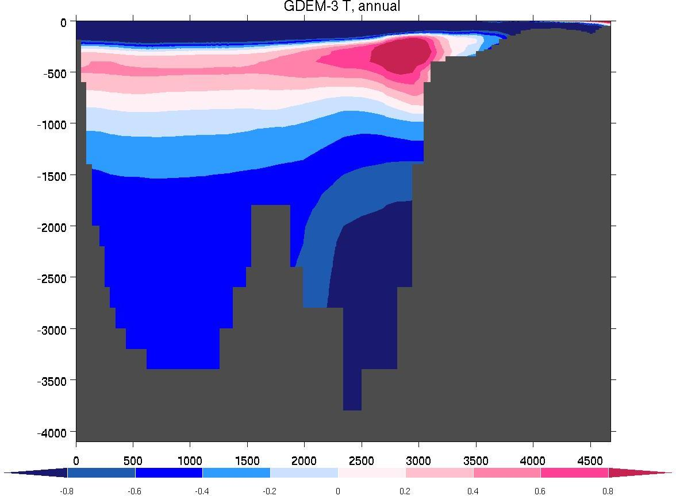
Kara Sea
1.4°C
ρ-level Vertical Grid
ARCc0.72-092
Lomonosov
Ridge
Canada Basin
Kara Sea
Kara Sea
1.0°C
2.8°C
2.8°C
Z-level Vertical Grid
ARCc0.72-040
GDEM 3
Lomonosov
Ridge
Lomonosov
Ridge
Canada Basin
Canada Basin
-0.8C
0C
0.8C
-0.8C
0C
0.8C

Slide 12
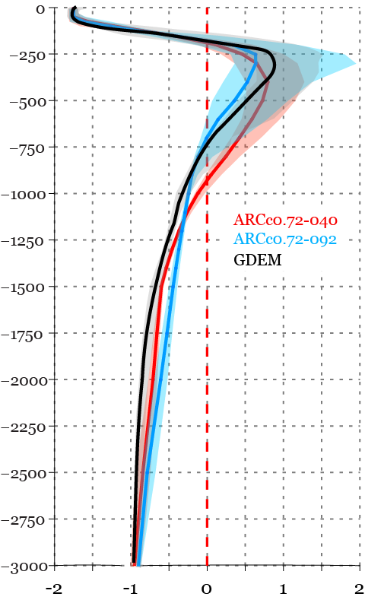
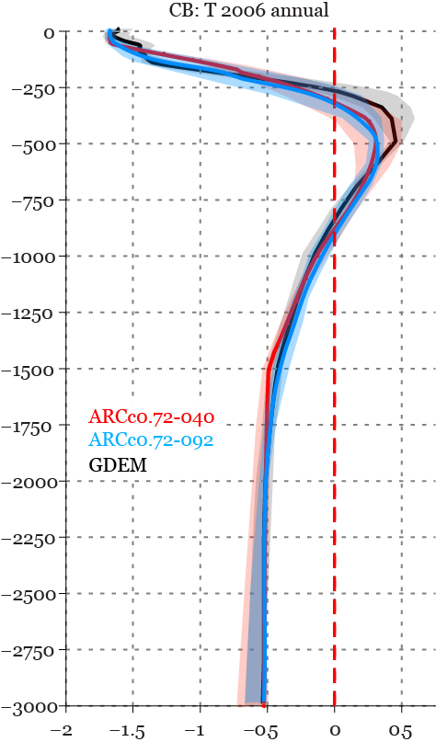
Average T Profiles
Eurasian Basin
Canada Basin
ρ-level
Z-level
Notes:
Annual mean T profiles. Solid lines – basin mean T profiles, shaded areas – 10th & 90th percentiles. Thermal structure in Canada Basin is weakly sensitive to vertical discretization schemes. Eur. Basin – vertical t distribution is different in Z and isopycnal models. Thickness of Atl. Layer in the isopycn. Model is very similar to that in GDEM. While in the Z-level model the warm layer is more diffused. Note the range of T within the layers. Both models, deep ocean has positive bias compared to GDEM.

Slide 13
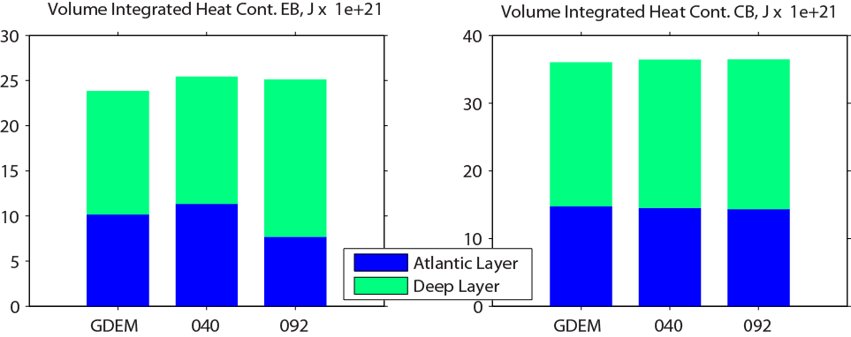
Volume Integrated Heat Content
Eurasian Basin, ZJ
Canada Basin, ZJ
z-level
ρ-level
z-level
ρ-level
Reference T = T freezing
Notes:
040 – higher heat cont. due to Atl. Layer diffusion
092 – Atl. Layer has lower heat content, although structure is reproduced better in the model with hybr. Coord. Deeper layer is warmer in 092. Cabeling effect
Overall heat cont. in climatology data is slightly lower than model results, due to warmer simulated deep ocean. Canada Basin – almost identical heat content. Heat is being redistributed among the vertical layers.

Slide 14
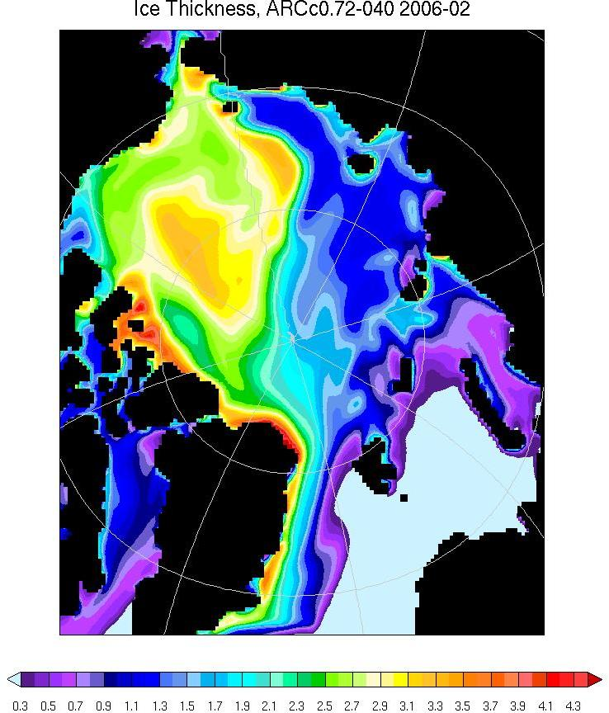
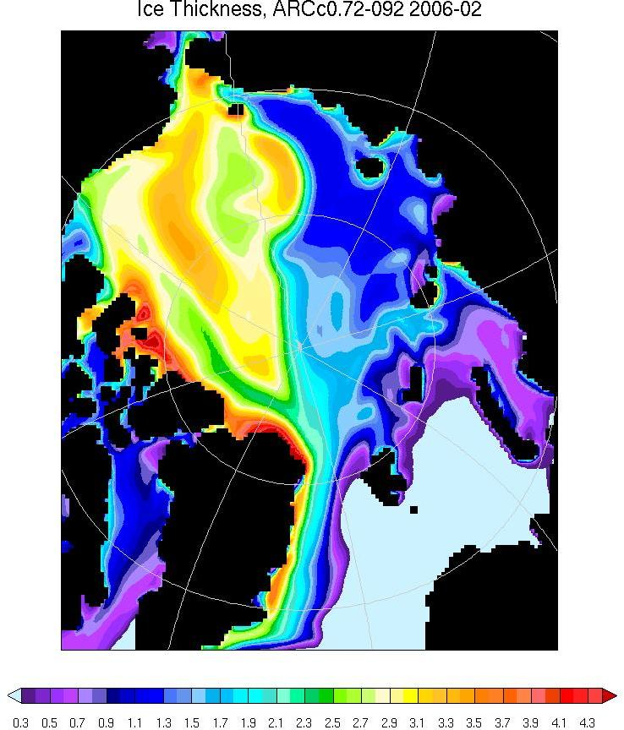
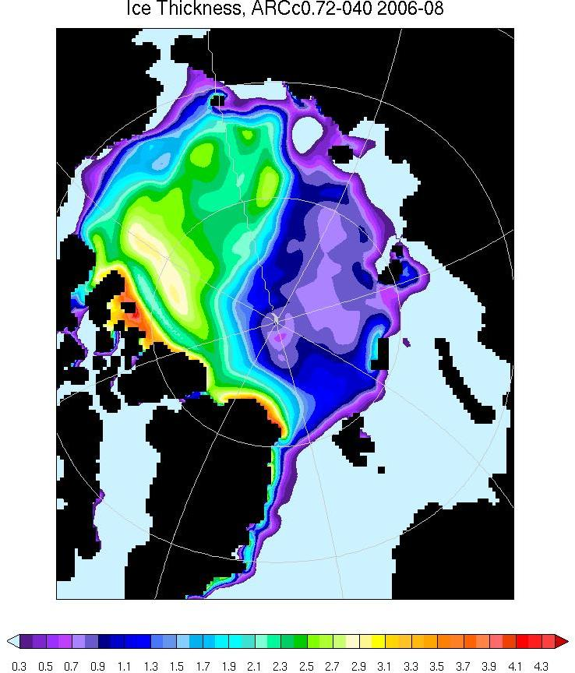
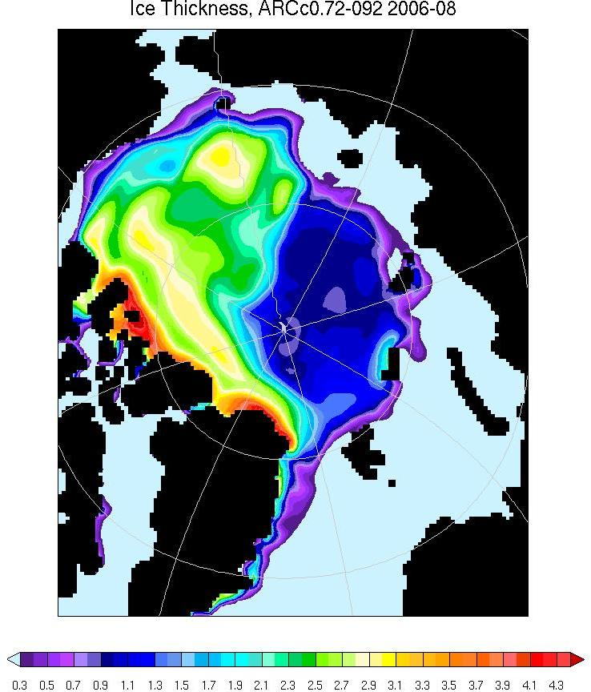
February, 2006
February, 2006
Z-level
Sea Ice Thickness
ρ-level
August, 2006
August, 2006
z-level
ρ-level
0.3
0.9
1.5
2.1
2.7
3.3
3.9
0.3
0.9
1.5
2.1
2.7
3.3
3.9
Notes:
Winter ice – very similar sea ice thickness pattern -> no obvious effect of different vert. grids, different heat content, different Atl. Layer properties.
Summer ice – similar, but some changes over Eurasian shelves and Eur. Basin of interior Arctic

Slide 15
Volume Fluxes (Sv) ARCc0.72 – 040
Z vertical grid
Volume Fluxes (Sv) ARCc0.72 – 092
ρ vertical grid
0.5
0.5
0.4
0.4
0.3
0.3
2.0
0.4
1.8
0.5
0.7
0.8
0.9
0.9
2.4
0.5
2.2
1.3
1.5
0.5
1.4
3.4
0.6
2.7
3.5
0.6
0.7
2.1
0.9
0.3
1.2
2.8
1.0
0.2
3.1
3.1
2.9
3.8
5.9
5.6
0.5
0.6
9.2
9.9

Slide 16
Summary
Different vertical discretization schemes impact numerical solution
Model with hybrid vertical levels (isopycnal below ~100 m in the deep open ocean) simulates Atlantic Layer better than the model with z-levels compared to climatology:
vertical positioning and thickness of the layer
horizontal distribution
core temperature
Atlantic Layer is more diffused in the model configured with z-levels and thus thicker and accumulates more heat than Atlantic Layers in the ρ-level model or GDEM
Estimates of volume fluxes demonstrate:
increased inflow through Fram Strait and outflow through CAA in ρ-level model
Vertical discretization of the ocean model has little effect on the sea ice over the deep Arctic Ocean

Slide 18
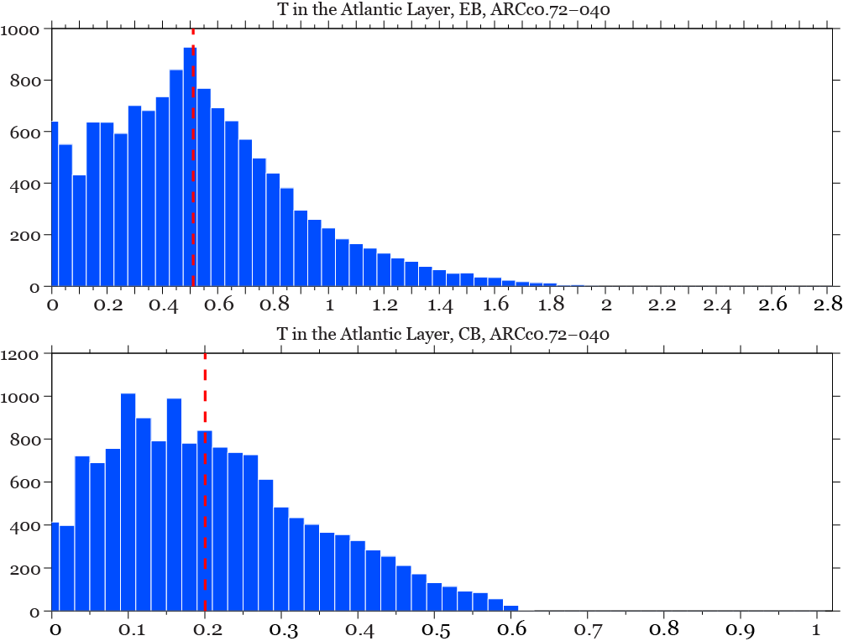
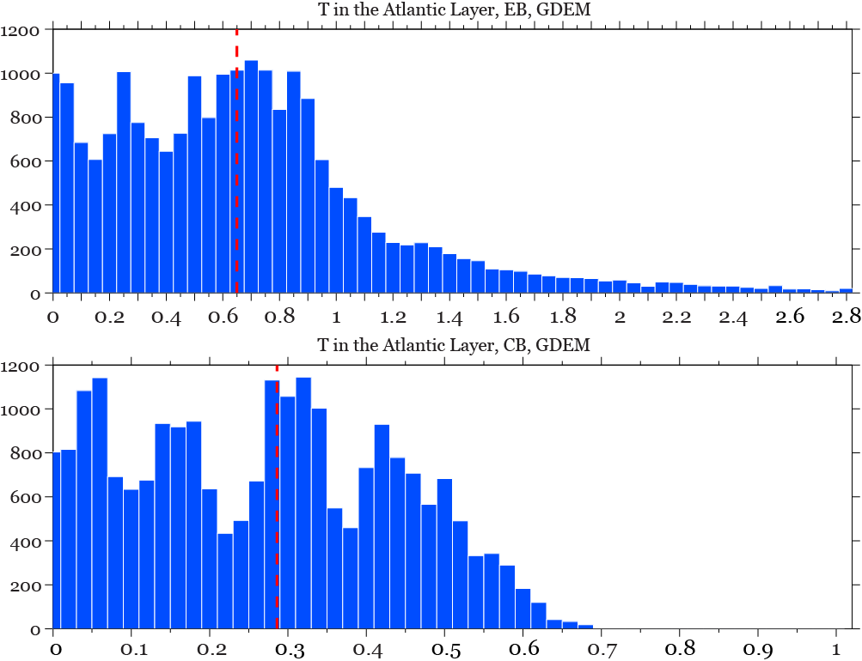
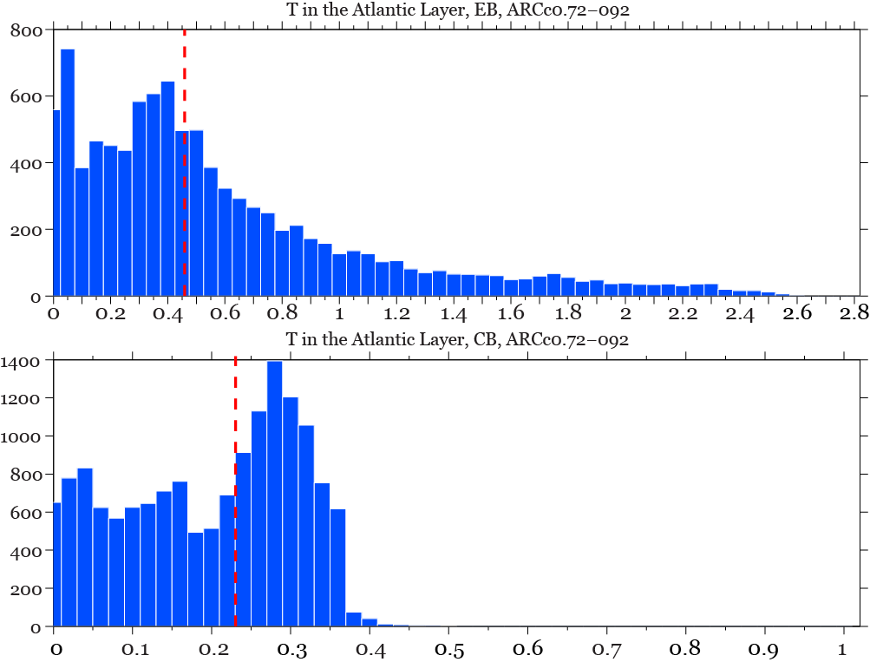
Histograms of T in the Atlantic Water Layer
Eurasian Basin
ARCc0.72-040 (Z-level)
Eurasian Basin
GDEM
Eurasian Basin
ARCc0.72-040 (ρ-level)
Canada Basin
Canada Basin
Canada Basin
Notes:
Histograms of atl. Water temperature in Eur. And Can. Basins reveal remarkable discrapencies between the models. Hist. of isopycn. Model has several modes most probably related to several water masses maintained in the model. Z-level model demonstrates more uniform distribution of the T with a single model. Tail of the distribution is longer in isopycn. Model. Compared to GDEM, isopycn. Model looks better in the eur. Basin, Canada basin – the

Slide 19
Terrain-following (“σ-level”) Vertical Coordinates
Pros:
Accurate representation of the bottom topography
Ease in providing high resolution in unstratified ocean
High resolution of shallow regions
Cons:
Spurious diapycnal mixing
Numerical truncation errors when calculating horizontal gradients of depth dependent quantities (e.g, pressure, velocity) over sloping bottom
- generic variable
D – total depth
Volume-averaged kinetic energy from σ model test runs with different schemes of calculation of the horizontal pressure gradient
Spurious currents simulated 200 m above the bottom in model test runs with 80 and 40 σ-levels
Dukhovskoy et al., Oc. Modelling, 2009
Mellor, JAOT, 1994
Notes:
First term on the right – gradient along sigma level, second term – sometimes referred as hydrostatic correction due to sloping sigma surfaces. If the LH term is small compared to the RHS terms, than the horizontal gradient in sigma coordinates is estimated as difference of large numbers potentially leading to large errors. When slope is zero, two methods are identical.
Truncation error - (first recognized in atmospheric models, Rouseau and Pham, 1971)

Slide 20
Numerical Dispersion in a Z-level Model
Dispersion of a Tracer in a Water Column Subjected to Gravity Wave-Induced Oscillatory Vertical Motion
Bleck, “Hybrid Vertical Coordinates”,2009
Notes:
Shown is a stack of three grid cells. The initial state, T=0, is chosen to coincide with the wave trough, at which time the middle cell is assumed to be filled with a tracer of concentration 100. The approaching wave crest causes water to be advected upward by a distance chosen in this example to correspond to one-fifth of the vertical cell size (T=1). In level models (a), the clock is stopped momentarily to allow the tracer to be reapportioned (“rezoned”) among the original grid cells. The next wave trough causes the water column to return to its original position (T=2). After renewed rezoning, tracer concentration in the middle cell has fallen to 68, the remainder having seeped into cells above and below. In layer models (b), the periodic rezoning steps are skipped, so tracer concentration remains unaffected by the wave motion.

Slide 21
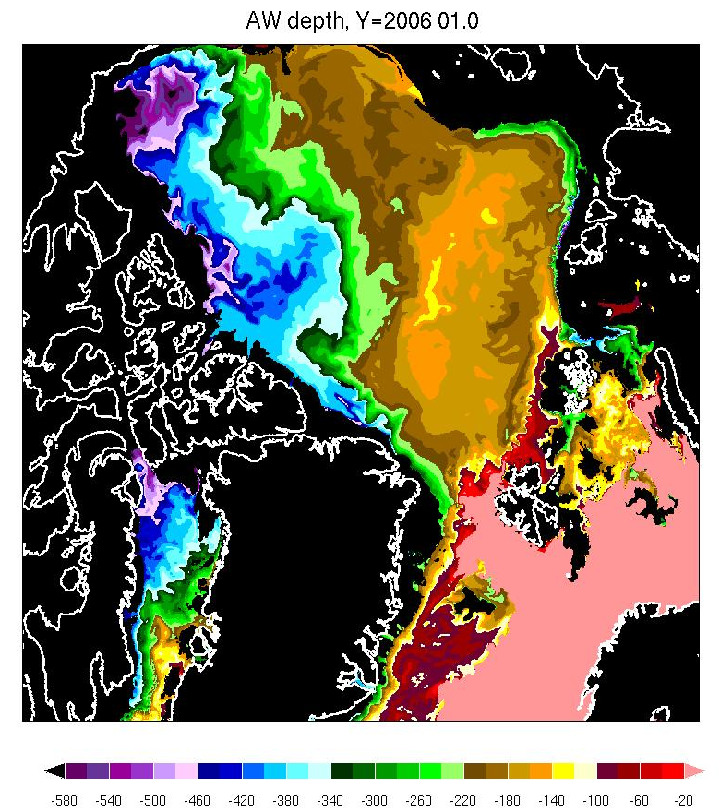
Atlantic Water Depth
ARCc0.08-010
PHC Climatology

Slide 22
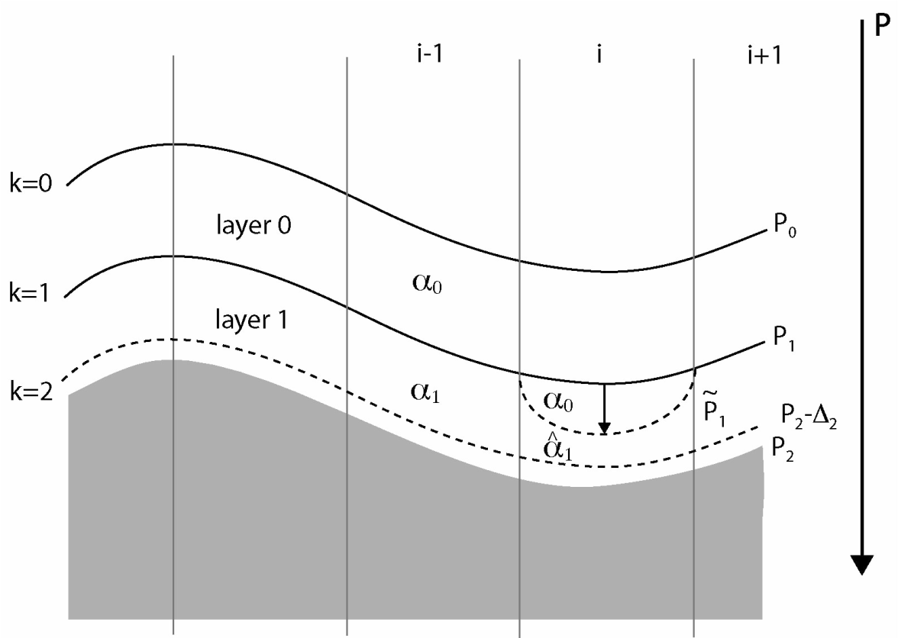
Case 2:
If layer 1 is the last nonzero thickness layer
Unmixing
The water in layer 1 must be restratified into two sublayers such that:
the density of the upper sublayer exactly equals the density of layer 0,
the density of the lower sublayer is close to the desired reference density
the density averaged over the two sublayers equals the original layer density
Bleck, Oc. Modelling, 2002
Notes:
If layer 1 is the deepest layer with nonzero thickness and it is too light, interface 2 cannot move downward to restore ispoycnic conditions and a special algorithm, must be executed: Since only interface 1 can be moved, this interface is moved downward to restore isopycnic conditions in layer 1. An “unmixing” algorithm is employed to achieve this goal.
Unmixing is constrained by T/S bounding box. Filled dot – T/S before, hollow – after unmixing.

Slide 23
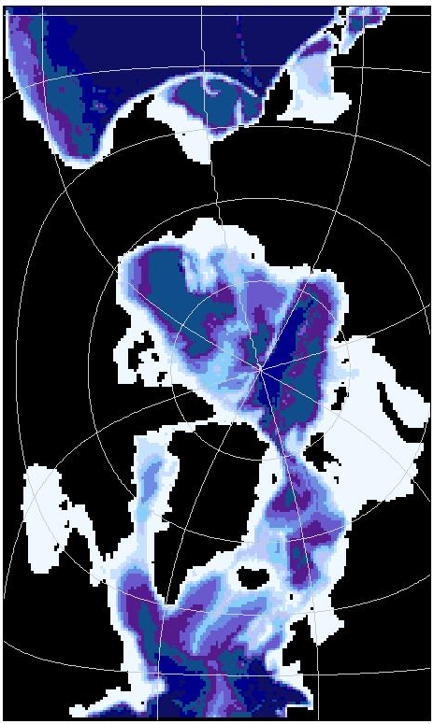
ARCc0.72 Sensitivity Experiments
ARCc0.72, 2003-2009, (COAPS):
1) Realistic Topography (“RT”)
2) RT, closed Bering Strait
3) RT, closed CAA
4) RT, isolated Kara Sea
5) ST (replicated NRL test run)
HYCOM Initialization:
Climatology
CICE initialization:
3m ice where t < t_{freezing}
HYCOM/CICE Spin-up:
1-year run with climatology
5-year run with 2003 forcing
Bering
Strait
Model Runs:
CAA
Kara Sea
Atmospheric forcing: 3 hourly NOGAPS 0.5˚ fields
Lateral OBs: relaxation to T/S climatology
Rivers: climatology
Barotropic/barocl ∆t: 20 s/360 s
CICE ∆t: 1800 s
Notes:
Originally, a 27 year spin-up integration was used forced with a daily-averaged annual cycle of climatological atmospheric forcing derived from ECMWF. Then a 12 year run was completed using the repeated 1979 ECMWF annual forcing for the first 6 years and 1979-1981 inter-annual fields for the last 6 years. All of this was done at the Naval Post-Graduate School (NPG). Once we got the model, I made an ice-only run starting from the NPG restart but using NOGAPS data from 1999-2005. We restarted the HYCOM/CICE 0.72 test from this ice-only NOGAPS run.

Slide 24
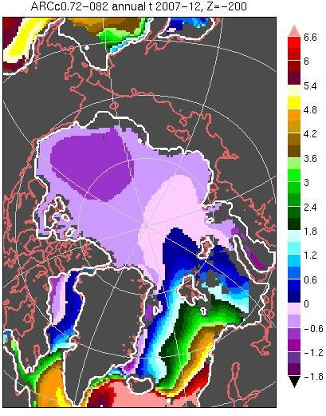
T Fields at 200 m
Test Run with Simplified Topography
Realistic Topography
GDEM
Notes:
Simulation with RT reveals improvement in the Atl. Layer + warm Kara Sea/St. Anna trough
Model with closed Ber. Str – no difference (Bering Strait is not resolved)
CAA – slightly colder Atl. Layer at this depth
Isolated Kara Sea – depleted warm layer and cold Kara Sea
ST COAPS – did not reproduce ST NRL (too short run) but similar results with RT – KARA Sea. Reason: changed circulation in the Barents Sea results in the reduced inflow through Fram Strait

