Slide 1
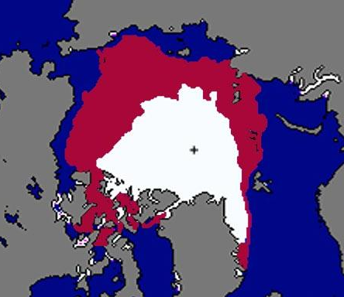
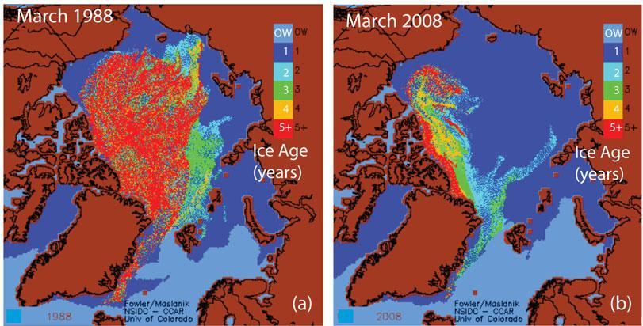
When we last met a year ago…
Many different changes
Loss of ice extent
Loss of ice thickness
Loss of multiyear ice
Average
2012
September
Alaska
Loss, loss, loss – what is happening to the ice cover?

Slide 2
Sea ice in 2013
1981-2010 average
Extent (millions km²)
2013
2012
Courtesy NSIDC
Less than average, more than 2012

Slide 3
Sea ice in 2013
-13.7% per decade
-2.6% per decade
A big rebound

Slide 4
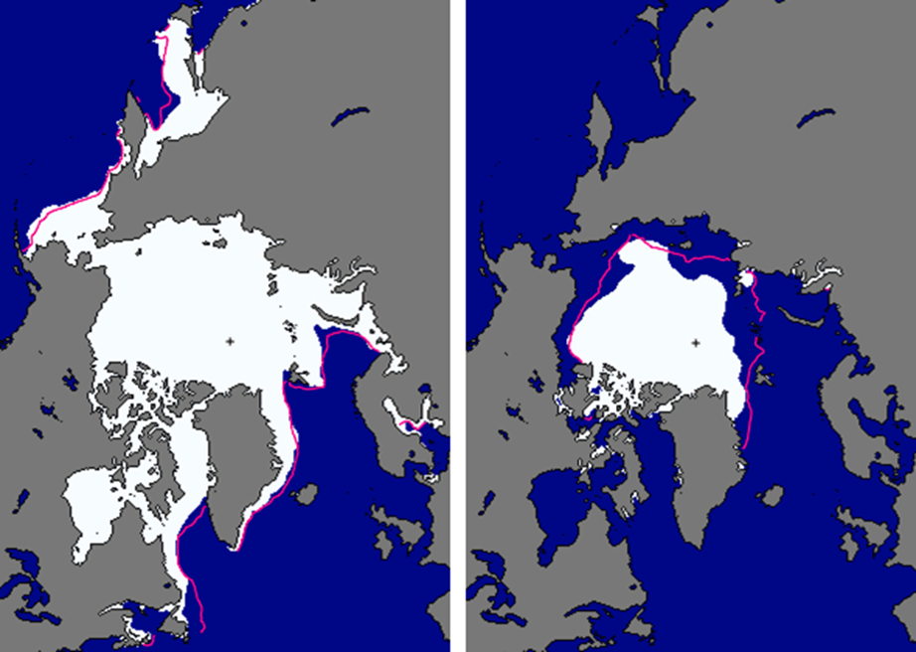
Sea ice in 2013
March
15.0 x 10⁶ km²
September
5.1 x 10⁶ km²
Courtesy NSIDC
Recovery in the west

Slide 5
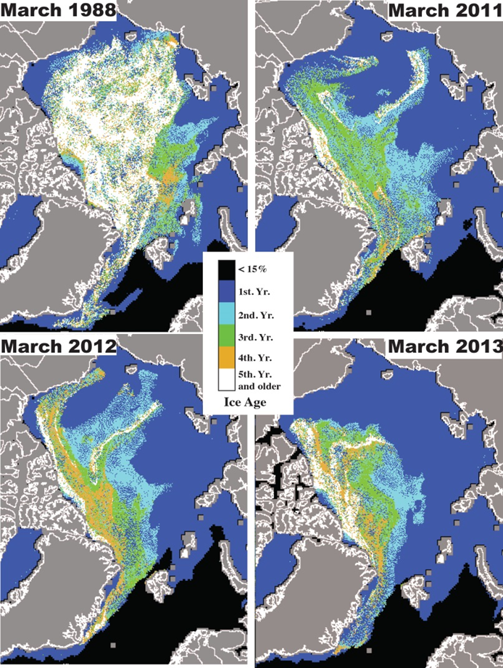
Multiyear ice in 2013
Multiyear “stayed home” in 2013

Slide 6
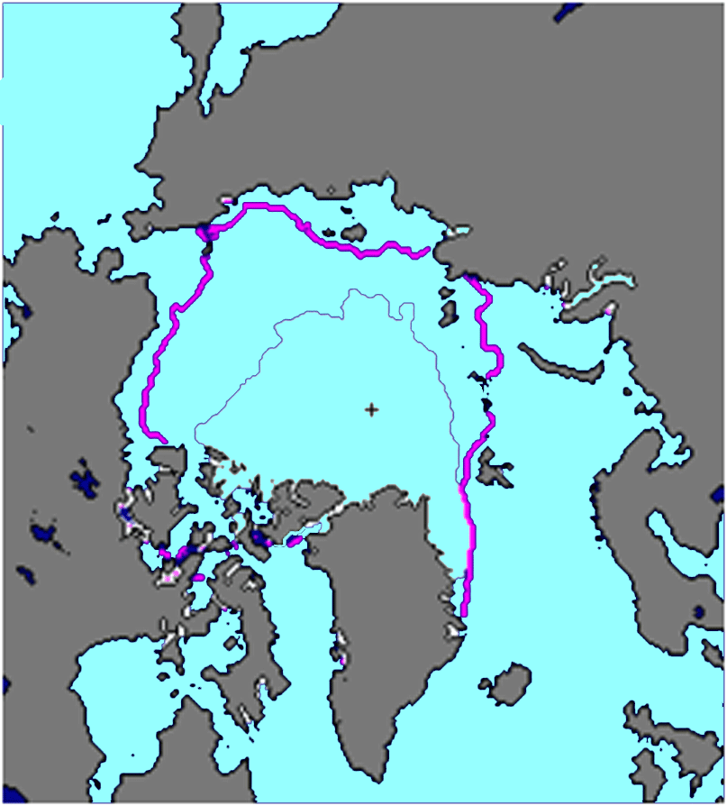
The Challenge
What is the minimum ice extent?
When is the minimum ice extent
Draw the minimum ice extent.

Slide 7
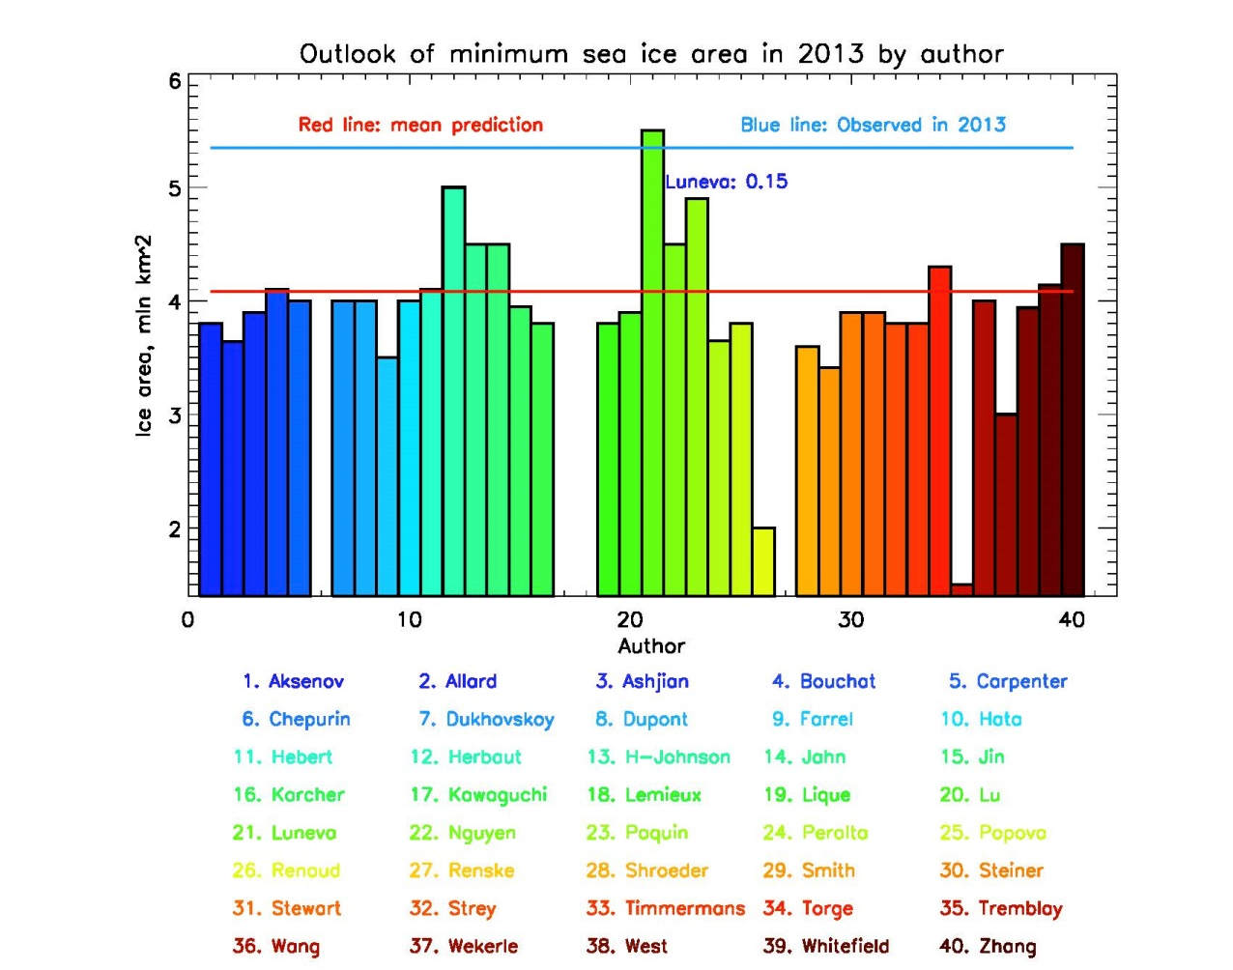
Minimum ice extent

Slide 8
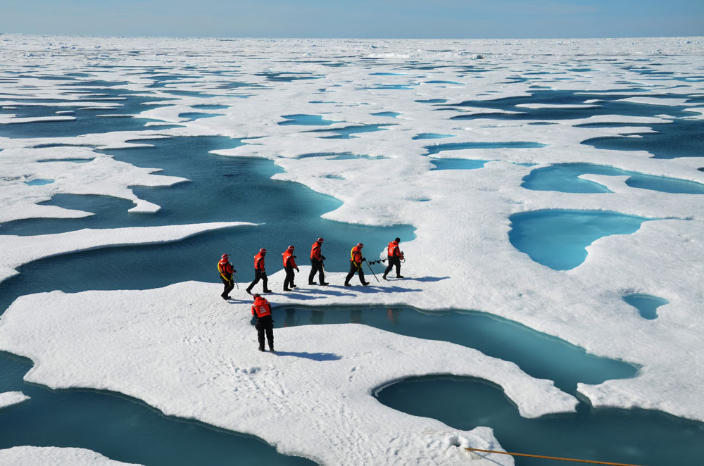
Sea ice extent
Maria Luneva

Slide 9
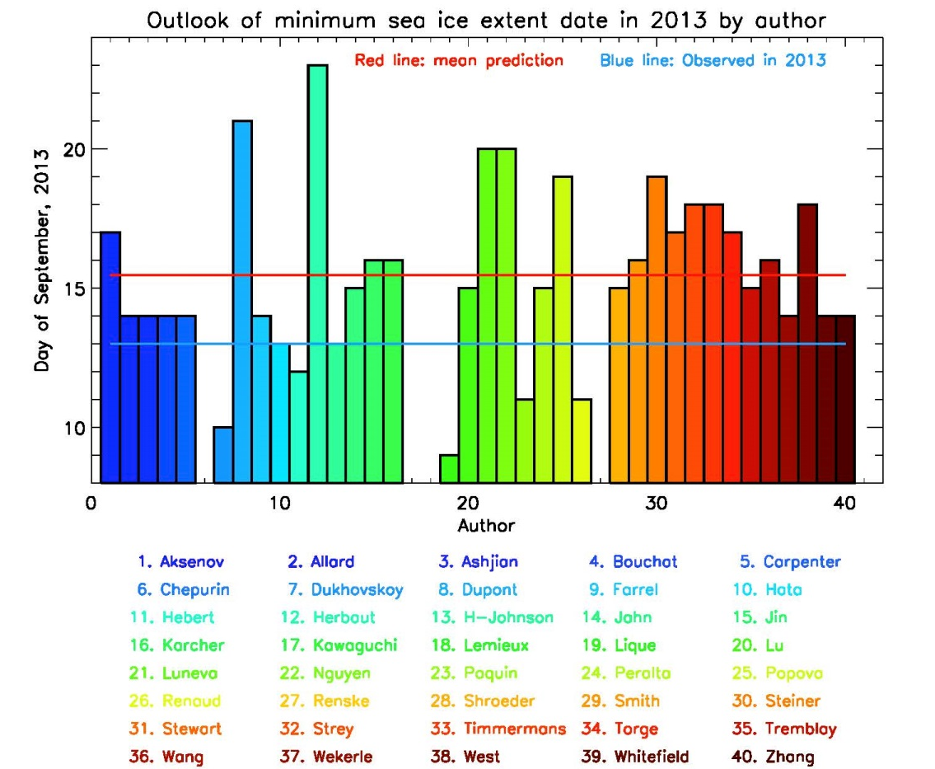
Timing of minimum ice extent

Slide 10
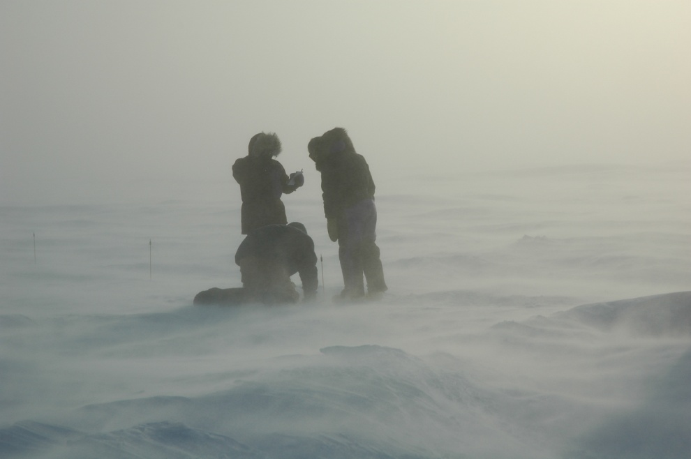
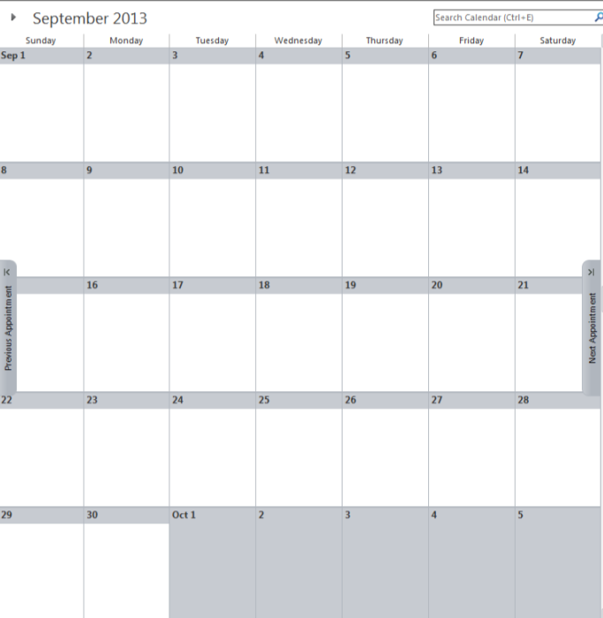
Timing of minimum
Yukie Hata

Slide 11
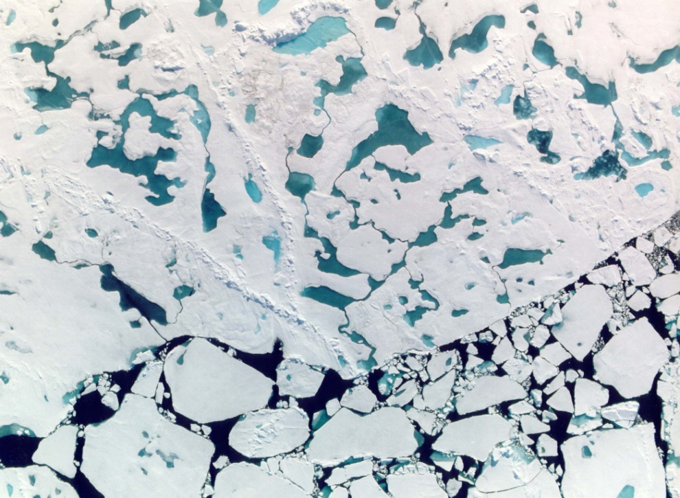
Timing of minimum
Helen Johnson

Slide 12
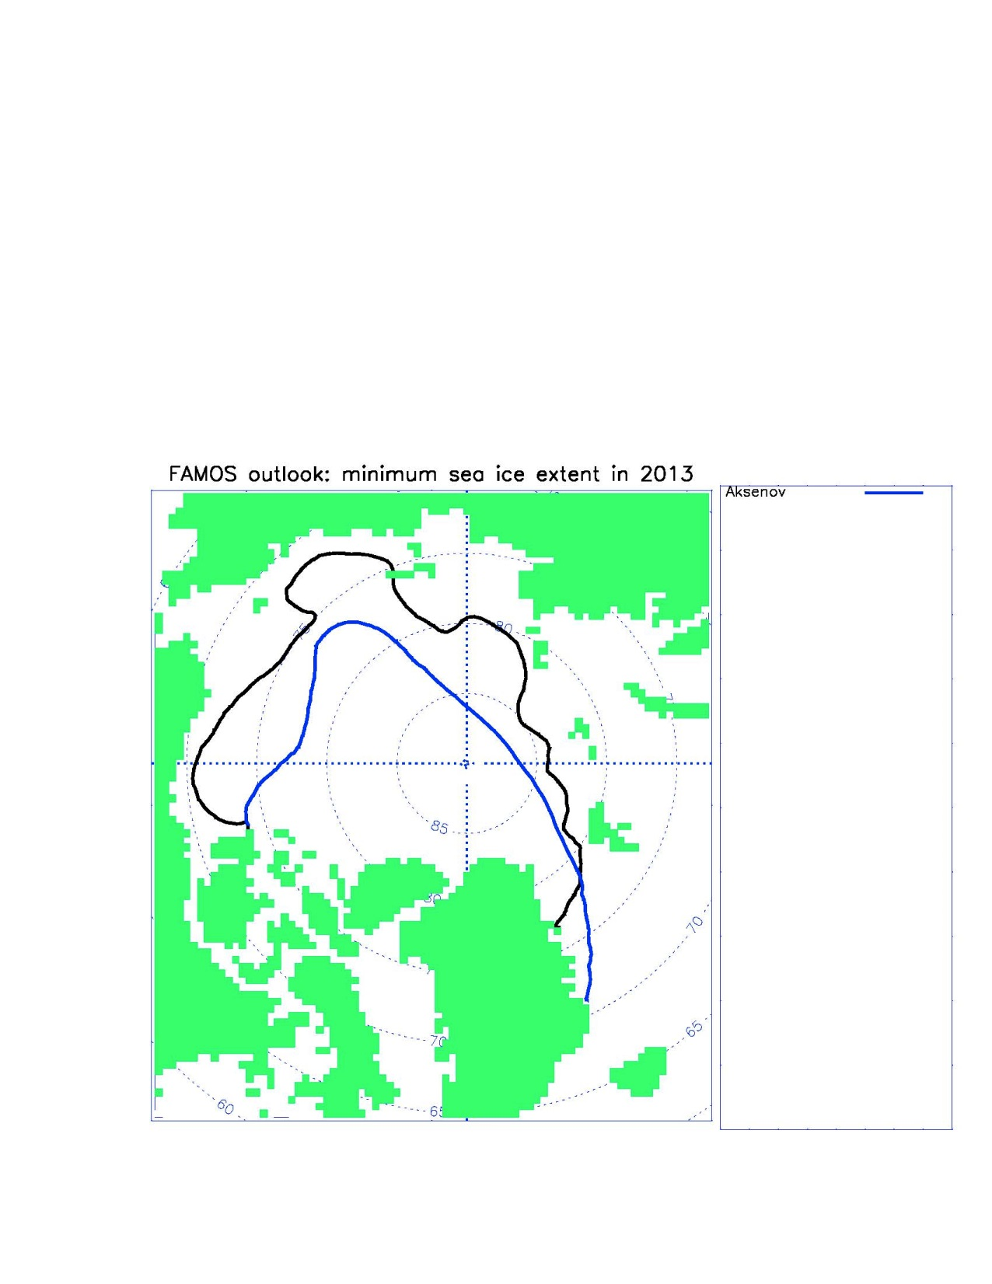
Draw the minimum ice extent

Slide 13
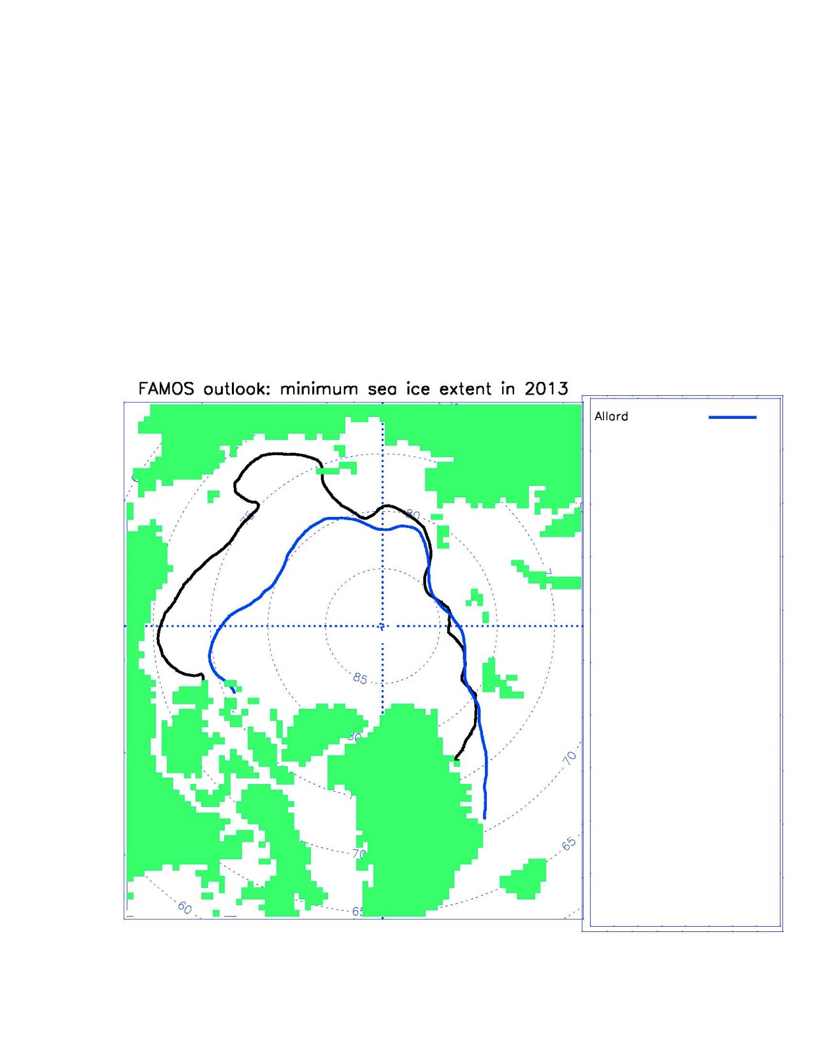
Draw the minimum ice extent

Slide 14
Draw the minimum ice extent

Slide 15
Draw the minimum ice extent

Slide 16
Draw the minimum ice extent

Slide 17
Draw the minimum ice extent

Slide 18
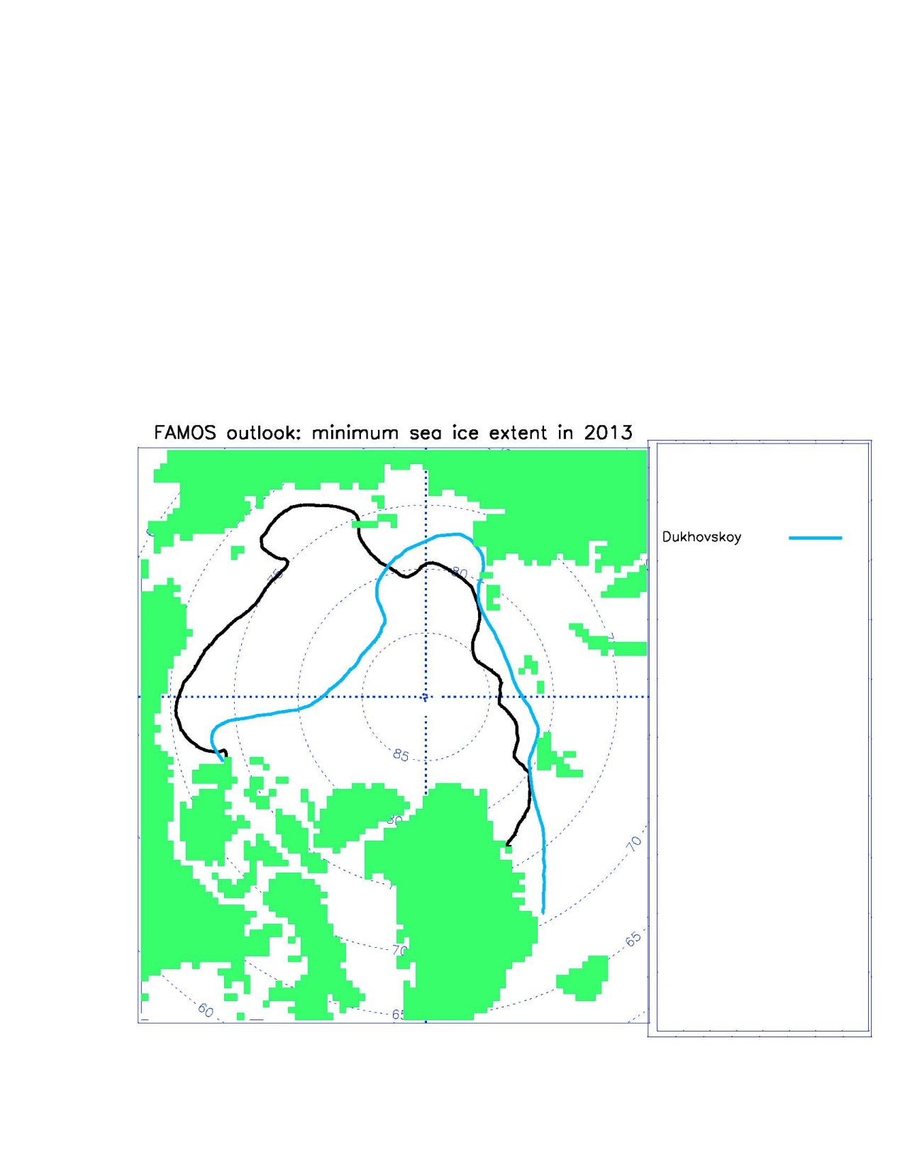
Draw the minimum ice extent

Slide 19
Draw the minimum ice extent

Slide 20
Draw the minimum ice extent

Slide 21
Draw the minimum ice extent

Slide 22
Draw the minimum ice extent

Slide 23
Draw the minimum ice extent

Slide 24
Draw the minimum ice extent

Slide 25
Draw the minimum ice extent

Slide 26
Draw the minimum ice extent

Slide 27
Draw the minimum ice extent

Slide 28
Draw the minimum ice extent

Slide 29
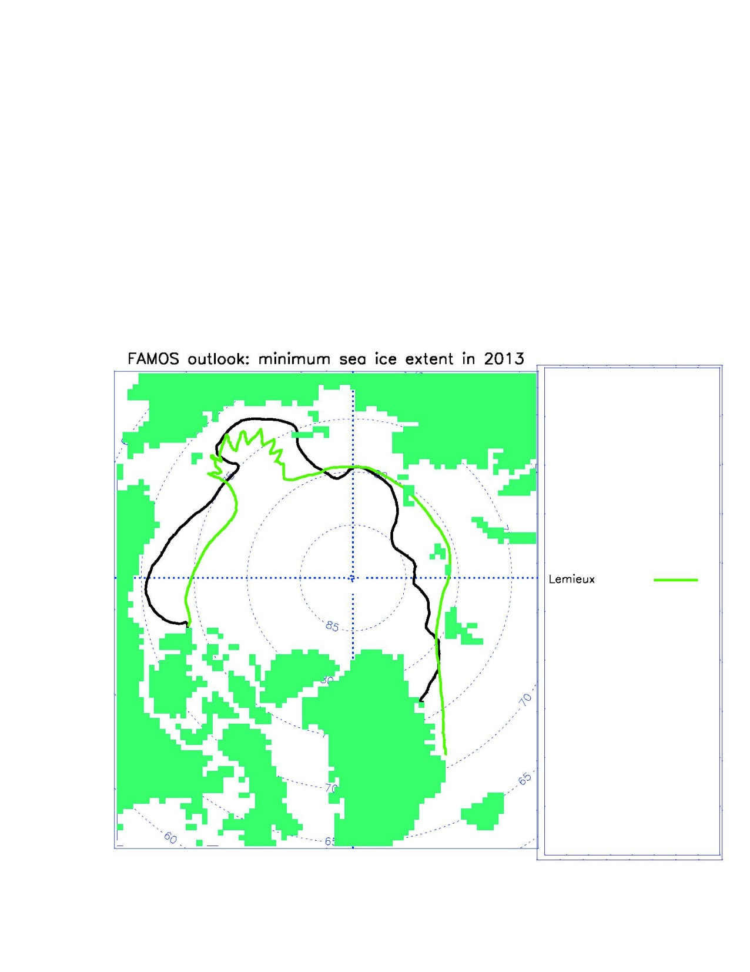
Draw the minimum ice extent

Slide 30
Draw the minimum ice extent

Slide 31
Draw the minimum ice extent

Slide 32
Draw the minimum ice extent

Slide 33
Draw the minimum ice extent

Slide 34
Draw the minimum ice extent

Slide 35
Draw the minimum ice extent

Slide 36
Draw the minimum ice extent

Slide 37
Draw the minimum ice extent

Slide 38
Draw the minimum ice extent

Slide 39
Draw the minimum ice extent

Slide 40
Draw the minimum ice extent

Slide 41
Draw the minimum ice extent

Slide 42
Draw the minimum ice extent

Slide 43
Draw the minimum ice extent

Slide 44
Draw the minimum ice extent

Slide 45
Draw the minimum ice extent

Slide 46
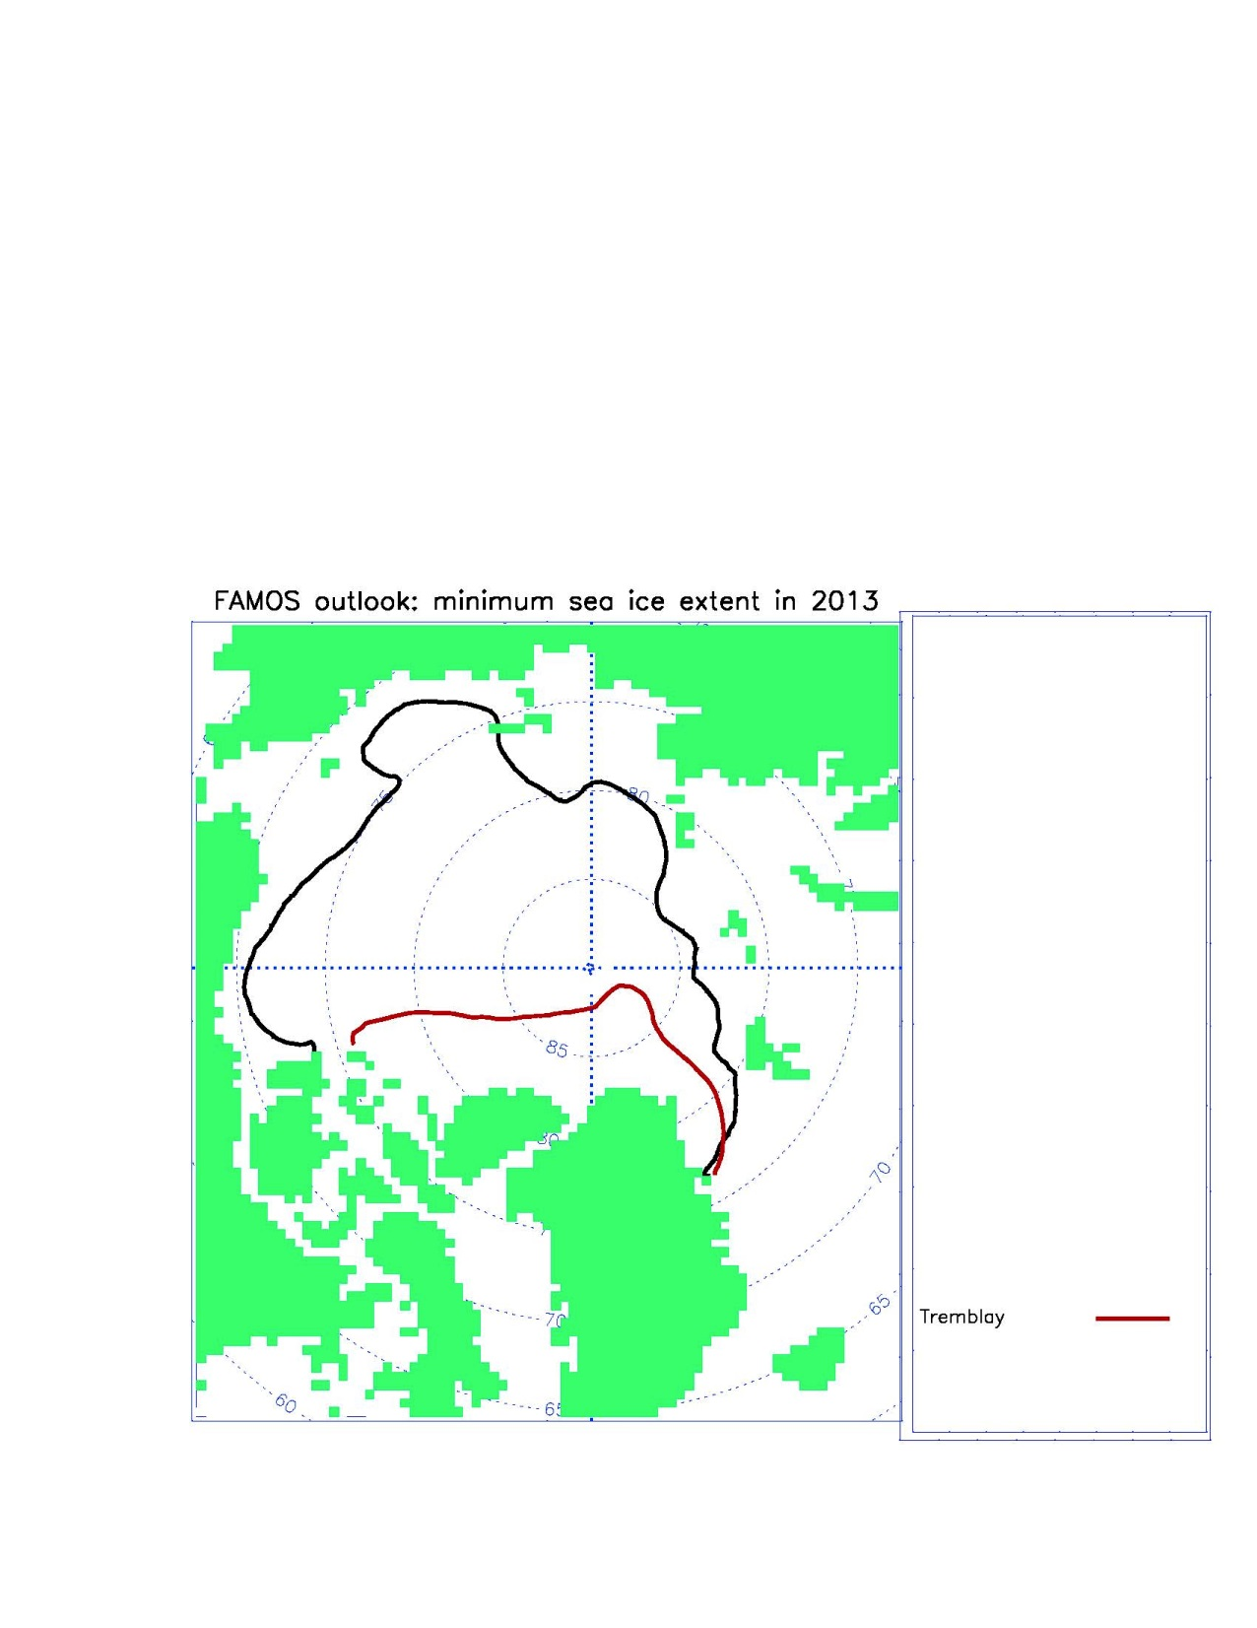
Draw the minimum ice extent

Slide 47
Draw the minimum ice extent

Slide 48
Draw the minimum ice extent

Slide 49
Draw the minimum ice extent

Slide 50
Draw the minimum ice extent

Slide 51
Draw the minimum ice extent

Slide 52
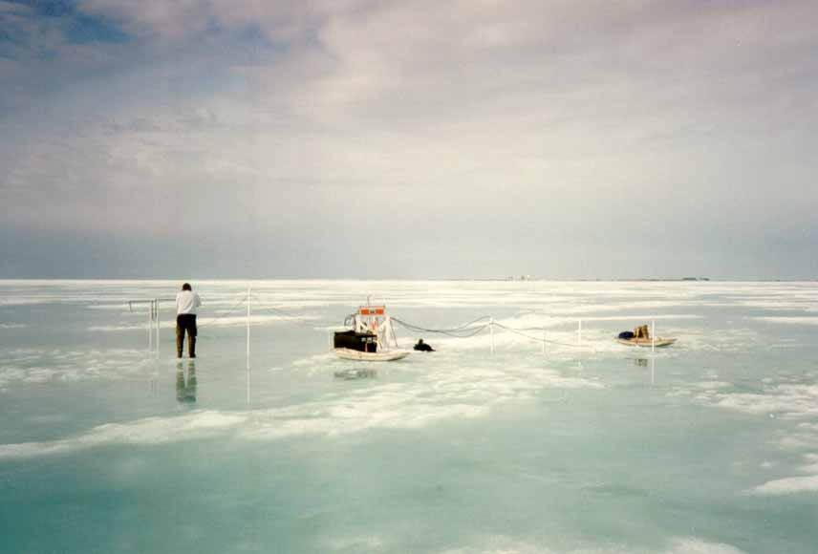
Sea ice distribution
Maria Luneva

Slide 53
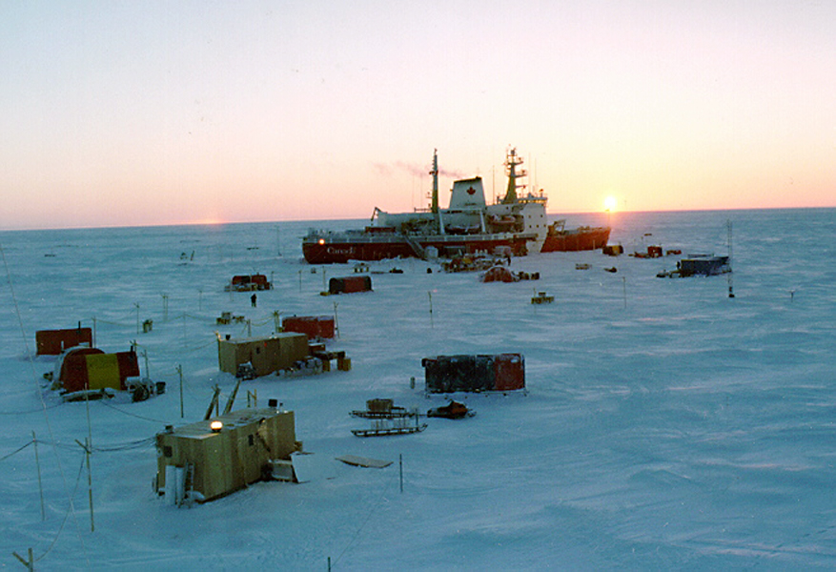
Sea ice distribution
Gennady Chepurin

Slide 54
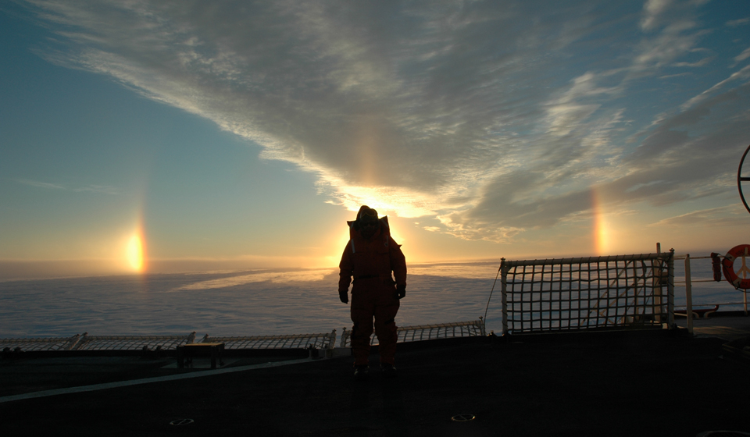
Sea ice distribution
Jean-Francois Lemieux

Slide 55
2014 Sea ice minimum outlook
2014 SEA ICE MINIMUM OUTLOOK
Please use this information to
predict sea ice conditions in 2014 using attached information below (slide 4) .
What is your:
Area of minimum sea ice extent in 2014? (slide 2)
Date of minimum sea ice extent in 2014? (slide 2) Draw your line showing your prediction of sea ice extent configuration in 2014 (slide 3)
YOUR NAME and INSTITUTION:
----------------------------------------------------------------------- 1

Slide 56
What is your prediction of September minimum and September mean sea ice extent in 2014?
A) MINIMUM : ? B) MEAN: ?
Million Square kilometers
In 2013: minimum September= 5.30 Mean September = 5.35

Slide 57
RED: This is 1979-2000
mean minimum ice extent
BLACK – minimum ice extent in 2013
DRAW HERE YOUR LINE SHOWING YOUR PREDICTION OF MINIMUM SEA ICE EXTENT in 2014

Slide 58
Information for 2014 predictions
Good luck!

