Slide 1
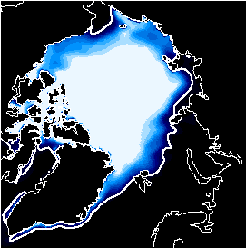
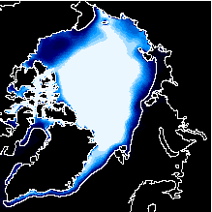
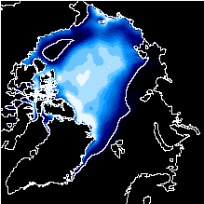
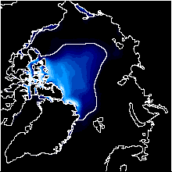
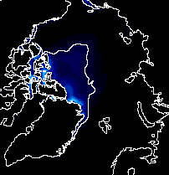
Using coupled climate models to investigate the predictability of sea ice
Marika Holland
National Center for Atmospheric Research
Collaborators:
David Bailey (NCAR), Steve Vavrus (U.WI), Julienne Stroeve (NSIDC), Ed Blanchard-Wrigglesworth (U. WA), Cecilia Bitz (U. WA), Jennifer Kay (NCAR)
University of Toronto
November 2012
FAMOS Meeting, October 2013
NCAR is sponsored by the National Science Foundation

Slide 2
Outline
Background
Using climate models to assess Arctic sea ice predictability on seasonal to interannual timescales
Thoughts on building a forecasting system
Conclusions

Slide 3
Outline
Background
Using climate models to assess Arctic sea ice predictability on seasonal to interannual timescales
Thoughts on building a forecasting system
Conclusions

Slide 4
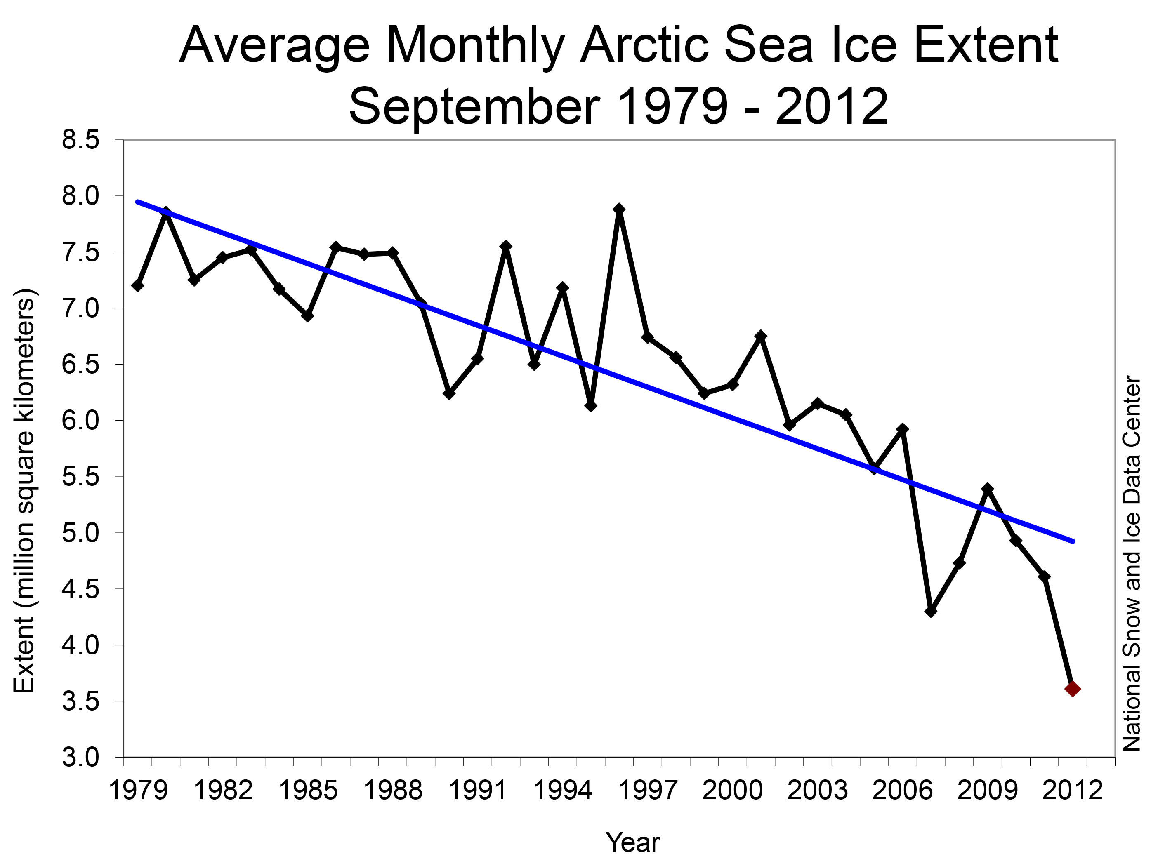
When I received my Ph.D.
6.74 million sq km
Where we were Sept 2012
3.61 million sq km
~13% per decade linear trend

Slide 5
September Ice Cover
From The Cryosphere Today website
University of Illinois

Slide 6
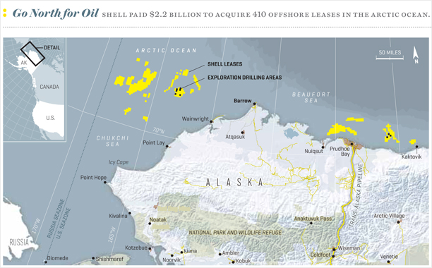
2010 – 4 vessels
2011 – 34 vessels
2012 – 46 vessels
Norwegian Tanker – ‘Marika’
Transported jet fuel from Korea to Finland in Aug

Slide 7
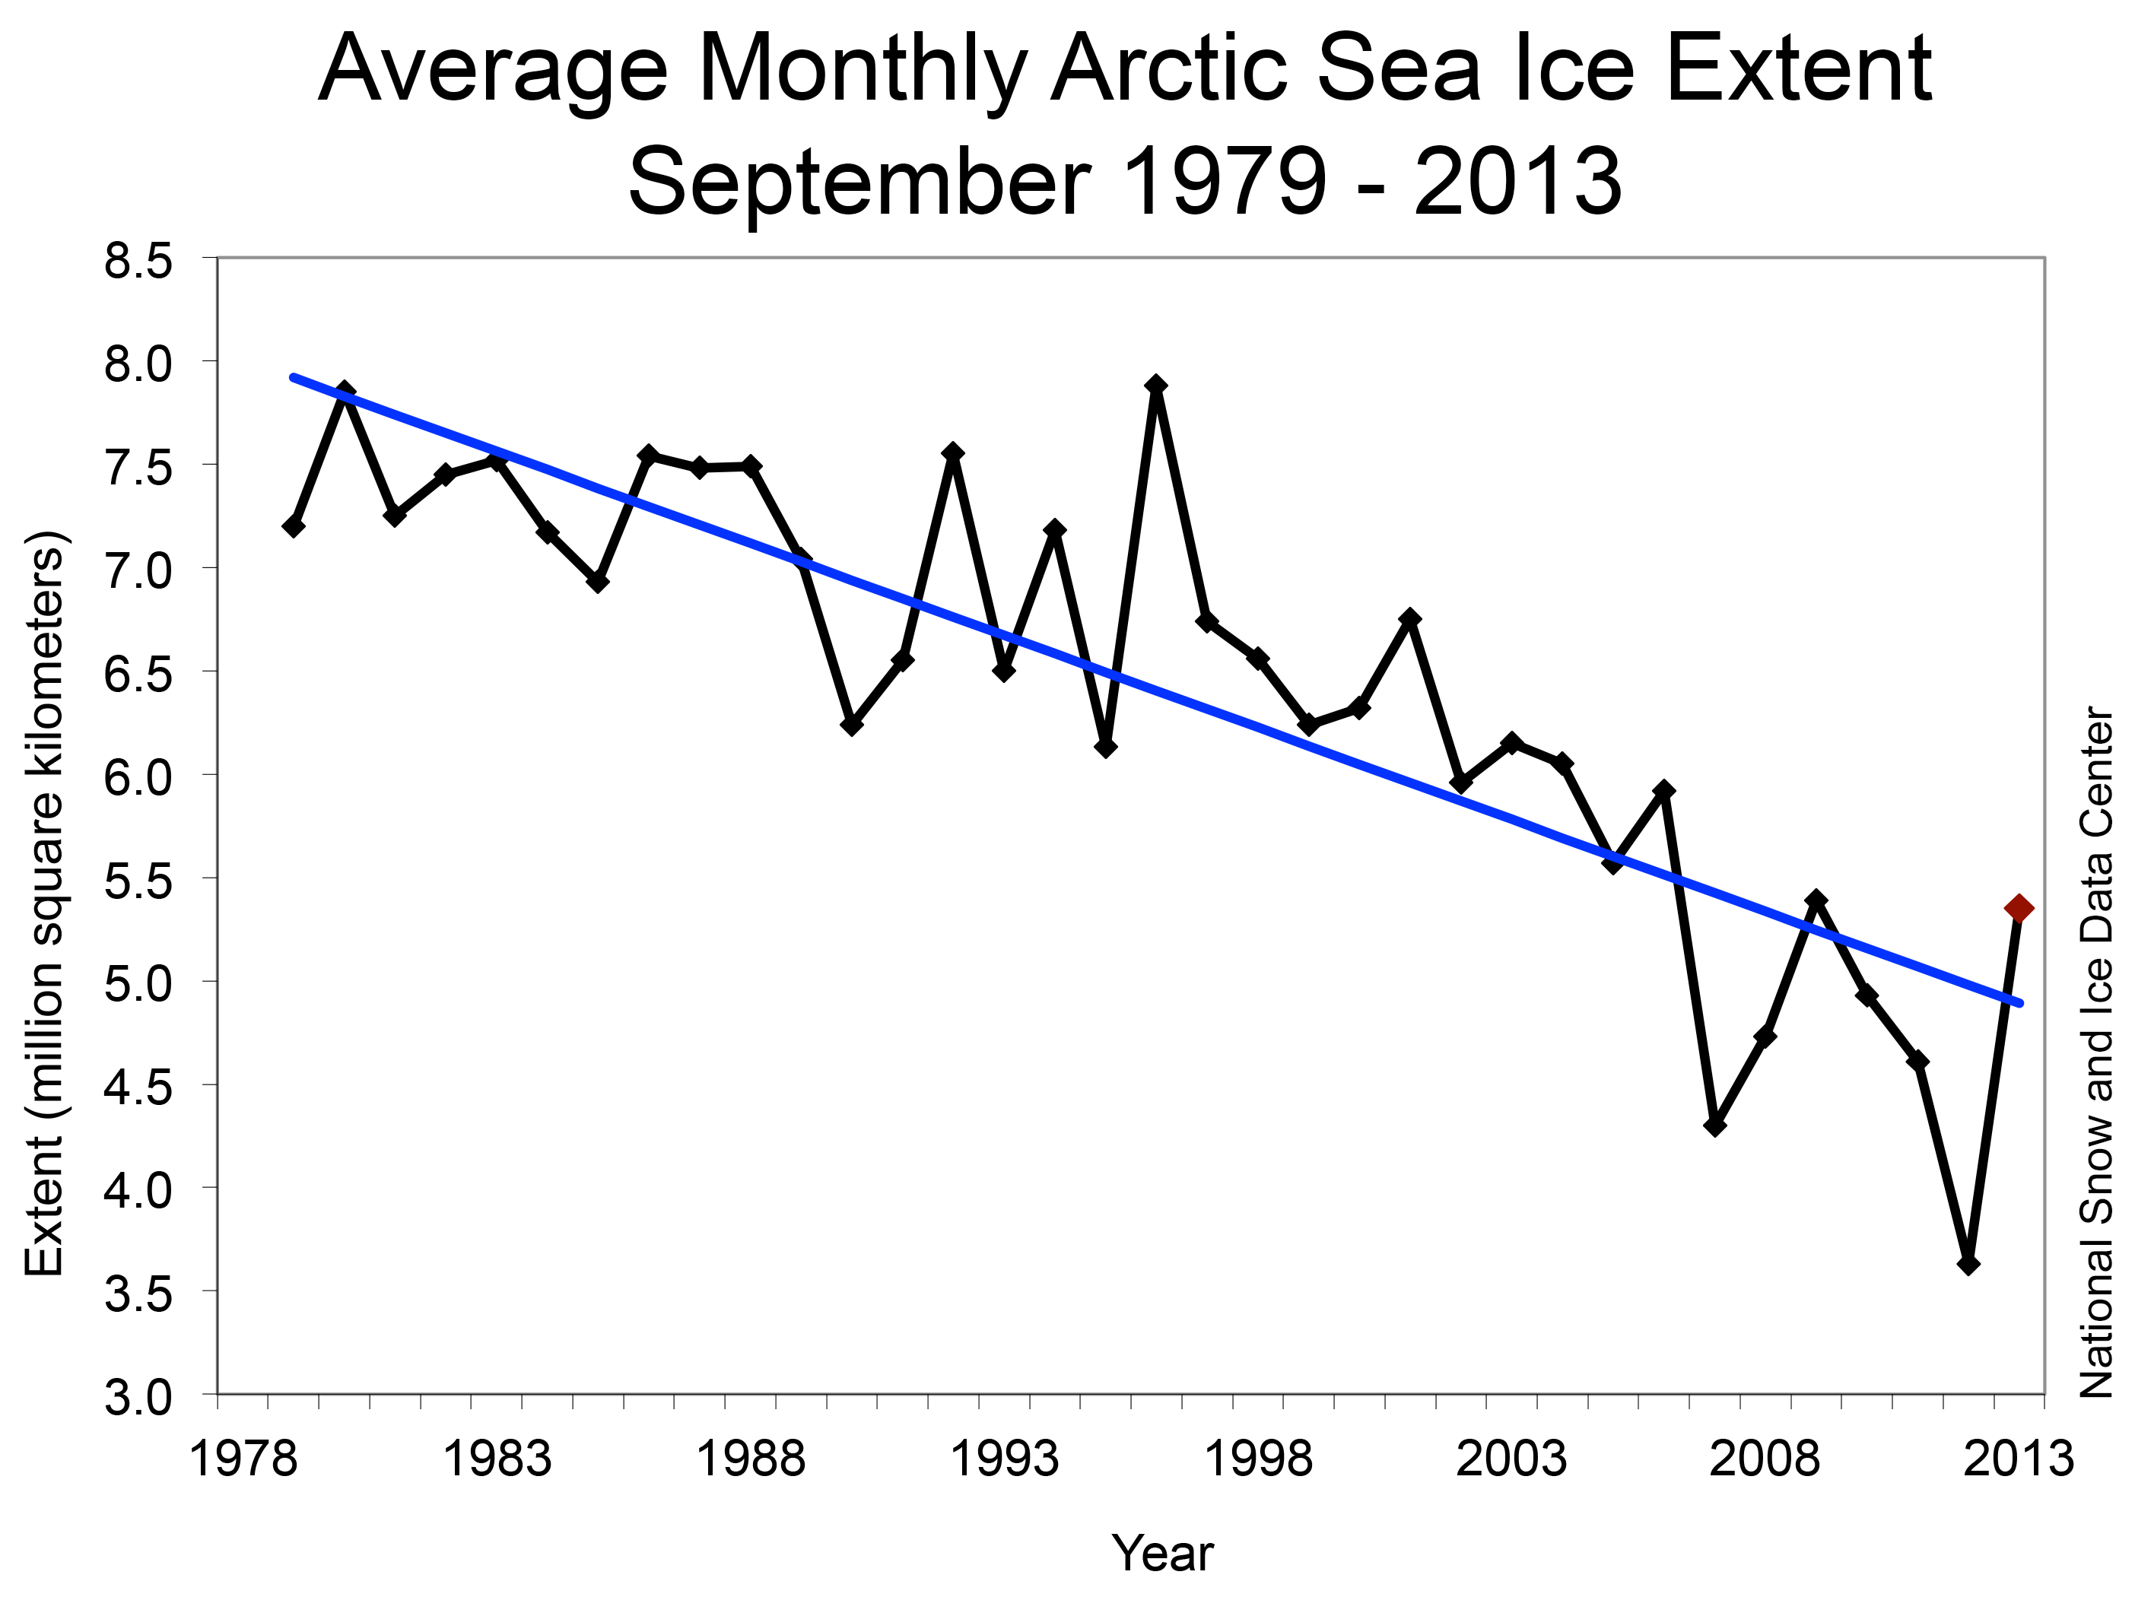
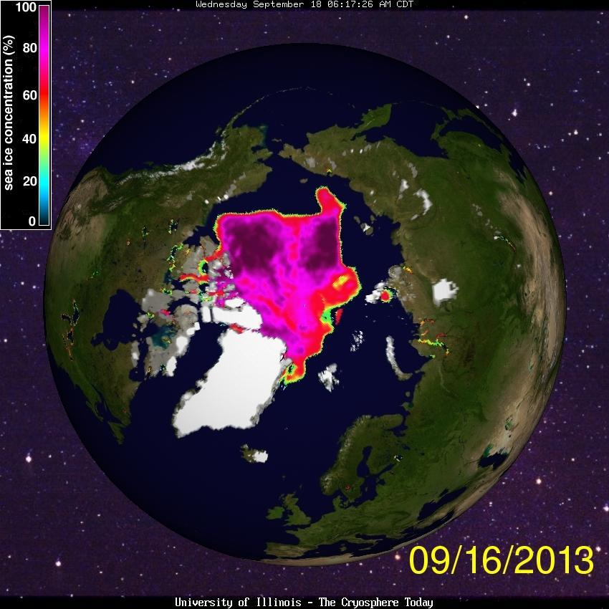
~13% per decade linear trend

Slide 8
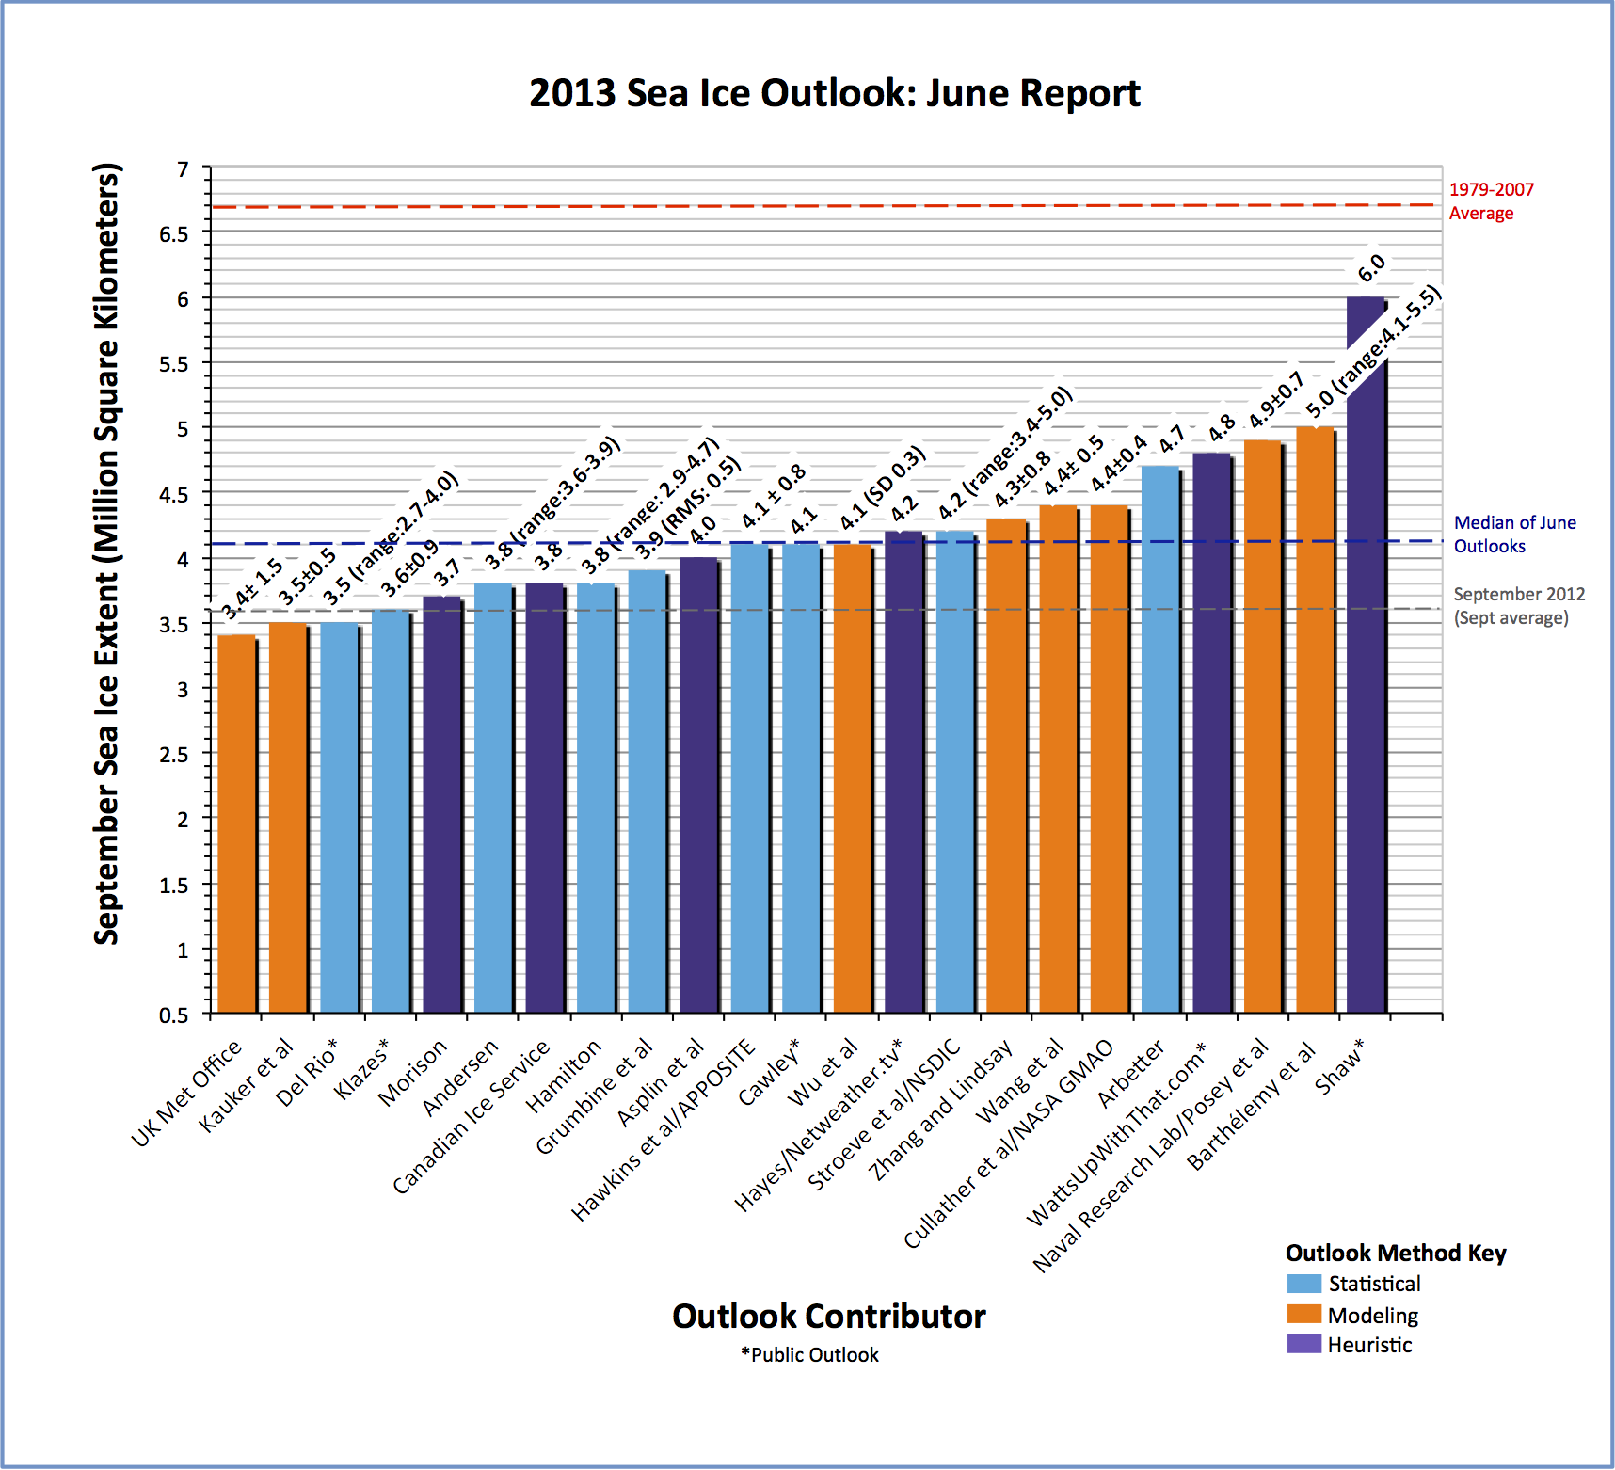
State of Predictions 2013 Sea Ice Outlook
1979-2007 average: 6.7 mil km²
Actual Sept 2013 extent
Median of 6/13 Outlooks: 4.1e6 km²
Sept 2012: 3.6 mil km²
Sept 2013: Predictions generally under estimate actual state

Slide 9
Predictability
Of the First Kind:
Initial value problem
Sensitive dependence on initial conditions limits predictability
Timescale depends on system
State
Of the Second Kind:
Boundary value problem
Prediction of statistical properties of the climate system subject to some external forcing
Time
Total: Combination of the two
(Adapted From Branstator and Teng, 2011)

Slide 10
Outline
Background
Using climate models to assess Arctic sea ice predictability on seasonal to interannual timescales
Thoughts on building a forecasting system
Conclusions

Slide 11
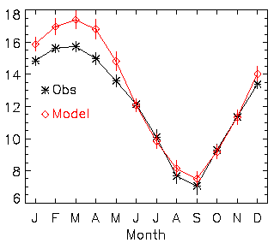
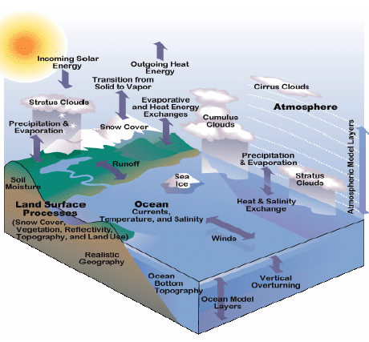
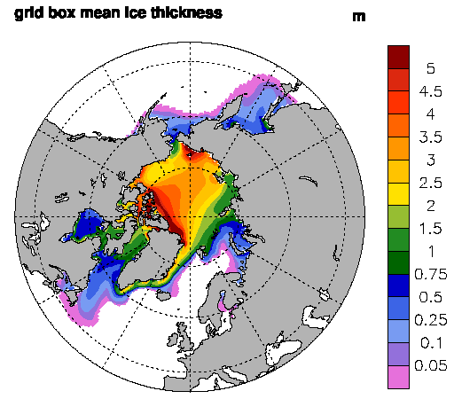
Using coupled models
Coupled climate model
CCSM3
NH Ice Extent
Ice Thickness
1979-1999 climatology

Slide 12
Simulated September Sea Ice 20th-21st Century
Climate models simulate the statistics of climate, not the events of any particular year
Exhibit rich natural variability (e.g. Kay et al., 2011)
Including rapid ice loss events (similar to obs), instances of positive trends even within 21st century
Sept Extent Decadal Trends 2000-2049
Simulated September Ice Extent
Preindustrial Control
2000-2049
Observations
NSIDC Ice Index
CCSM3 IPCC-AR4 Run

Slide 13
Simulate Realistic Statistical Relationships Example: Sept Extent and Summer Atmospheric Circulation
Observations
Climate Model
(Data from 1979-2006)
High SLP leads low ice cover
1950-1980
Regression:
Summer SLP on Sept ice extent
Ekman transport of sea ice results in net ice convergence
Correlation:
August SLP and Sept ice extent
High SLP leads low sea ice
From 8-members of CCSM3
(Ogi and Wallace, 2007)
(Holland and Stroeve, 2011)

Slide 14
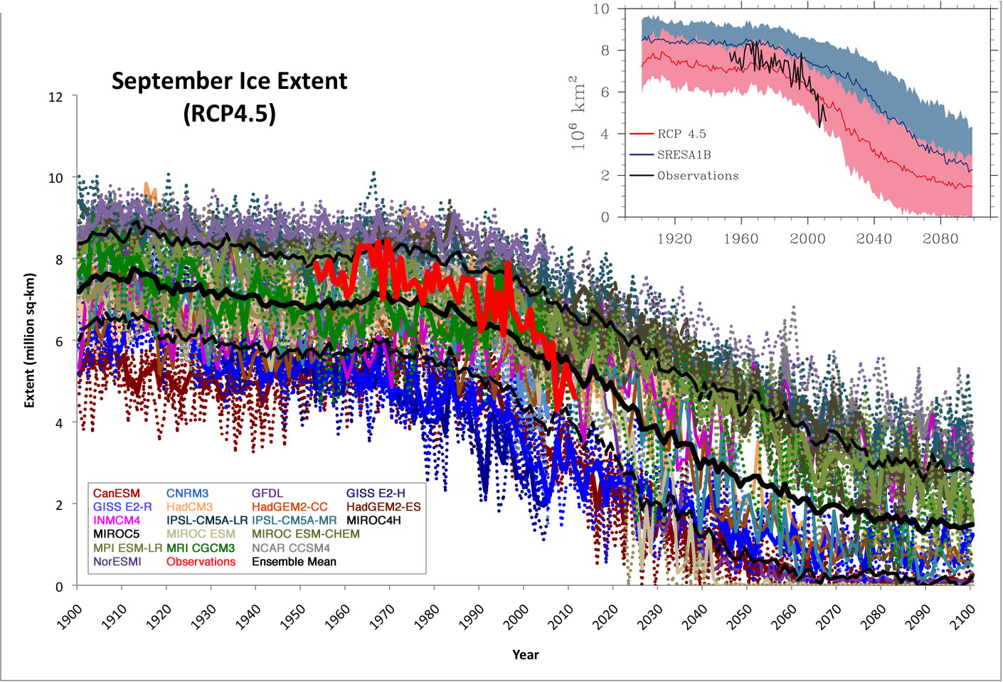
Simulated September Arctic Sea Ice Extent
CMIP3
OBS
CMIP5
Stroeve et al., GRL, 2012

Slide 15
Model Evidence of Seasonal-Interannual Predictability
Lagged Correlation Ice Area
Climate Model Ensemble
(Blanchard-Wrigglesworth et al., 2011)
Model
Ensemble
CCSM3 Ice Area Annual Cycle
Summer
Limb
(Ocn Heat)
Winter
Limb
(Ice Thickness)

Slide 16
Seasonal Prediction
(Lorenz, 1963)
Because of chaotic nature of system, sensitive dependence on initial conditions limits predictability
The predictability characteristics can be dependent on the initial conditions
Cold, thick ice covered Arctic could be different than a warm, thin ice covered Arctic
(Figure courtesy of Branstator and Teng, 2011)

Slide 17
Seasonal-Interannual Sea Ice Predictability
What is the inherent predictability in Arctic sea ice?
What factors contribute to predictability/influence loss of predictability?
Do predictability characteristics change with a changing mean climate?
Model experiments:
20+ member ensembles of CCSM3 with same initial ice-ocean-land state/slight change in initial atmospheric state
Run for 2 years
Perform 3 sets with initial conditions obtained from 20th-21st century runs
(Holland et al., 2011)

Slide 18
Model Integrations
September Extent
Set 1
Set 2
CCSM3 IPCC-AR4 Run
Set 1
Observations
NSIDC Ice Index
Set 2
Set 3
Initialize runs with identical ice-ocean-land conditions from CCSM3
Use 3 sets of Jan 1 initial conditions
Each ensemble set has ~20 members
Run forward 2-years
Set 3

Slide 19
Preindustrial Control
September Ice Area
Set 1: Initialized in thick (1970) sea ice regime
Present Control
Set 2: Initialized in thinner regime just prior to large ice loss event
Set 3: Initialized in thinner regime just following large ice loss event
Present Control

Slide 20
Assessing Predictability
Examine how ensemble members diverge over time
Compare to the natural variability of the system
When these are indistinguishable, predictability associated with initial state is lost

Slide 21
Ice Area
Potential Predictability
PPP = 1-σ²_{t}(ens)/σ²(cont)
PPP decreases during spring, regained during summer and following winter
Thick initial ice

Slide 22
Ice Area
Potential Predictability
PPP = 1-σ²_{t}(ens)/σ²(cont)
PPP decreases during spring, regained during summer and following winter
Significant winter predictability - memory in ocean heat content
Thick initial ice
January SST PPP
Memory of ice edge location associated with SST predictability
Consistent with results from Blanchard-Wrigglesworth et al., 2011

Slide 23
Ice Area
Potential Predictability
PPP = 1-σ²_{t}(ens)/σ²(cont)
PPP decreases during spring, regained during summer and following winter
Significant winter predictability - memory in ocean heat content
Thick initial ice
January SST PPP

Slide 24
Ice Area
Potential Predictability
PPP = 1-σ²_{t}(ens)/σ²(cont)
PPP decreases during spring, regained during summer and following winter
Significant winter predictability - memory in ocean heat content
Significant summer predictability – memory in ice thickness and strong ice area-thickness coupling
Thick initial ice
Ice Thickness “Memory”
Correlation: Jan Ice Thickness and Sept Ice Thickness
Ice Thickness/Area Coupling
Correlation: Sept Ice Thickness and Sept Ice Concentration

Slide 25
Ice Area
Potential Predictability
PPP = 1-σ²_{t}(ens)/σ²(cont)
PPP decreases during spring, regained during summer and following winter
Significant winter predictability - memory in ocean heat content
Significant summer predictability – memory in ice thickness and strong ice area-thickness coupling
Thick initial ice
Thinner initial ice
Thinnest initial ice

Slide 26
Ice Area
Potential Predictability
PPP = 1-σ²_{t}(ens)/σ²(cont)
PPP decreases during spring, regained during summer and following winter
Significant winter predictability - memory in ocean heat content
Significant summer predictability – memory in ice thickness and strong ice area-thickness coupling
Thick initial ice
Thinner initial ice
Thinnest initial ice

Slide 27
Ice Area
Potential Predictability
PPP = 1-σ²_{t}(ens)/σ²(cont)
PPP decreases during spring, regained during summer and following winter
Significant winter predictability - memory in ocean temperature
Significant summer predictability – memory in ice thickness and strong ice area-thickness coupling
Thick initial ice
Thinner initial ice
Thinnest initial ice
Reduced summer predictability in thin ice conditions

Slide 28
Why does Sept extent variance increase in year 2 in thin ice regime?
Too thin to vary
Too thin to vary
Too thick to vary
Too thick to vary
Too thick to vary
Year 1
Too thick to vary
Year 2
Thick Ice
Ensemble
Thin Ice
Ensemble
Thinnest Ice
Ensemble

Slide 29
Outline
Background
Using climate models to assess Arctic sea ice predictability on seasonal to interannual timescales
Thoughts on building a forecasting system
Conclusions

Slide 30
(From Jim Kinter, COLA)

Slide 31
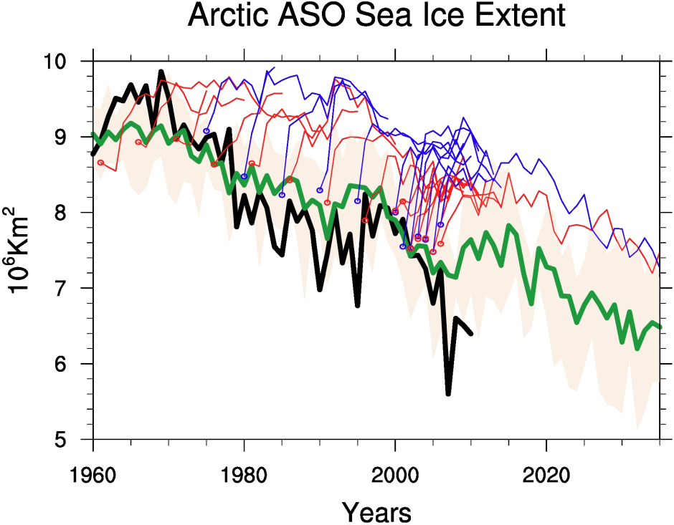
Sea ice extent – Initialized decadal forecasts
Arctic ASO
CCSM4
Fully coupled
~1-degree
initialized with T/S/atm info
Considerable drift after initialization
Decadal
forecasts
HadISST (Obs)
CCSM4
Non-initialized runs
(Courtesy of Haiyan Teng)
Recent papers do suggest some forecast skill in initialized predictions; Much of this comes from the trend.

Slide 32
Importance of atmospheric coupling
Simulations driven with prescribed atmospheric conditions (from climate model – atm forcing compatible with model state)
September Ice Area
March Ice Area
Exhibit ice area anomalies very similar to the forcing year regardless of their initial conditions
Correlation of forcing year anomaly and “forecasted” ice area:
R=0.65 for September; R=0.97 for March

Slide 33
High-resolution simulations suggest similar inherent predictability for ice extent
CESM simulation:
0.1º ocean/0.25º atmosphere
62 years in length
NH Ice Extent autocorrelation

Slide 34
Required Initialization Information?
Coupled studies suggest importance of ice thickness, upper ocean heat content
What accuracy? spatial resolution? Etc.
Do other variables provide skill? Which ones? Why?
What assimilation techniques (anomaly, state)?
What model complexity needed?
Some coupled interactions should be represented
Necessary to include a full depth ocean? Wave interactions? Resolution?

Slide 35
Summary/Conclusions
Predictability of Arctic sea ice important for marine access and planning (on multiple timescales)
Ice area inherent predictability in winter and summer for 2 yrs – ocean heat content and ice thickness memory
Less predictable in thinner ice regime
Note that the predictability that can actually be realized is less and dependent on observational network, etc.
Requirements for a forecasting system remain unclear – model complexity, model resolution, initialization data, necessary ensemble size

Slide 36
Questions?

Slide 37
References
Blanchard-Wrigglesworth, E., K. Armour, C. M. Bitz, and E. deWeaver: Persistence and inherent predictability of Arctic sea ice in a GCM ensemble and observations. J. Climate, 2011
Branstator, G., and H. Teng: Two limits of initial-value decadal predictability in a CGCM. J. Climate, 2010.
Holland, M.M., and J. Stroeve: Changing seasonal sea ice predictor relationships in a changing Arctic climate. GRL, 2011
Holland, M.M., D.A. Bailey, and S. Vavrus: Inherent sea ice predictability in the rapidly changing Arctic environment of the CCSM3. Climate Dyn., 2011.
Kay, J.E., M.M. Holland, and A. Jahn: Inter-annual to multidecadal Arctic sea ice extent trends in a warming world. GRL, 2011.
Stroeve, J.C., et al. : Trends in arctic sea ice extent from CMIP5, CMIP3, and observations, GRL, 2012.

