Slide 1
Overview of Fly America Act Open Skies Agreement January 27, 2016
Prepared by: Lauren Amidon | Program Manager
Carlson Wagonlit Travel

Slide 2
Fly America Act
The Fly America Act mandates that if an organization has an employee/employees traveling to a foreign destination on funds provided by the federal government, then travel must be on a U.S flag carrier.
The Fly America Act Applies To:
Recipients of federal grants
Recipients of federal subsidies
Government employees
U.S. Government contractors
U.S. Government sub-contractors

Slide 3
WHAT IS OPEN SKIES?
Open Skies is an international agreement under which two or more countries allow unrestricted over flight and landing rights to one another.
This agreement allows travelers who need to adhere to the Fly America Act more flexibility in the flights they may choose.
Open Skies agreements between the United States and other countries expand international passenger and cargo flights by eliminating government interference in commercial airline decisions about routes, capacity and pricing.
Open Skies policy rejects the outmoded practice of highly restrictive air services agreements protecting flag carriers.

Slide 4
Open Skies Agreements
The United States Government has entered into several air transport agreements that allow federal funded transportation services for travel and cargo movements to use foreign air carriers under certain circumstances. The Department of Transportation has determined these agreements meet the requirements of the Fly America Act.
There are currently four bilateral and 2 multilateral “Open Skies Agreements” (U.S. Government Procured Transportation) in effect:
Bilateral Agreements
United States (US) Government and the European Union (EU) effective April 30, 2007
US-EU Amendment effective June 24, 2010
US-EU Amendment effective June 21, 2011
United States (US) and Australia effective October 1, 2008
United States (US) and Switzerland effective October 1, 2008
United States (US) and Japan effective October 1, 2011
Multilateral Agreements
Multilateral Agreement on the Liberalization of International Air Transportation (MALIAT)
New Zealand, Singapore, Brunei, and Chile,
Samoa, Tonga, and Mongolia

Slide 5
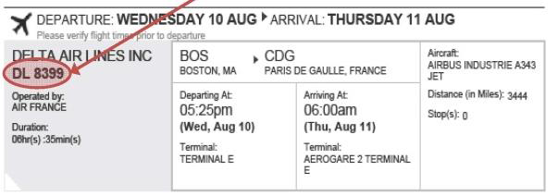
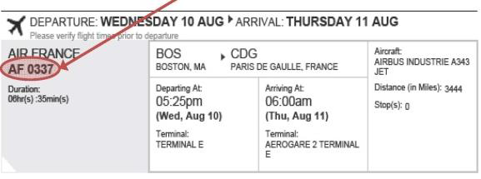
CODE SHARE FLIGHTS AND FLY AMERICA
Code sharing is a commercial agreement between two airlines that allows an airline to put its two-letter identification code on the flights of another airline as they appear in computerized reservations systems.
A U.S. airline may sell a seat on the plane of a foreign air carrier; this seat is considered the same as one on a plane operated by a U.S. flag carrier. Compliance with the Fly America Act is satisfied when the U.S. flag air carrier's designator code is present in the area next to the flight numbers on the airline ticket, boarding pass, or on the documentation for an electronic ticket (passenger receipt) – see example below, where Delta Airlines (DL) has a code share agreement with Air France (AF) to Paris, France.
COMPLIANT
NON-COMPLIANT

Slide 6
PERMITTED EXCEPTIONS TO THE FLY AMERICA ACT 1/2
If a U.S. flag air carrier offers nonstop or direct service (no aircraft change)
from your origin to your destination, you must use the U.S. flag air carrier
service unless such use would extend your travel time, including delay at
origin, by 24 hours or more.
If a U.S. flag air carrier does not offer nonstop or direct service (no aircraft
change) between your origin and your destination, you must use a U.S. flag air
carrier on every portion of the route where it provides service unless, when
compared to using a foreign air carrier, such use would:
Increase the number of aircraft changes you must make outside of the U.S. by 2 or more; or
Extend your travel time by at least 6 hours or more; or
Require a connecting time of 4 hours or more at an overseas interchange point.

Slide 7
PERMITTED EXCEPTIONS TO THE FLY AMERICA ACT 2/2
In what circumstances is foreign air carrier service deemed a matter of necessity?
Foreign air carrier service is deemed a necessity when service by a U.S. flag air carrier is available, but
1.Cannot provide the air transportation needed; or
2.Will not accomplish the company’s mission.
Necessity includes, but is not limited to, the following circumstances:
1.When the company determines that use of a foreign air carrier is necessary for medical reasons, including use of foreign air carrier service to reduce the number of connections and possible delays in the transportation of persons in need of medical treatment; or
2.When use of a foreign air carrier is required to avoid an unreasonable risk to your safety and is approved by your company (e.g., terrorist threats). Written approval of the use of foreign air carrier service based on an unreasonable risk to your safety must be approved by your company on a case by case basis. A company determination and approval of use of a foreign air carrier based on a threat against a U.S. flag air carrier must be supported by a travel advisory notice issued by the Federal Aviation Administration and the Department of State. A company determination and approval of use of a foreign air carrier based on a threat against Government employees or other travelers must be supported by evidence of the threat(s) that form the basis of the determination and approval; or
3.When you cannot purchase a ticket in your authorized class of service on a U.S. flag air carrier, and a seat is available in your authorized class of service on a foreign air carrier.

Slide 8
SOME GENERAL EXCEPTIONS TO THE FLY AMERICA ACT
To every rule, there are some exceptions, and the Fly America Act is no different. As a matter of fact, there are many exceptions to the Act. Some of the exceptions are listed below.
• No U.S. Air-Carrier Service on that Particular Leg. If there is no U.S. air-carrier that provides service on a certain leg of your flight, then you may use a foreign air carrier. But only to or from the nearest exchange point on a usually traveled route to connect with a U.S. air-carrier.
• Involuntary Re-routing. You can use a foreign air-carrier if a U.S. air carrier involuntarily re-routes your travel and puts you on a foreign air carrier.
• Saving a Substantial Amount of Time. You can use a foreign air carrier if service on the foreign air carrier would be three hours or less, AND use of a U.S. air-carrier would at least double your en route travel time.
• Costs of Transportation Reimbursed by a Third Party. You may use a foreign air-carrier when the costs of your transportation are reimbursed in full by a third party, such as a foreign government or international company.

Slide 10
FAQS 2/2
Q4: May I travel by a foreign air carrier if the cost of my ticket is less than traveling by a U.S. flag air carrier?
A: No. Foreign air carrier service may not be used solely based on the cost of your ticket.
Q5: May I use a foreign air carrier if the service is preferred by or more convenient for my company or me?
A: No. You must use U.S. flag air carrier service, unless you meet one of the exceptions as previously noted on slides 6-8.
TIP:
\
REMIND TRAVELERS
Before starting your booking with a CWT Travel counselor please let the counselor know if the trip is being paid for with federal funding to avoid costly mistakes.

Slide 11
APPENDIX
Open Skies Agreements
http://www.state.gov/e/eb/tra/ata/
List of EU Countries
http://europa.eu/about-eu/countries/index_en.htm
List of Open Skies and Multilateral Agreement on the Liberalization of International Air Transportation (MALIAT) Partners
http://www.state.gov/e/eb/rls/othr/ata/114805.htm
Multilateral Agreement on the Liberalization of International Air Transportation (MALIAT)
https://www.transportation.gov/policy/aviation-policy/multilateral-agreement-liberalization-international-air-transport
Government Publications
https://www.gpo.gov

