Slide 1
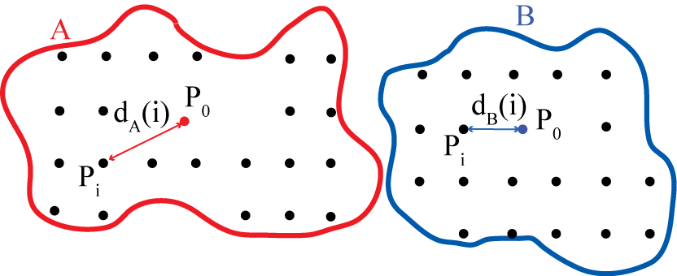
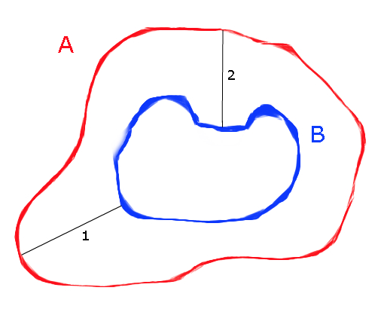
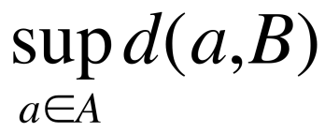
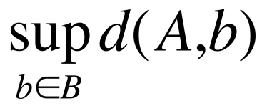
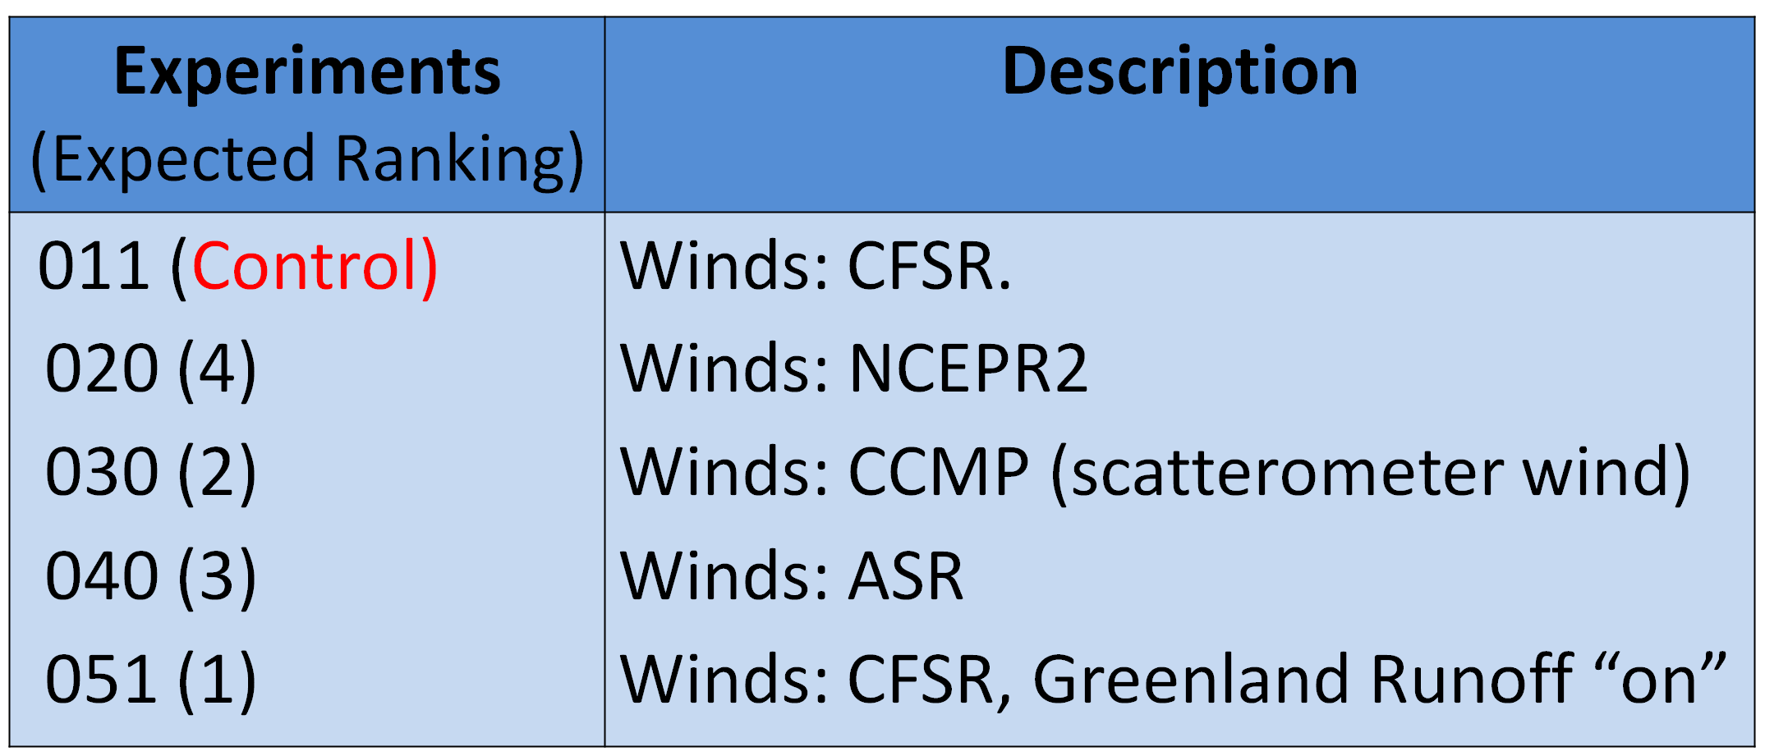
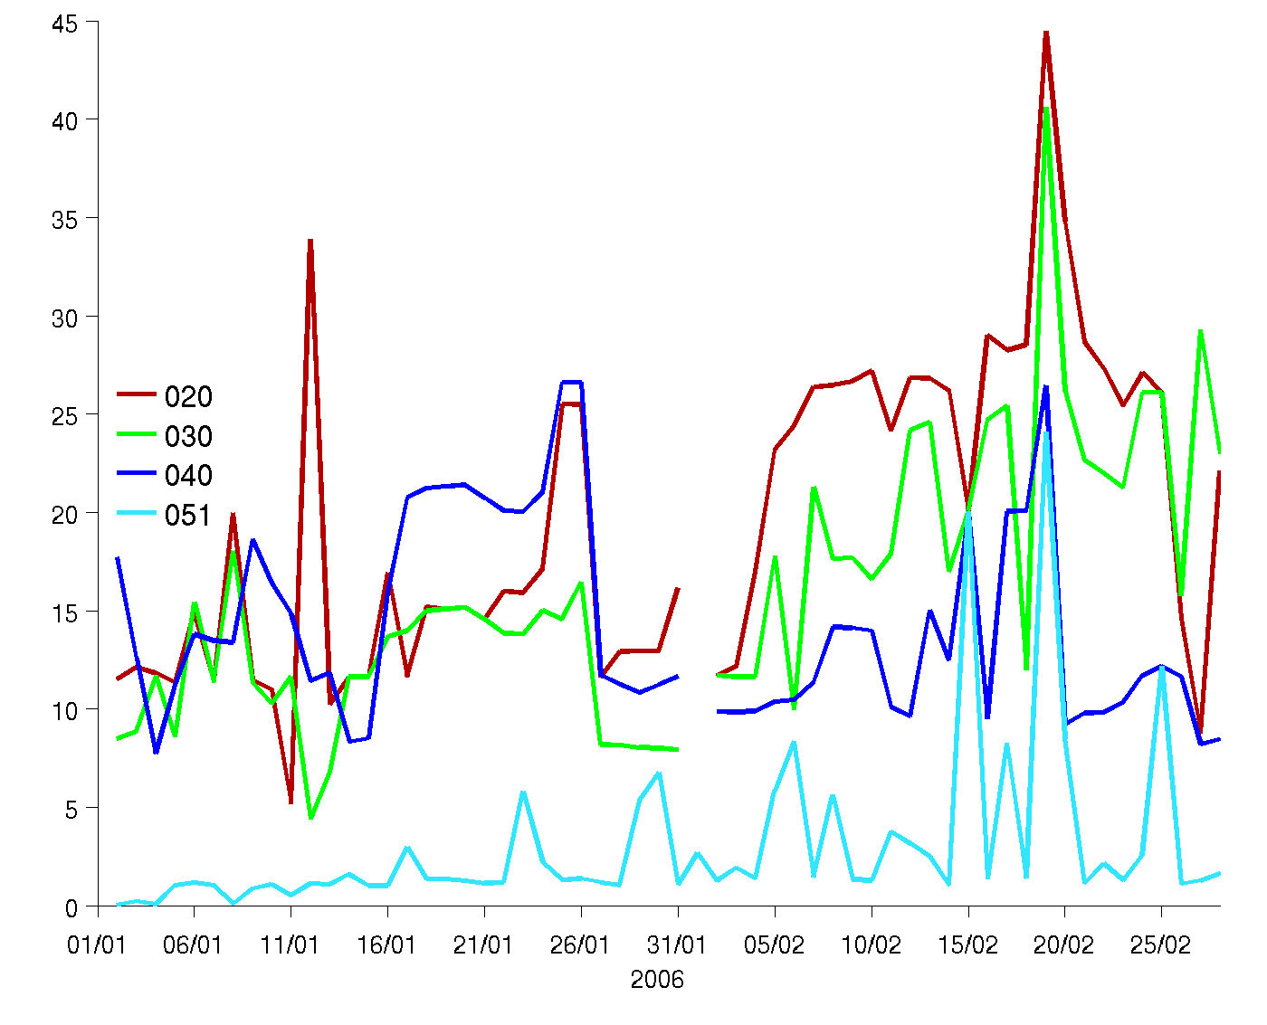
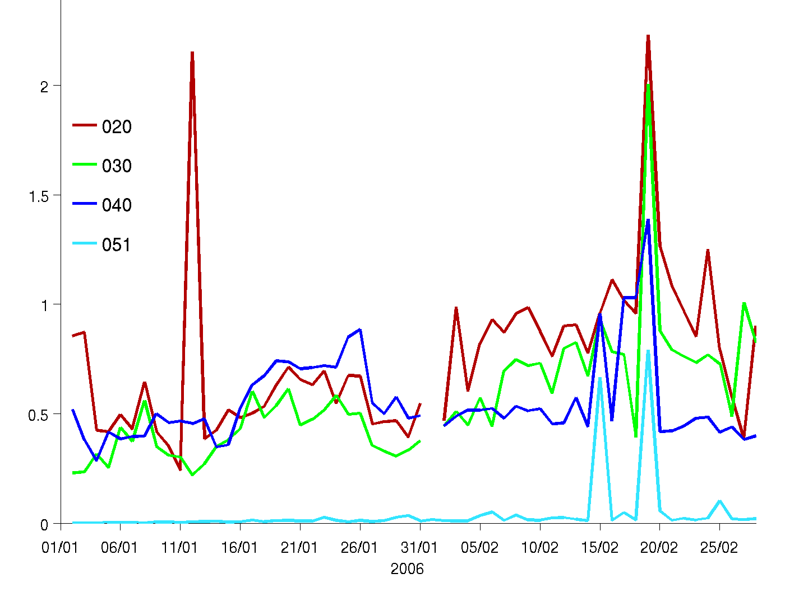
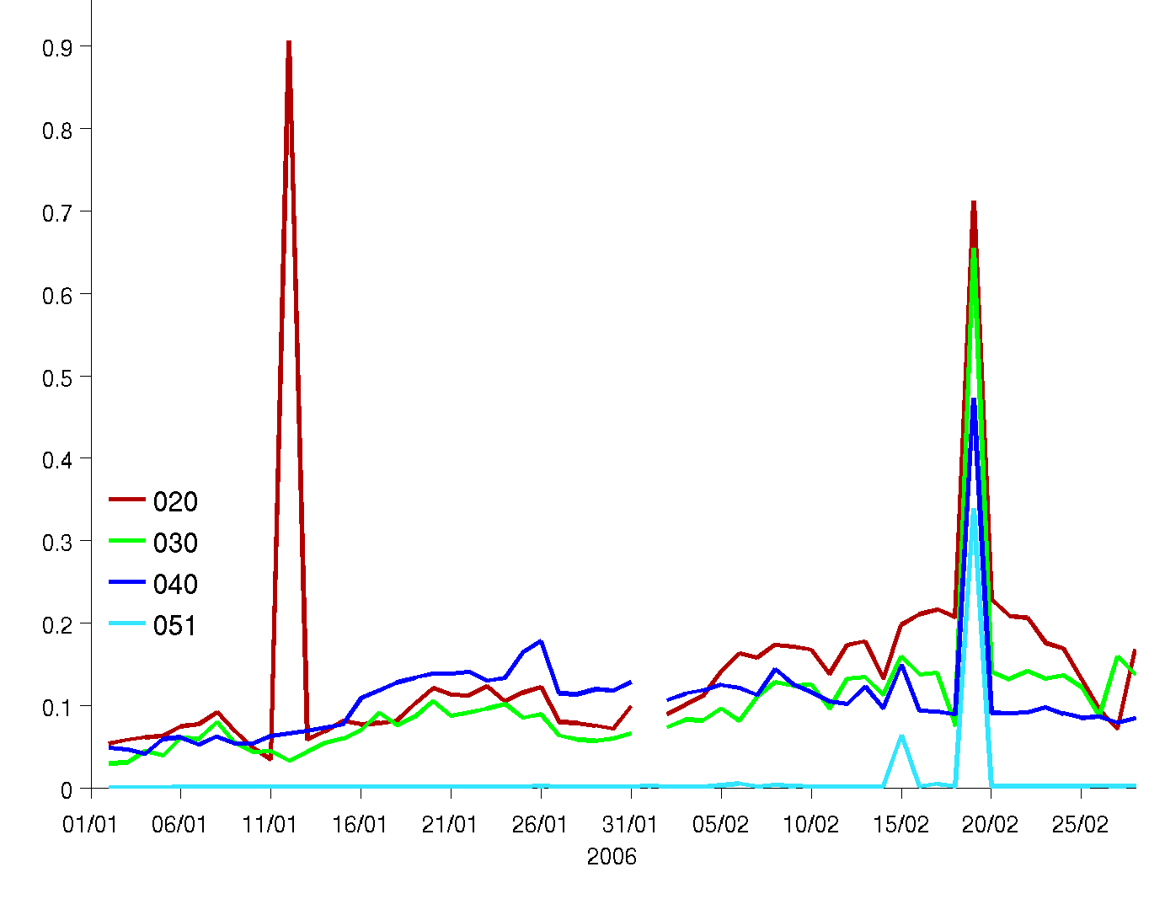
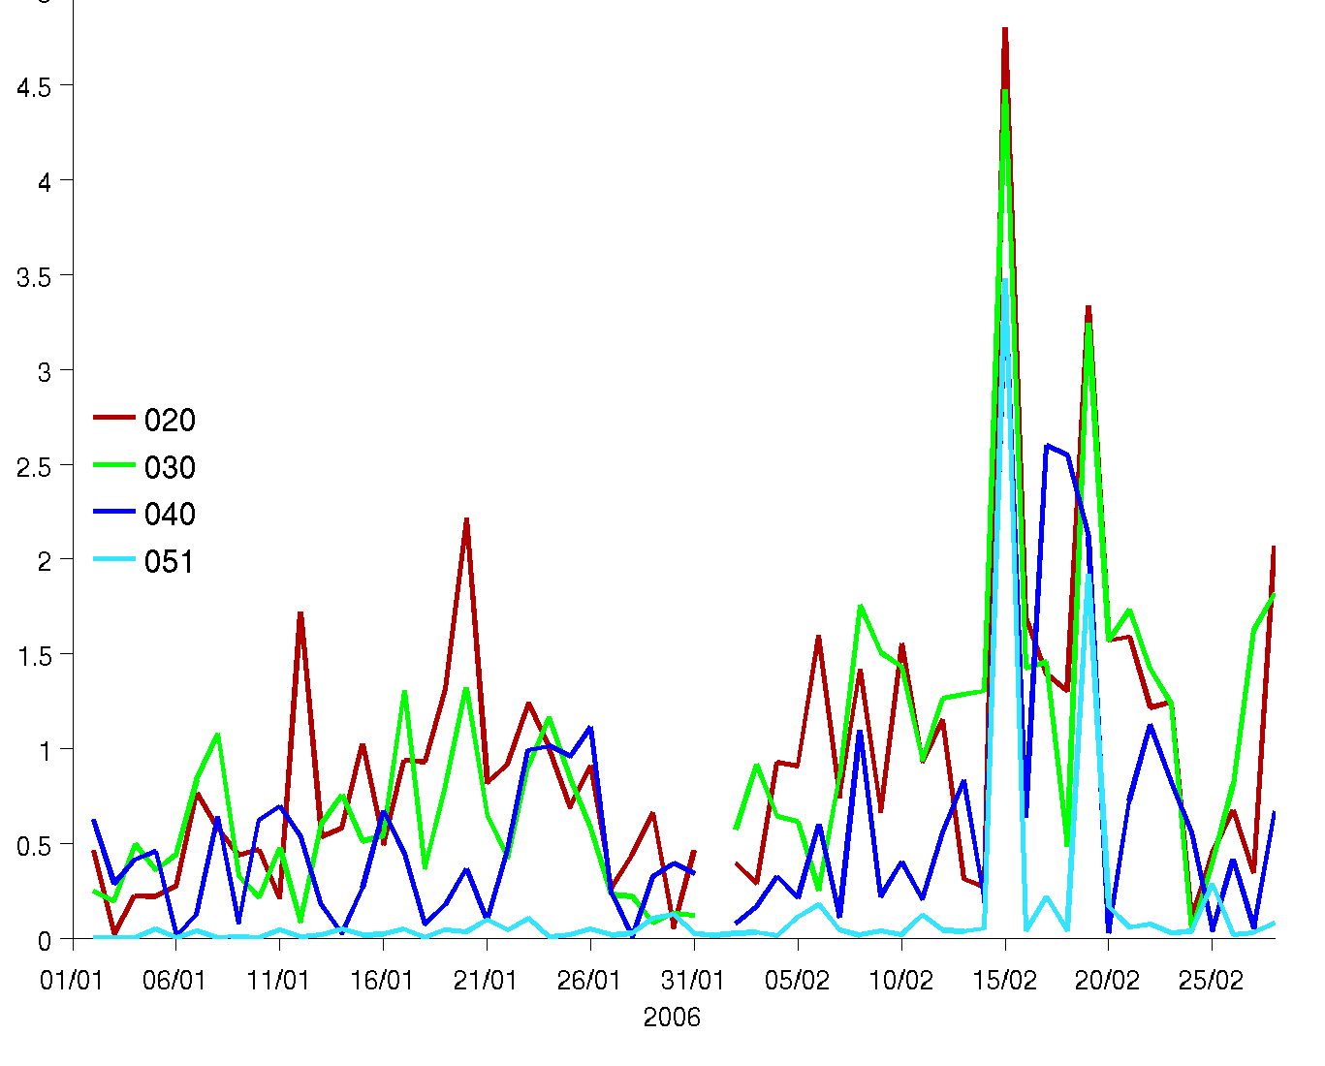
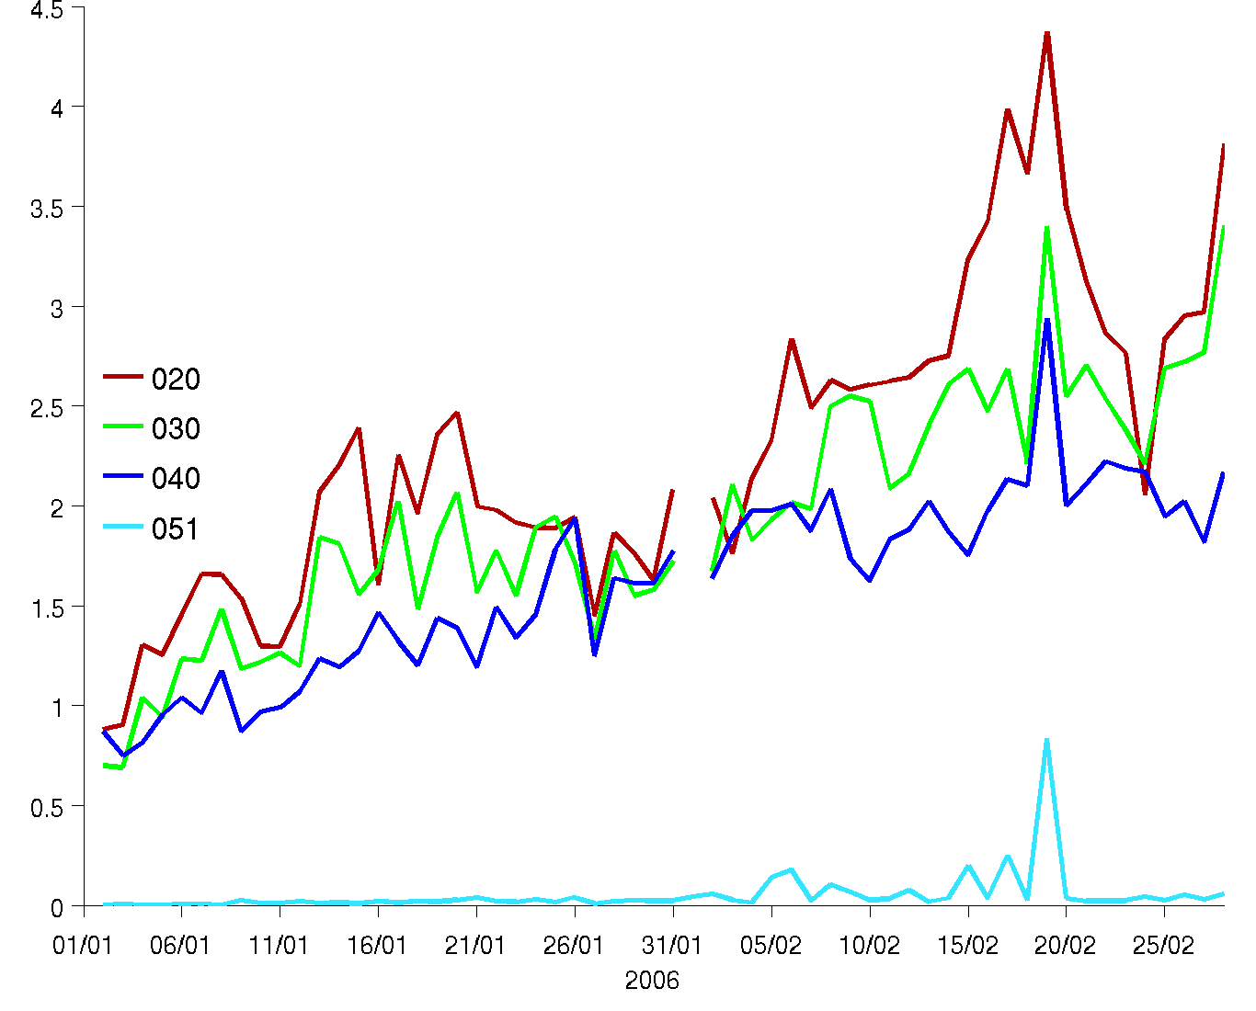
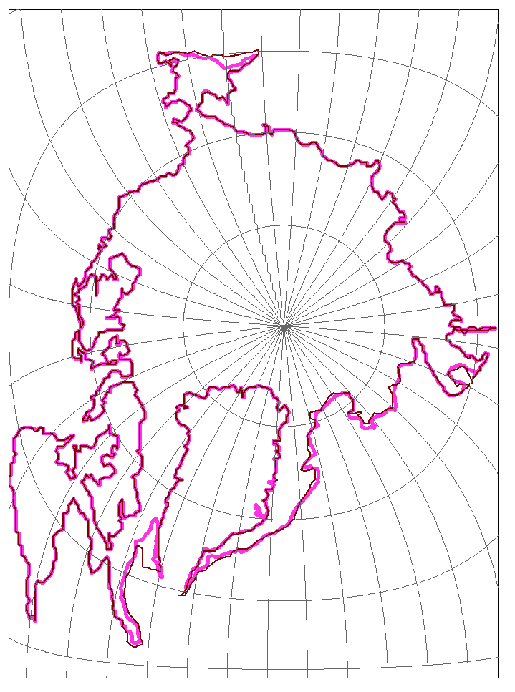
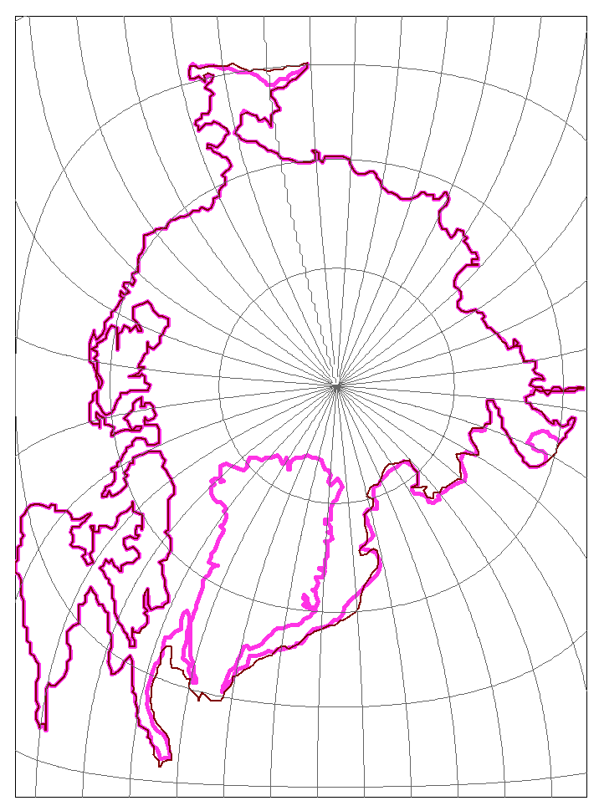
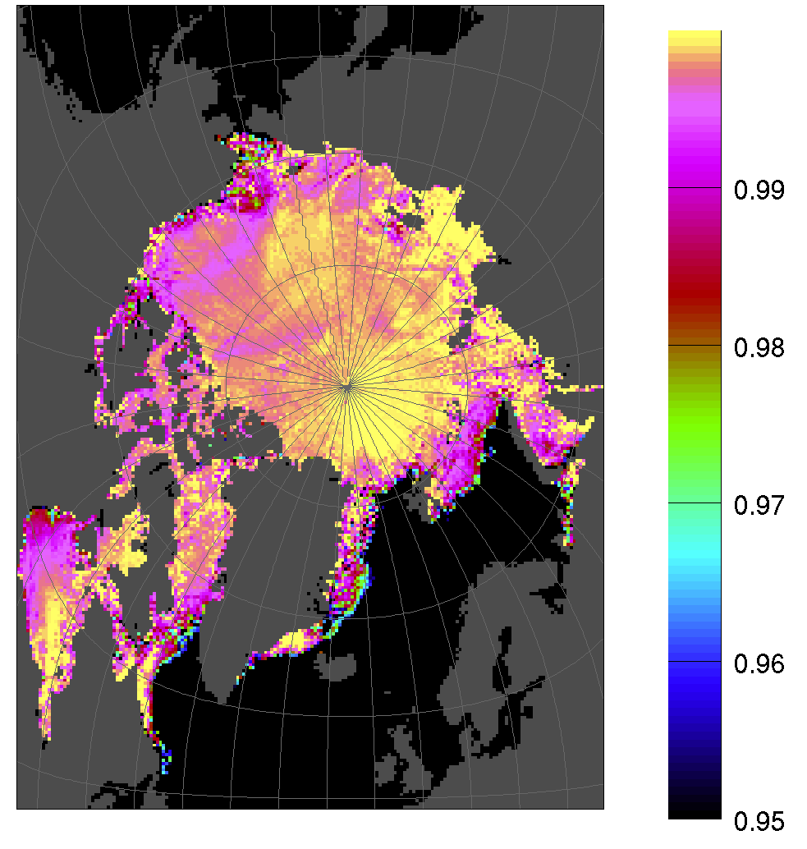
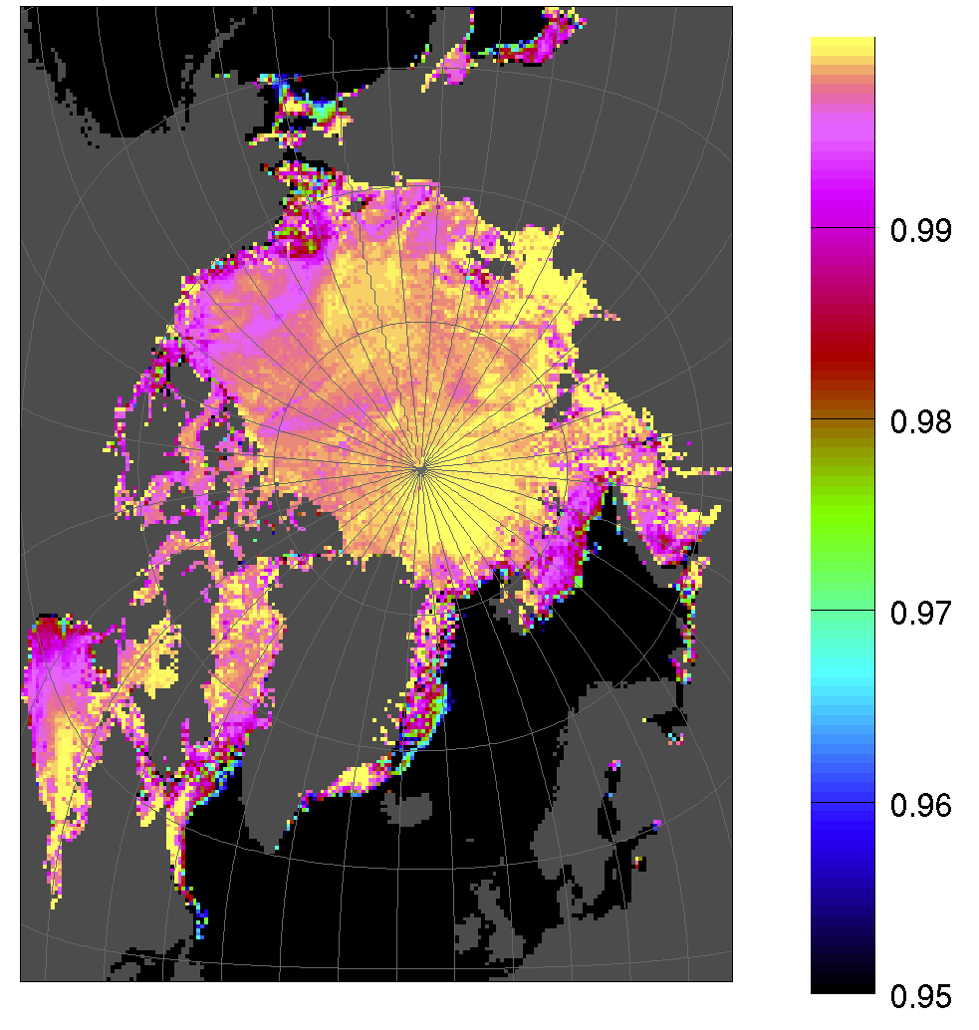
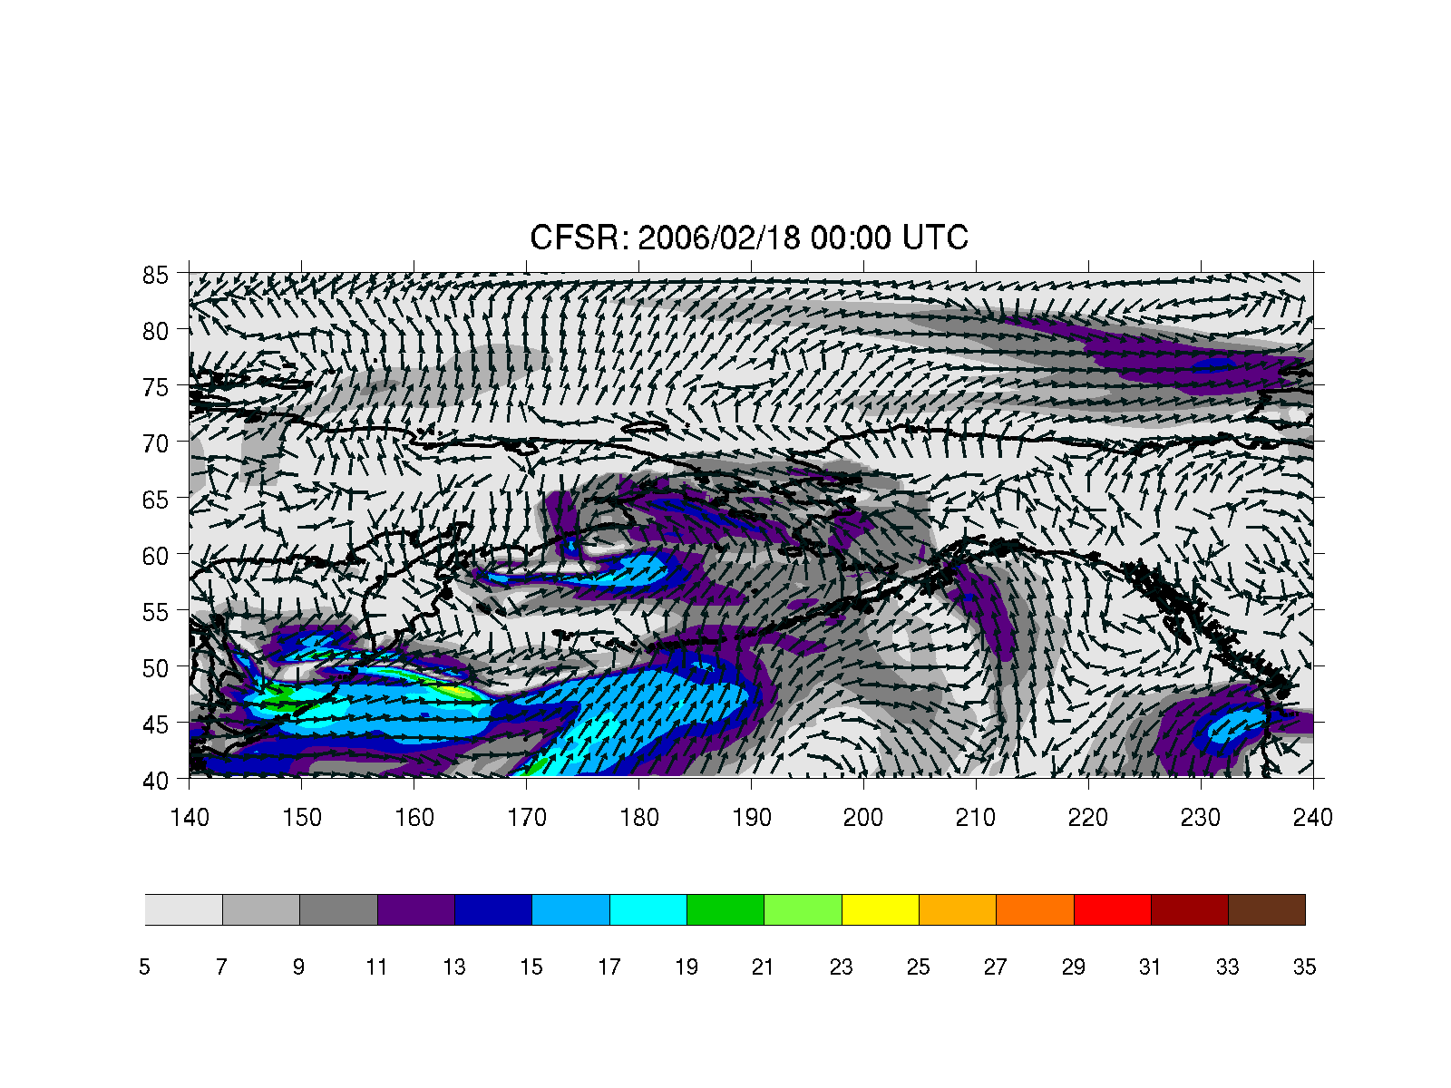
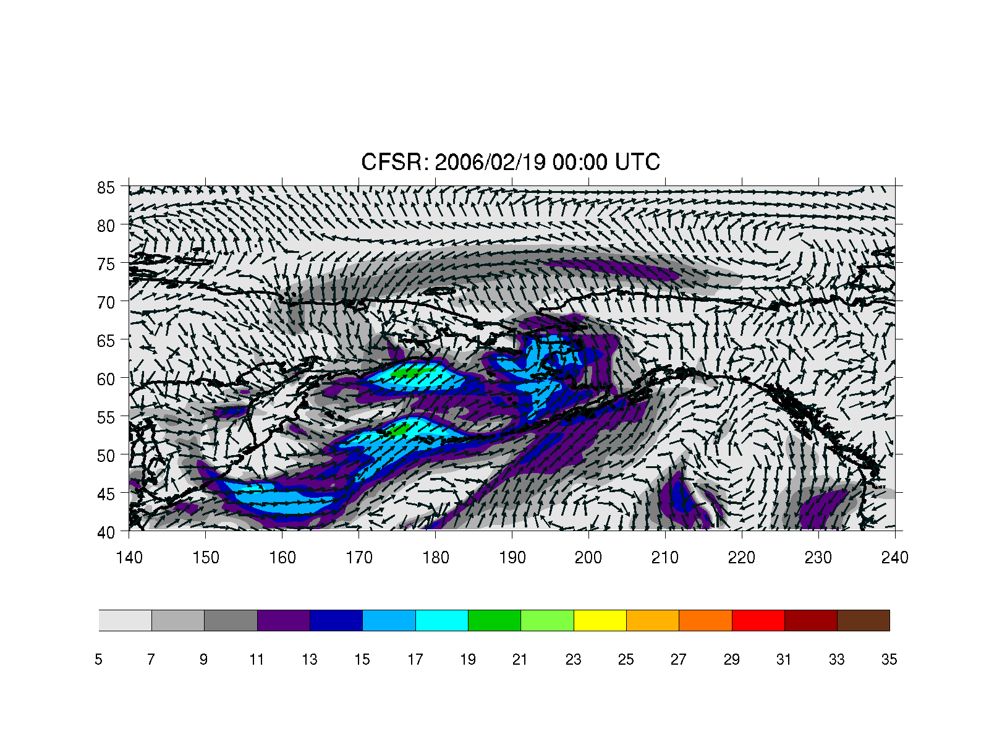
A3
Sea Ice Model Evaluation: A Topological Approach
Dmitry Dukhovskoy^{(*)} and Jonathan Ubnoske
Florida State University
^{(*)} ddukhovskoy@fsu.edu
Background
Validation Metrics: Statistical Perspective
Modified Hausdorff Distance
Model skill assessment is an important step in model evaluation and improvement (Hunke et al., 2007; Johnson et al., 2007). In many studies, sea ice model comparison is conducted by qualitative description of spatial patterns of the sea ice between models and observations or among models. A quantitative approach is necessary for objective model-model and model-data skill assessment. We consider a skill metric that compares a simulated sea ice field to a control field by measuring their similarity in shape via a “shape distance” metric.
The motivation for this approach stems from topology, namely from the theory of metric spaces. The approach is selected based on the following criteria:
A function can compare several sea ice fields and rank them according to similarity in shape from a geometric (rather than a statistical) perspective.
This function corresponds to human perception of shape and is robust to noisiness and outliers.
This function works for directed (a requirement for the RMSE or Frechet distance) and closed curves and any shape.
Mean Displacement
Weighted Mean Displacement
The suggest validation metric is based on the well-known Hausdorff Distance (HD):
The third dimension can be added to the metric:
Where f_{i} is a weight of the i^{th} grid cell.
The weight is calculated based on a sea ice characteristic (e.g., concentration).
The two shapes match when
|D(A)-D(B)|➔0.
In the diagram, line 1 represents
Where P₀ is the centroid and d_{A,B} is the centroid distance.
The two shapes match when
|D(A)-D(B)|➔0.
These validation metrics do not consider shape of the fields.
Line 2 represents
The Hausdorff distance is Line 1.
Table 1: ARCc0.08 Experiments
The Modified Hausdorff Distance (MHD):
The MHD is a generalization of the HD.
Compared to the HD, it is more resistant to outliers.
Application of Validation Metrics to ARCc0.08
Validation metrics are applied to the sea ice fields simulated in several twin experiments of the 1/12° Arctic Ocean HYCOM-CICE (ARCc0.08) (Table 1). All experiments are compared against a control run (experiment 011) over the time period January – February of 2006. The comparison is conducted for shapes of the sea ice edge approximated by the 80% concentration contour. Also, the distribution of the sea ice concentration inside this contour is compared in the MDH and Weighted Mean Displacement metrics. Only one closed contour around the Arctic Ocean is considered. To make contours closed, they follow the coastline when the sea ice concentration is >80% off the coast. Since experiment 051 is nearly identical to the control run, it is expected that a reliable skill metric should be able to identify this similarity. The expected ranking of the simulated sea ice fields is listed in the Table 1. The diagrams below show time series of the validation metrics. Some metrics compare only the shape of the 0.8 sea ice contour, the others compare both the shape and the concentration.
Hausdorff Distance (shape)
Feb 19
Modified Hausdorff Distance (shape)
Modified Hausdorff Distance
(shape+conc.)
Mean Displacement
(shape)
Weighted Mean Displacement
(shape+conc.)
Jan 12
All metrics have clearly ranked experiment 051 as the closest to the control run.
The MHD gives the most accurate skill scores to the model experiments according to the expected ranking (Table 1).
Compared to the MHD, the HD metric is noisier due to its higher sensitivity to outliers in the sea ice contour.
All metrics indicate a sudden change in the sea ice field simulated in experiment 020 on January 12. Another peak in the metrics occurs on February 19 for all experiments. These two jumps worth special investigation in order to understand what caused this high values of the evaluation metrics.
Analysis of the Sea Ice Field on January 12
Analysis of the Sea Ice Field on February 19
Jan 11, 2006
Jan 12, 2006
011
011
011
Jan 11
Jan 12
Feb 18
Feb 19
Feb 19
The 80% contours from the model experiments follow closely the contour from the control run (011).
The 80% Sea Ice Contours from 011 and 020.
Sea Ice Concentration from experiment 011. The sea ice field is only shown inside the 80% closed contour, as it is evaluated by the skill metrics.
Actual sea ice concentration from experiment 011. The definition of the sea ice boundary does not include sea ice fields in the northern Bering Sea separated from the Arctic Ocean sea ice.
On January 12, the 80% contour in 020 has drastically changed: the contour goes around Greenland to the south, instead of going north as on the previous day. This results in a distinct change of the shape of the sea ice field correctly identified by the skill metrics. However, in reality the discrepancy in the sea ice distribution in the experiments is minor. The strong response of the skill metrics is caused by imperfect definition of the sea ice boundary.
CFSR surface winds in the North Pacific on Feb. 18 – 19, 2006. Storms impacted the region and caused changes in the sea ice fields.
Feb 18
Feb 19
There are noticeable changes in the simulated sea ice concentration in the Arctic Pacific sector. These changes were caused by several storms impacted the North Pacific during February 18 and 19. In experiment 011, the sea ice concentration in the northern Bering Sea decreased and caused the retreat of the 80% contour into the Arctic Ocean, north of Bering Strait. In all other experiments, the contour stayed extended into the Bering Sea. This difference in the contour shapes between the control run and other experiments caused high metric values, indicating apparent difference among the experiments.
Conclusions
Tested metrics demonstrate the ability to identify differences in the shape of the sea ice fields and sea ice concentration among the model experiments.
The HD and Mean Displacement metrics are noisy due to their higher sensitivity to outliers compared to other metrics.
All metrics, except for the Mean Displacement method, persistently rank 051 as the closest to the control run simulation.
Only MHD rank all the models close to the expectation.
All skill metrics correctly identified two cases of distinct differences in the sea ice fields among the models, approximated by the 80% concentration contours.
Selecting an accurate and robust definition of the sea ice boundary is crucial for the skill assessment and it seems to be a challenging problem.
The 80% sea ice contours from all model experiments.
References
Hunke, E.C. and M.M. Holland (2007): Global atmospheric forcing data for Arctic ice-ocean modeling, JGR, 112, doi:10.1029/2006JC003640, 2007.
Johnson, M., S. Gaffigan, E. Hunke, and R. Gerdes (2007): A comparison of Arctic Ocean sea ice concentration among the coordinated AOMIP model experiments, JGR, 112, doi:10.1029/2006JC003690
Acknowledgments: The study is funded by the Deep-C consortium and a grant from BOEM. Model experiments were performed at the Navy DoD HPC, NRL SSC and FSU HPC facilities.

