Slide 1
Coordinated water circulation experiments in 2013
Yevgeny Aksenov¹, Michael Karcher², Christophe Herbaut³, Marie-Noelle Houssais³, George Nurser¹, Elena Golubeva⁴, and Gennady Platov⁴
¹National Oceanography Centre, Southampton, U.K.
²Alfred Wegener Institute, Bremerhaven, Germany
⁵ILOCEAN-IPSL, Paris, France
⁴Institute of Computational Mathematics and Mathematical Geophysics, RAS, Novosibirsk, Russia.
2nd FAMOS Annual Workshop
WHOI, 22-25 October 2013
Notes:
1

Slide 2
Outline
Motivation
Setup for Atlantic Water model experiments
Results in 2013
Ideas for diagnostics
Future plans
Notes:
2

Slide 3
Motivation
(i) Examine dynamics and distribution of Fram Strait and Barents Sea Branches in the models
(ii) How good are models in simulating AW
variability?
(iii) Can improve simulations?
(iv) Driving mechanisms of the variability
Notes:
3

Slide 4
Setup
Model on-line passive tracers released in the inflow area
Tracer release: Eastern Fram Strait, WSC (5°E-coast) and Western Barents Sea (Bjørnøya-Norway)
Spin-up 1958-1978 and release 1979-2010
NAOSIM (AWI): NCEP, regional
ICMMG (RAS): NCEP, regional
NEMO-1 (NOC): ERA, global
NEMO-1/4 (LOCEAN): ERA, regional.
Notes:
4

Slide 5
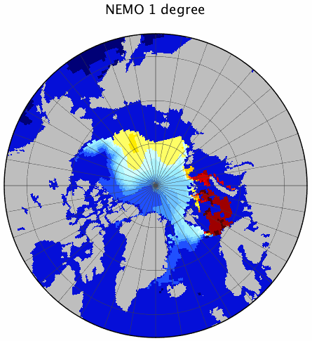
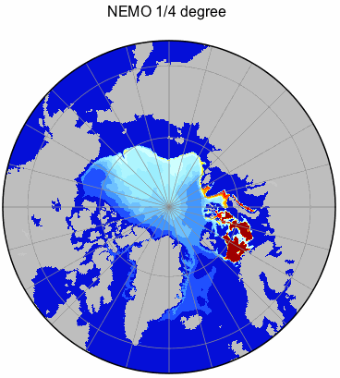
Barents Sea Water Tracer at ~250m in 1996
BSO
BSW Tracer concentration [non-dimensional]
Notes:
5

Slide 6
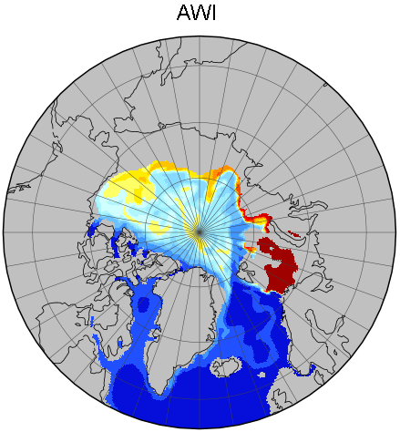
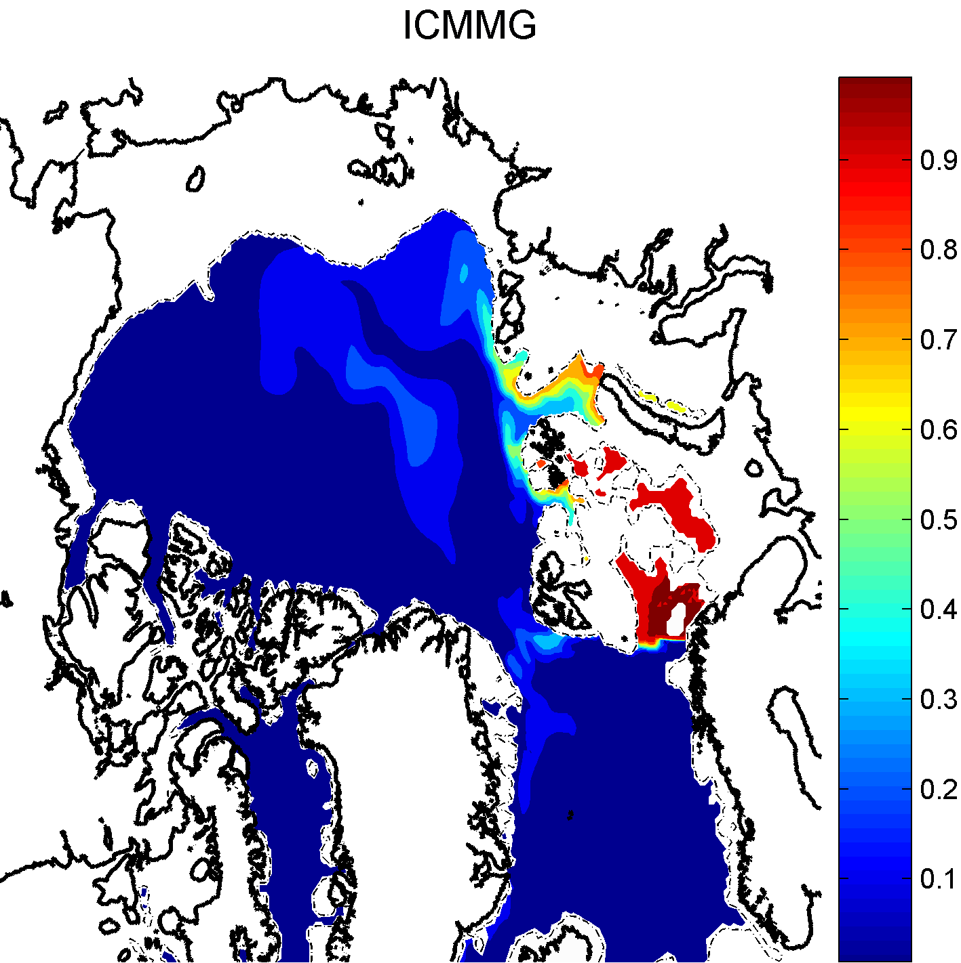
Barents Sea Water Tracer at ~250m in 1996
BSO
BSO
BSW Tracer concentration [non-dimensional]
Notes:
6

Slide 7
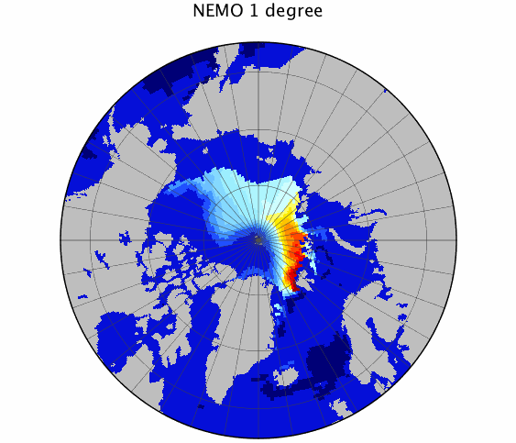
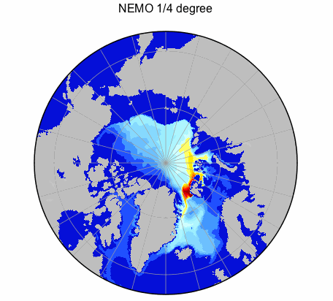
Fram Strait Water Tracer at ~250m in 1996
FS
FS
FSW Tracer concentration [non-dimensional]
Notes:
7

Slide 8
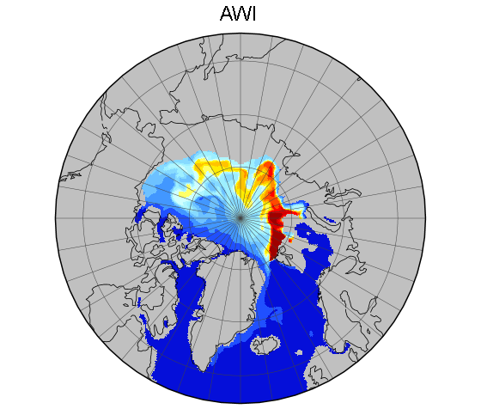
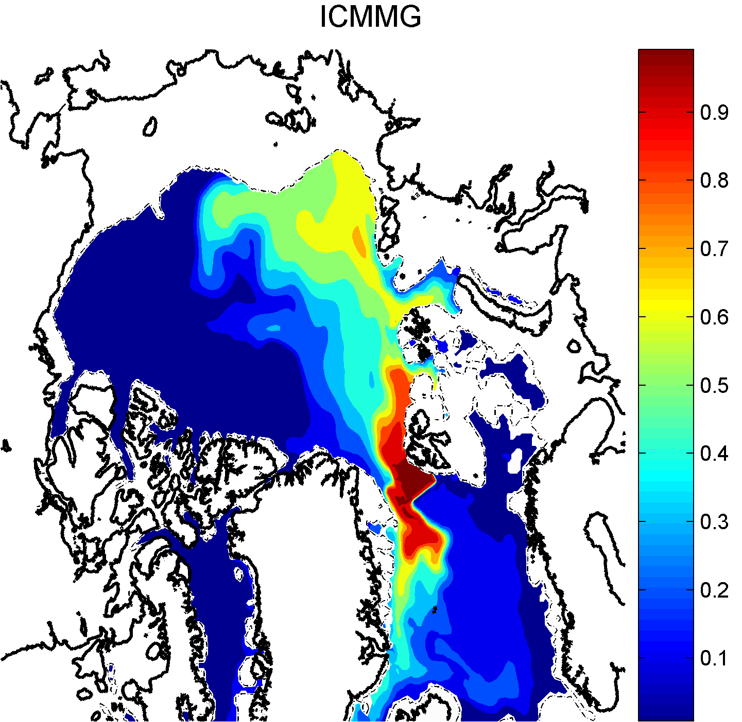
Fram Strait Water Tracer at ~250m in 1996
FS
FS
FSW Tracer concentration [non-dimensional]
Notes:
8

Slide 9
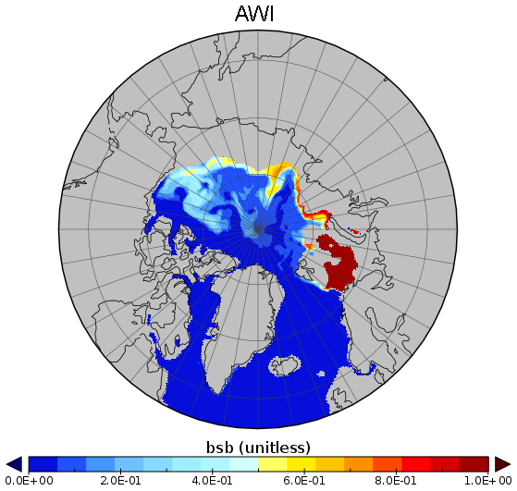
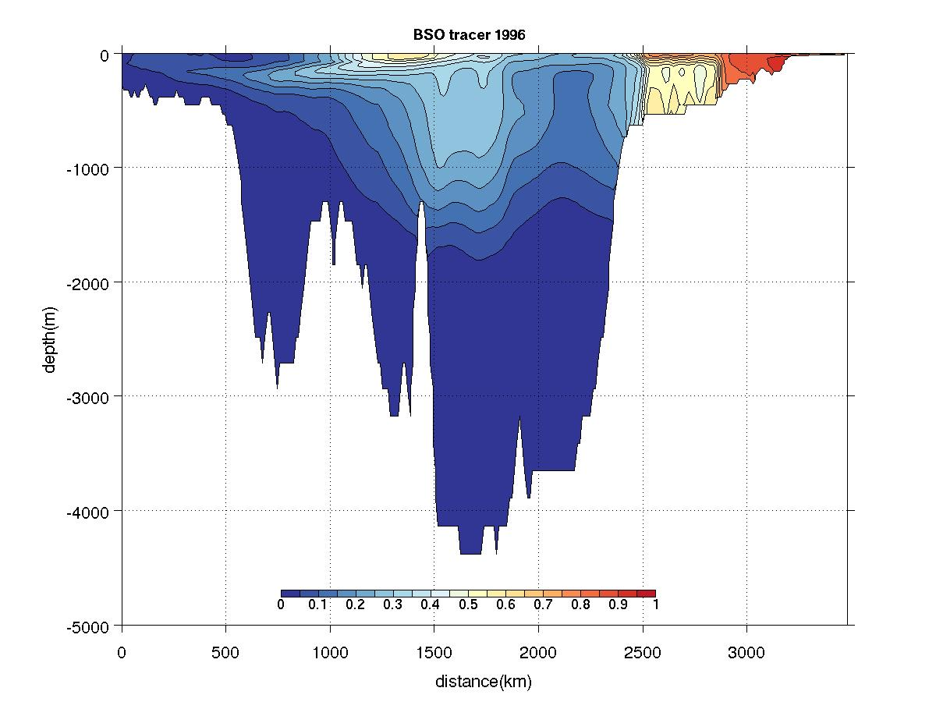
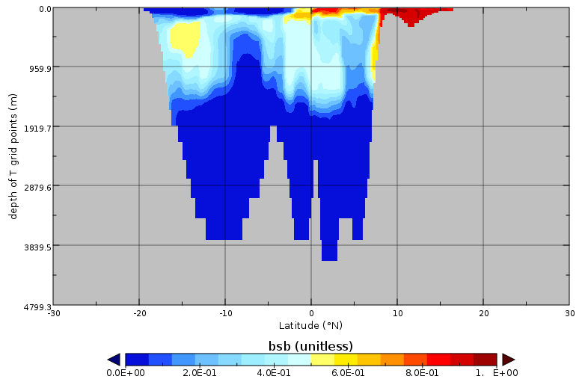
Barents Sea Tracers in 1996
ICMMG
Alaska
Siberia
NEMO 1/4
AWI
Lower mode
of BSW
Upper mode
of BSW
Alaska
Siberia
Alaska
Siberia
Notes:
9

Slide 10
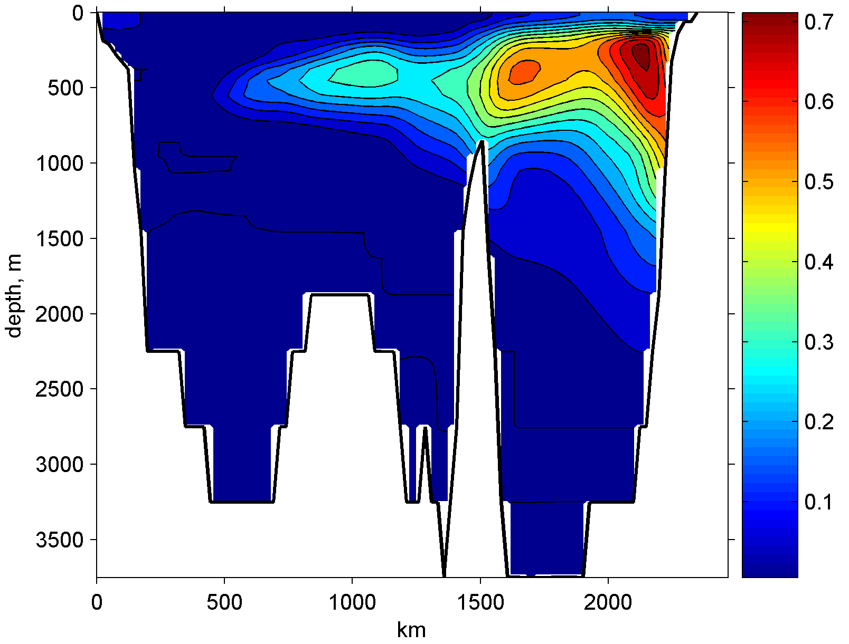
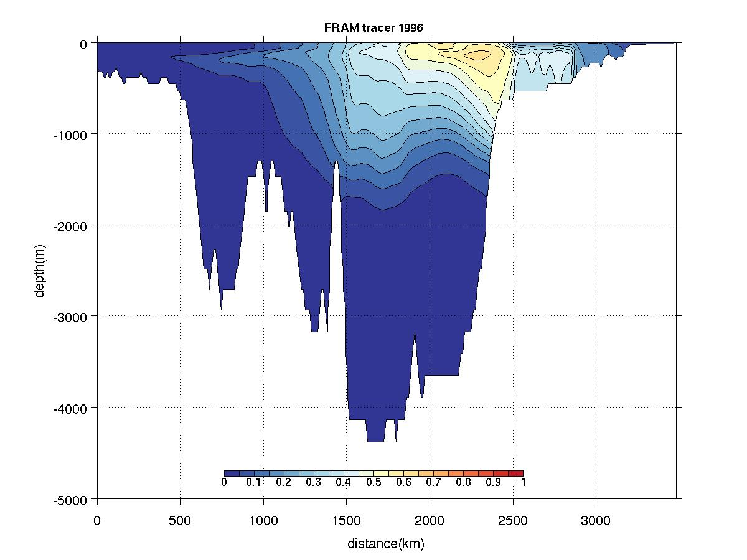
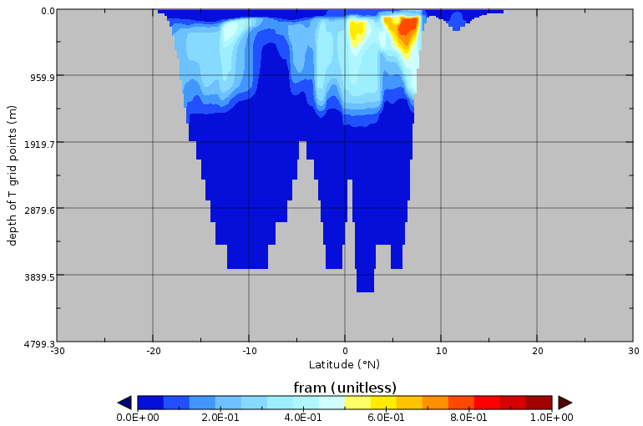
Fram Strait Tracer in 1996
ICMMG
Alaska
Siberia
NEMO 1/4
AWI
Alaska
Siberia
Alaska
Siberia
Notes:
10

Slide 11
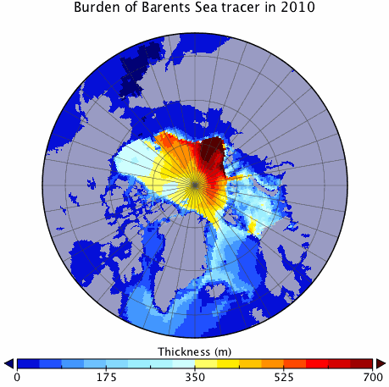
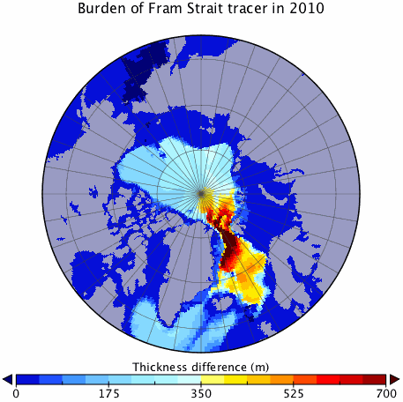
Burden of Barents Sea and Fram Strait Tracers in NEMO 1 deg.
BSO
FS
Notes:
11

Slide 12
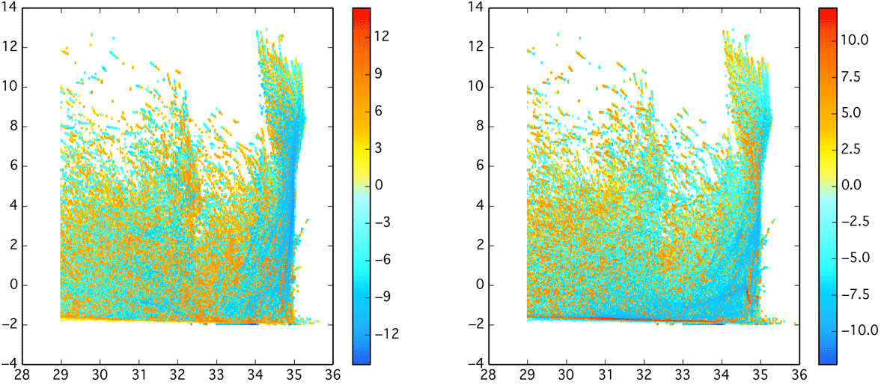
Total water mass classes modification in NEMO 1 degree 2007
Sv/psu
Sv/Deg
DT/dt
DS/dt
Notes:
12

Slide 13
Surface forcing for T&S classes in NEMO 1 degree, 2007
Sv/psu/deg
Sv/psu
Sv/Deg
P-E
Heating
Salinity flux
Notes:
13

Slide 14
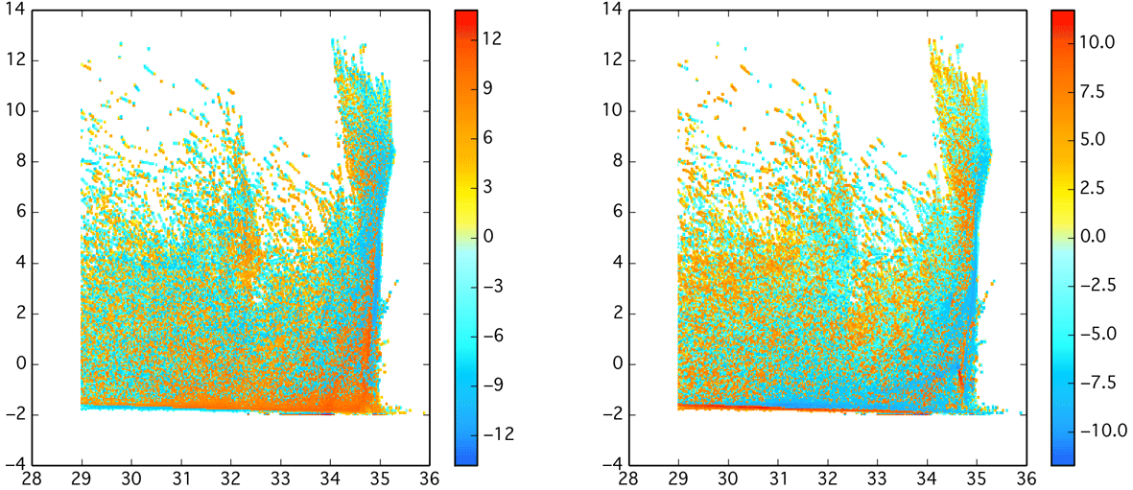
Water mass modification (mixing) in NEMO 1 degree 2007
Sv/psu
Sv/Deg
DT/dt
DS/dt
Notes:
14

Slide 15
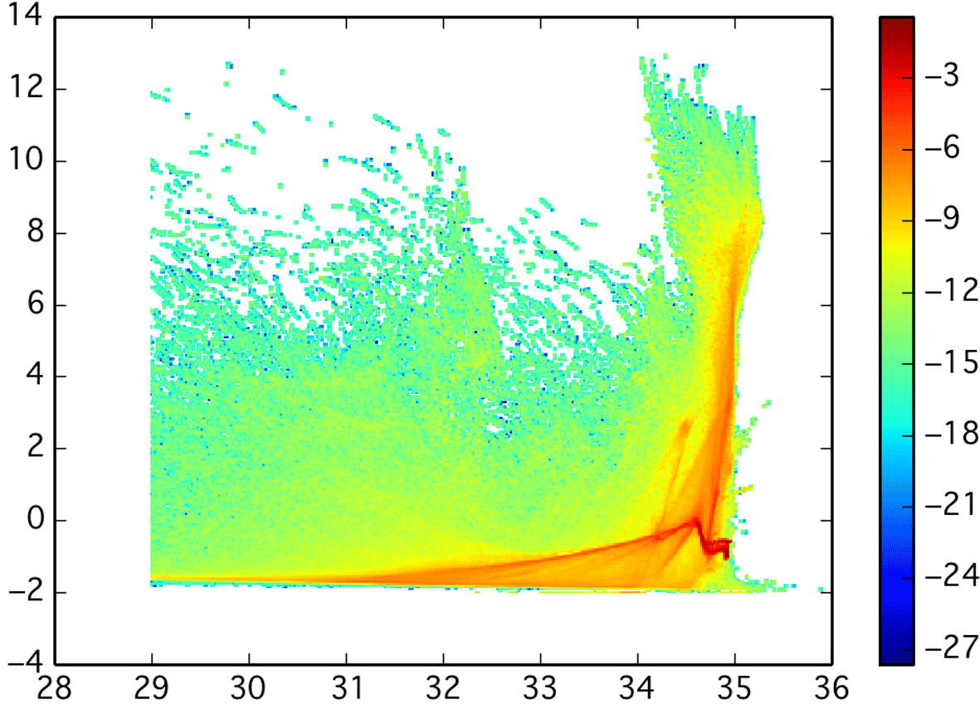
Water mass census in NEMO 1 degree in 2007
Log(m3)/PSU/Deg
Notes:
15

Slide 16
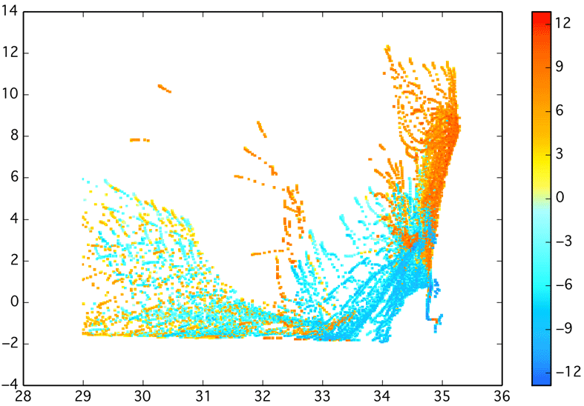
Volume transport (+e northwards) of T&S classes in NEMO 1 deg.
Sv/PSU/Deg
Notes:
16

Slide 17
2014 experiments (for discussion)
Fram and Barents water branches interactions
Heat loss and variability
What drives the Fram Strait inflow? – Mike Spall et al.
Driving Beaufort Gyre. – Camille Lique et al.
Models Validation
Diagnostics: Temperature tracers, water mass transformation, etc..
Notes:
17

Slide 18
Thank you!

Slide 19
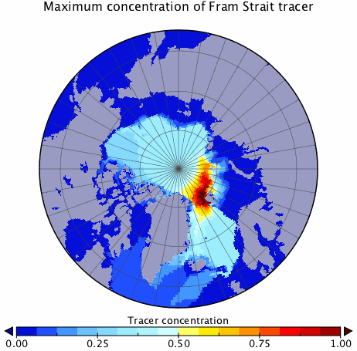
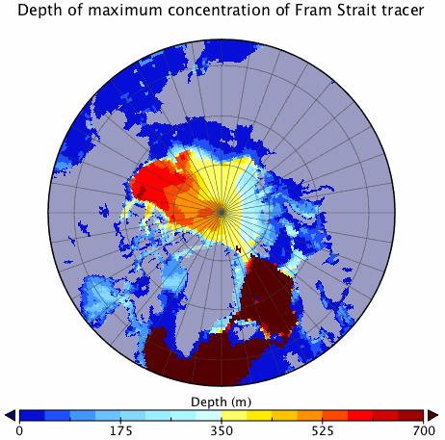
Fram Strait Tracer in NEMO 1 degree in 2010
FS
FS
Notes:
19

Slide 20
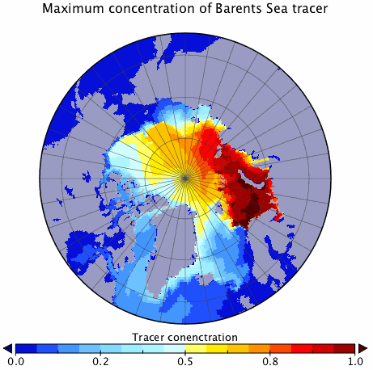
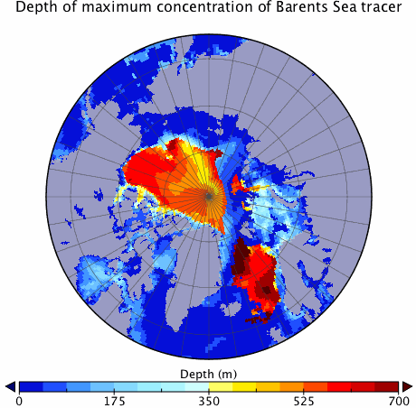
Barents Sea Tracer in NEMO 1 degree in 2010
BSO
BSO
Notes:
20

Slide 21
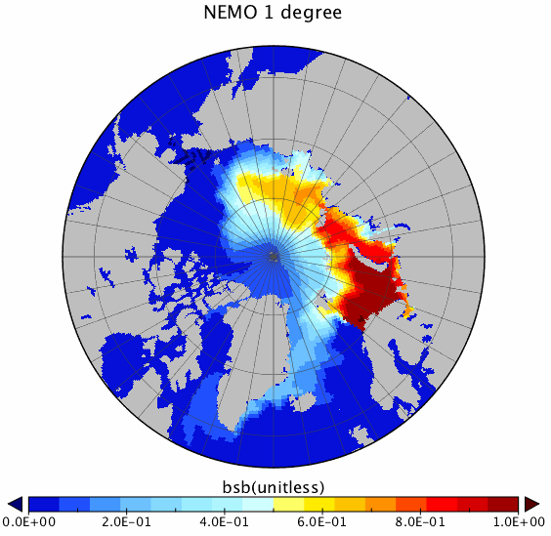
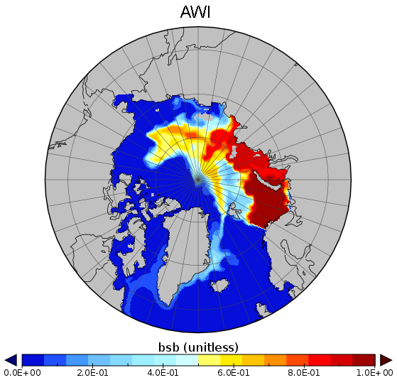
Barents Sea Water Tracer at the surface in Sep 1996
BSO
BSO
Notes:
21

Slide 22
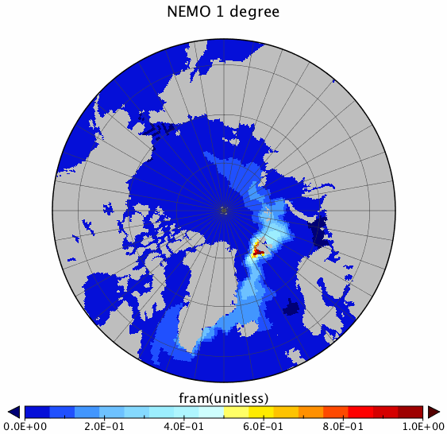
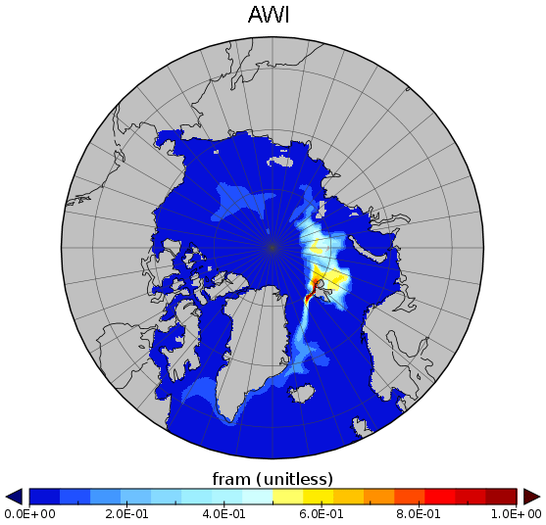
Fram Strait Water Tracer at the surface in Sep 1996
FS
FS
Notes:
22

Slide 23
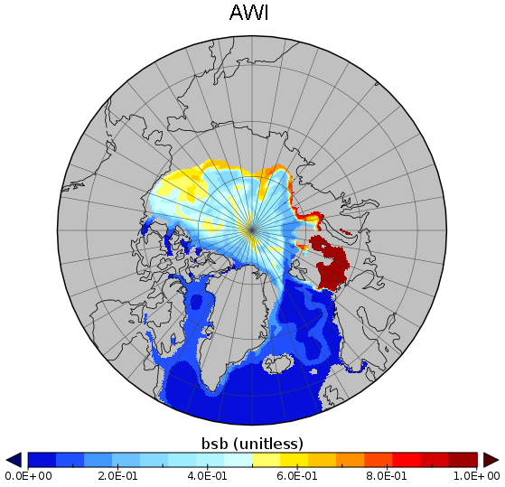
Initial Conditions: Barents Sea Tracer in AWI model at ~250m in Sep 1996
BSO
BSO
1948-1996
1979-1996
Notes:
23

Slide 24
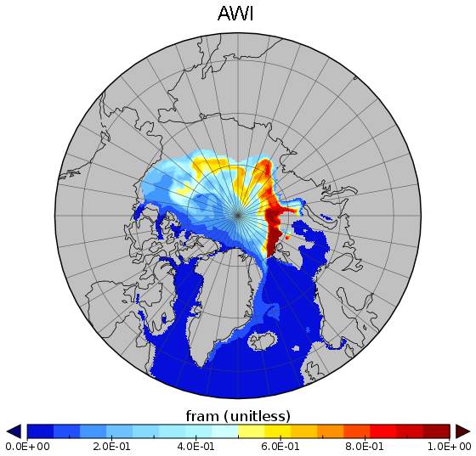
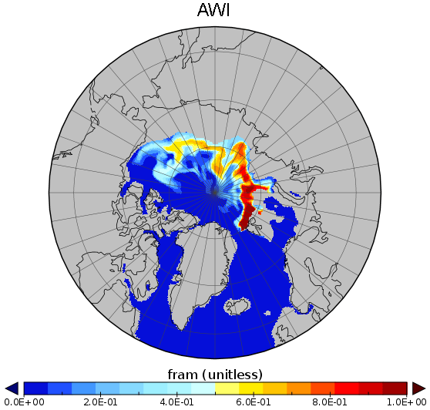
Initial Conditions: Fram Strait Tracer in AWI model at ~250m in Sep 1996
FS
FS
1948-1996
1979-1996
Notes:
24

Slide 25
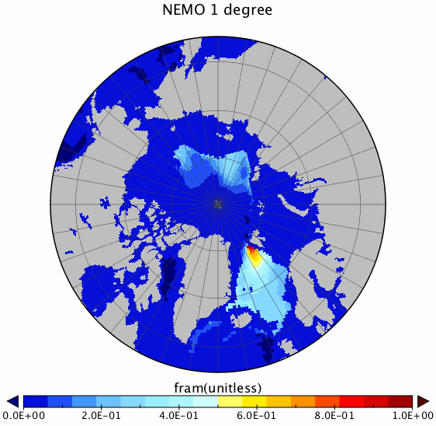
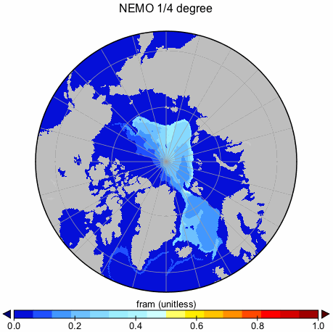
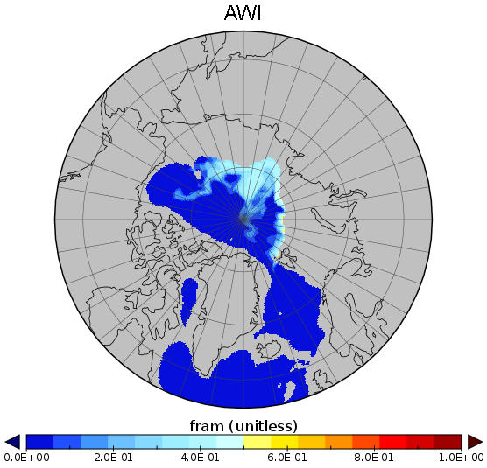
Fram Strait Water Tracer at ~950m in 1996
FS
FS
FS
Notes:
25

