Slide 1
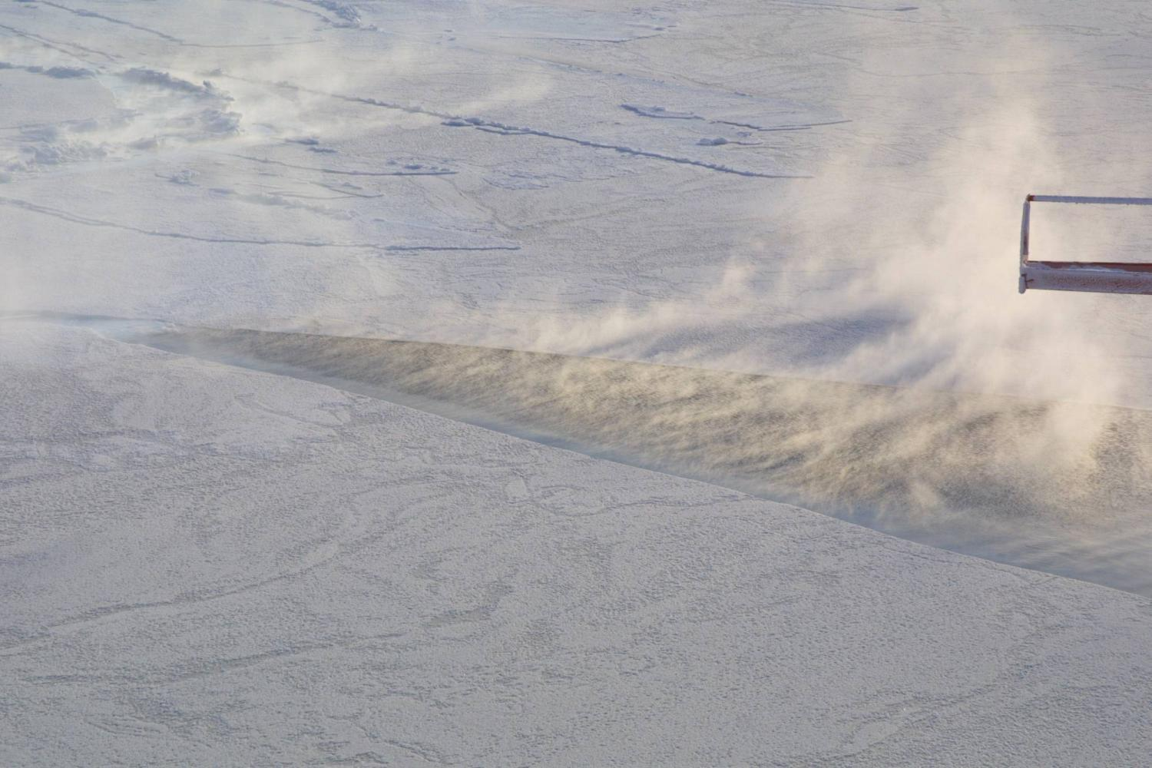
Atlantic Water in the Arctic Ocean – can we estimate the heat supplied through its inflow?
Ursula Schauer
+ Agnieszka Beszczynska-Möller, Eberhard Fahrbach, AWI Bremerhaven;
Edmond Hansen, NPI Tromsö
Notes:
Session Towards comprehensive Observing Systems in Polar Regions
The title implies that today we can only poorly assess the changes
And that the simply answer would just be: More measurements

Slide 2
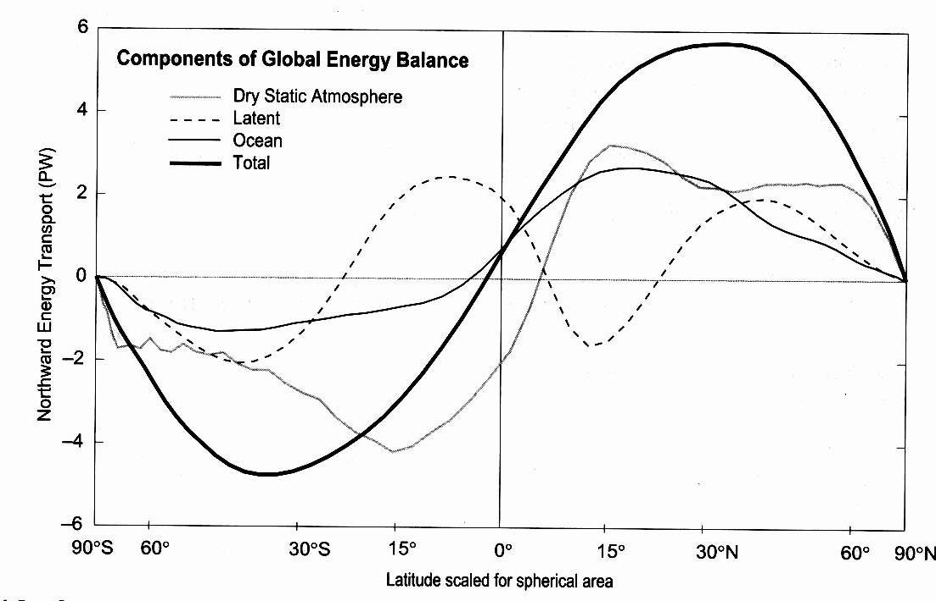
Motivation I
Oceanic heat transport is an important component of global and regional climate
Bryden and Imawaki (2001)
Notes:
Before checking

Slide 3
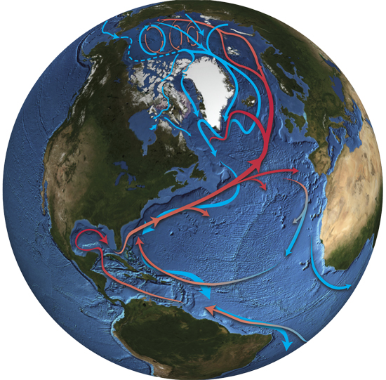
Atlantic warm water circulation extends to the Arctic Ocean
Oberlander

Slide 4
Motivation II
Ocean heat transport is very often computed incorrectly.
Notes:
Per paper several authors, at least two reviewers.

Slide 5
Outline:
Motivation
What is and what is not ocean heat transport?
Can it be determined for the Arctic Ocean?
Example Fram Strait
Error bars?
Suggestions for observing strategies

Slide 6
Oceanic heat transport?
Heat conservation
Surface heat flux (x)
Advection (x-Δx)
Temp (x,t)
Advection (x+Δx)
+ diffusion

Slide 7
Oceanic heat transport?
Heat conservation for an extended piece of ocean
Surface heat flux (x)
Advection (s₁)
Temp (x,t)
Advection (s₂)
+ diffusion
arbitrary scale

Slide 8
Oceanic heat transport?
Advection (s₁)
Temp (x,t)
Advection (s₂)
can be derived only with net zero volume flux
Montgomery, 1974; Hall & Bryden, 1982; Wallace, 2008; …; …
8

Slide 9
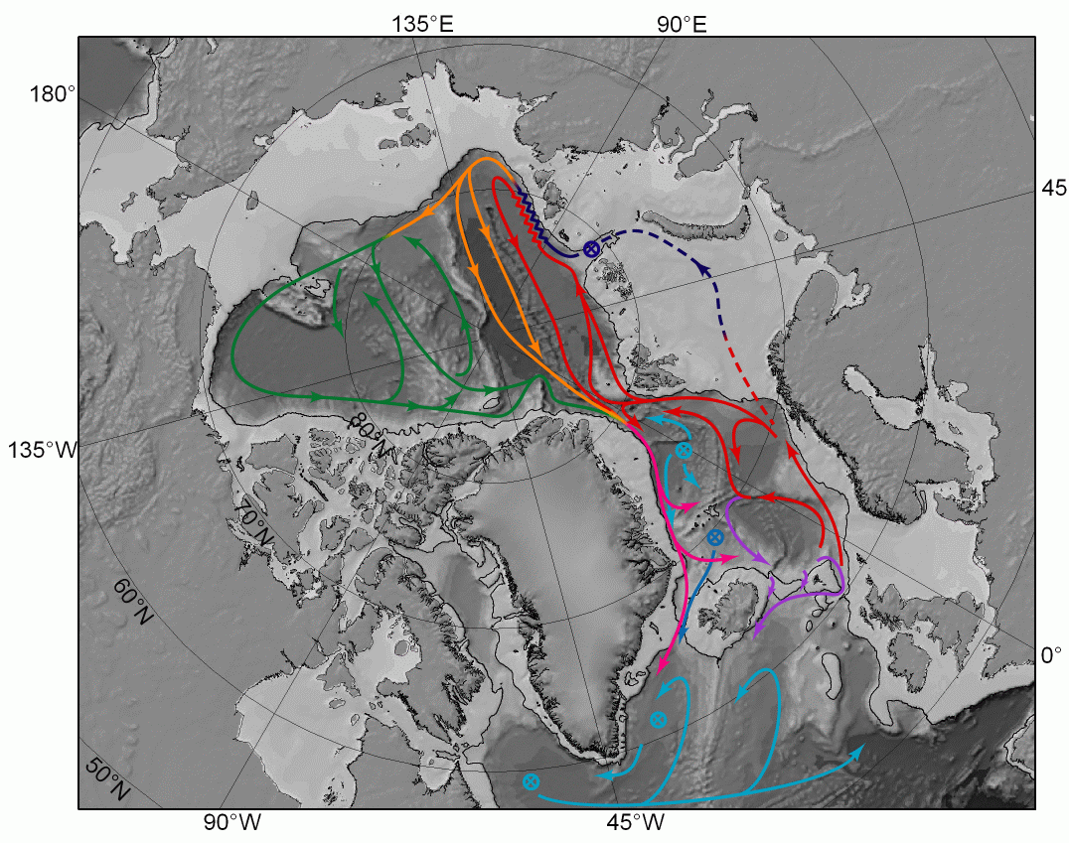
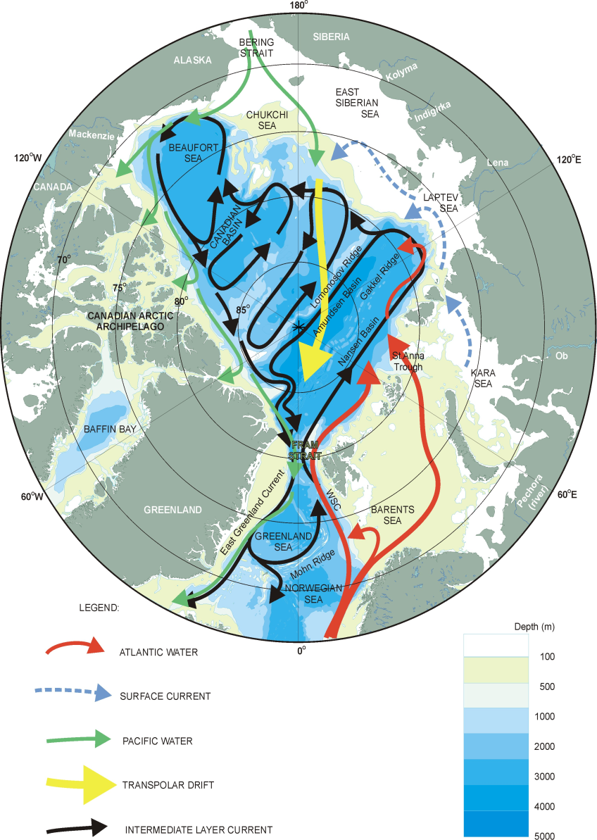
Arctic Ocean exchange through various passages
Barents Sea, 200m
2 Sv
Fram Strait, 2600m
11 Sv, 9 Sv
Since late 1990s mooring arrays in the straits
(ASOF)
Rudels et al., 2005

Slide 10
Well,
but what if we only want to evaluate changes?
… Or compare different sections?

Slide 11
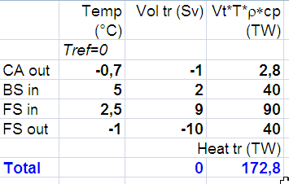
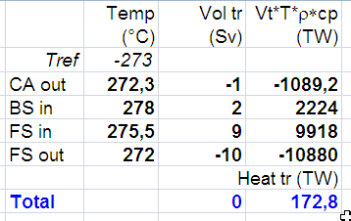
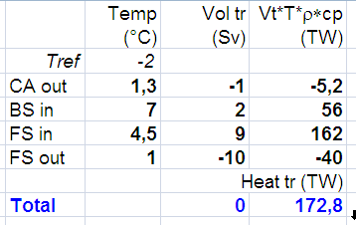
Little exercise
Comparison of flow through passages
Ratio
2.25
4.46
2.9

Slide 12
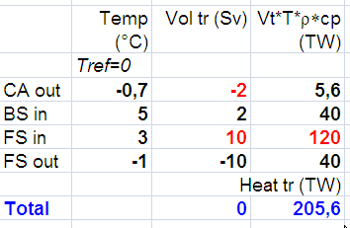
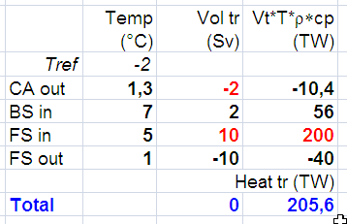
Little exercise
Temporal changes
Increase FS inflow and CA outflow
Diff= 30 TW
Diff= 38 TW
True Difference= 32.8 TW
Notes:
BSO outflow and FS inflow

Slide 13
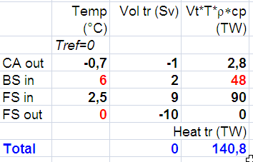
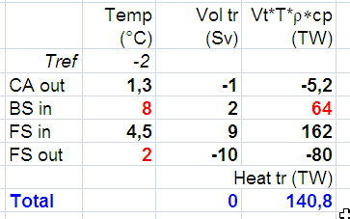
Little exercise
Temporal changes
Increase BS inflow and FS outflow temperature
Diff=
8 TW
Diff=
8 TW
True Difference= 0 TW
Notes:
BSO outflow and FS inflow

Slide 14
Arctic Ocean exchange through various passages
1 Sv
9 Sv
2 Sv
1 Sv
11 Sv
Barents Sea, 200m
2 Sv
Fram Strait, 2600m
11 Sv, 9 Sv
Since late 1990s mooring arrays in the straits
(ASOF)
Rudels et al., 2005

Slide 15
Integration over Fram Strait only reasonable with a stream tube concept

Slide 16
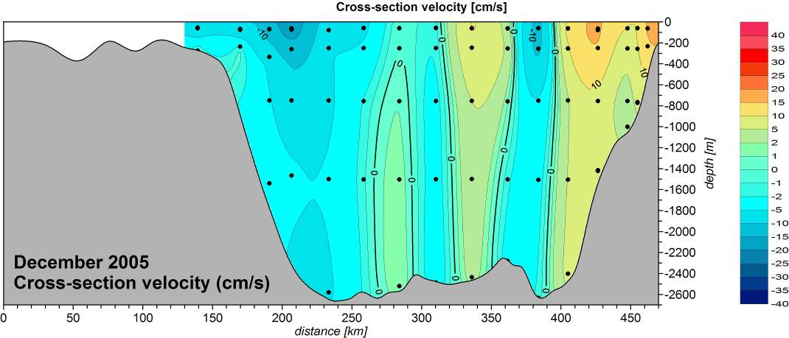
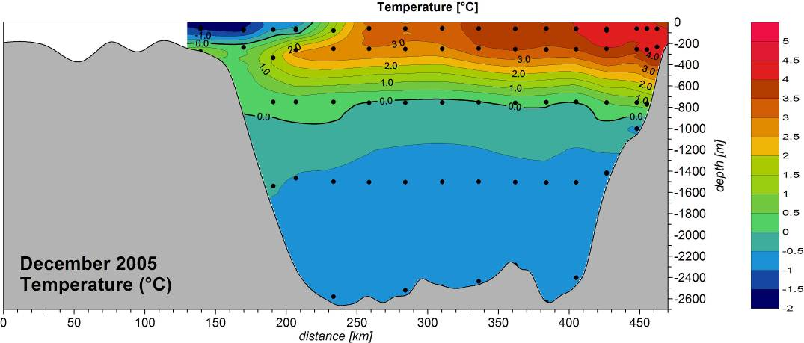
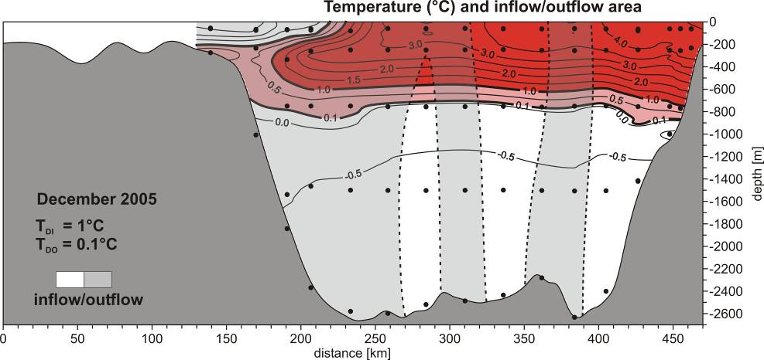
Heat transport through Fram Strait estimated with assumptions …
All water entering the Arctic Ocean through Fram Strait also exits through FS.
Inflow:
Only water with T>1°C considered.
Can only return at same temperature or colder.
Outflow:
Integrated until net volume flux is zero.

Slide 17
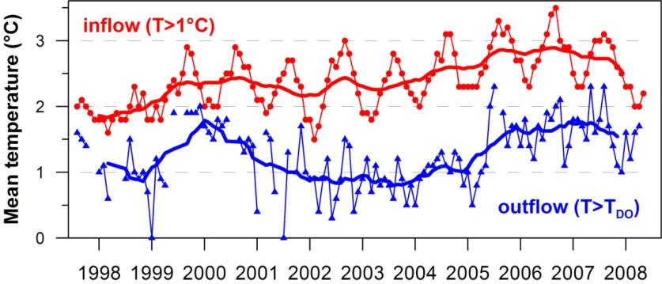
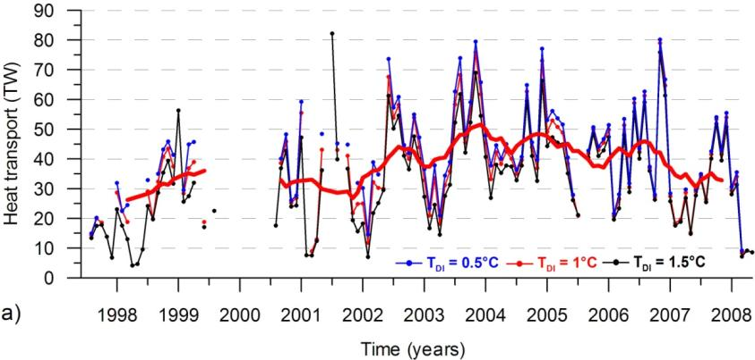
Oceanic heat transport through Fram Strait
Mean temperature of Atlantic inflow increased by ca. 1°C between 1997 and 2006.
But also temperature of Atlantic outflow varied.
Increase from 29 TW to 43 TW for 5 years
Schauer & Beszczynska-Möller, 2009
Notes:
Barents Sea water looses much of its heat in the Barents and Kara seas so that it is densified and sinks
to intermediate depths when entering the Eurasian Basin. According to observations
taken between the 1960s and mid-1990s (Schauer et al. 2002) all Atlantic Water
that leaves the northern Kara Sea is colder than 1 °C.

Slide 18
Error sources?

Slide 19
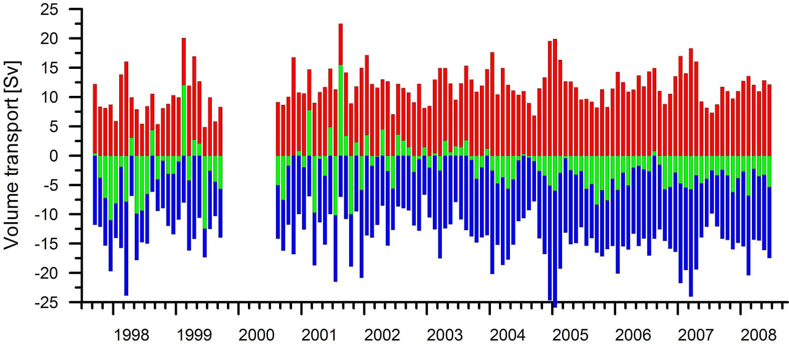
Error sources
Insufficient spatial resolution
monthly mean volume fluxes
northward
southward
net
12 moorings
14 moorings
net mean 2.1 Sv
std 5.9 Sv
net mean 2.8 Sv std 2.6 Sv
Unrealistic high (+-5 Sv) variability in net flow
This „control“ is available in Fram Strait measurements but not in the other straits.
Notes:
Time series of volume transport through the entire Fram Strait (including the Norwegian moorings), upper plot – monthly means, lower plot – winter-centered annual averages.
Difference between early years with low resolution of moorings and instruments is visible in standard deviation before and after 2002 deployment. Value 2.5 Sv southward for net transport is higher that given in the 'ASOF book' (2.2 Sv) due to including the last two years with stronger southward transport.

Slide 20
Error sources
Ice
Advection (s₁)
Temp (x,t)
Advection (s₂)
If the outflow implied to our balance contains cold Barents Sea Water (mixing) we overestimate the heat transport,
BUT
If ice is exported
we underestimate
the heat transport.
Mean sea ice export through Fram Strait O(0.1 Sv) (Vinje et al., 2001).
Corresponds to 33 TW!
20

Slide 21
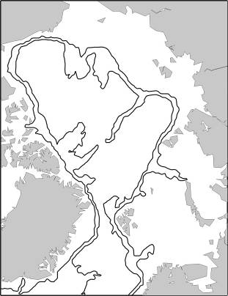
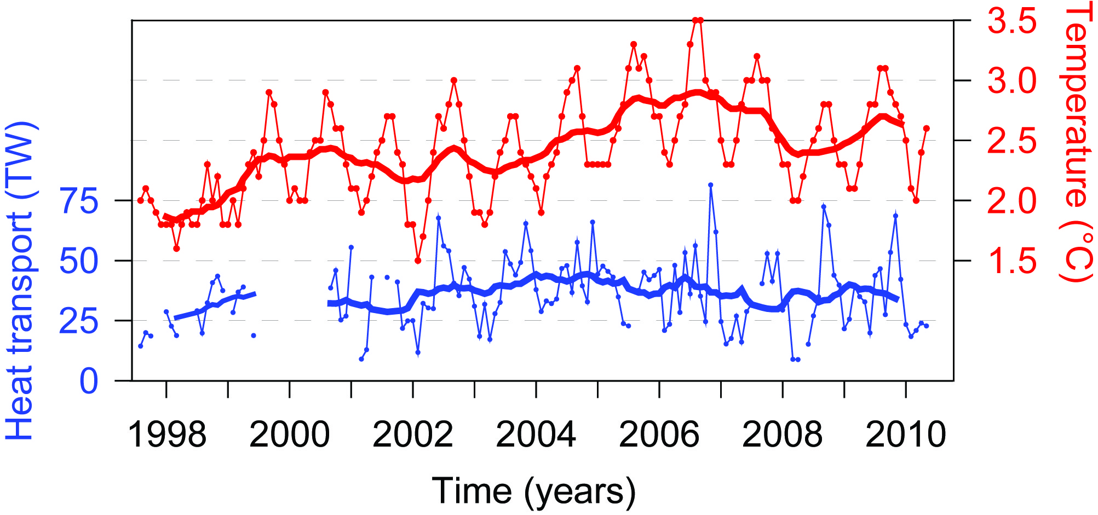
What happens with the heat – what about the additional heat?
Heat transport
t1
t2
Increase from 29 TW to 43 TW for 5 years -> additional heat of 2.2 ZJ
Z=10²¹

Slide 22
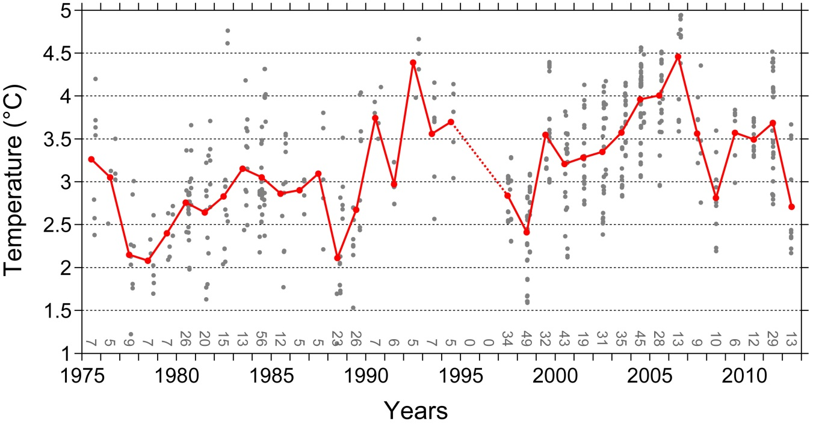
What happens with the heat – what about the additional heat?
-> additional heat of 2.2 ZJ
summer CTD data
in West Spitsb Curr

Slide 23
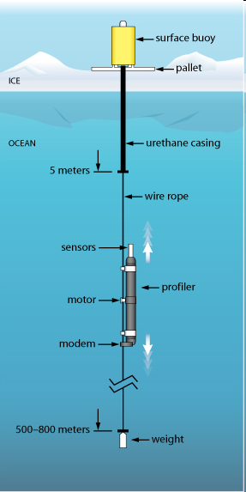
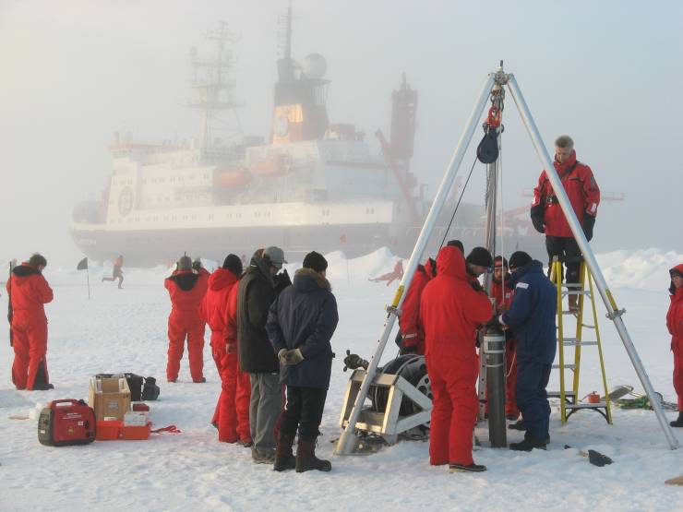
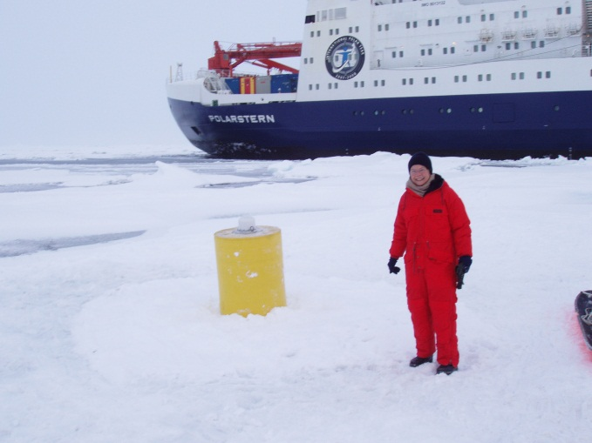
No Argo floats – but since 2007 autonomous drifting profilers (ITPs and POPs)
WHOI

Slide 24
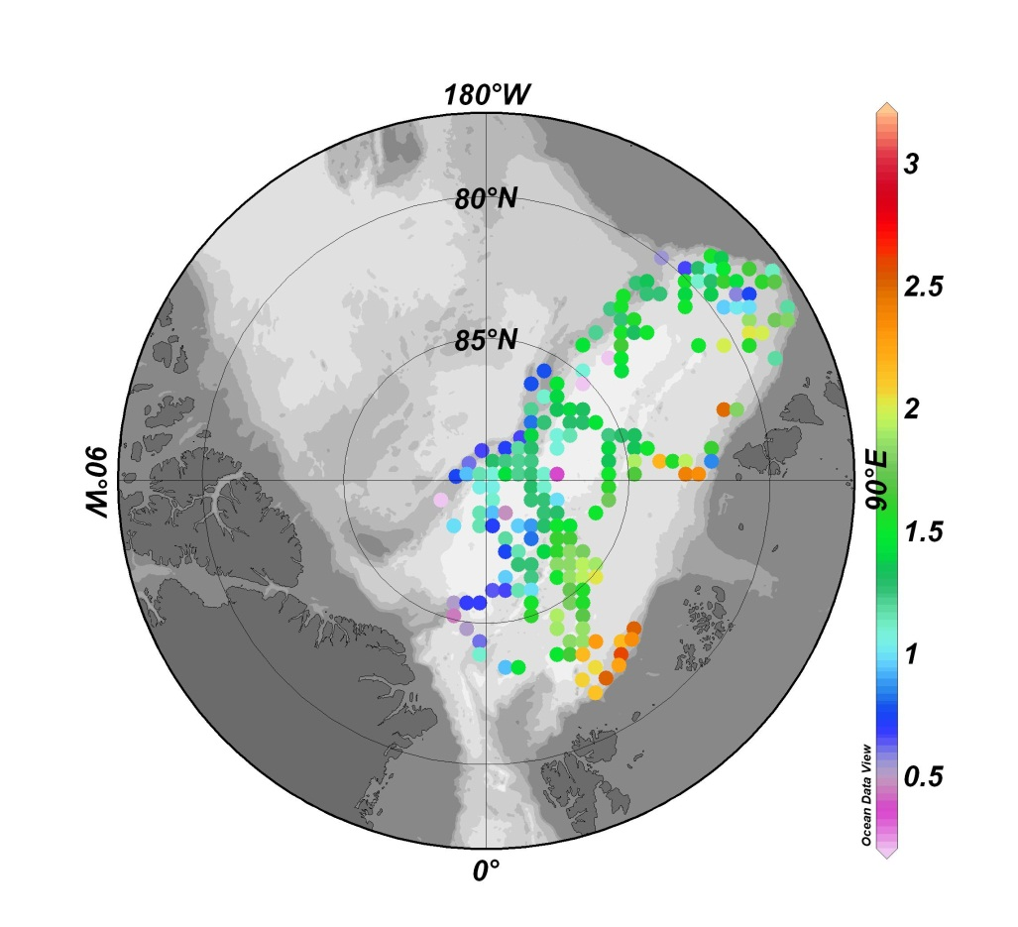
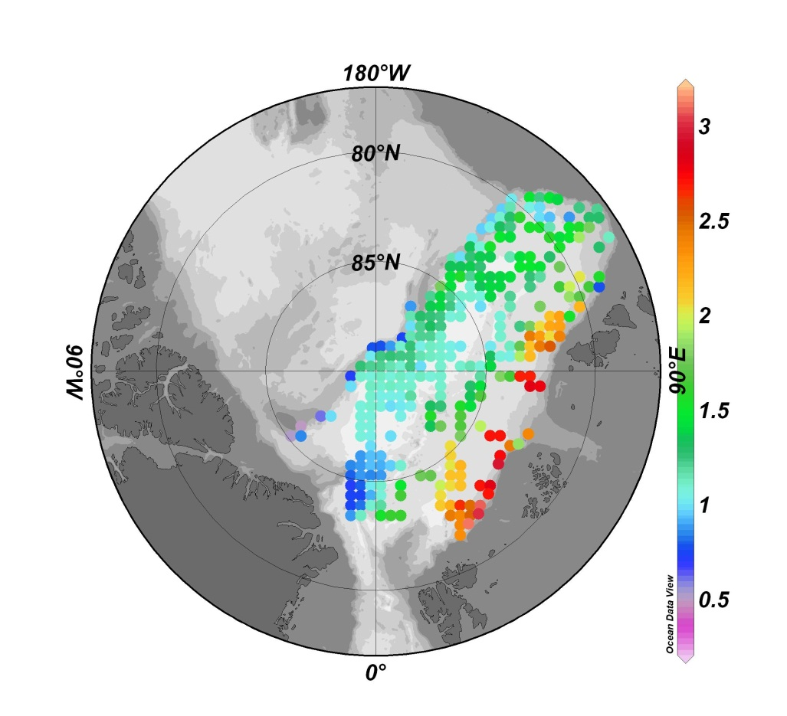
Mean temperature between 150 and 400 m in the Eurasian Basin
1991 - 2002
2003 - 2008
Fram Strait CTD data

Slide 25
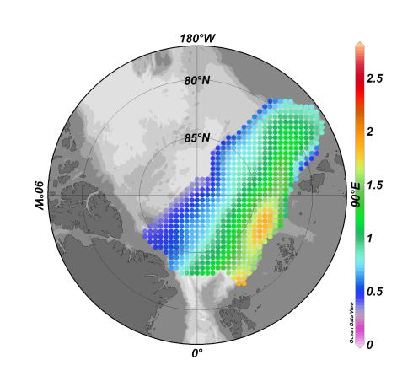
Mean (1950 – 1990) winter temperature between 150 and 400 m (EWG 1998)
Temp
°C
All data referenced to temperature climatology
(EWG 1998)
grid cells of 55 *55 km²

Slide 26
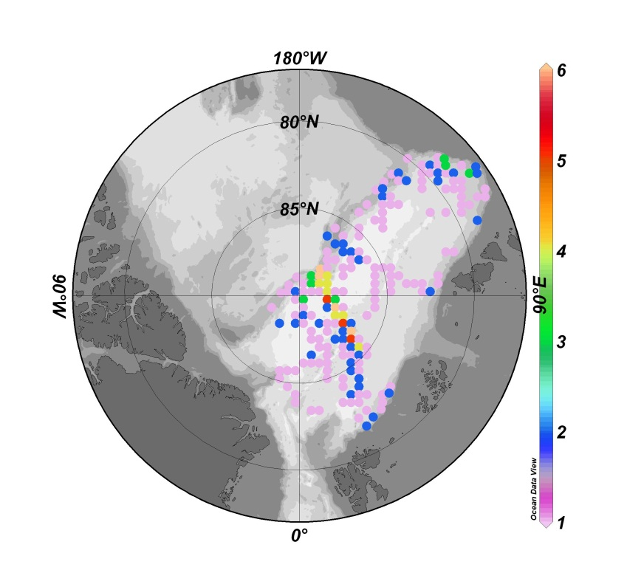
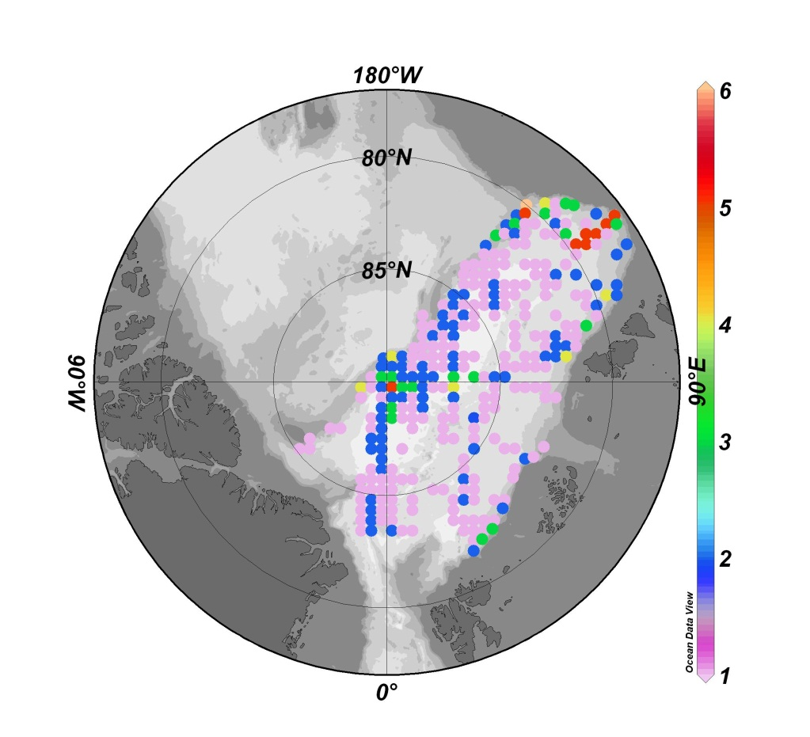
Number of years during which observations were made
in a grid cell of 55 *55 km²
1991-2002
2003-2008
Fram Strait CTD data

Slide 27
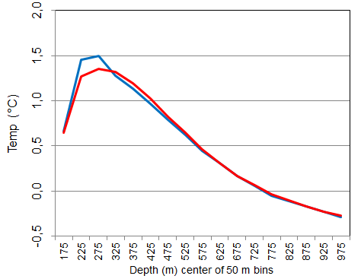
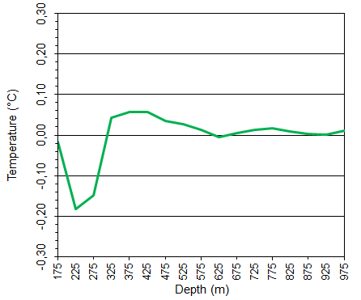
Eurasian Basin mean potential temperature profiles 1991-1997 and 1998-2008
0.0
1991 - 1997
1998 - 2008
Difference
Fram Strait CTD data

Slide 28
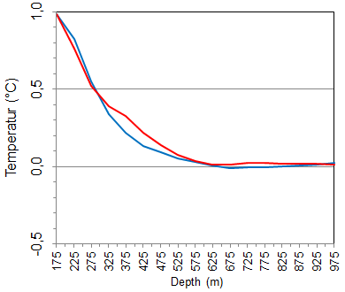
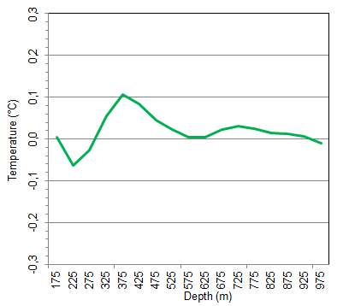
Temperature anomalies to EWG climatology 1950-1990
0.0
1991 – 1997
Difference
1998 - 2008
Fram Strait CTD data
Notes:
Heat difference
1991-1997mEWG 1998-2008mEWG
1,00E+09 TJ 1,11E+09 TJ Diff=10,4E+07 TJ
1 ZJ 1,11 ZJ 0,1 ZJ

Slide 29
Temperature anomalies to EWG climatology 1950-1990
0.0
1991 – 1997
Difference
1998 - 2008
0.1 ZJ
1.0 ZJ
1.1 ZJ
Fram Strait CTD data
Notes:
Heat difference
1991-1997mEWG 1998-2008mEWG
1,00E+09 TJ 1,11E+09 TJ Diff=10,4E+07 TJ
1 ZJ 1,11 ZJ 0,1 ZJ

Slide 30
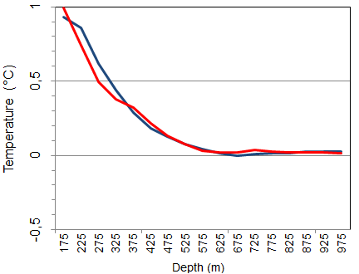
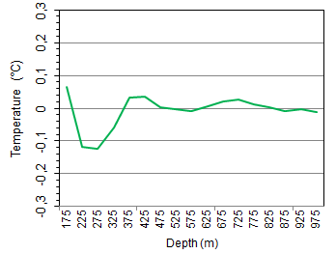
Temperature anomalies to EWG climatology (1950-1990)
0.0
1991 - 2002
Difference
2003 - 2008
-0.04 ZJ
1.14 ZJ
1.09 ZJ
Fram Strait CTD data
Notes:
Heat difference
1991-2002 mEWG 2003-2008mEWG Diff
1,14E+09 TJ 1,09E+09 TJ -4,11E+07 TJ
1,14 ZJ 1,09 ZJ -0.04 ZJ

Slide 31
Take problems into account assessing the Arctic ocean heat budget:
Observe fluxes at entrance and exits of connected streamtubes.
Observe fluxes at high enough spatial resolution to enable integrals over v*T (or v*S)
Include ice fluxes
Panarctic surveys (every 5 (or more) years?) –
i.e. needs international coordinated multiship effort
supported by synoptic panarctic seeding with autonomous platforms: ITPs on ice and in open water, later (when ice is shrinking) also acoustically tracked ARGO floats

Slide 32
Results sofar
Multiannual heat transport through Fram Strait after 1997
between 29 and 43 TW,
difference makes additional supply of 2.2 ZJ in early 2000s
Heat changes in European Basin between 150 and 1000 m depth from EWG to last two decades
1 – 1.1 ZJ
Multiannual heat changes in Eurasian Basin within the last two decades
-0.04 – 0.1 ZJ, i.e. none
„Imbalance“ of O(1 ZJ)
- Released to atmosphere immediately north of Fram Strait?
- Transfered to Canadian Basin?
- Released to atmosphere/sea ice on Eurasian shelves?
- Balanced within error limits of heat transport estimates (FS) and temperature changes (EB), and taking into account the temporal mismatch?
Probably a mixture of all.
THANK YOU.

Slide 33
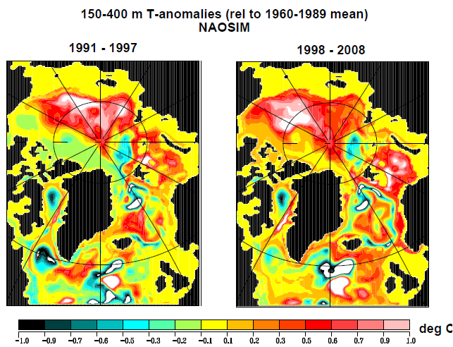
Michael Karcher, AWI

Slide 34
Summary
Heat transport computation only possible with net zero volume flux
This is true also for relative values such as comparison between passages or temporal variability
I.e. in the Arctic Ocean fluxes must be observed/simulated at entrance and exits of streamtubes
In the Arctic Ocean sea ice must be included in the oceanic heat transport.
Notes:
Per paper several authors, at least two reviewers.

Slide 35
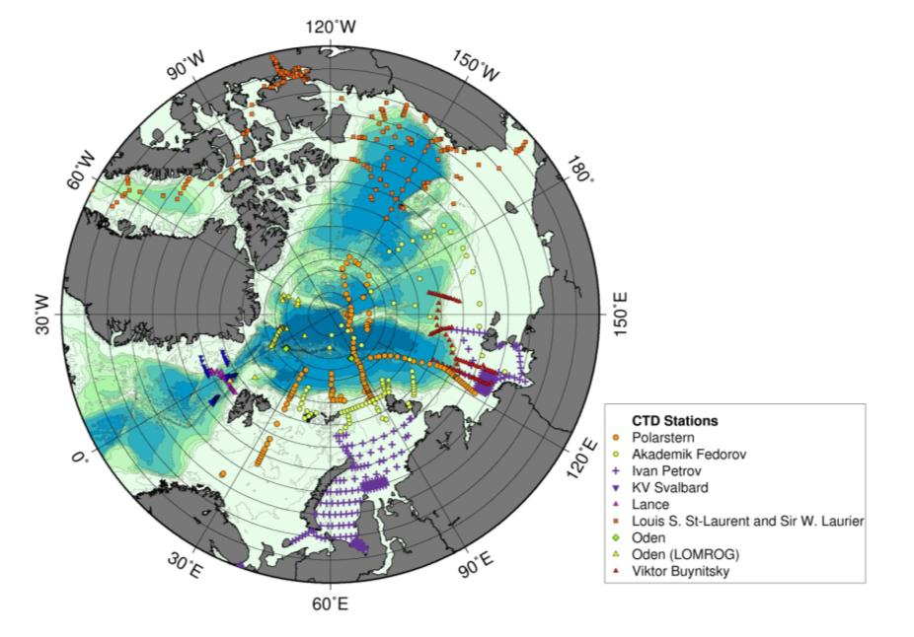
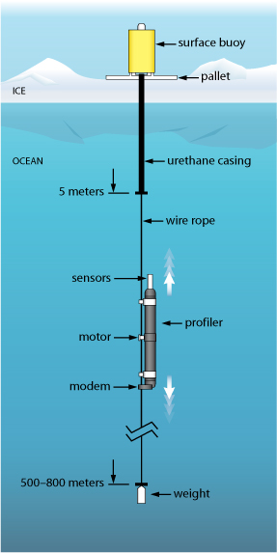
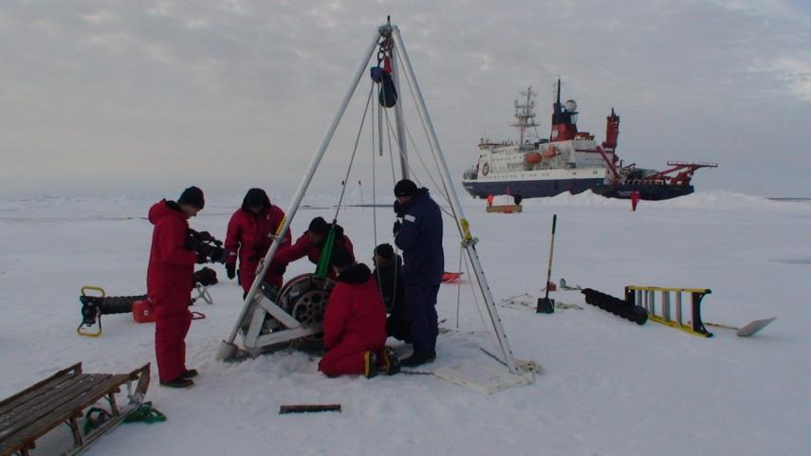
Hydro stations during International Polar Year 2007/08 provided the best coverage since the 1950s to 1980s (EWG Atlas)
2007
Largely augmented through profiles from autonomous Ice Tethered Platforms
WHOI

