Slide 1
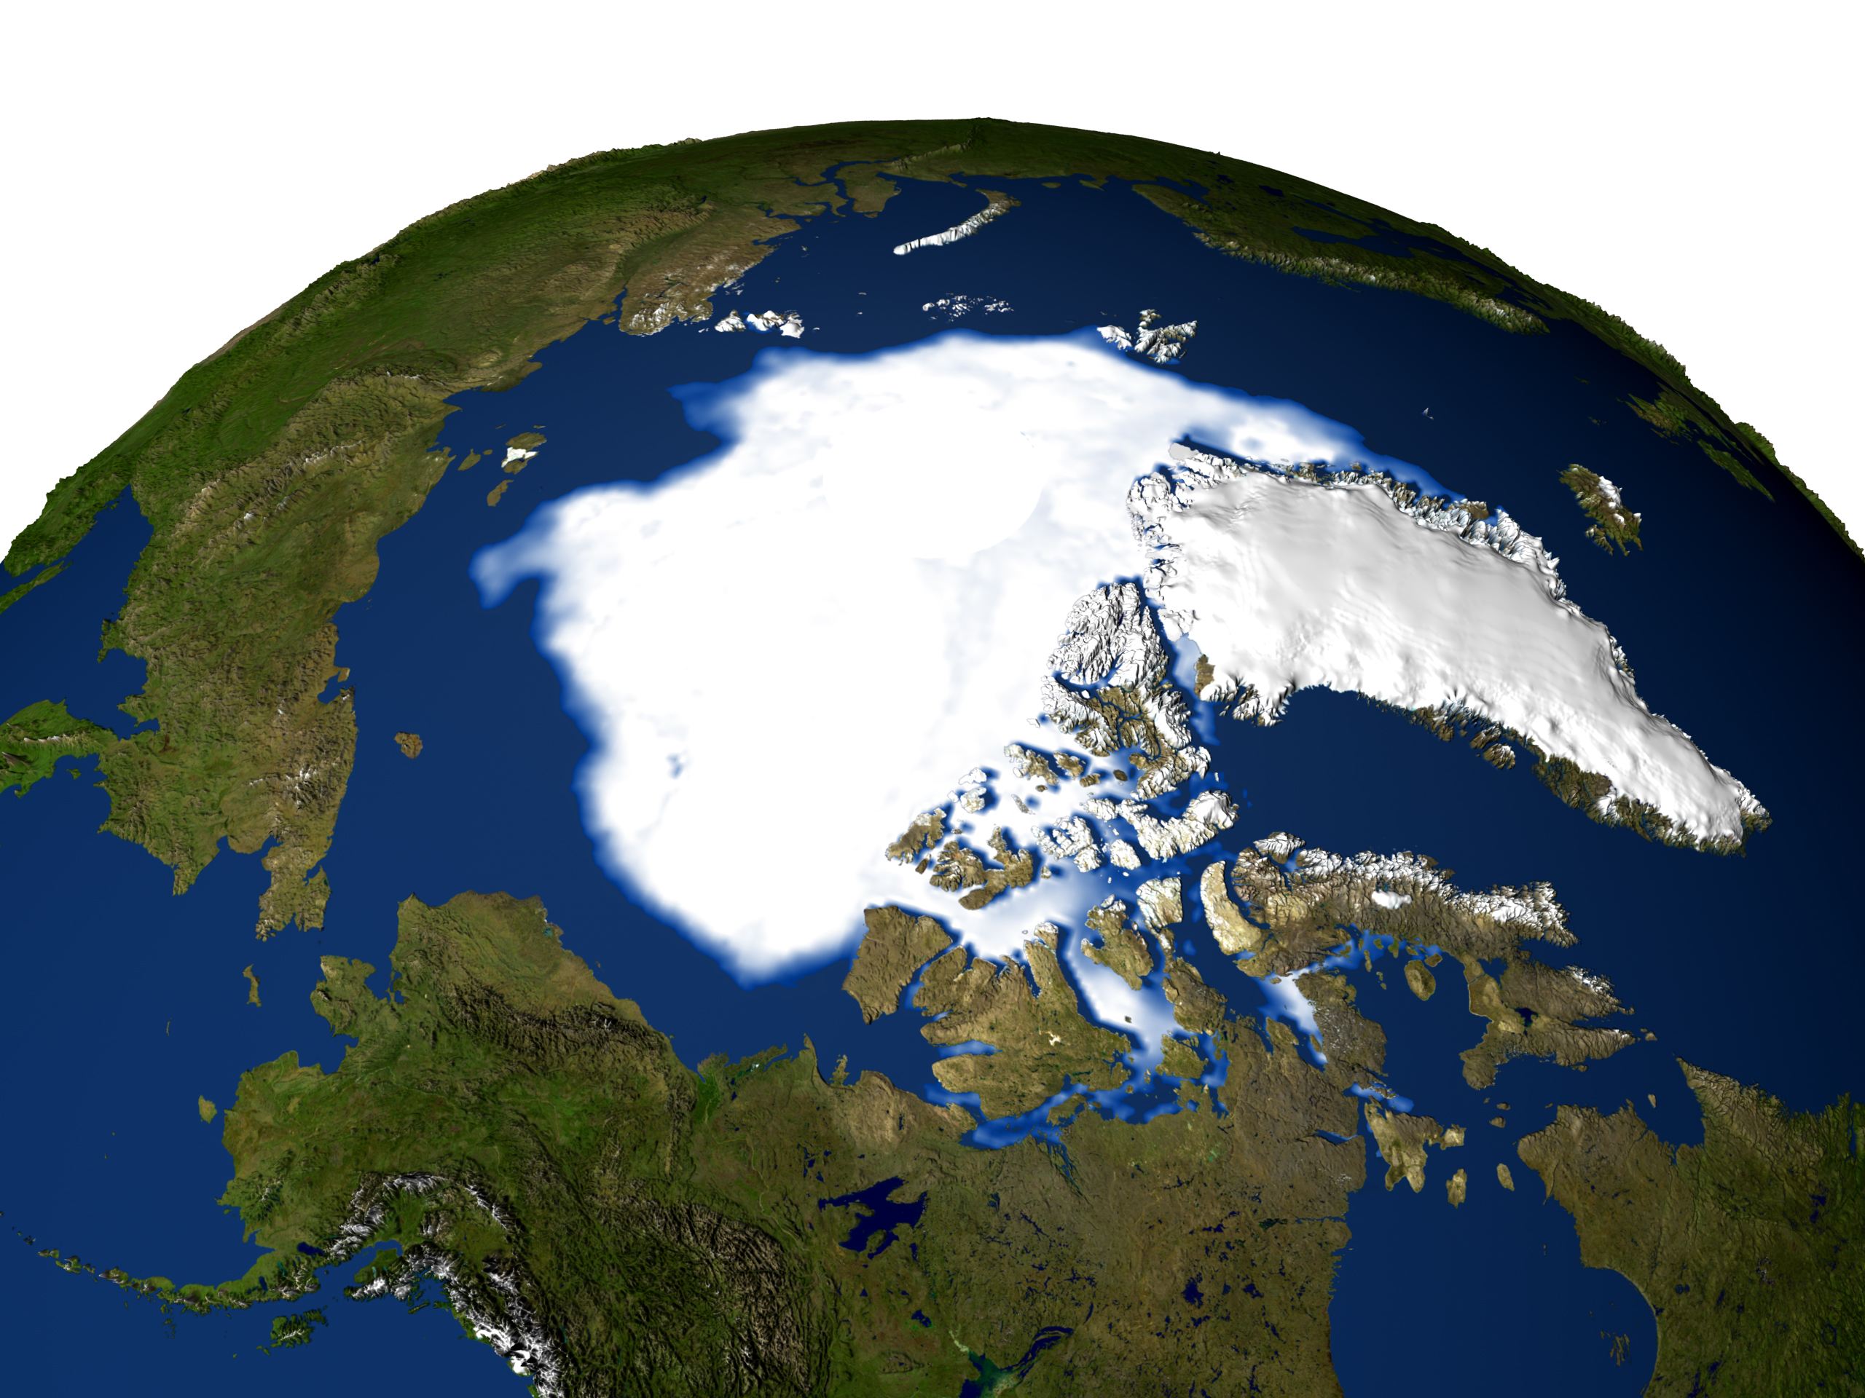
The changing Arctic sea ice cover: challenges to understanding and models
Danny Feltham
Centre for Polar Observation and Modelling
University of Reading, UK

Slide 2
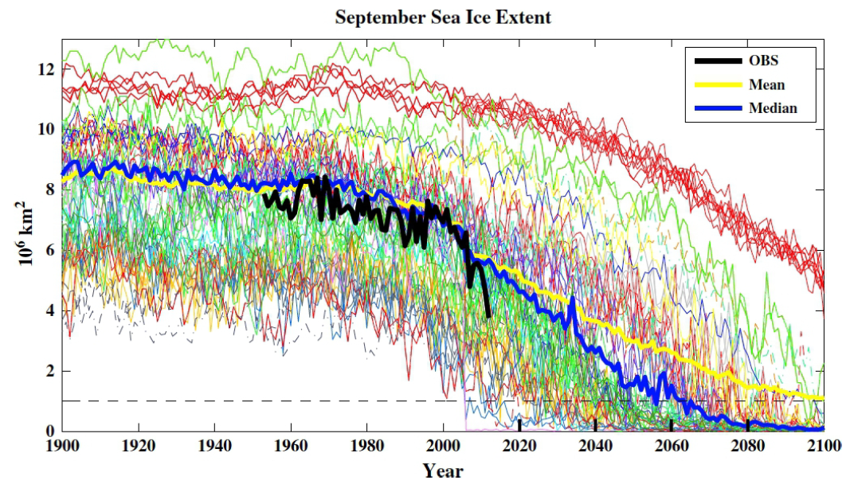
Sea ice model performance against observations
Coupled climate models, although not designed to reproduce actual sea ice concentration, can produce realistic ice concentrations and levels of natural variability of concentration.
Thickness and motion (and hence mass fluxes) are typically
wrong by a factor of 2 or more [e.g. Holland, 2007; Stroeve, 2012]
Overland 2013

Slide 3
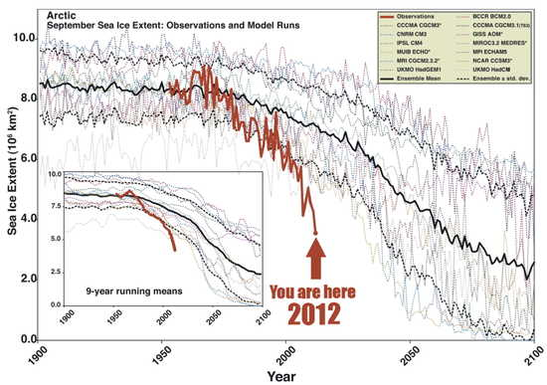
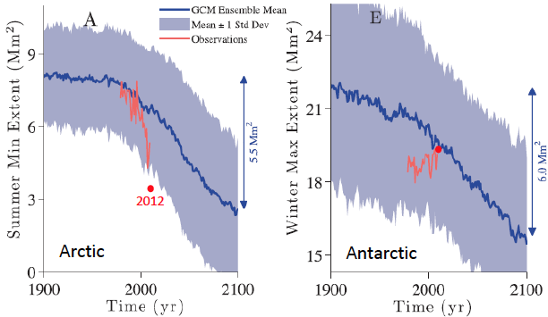
Sea ice model performance against observations
Coupled climate models, although not designed to reproduce actual sea ice concentration, can produce realistic ice concentrations and levels of natural variability of concentration.
Thickness and motion (and hence mass fluxes) are typically
wrong by a factor of 2 or more [e.g. Holland, 2007; Stroeve, 2012]
Climate models do predict a reduction of Arctic sea ice but underestimate the trend. Climate models typically predict an equal loss of sea ice in the Southern Ocean, which is not observed.
[Eisenman et al, 2011]
2012
2065

Slide 4
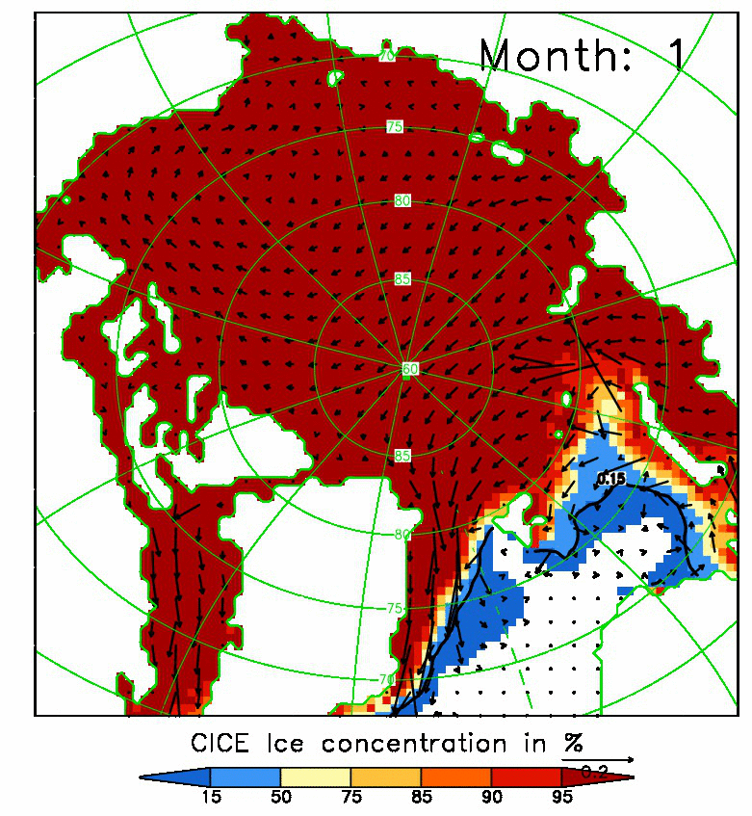
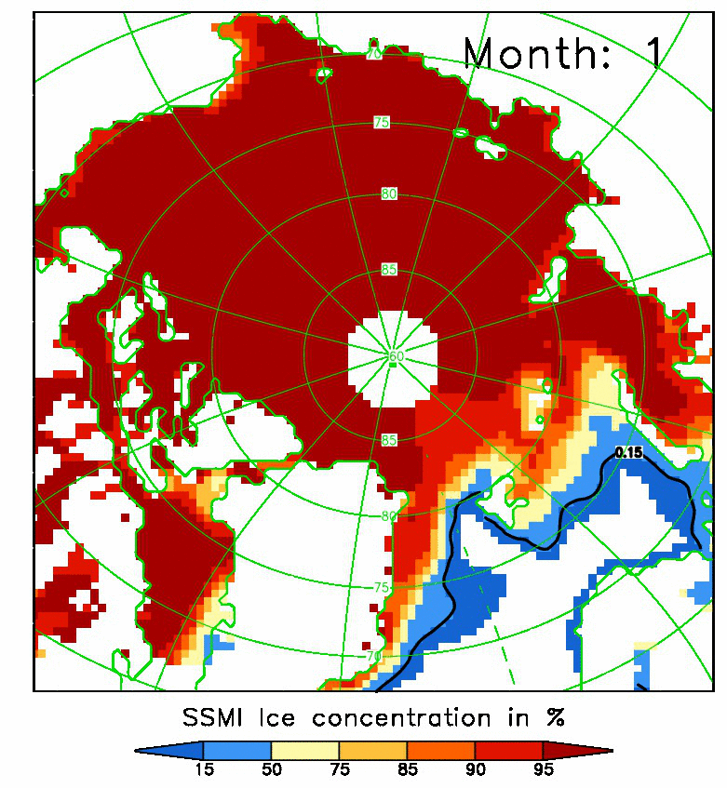
Sea ice model performance against observations
Coupled climate models, although not designed to reproduce actual sea ice concentration, can produce realistic ice concentrations and levels of natural variability of concentration.
Thickness and motion (and hence mass fluxes) are typically
wrong by a factor of 2 or more [e.g. Holland, 2007; Stroeve, 2012]
Climate models do predict a reduction of Arctic sea ice but underestimate the trend. Climate models typically predict an equal loss of sea ice in the Southern Ocean, which is not observed.
Highly-tuned, forced (uncoupled) sea ice models can produce quite accurate hindcasts of ice concentration, but do less well for ice motion and thickness.
Notes:
Climatology 1990-2007. Left is CPOM CICE. Right is SSM/I.

Slide 5
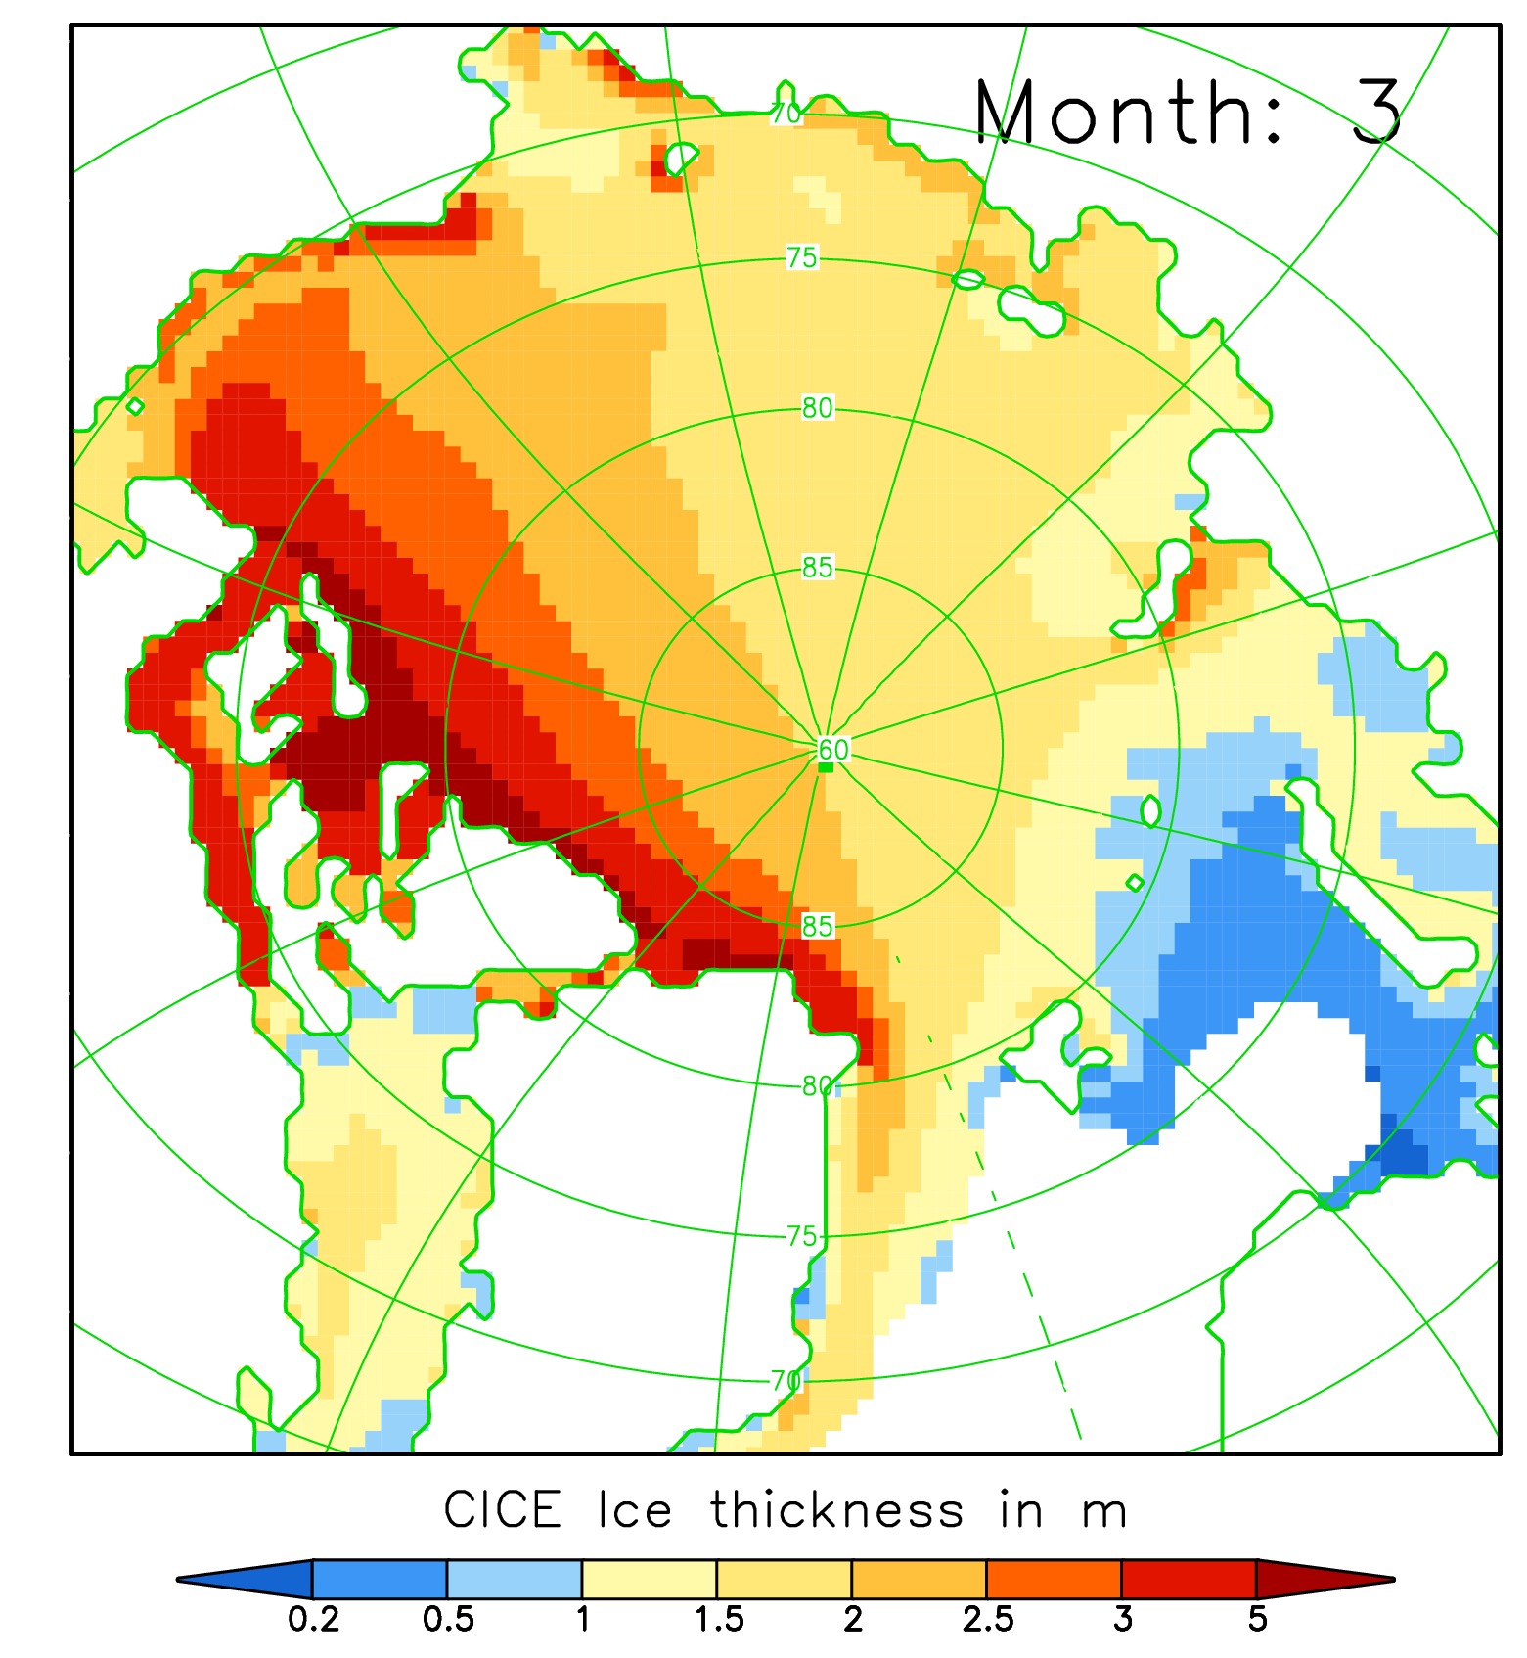
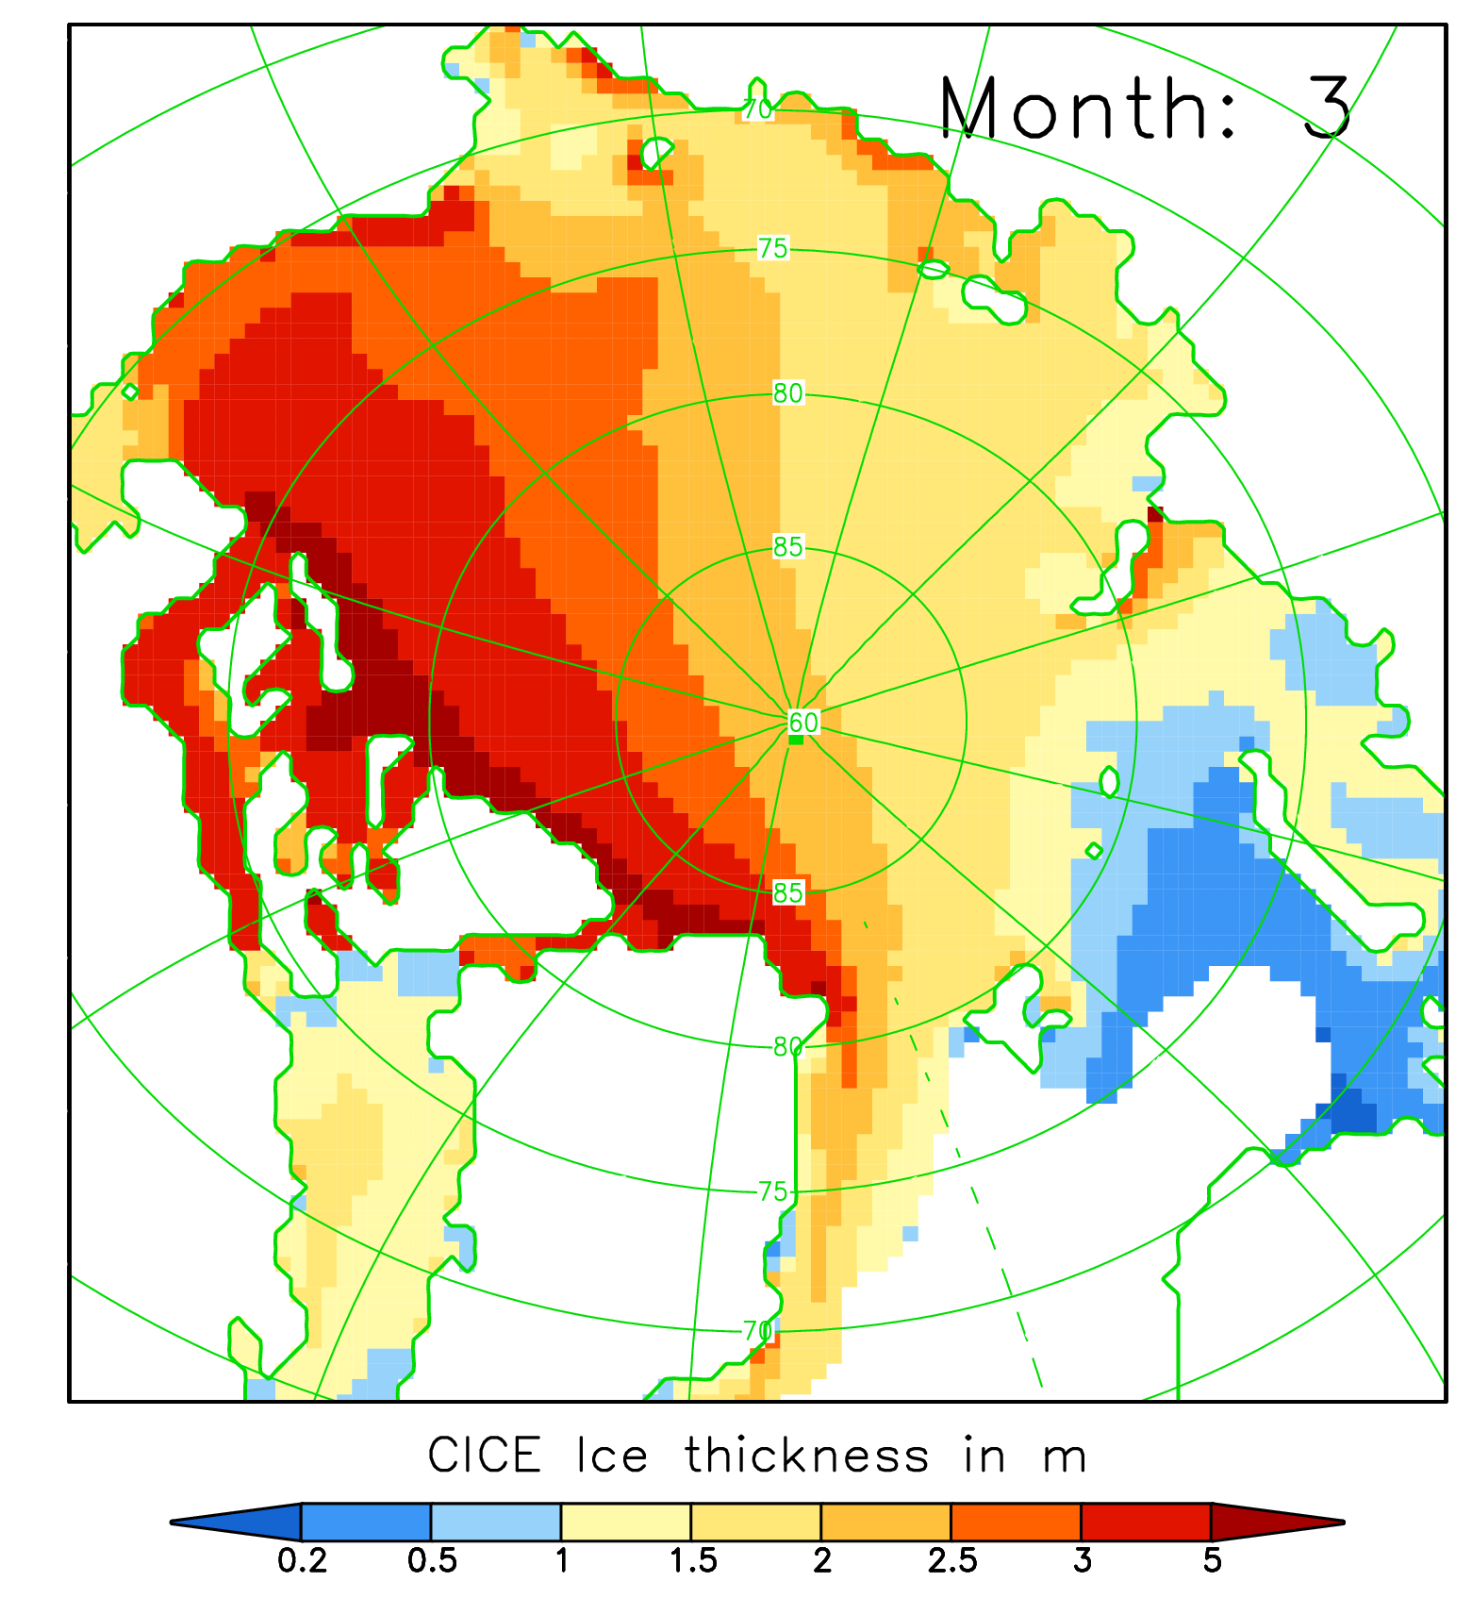
Sea ice model performance against observations
Coupled climate models, although not designed to reproduce actual sea ice concentration, can produce realistic ice concentrations and levels of natural variability of concentration.
Thickness and motion (and hence mass fluxes) are typically
wrong by a factor of 2 or more [e.g. Holland, 2007; Stroeve, 2012]
Climate models do predict a reduction of Arctic sea ice but underestimate the trend. Climate models typically predict an equal loss of sea ice in the Southern Ocean, which is not observed.
Highly-tuned, forced (uncoupled) sea ice models can produce quite accurate hindcasts of ice concentration, but do less well for ice motion and thickness.
Poor performance of sea ice models related to atmospheric and oceanic forcing but simulations also sensitive at leading order to poorly constrained model physics [e.g. Miller et al, 2006; Flocco et al, 2012; Tsamados et al 2013, …].
WINTER
WITH MELT PONDS
WITHOUT MELT PONDS

Slide 6
Implications of changes in ice cover on model physics
In recent years, the Arctic ice cover is becoming thinner, younger, less extensive.
Does this have implications for models of sea ice?

Slide 7
Implications of changes in ice cover on model physics
In recent years, the Arctic ice cover is becoming thinner, younger, less extensive.
Does this have implications for models of sea ice?
YES

Slide 8
Implications of changes in ice cover on model physics
In recent years, the Arctic ice cover is becoming thinner, younger, less extensive.
Does this have implications for models of sea ice?
YES
Physics is inviolate and unsullied by our Earthly realm
…but which physics we choose to include in models is a human, expedient endeavor influenced by our objectives, observations, understanding, financial or computational budget, complexity, fashion, etc.

Slide 9
Implications of changes in ice cover on model physics
In recent years, the Arctic ice cover is becoming thinner, younger, less extensive.
Does this have implications for models of sea ice?
YES
Physics is inviolate and unsullied by our Earthly realm
…but which physics we choose to include in models is a human, expedient endeavor influenced by our objectives, observations, understanding, financial or computational budget, complexity, fashion, etc.
(Not to mention model tuning.)

Slide 10
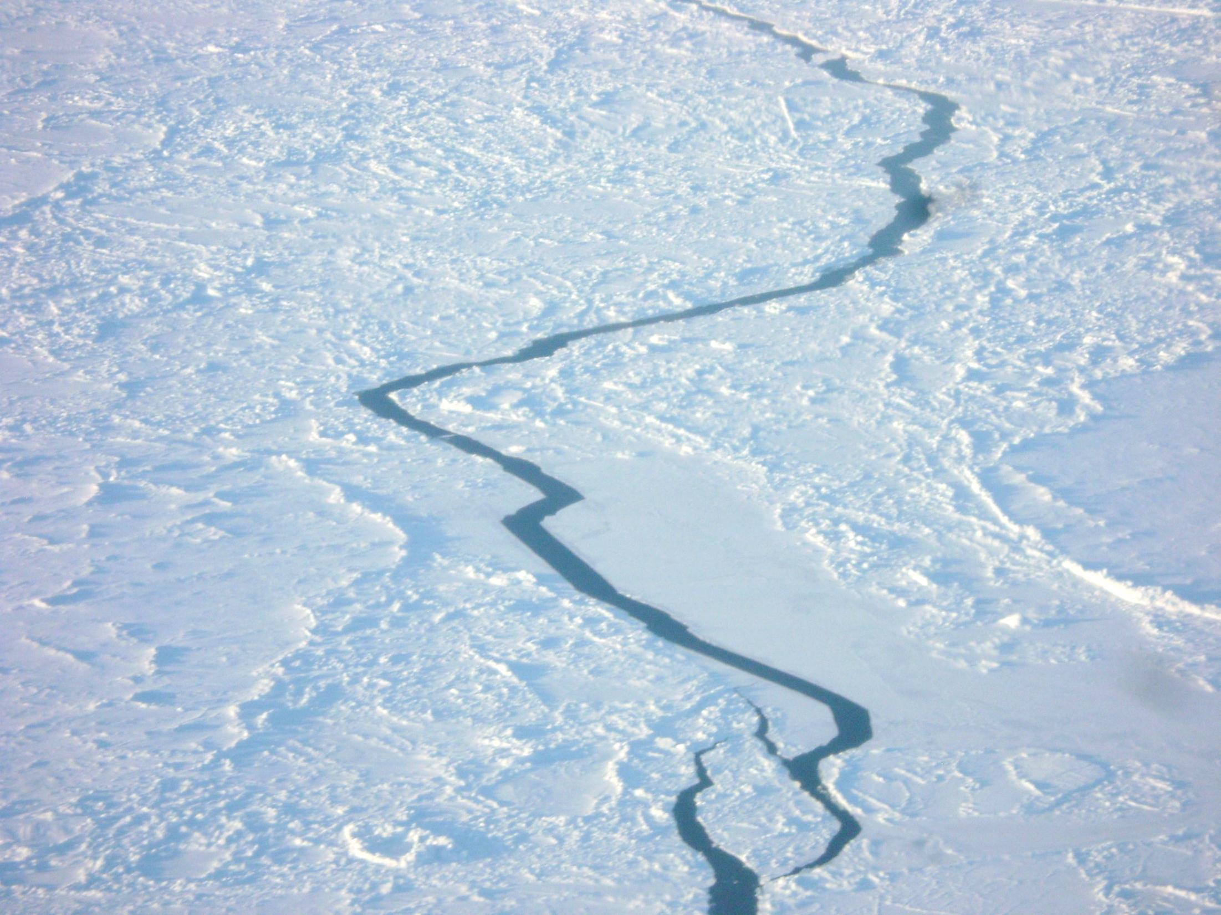
Changes in Arctic sea ice
Sea ice failure
Form drag
Melt ponds

Slide 11
Sea ice stress and failure
The ice cover resists imposed stresses until it fails.
Ridging results in increased ice stresses (plastic hardening), whereas shear rupture (cracking) and flexure failure do not.
As the ice cover thins, we may expect changes in the type of failure:
Dumont et al, 2011
FLEXURE FAILURE
SHEAR RUPTURE
Wilchinsky and Feltham, 2006,
Tsamados et al, 2013
PRESSURE RIDGING
Hopkins, 1996

Slide 12
Sea ice stress and failure
The ice cover resists imposed stresses until it fails.
Ridging results in increased ice stresses (plastic hardening), whereas shear rupture (cracking) and flexure failure do not.
As the ice cover thins, we may expect changes in the type of failure:
Dumont et al, 2011
FLEXURE FAILURE
THINNER ICE ➔ FLOE BREAK UP IN MIZ
SHEAR RUPTURE
Wilchinsky and Feltham, 2006,
Tsamados et al, 2013
PRESSURE RIDGING
Hopkins, 1996

Slide 13
Sea ice stress and failure
The ice cover resists imposed stresses until it fails.
Ridging results in increased ice stresses (plastic hardening), whereas shear rupture (cracking) and flexure failure do not.
As the ice cover thins, we may expect changes in the type of failure:
Dumont et al, 2011
FLEXURE FAILURE
THINNER ICE ➔ FLOE BREAK UP IN MIZ
SHEAR RUPTURE
Wilchinsky and Feltham, 2006,
Tsamados et al, 2013
THICKNESS INDEPENDENT ➔ ANISOTROPIC MECHANICS CONTINUES TO DOMINATE
NOW IN CICE 5.0
PRESSURE RIDGING
Hopkins, 1996

Slide 14
Sea ice stress and failure
The ice cover resists imposed stresses until it fails.
Ridging results in increased ice stresses (plastic hardening), whereas shear rupture (cracking) and flexure failure do not.
As the ice cover thins, we may expect changes in the type of failure:
Dumont et al, 2011
FLEXURE FAILURE
THINNER ICE ➔ FLOE BREAK UP IN MIZ
SHEAR RUPTURE
Wilchinsky and Feltham, 2006,
Tsamados et al, 2013
THICKNESS INDEPENDENT ➔ ANISOTROPIC MECHANICS CONTINUES TO DOMINATE
NOW IN CICE 5.0
PRESSURE RIDGING
Hopkins, 1996
THINNER ICE ➔ MORE DEFORMATION, BUT RIDGES NO BIGGER

Slide 15
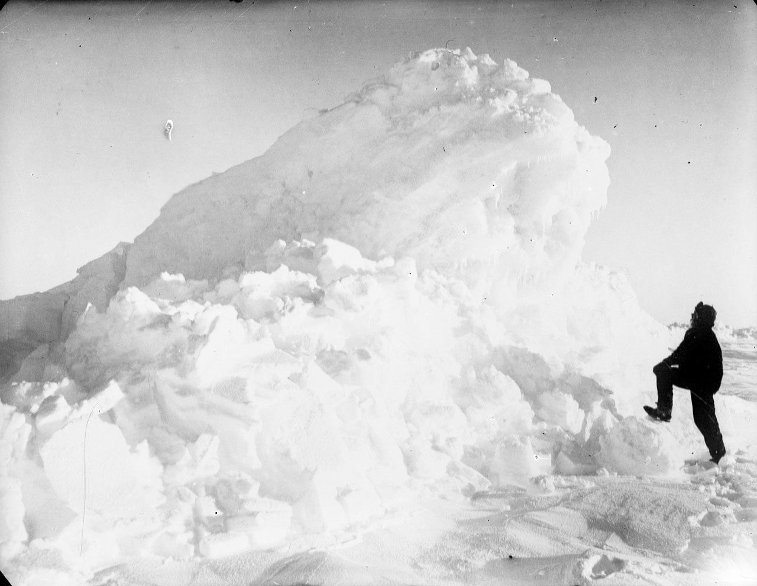
Changes in Arctic sea ice
Sea ice failure
Form drag
Melt ponds
Poster later today: Variable atmospheric and oceanic drag over sea ice
by Tsamados et al

Slide 16
Form drag
Air-ice and ice-ocean drag laws are given by bulk formulae of the form
(often with a turning angle)
Current models treat the neutral drag coefficients C_{D} at the air-ice and ice-ocean interfaces as constants.
The reality is that the topography of the ice cover creates spatially and temporally variable form drag.
What is more, the turbulent sensible H and latent E heat transfer coefficients are typically taken as proportional to the drag transfer coefficient.
100% skin drag,
0% form drag
0% skin drag,
100% form drag
(Atmospheric boundary layer stability is separately accounted for.)
Notes:
Stable conditions are common during winter
Neutral conditions mainly occur during periods with strong wind
Unstable conditions occur due to large temperature contrasts, e.g. over leads during winter

Slide 17
Different types of form drag

Slide 18
Different types of form drag

Slide 19
Different types of form drag

Slide 20
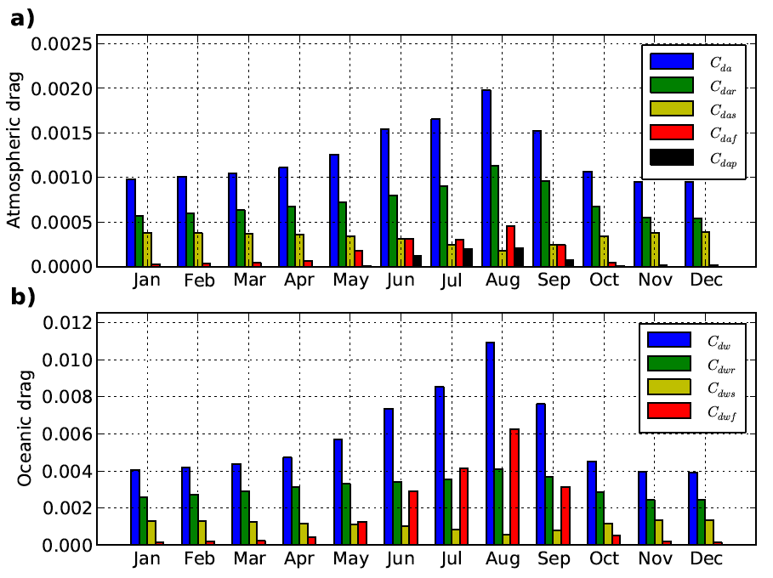
FORM DRAG NOW IN CICE 5.0: MODEL RESULT
Mean time dependence (1990-2012) of mean Arctic drag
[Tsamados et al, submitted]
Seasonal variation of total drag coefficient by a factor of 2.

Slide 21
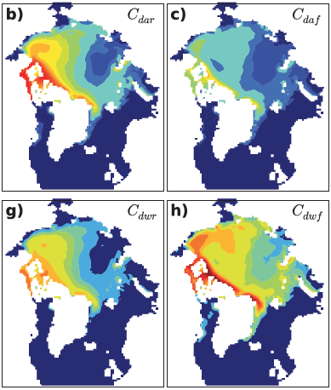
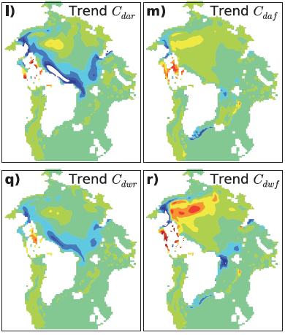
MODEL RESULT: Ridge/keel and floe edge drag August 1990-2012
As ice cover becomes more dilute (especially in summer), we can expect floe edges to
contribute more significantly to air-ice and ice-ocean drag.
The air-ocean momentum transport through the sea ice could increase.

Slide 22
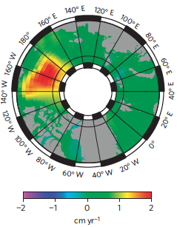
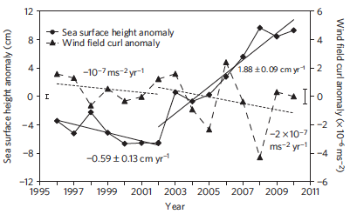
Spin up of Arctic Ocean
?
Giles et al 2012

Slide 23
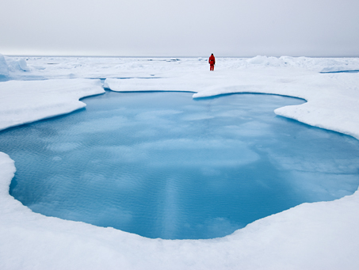
Changes in Arctic sea ice
Sea ice failure
Form drag
Melt ponds
Poster later today: An estimate of the impact of trapped melt ponds
ponds on sea ice thinning by Flocco et al

Slide 24
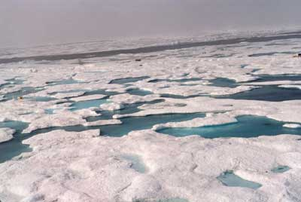
Melt ponds
SHEBA August 14, 1998
SHEBA CD, Perovich et al 1999
Surface snow and ice melts due to absorbed solar, short wave radiation and
accumulates in ponds. Ponds are typically 1-100m wide and 0.1-1.5m deep.
Pond coverage ranges from 5—50%.
albedo of pond-covered ice < albedo of bare sea ice or snow covered ice
(0.15—0.45) (0.52—0.87)
Deeper ponds have a lower albedo, which saturates at about 1.5m depth.
Ponded ice melt rate is 2—3 times greater than bare ice and melt ponds
contribute to the albedo feedback mechanism.

Slide 25
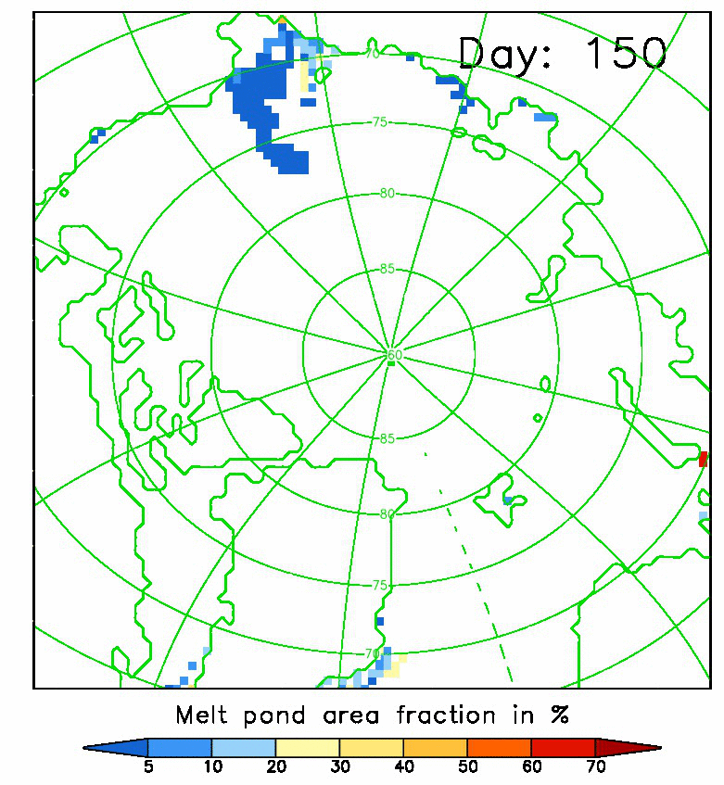
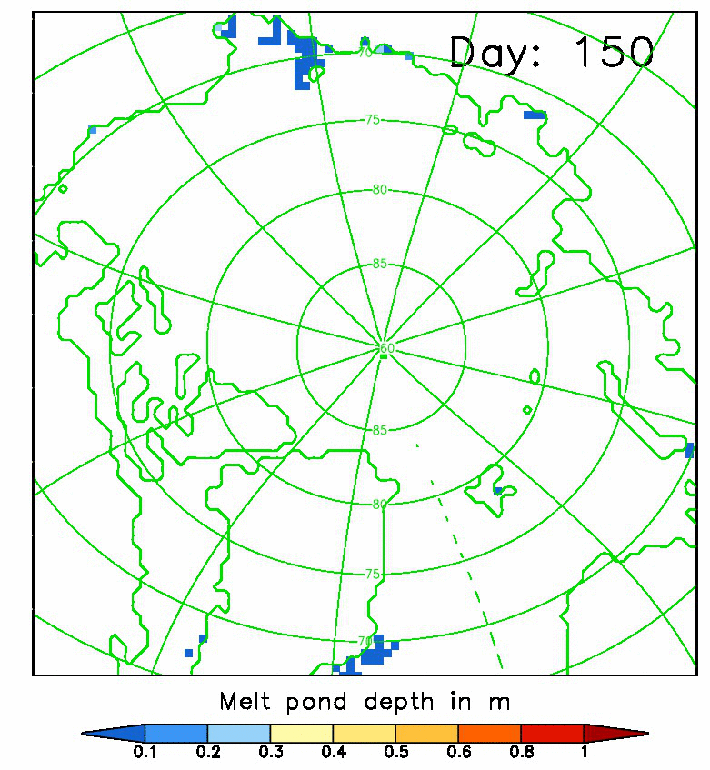
Melt pond area and depth (NOW IN CICE 5.0)
30th May (Day 150) – 18th August (Day 230) 2007

Slide 26
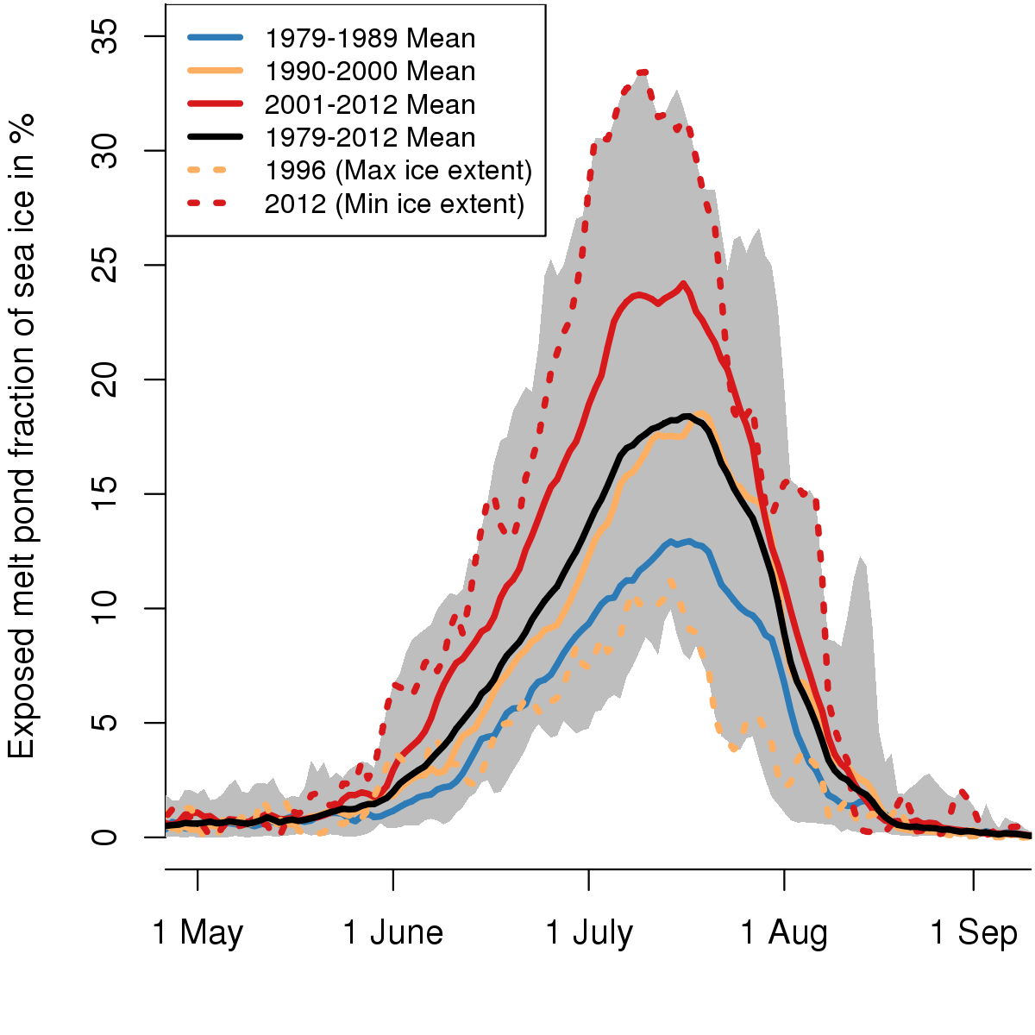
Exposed melt pond area fraction, 1990-2012
Low summer ice extent (2007,2011)
Large pond area
Large summer ice extent (1996)
Small pond area

Slide 27
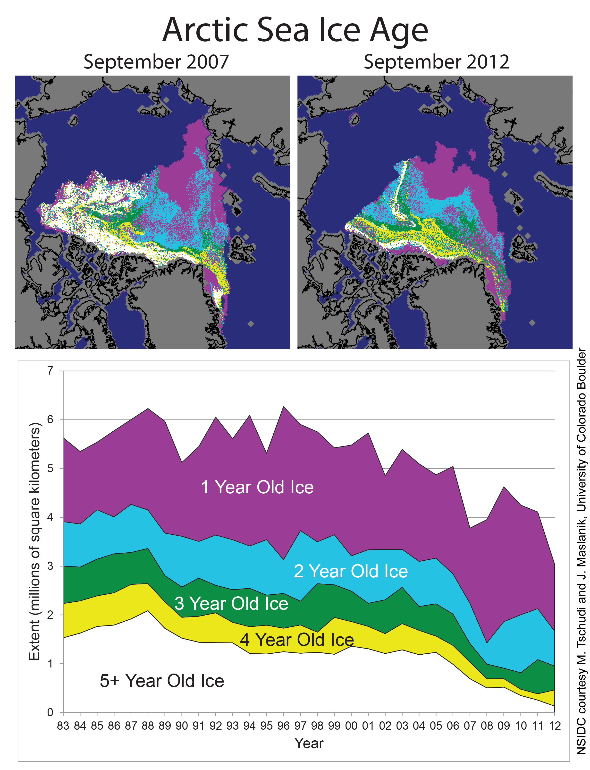
Melt ponds in a changing climate
Younger ice is flatter than older ice.
Fraction of younger ice is increasing.
Contribution of melt ponds to albedo feedback is stronger on flatter ice, because of greater pond area, and leads to greater total ablation.
Even with no change in radiative forcing, atmospheric or oceanic conditions, the change in sea ice topography alone will result in greater sea ice melt.
Accurate melt pond models must account for changing sea ice conditions.
Melt ponds will become increasingly important.

Slide 28
Summary
The sea ice cover of the Arctic Ocean is getting younger, thinner, and less extensive in summer
Models do not predict the observed rates of change or aspects of the observed state (e.g. thickness)
The model-observation discrepancy can be due to atmosphere and ocean forcing but is also dependent on model sea ice physics
While physics is inviolate, model representations of this physics is tied to current conditions and understanding
We can predict some changes to the sea ice cover, e.g. increased importance of melt ponds, floe edge drag, wave-ice break up
But we can’t predict the unknown unknowns

Slide 29
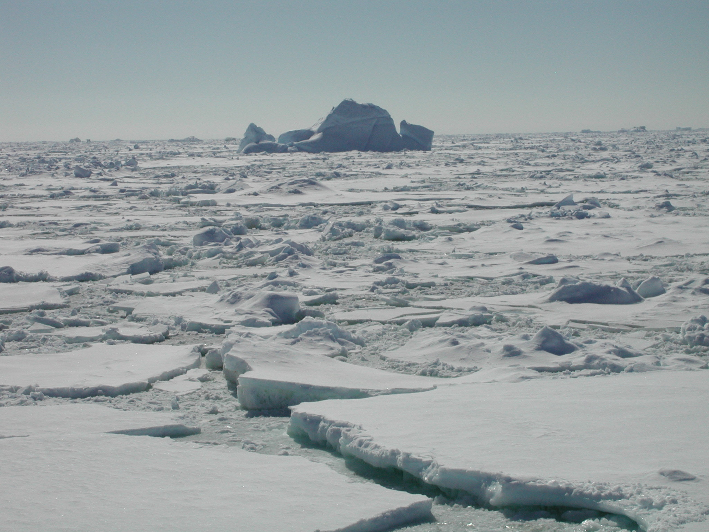
Antarctic Bottom Water (AABW) formation is the most prevalent water mass on Earth.
Questions?
The formation of AABW is intimately connected with the ice cover.

Slide 30
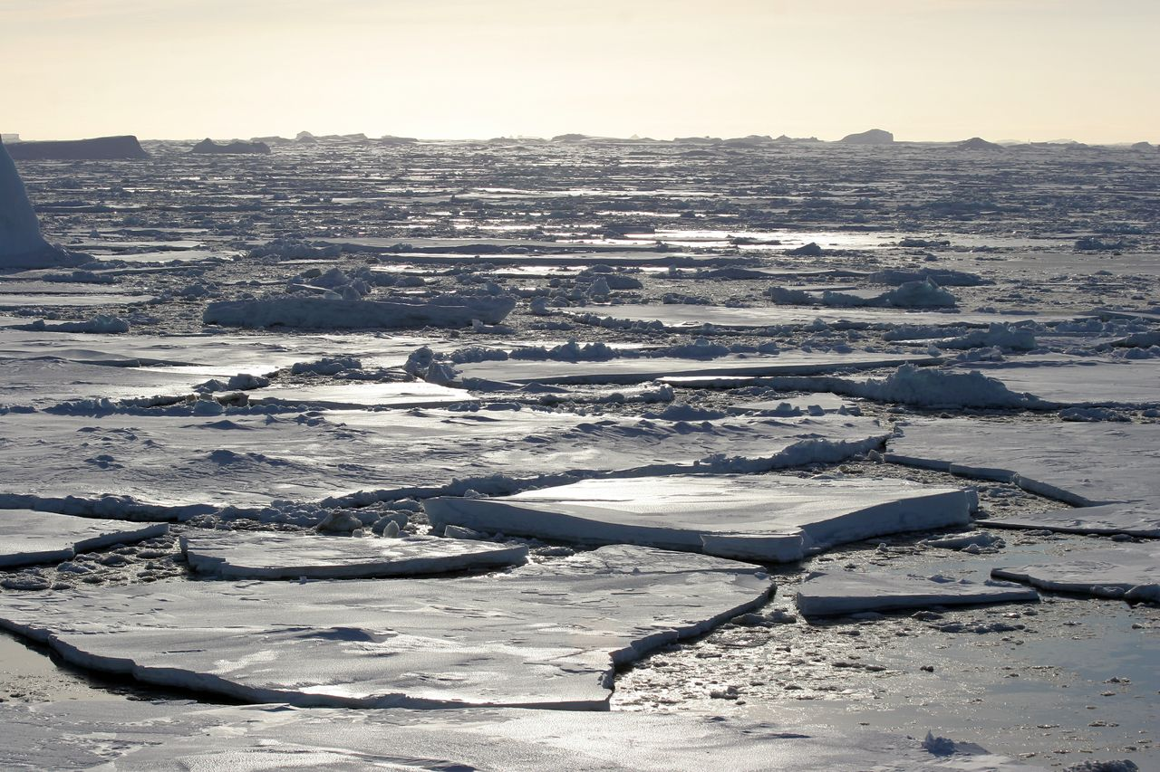
Arctic sea ice reduction: the evidence, models, and global impacts
Scientific discussion meeting organised by Professor Daniel Feltham,
Dr Sheldon Bacon, Dr Mark Brandon and Professor (Emeritus) Julian Hunt FRS
http://royalsociety.org/events/2014/arctic-sea-ice/
LONDON MEETING, CARLTON TERRACE
9:00 am on Monday 22 September 2014 – 5:00 pm on Tuesday 23 September 2014
CHICHELY HALL, BUCKINGHAMSHIRE
9:00 am on Wednesday 24 September 2014 – 5:00 pm on Thursday 25 September 2014

Slide 31
Incorporation of melt pond model into CICE
[Flocco, Feltham, and Turner, 2010; Schroeder, Flocco, Feltham, Hunke, 2012]
Melt pond routine incorporated into CICE v. 4.1 and uses the Delta-Eddington radiation scheme.
CICE is the sea ice component of
several IPCC climate models.
We run CICE in stand-alone mode.
Forcing data:
Atmosphere: T2m, q2m (6-hourly); u10m, v10m (6-hourly); QLW, QSW (daily); PRECIP, SNOW (monthly)
NCEP2, ERA-Interim, DRAKKAR DFS5;
Ocean:Mixed-layer ocean (20 m); SO1m, TO1m (clim. monthly means); SO prescribed, TO prognostic, 20d restoring Reading Ocean-Reanalysis
Model is spun up from 1980-1989, analysed from 1990-2012.

Slide 32
Processes that will become more significant in a changing Arctic sea ice cover
A thinner ice cover will support weaker ice stresses, making deformation more common
Waves may cause breakup into smaller floes in the seasonal and marginal ice zones
The momentum transfer from atmosphere to ocean may increase, either through weaker ice stresses or through increased form drag
The thinner, flatter, possibly more fragmented ice cover may melt differently, e.g. melt ponds, lateral melt
Look to the Southern Ocean for clues?

