Slide 1
12.708: Topics in Paleoceanography
Alan CONDRON & Olivier MARCHAL

Slide 2
ORBITAL THEORY OF CLIMATE CHANGE
with emphasis on:
sea level variability
roles of Antarctic Ice Sheet and Southern Ocean
Atlantic Meridional Overturning Circulation (AMOC)
…

Slide 3
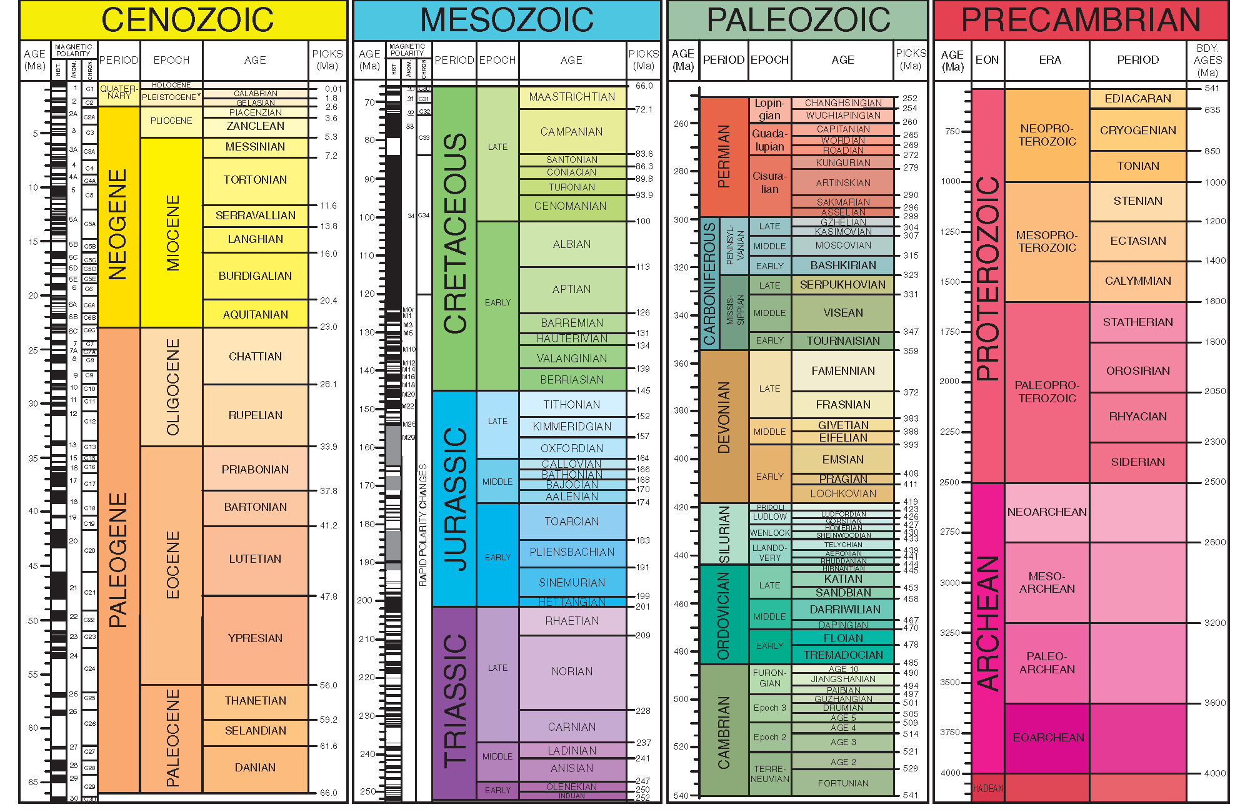
The Geologic Time Scale (GSA, 2012)
Notes:
We will cover only a tiny part of the Earth’s climate history …

Slide 4
TODAY: A few words about …
1) Climate System & Orbital Theory
2) Paleoclimate Indicators (“proxies”)
3) Paleoclimate Records

Slide 5
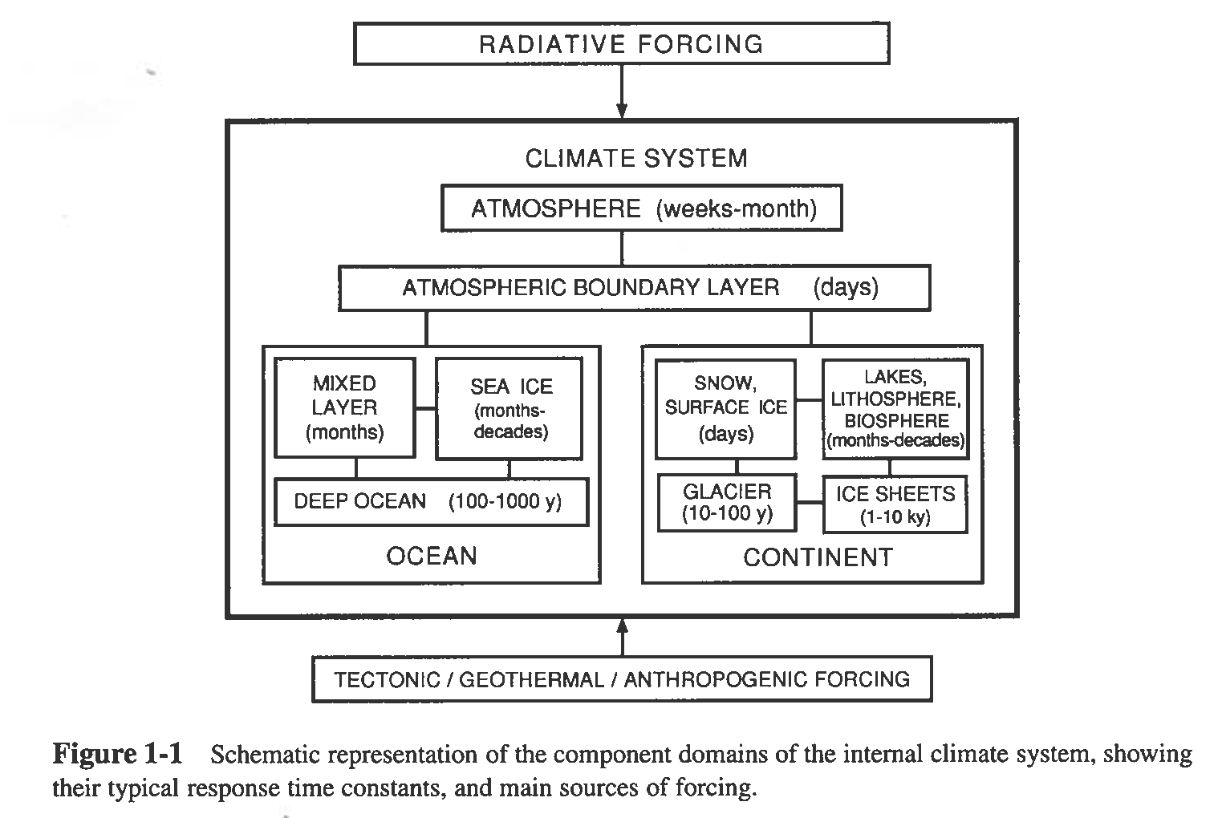
The Climate System
Saltzman (2002)
Notes:
The climate system is composed of 3 major components: (i) the atmosphere, (ii) the ocean with sea ice, and (iii) the continents with ice sheets, glaciers, etc.
These components and subcomponents of the climate system are characterized by response times that vary over a huge range. Thus, the atmosphere has estimated response times of days to months, the ocean from months to a millennium, sea ice from months to decades, ice sheets from 1,000 to 10,000 years, etc.
The climate system is forced by different agents:
1) Radiative forcing: this includes variations in “solar activity” and (ii) changes in the parameters that describe the orbit of the earth around the Sun (eccentricity, obliquity, and precession) [these 3 parameters will be looked at in detail].
2) Forcing emanating from continental drifts, geothermal fluxes from the ground or the seafloor, and the anthropogenic forcing. Re. continental drift, consider, for example, the positioning of continents near the poles that may favor the growth of land ice (glaciations), the gradual emission of CO2 to the atmosphere from volcanism, the orogenesis that may favor the occurrence of monsoons, etc.
A last point: please contrast the longest response time in this schematic, on the order of 10,000 yr for the ice sheets, with the length of the instrumental records, which is on the order of 100 yr at best. Thus, the span of even the longest instrumental records amounts to only 1% the response time of ice sheets. This clearly indicates that the instrumental records are inadequate to provide a comprehensive picture of climate variability.

Slide 6
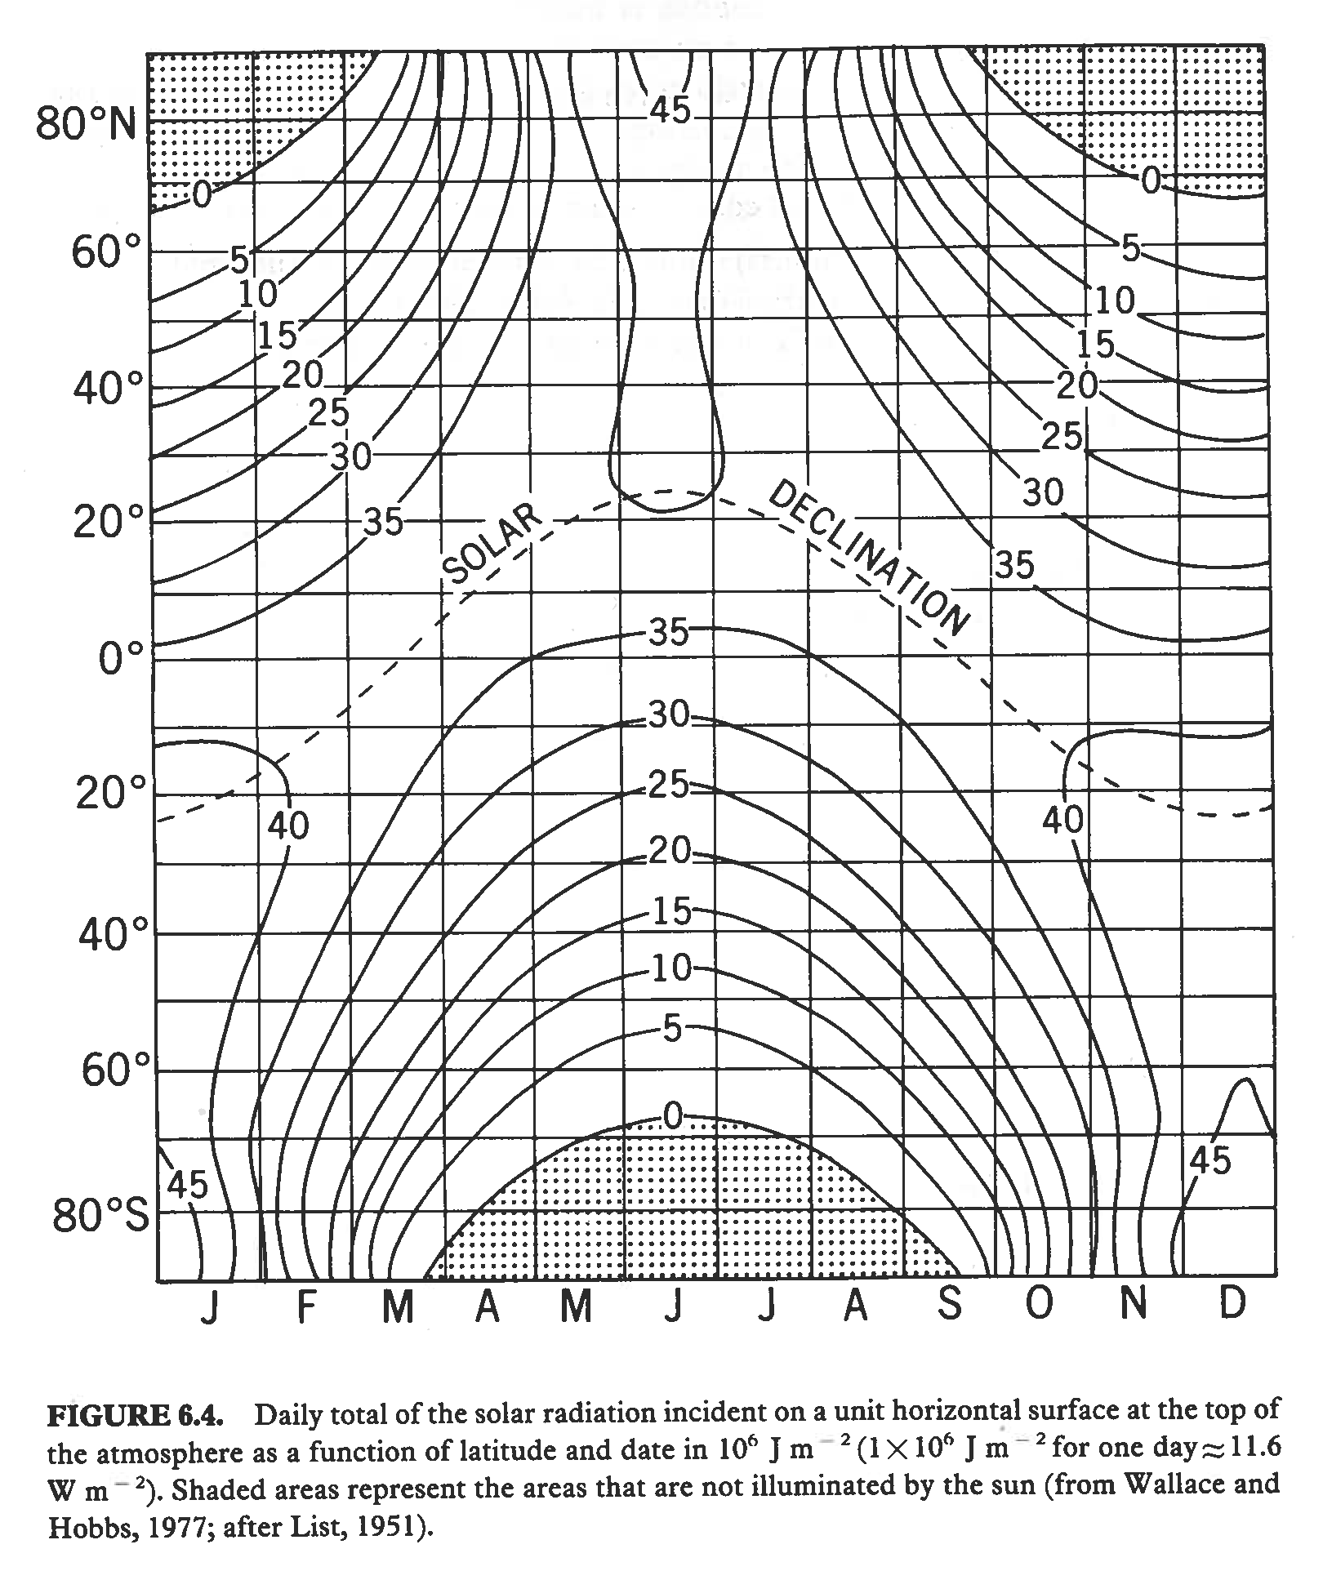
Notes:
This figure shows the solar radiation incident today on a unit horizontal area at the top of the atmosphere as a function of latitude and date of the year in units of 10^6 J/m2/day. Shaded regions represent regions not illuminated by the Sun (polar nights). The solar declination is an angle that defines the annual march of the Sun in the sky.
Maxima in northern hemisphere (NH) insolation occur near the NH summer solstice (June), when the Earth’s axis leans towards the Sun.
Minima in NH insolation occur near the NH winter solstice (December), when the Earth’s axis leans away from the Sun (note the polar night).
Maxima and minima in SH insolation are out of phase with those in the NH
The orbital theory of climate change posits that changes in the orbital parameters led to changes in the seasonal and latitudinal distributions in insolation and hence on climate.

Slide 7
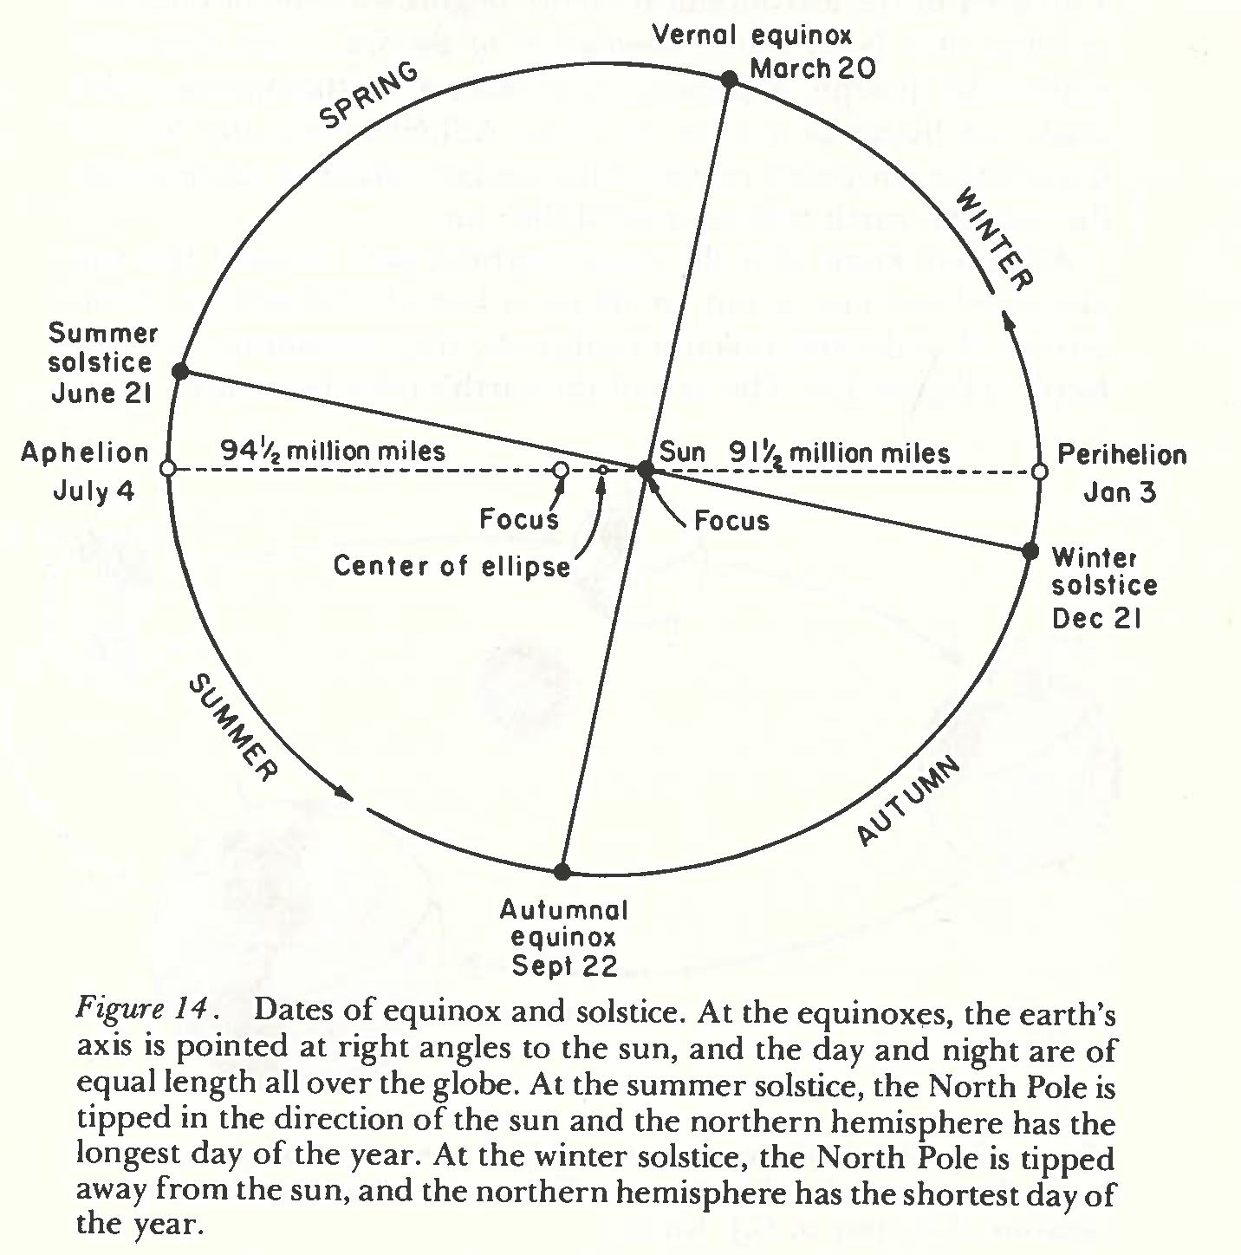
Imbrie & Imbrie (1979)
Notes:
This figure provides context for the rest of the class.
It shows the elliptical orbit of the Earth around the Sun (cf. 1st law of Kepler).
The Sun occupies one of the focal points; the other focus is empty.
The position of the Earth closest to the Sun is the perihelion (Jan 3) and the position farthest away from it is the aphelion (Jul 4).
Four other points are indicated along the orbits: these are the cardinal points (CP).
A first CP is the summer solstice: at this location, the earth rotation axis is tipped in the direction of the sun (longest day of the year in northern hemisphere, NH).
At the winter solstice, the earth rotation axis is tipped away from the sun (shortest day of the year in NH).
At the fall and vernal equinoxes, the two poles are equidistant from the sun (# of daylight hours = # of night hours).

Slide 8
Eccentricity (e)
y
b
a
x
Modern value of e is 0.0167 (insolation at perihelion = 1.064 that at aphelion)
e varied between 0.005 and 0.0607 over the past 1.5 Myr or so
e has quasi-periodicities near 100 kyrs & 413 kyrs
Annual global insolation varies as (1 – e²)^{-1/2}

Slide 9
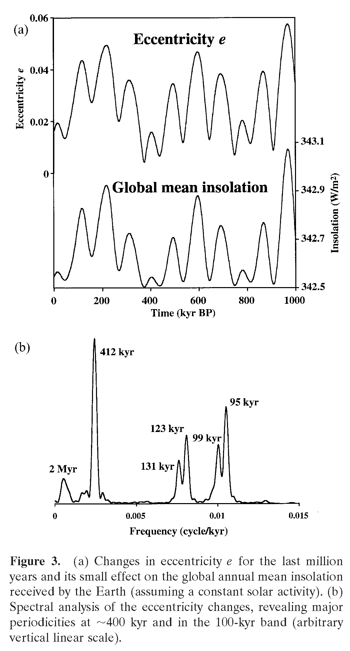
Paillard (2001)
Notes:
Eccentricity influences the global mean insolation, but by a very small amount.
Its spectrum features several peaks, near 412-413 kyr and 100 kyr

Slide 10
Obliquity or Tilt (ε)
N
ε
SUN
Ecliptic plane
ε
S
Configuration of Sun and Earth during NH summer (summer solstice)
Obliquity = angle between Earth rotation axis & normal to ecliptic plane
Modern value of obliquity is 23.5º
ε varied between about 22.2º and 24.5º over the past 1.5 Myr or so
ε has a quasi-periodicity of 41 kyrs
Notes:
The obliquity or tilt is the angle between the earth rotation axis and the perpendicular to the plane of the earth’s orbit around the sun (=orbital or ecliptic plane).
It is therefore the latitude of the two tropical circles (cancer and capricorn) and the colatitude of the two polar circles (in NH and SH).
The obliquity is obviously responsible for the occurrence of seasons on Earth.

Slide 11
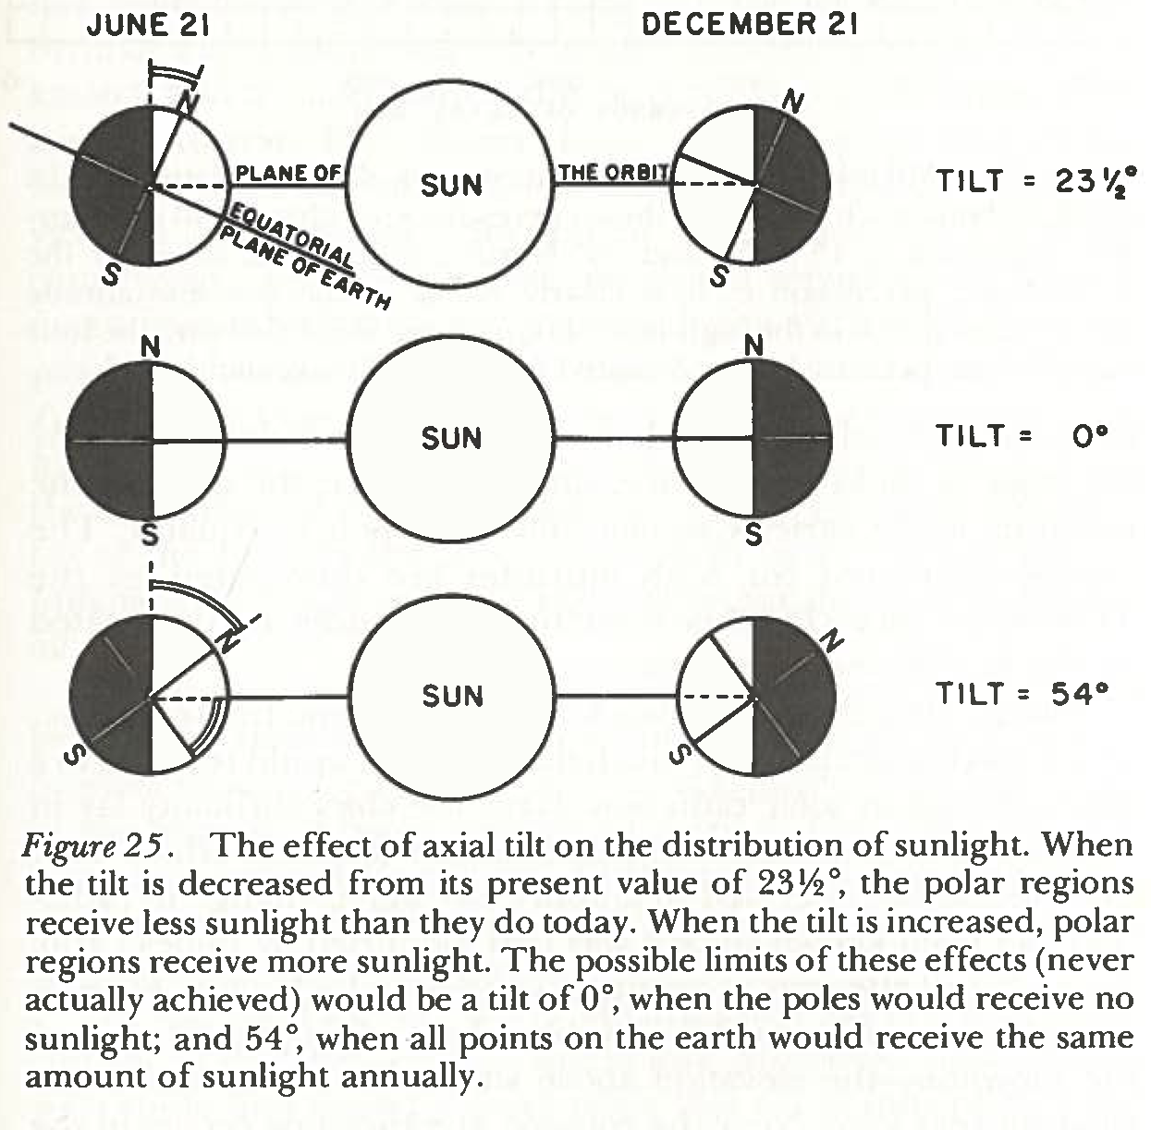
Effect of Obliquity on Latitudinal Distribution of Insolation
Imbrie & Imbrie (1979)
Notes:
The tilt is particularly important for the amount of solar radiation that is received at high northern and southern latitudes.
When the tilt is decreased compared to its modern value, polar regions receive less sunlight.
When the tilt is increased, they received more sunlight.
Two extreme values of the tilt (never actually achieved) are shown here.

Slide 12
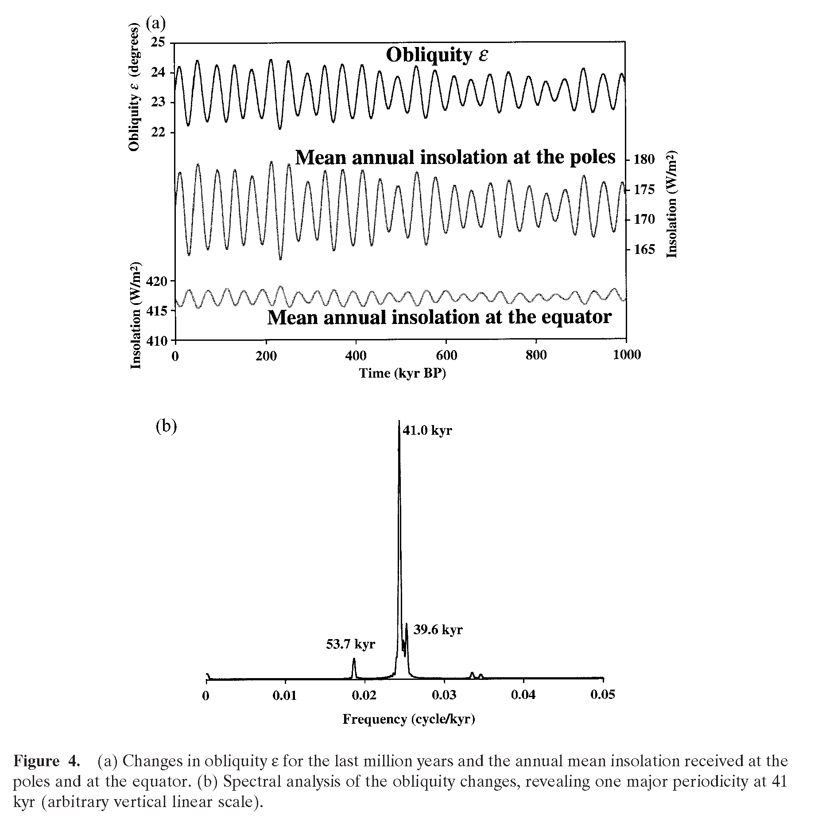
Paillard (2001)
Notes:
Obliquity influences the latitudinal distribution of annual mean insolation.
Its major peak in the spectrum is near 41 kyr.

Slide 13
Precession
Orientation of Earth rotation axis near the aphelion today
N
ε
SUN
Ecliptic plane
ε
S
Earth rotation axis tipped toward the Sun near aphelion: cold NH summer & SH winter
Notes:
The third parameter to consider is precession.
This figure shows the orientation of the earth rotation axis, tipped in the direction of the Sun, near the aphelion today (early July; summer in NH).
Thus, the NH summers & SH winters are relatively cold compared to what these seasons would be for a circular orbit.

Slide 14
Precession
Orientation of Earth rotation axis near the aphelion (26 kyr)/2 = 13 kyr ago
ε
N
SUN
Ecliptic plane
ε
S
Earth rotation axis tipped away from the Sun near aphelion: cold NH winter & SH summer
Notes:
The direction of the earth rotation axis with respect to “fixed stars” changes gradually with time (analogy with wobbling motion of spinning top).
For example, when the Earth was near the aphelion 13 kyr ago, its rotation axis was tipped away from the Sun.
Thus, the NH winters and SH summers were relatively cold compared to those for a circular orbit.
The precession is thus expected to have an important influence on the seasonal distribution of solar radiation at a given latitude.

Slide 15
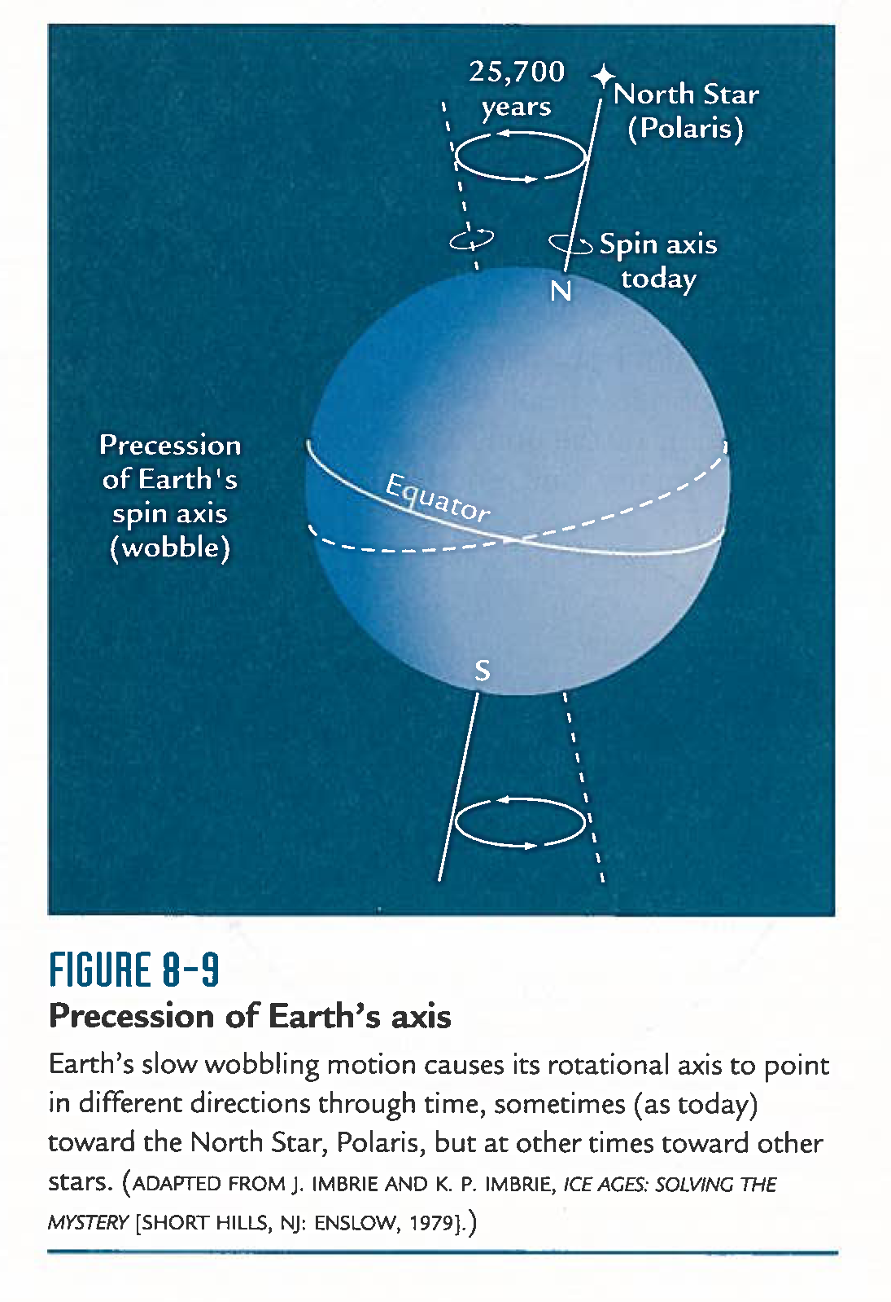
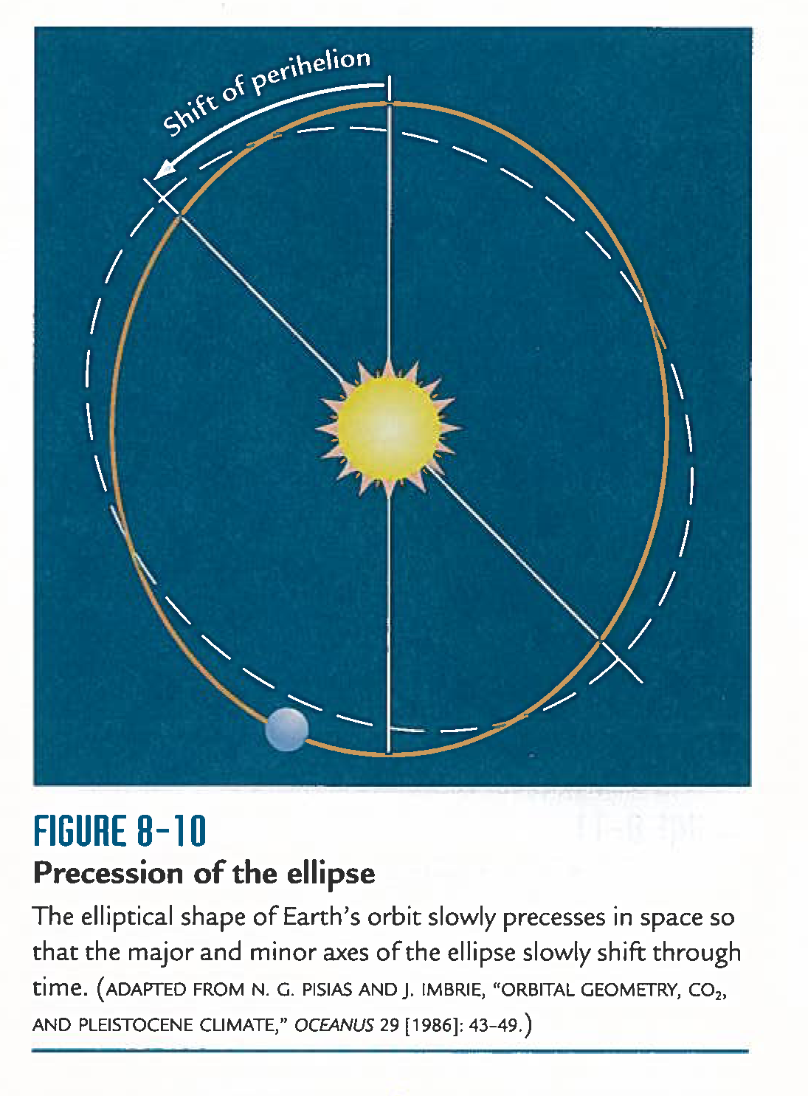
The Two Components of Precession
Ruddiman (2007)
Notes:
The precession phenomenon we discussed in previous slides is the “axial precession”.
It is a periodic motion with a period of 25.7 kyrs.
This motion is analogous to the wobbling motion of a spinning top.
Another type of precession involves the rotation of the entire elliptic orbit with respect to fixed stars. This motion is even slower than the wobbling motion of the earth rotation axis.

Slide 16
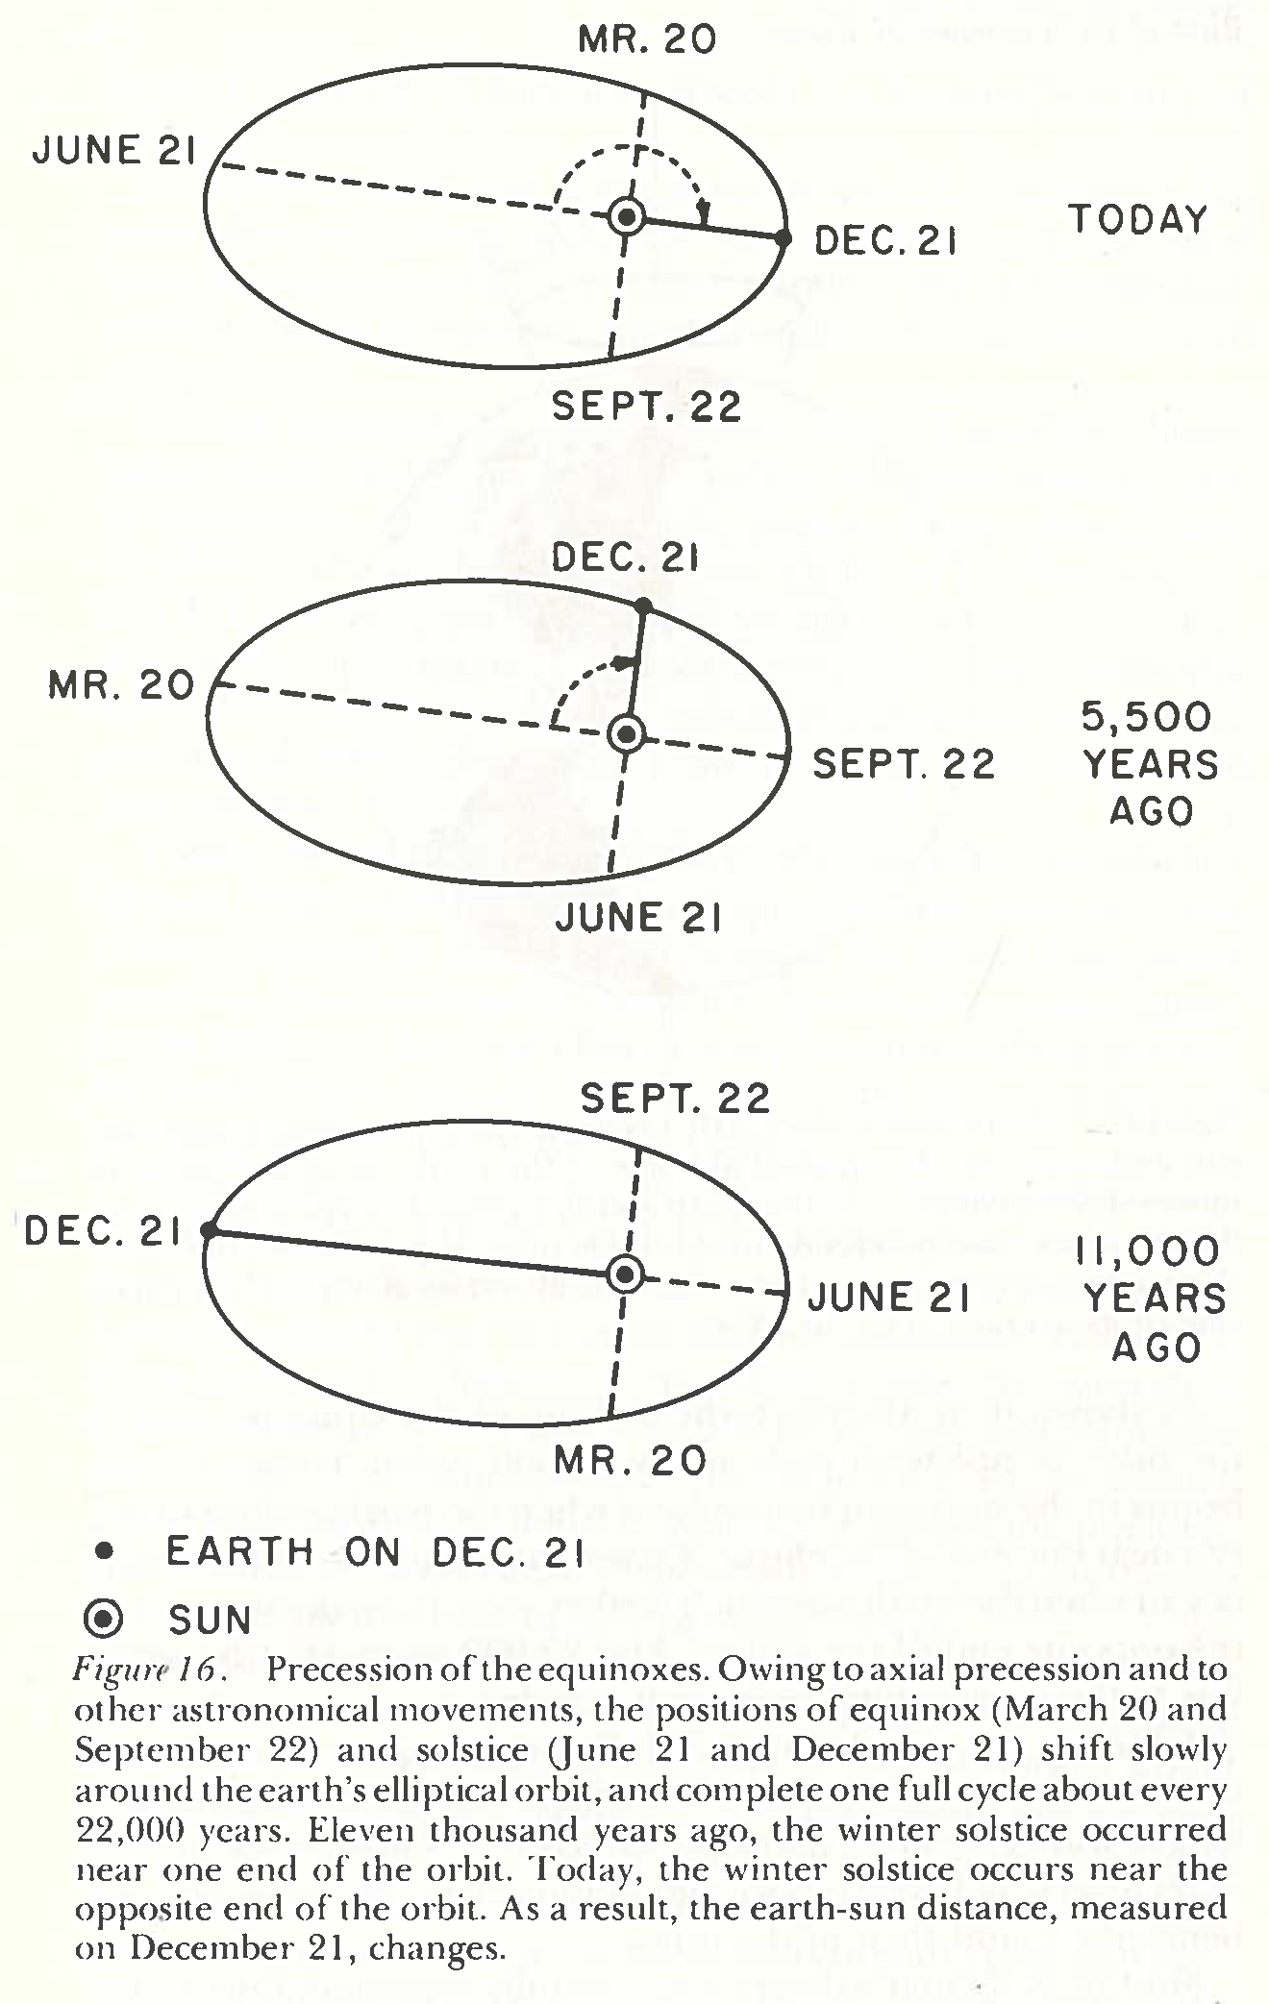
Precession of the Equinoxes
Imbrie & Imbrie (1979)
Notes:
The combined effects of these two precessional movements (wobbling of the axis and turning of the ellipse) cause the solstices and equinoxes to move around the Earth’s orbit.
This combined movement is the precession of equinoxes.
It consists of a strong cycle near 23 kyrs and a weaker one near 19 kyrs.
Today, NH summer (earth axis leaning toward the Sun) occurs near the aphelion->relatively cold NH summer & SH winter
About 11 kyrs ago, NH summer occurred near the perihelion->relatively warm NH summer & SH winter.

Slide 17
Joint Effect of Eccentricity & Precession
e = 0
Still seasons, but precession has no impact on seasonal distribution of solar radiation
e > 0
Precession has an impact seasonal distribution of solar radiation
-> Eccentricity modulates the effect of precession on insolation
Notes:
Note that the effect of precession on insolation depends on eccentricity.
If e=0, effect of precession is a mere displacement of cardinal points along the ecliptic. There are still seasons, but precession has no impact on seasonal distribution of solar radiation at a given latitude.
If e > 0, precession does have an impact on the seasonal distribution of solar radiation at a given latitude, because now NH summers, say, do not occur at the same distance from the sun: NH summer insolation will be higher when NH summer solstice coincides with perihelion and lower when NH summer coincides with aphelion.

Slide 18
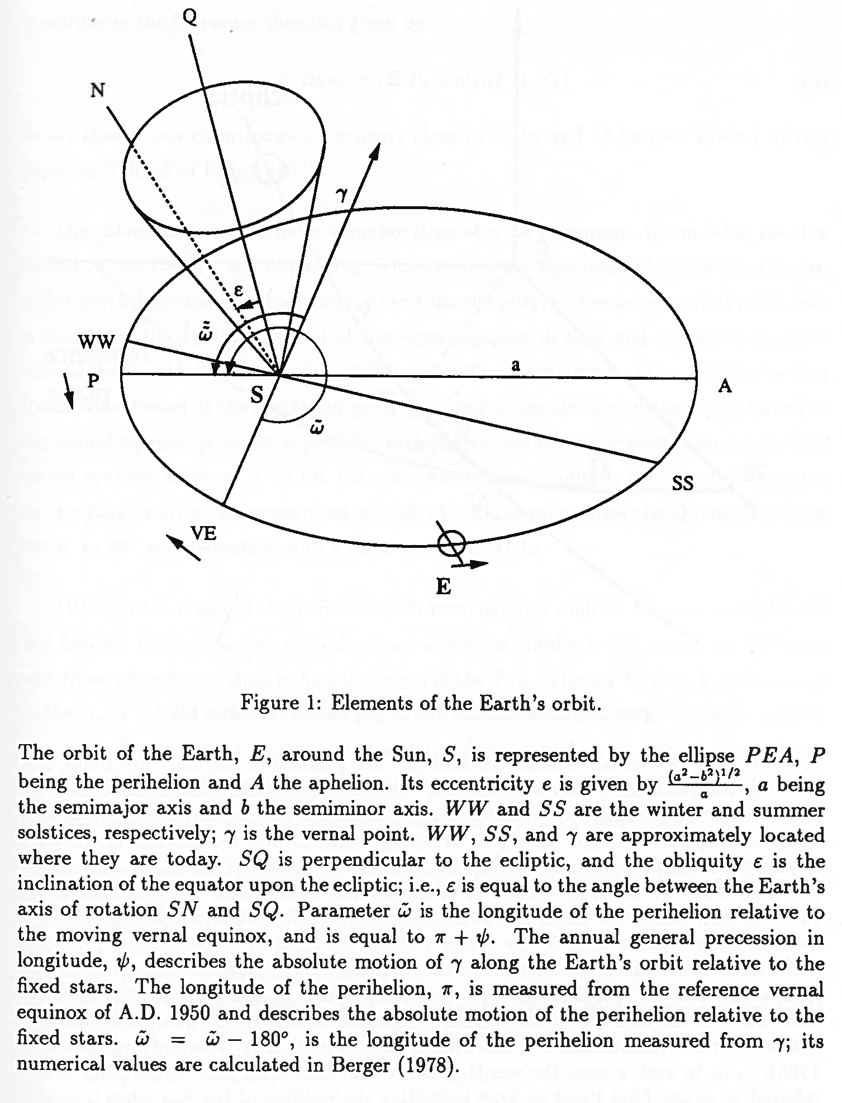
Precession index = e sin ϖ
Berger & Loutre (1994)
Notes:
To describe quantitatively the joint effect of eccentricity and precession on insolation, we define an index called precession index, precessional parameter, or climatic precession.
This figure summarizes several elements of the earth orbital geometry we already touched on.
Precession is conventionally measured by the angle between two points on the orbit of the Earth around the Sun: the vernal equinox and the perihelion.
We call this angle omega-bar, the longitude of the perihelion.
The joint effect of eccentricity and precession is described by the product of e and the sine of omega-bar: this is the precession index.
Thus, the eccentricity (with periods of ca. 100 and 413 kyrs) modulates the effect of precession (with periods of ca. 19 and 23 kyrs).

Slide 19
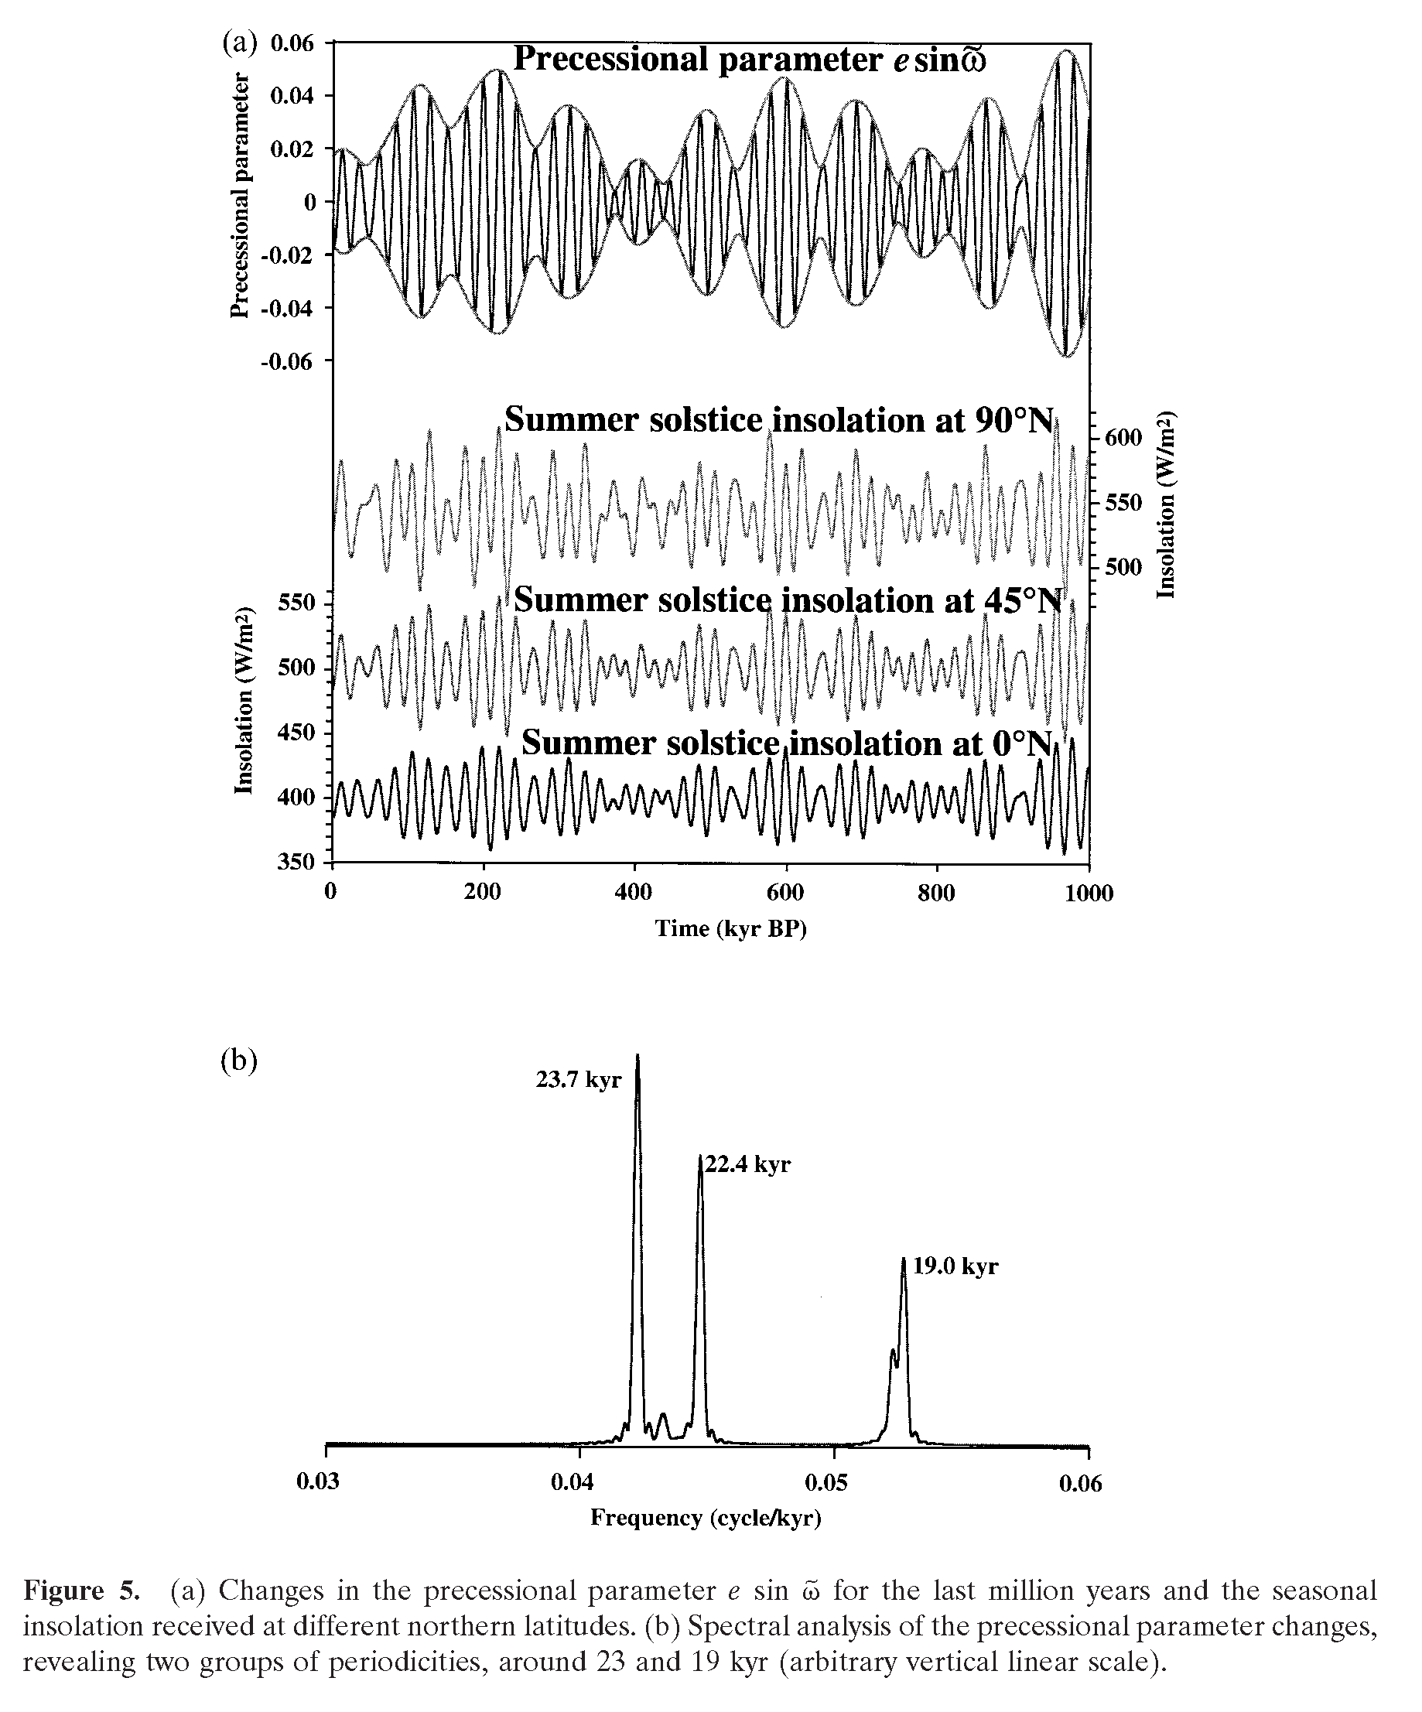
Paillard (2001)
Notes:
Precession influences the seasonal distribution of insolation at different latitudes.
Its major spectral peaks are near 23 and 19 kyr.

Slide 20
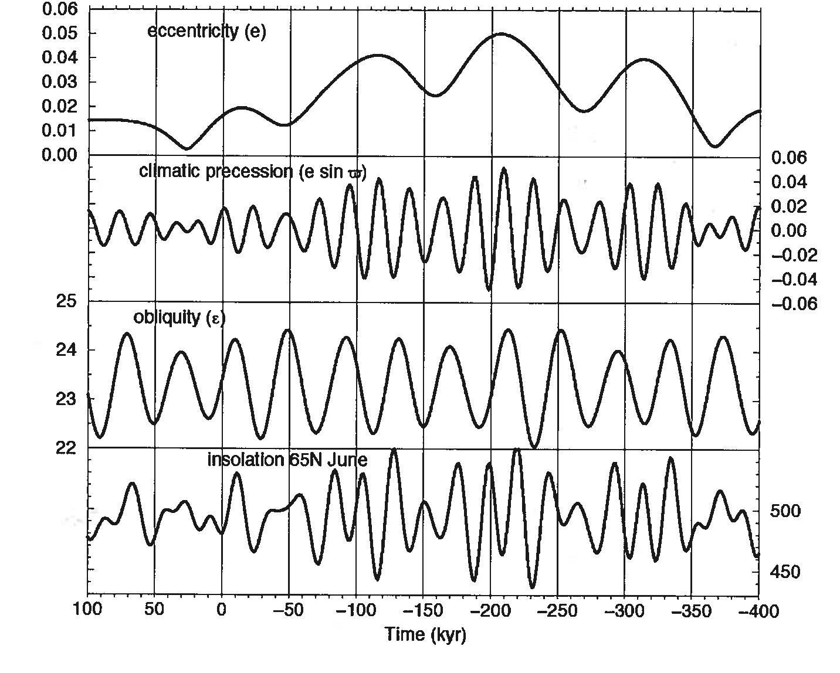
W m⁻²
Berger & Loutre (2004)
Notes:
The lower panel shows the calculated variations of insolation (=solar irradiance at top of the atmosphere) at 65N during the summer solstice (21st of June).
The summer insolation at 65N is chosen as it is often assumed that it is the insolation received at high northern latitudes during summer that determines glacial inception: if insolation is relatively low, snow that has fallen during the previous winter would not melt and could be present for the next winter, thereby leading to net accumulation.
The insolation changes are caused by changes in eccentricity, the precession parameter, and the obliquity.

Slide 21
PALEOCLIMATE INDICATORS
An Important Example: Oxygen Isotopes ¹⁶O and ¹⁸O

Slide 22
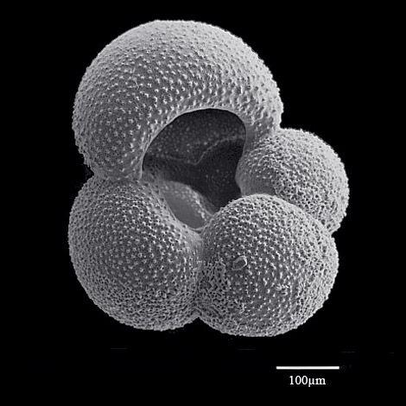
Planktonic Foraminifera Globigerina bulloides
SEM image: Lucia de Abreu
Notes:
Several substrates can be used for paleoceanographic reconstructions.
In sediments, an extremely useful substrate is provided by fossil shells of planktonic foraminifera (PF) and benthic foraminifera (BF).
These shells are composed of calcium carbonate secreted by the organisms during their lifetime (in near-surface waters for PF and in bottom waters or pore waters for BF).
During calcification, a range of chemical elements and isotopes are incorporated into the shells.
Measurements of these elements and isotopes provide information about chemical and isotopic properties of ocean surface and bottom waters in the geologic past.
PLANKTONIC FORAMINIFERA: This figure is an image of a shell of GB picked from a sediment core. Shells of G. bulloides are composed of different chambers.

Slide 23
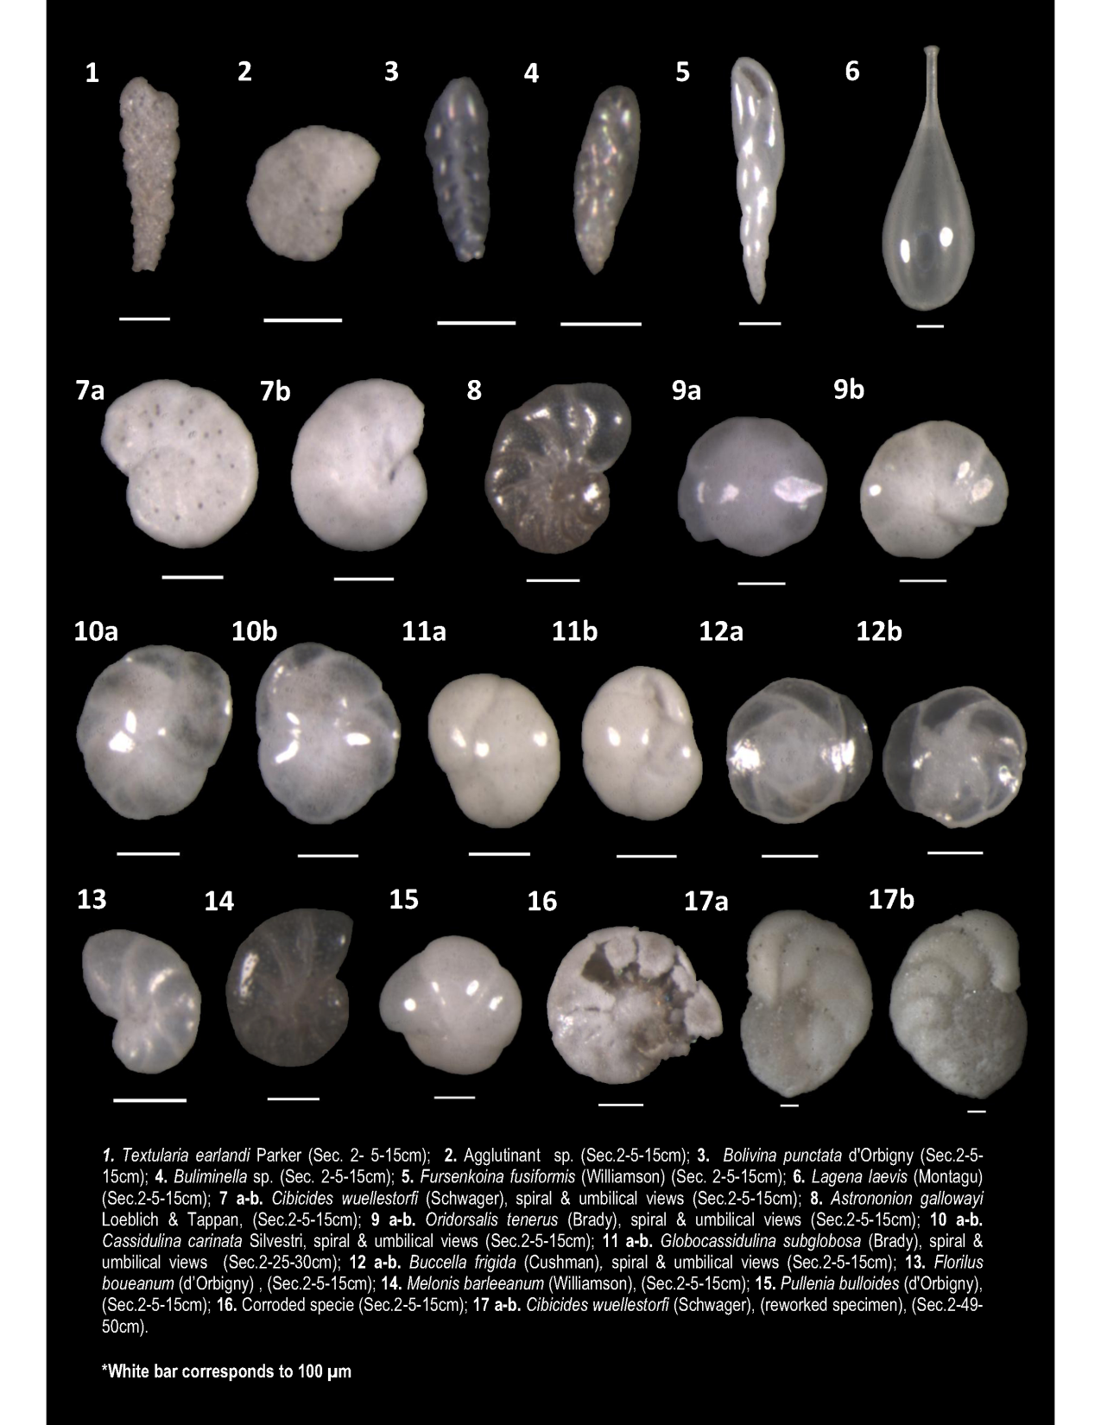
Benthic Foraminifera in Deep-Sea Sediments
white bar = 0.1mm
http://cost-pergamon.eu/Administrative-doc/STSM-6276.pdfReport
Report STSM; C. S. Cervera (http://cost-pergamon.eu/Administrative-doc/STSM-6276.pdf)
Notes:
BENTHIC FORAMINIFERA: This photograph illustrates fossil shells of benthic foraminifera. The white bar on the left gives you the scale.

Slide 24
Oxygen Isotopic Composition, δ¹⁸O
Definition
Notes:
A tracer of preeminent importance in paleoceanography is the oxygen isotopic ratio, commonly expressed as d18O.
The d18O of a sample (SPL) is defined relative to a standard (STD).

Slide 25
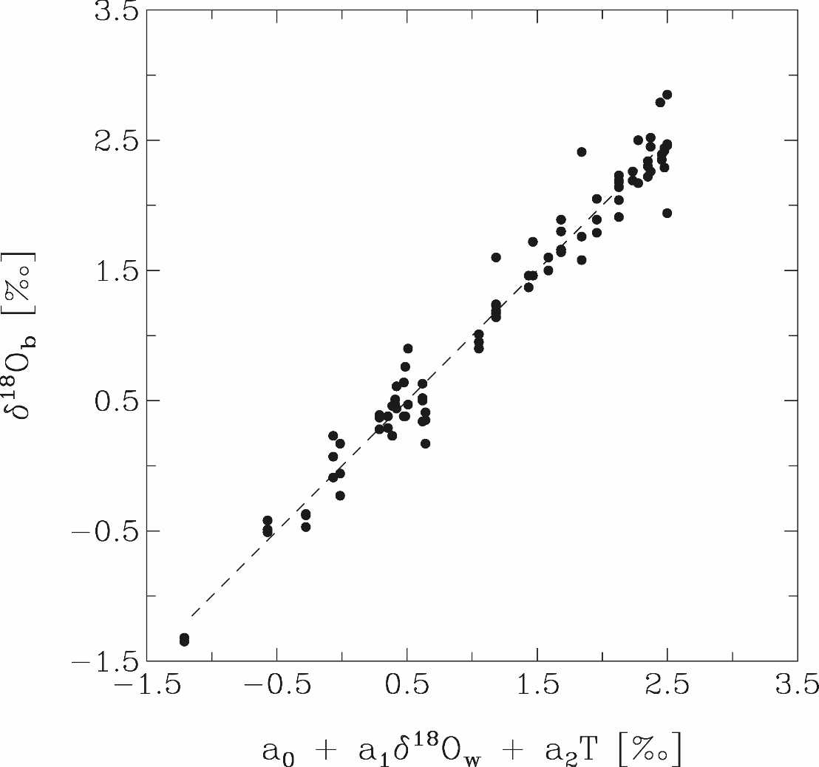
δ¹⁸O_{c} versus seawater δ¹⁸O & temperature
Cibicidoides spp.
Planulina spp.
a₁ = 0.97, a₂ = -0.21 º/oo (ºC)⁻¹
R = 0.98
N = 91
data: Lynch-Stieglitz et al. (1999)
Notes:
This figure is a plot of d18O of benthic foraminifera from sediment core tops versus a linear combination of d18O and T of ambient seawater. The d18O measurements were conducted on shells of two different genera: Cibicidoides and Planulina. The shells were sampled from the top of sediment cores raised from water depths from 53 to 1535 m at the Little Bahama Bank (Western North Atlantic). The dashed line is the least-squares fit obtained by multiple linear regression. The value of the correlation coefficient ( R ) indicates that about 0.98^2=96% of the variance in the benthic d18O can be explained by variations in the d18O and T of ambient seawater. The regression coefficient a1 expresses the dependency of d18O of calcite on seawater d18O and is very close to 1. The regression coefficient a2 expresses the dependency of d18O of calcite on seawater temperature and is -0.21 permil per degree C.

Slide 26
Relationship between Ocean δ¹⁸O & Continental Ice Volume
H₂O made with ¹⁸O has 1% lower saturating vapor pressure than H₂O made with ¹⁶O.
During evaporation, H₂¹⁸O is left behind in water relatively to H₂¹⁶O.
The greater the removal of water from the ocean by evaporation, the greater the amount of ice on continents and the greater the amount of H₂¹⁸O in the ocean relatively to H₂¹⁶O.
Ocean δ¹⁸O should be positively correlated with ice volume on land.
Notes:
So far, we saw that d18O of biogenic carbonate (foraminiferal tests) can be influenced by T and d18O of seawater.
But what can influence d18O of seawater?

Slide 27
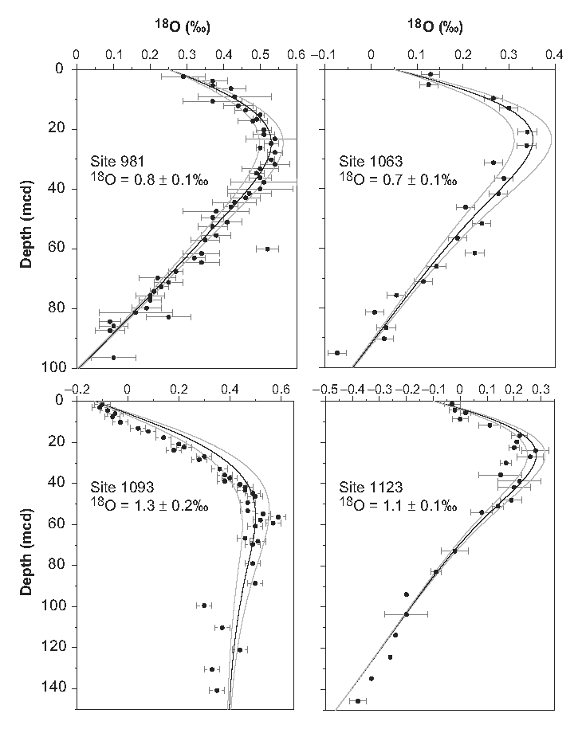
Pore Water δ¹⁸O in Sediment Cores
Adkins et al. (2002)
Notes:
d18O (and other properties) can be measured in sediment pore waters of glacial age.
Analysis of sediment pore water d18O data suggests that the last glacial-interglacial change in bottom water d18O amounted to about 1 permil.

Slide 28
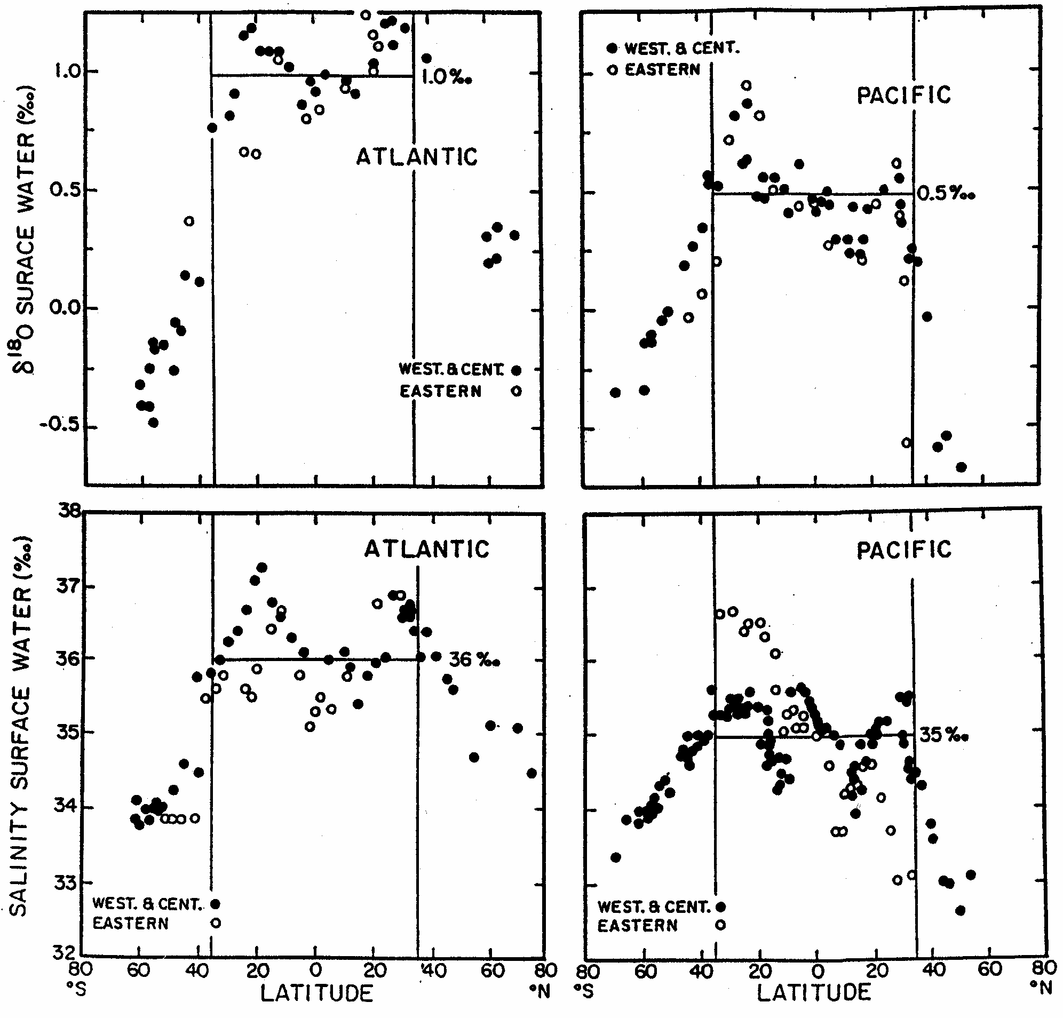
Distribution of δ¹⁸O & Salinity in Surface Waters
Broecker (2002)
Notes:
Seawater d18O is not uniform in the ocean, so foraminiferal d18O from one core site does not necessarily record ocean mean d18O.
Maxima in surface water d18O are found in regions of enhanced evaporation in subtropical areas and minima are found at high latitudes with more intense precipitation and ice melting (precipitation and land ice have relatively small d18O compared to seawater). Note also the relative minimum at the equator which is likely due to the enhanced rainfall (ITCZ) and the effect of wind-driven upwelling (Ekman divergence) near the equator. The same latitudinal pattern can be seen for salinity.
Thus, to sum up, when interpreting foraminiferal d18O records in terms of varying ice volume on land, one has to consider (i) the effect of temperature, (ii) the spatial heterogeneities in seawater d18O, and (iii) the fact that the mixing time of the ocean is finite
Data from Harmon Craig (GEOSECS), figure from Wally Broecker (2002).

Slide 29
δ¹⁸O: SUMMARY
δ¹⁸O of calcite varies with δ¹⁸O & temperature of ambient water:
º/oo (ºC)⁻¹
Δδ¹⁸O of BF & PF can be due to: - Δδ¹⁸O of seawater due to ΔCIV
- Δδ¹⁸O of seawater due to other Δ’s
- ΔT
In a glacial climate, seawater δ¹⁸O & T conspire to produce high
δ¹⁸O of foraminiferal tests
Notes:
In a glacial climate, characterized by coldness and large continental ice sheets (CIS), T and d18O of seawater conspire to create high d18O of biogenic carbonates. The d18O of foraminiferal tests is, in this sense, a very useful indicator of glaciations and deglaciations. On the hand other, the relative contributions of seawater T and seawater d18O on changes in foraminiferal d18O is generally poorly understood.

Slide 30
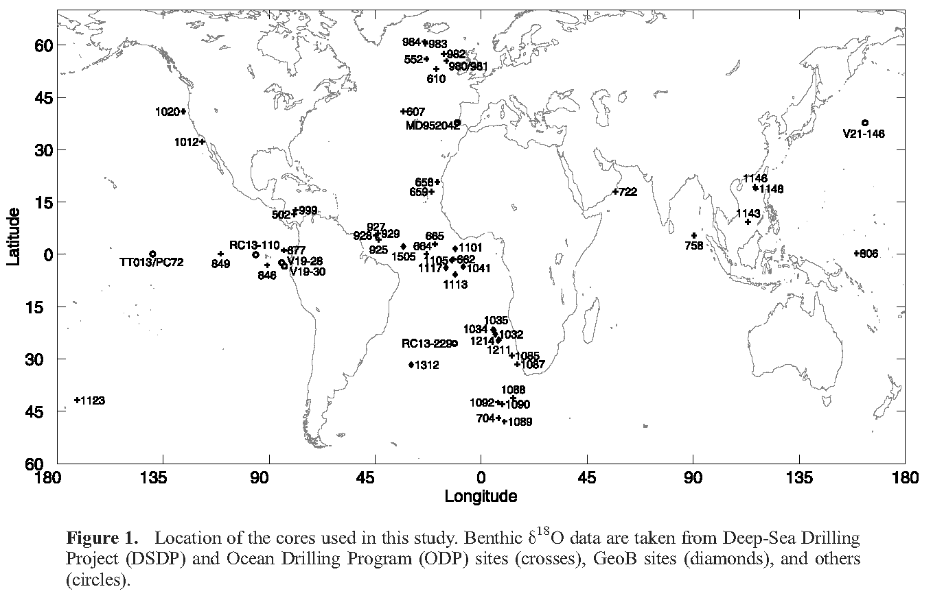
The Pliocene-Pleistocene δ¹⁸O Record
Lisiecki & Raymo (2005)
Notes:
Compilation of 57 benthic d18O records by Lisiecki and Raymo (2005).

Slide 31
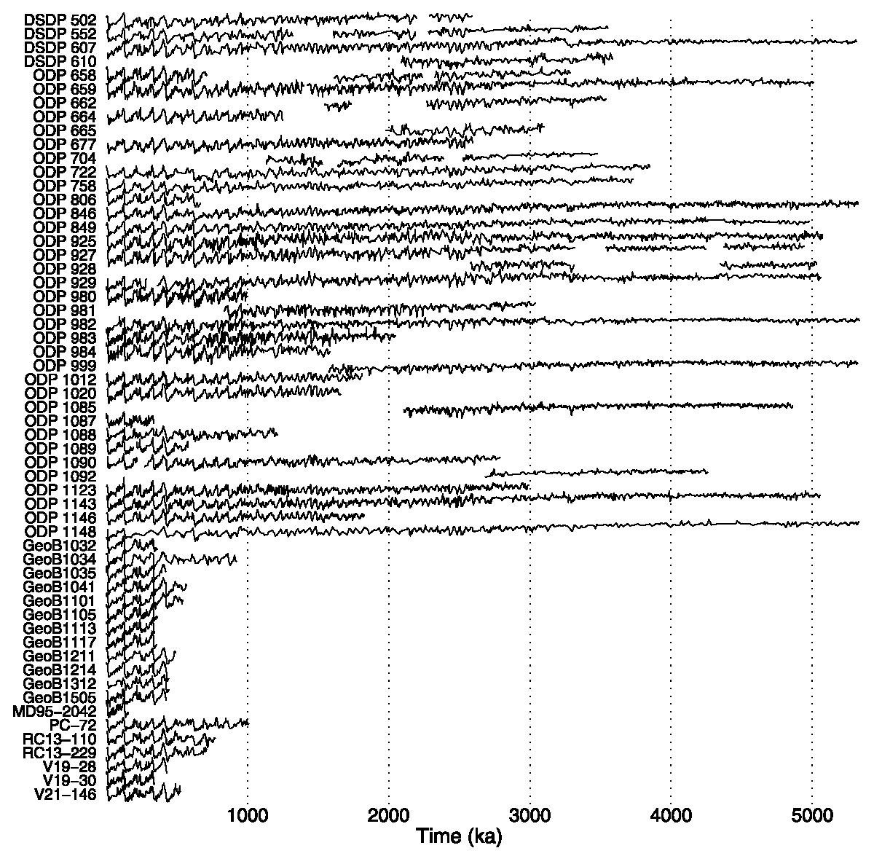
The Pliocene-Pleistocene δ¹⁸O Record (LR04)
Lisiecki & Raymo (2005)
Notes:
The 57 benthic d18O records compiled by Lisiecki & Raymo (2005)

Slide 32
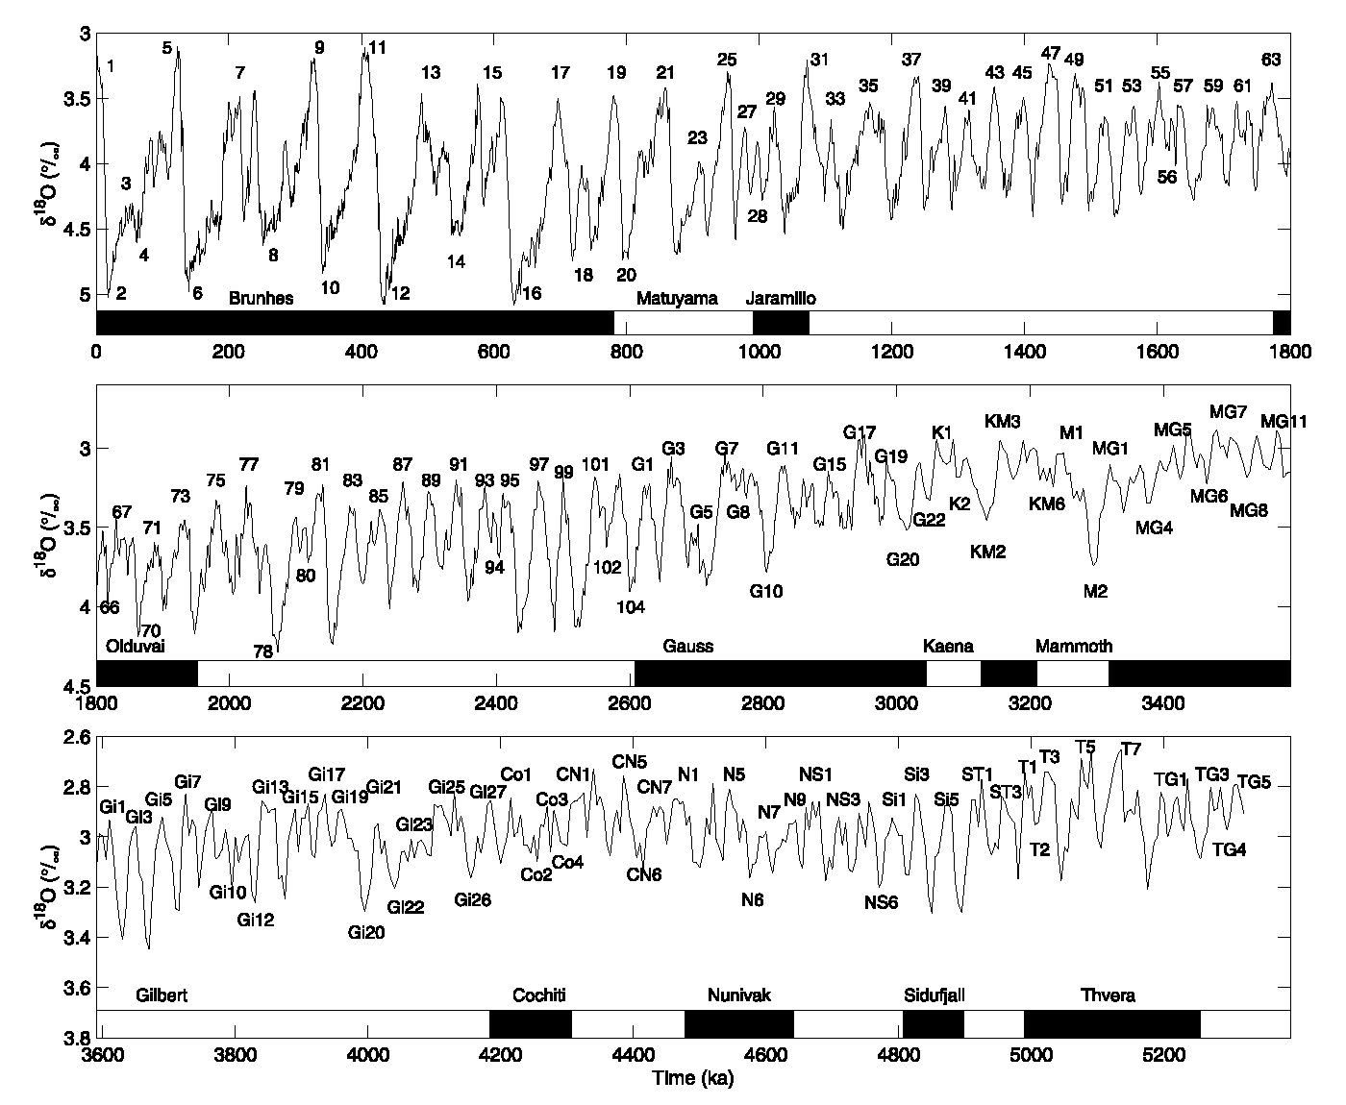
The Pliocene-Pleistocene δ¹⁸O Record (LR04)
Lisiecki & Raymo (2005)
Notes:
The 5.3-Myr long d18O stack of Lisiecki & Raymo (2005)
It is based on 57 benthic d18O records.
The dating is partly based on magnetic reversals (the most recent one is the Brunhes-Matuyama reversal ca. 780 kyr ago).
Note the different marine isotopic stages (MIS): odd number = interglacial or warm stage; even number = glacial or cold stage.
Exception to this rule: MIS3 which took place during the last glacial period.

Slide 33
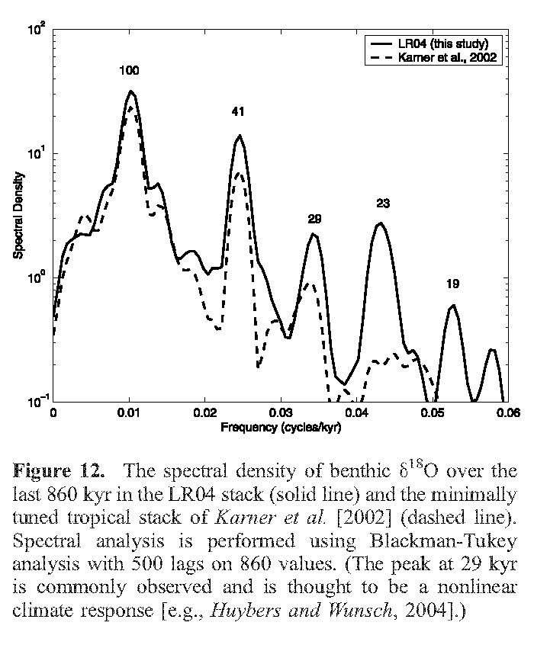
The Pliocene-Pleistocene δ¹⁸O Record (LR04)
Lisiecki & Raymo (2005)
Notes:
Spectral analyses of two different d18O stacks show the presence of variance maxima in the orbital bands, suggesting that changes in the Earth’s orbital parameters (eccentricity, obliquity, and precession) contributed to past climate changes (recall that d18O of calcite reflects a combination of changes in temperature and d18O of ambient water, with d18O of ambient water related to global sea level and hence to the global ice volume on land).

Slide 34
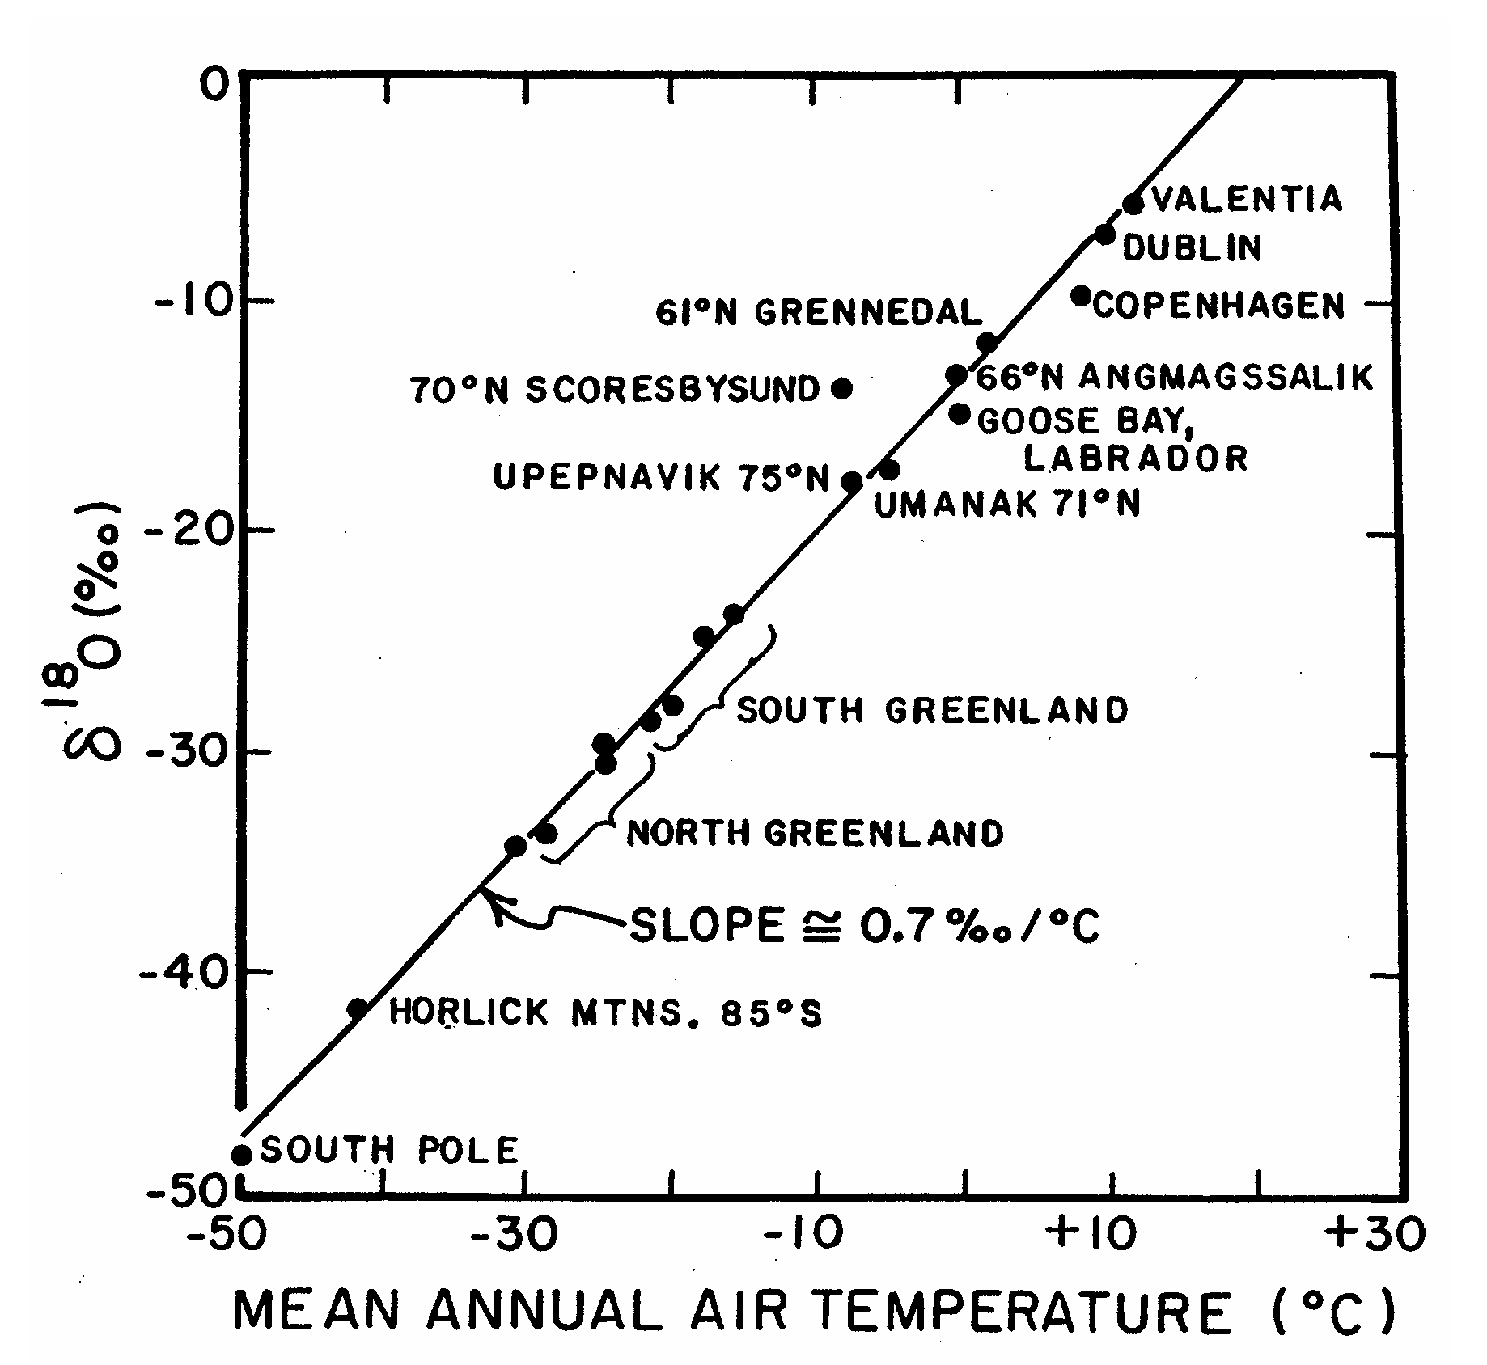
Precipitation δ¹⁸O versus Air Temperature
Dansgaard (1964)
Fig: Broecker (2002)
Notes:
d18O can also be measured on other archives, such as ice cores.
This figure shows the relationship between d18O of precipitation and annual mean air temperature measured at a number of locations in the Southern and Northern hemispheres (modern observations).
The slope that characterizes the variation of precipitation d18O with annual mean temperature is about 0.7 permil/degC.
A key assumption in the use of ice d18O a paleothermometer is that the present spatial relationship between precipitation d18O and air temperature could be applied to estimate air temperatures in the past.

Slide 35
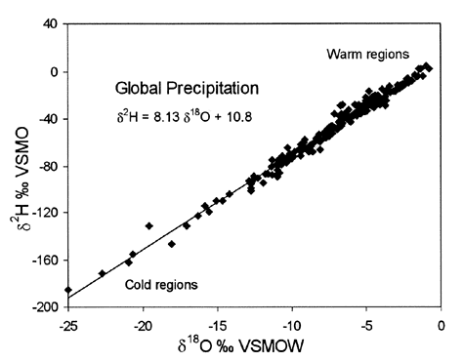
The Global Meteoric Water Line
Clark & Fritz (1997)
Notes:
Many of the air temperature reconstructions for Antarctica are based on measurements of the ratio between two isotopes of hydrogen in ice core samples: H-2 (deuterium) and H-1.
These measurements are expressed as d2H, whose definition follows that of d18O, i.e., d2H of a sample is simply proportional to the (H-2)/(H-1) ratio of the sample, normalized to that of a standard. Notice that d2H is also sometimes called dD (“D” for deuterium).
Hydrogen isotopes are fractionated similarly to oxygen isotopes, implying that d2H of precipitation will decrease with decreasing cloud temperature.
As a result, there is a positive relationship between d2H and d18O of precipitation: this empirical relationship is called the “Global Meteoric Water Line” (see figure).
Both d2H and d18O of precipitation tend to be small in cold regions and large in warm regions.
Note that “VSMO” stands for “Vienna Standard Mean Ocean Water”, which is the standard used for the d2H and d18O data in the plot.

Slide 36
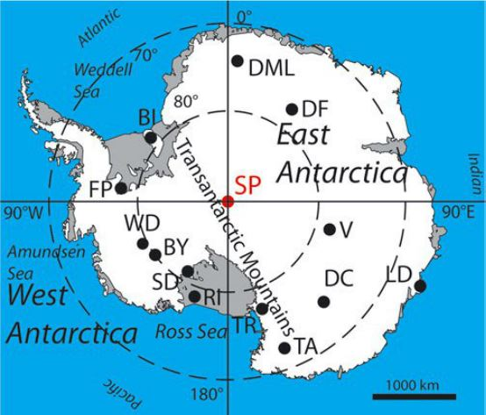
BY Byrd
DC Dome C
DML Dronning Maud Land
TR Taylor Dome
V Vostok
Notes:
This map shows locations of some of the Antarctic ice cores to be discussed in this course.

Slide 37
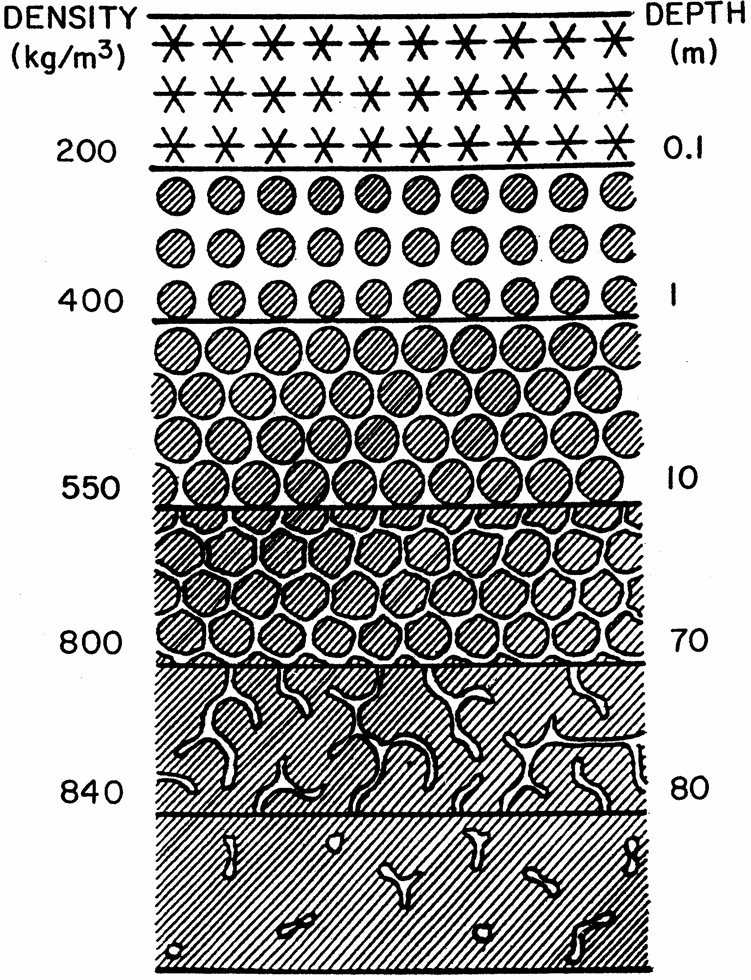
The Polar Firn
CLOSE-OFF DEPTH
δ¹⁸O, δ²H, etc.
CO₂, CH₄, N₂O, etc.
Broecker (2002)
Notes:
The upper part of ice sheets is comprised of a layer of unconsolidated snow, called the firn. Below the firn, air can be occluded in bubbles. These bubbles provide an archive for the reconstruction of the chemical composition of the atmosphere in the past.

Slide 38
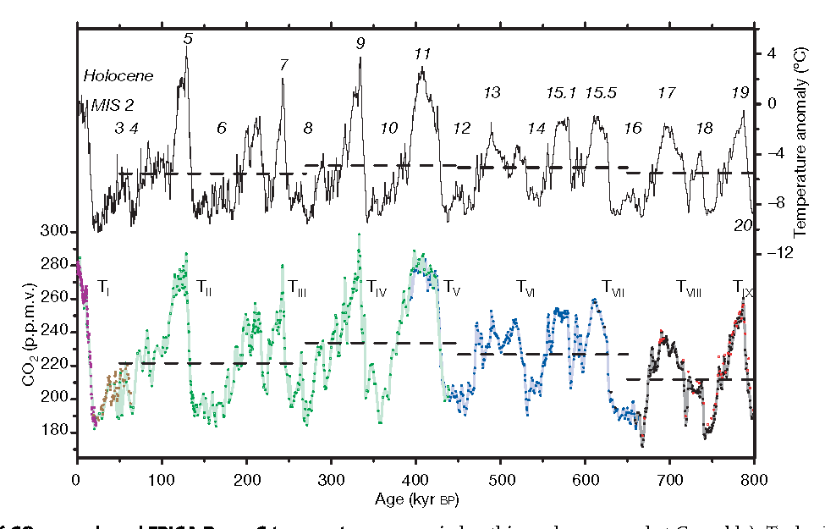
δ²H & CO₂ Records from Antarctic Ice Cores
based on δ²H
Dome C
Taylor Dome
Vostok
Dome C
Lüthi et al. (2008)
Notes:
The scientific content of this figure is hard to overestimate.
The upper panel shows the d2H record from the Epica Dome C (EDC) ice core, expressed in terms of temperature.
The lower panel shows the concentration of CO2 measured on air trapped in different Antarctic ice cores:
Taylor Dome (brown), Vostok (green), and EDC (other colors: black dots are measurements from Bern, Switzerland, and red dots are measurements from Grenoble, France).
The horizontal dashed lines are mean values for different time intervals.
The Arabic numerals indicate the Marine Isotopic Stages (MISs), whereas the Roman numerals indicate the deglaciations or “terminations” (e.g., T-sub-I is the most recent termination).
Note the strong apparent correlation between both records: Antarctic air temperature and atmospheric CO2 concentration have evolved largely in parallel over the past 800 kyrs.

Slide 39
δ²H & CO₂ Records from Antarctic Ice Cores
TODAY 400 ppmv -
based on δ²H
Dome C
Taylor Dome
Vostok
Dome C
Lüthi et al. (2008)
Notes:
The current concentration of atmospheric CO2 has no precedent over the past 800,000 years …

