Slide 1
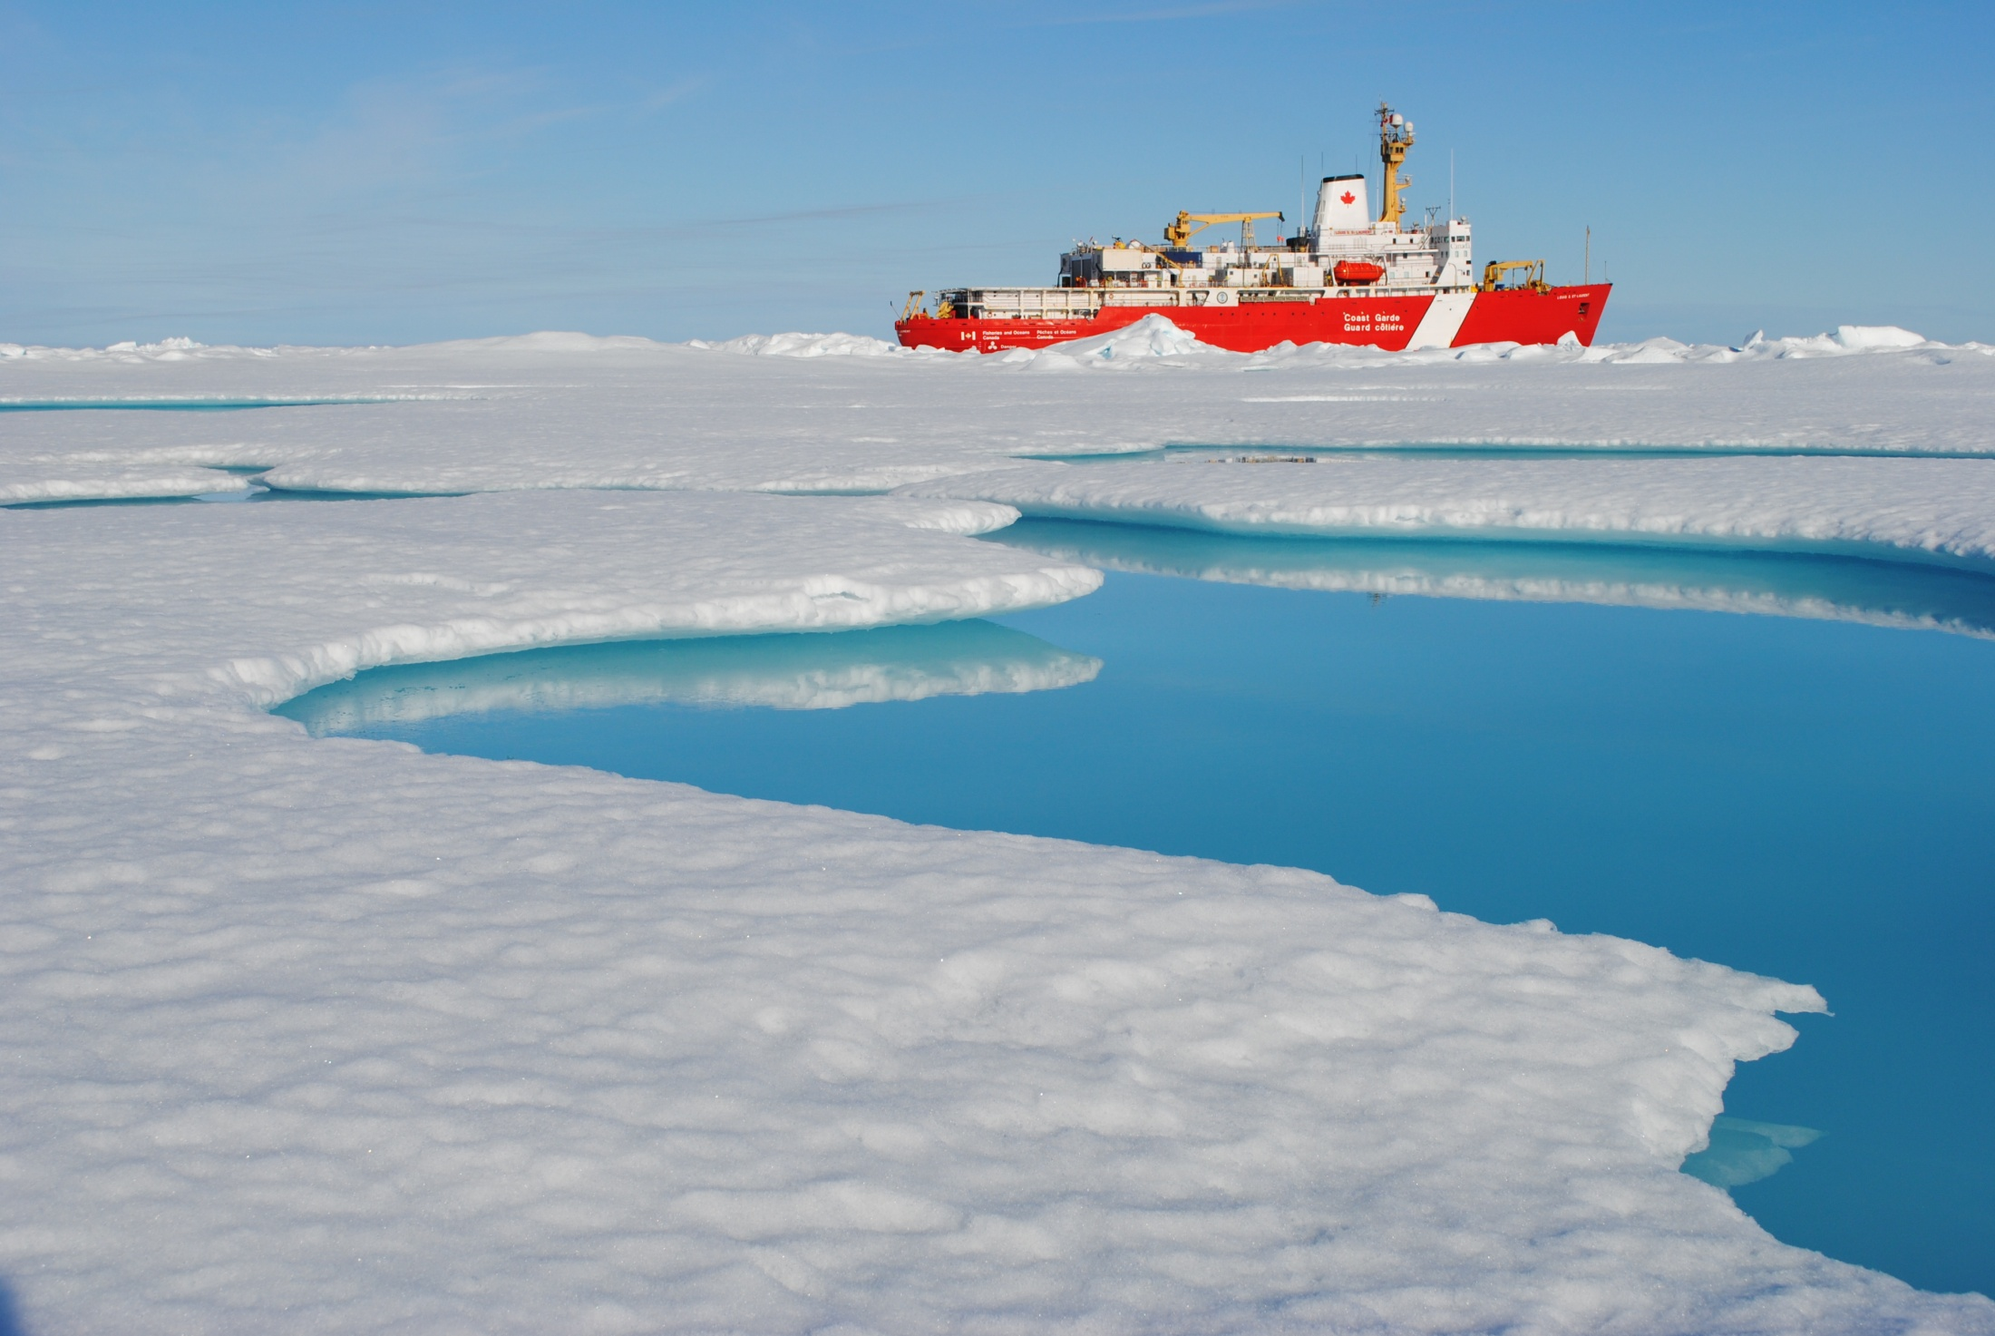
Structure and Dynamics of the Arctic Ocean
Mary-Louise Timmermans

Slide 2
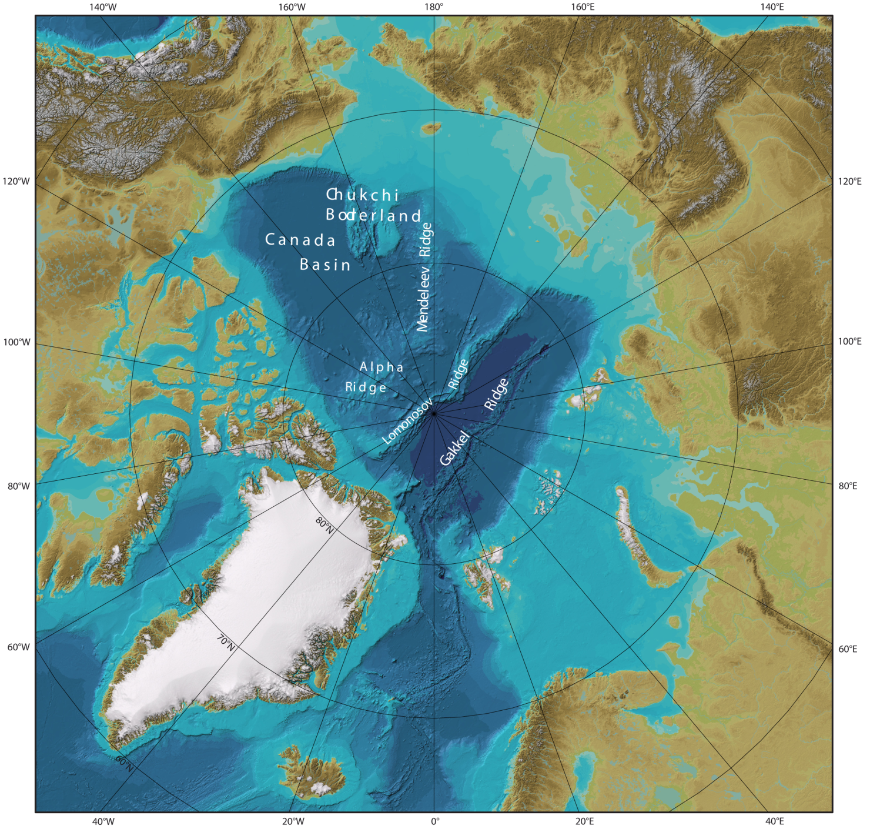
The Arctic Ocean

Slide 3
Project SKIJUMP: Arctic Ocean Circulation
Worthington (1953)
Ocean observations were made by aircraft from ice floes (1951-52).
Observations suggested the existence of the Lomonosov Ridge.

Slide 4
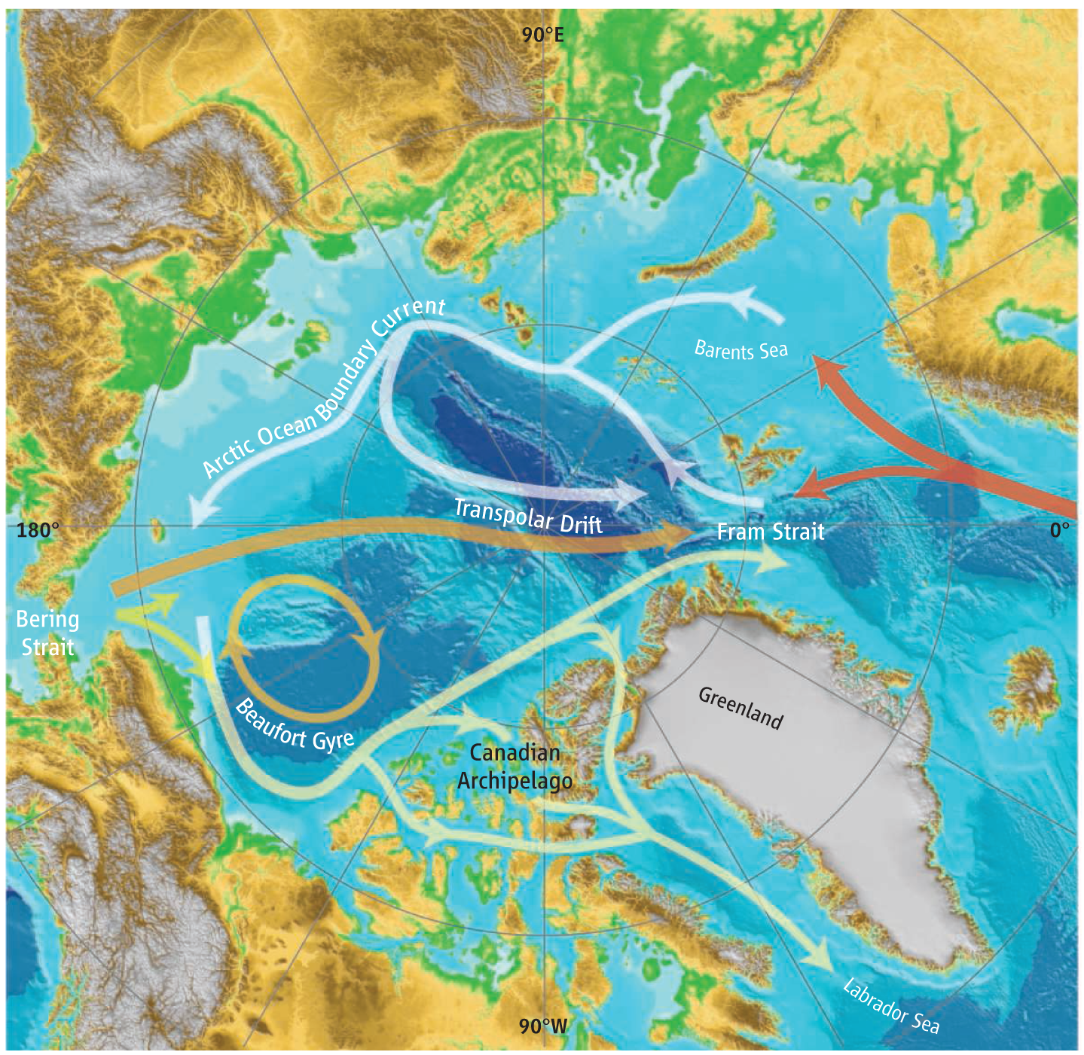
Arctic Ocean circulation
Greene and Pershing, 2007

Slide 5
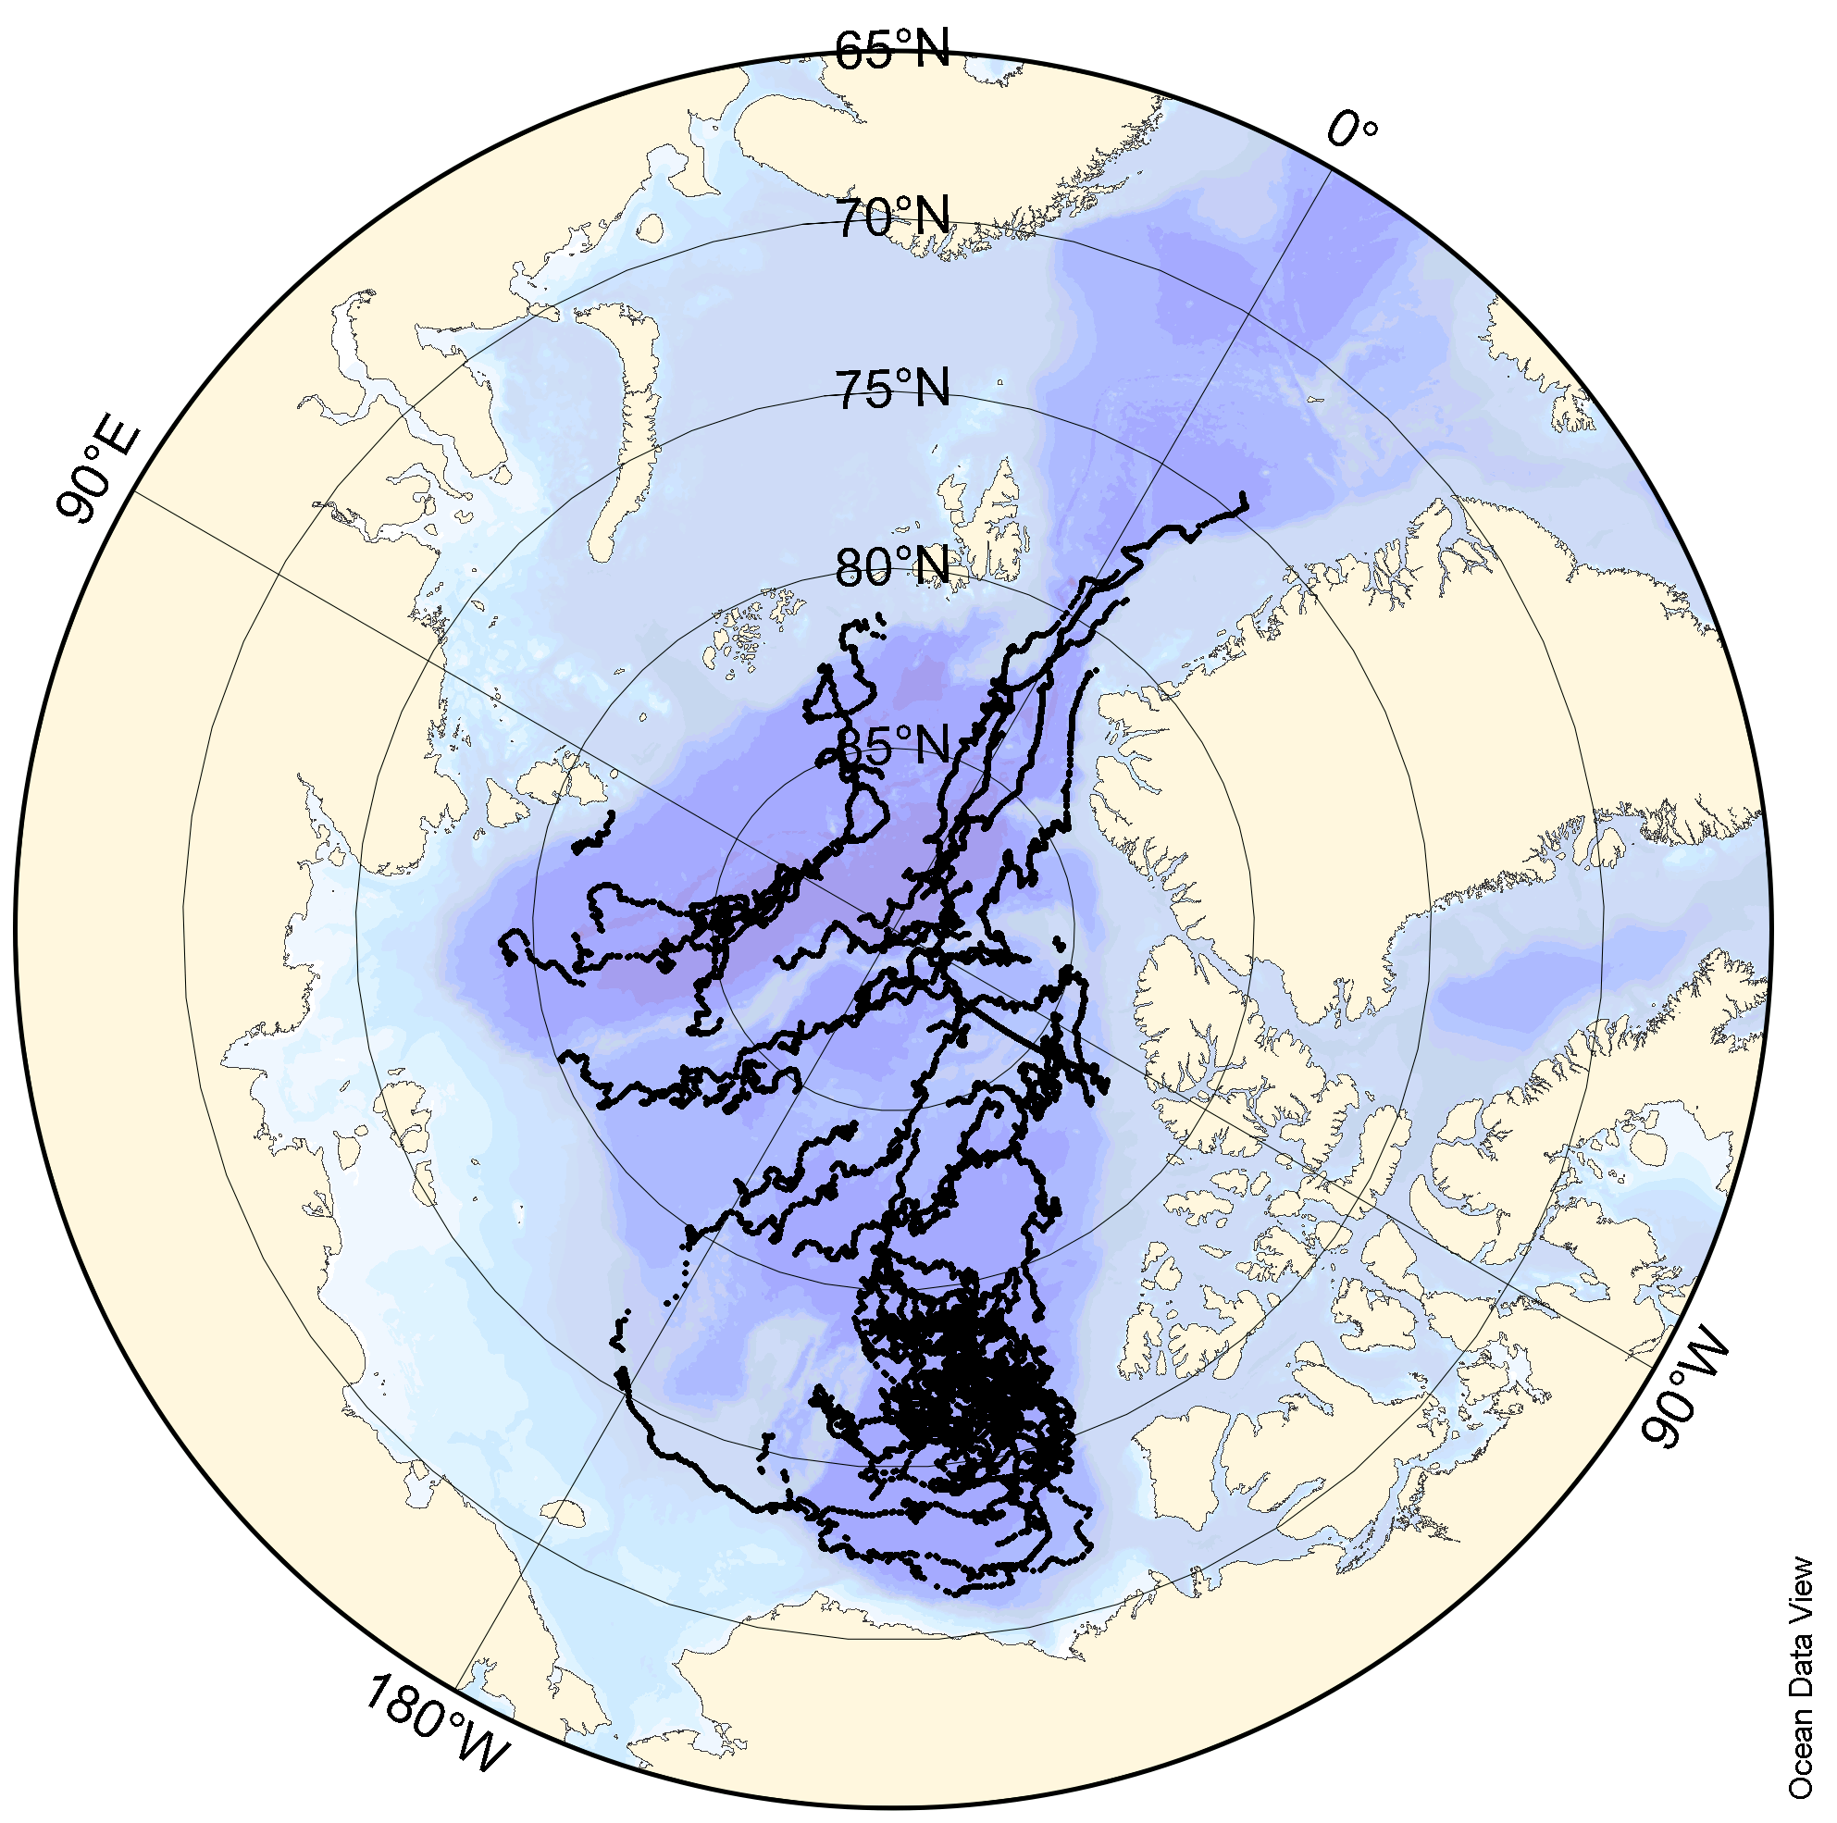
50 ITPs deployed in the Arctic since 2004
more than 30 000 temperature/salinity
profiles
ITPs can drift relatively rapidly across features being advected slowly with the mean flow
Horizontal resolution: a few kilometers
Vertical resolution: about 25 cm

Slide 6
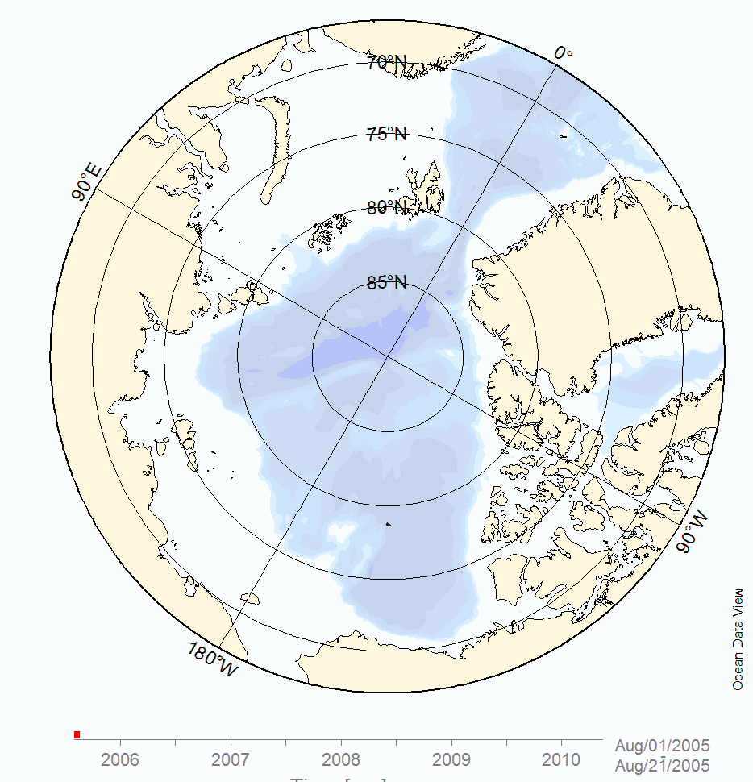
Ice-Tethered Profiler
Drift tracks (2005-2010)

Slide 7
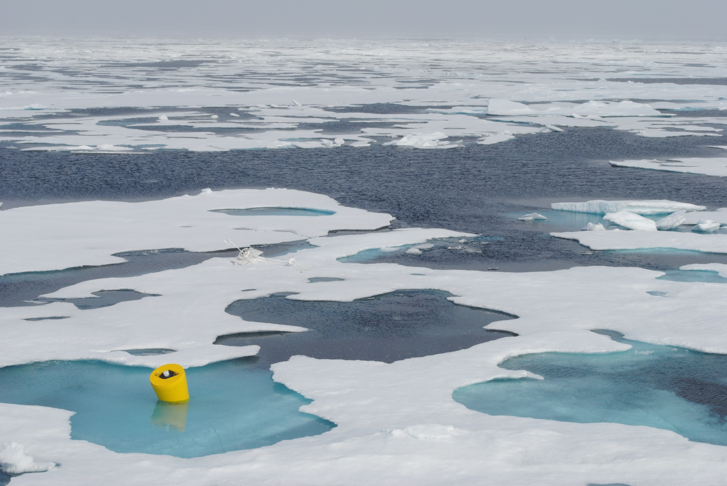
Recovery of an ITP, Beaufort Sea August 2011

Slide 8
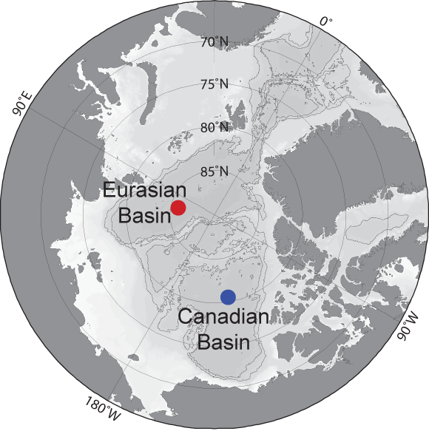
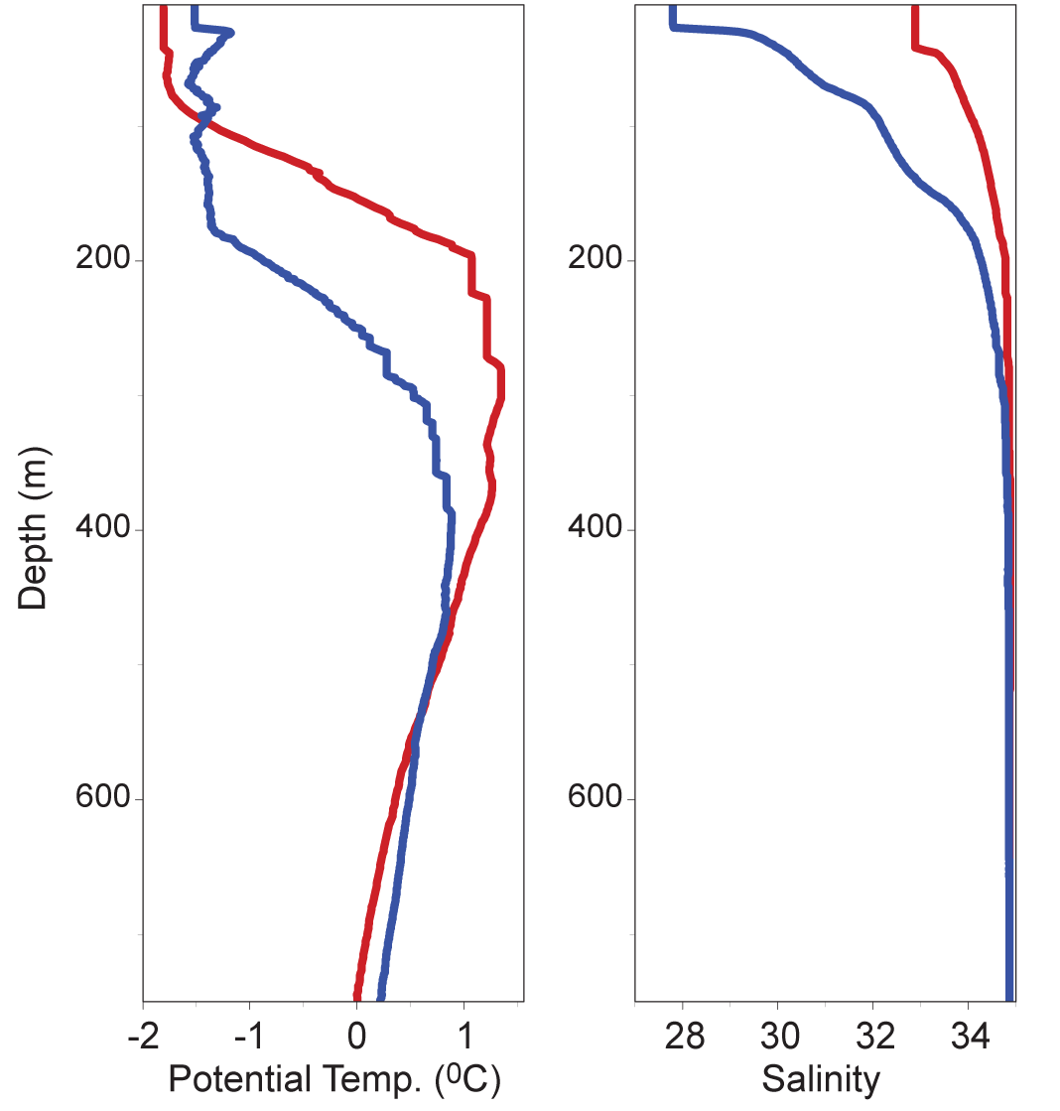
Arctic Ocean Temperature/Salinity profiles
ITP

Slide 9
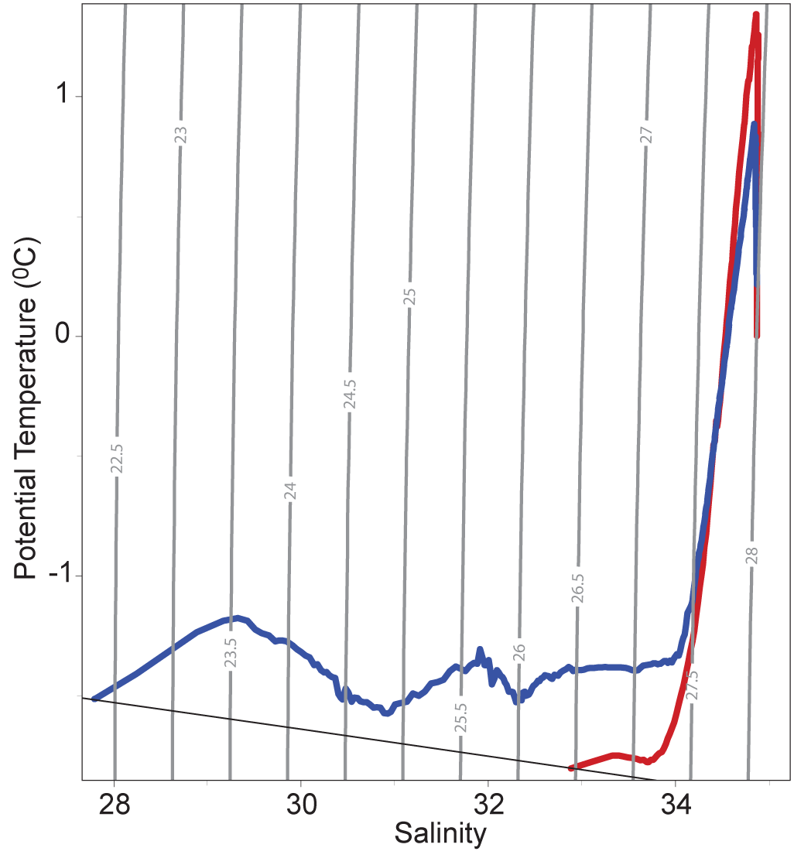
Corresponding Temperature/Salinity curve

Slide 10
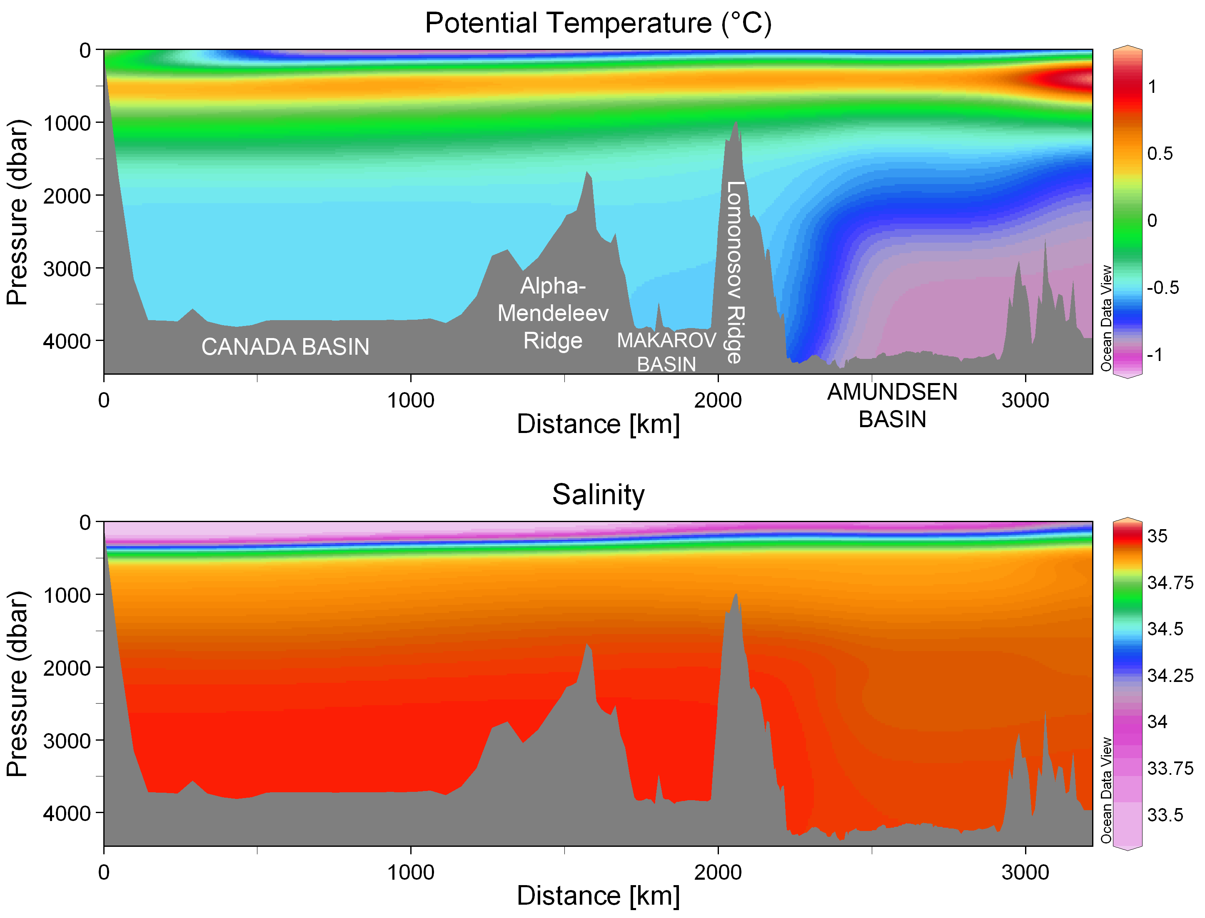
Arctic Ocean Section data are from the icebreaker Oden expedition in 2005

Slide 11
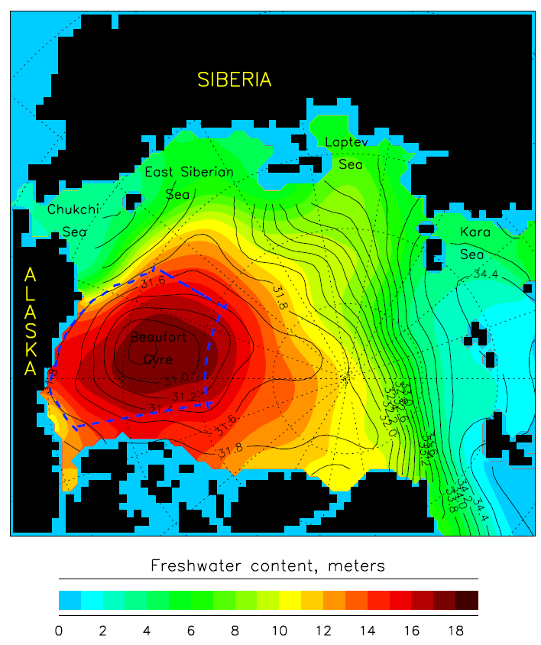
The Arctic Ocean’s Beaufort Gyre
Freshwater content in the Arctic Ocean
(relative to salinity 34.8) from climatology 1950-1980.
The Beaufort Gyre is the largest freshwater storage area of the Arctic Ocean.
Between 2003 and 2009, the freshwater content of the Beaufort Gyre increased by more than 30%.
Ekman Pumping generated by the anticyclonic atmospheric circulation over the Canada Basin is the major cause.
Proshutinsky et al., 2009; 2011
Proshutinsky et al., 2009

Slide 12
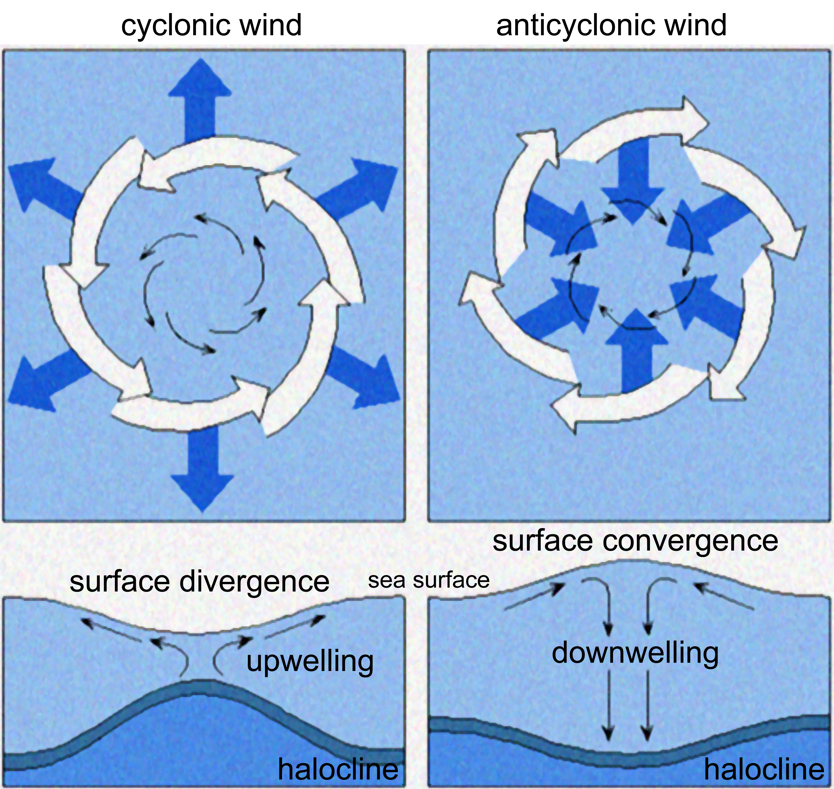
Ekman convergence and divergence

Slide 13
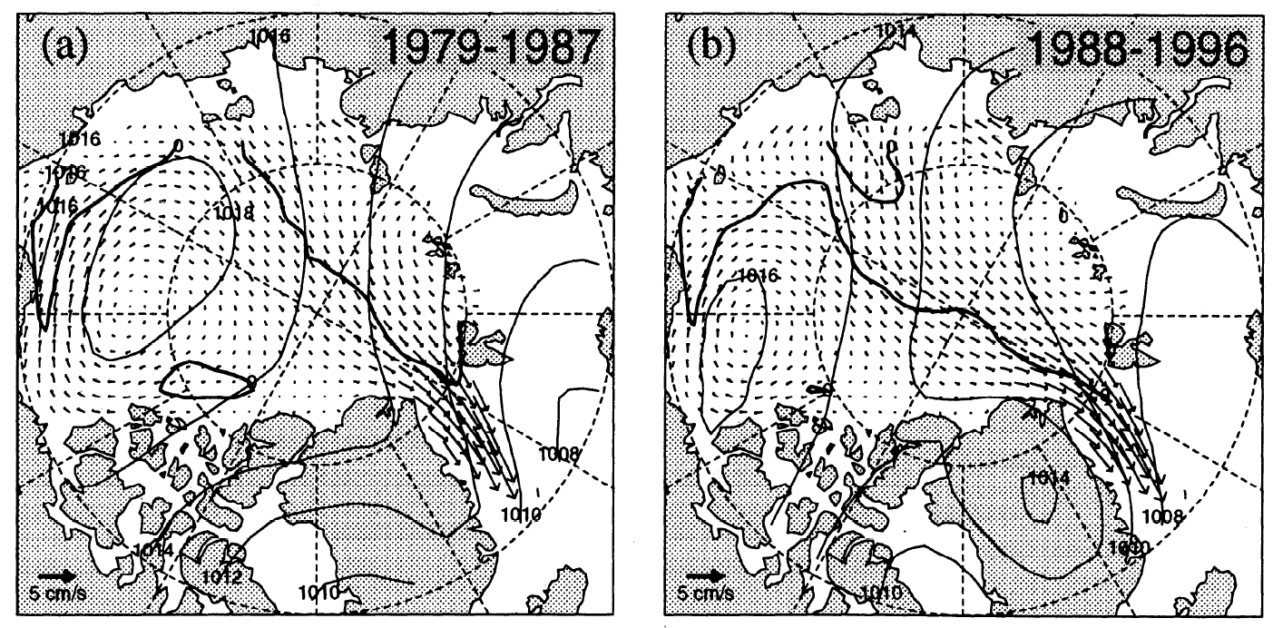
Interannual variability in freshwater distribution
Average sea-ice motion (from the International Arctic Buoy Program)
Laptev
Sea
Kara Sea
Steele and Boyd, 1998
Notes:
Dark line shows the axis of the TPD which separates the anticyclonic BG from the generally cyclonic motion of the EB. A shift in the axis occurred in the late 1980s which steele and boyd speculated lead to an eastward shift in the location where fresh shelf waters from the Kara and Laptev seas are injected into the ocean interior

Slide 14
The Beaufort Gyre: Understanding mechanisms of freshwater accumulation & release
Wind-driven ice motion (2-D ice-ocean model forced by NCEP/NCAR reanalysis)
annually-averaged ice drift (arrows) and sea-level pressure
freshwater is accumulated under anticyclonic wind forcing, released when forcing weakens
See Proshutinsky & Johnson, 1997; Proshutinsky et al., 2002

Slide 15
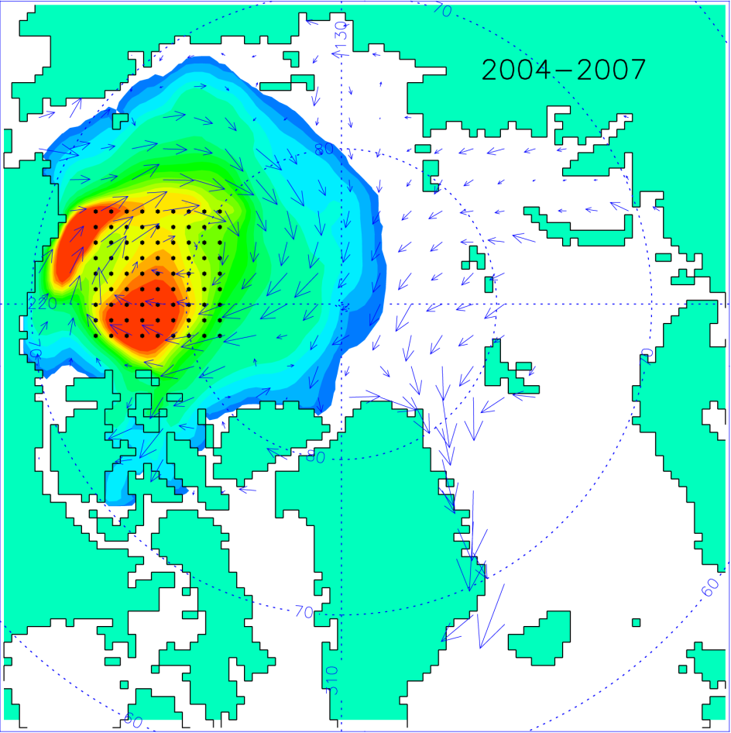
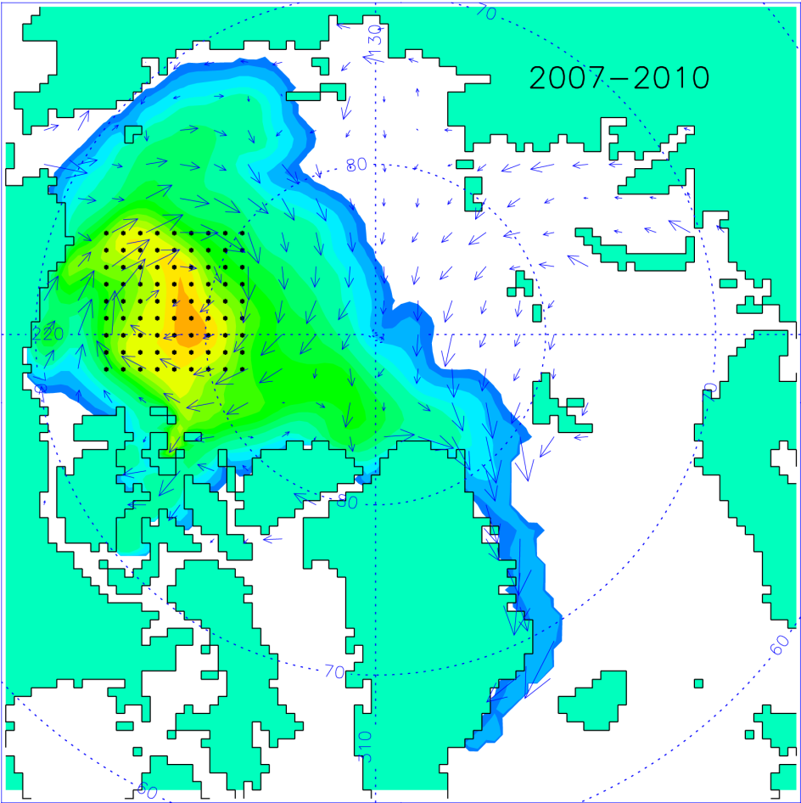
Modeled surface circulation
strong, anticyclonic BG
weakened BG
Unusually fresh surface waters in the Eurasian Basin in 2010 may have been due to spreading of anomalously fresh water from the Beaufort Gyre. This flux is likely associated with a 2009 shift in the atmospheric circulation to a reduction in strength of the Beaufort Gyre.
Timmermans et al., 2011
Notes:
Conservative tracer particles were released in the Beaufort Gyre. Ice and surface water pathways were assessed by examining the particle hours that tracer particles occupied a given model grid cell.

Slide 16
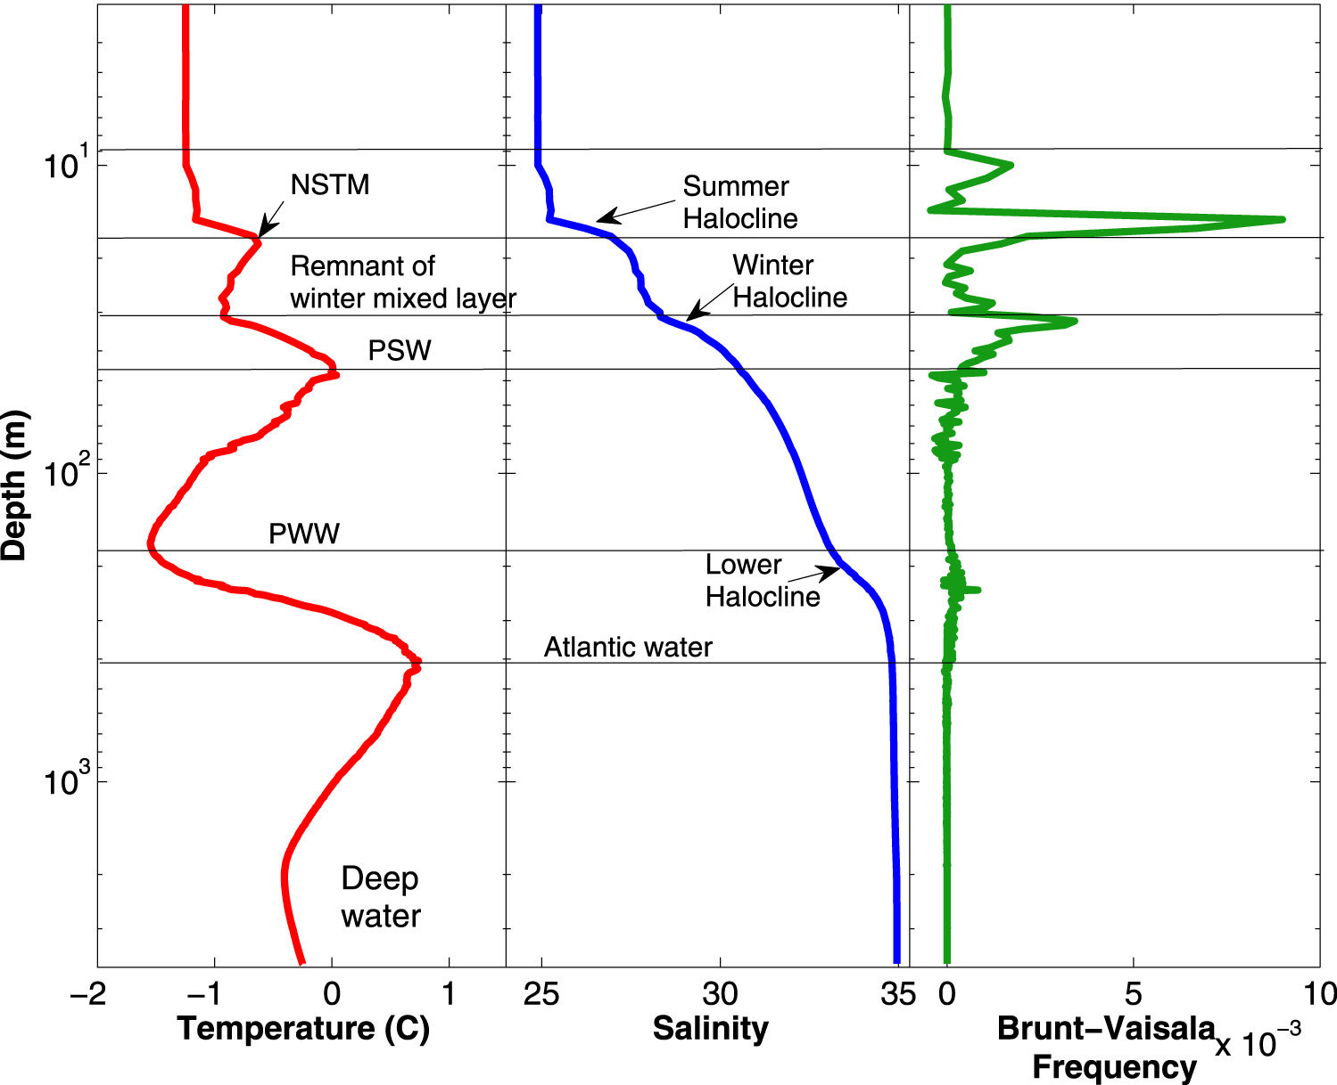
Upper-ocean profiles in the central Canada Basin
Jackson et al., 2010 and see Steele et al., 2004
Notes:
Read Steele et al., 2004

Slide 17
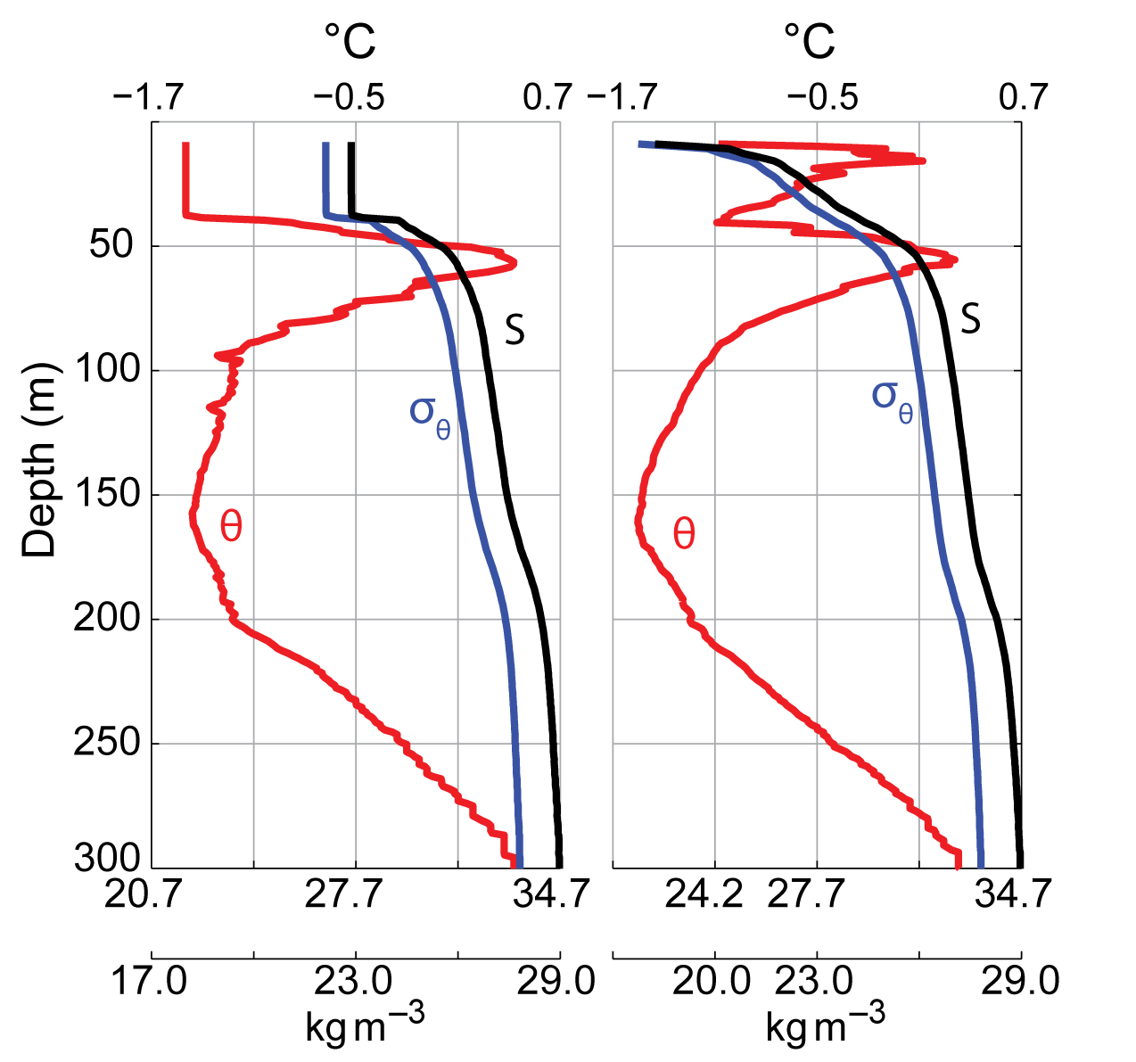
Upper-ocean profiles in the central Canada Basin
April 2007
September 2007
Toole et al., 2010
Surface mixed layers have freshened in recent years → enhanced stratification
Strong NSTM in recent years

Slide 18
Influence of upper-ocean stratification on sea ice in the Canada Basin
Stratification barriers at 30-40 m depth isolate surface waters and sea ice from the influence of Pacific Water heat anomalies in the Central Basin (Maykut and McPhee, 1995; Shaw et al., 2009; Toole et al., 2010).
Heat in the near-surface temperature maximum layer can be entrained into the mixed layer in autumn & delay the onset of seasonal sea ice growth (e.g., Jackson et al. 2010; Toole et al., 2010).
Potential density (kg m⁻³) in the upper ocean of the central Beaufort Gyre, sampled by an ITP.

Slide 19
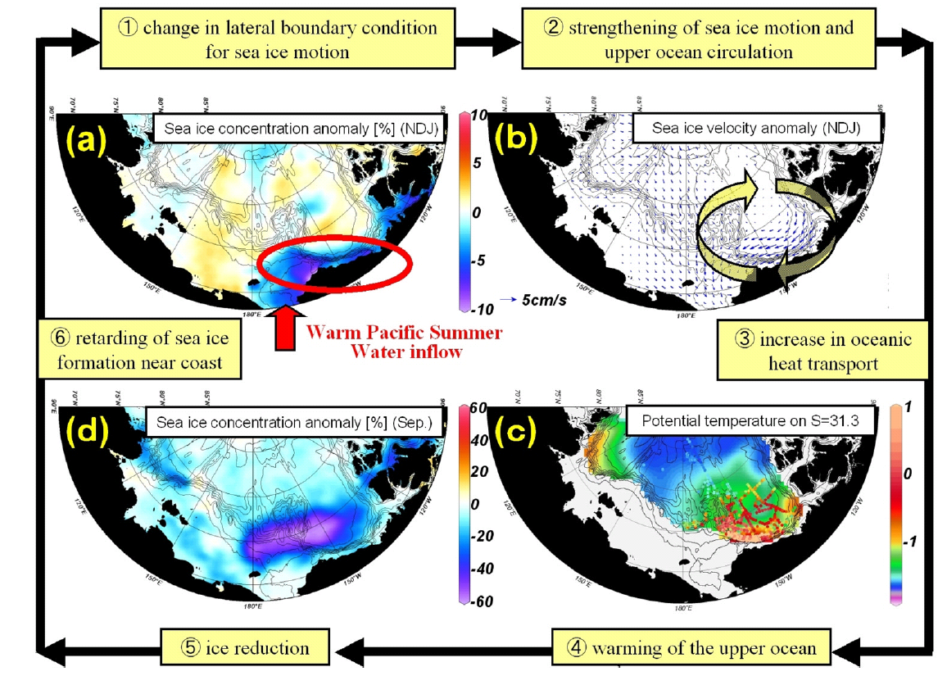
Influence of Pacific Water on Sea-ice cover at the Canada Basin boundary
Shimada et al., 2006
Notes:
1997-2003 minus 1979-1997

Slide 20
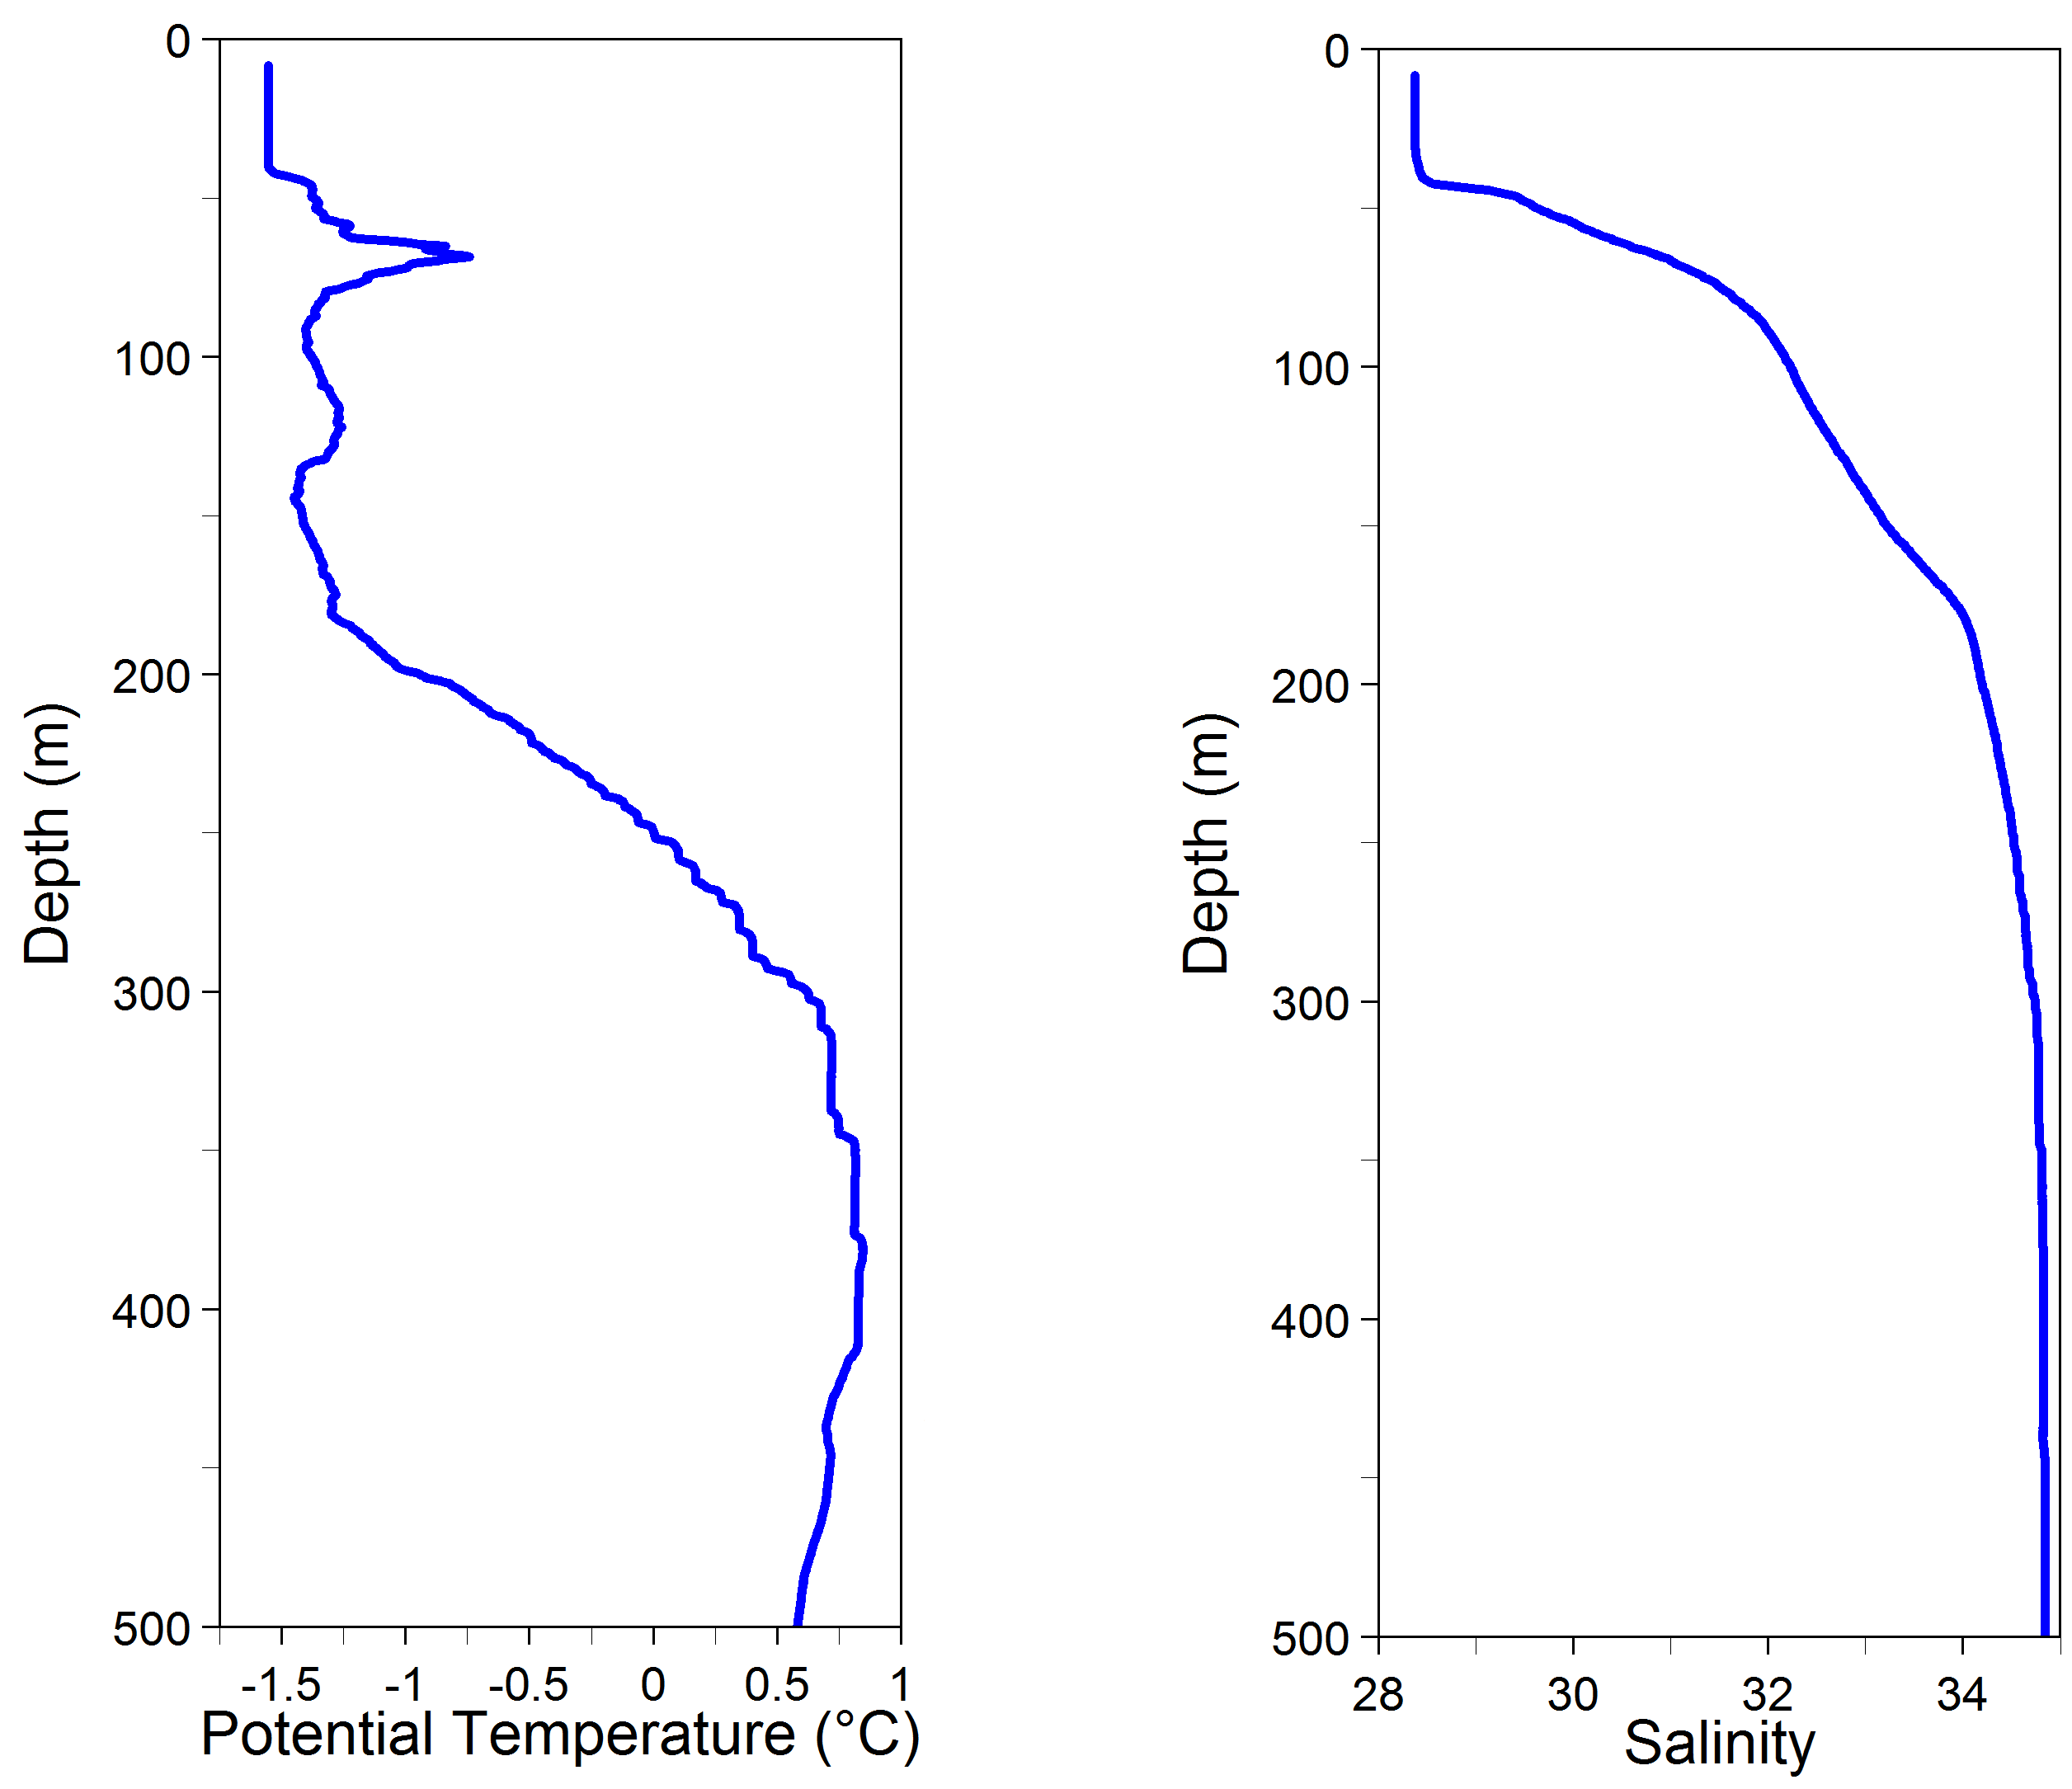
Upper Arctic Ocean temperature/salinity structure
OUTLINE
Pacific
Tmax
halocline
Atlantic
Tmax

Slide 21
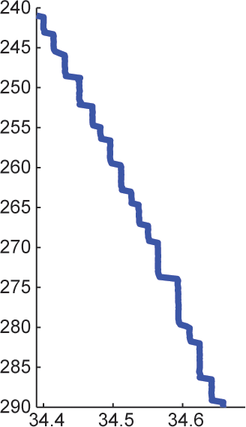
Upper Arctic Ocean temperature/salinity structure
OUTLINE
Pacific
Tmax
halocline
0.2 Wm⁻²
Atlantic
Tmax

Slide 22
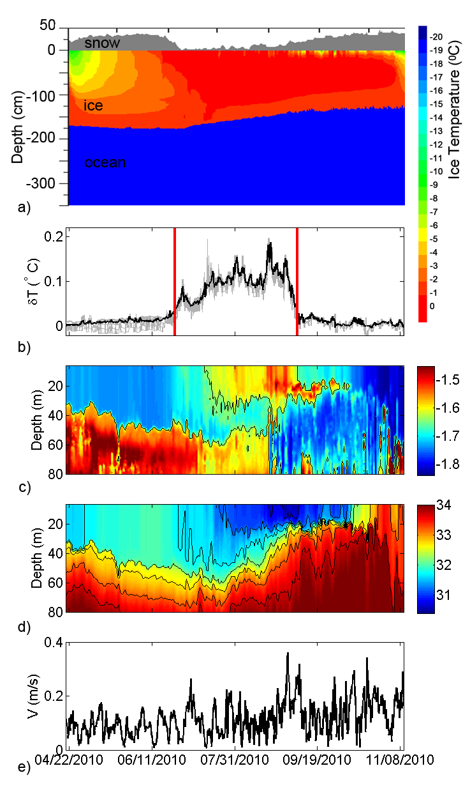
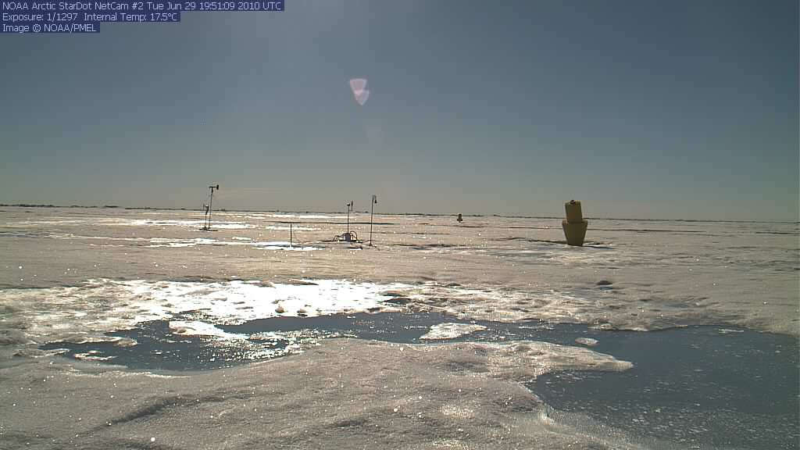
Ice-Based Observatory time-series measurements
Total: 0.4 m bottom melt
0.35 m snow melt
Temp. above
freezing
Heat that caused basal ice melt derived entirely from surface-ocean warming by incoming solar radiation , rather than entrainment of heat from warmer water below the mixed layer.
⁰C
salinity

Slide 23
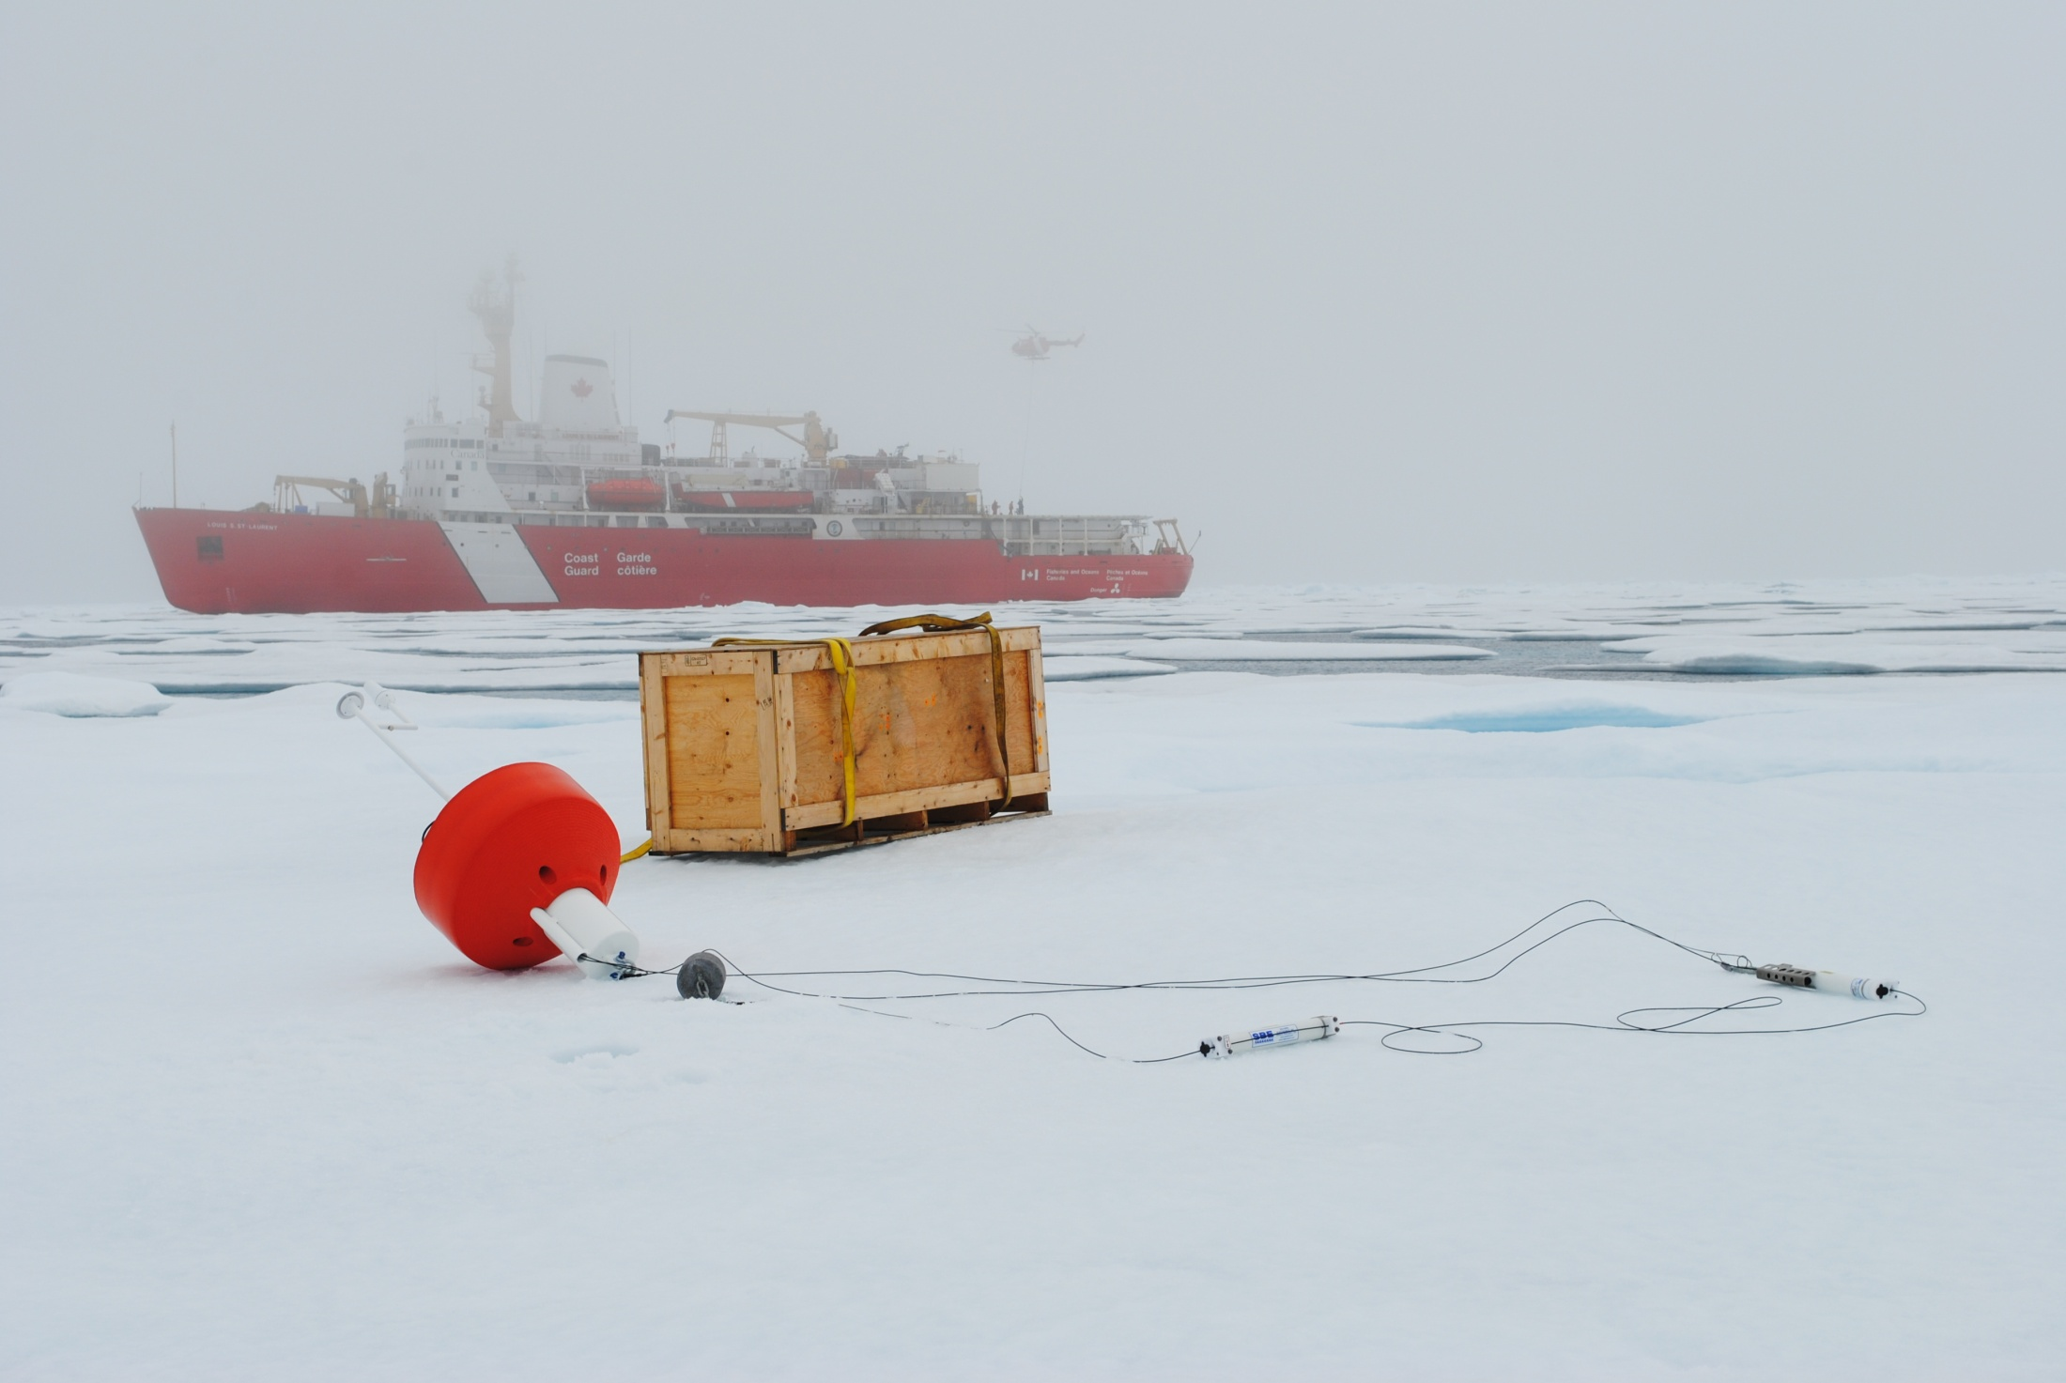
Observing and characterizing submesoscale dynamics is the Arctic Ocean
Timmermans, Krishfield, Proshutinsky and Toole

Slide 24
Buoy drift over a week (starting Aug. 16 2011)

Slide 25
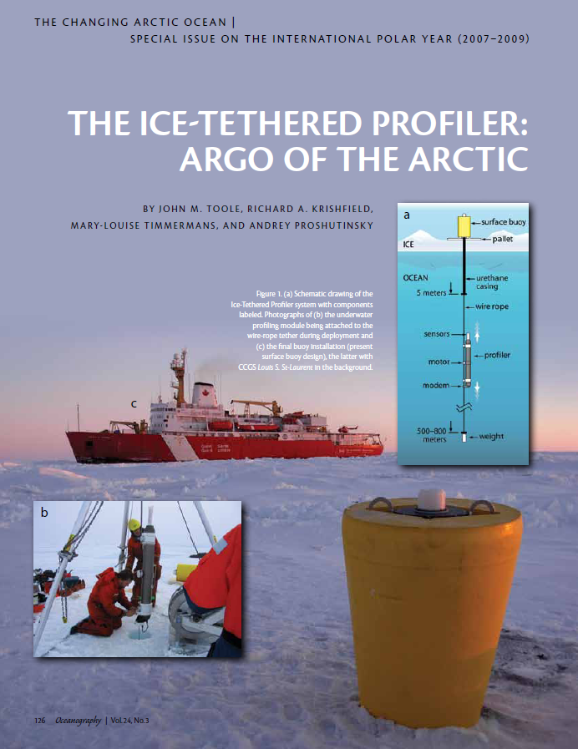
Reading
Eds: Ortiz, Falkner, Matrai, Woodgate
Toole et al., 2011

Slide 26
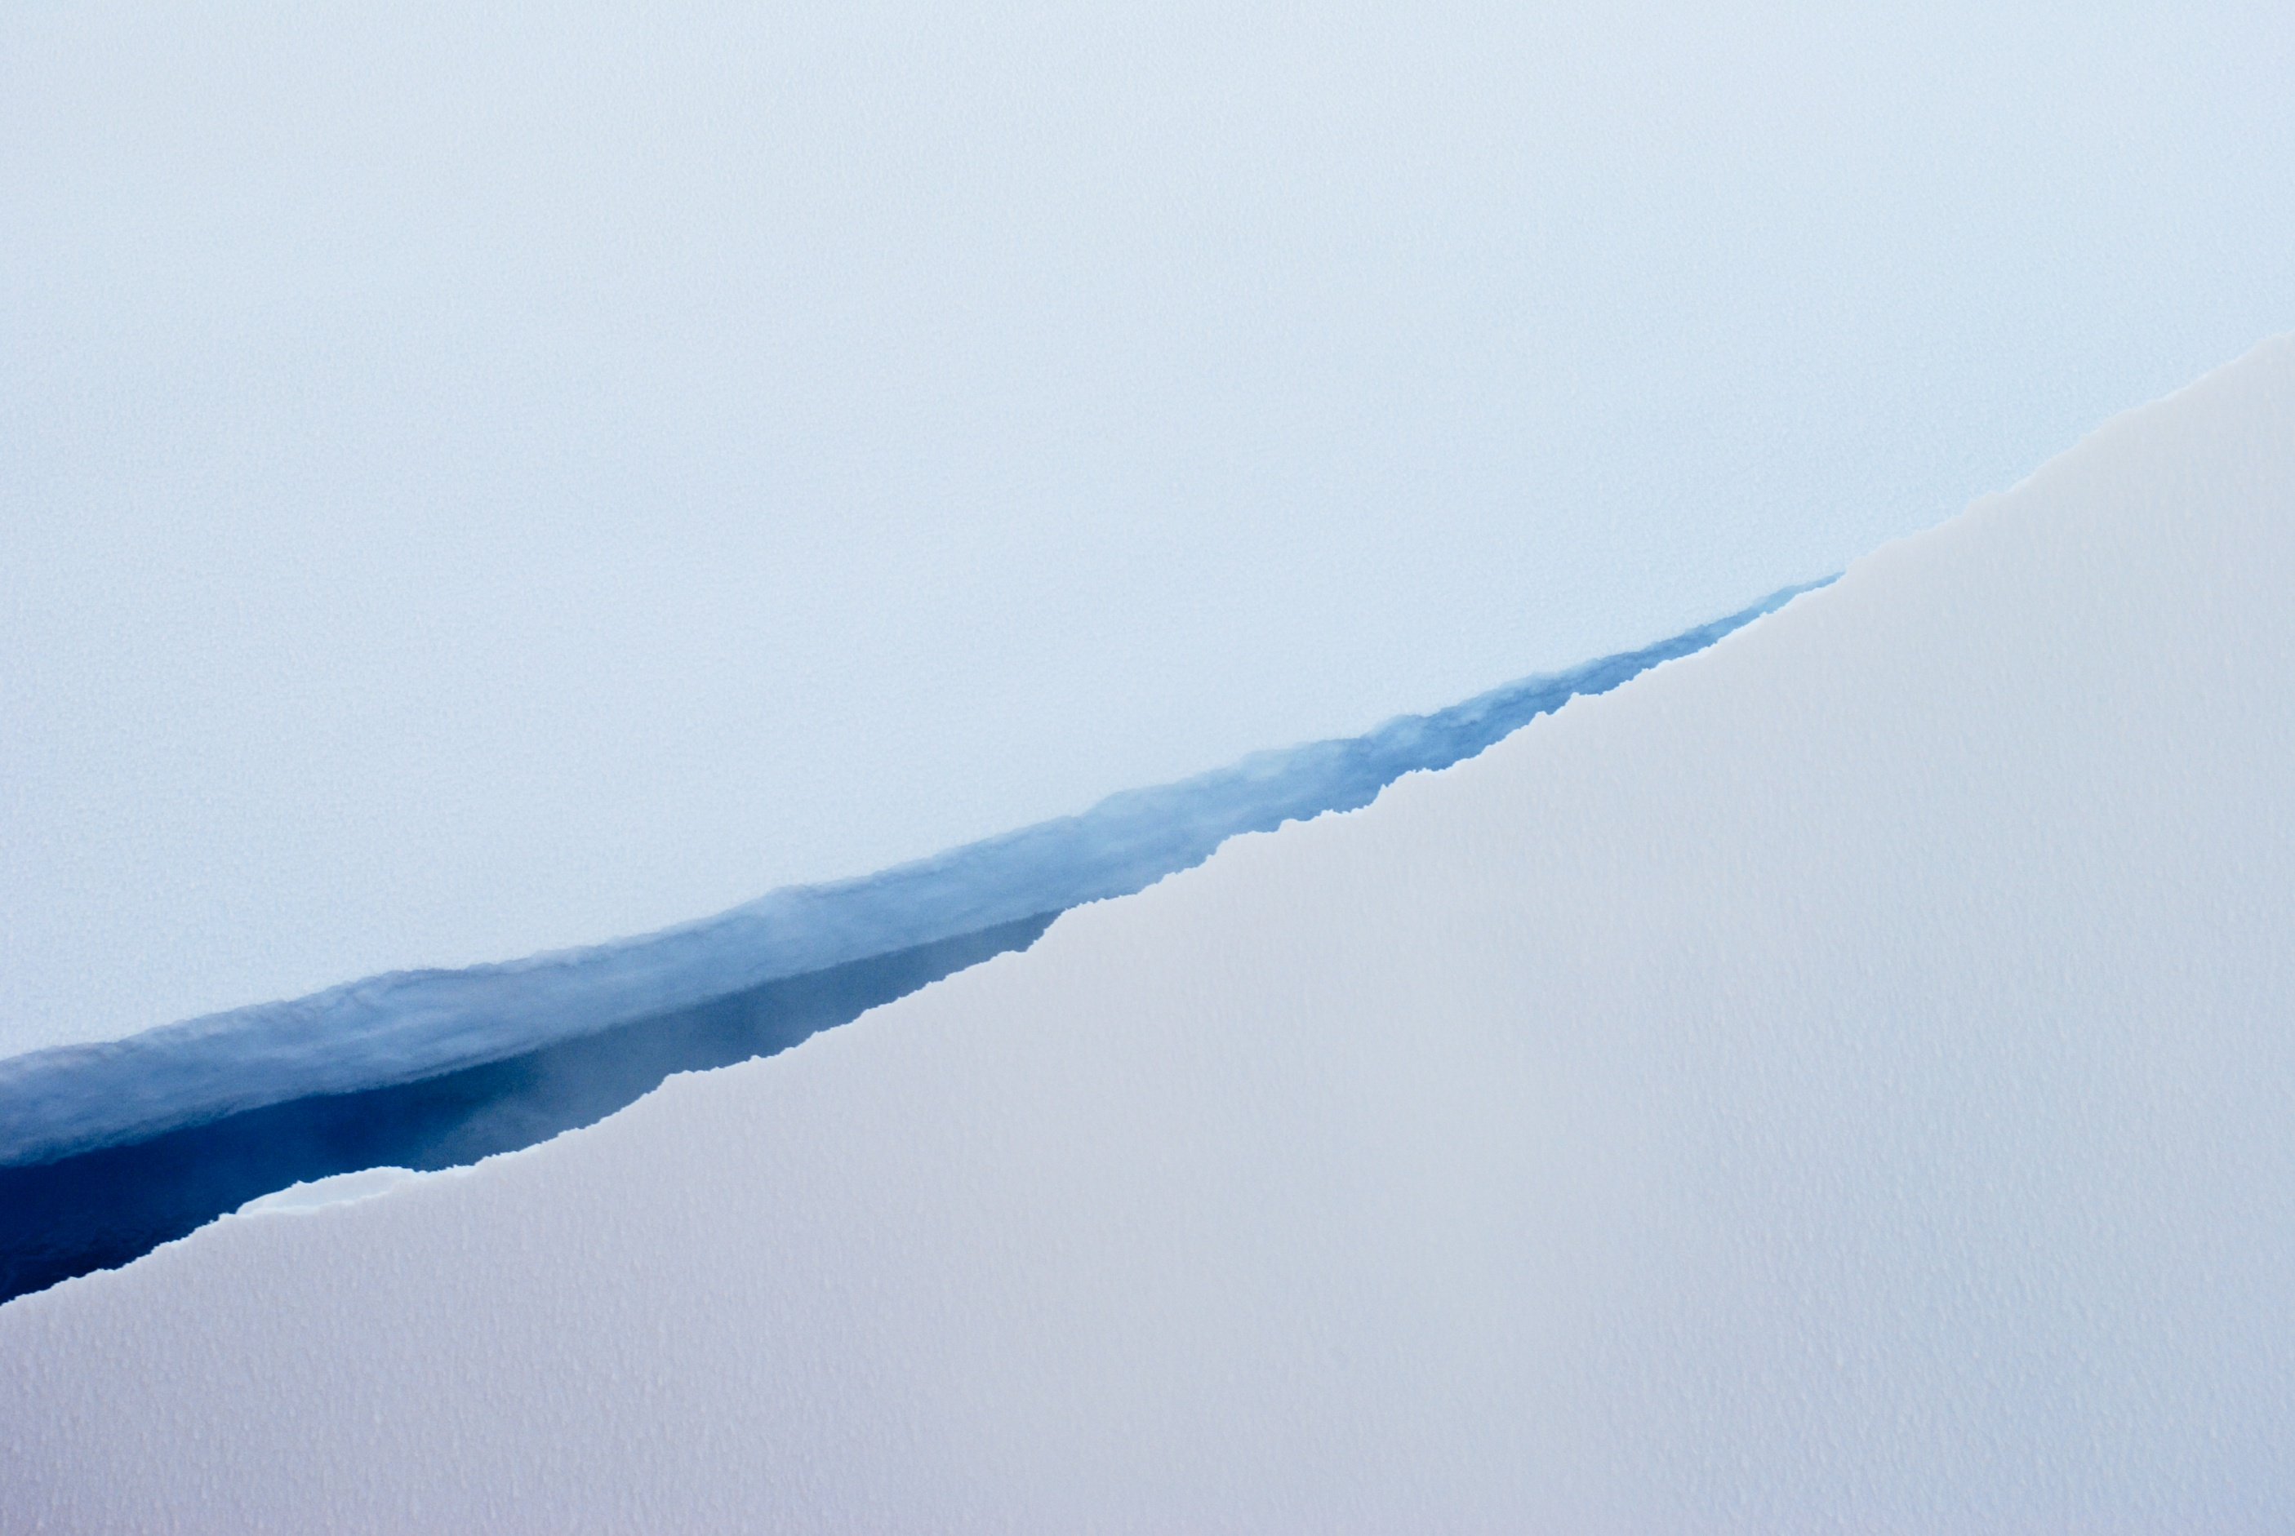
Summary: some aspects of the ocean’s role in Arctic Climate
Fresh-water content of the Beaufort Gyre increased by more than 30% since the late 1990s (ocean stratification is increasing). A partial release of fresh water was observed in 2010.
The large vertical density gradient due to low surface salinities limits the flux of Arctic Ocean heat to the under ice.
On seasonal time scales, mixed-layer heat content is more strongly influenced from above than below.
The large mixing rate required for Atlantic Water heat to contribute significantly to the surface ocean heat budget may not be energetically possible.
Small-scale horizontal processes stratify the upper-ocean and influence ice-ocean interactions.

