Slide 1
Some pics of deck, overboarding and equipment from the first EXPORTS campaign

Slide 2
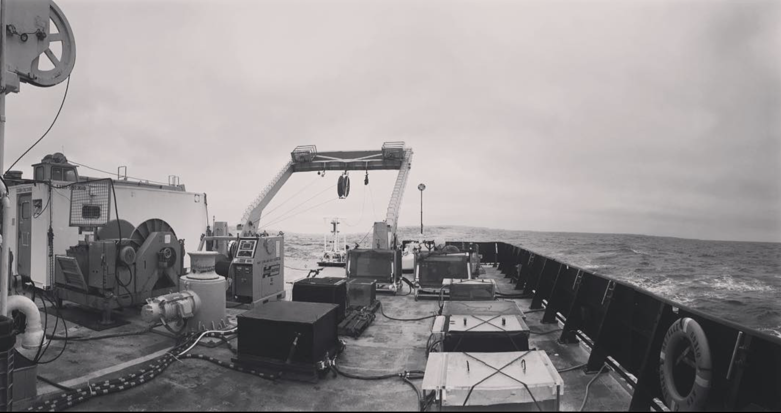
Image of aft deck from port side. 9 incubators, two winches and TMC van and TMC rosette (minus bottles)

Slide 3
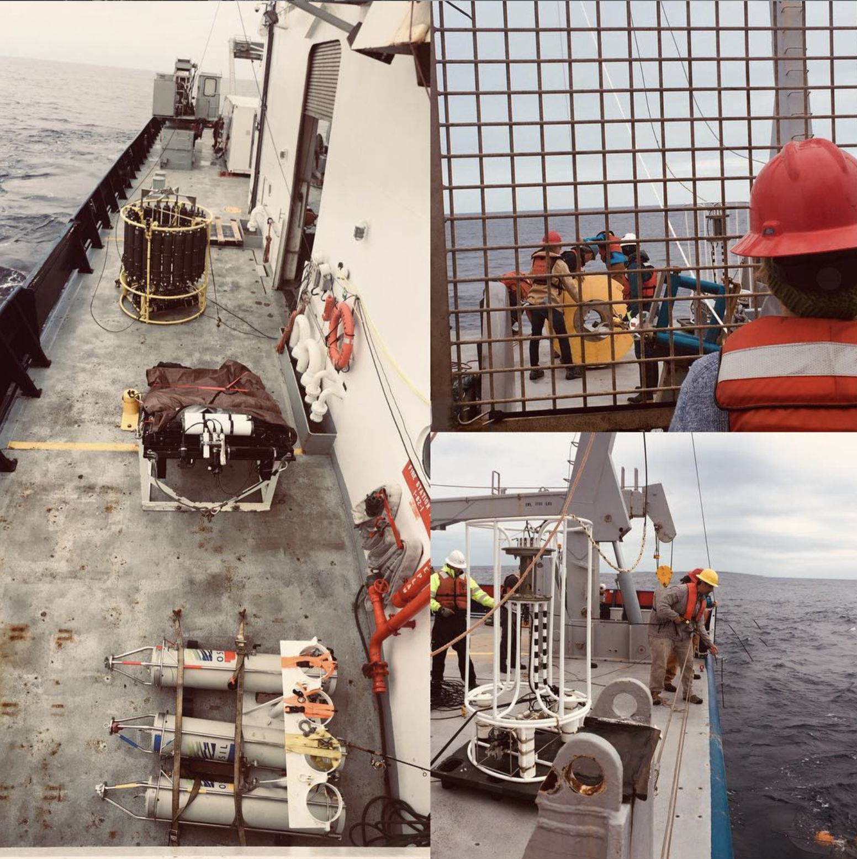
Optics team hand deploying one of the packages.

Slide 4
Starboard side equipment.
Missing TMC tow-fish image and zooplankton nets.

