Slide 1
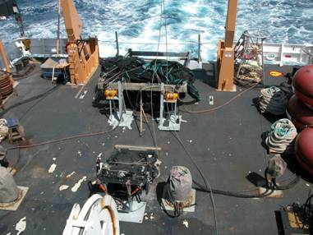
Launch of 10 m² MOCNESS
R/V Ron Brown - April 2006

Slide 2
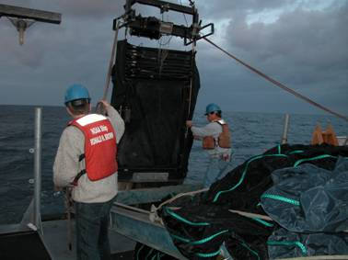
Launch of 1 m² MOCNESS
R/V Ron Brown - April 2006

