Slide 1
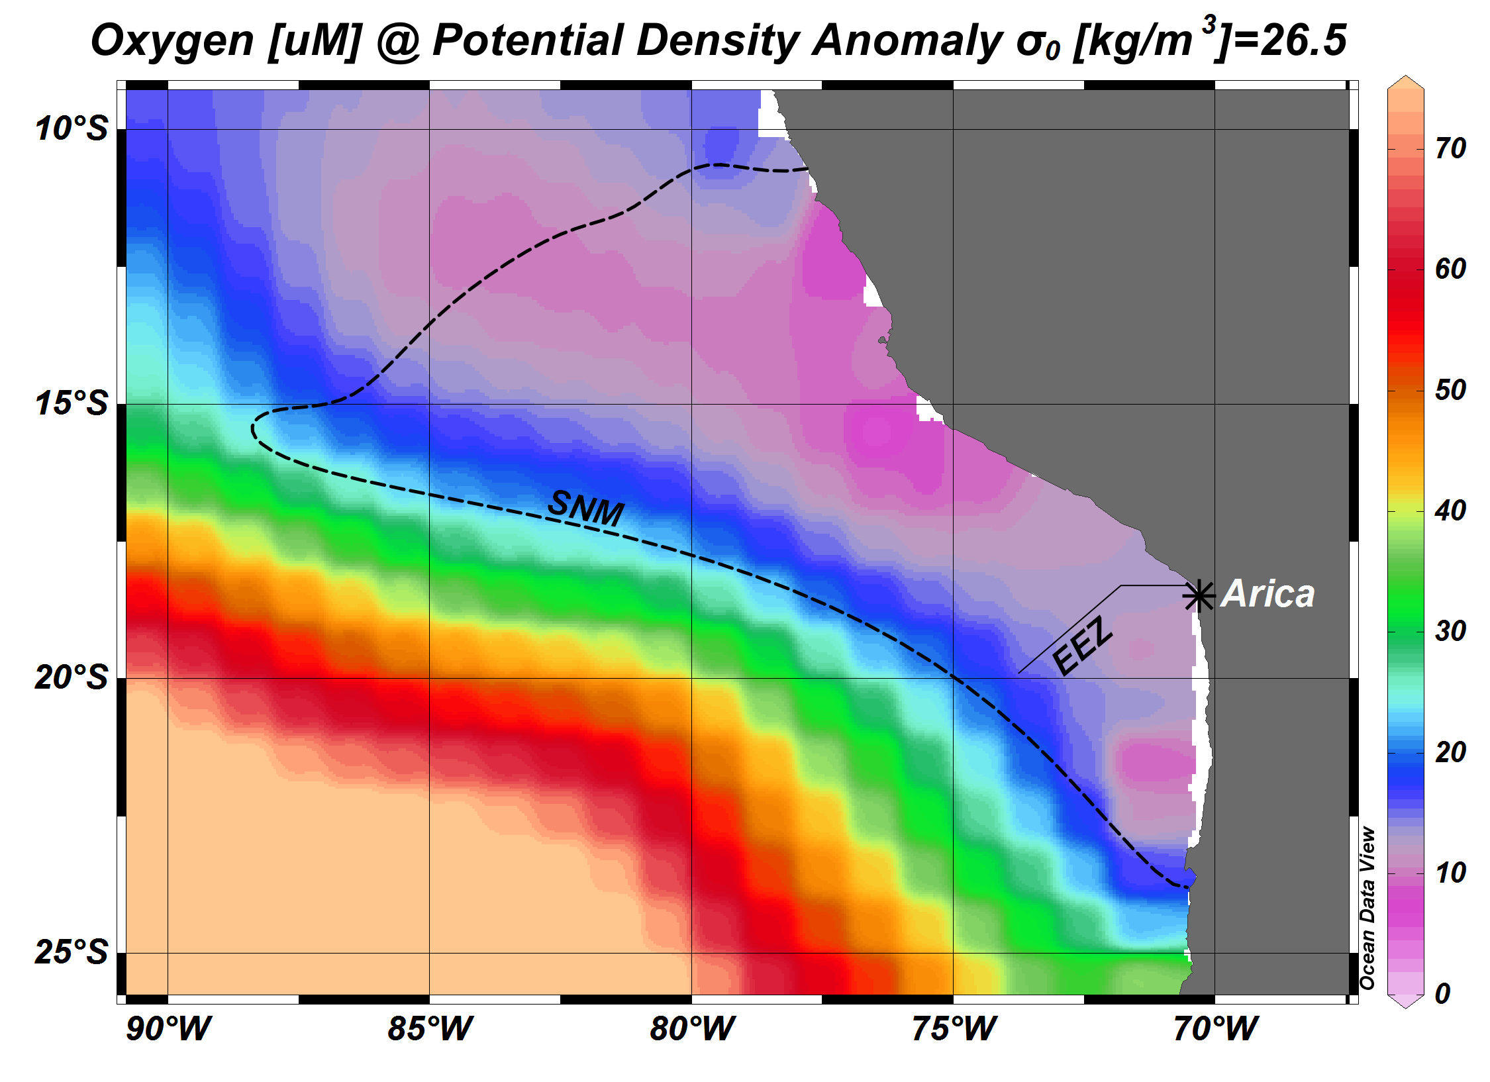
1/8/15
1/9/15
1/6-7/15
1/10-11/15
1/5/15
1/12/15
1/3-4/15, 1/14/15
1/13/15
1/15-16/15
1/2/15
1/22/15
1/17/15
1/1/15
1/21/15
1/20/15
1/18-19/15
12/31/14 – 1/23/15

