Slide 1
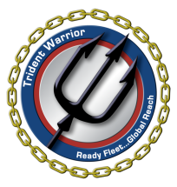
Trident Warrior 13
Unmanned System (UxS) METOC
Knorr Cruise Planning
Project
FIMS# 11738
Sponsor
Oceanographer of the Navy OPNAV N2/N6E
Office of Naval Research OPNAV N091
Daniel Eleuterio, ONR-322
703-696-4303
daniel.eleuterio@navy.mil
18NOV12

Slide 2
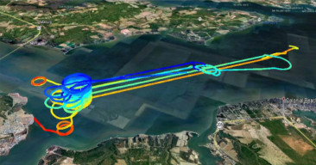
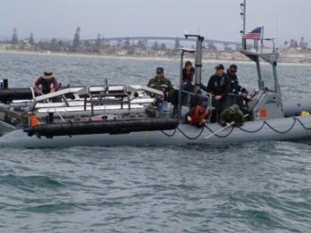
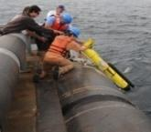
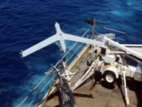
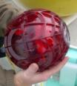
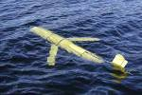
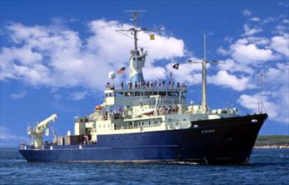
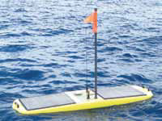
Overview
Official Initiative Description:
Unmanned Aerial and Surface System sensing and the METOC impact on EW, Communications, and ISR mission planning (“Approve” objective)
Additionally, assess opportunities to demonstrate emerging capability from S&T/R&D in integrated air-sfc-underwater Rapid Environmental Assessment under LBSF&I (“Improve” objective)
5 days on-station R/V Knorr (AGOR-15)
50 ScanEagle UAV Flight Hours
  (~10 sorties) (~50 Kts)
4 Waveglider USVs
6-8 Scripps drifting wave buoys
2 NPS Flux Buoys
4-6 SLOCUM Seaglider UUVs
2 REMUS-600 UUVs

Slide 3
Schedule (as of 12NOV12)
KNORR (AGOR-15)
July 8 – 10: Transit from WHOI to Norfolk.
July 11 – 12: In port Equipment On-load/mobilization
July 13: At-sea Transit
July 13/14 - July 17/18: On-station ops
July 18: At-sea Transit
July 19: In port Equipment Off-load demob
July 20 = ETD Norfolk to WHOI.
WASP (LHD-1)/ JASON DUNHAM (DDG-109)/ HUGO(TYL-8201)/ HUE CITY (CG-66)
July 15-19 At-sea

Slide 4
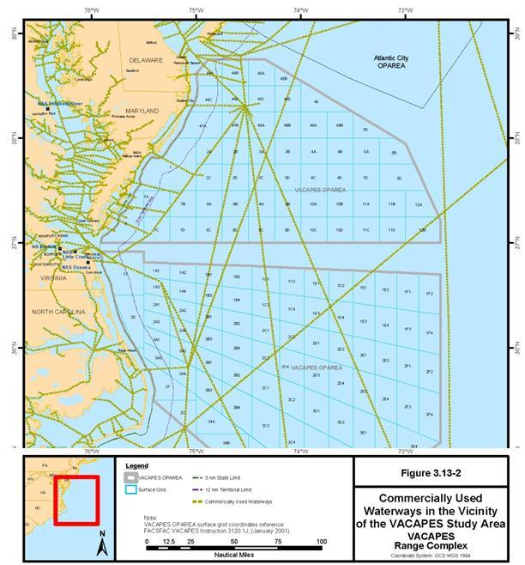
July 9/10
UUV/ USV Glider Deployment
UUV/USV SeaGlider and WaveGlider Launch
Knorr transit Woods Hole, MA to Norfolk, VA.
SeaGliders deployed south of Gulf Stream ~150-175 nm from shore
WaveGliders deployed in outer ranges 25-75 nm from shore
SeaGliders transit westward at ~1 KT for 7 days characterizing the ocean thermal structure

Slide 5
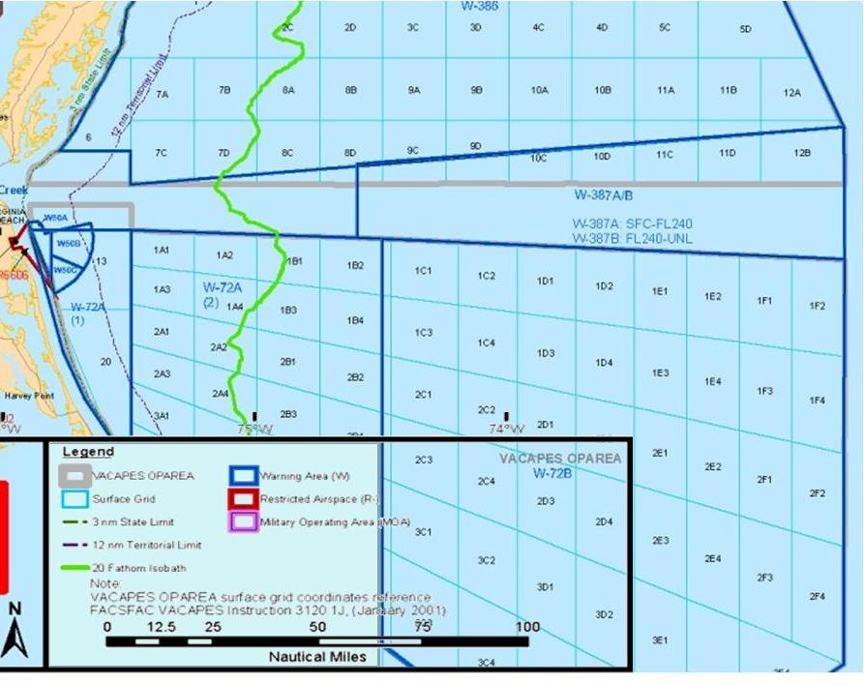
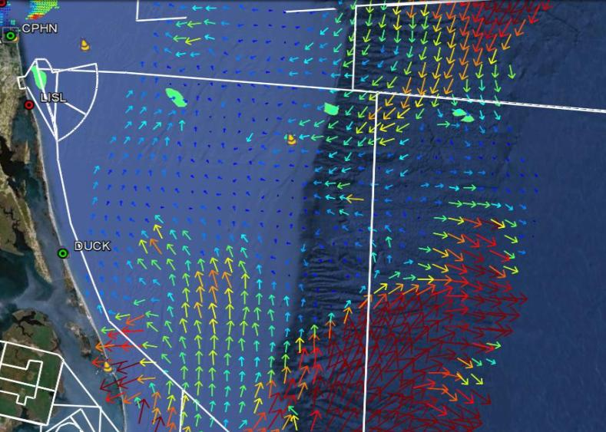
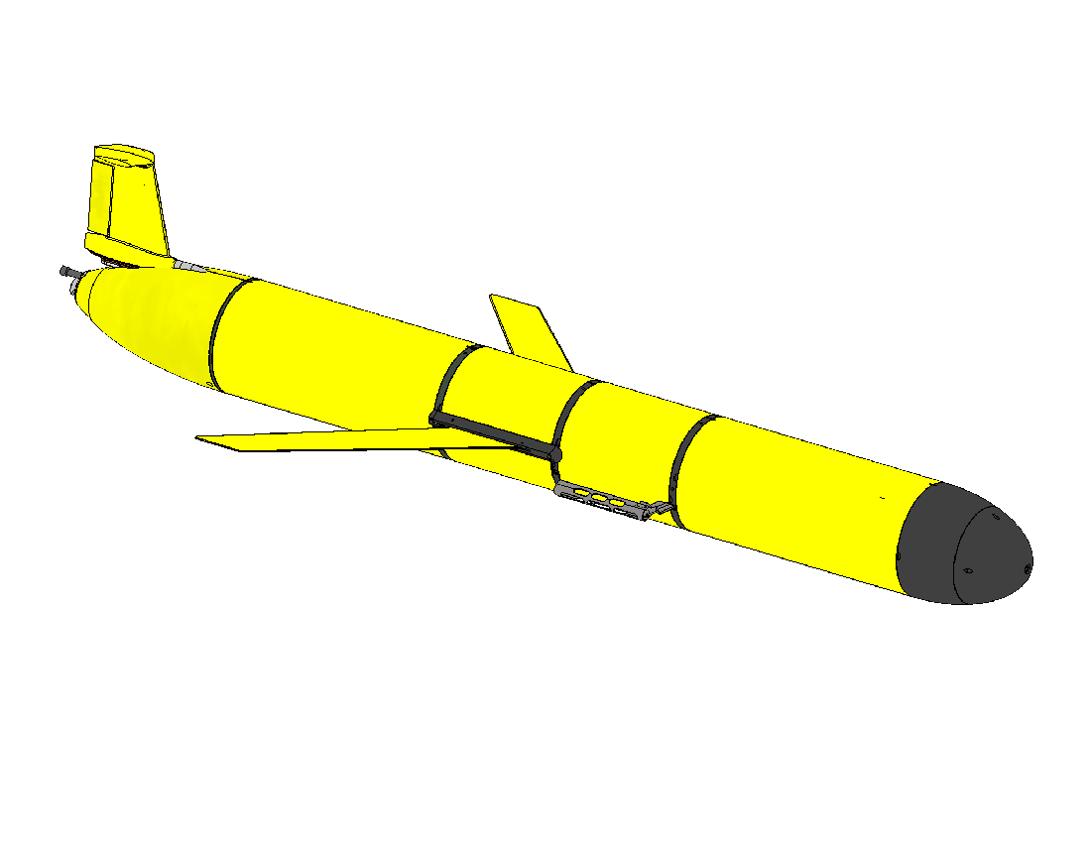
UUV/USV/Ship Operations
SLOCUM sea glider UUVs will be deployed to the East off of the shelf break by Knorr during ingress to Norfolk and will progress West at 0.5-1.0 kts collecting sea T(z), S(z) data.
SHARC waveglider USVs will be deployed in W-72(2) during ingress and will take station for first event 3 days later collecting air and sea T, q, U, V as well as currents and waves.
SIO Drifting Wave buoys will be deployed when Knorr gets back underway before taking station.
The Rapid Environmental Assessment NCOM forecasts with and without this additional data will be compared to in-situ ocean current and temperature data from REMUS-600 UUV CTD and ADCP sensors, either deployed via RHIB from shore or from Knorr if LARS system is available. REMUS-600 with 1 battery tray can travel ~130 nm at 3 kts before recovery.

Slide 6

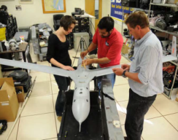
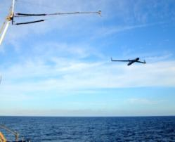
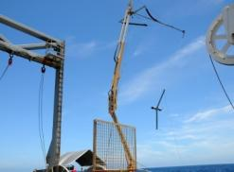
Airborne Sensing
Lead PIs: Jim Doyle (NRL) and Ken Melville (UCSD)
Specific flight profiles for best sampling strategy against likely synoptic and mesoscale regimes and EM propagation still in development
Flight corridors and requests for dedicated airspace needed now to provide to NWDC and FACSFAC (Melville/Lorenz Eber (NSWCDD)
Aircraft can fly between 100-15,000 ft at ~50kts for up to 10 hours, day or night. Typical mission day is 2 x 5hr flights. 1-Hz data resolution is ~90 ft horiz/ 10 ft vertical.
Measured variables (realtime: lat/lon/ht, t, p, q, u, v, time) (stored onboard: imagery, wave spectra, turbulence data)
Comms link is ~25 NM if aircraft is near the surface, farther at altitude.

Slide 7
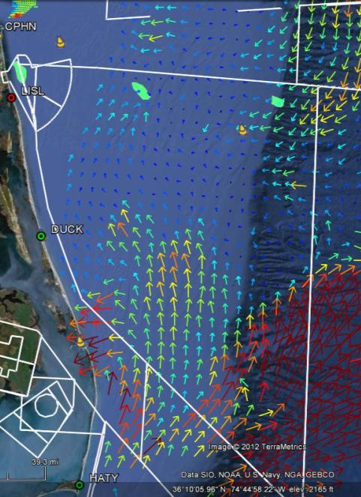



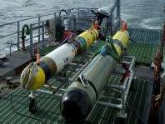
Ocean Sensing
Goals: Demo wave and ocean data assimilation system using in-situ observations Lead PIs: Kipp Shearman (OSU) and
Ken Melville (UCSD)
    6-8 drifting wave buoys (directional wave spectra)
    4 Waveglider/”SHARC” USVs with sfc met and ADCP current sensors (Tair, Tsea, q, p, U, V, currents (z))
    4-6 SLOCUM Gliders (T(z), S(z), currents (z), Fluorescence (z)).
    2 REMUS 600 (T(z), S(z), currents (z)). Either RHIB Launch Daily from shore or from Knoor TBD.
Notes:
6

Slide 8
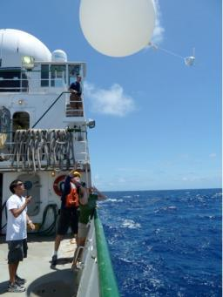
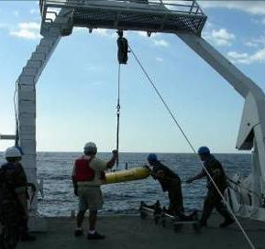
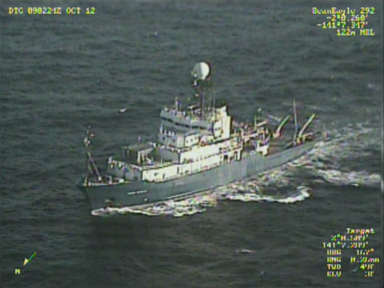
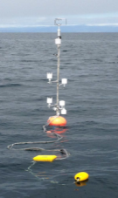
Shipboard Sensing
Goals: Demo wave and ocean data assimilation system using in-situ observations Lead PIs: Luc Lenain (UCSD)/ Qing Wang/Peter Guest(NPS)
    Leosphere Lidar Winds, Flux Tower, and Wave Lidar (Luc Lenain UCSD)
    Rawinsondes (Peter Guest NPS)
    EM Spectrum Analyzer (Ted Rogers SSC Pac)(RF SNR/Detection Ranges for known emitters)
    NPS Mini Flux Buoy (Corey Cherrett NPS)
    SeaBeam 3012-P1 multibeam swath mapping system
    Sippican MK 21 XBT
    SBE 911+ Deck Unit and CTD
    RDI Ocean Surveyor 75 KHz and RDI WorkHorse Mariner 300 ADCP
Notes:
7

Slide 9
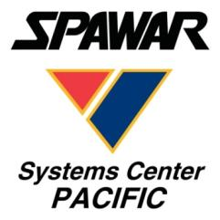
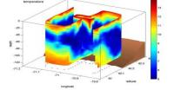
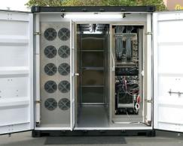
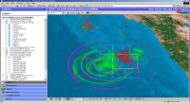
Shipboard Unmanned Maritime System Command & Control Van (UMV C2)
Lead PI - Gary Davis (SSC-Pac)
Integrator for Distributed Systems C2 applications
Vehicle command and control/mission planning
Environmental models and data
Situation awareness and display
SIPR Chat Ops Coordination
Autonomy
Navigation
Obstacle avoidance
Communications
SATCOM links (Iridium, INMARSAT)
OTH radio payloads
ACOMMS
Information Assurance
Encryption
Cross-domain solutions
Environmental
Optimization
Situational Awareness
8

Slide 10
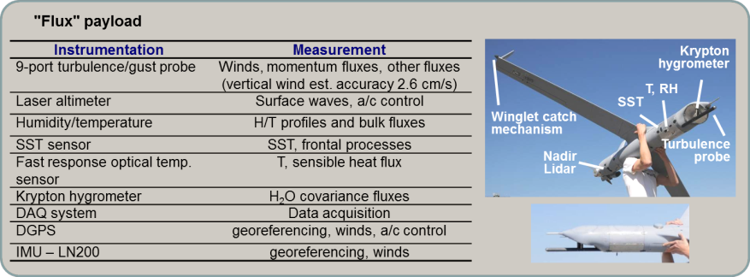
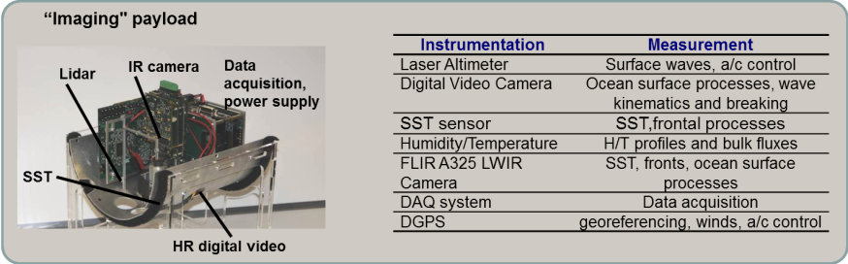
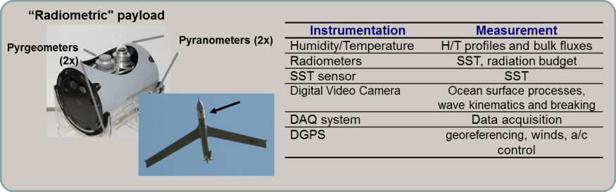
Scripps Scan Eagle UAV payloads

Slide 11
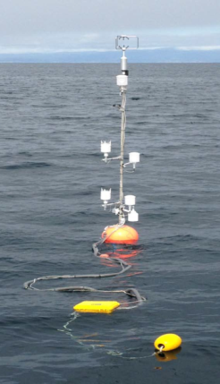
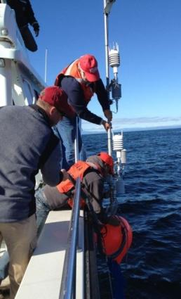
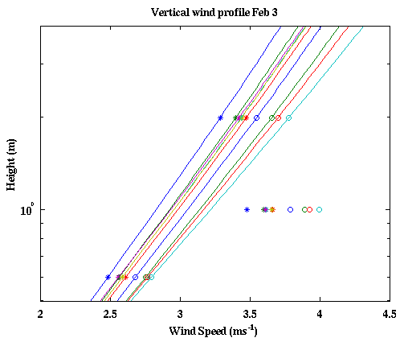
NPS Flux Buoy
NPS has developed a new flexible buoy system for sampling close to the air-sea interface. Instrumented spar buoys can be used to quantify the wave/swell-affected surface layer by making concurrent measurements in the lowest few meters of the atmospheric surface layer, the top 1 m of the upper ocean, and surface waves.
They are small, inexpensive, and easy to deploy and recover, and can be deployed in multiples near the ship and be recovered at a later time. The measurements from the system provide much needed ocean and atmospheric characterization at the interface away from flow and thermal distortions of the ship superstructure.
The system enables momentum flux measurement through direct eddy correlation method at 20 Hz sampling rate. For the mean met/ocean measurements, the system now has four temp/RH levels, three horizontal wind levels, and three levels of ocean temperature at 1 Hz sampling rate. Wave measurements are also done with a six-axis accelerometer.
Wind measurements within 2 m of the ocean surface in a low-wind and high-swell condition by the NPS mini buoy system showing the deviations (highlighted in circle) from the Monin-Obkhov similarity profiles (lines).

Slide 12
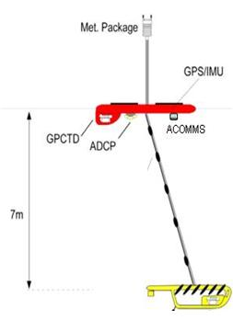
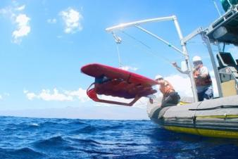
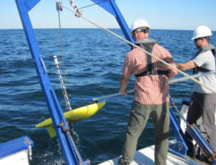
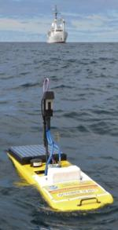
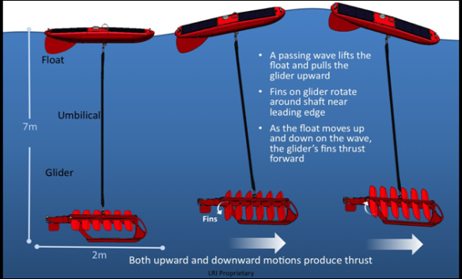
SSC-Pac Wavegliders
The LRI Waveglider or the Navy variant called SHARC (Sensor Hosting Autonomous Remote Craft) is a unique Two‐Part Vehicle that converts wave motion into thrust in calm and rough seas with a 1.5 kt average speed. On-board solar cells augment batteries to enable persistent, long duration missions with a variety of payloads.
Ingress to operations area from 100’s nm
Patrol, survey, or hold station for months
Provides C2 Gateway undersea to satcom
Egress and rendezvous for servicing
Existing fleet has traveled over 100,000 nm
Duration of longest mission: >12 months
Transit from Hawaii to San Diego in 79 days
Demonstrated survivability in Sea State 7

Slide 13
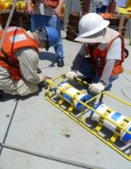

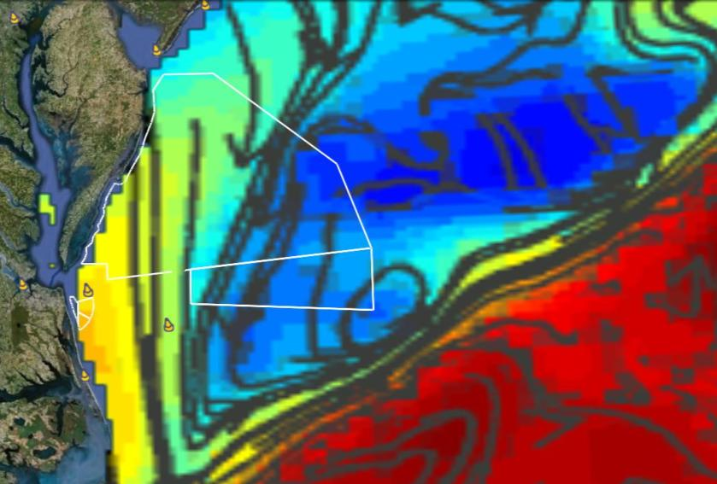
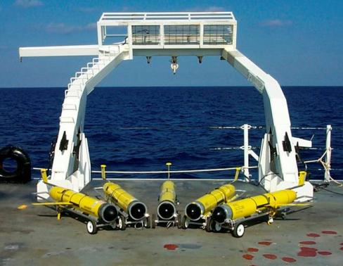
UUV Waterspace
Coordinated Operations
Gliders typically deploy in Phase 0: 1-2 weeks ahead of ESG at ~1 kt transit
Wave Buoys will be seeded during transit and slowly advect across the OPAREA to be picked up on July 18
Other assets can reposition at 1-2 knots – generally not considered in PMI or waterspace allocation

Slide 14
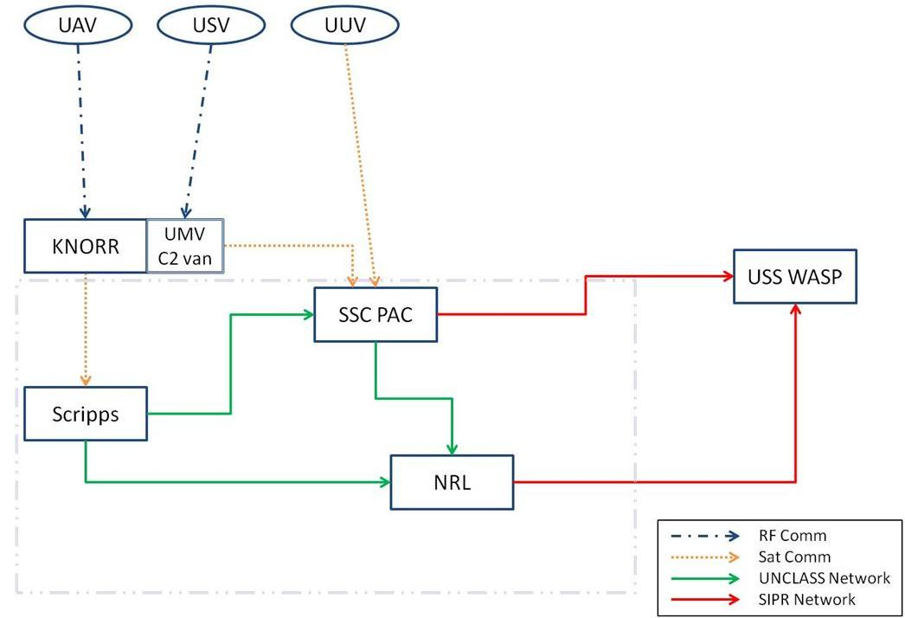
Phase II: System Identification and Documentation
NAVOCEANO
HWCDD Data
Observed Comms and Radar Ranges
FNMOC
Document system architecture, and implement Information Assurance (IA), test plans and procedures.

Slide 15
July 11/12 Ships
1 | 2 | 3 | 4 | 5 | 6 | 7 | 8 | 9 | 10 | 11 | 12 | 13 | 14 | 15 | 16 | 17 | 18 | 19 | 20 | 21 | 22 | 23 | 24
In Port Equipment Install
In Port Equipment Install
In Port Equipment Install
Key: LHA DDG Hugo Knorr

Slide 16
July 13 Ships
1 | 2 | 3 | 4 | 5 | 6 | 7 | 8 | 9 | 10 | 11 | 12 | 13 | 14 | 15 | 16 | 17 | 18 | 19 | 20 | 21 | 22 | 23 | 24
In Port Equipment Install
In Port Equipment Install
ScanEagle Inversion/GulfStream Variability
W-50 to W-72 (2)
Large Scale Boundary Layer / Gulf Stream Variability
W-72A(2) 1B3
Key: LHA DDG Hugo Knorr

Slide 17
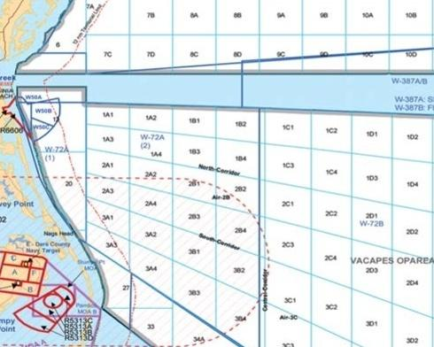
Flight Events
July 13, 2013
Large Scale: Sloping Inversion/ Gulf Stream Variability
Knorr MODLOC in W-72A(2) 1B1-1B3. Wasp in-port.
Need to assess max distance for UAV Control freq.
Launch 3 hr rawinsondes
USVs in green sfc data
UAV conducts spiral
soundings to 8 KFT
above USVs and vertical
Sawtooth at inversion
height ~3 KFT
One flight ~10AM- 6PM
Knorr
45 NM

Slide 18
July 14 Ships
1 | 2 | 3 | 4 | 5 | 6 | 7 | 8 | 9 | 10 | 11 | 12 | 13 | 14 | 15 | 16 | 17 | 18 | 19 | 20 | 21 | 22 | 23 | 24
In Port Equipment Install
In Port Equipment Install
ScanEagle SeaBreeze
W-50 to W-72 (2)
Mesoscale Diurnal SeaBreeze
Key: LHA DDG Hugo Knorr

Slide 19
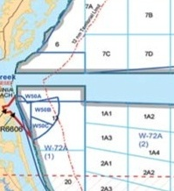
Flight Events
July 14, 2012
Mesoscale: Diurnal SeaBreeze
Knorr MODLOC at NE corner
W-72A(1). Wasp in-port
3 hr sondes
USVs in green for sfc data
UAVs in purple conduct spiral soundings to 8 KFT (60 mins) above USVs and stacked legs
in between sfc stations
Since Wasp is in port – one long daytime flight ~2PM-11PM in W-50 more possible to best capture diurnal near-shore structure.
Knorr
20 NM

Slide 20
July 15 - Ships
1 | 2 | 3 | 4 | 5 | 6 | 7 | 8 | 9 | 10 | 11 | 12 | 13 | 14 | 15 | 16 | 17 | 18 | 19 | 20 | 21 | 22 | 23 | 24
Nite Steaming Box
Underway
AMIIP
Nite Steaming Box
Small Boat Attack
Ship Defensive Screen Detection Ranges W-72
Medium Scale: Ship Defensive Screen Detection Ranges W-72A(2) 1A1
Target ship
Key: LHA DDG Hugo Knorr

Slide 21
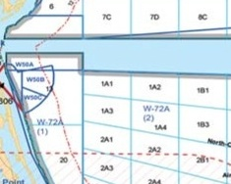
Flight Events
TBD ~July 15, 2013
Medium Scale: Ship Defensive Screen Detection Ranges
Knorr MODLOC 20 NM NE of LHD.
Need to assess maneuver distance for USVs or re-position with ship
6 hr sondes, 3 during flight
USVs in green sfc data
UAV conducts spiral
soundings to 5 KFT
above USVs and LHD
and stacked legs below and
at inversion to ~3 KFT
One flight ~10AM - 6PM
Knorr
30 NM
DDG
LHD

Slide 22
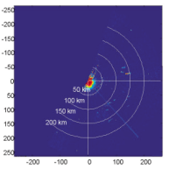
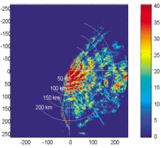
July 16 – Synchronization Matrix
1 | 2 | 3 | 4 | 5 | 6 | 7 | 8 | 9 | 10 | 11 | 12 | 13 | 14 | 15 | 16 | 17 | 18 | 19 | 20 | 21 | 22 | 23 | 24
Nite Steaming Box
FAC FIAC
W-50
Nite Steaming Box
Nite Steaming Box
EMIO W 72
Nite Steaming Box
AMIIP W 72
ScanEagle LandBreeze
W-50
ScanEagle SeaBreeze
W-50
Mesoscale Diurnal SeaBreezeW-72A(2) 1A1
EMIO W 72
Radar Clutter Elevated Duct vs. Strong Evap. Duct
Key: LHA DDG Hugo Knorr

Slide 23
Flight Events
July 16, 2012
Mesoscale: Diurnal SeaBreeze
Knorr MODLOC at NE corner
W-72A(1). Wasp at-sea
3 hr sondes
USVs in green for sfc data
UAVs in purple conduct spiral soundings to 8 KFT (60 mins) above USVs and stacked legs
in between sfc stations
Since Wasp is at sea – UAV operations may need to be suspended during other very active events like FAC/FIAC.
Two flights 4AM-9AM and 4PM-9PM
Knorr
20 NM
LHD
DDG

Slide 24
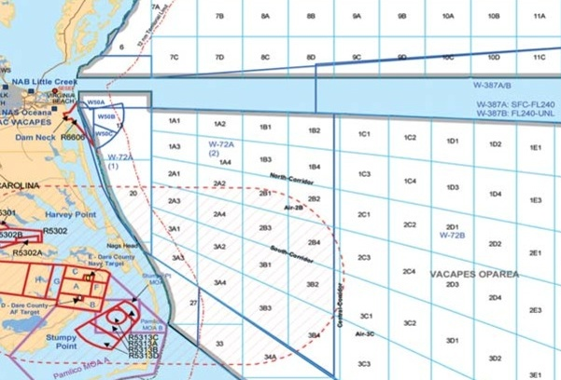
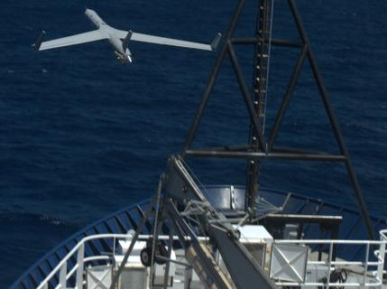
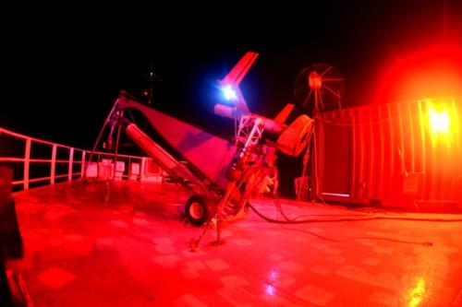
July 16
Near-shore Day/Night Ops
Knorr
LHD
Hugo
DDG

Slide 25
July 17 – Synchronization Matrix
1 | 2 | 3 | 4 | 5 | 6 | 7 | 8 | 9 | 10 | 11 | 12 | 13 | 14 | 15 | 16 | 17 | 18 | 19 | 20 | 21 | 22 | 23 | 24
Nite Steaming Box
Nite Steaming Box
Nite Steaming Box
Nite Steaming Box
AMIIP W 72
Ship Defensive Screen Detection Ranges W-72
Medium Scale: Ship Defensive Screen Detection Ranges W-72A(2) 1A1
Target ship
Key: LHA DDG Hugo Knorr

Slide 26
July 17 Medium Scale: Ship Defensive Screen Detection Ranges (with DDG vice LHD)
LHD
Hugo
Knorr
DDG

Slide 27
Flight Events
TBD ~July 17, 2013
Medium Scale: Ship Defensive Screen Detection Ranges
Knorr MODLOC 20 NM NE of LHD.
Need to assess maneuver distance for USVs or re-position with ship
6 hr sondes, 3 during flights
USVs in green sfc data
UAV conducts spiral
soundings to 5 KFT
above USVs and DDG
and stacked legs below and
at inversion to ~3 KFT
Knorr
20 NM
LHD
DDG

Slide 28
July 18 – Synchronization Matrix
1 | 2 | 3 | 4 | 5 | 6 | 7 | 8 | 9 | 10 | 11 | 12 | 13 | 14 | 15 | 16 | 17 | 18 | 19 | 20 | 21 | 22 | 23 | 24
Nite Steaming Box
FAC FIAC
W-50
Nite Steaming Box
Nite Steaming Box
EMIO W 72
Nite Steaming Box
AMIIP W 72
At-sea USV/UUV/Wave Buoy Recovery and Transit to In Port
EMIO W 72
Key: LHA DDG Hugo Knorr

Slide 29
July 19 – Synchronization Matrix
1 | 2 | 3 | 4 | 5 | 6 | 7 | 8 | 9 | 10 | 11 | 12 | 13 | 14 | 15 | 16 | 17 | 18 | 19 | 20 | 21 | 22 | 23 | 24
Nite Steaming Box
Nite Steaming Box
Nite Steaming Box
Nite Steaming Box
AMIIP W 72
In Port Equipment De-Install
Target ship
Key: LHA DDG Hugo Knorr

Slide 30
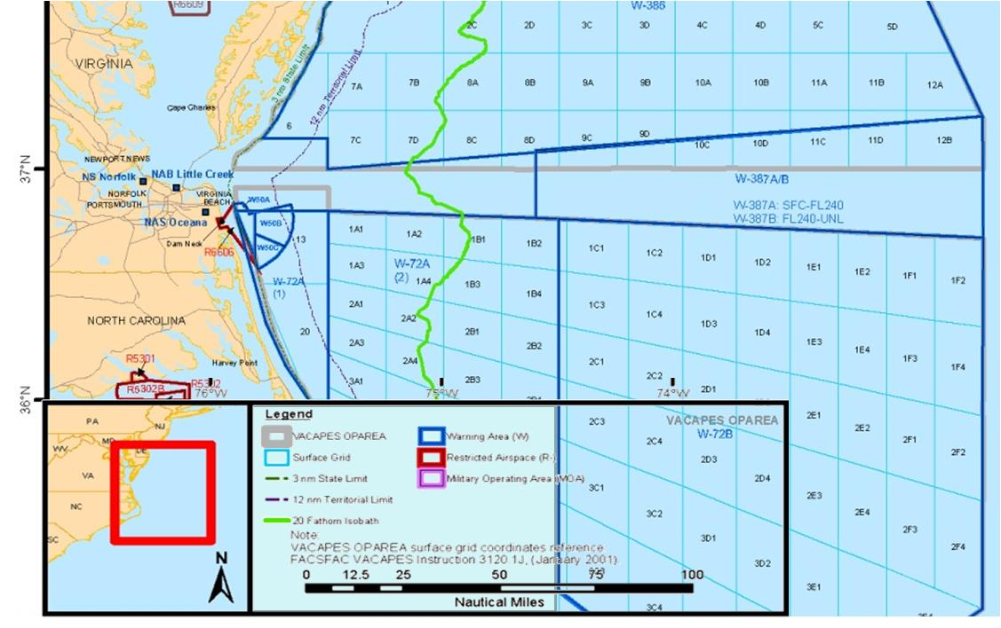
UUV/USV/Ship Operations

