Slide 1
Mid-Deployment Position
NRL Source Array (and NRL hydrophone/cable)
Sheave and block
Source cable
to Winch
NRL source array
8 July 2011

Slide 2
Pre-Deployment Position
NRL Source Array (and NRL hydrophone/cable)
Lots of slack
Sheave and Block
(flaked)
drogue
3'-0"
NRL winch
deck cable
DEPLOY
NRL source
CTD Winch
Capstan
J-box
NRL HLA receiver
HLA Weight
(flaked)
drogue
XF-4 source
and cable
DEPLOY
8 July 2011

Slide 3
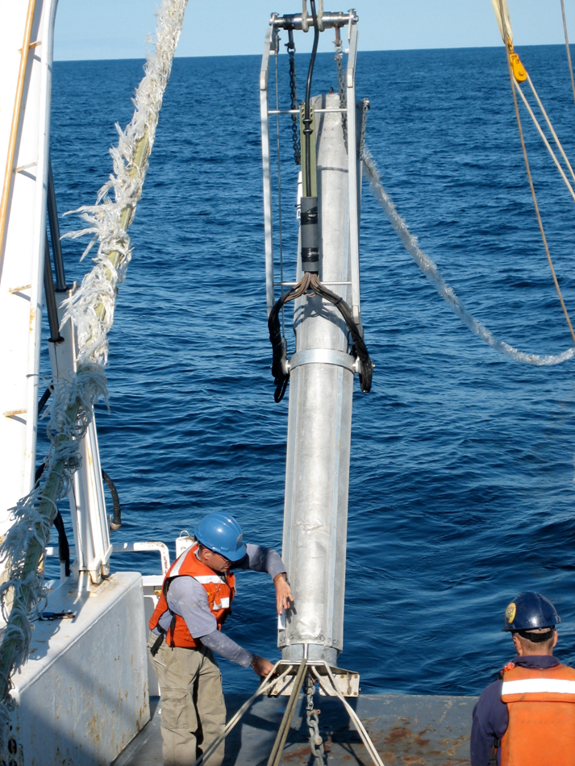
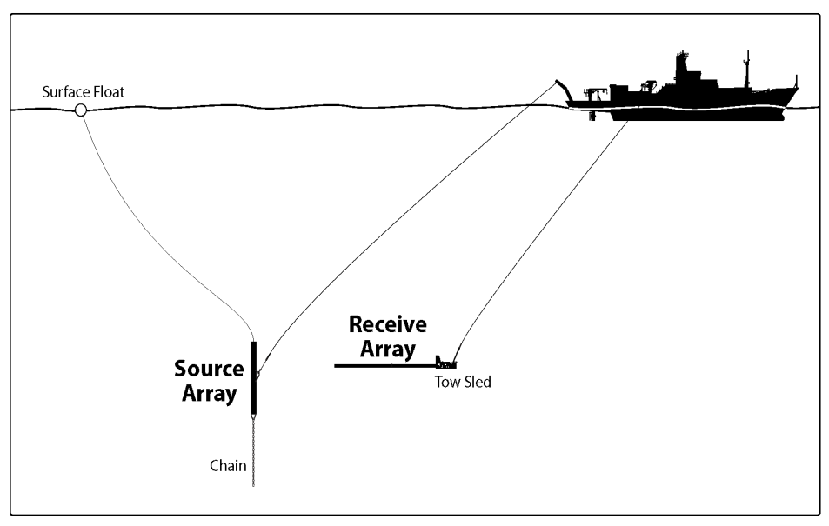
Measurement Approach
Experimentally, exploit the broadband capabilities of the NRL MF acoustic system to map out both reverberation and clutter spatially. temporally, and spectrally
Main acoustical sampling strategies
regional surveys, which produce synoptic “snap-shots” of the reverb/clutter
recording at fixed stations to observe the temporal evolution of the reverb/clutter
~3 kts
Drogue
Typical separation: < 35 m
NOT TO SCALE
Notes:
3

Slide 4
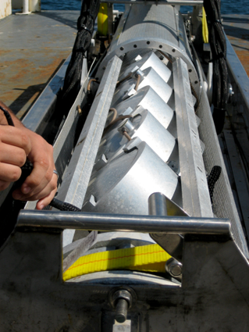
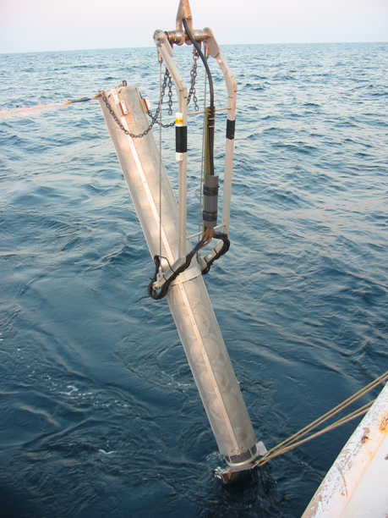
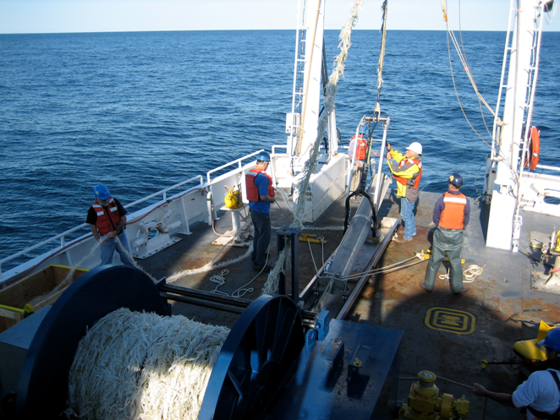
NRL MF Source Array (MFA)
10-transducer vertical line array (VLA) cut for ~3 kHz
Frequency: 1.5-9.5 kHz
Towable at up to 4 kts
Depths 20-200 m
2 NAS suites (depth, tilt, etc.)
’Quasi-omni’ azimuthally
10-% duty cycle
Elements individually
controllable
Shadeable, steerable
440-V power
Notes:
4

Slide 5
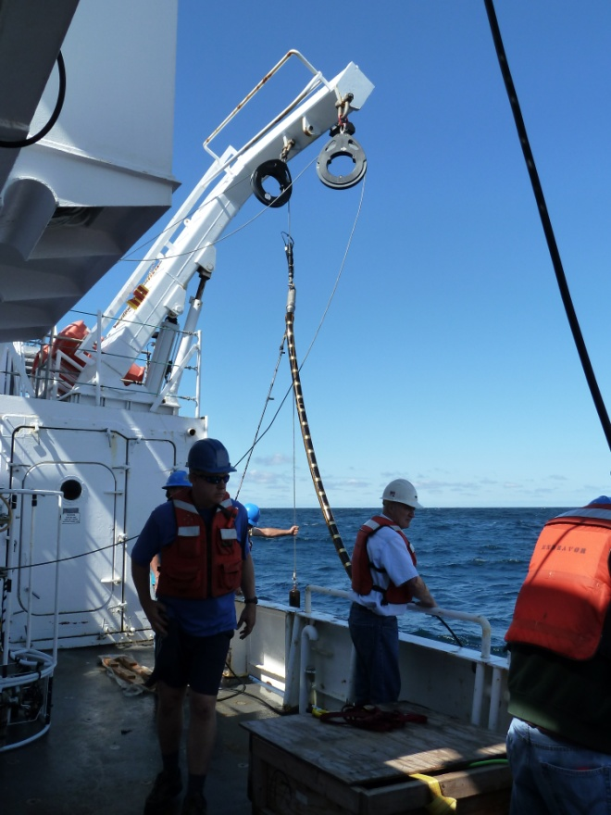
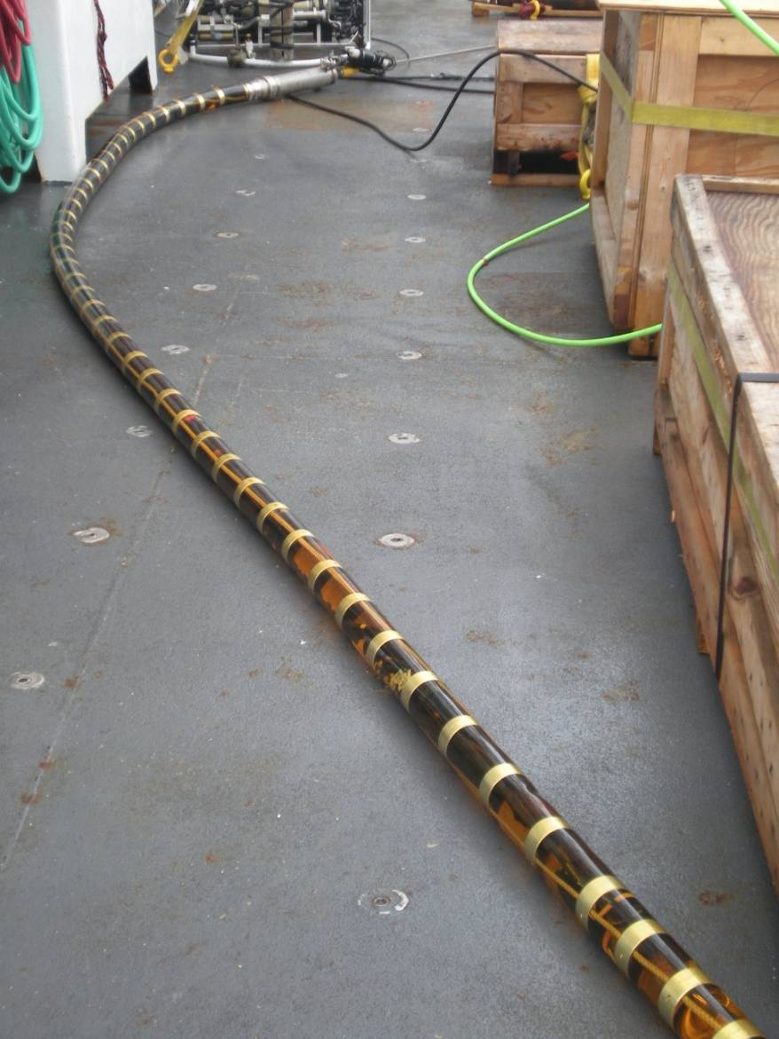
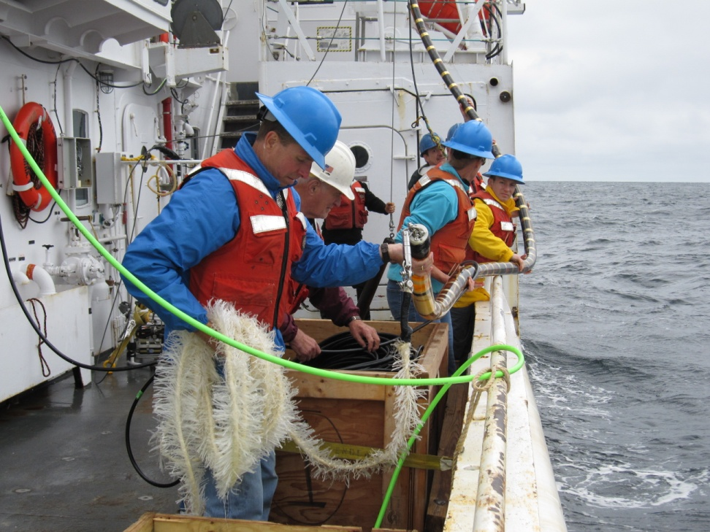
NRL MF Line-Array Receiver - 32 elements (w/ desen phone) (cut for 5 kHz; 0.1524-m spacing) - HLA or VLA mode - NAS sensors - No VIMs, so ‘sea-state sensitive’ - Max depths ~150 m or so - 30-kHz typical sample rate - Hand deployed off starboard/port
Notes:
5

Slide 6
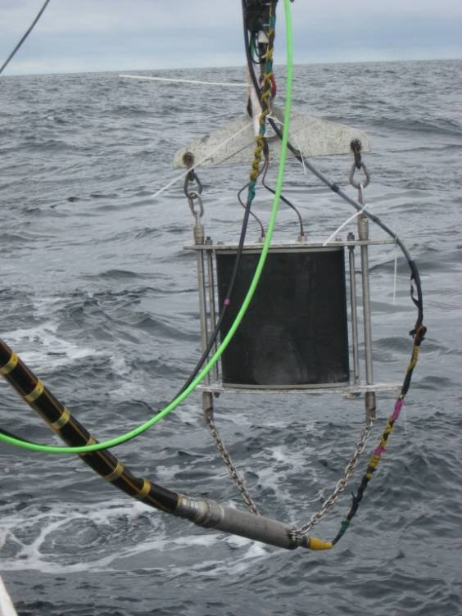
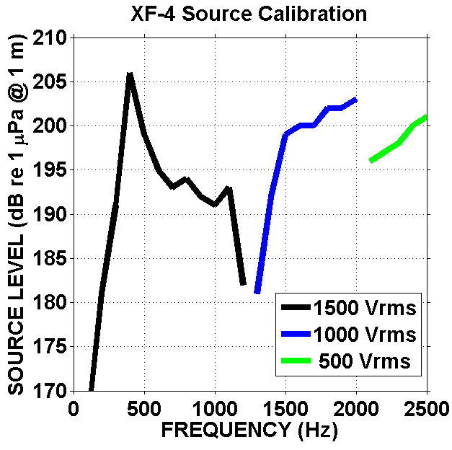
NRL XF-4 Source
- Towable (up to 4 kts)
Omni
Depths: up to 125 m
10% duty cycle
Notes:
6

Slide 7
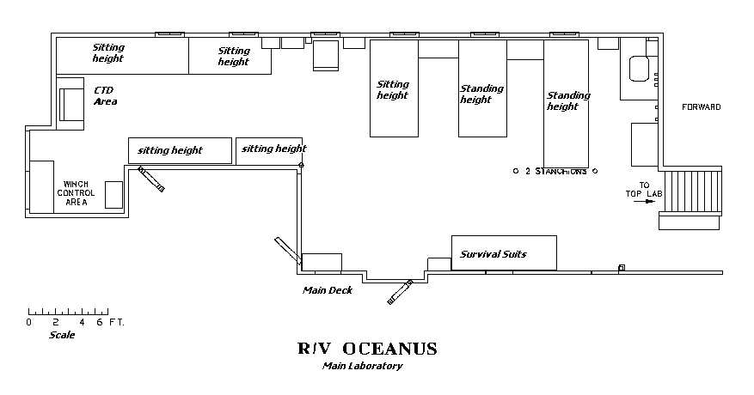
NRL Main Lab Equipment/Cabling Layout
Option A (preferred)
CONSTRAINT: Need separation of front of amplifier to be ≤ 3 feet from an NRL table
XF-4
Amp
Sitting
height
Sitting
height
Stacked
Orange
Boxes
MFA
Amp
Source
deck
cables
Front of amplifier
Need 2 feet of clearance behind
back of amp (where its fans are)
Hydrophone wires
(NRL array)
GPS antenna cable
8 July 2011

Slide 8
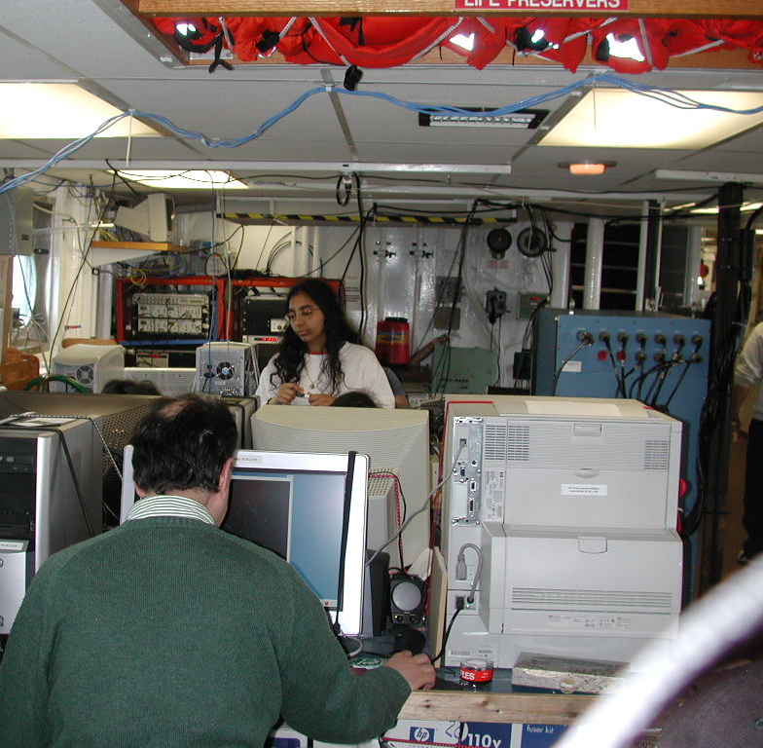
Geoclutter 03 (R/V Oceanus)
NRL Amplifier (back and front)

Slide 9
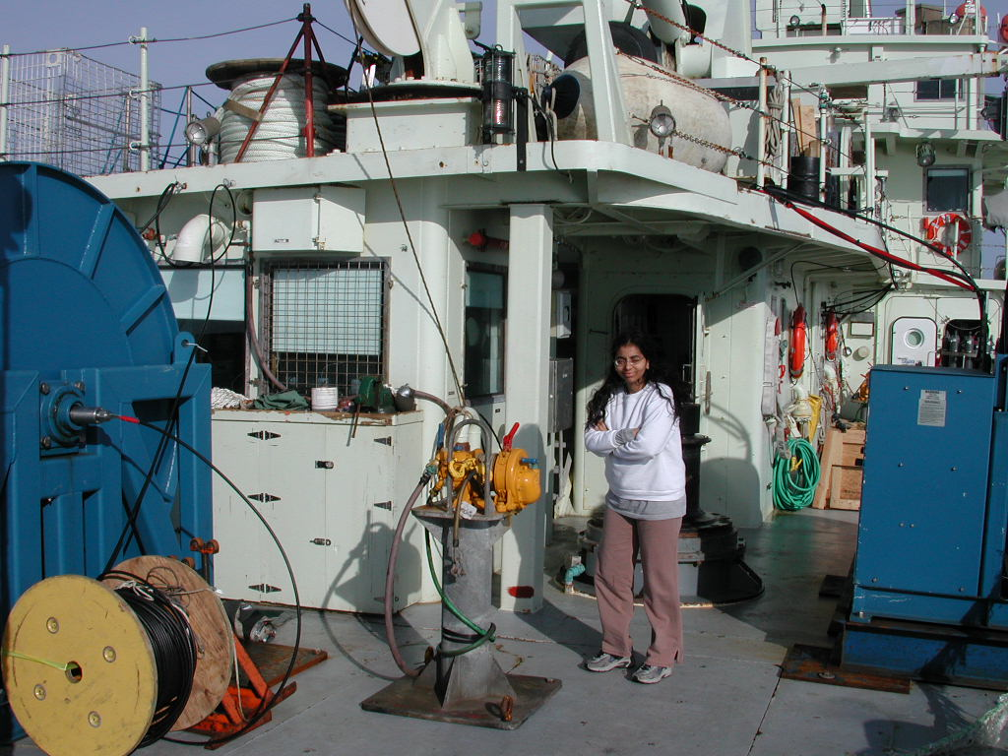
R/V Oceanus
Note starboard overhang which made it tricky to crane the NRL amplifier into the dry lab

