Slide 1
12.708: Special Topics in Paleoclimatology
Delia OPPO doppo@whoi.edu
Olivier MARCHAL omarchal@whoi.edu
Temperature Reconstruction in the Ocean & Atmosphere
over the Past Millennium

Slide 2
Assignments:
READ!
One or two papers will be posted prior to each class. Please read these papers carefully
& prepare a list of questions about them for next class. You will ask your questions in class.
PRESENT!
You will present a particular paper in class (ppt, ca. 15-min). You will summarize the paper,
put it in perspective, and identify its pros & cons. Please insert in your presentation
questions to be addressed in class.
PARTICIPATE!
Please contribute to the discussion in class. Do not hesitate to ask questions, including
very basic ones, and try to answer the others’ questions.

Slide 3
Today: Instrumental Record
1) Introduction: The Climate System
2) Atmospheric Temperature & Sea Surface Temperature (SST)
3) Subsurface Ocean Temperature
4) Paper of Roemmich et al. (2012)
(Reconstructed NH, SH, and global temperatures over the past 2,000 yrs)

Slide 4
What is “climate”?
Climate
∼ 30-yr average state of the atmosphere
Average State
mean, variance, and higher moments of:
- temperature
- precipitation
- wind velocity
- ...
WMO (2015)
Notes:
Climate is generally defined as a mean state of the atmosphere over some time interval, such as 30 yr.
Note the term “climate” is sometimes used loosely in the literature, i.e., one could read “the climate of the ocean”, the “hydroclimate”, etc. By “climate” what it usually implied is a mean state of the component of interest (e.g., the ocean) over some stated or unstated period.

Slide 5
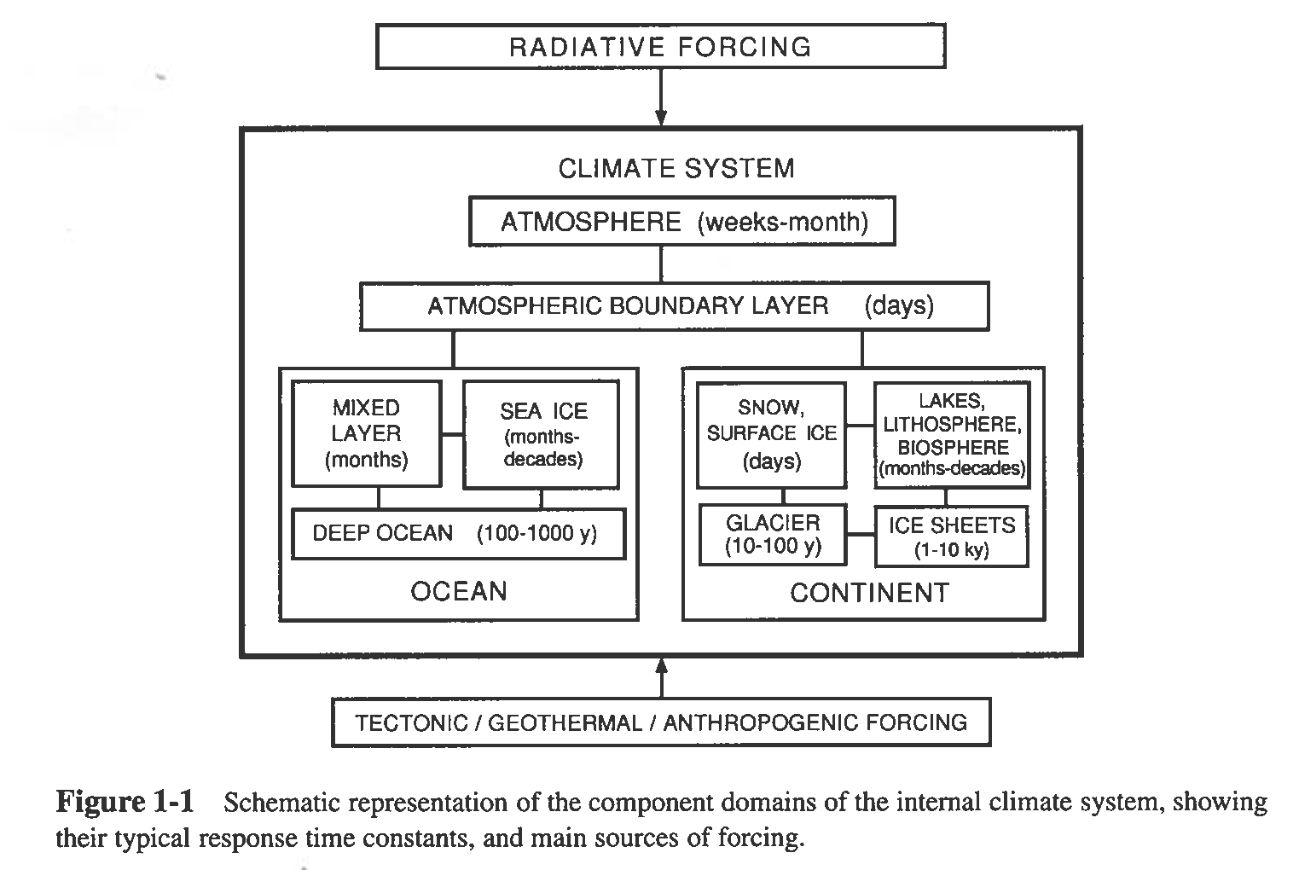
The Climate System
Saltzman (2002)
Notes:
The climate system is composed of three major interacting components: (i) the atmosphere, (ii) the ocean with sea ice, and (iii) the continents with snow- and ice-covered regions, lakes, etc.
The components and subcomponents of the climate system are characterized by response times that vary over a huge range. Thus, the atmosphere has estimated response times of days to months, the ocean from months to a millennium, sea ice from months to decades, ice sheets from 1,000 to 10,000 years, etc.
The climate system as a whole is forced by two types of external agents: radiative forcing and tectonic/geothermal forcing. By external agent is meant an agent that can influence earth climate but that could not be influenced by it. In that spirit, the anthropogenic forcing should be regarded as an internal agent, since greenhouse gas emission, for example, could be influenced by climatic conditions.
The radiative forcing: this includes variations in the solar irradiance at the “top of the atmosphere” (which we will call “insolation”). These variations can be caused by (i) changes in the “solar constant” and (ii) changes in the parameters that determine the orbit of the earth around the Sun (eccentricity, obliquity, and precession)
Tectonic/geothermal forcing: this forcing emanates from plate movements and from geothermal fluxes from the ground or the seafloor. Re. the effect of plate movements, consider, for example, the positioning of continents near the poles that may favor glaciations, the gradual emission of CO2 to the atmosphere from volcanism, the orogenesis that may favor the onset of monsoons, etc.
Anthropogenic forcing: the combustion of fossil fuels and tropical deforestation are two prominent examples thereof.
It is interesting to contrast the longest response time, on the order of 10,000 yr for the ice sheets, with the length of the instrumental records, which is on the order of 100 yr at best. Thus, the span of even the longest instrumental records amounts to only 1% the response time of ice sheets. Clearly, instrumental records are utterly inadequate to provide a comprehensive picture of climate variability.

Slide 6
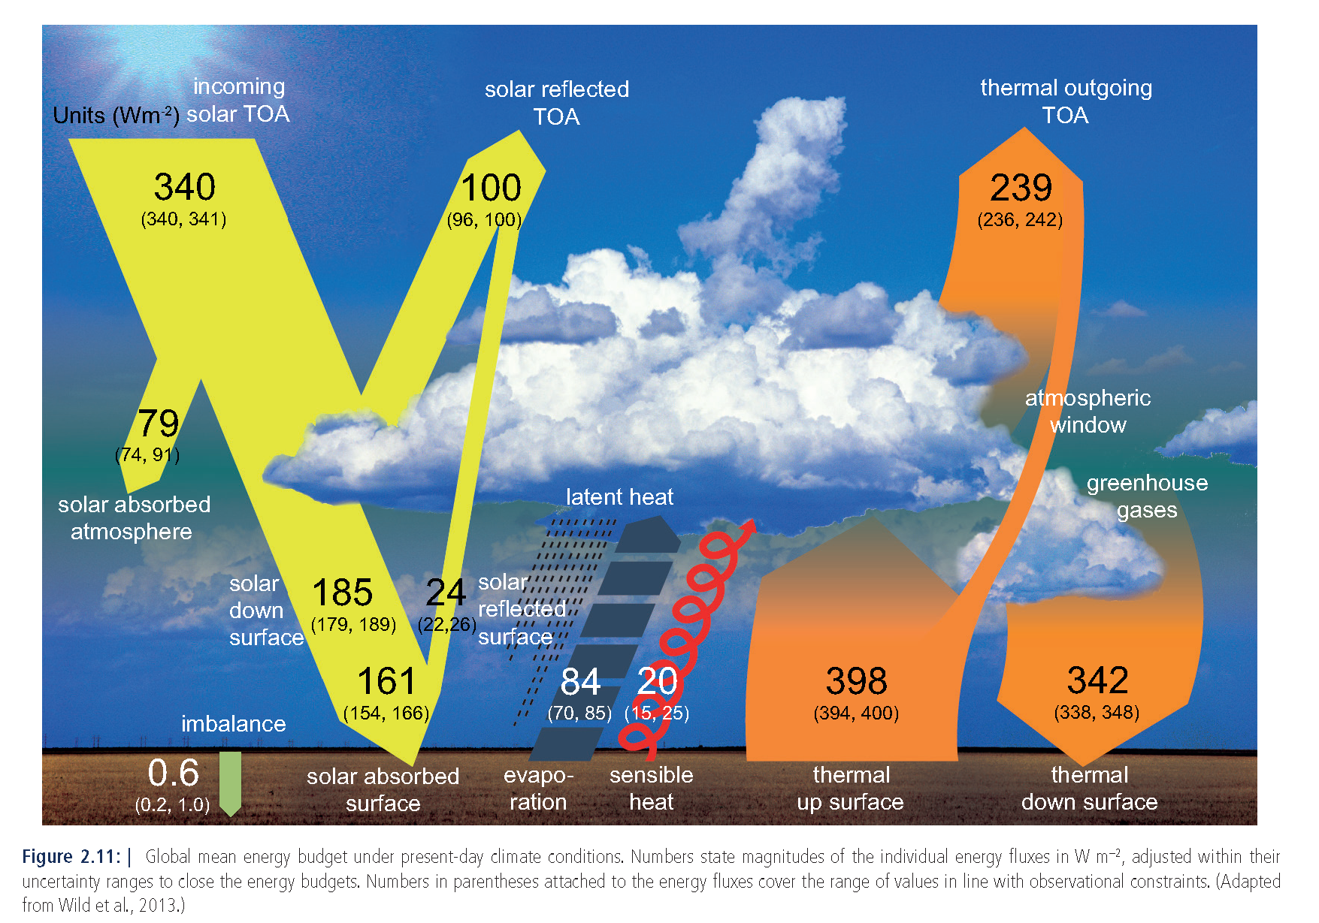
Global Mean Energy Budget
IPCC, Chapter 2 (2013)

Slide 7
Atmospheric Temperature & SST

Slide 8
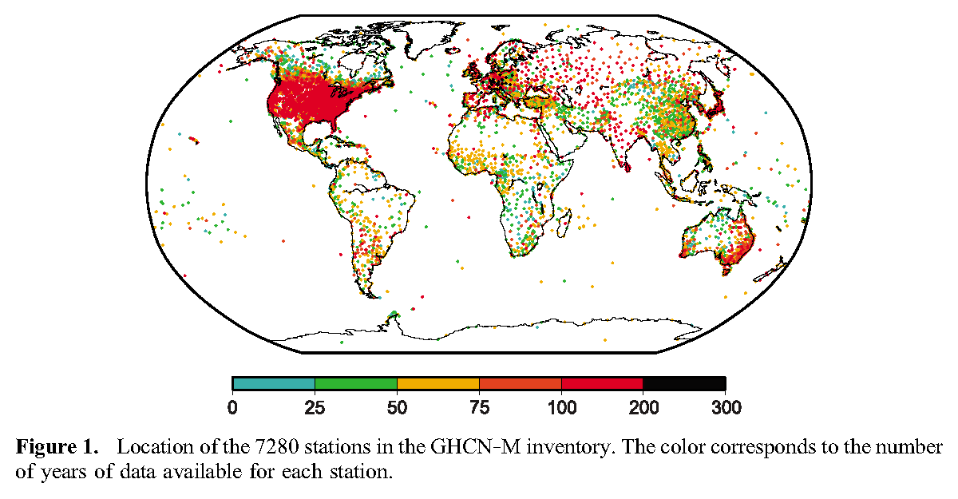
Global Historical Climatology Network
Lawrimore et al. (JGR-Atmosphere, 2011)

Slide 9
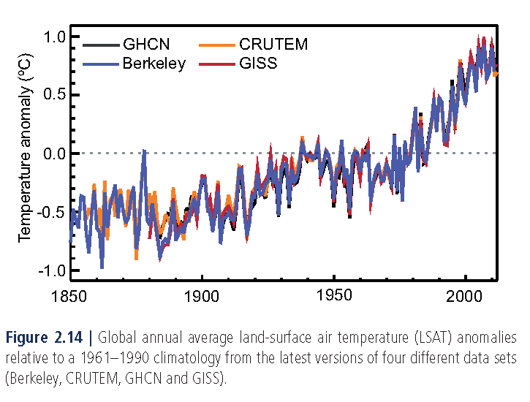
Global Annual Mean Land Surface Air Temperature
IPCC, Chapter 2 (2013)

Slide 10
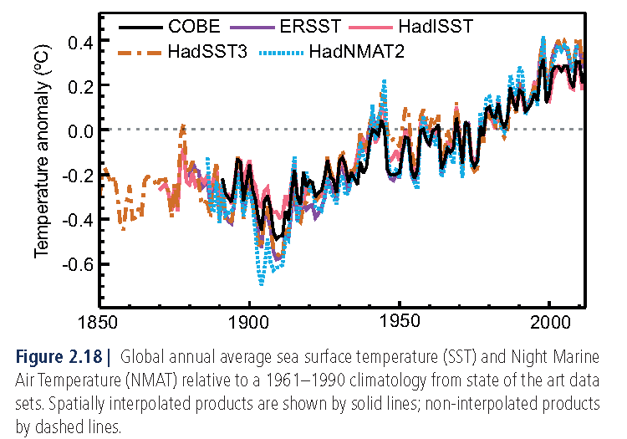
Global Annual Mean NMAT & SST
IPCC, Chapter 2 (2013)

Slide 11
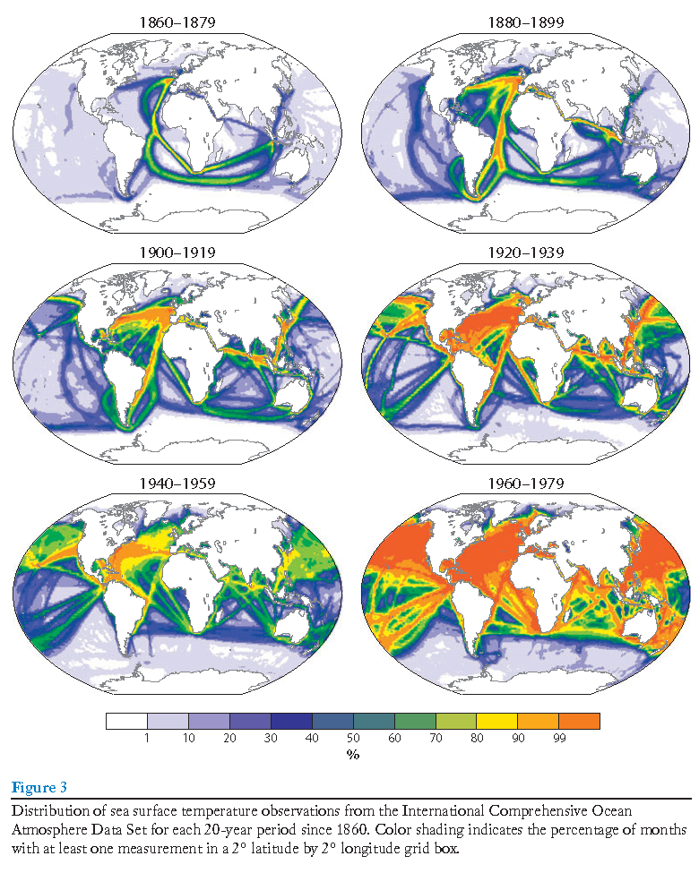
Coverage of SST Data from International Comprehensive Ocean Atmosphere Data Set
Deser et al. (ARMS, 2010)

Slide 12
Trend Estimates of Global Mean Surface Temperature
IPCC, Chapter 2 (2013)

Slide 13
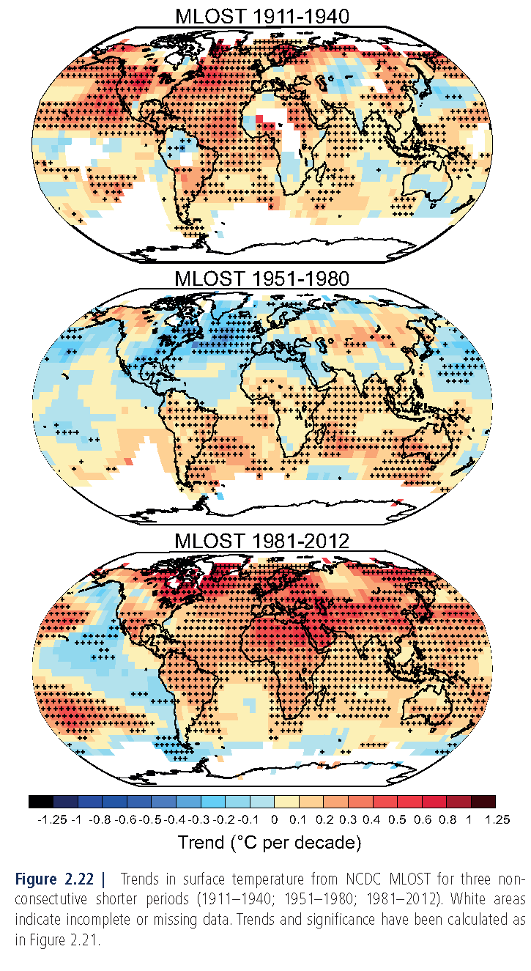
IPCC, Chapter 2 (2013)
Notes:
keep

Slide 14
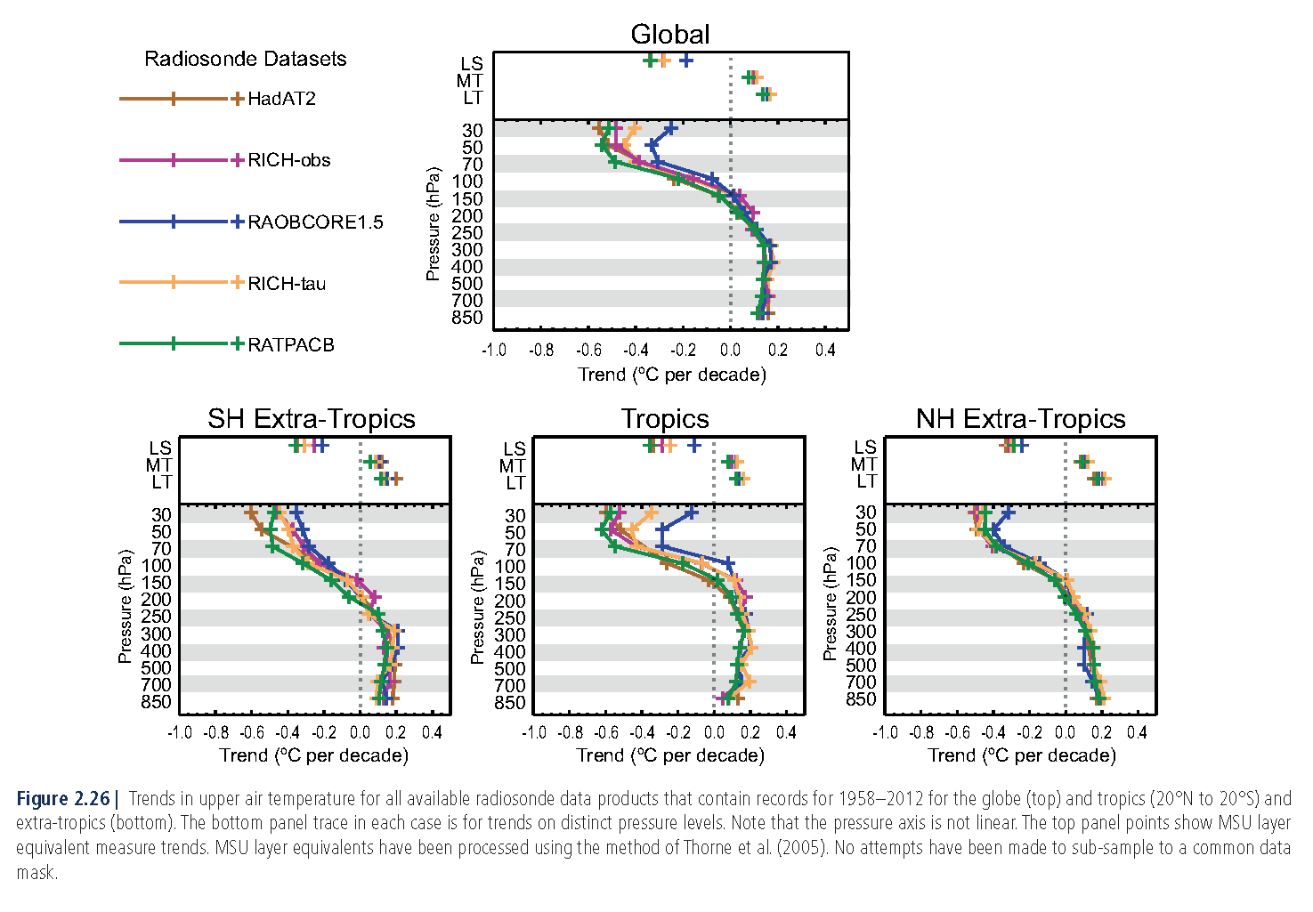
Trend Estimates of Upper Air Temperature
IPCC, Chapter 2 (2013)
Notes:
Destruction of O3
Relation with radiative balance

Slide 15
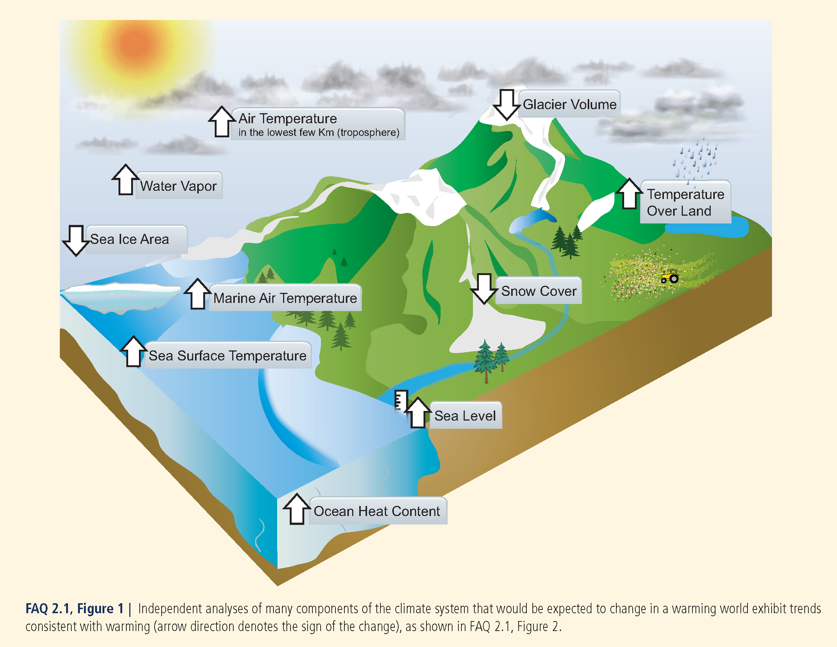
Trends Expected in a Warming World
IPCC, Chapter 2 (2013)

Slide 16
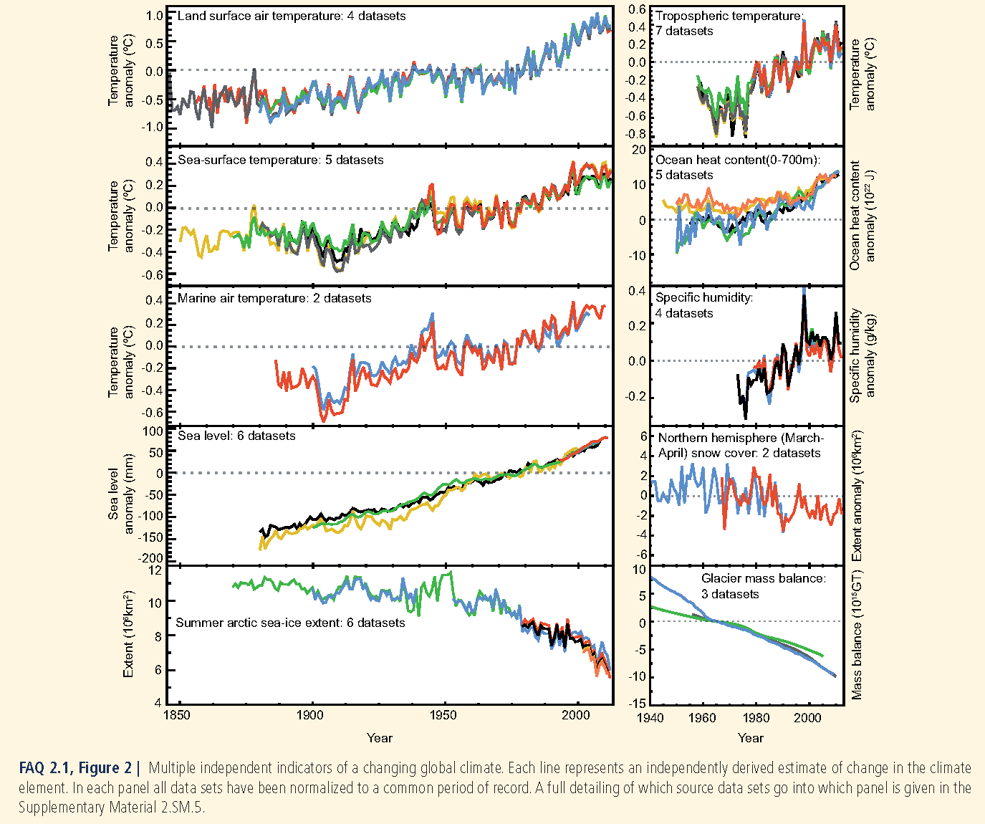
IPCC, Chapter 2 (2013)

Slide 17
Subsurface Ocean Temperature

Slide 18
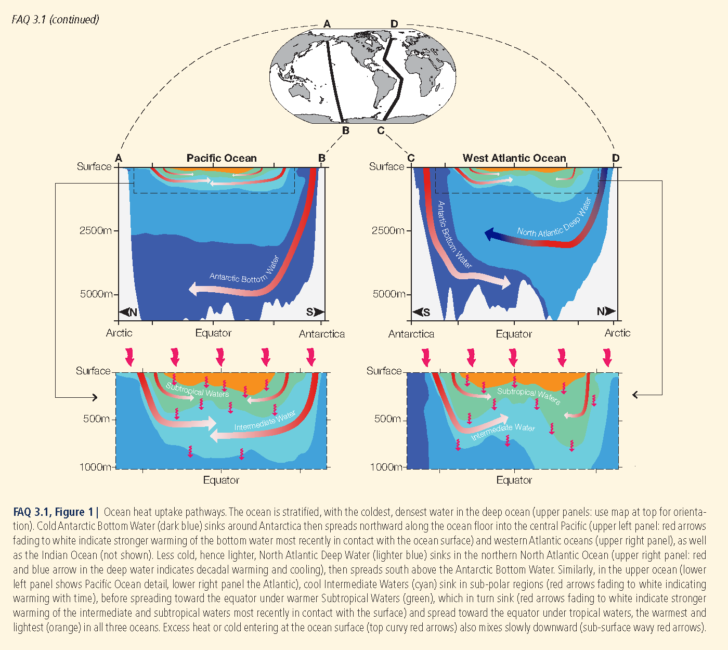
PATHWAYS OF OCEAN HEAT UPTAKE
IPCC, Chapter 3 (2013)

Slide 19
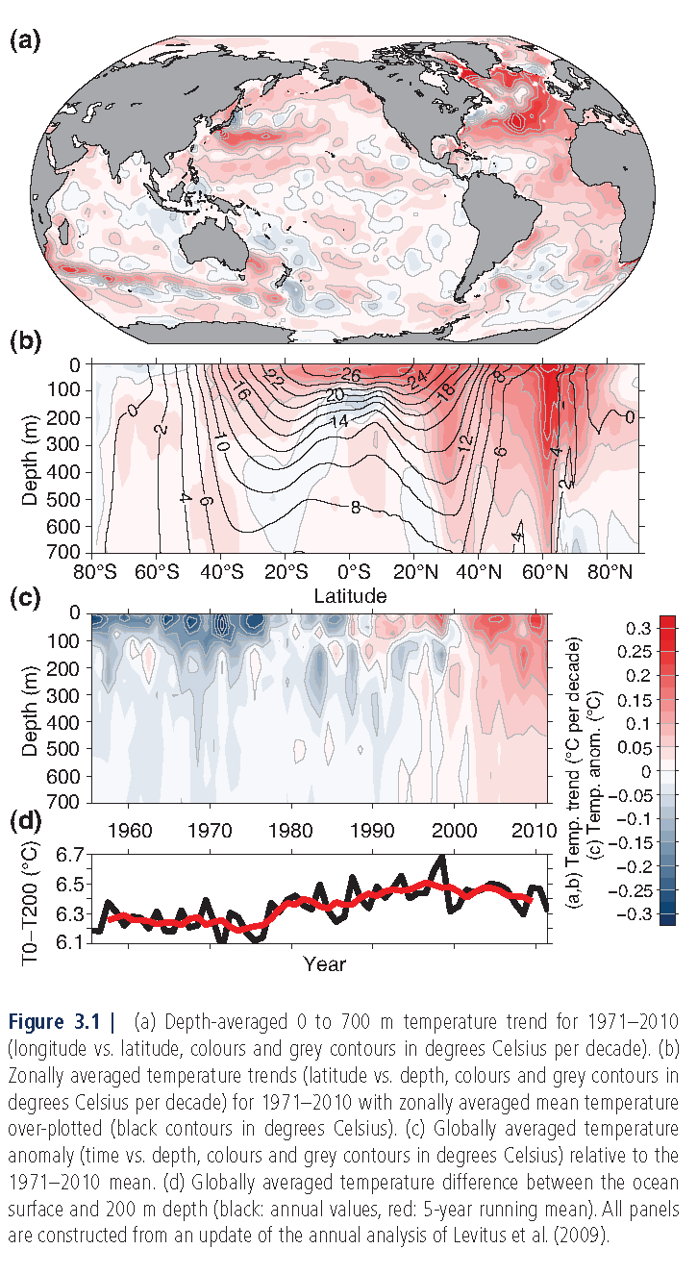
T trend between 0-700 m (ºC/decade)
T trend between 0-700 m (ºC/decade)
T anomaly between 0-700 m (ºC)
IPCC, Chapter 3 (2013)

Slide 20
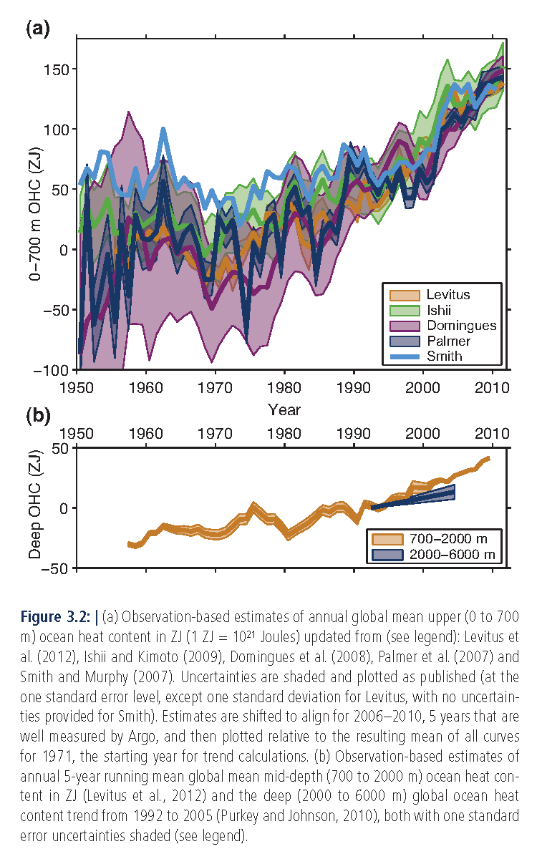
Global annual mean heat content
between 0 and 700 m
between 700 and 2000 m
IPCC, Chapter 3 (2013)

Slide 21
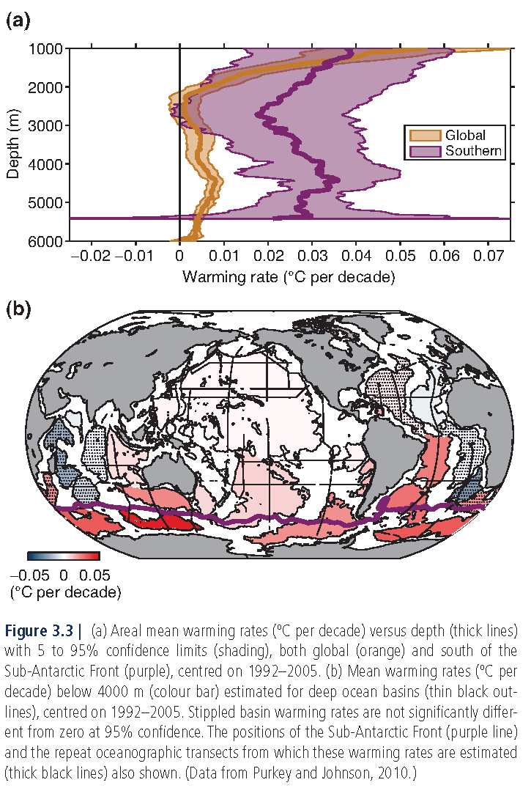
Warming Rates
areal mean rates
mean rates below 4000 m
IPCC, Chapter 3 (2013)

Slide 22
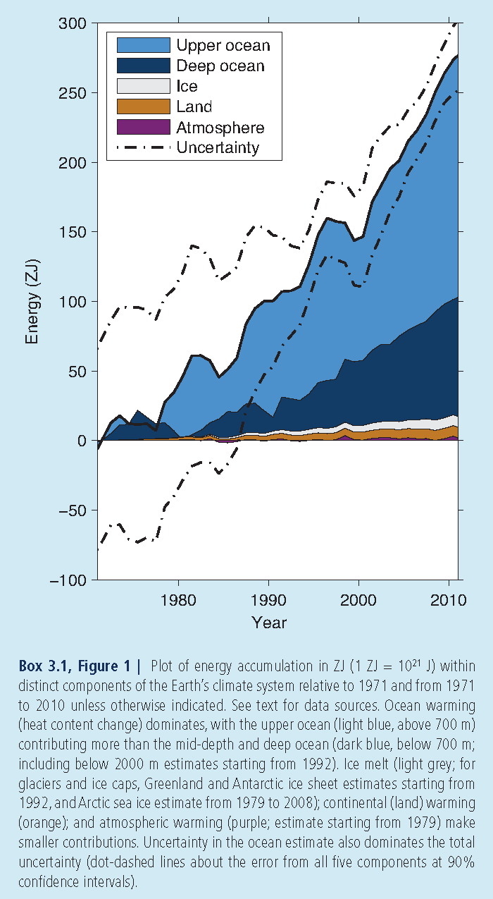
HEAT ACCUMULATION IN DIFFERENT CLIMATE SYSTEM COMPONENTS
IPCC, Chapter 3 (2013)

Slide 23
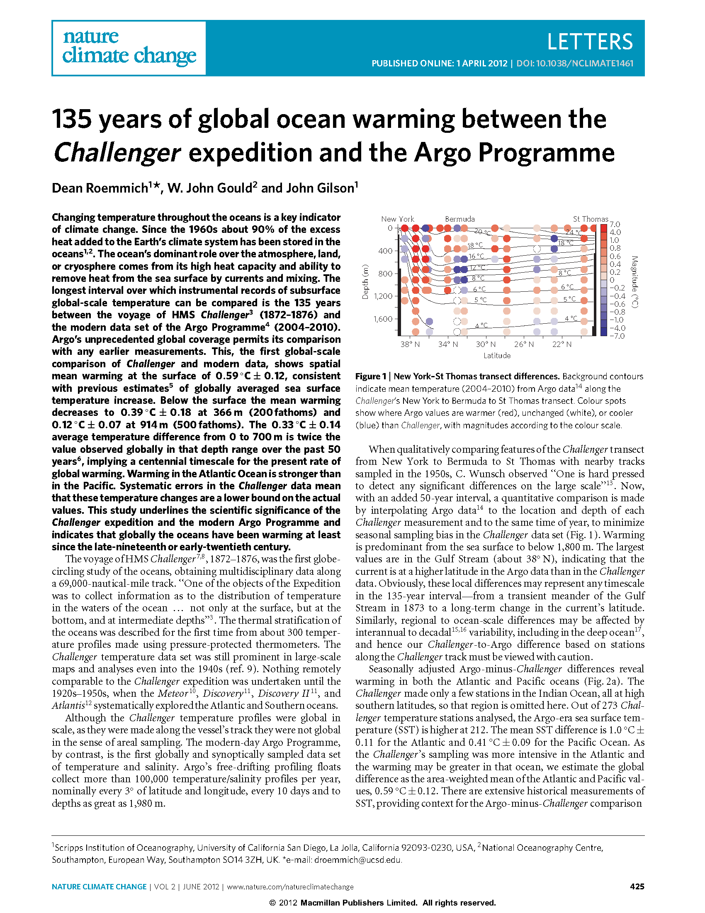
Paper of Roemmich et al. (2012)

Slide 24
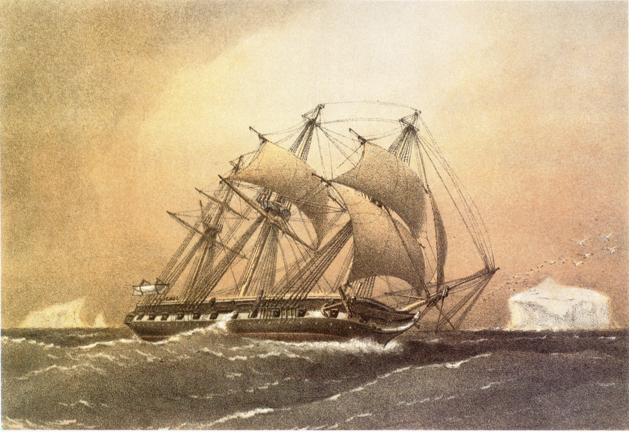
H.M.S. Challenger by William Frederick Mitchell

Slide 25
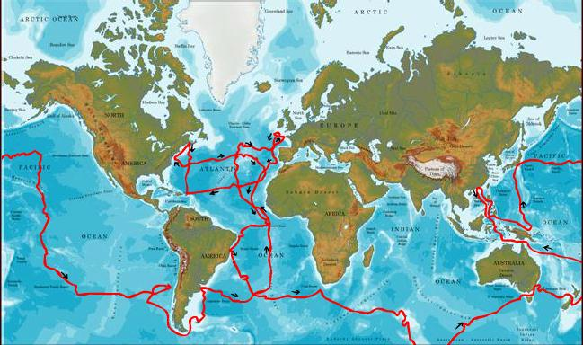
H.M.S. Challenger Expedition
The expedition in a nutshell: 1872-1876
1st globe-circling study of the oceans (69,000 n.m.)
ca. 300 temperature profiles (inter alia)

Slide 26
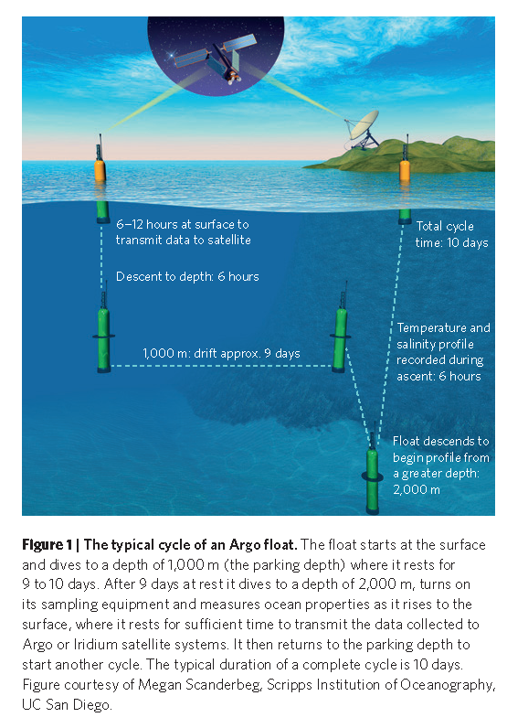
Typical Cycle of an Argo Float
Riser et al. (2016)

Slide 27
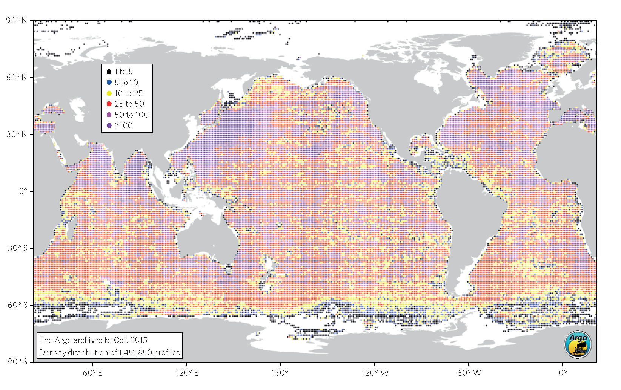
Coverage of Argo Float profiles
Riser et al. (2016)

Slide 28
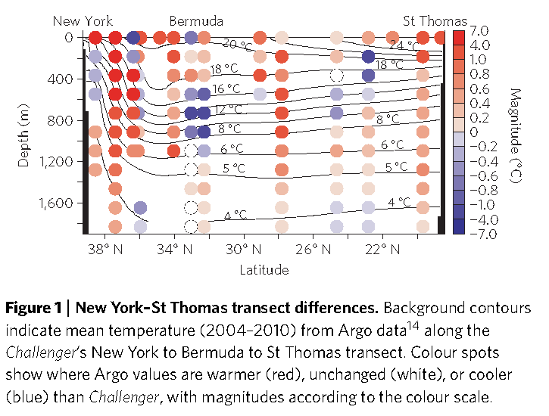
Difference between ARGO & Challenger Temperatures
Roemmich et al. (2012)

Slide 29
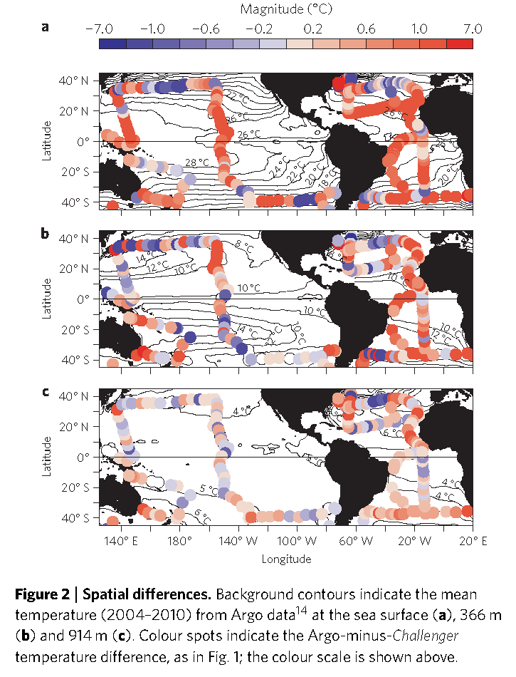
Difference between ARGO & Challenger Temperatures
Roemmich et al. (2012)

Slide 30
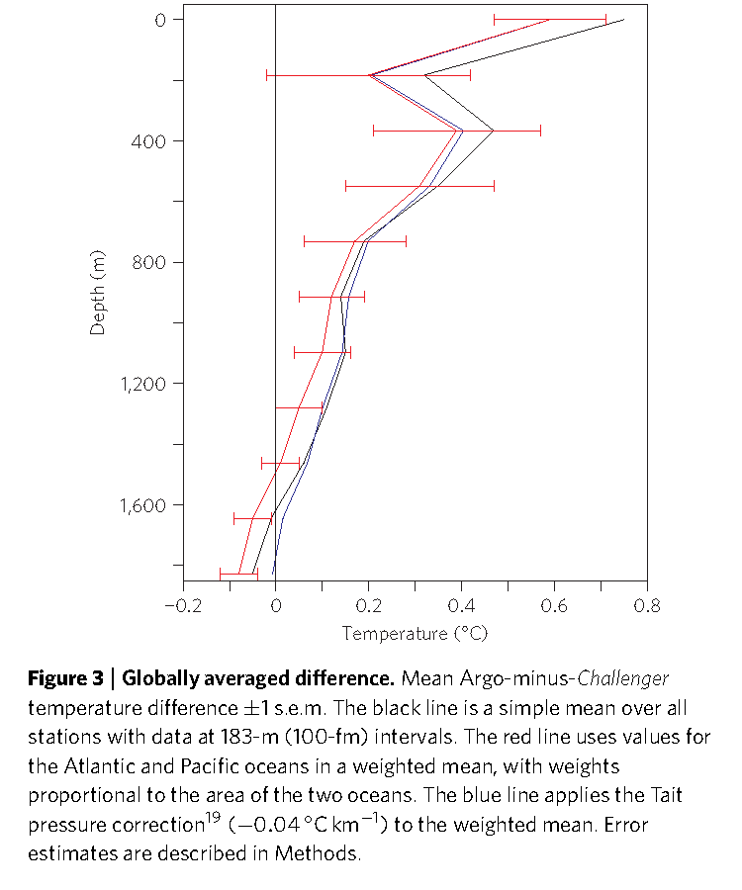
Difference between ARGO & Challenger Temperatures
Roemmich et al. (2012)

Slide 31
Conclusions
The sea surface warmed by 0.59 ± 0.12ºC over the ca. 135-yr period between
Challenger and Argo
The warming amounted to 0.39 ± 0.18ºC at 366 m and 0.12 ± 0.07ºC at 914 m
The 0.33 ± 0.14ºC mean difference from 0 to 700 m is twice the value observed
globally in that depth range over the past 50 yr
Warming in the Atlantic was stronger than in the Pacific
Warming estimates should be lower estimates given systematic errors in Challenger data
The study underlines the merit of large-scale sampling programs and suggests that
the oceans have been warming at least since the late 1870s

Slide 32
Questions
“Centennial-scale warming” is being inferred from on “2 data points”.
Which are examples of oceanographic phenomena that could produce aliasing on
the centennial-time scale?
Is the spatial coverage of the Challenger expedition adequate to argue for “global”
ocean warming?
The density of seawater is a function of temperature and salinity (and pressure).
Assuming no change in salinity over the 135-yr period, what would be the effects
of warming on (i) the ocean density distribution and (ii) the ocean circulation?

Slide 33
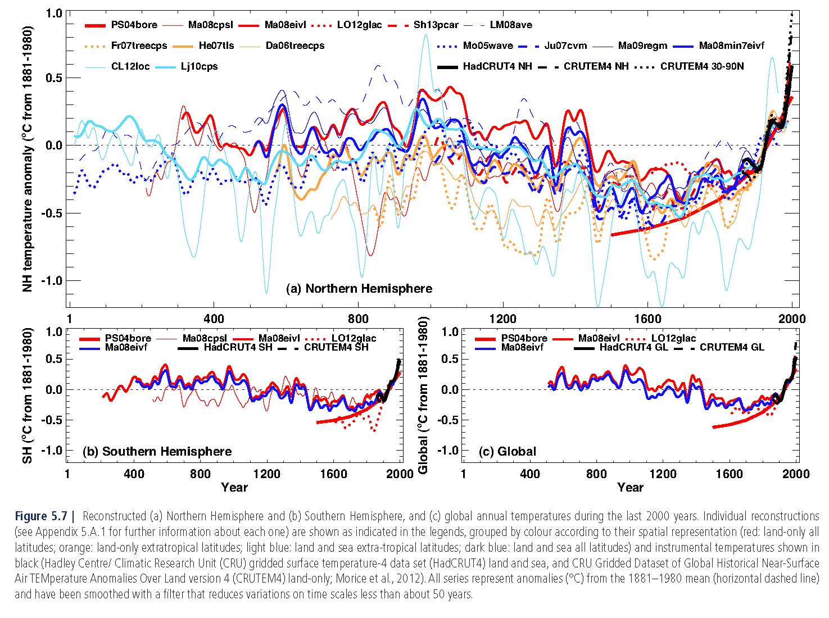
Reconstructed Hemispheric & Global Temperatures over past 2,000 yrs
IPCC, Chapter 5 (2013)

Slide 34
End

Slide 35
Back-up Slides

Slide 36
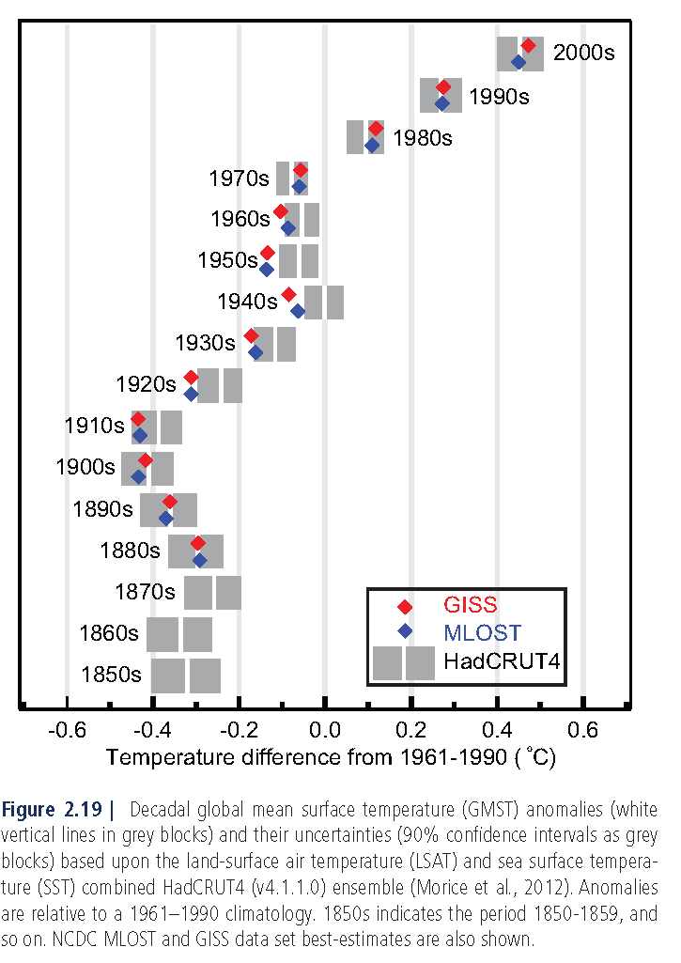
Global Annual Mean LSAT & SST Combined
IPCC, Chapter 2 (2013)

Slide 37
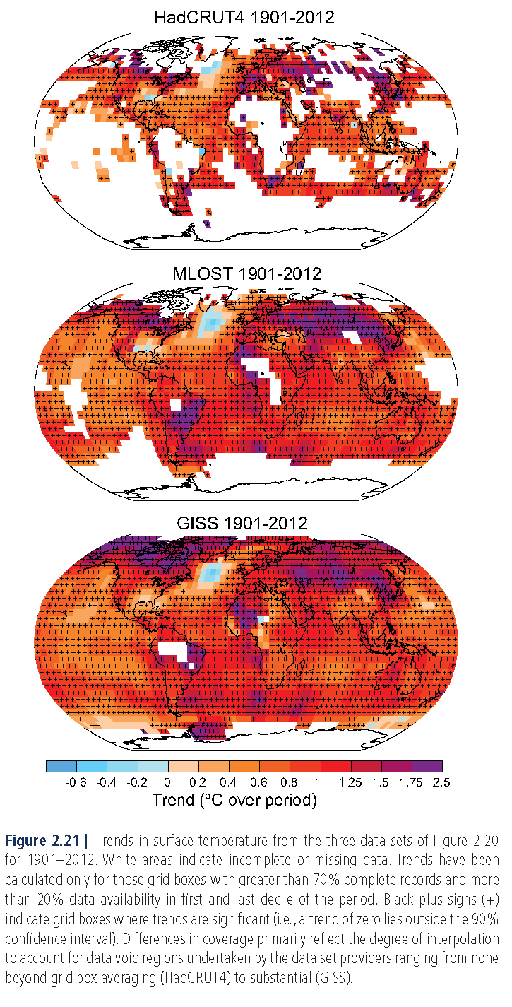
IPCC, Chapter 2 (2013)

Slide 38
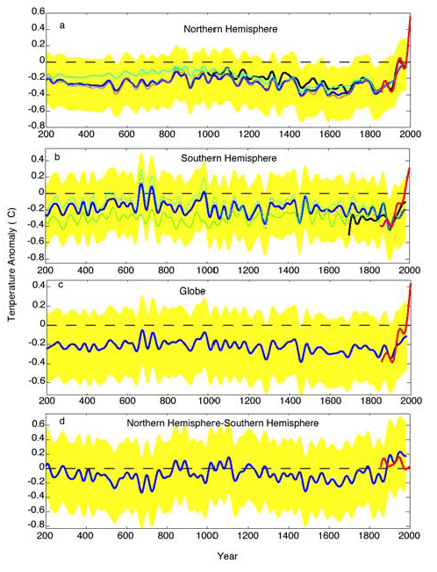
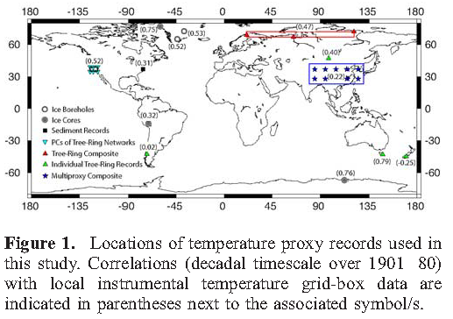
Reconstructed Hemispheric & Global Temperatures over past 2,000 yrs
Instrumental T
Reconstructed T
Yellow: 95% CI in reconstructed T
Other colors: other reconstructed Ts
Mann and Jones (2003)

Slide 39
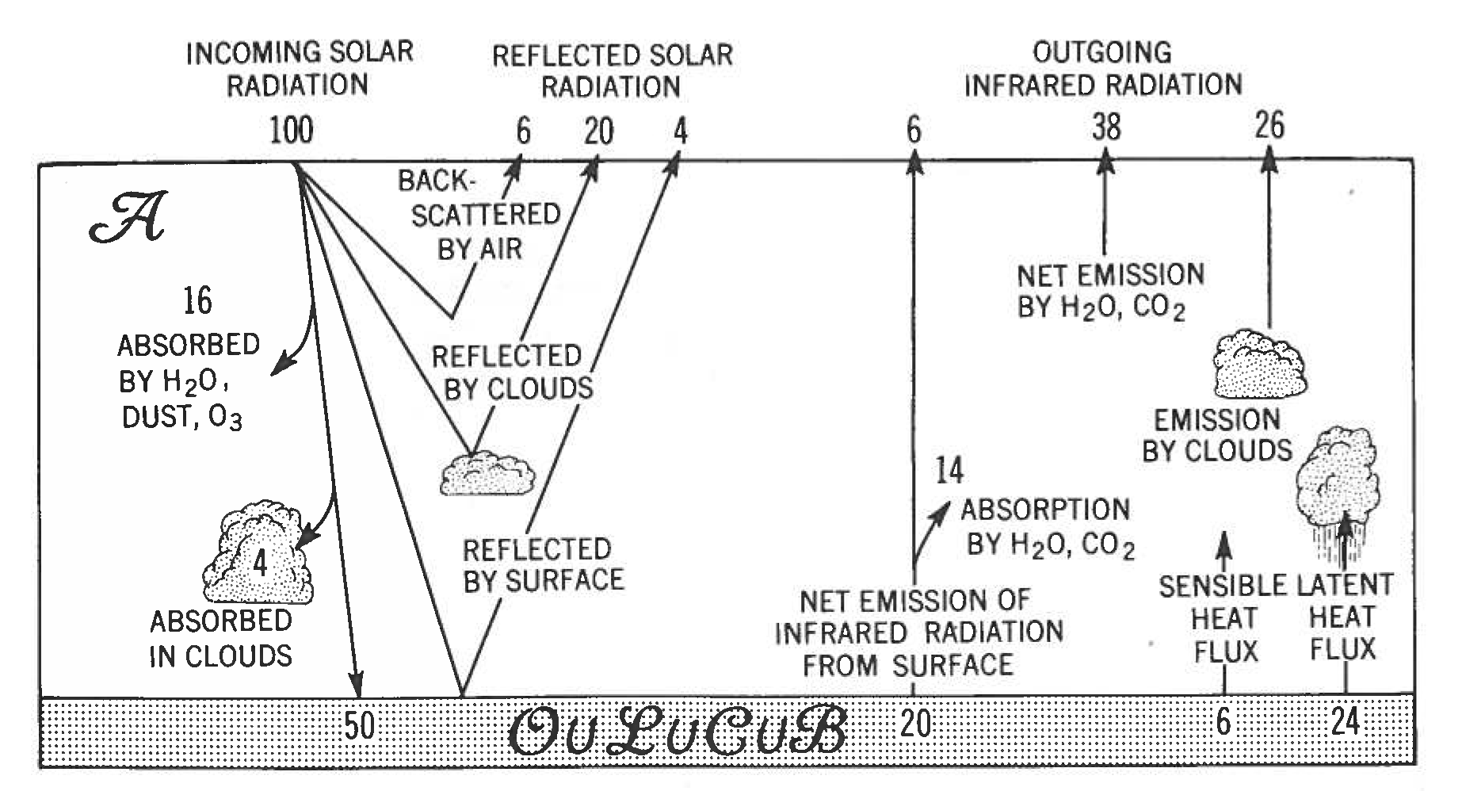
Global “Radiation” Budget
Peixoto & Oort (1992)
Notes:
This is a schematic of the radiation budget on earth. Average over time and space.
Note 30% of SW reflected back to space, 20% absorbed in atm, so 50% reaching the ground.
The ground should thus loose 50 units, by radiation (20%), SHF (6%), and LHE (24%).
Budget of the ATM: SW: gets 20. LW: gets 14+6+24=44. So total gets 64. This balanced by 38+26 of LW
Different ways to modify GRB: e.g., change surface albedo, change absorption by CO2
Note that this is global budget. In fact, net gain at low lat. And net deficit at high lat. Heat transport by O+A compensate.
As we will see, instrumental temperature records indicate that the current radiation budget is in a state of imbalance, i.e., the amount of heat energy absorbed by the climate system exceeds the amount of heat energy radiated back to space.

Slide 40
Trend Estimates of LSAT
IPCC (2013)

Slide 41
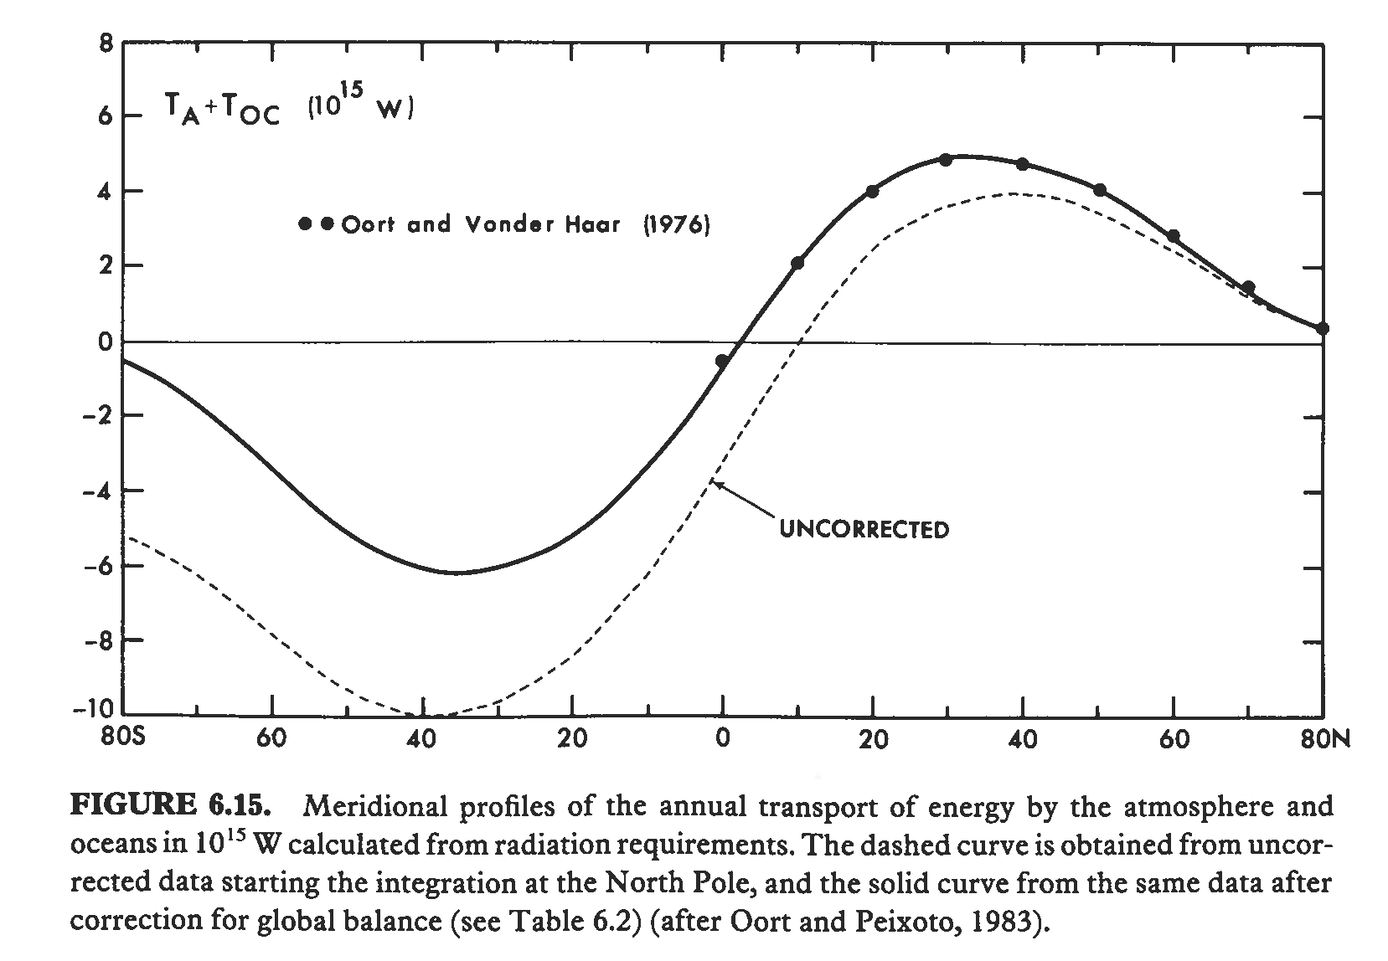
Meridional Heat Transport by the Ocean & Atmosphere
Peixoto & Oort (1992)

Slide 42
Schematic of Net Radiative Fluxes at T.O.A.
HEAT FLUX
HEAT FLUX
HEAT FLUX
T.O.A.
Southern hemisphere
Equator
Northern hemisphere
ATMOSPHERE
OCEAN
Notes:
Net gain of radiant energy at low latitudes and net loss of radiant energy at high latitudes.

Slide 43
Schematic of Net Radiative Fluxes at T.O.A.
HEAT FLUX
HEAT FLUX
HEAT FLUX
T.O.A.
Southern hemisphere
Equator
Northern hemisphere
ATMOSPHERE
HEAT FLUX
HEAT FLUX
OCEAN
HEAT FLUX
HEAT FLUX
Notes:
The gains and losses are balanced by meridional heat transport in both ocean & atmosphere.

Slide 44
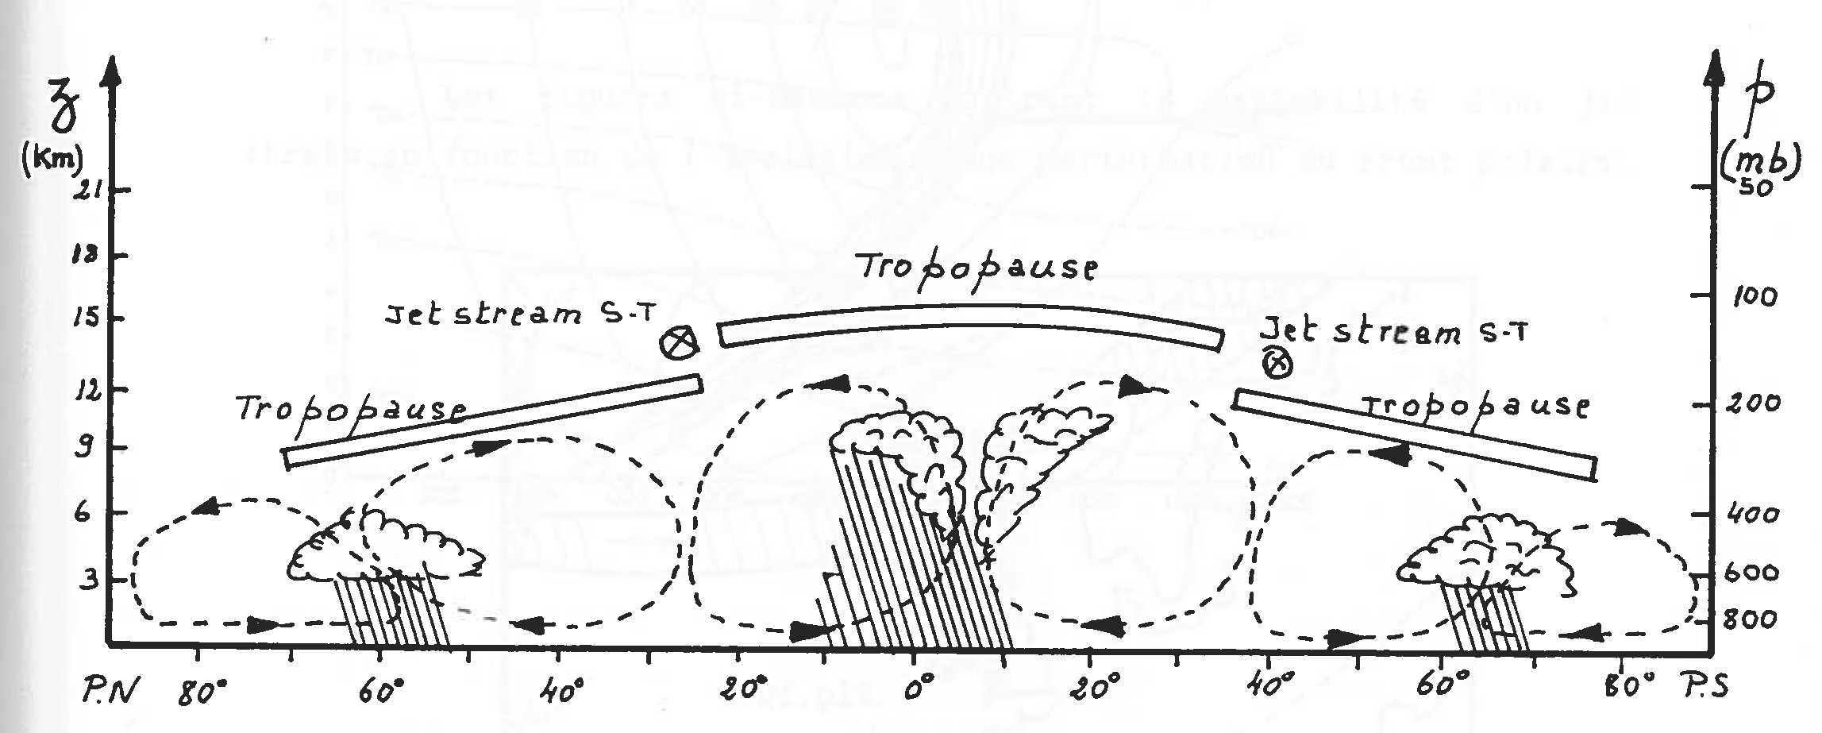
Schematic of Tropospheric Mean Circulation
Polar
cell
Ferrel
cell
Hadley
cell
Hadley
cell
Ferrel
cell
Polar
cell
F. Ronday (1990)
Notes:
Schematic of meridional circulation in troposphere.
Low altitude air is converging toward to equator (Intertropical Convergence Zone or ITCZ).
Air is ascending and water vapor condenses, leading to intense rainfall (rainfall belt near equator).
Dry air aloft in both hemisphere then subsides in each H near 30 of latitude (deserts).
Note subtropical jet stream.
Note second region of low altitude converging air near 60 of latitude: synoptic systems (fronts, cyclones, etc.) and enhanced precip.
The net effect of this circulation is estimated to lead to a poleward heat flux of O(1 PW)

Slide 45
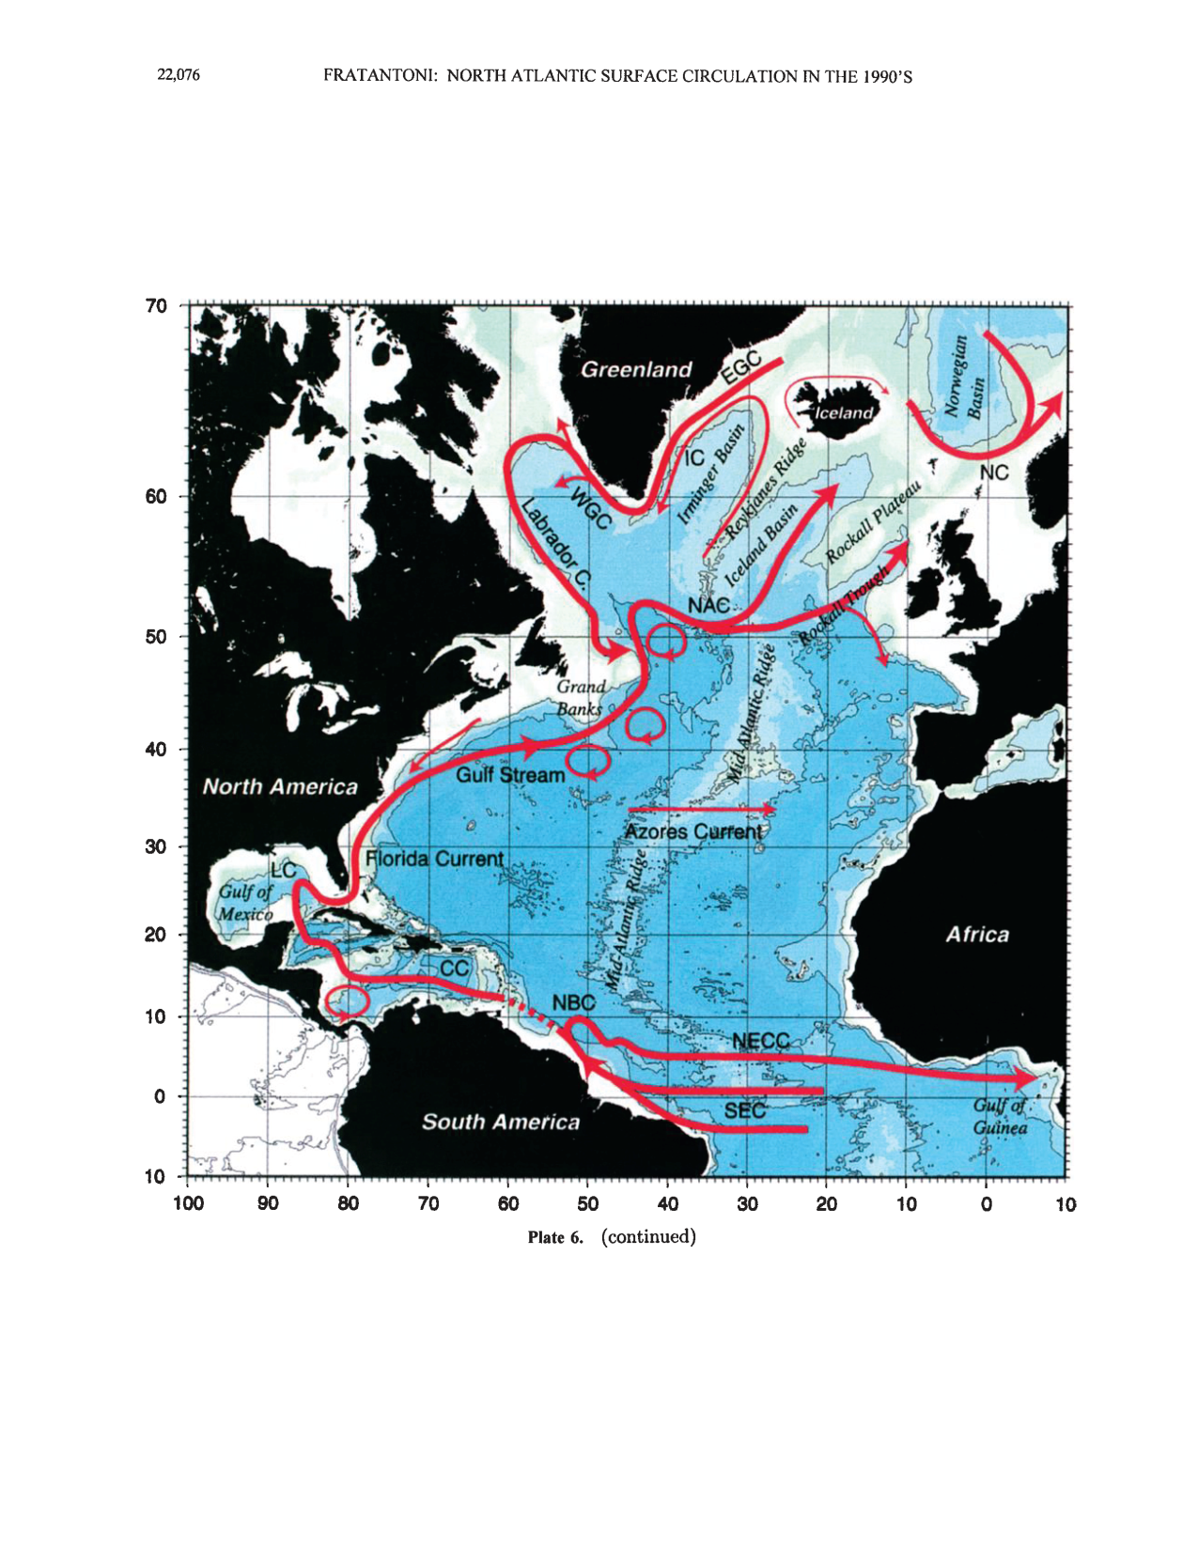
SCHEMATIC OF NORTH ATLANTIC SURFACE CIRCULATION
Fratantoni (2001)
Notes:
There is also a meridional circulation in the ocean.
Schematic of surface circulation in NA based on surface drifters deployed in the 90s
Note the Gulf Stream and North Atlantic Current (NAC): both are warm and salty currents. When flowing north under the cold atmosphere, NAC releases heat to atmosphere, which is thought to play a major role in the zonal asymmetry of winter climates between NE America and NW Europe (not unchallenged idea!).

Slide 46
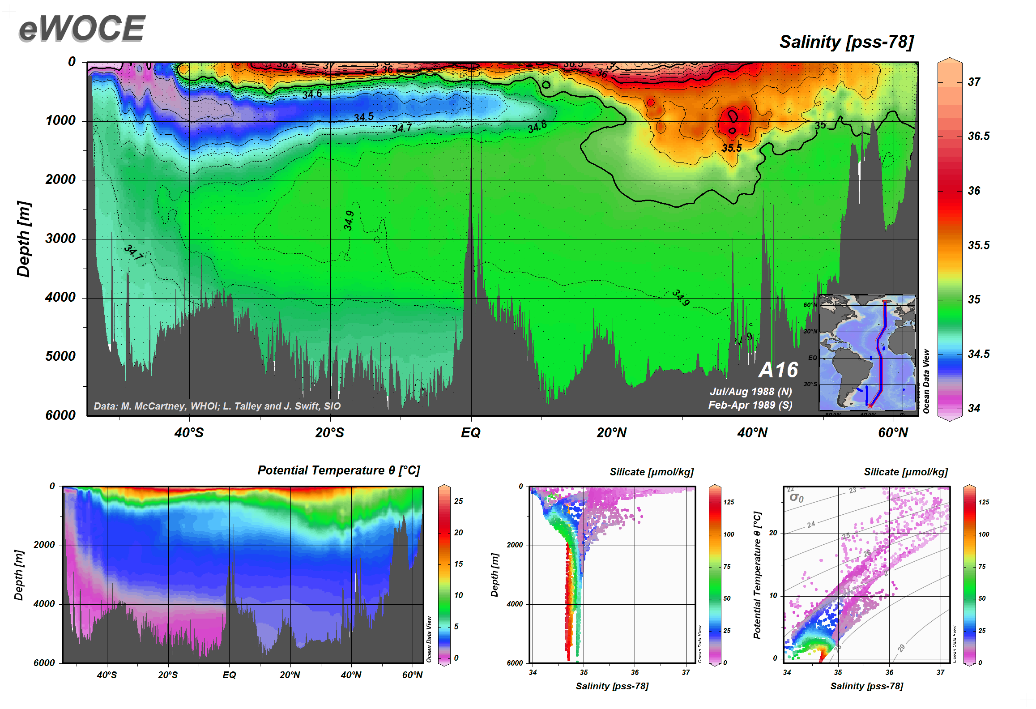
MERIDIONAL CIRCULATION IN THE ATLANTIC OCEAN
AAIW
MOW
NADW
AABW
Data: M. McCartney, L. Talley, J. Swift

