Slide 1
A Net Primary Productivity Algorithm Round Robin (PPARR) for the Arctic Ocean: A brief introduction to the PPARR 5 adventure
Patricia Matrai¹, Yoonjoo Lee¹,
Marjorie Friederichs², and Vincent Saba³
¹Bigelow Laboratory for Ocean Sciences
²Virginia Institute of Marine Sciences
³NMFS, NOAA

Slide 2
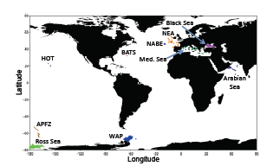
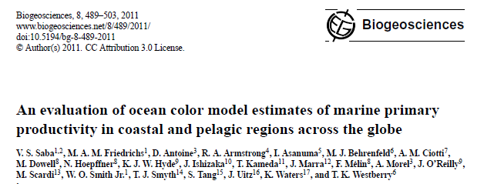
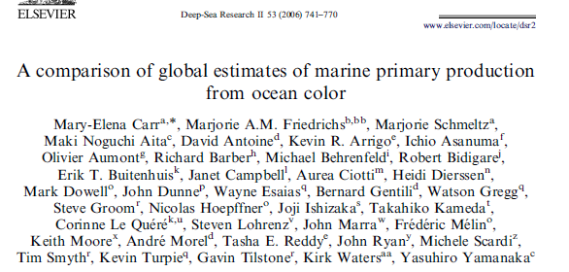
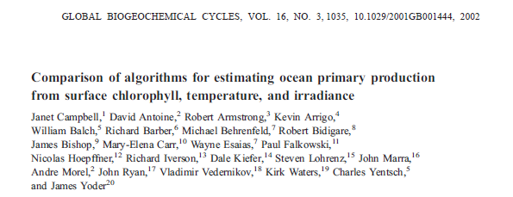
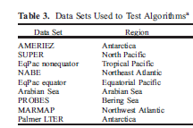
Previous NASA-funded PPARRs
PPARR-3: Ocean color and GCM models; satellite data only
PPARR-4: Ocean color and GCM models; field and satellite data; spatial or temporal resolution
PPARR-1, 2: Ocean color models; field data only

Slide 3
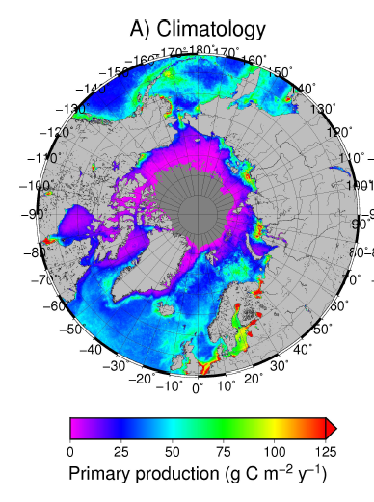
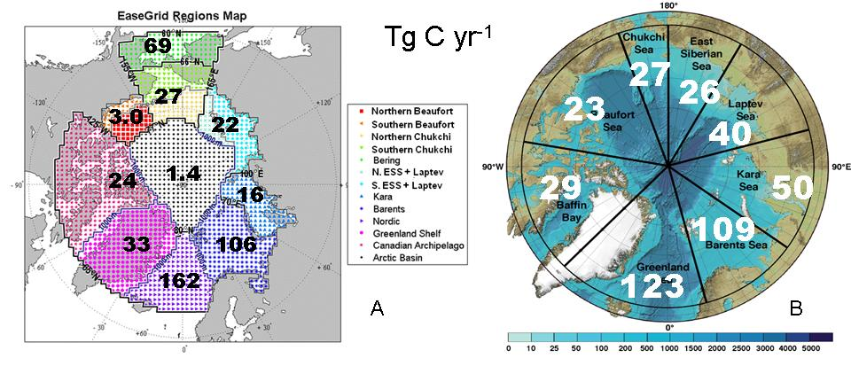
Three empirical estimates of Arctic annual, regional, integrated PP…
80
8
8
20
29
156
50
34
46
166
Combining in situ PP historical measurements, in situ chlorophyll-derived PP and satellite-derived PP (1998-2007). An arctic-specific empirical algorithm was used for the satellite derivations. Note that the Arctic Basin is separated [Hill et al. 2013].
Satellite-derived PP (1998-2009) . A polar algorithm was used for the satellite derivations. Note that the Arctic Basin is included in each of its individual regions [Pabi et al. 2008; Arrigo and Dijken 2011].
Satellite-derived PP (1998-2010) . Different algorithms were used for the satellite derivations. [Bélanger et al. 2013].

Slide 4
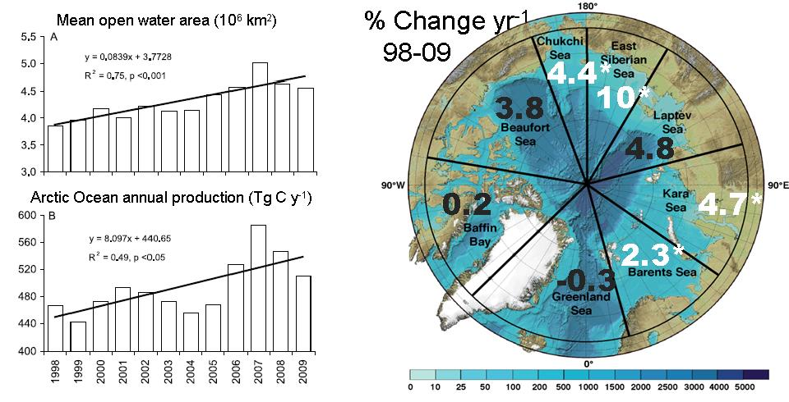
Changing!
Pan-Arctic mean open water area and annual production increasing trends in the Arctic Ocean (1998-2009), estimated from remotely-sensed parameters [Arrigo and Dijken 2011]
Regional % change in annual production per year (1998-2009), estimated from remotely-sensed parameters. White, starred numbers indicate a significant change. Blue scale bar indicates depth (m) [Arrigo and Dijken 2011]

Slide 5
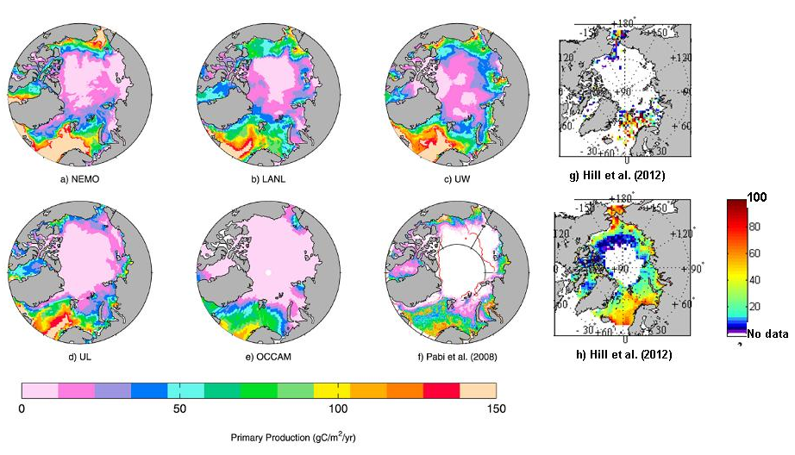
An AOMIP/FAMOS experiment: Recent ocean model estimates (and the underlying controls)
Nutrients?
MLD?
Popova et al. 2012
Hill et al. 2013
Mean annual integrated PP estimates from (a-e) 5 models [Popova et al. 2012], (f) a satellite-derived estimate and estimates derived from (g) in situ chlorophyll and (h) satellite-chlorophyll by Hill et al. [2013] . The latter two share the color bar in the lower right (gC/m²/yr).

Slide 6
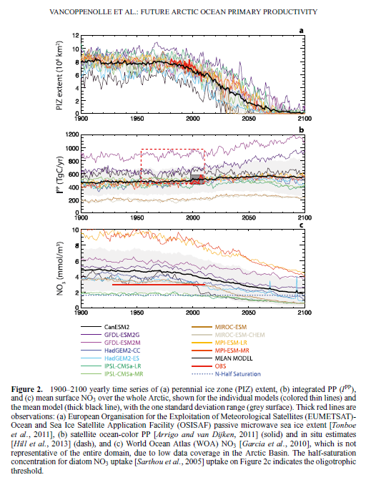
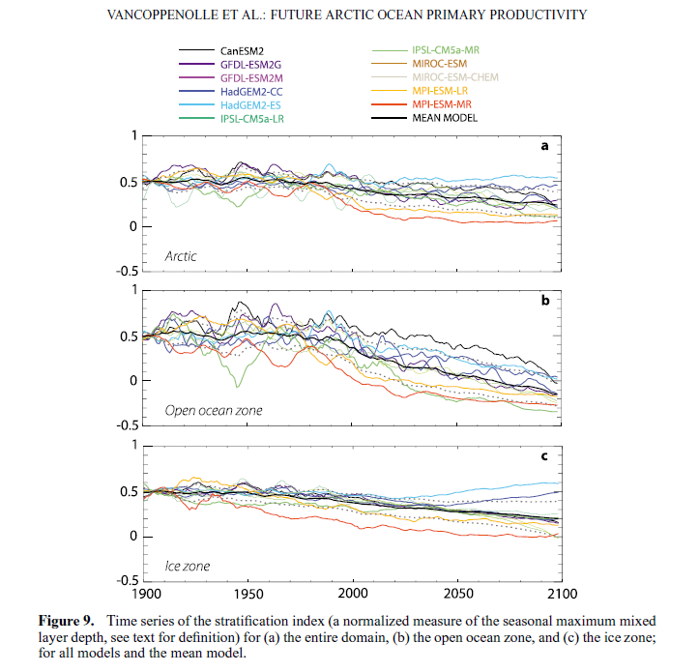
ESMs in the Arctic: CMIP5 simulation for 2100
(2013)
Ice
Integrated PP
Stratification index -> NO₃
Surf. NO₃

Slide 7
PPARR-5 Arctic Ocean Strategy
Compilation, quality control, and characterization of field and remotely-sensed data: Now
Over the next 2 years:
0-D and 1-D biological or biogeochemical; ocean color; phys-biol coupled ocean; GCM; ESM models to be invited
Statistical analyses of the observed and modeled NPP
Feedback and iterations with the modelers on model performance
Inter-model comparisons of Arctic NPP historical and future projections

Slide 8
Ah! An appeal for data…
ARCSS-PP: Spatial and seasonal distribution of in situ data of chlorophyll a (Chl) and PP data in the Arctic Ocean, 1954-2007. Color scale indicates the number of data points in each grid cell [Matrai et al. 2013]. Also ARCSS-NUT for nutrients [Codispoti et al. 2013].
Since 2007, additional data available from or collected by CASES, CFL, Korean expeditions, Chinese expeditions, ATOS-1, MALINA, ICESCAPES, NAACOS, ??? Let us know!

Slide 9
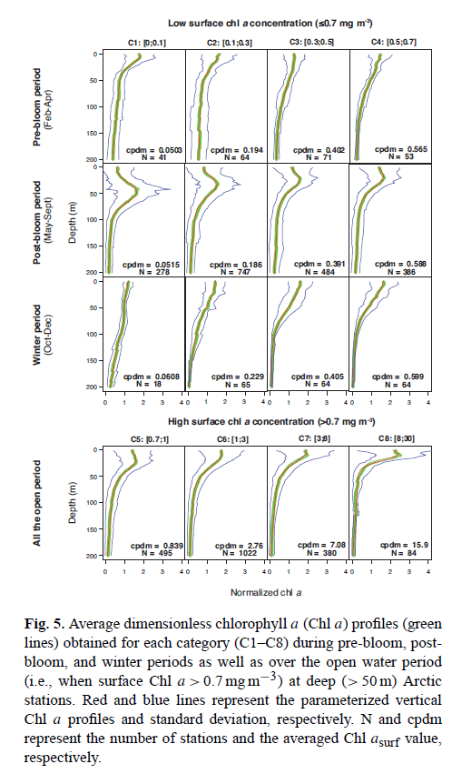
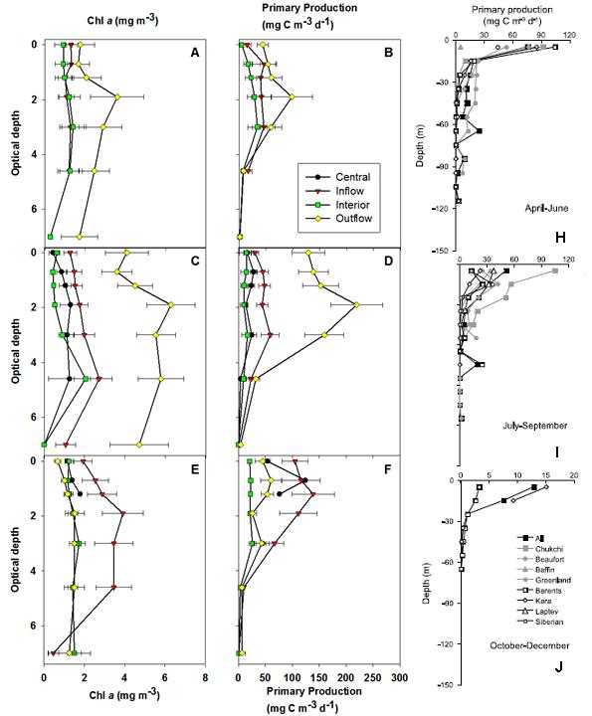
Special Arctic Ocean issues for PPARR, or not…
Profiles of mean in situ Chl-a and PP as a function of optical depth with 1 standard error bars (A-F) .
Profiles of PP also shown as regional averages as a function of depth [H-J] for spring, summer and fall data in the ARCSS-PP data set. Only ARCSS-PP data with matching Chl-a and PP measurements are plotted.
>60% ice cover
30-60% ice cover
<30% ice cover
Ardyna et al. 2013
Hill et al. 2013
Arrigo & Dijken 2011

Slide 10
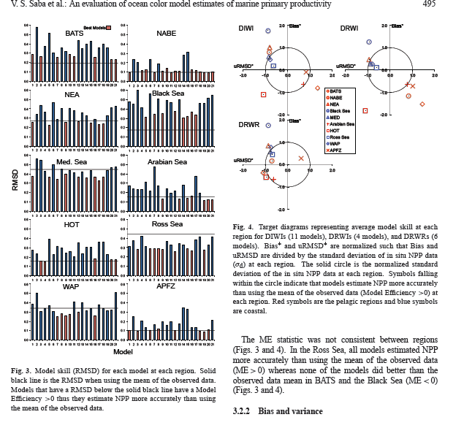
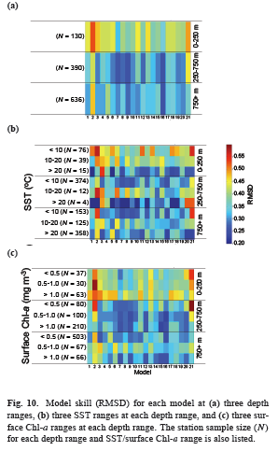
Building from PPARR-4: Understanding NPP simulations
Saba et al. 2011

Slide 11
PPARR-5 Arctic Ocean Strategy
0-d and 1-d biological and biogeochemical; ocean color; phys-biol coupled ocean; GCM; ESM models are invited
Open to new questions arising from FAMOS discussions
Please contact Yoonjoo Lee (ylee@bigelow.org) or Paty Matrai (pmatrai@bigelow.org)
for details.
We’ll contact you in early 2014!

