Slide 1
Greenland Freshwater Flux Experiment First steps with the 1/12° HYCOM-CICE
Dmitry Dukhovskoy, Andrey Proshutinsky
and Mary-Louise Timmermans
Center for Ocean-Atmospheric Prediction Studies
Florida State University
Acknowledgement: J.L. Bamber (Univ. Bristol)S
Notes:
One of the 1st step in the process of prep. Model exp. Is forcing fields. Forcing, what fields to use?

Slide 2
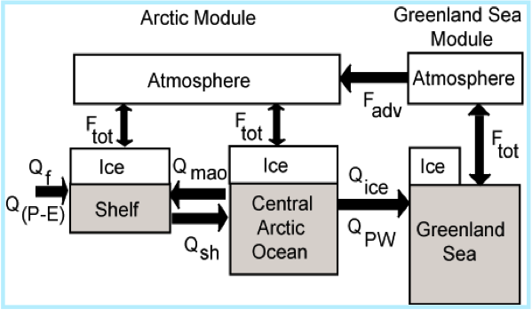
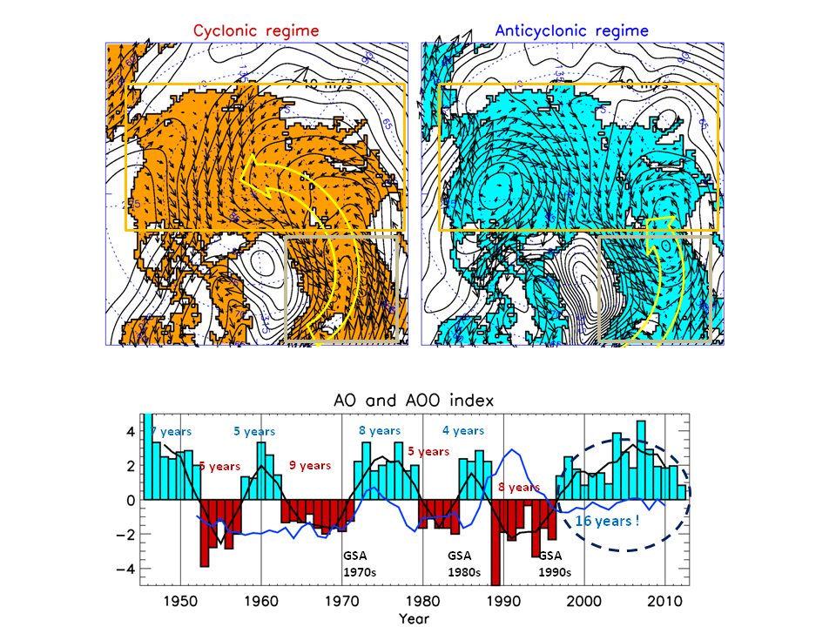
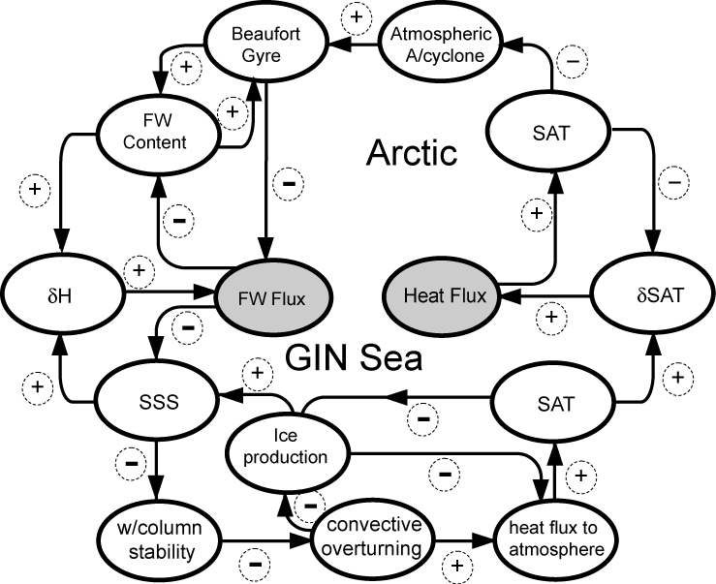
Arctic Climate Variability (before the 2000s)
AOO(+)
AO(-)

Slide 3
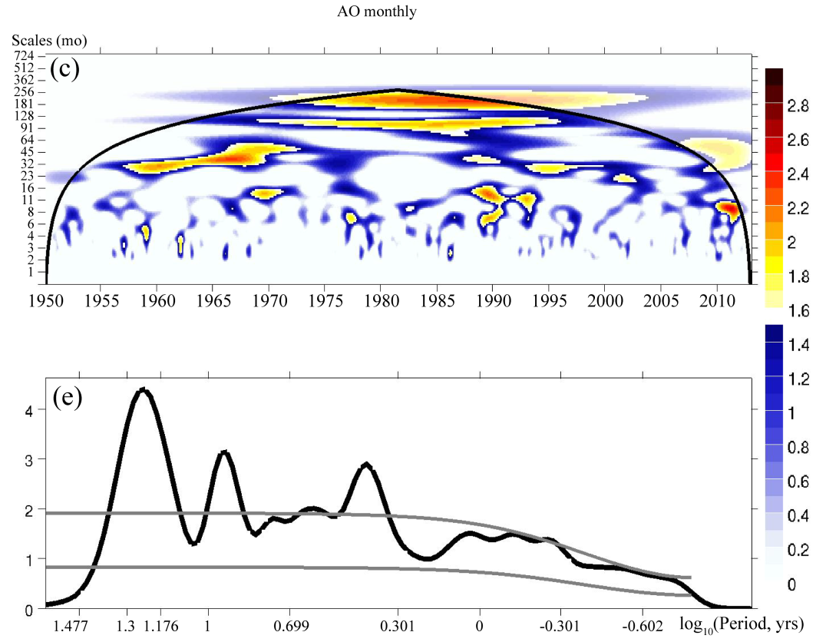
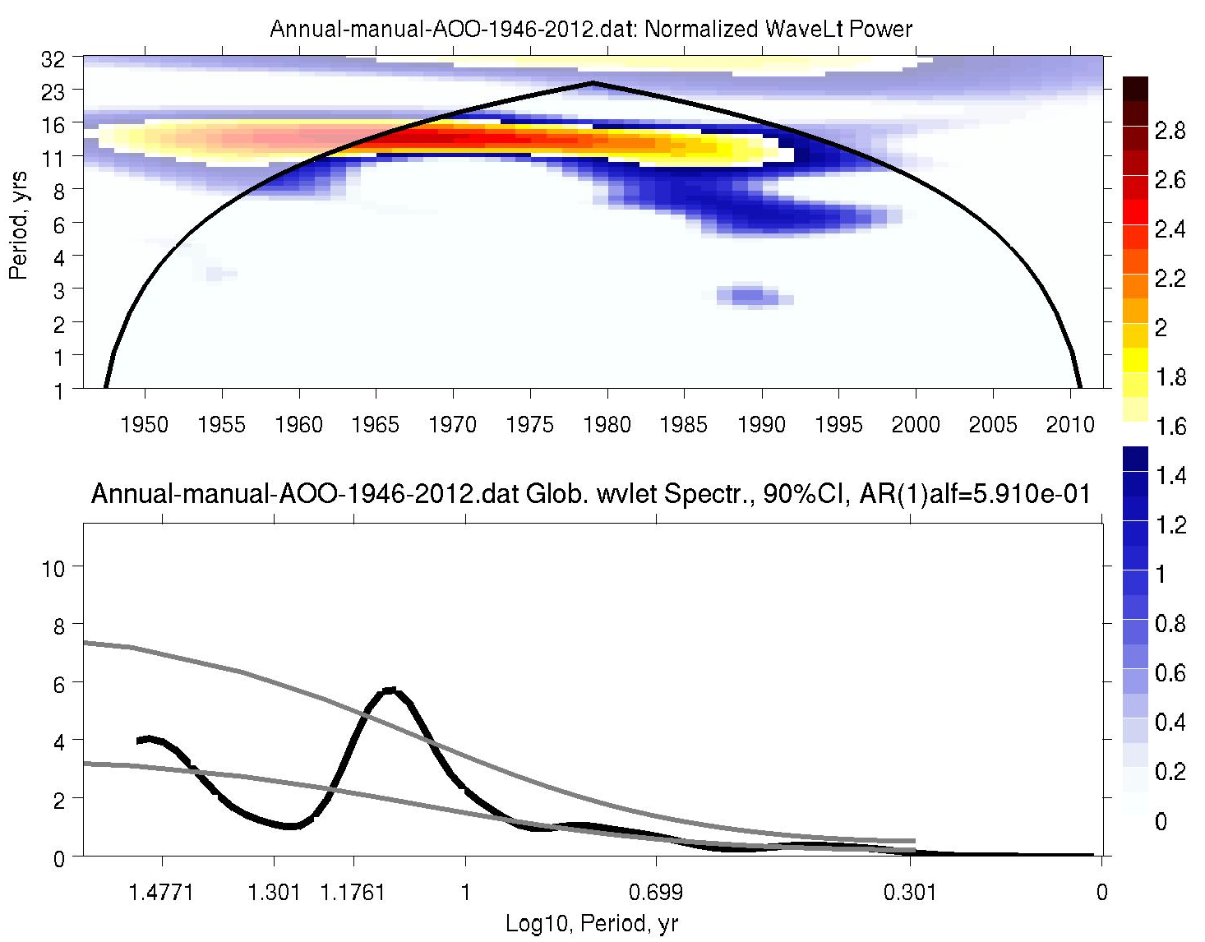
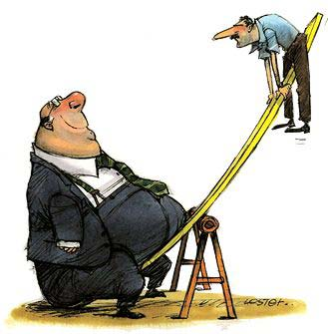
Changes in the Arctic Climate Variability
?
AOO (+)
~10yr
~12yr
Notes:
One of the most intriguing manifestations of climate change is the cessation of decadal Arctic climate variability in the 21st century. Between 1948 and 1996, the Arctic atmospheric circulation experienced a well pronounced decadal variability, alternating between anticyclonic circulation regimes (ACCRs) and cyclonic circulation regimes (CCRs) at 5 to 7 year intervals. Since 1997, however, the Arctic system has been dominated by a 16-year ACCR with a set of environmental parameters (e.g. sea ice extent, sea level, etc.) that are atypical for ACCRs.
We hypothesize that additional freshwater fluxes into the Greenland, Irminger and Norwegian Seas, associated with the acceleration of Greenland ice sheet melt in the 21st century, could be the major factor responsible for the cessation of decadal Arctic climate variability and stabilization of the present ACCR over the Arctic Ocean. Stabilization of the ACCR for more than 20 years can results in general Arctic cooling and increased sea ice extent.

Slide 4
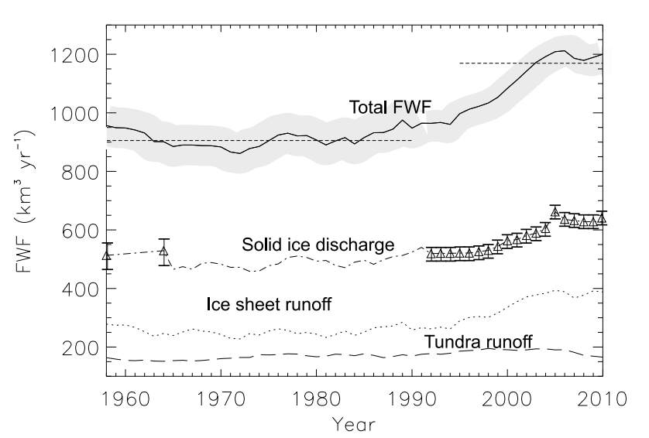
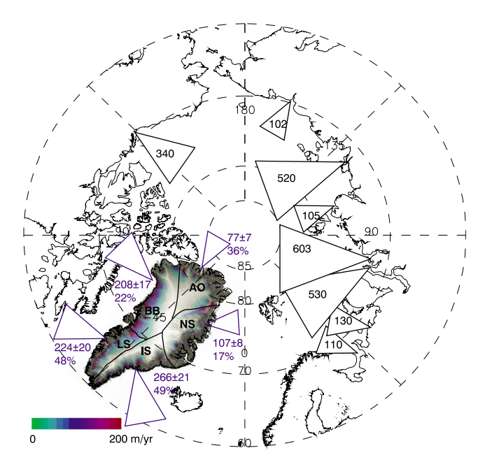
Greenland Freshwater Flux
Greenland Freshwater Fluxes (km³/yr)
Freshwater Fluxes (km³/yr) for Greenland and Largest Arctic Rivers
Bumber et al., GRL, 2013
Notes:
Ice sheet and solid ice discharge, and total freshwater fluxes form Greenland for 1958-2010. The triangles indicate the dates where discharge data were available. The grey shading indicates the RMSE of the FW flux estimate. Runoff was smoothed with a 5-eyar mean.

Slide 5
Working Hypothesis
We hypothesize that additional freshwater fluxes into the Greenland, Irminger and Norwegian Seas (GIN Sea), associated with the acceleration of Greenland ice sheet melt in the 21st century, could be the major factor responsible for the cessation of decadal Arctic climate variability and stabilization of the present ACCR over the Arctic Ocean.
Stabilization of the ACCR (AOO+) for more than 20 years can result in general Arctic cooling and increased sea ice extent.
Experiment with Greenland FW flux (Northern and Eastern) based on Bamber et al. (2012)
Experiment with Doubled Greenland FW flux

Slide 6
Greenland Freshwater Experiment
Questions:
Can Greenland FW flux be responsible for the cessation of decadal Arctic climate variability?
Budget analysis of the Greenland FW flux: amount, % of FW due to ice discharge, ice melt runoff, tundra runoff …
What are the pathways of Greenland FW in the Nordic Seas? Does it follow along the major fronts? Can it cross the fronts (lateral advection), at what rate?
What are transport mechanisms of Greenland FW to the deep convection regions?
What is the residence time of FW in the Nordic Seas? Can it be accumulated? At what rate?
How well do models simulate the FW content and deep convection processes in the Nordic Seas?
(2) Is the auto-oscillatory theory supported by model and observational studies in the Nordic Seas?
Is there (model/observational) evidence of ~decadal variability in deep convection processes in the Nordic Seas? Are they related to FW fluxes in the Arctic Ocean? Correlation with AO or AOO?
(3) Will the auto-oscillatory behavior return? What will the time scale of the oscillations be?

Slide 7
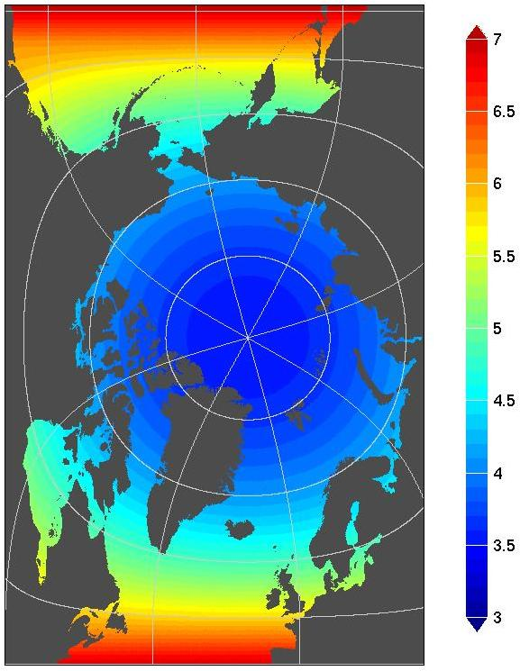
Greenland FW Flux Experiment
0.08° HYCOM/CICE Modeling System of the Arctic Ocean
Model Domain and
Grid Resolution (km)
ARCc0.08: Coupled HYbrid Coordinate Ocean Model and Los Alamos Sea Ice Model (CICE 4.0)
32 vertical ocean levels
Atlantic and Pacific Boundaries at ~39°N
Closed (no-ice) in CICE
Nested into 1/12° Global HYCOM
Initialized from January 1 2006
Currently run for 1 year
CFSR winds
Twin experiments:
011 – without Greenland FW flux
051 – with Greenland FW flux
(J. Bamber’s data)

Slide 8
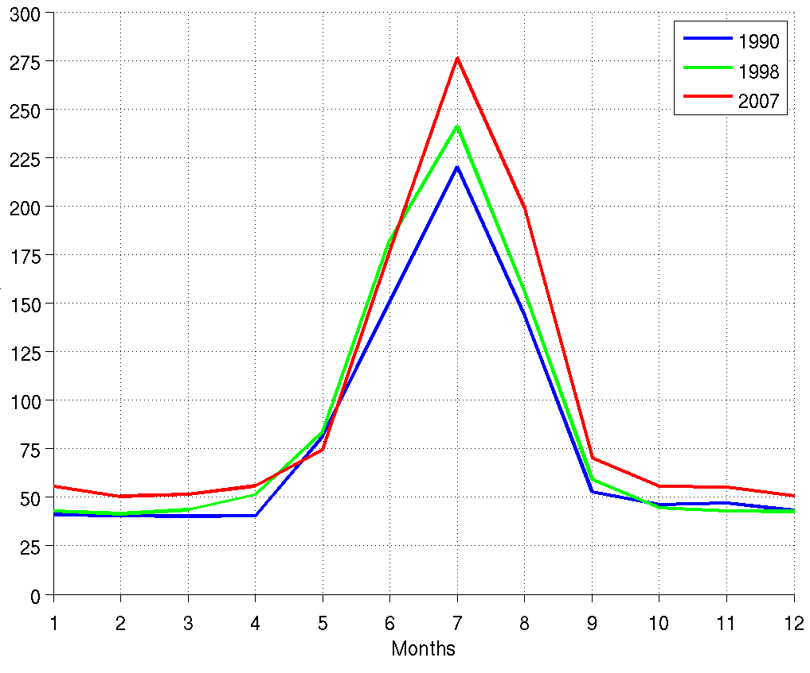
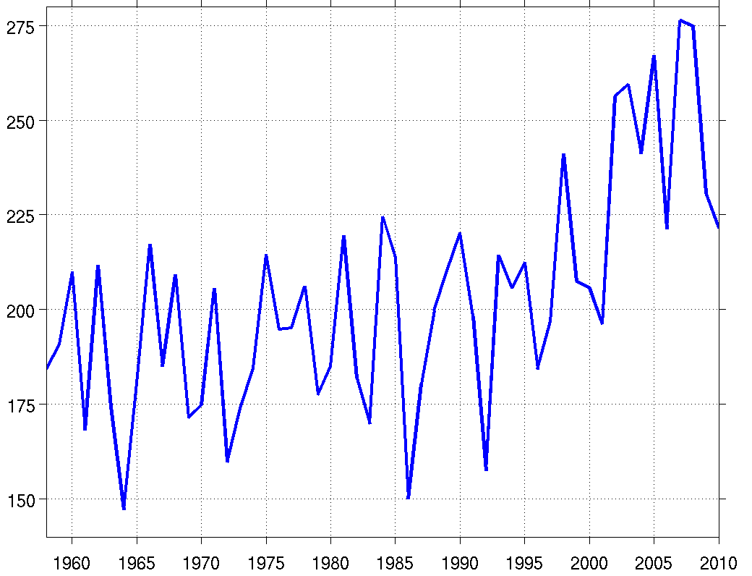
River Runoff Forcing in the Model
Monthly Freshwater Flux (km³/mo)
Greenland Freshwater Flux (km³/mo)
July, 2006
July Freshwater Flux (km³/mo)
(J. Bamber’s data)
Notes:
Regional pattern of fluxes is shown for 5 regions in Greenland. Also 8 largest rivers are shown.

Slide 9
Upper Ocean Salinity Anomaly (Experiment with Greenland FW Flux – control run)

Slide 10
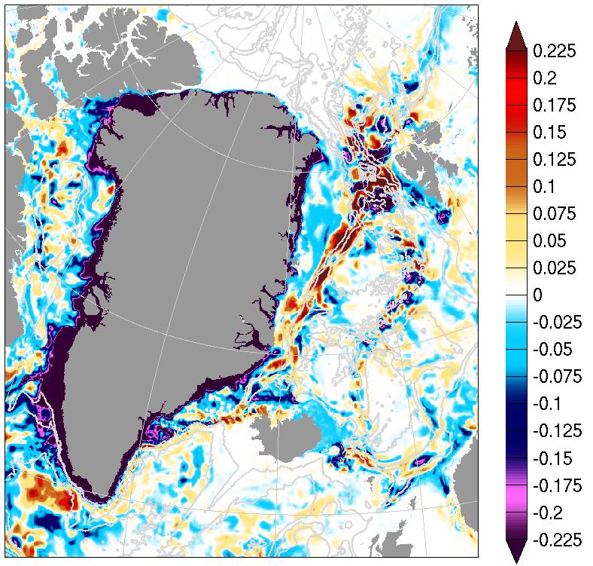
Mean Upper Ocean Salinity Anomaly (Experiment with Greenland FW Flux – control run)
R1
R2
Notes:
R1: Bounded by 10m isobath along Greenland

Slide 11
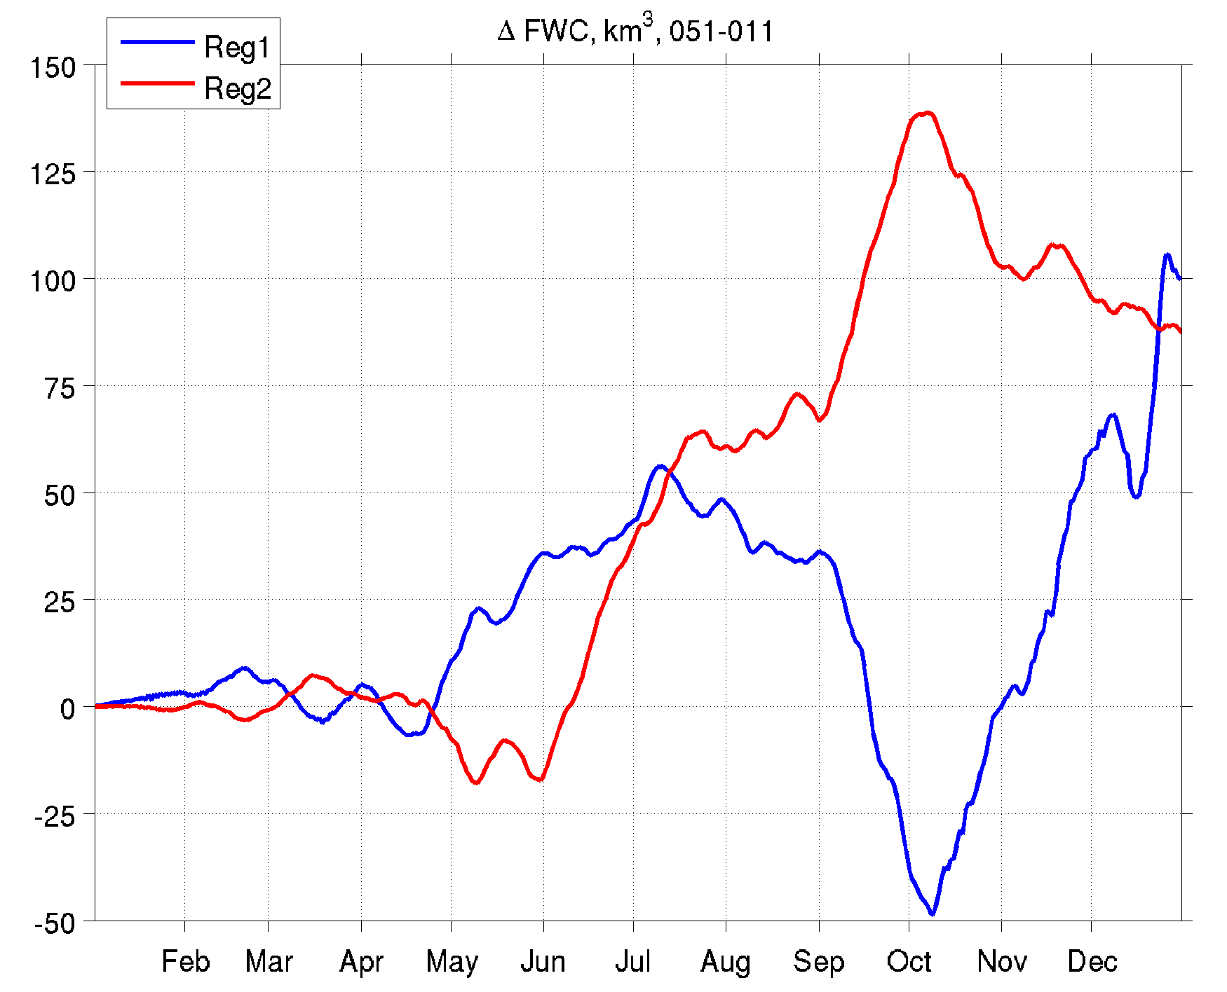
Fresh Water Content Difference between the Experiments
FW accumulated in the region 2
Sref = 34.8
Positive FWC difference indicates higher FW content in the experiment with Greenland runoff “on”
Notes:
Both regions – FW accumulation, more importantly – central

Slide 12
Greenland FW Flux Experiments
Long-term simulation with Greenland FW fluxes
Role of eddies: High resolution vs coarse resolution simulations
Role of winds: Simulations with and without winds (different winds?)
Pathways, residence time: Simulation with passive tracers

Slide 14
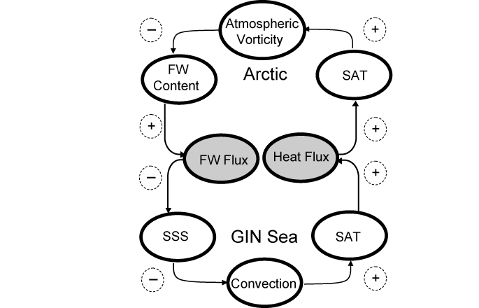
Amount of fresh water in the GSA: O(2,000 km³), S_{ref}=34.8
Amount of fresh water sufficient for regime shift (AO- ➔ AO+) in the box model: O(800-1000 km³), S_{ref} = 34.8

Slide 15
River Runoff Forcing in the Model
Notes:
Regional pattern of fluxes is shown for 5 regions in Greenland. Also 8 largest rivers are shown.

