Slide 1
Assessing the U.S. Navy Coupled Ice-Ocean Model vs. Recent Arctic Observations
David A. Hebert¹, Richard Allard¹, Pamela Posey¹, E. Joseph Metzger¹, Alan Wallcraft¹, Shelley Riedlinger¹, Steve Piacsek¹, Michael Phelps²
¹Naval Research Lab, Stennis Space Center, MS
²Jacobs Technology Inc., Stennis Space Center, MS

Slide 2
Motivation Observations and Models
How well does our model do?
Metrics?
Ice thickness, snow depth, T/S profiles
Assimilation
Helps keep model on track.
We only want to compare with non-assimilated data

Slide 3
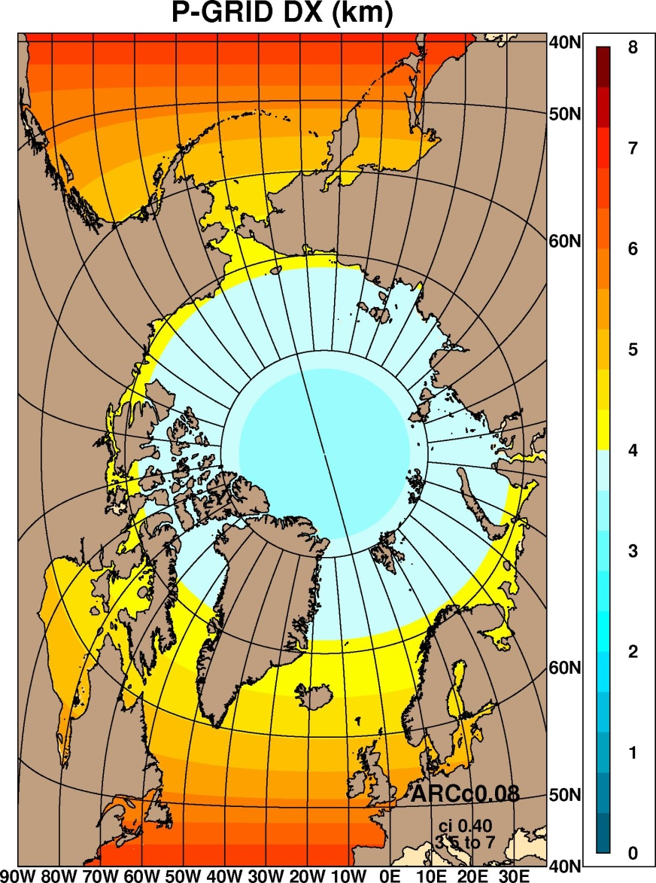
ACNFS (Arctic Cap Nowcast/Forecast System)
Domain: 40-90ºN
High resolution: 3.5 km at pole
Assimilation of ocean and ice concentration
7 day forecast daily
ACNFS consists of :
Ice Model – CICE V4.0
Ocean Model – HYCOM
Data assimilation – NCODA
Forced with 0.5º NOGAPS
As of 28 AUG 2013, 0.5º NAVGEM

Slide 4
Observations we looked at
Ice/Snow Thickness
Ice Bridge (NASA)
Ice Mass Balance Buoys (CRREL)
Beaufort Gyre Upward Looking Sonar (WHOI)
Ocean Data
Ice Tethered Profilers (T, S Profiles) (WHOI)
McLane Moored Profiles (T,S,U,V) (WHOI)
GDEM4 – Climatology T/S

Slide 5
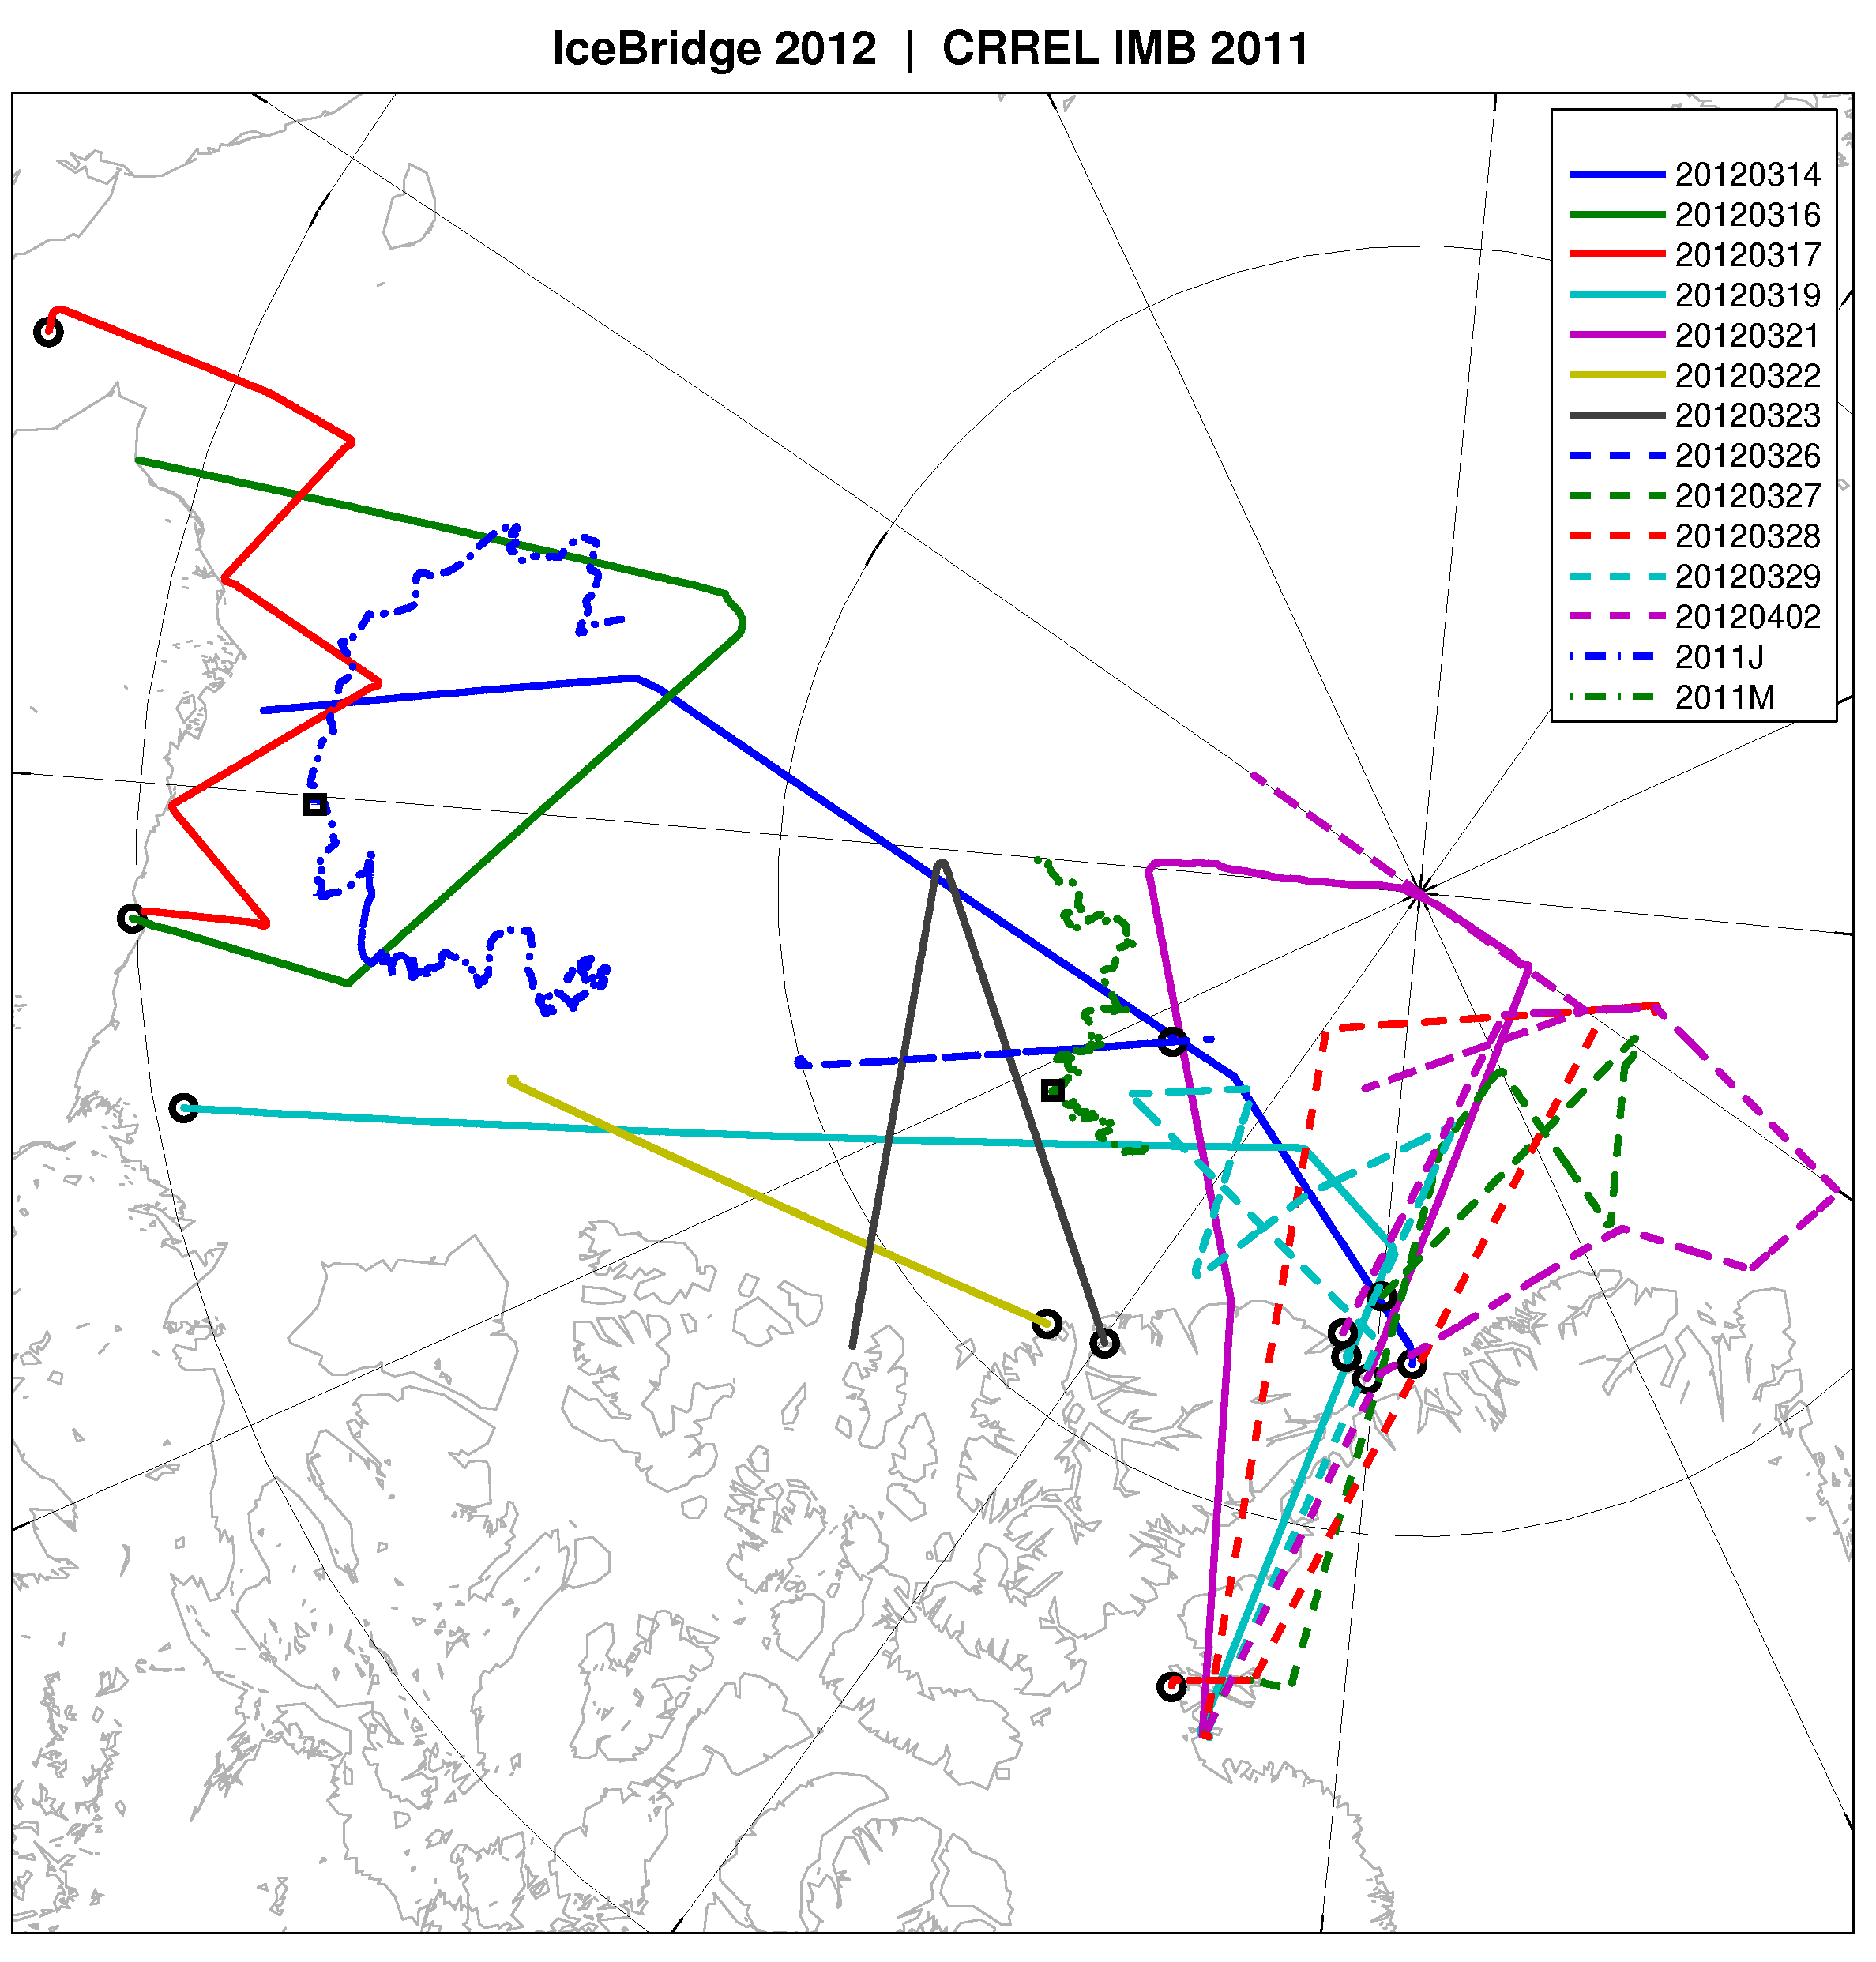
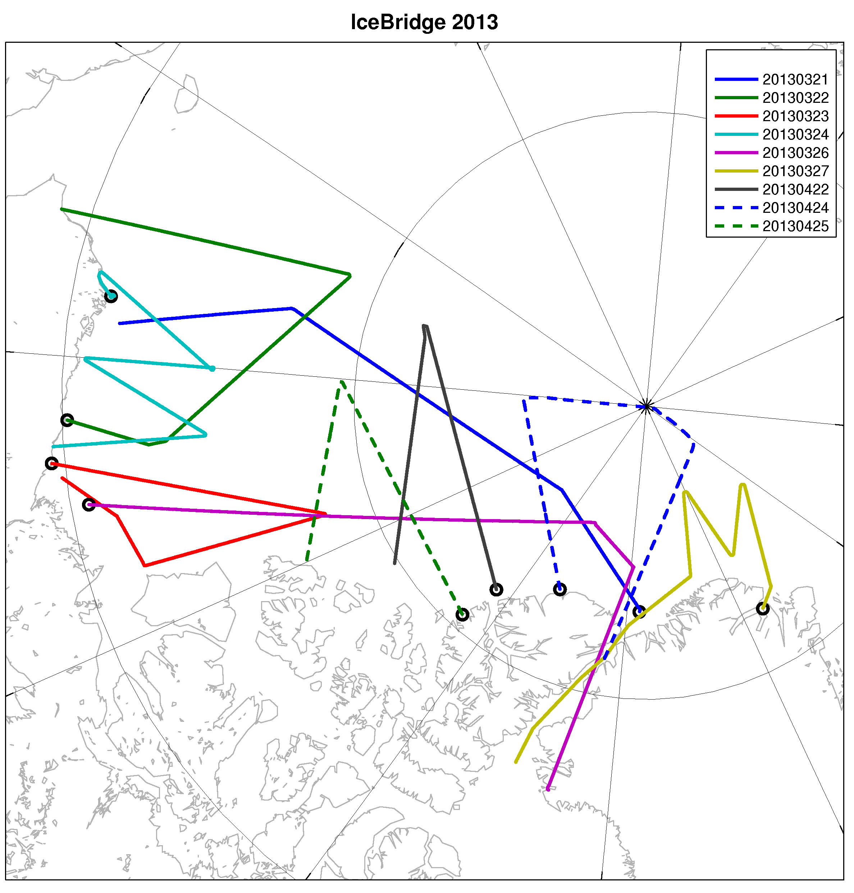
Ice Bridge
2012
2013
Notes:
All Tracks 2012 and 2013

Slide 6
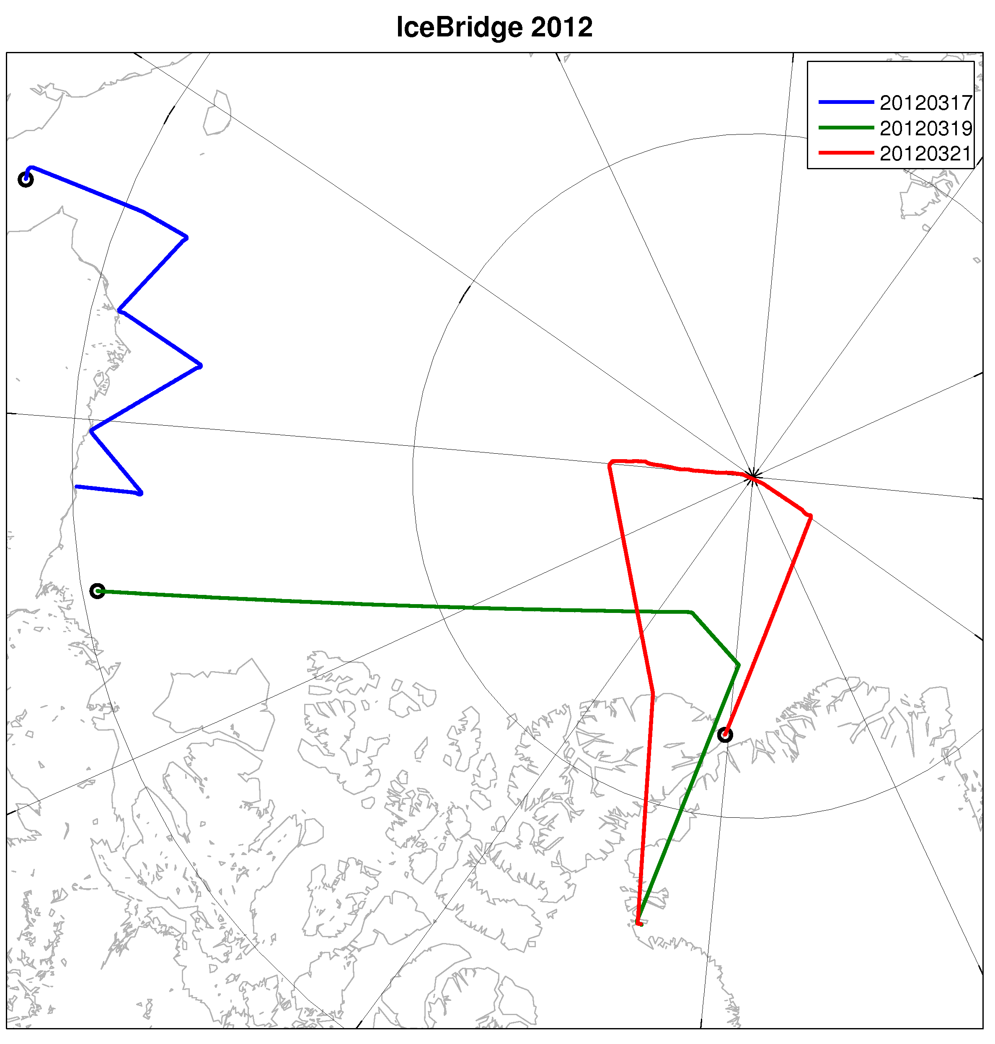
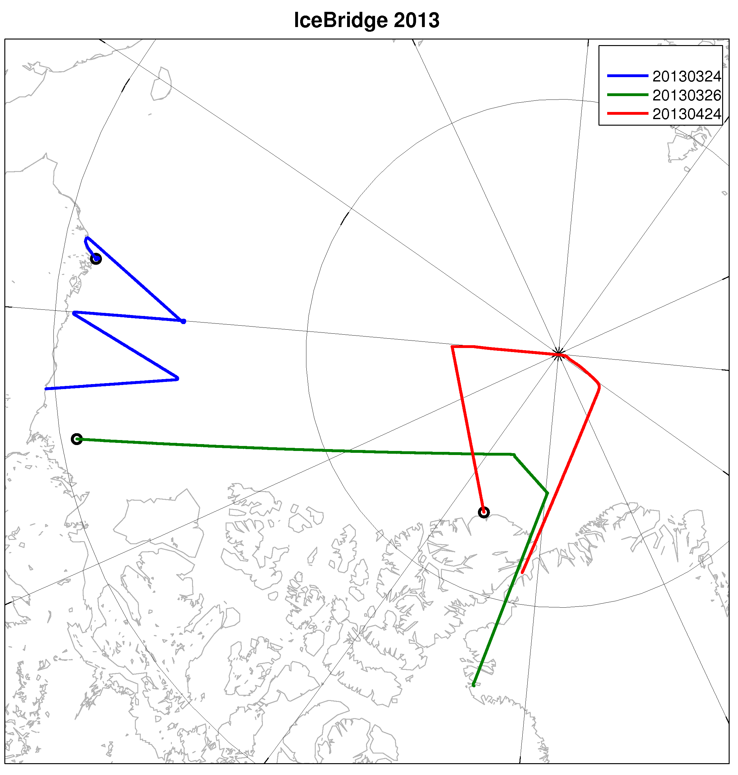
Ice Bridge
2012
2013
Notes:
Only those tracks we will look at. Virtually the same for each year.

Slide 7
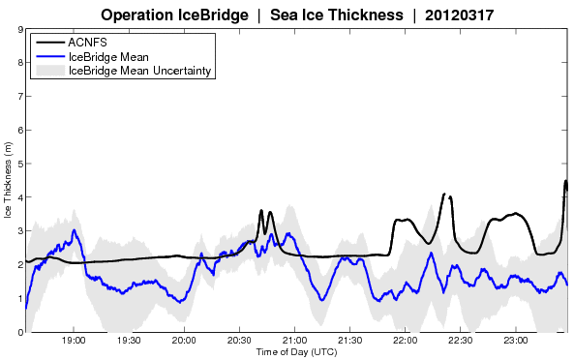
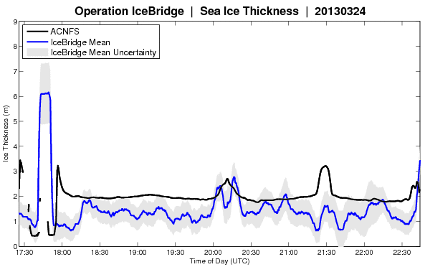
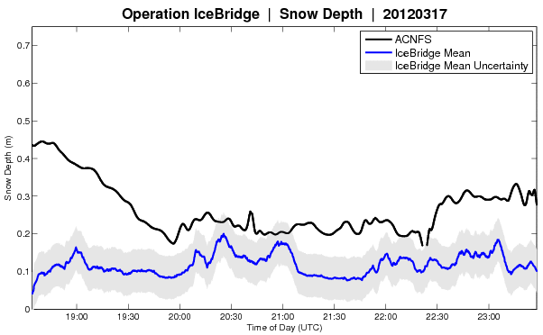
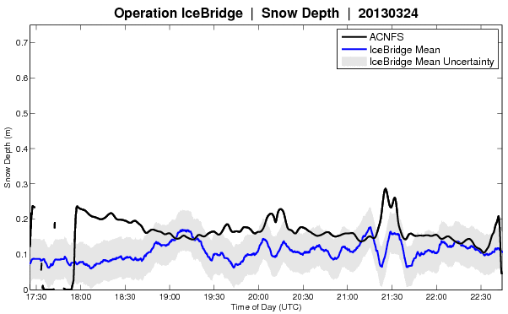
Ice Bridge - Beaufort Sea
2012
2013
9
meters
0
0.7
meters
0

Slide 8
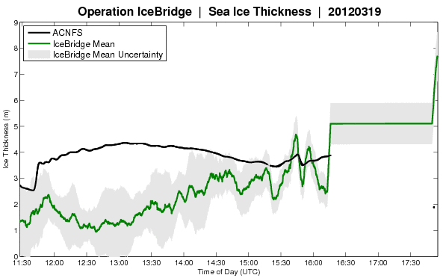
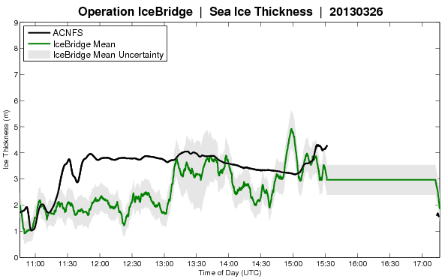
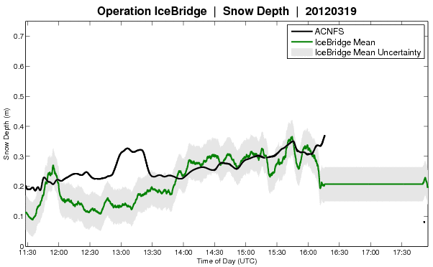
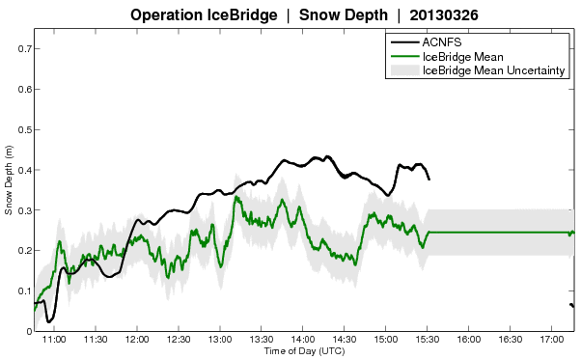
Ice Bridge - Canadian Archipelago
2012
2013
9
meters
0
0.7
meters
0

Slide 9
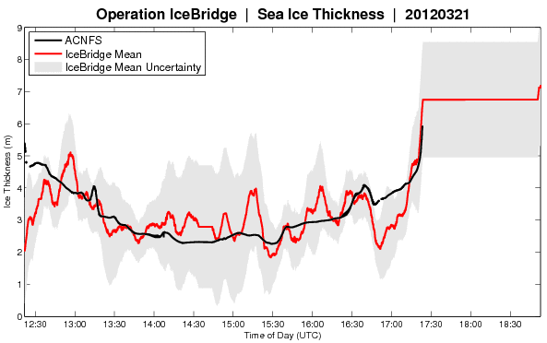
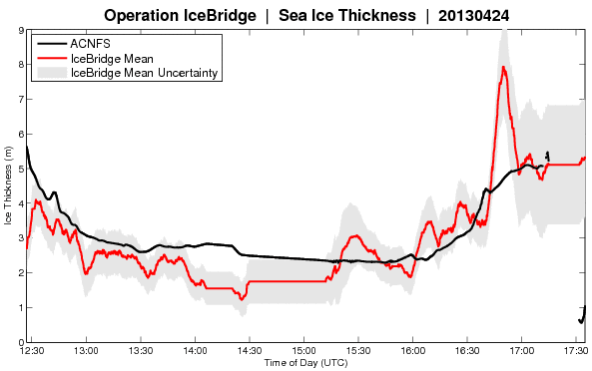
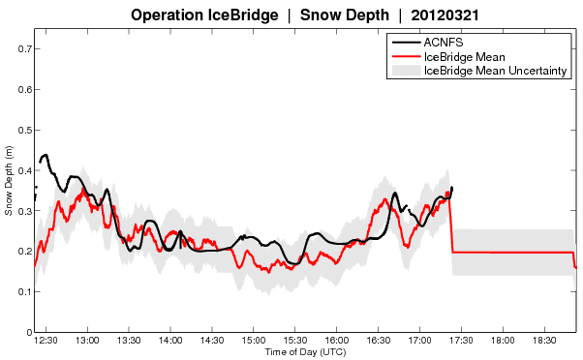
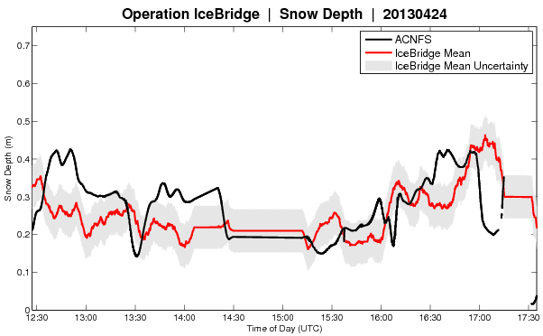
Ice Bridge - Central Arctic
2012
2013
9
meters
0
0.7
meters
0
Notes:
Black = ACNFS
Red = Ice Bridge

Slide 10
IMBB Ice Thickness - CRREL
ACNFS
IMBB
Notes:
ACNFS too thick. Need to add 2011.

Slide 11
MMP/ULS - WHOI

Slide 12
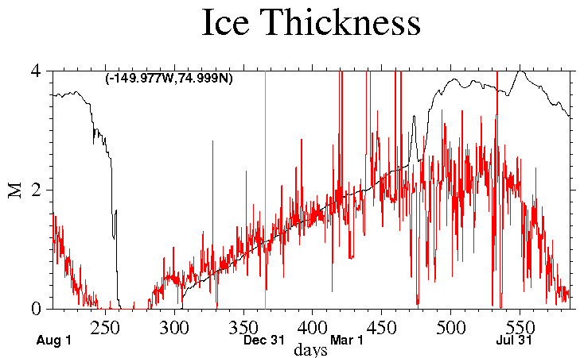
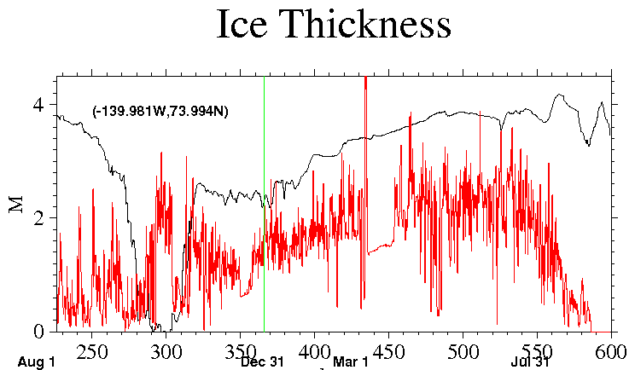
ULS Ice Draft - WHOI
Draft = 0.88 Ice thickness
Aug 2011-Aug 2012
6 hour moving average
Model too thick
Model growth OK.
Model Melt: not so much…
Mooring D
Mooring A
RED = ULS
BLACK = ACNFS

Slide 13
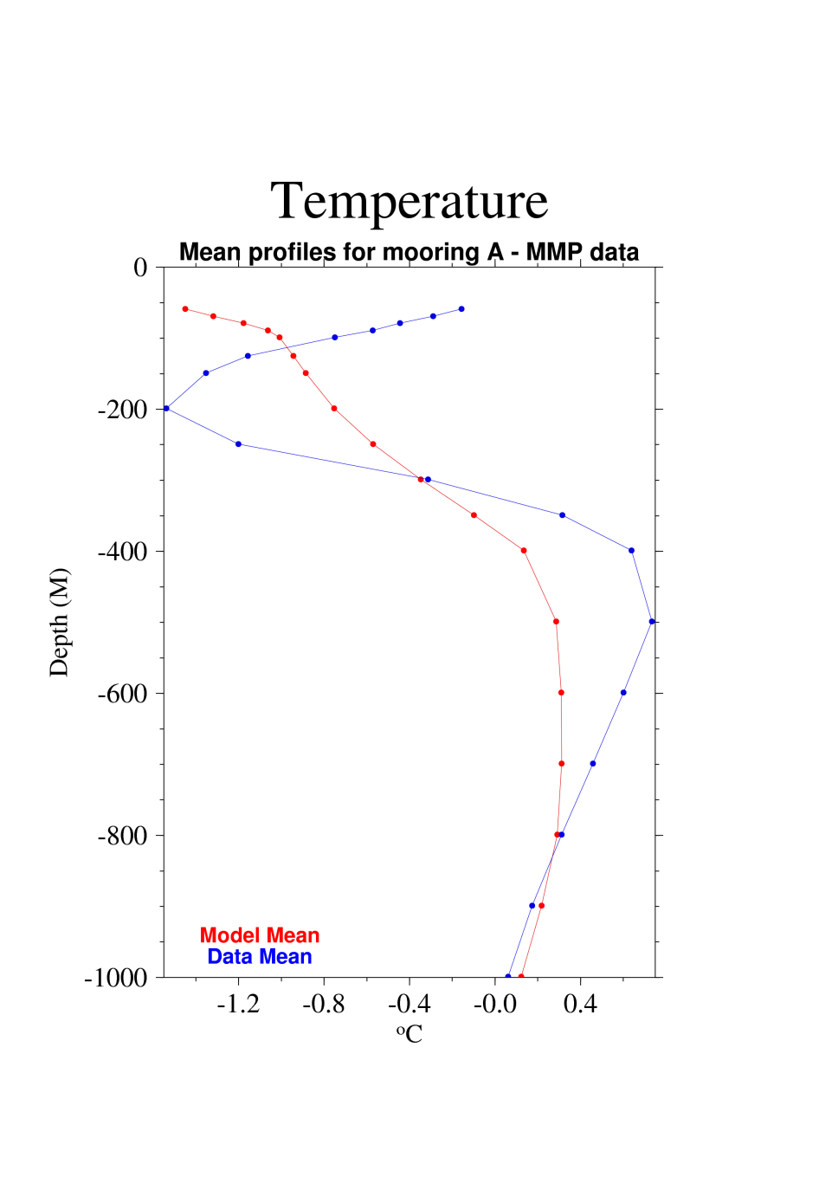
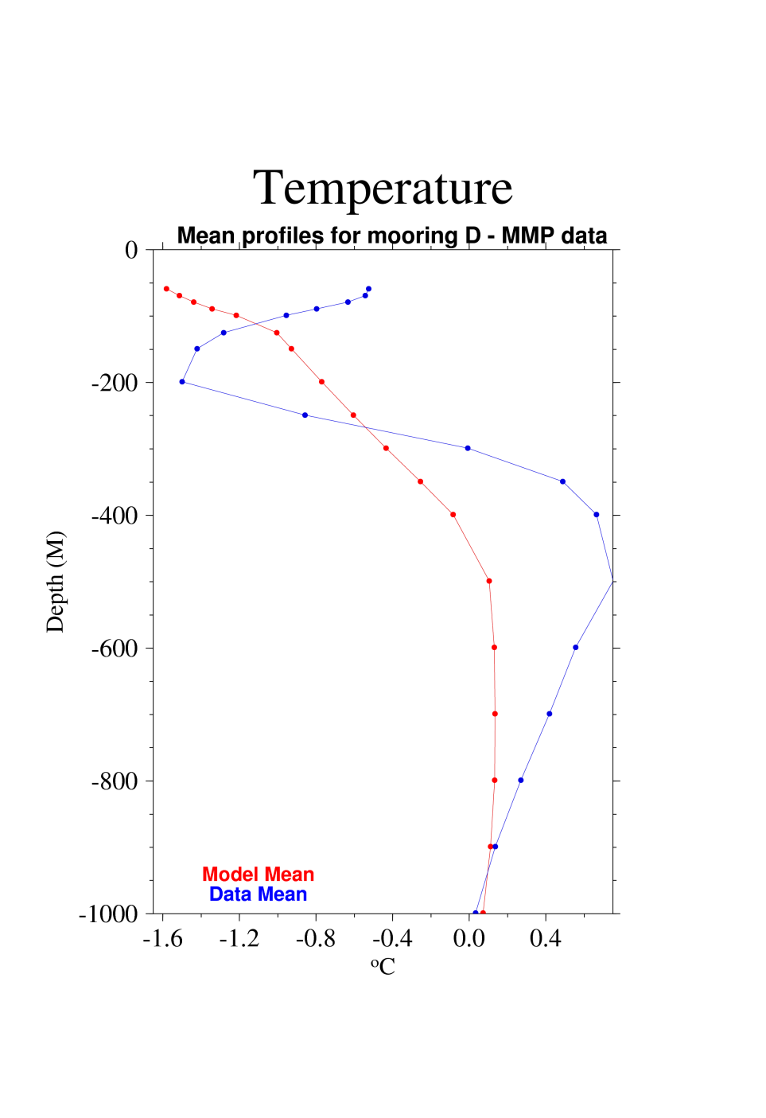
MMP - Temperature
Notes:
Completely missed warm upper layer

Slide 14
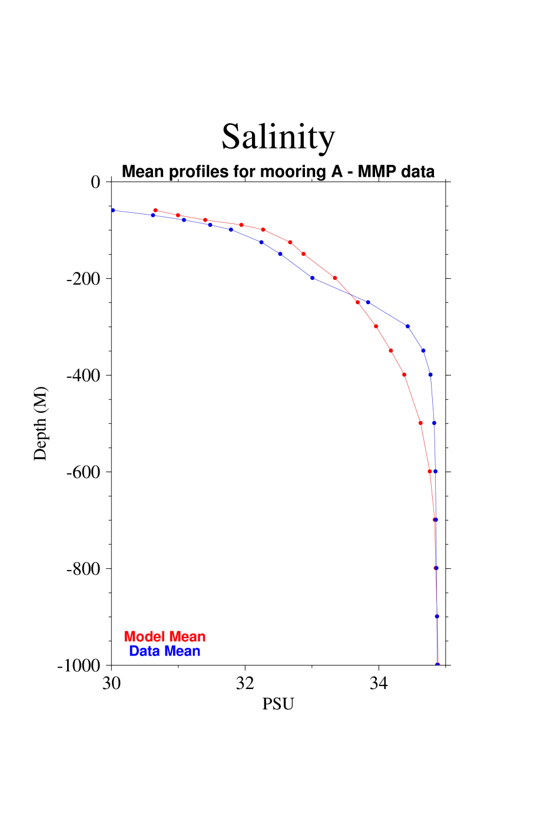
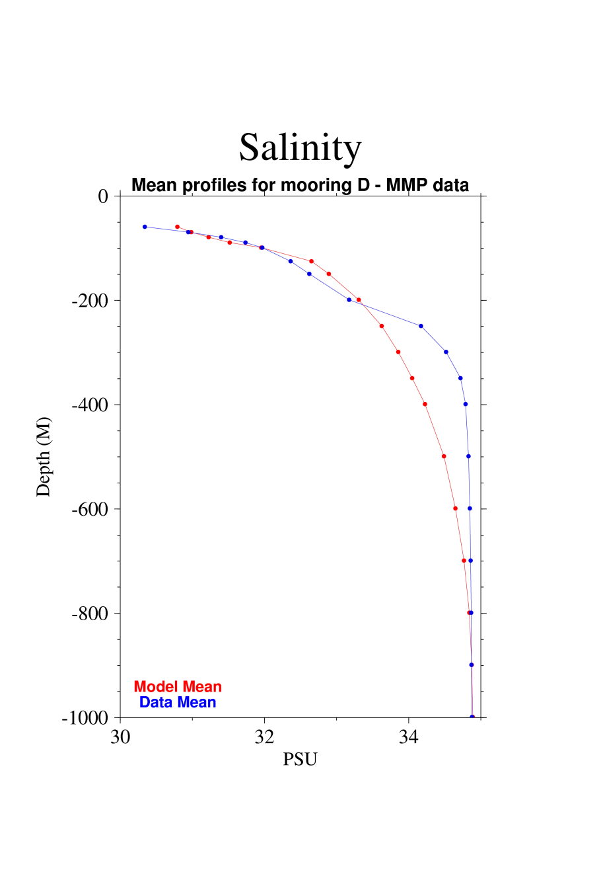
MMP - Salinity
Notes:
A little more saline, but not too bad

Slide 15
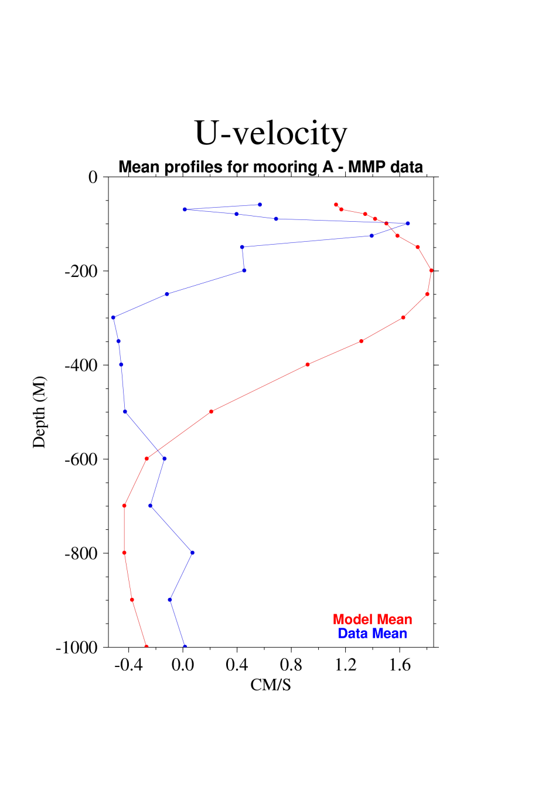
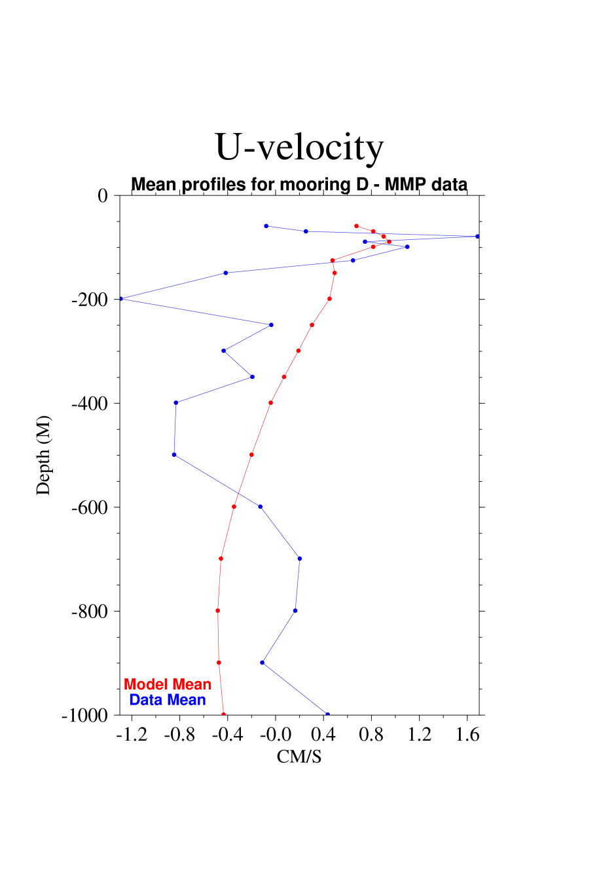
MMP – U velocity

Slide 16
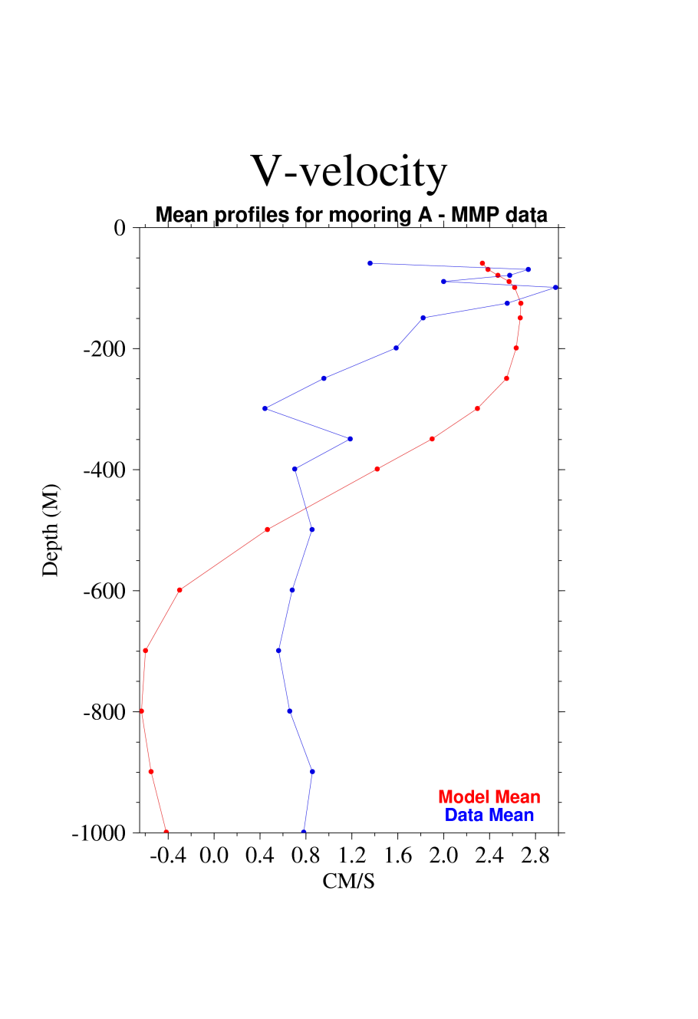
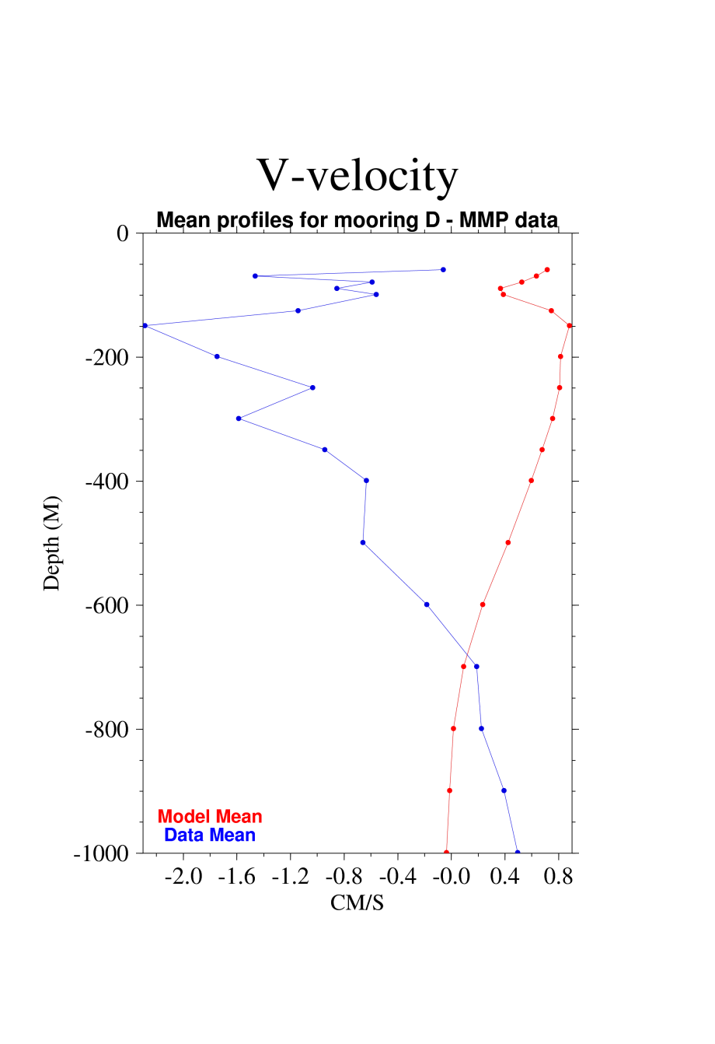
MMP – V velocity

Slide 17
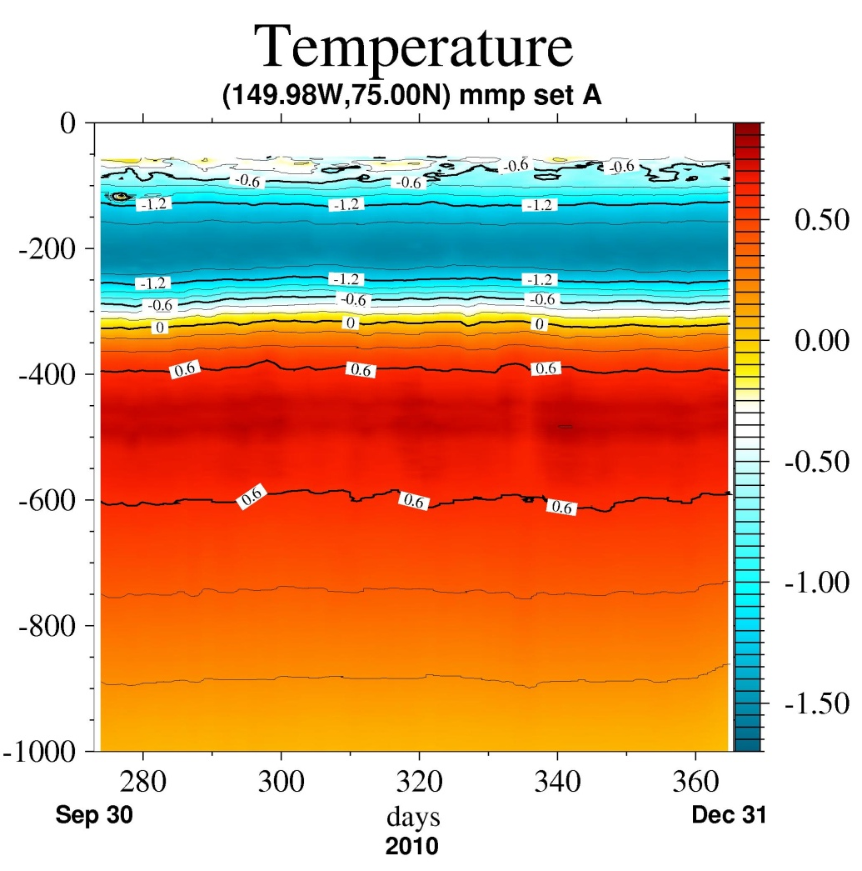
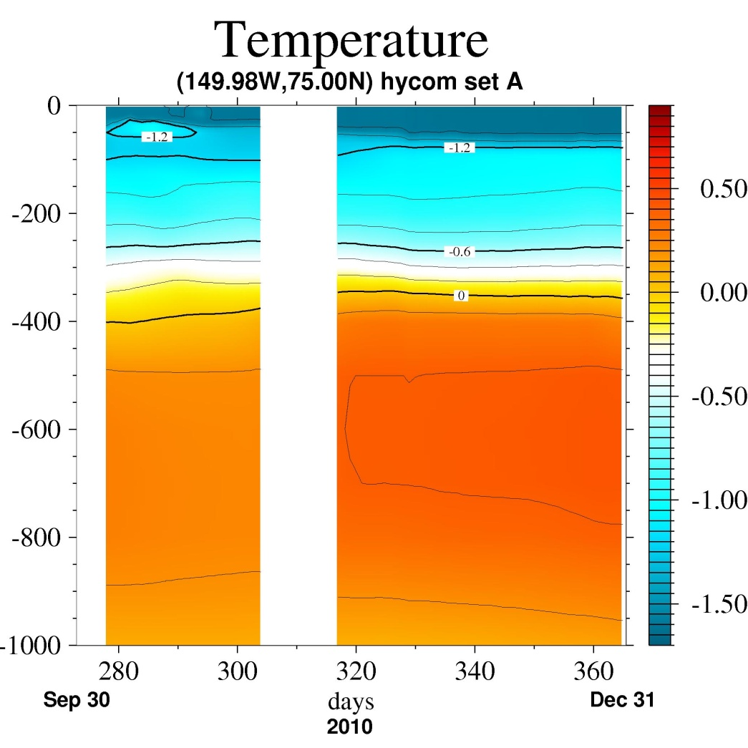
MMP vs. ACNFS Temp 2010

Slide 18
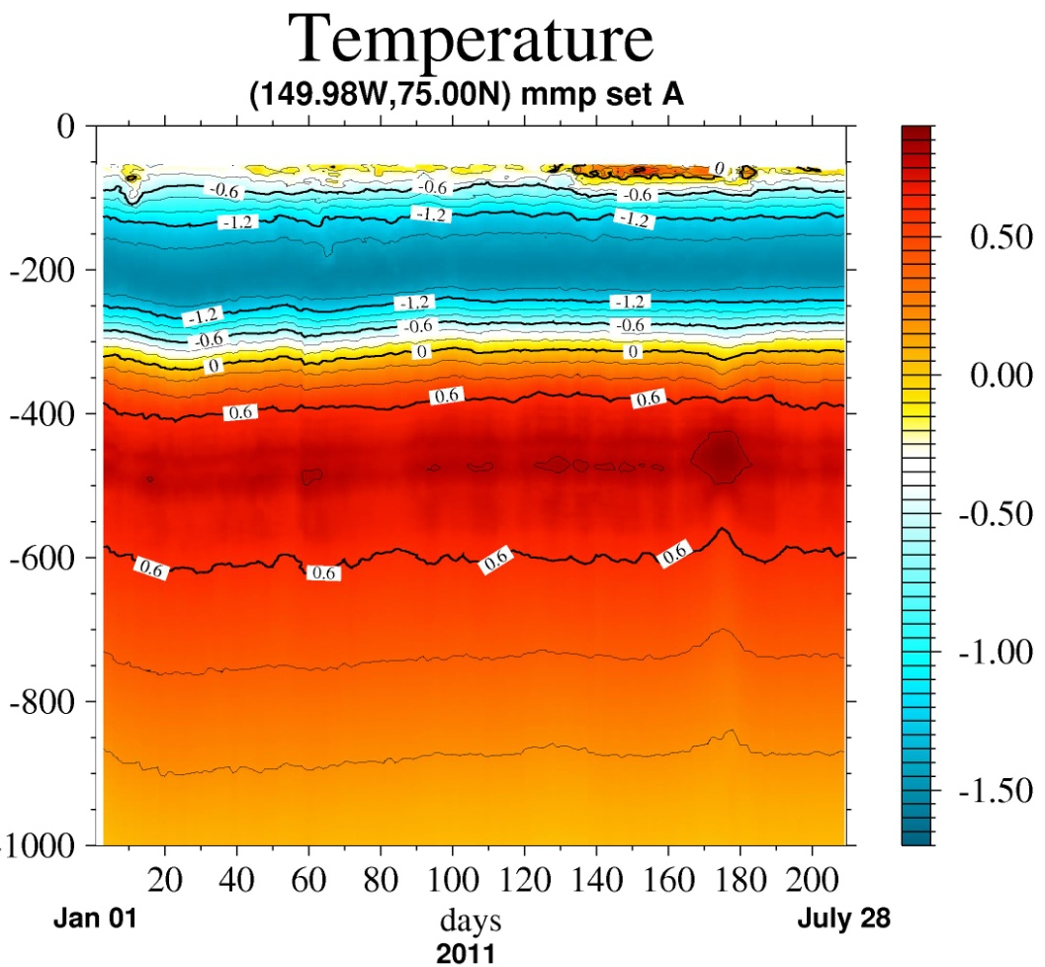
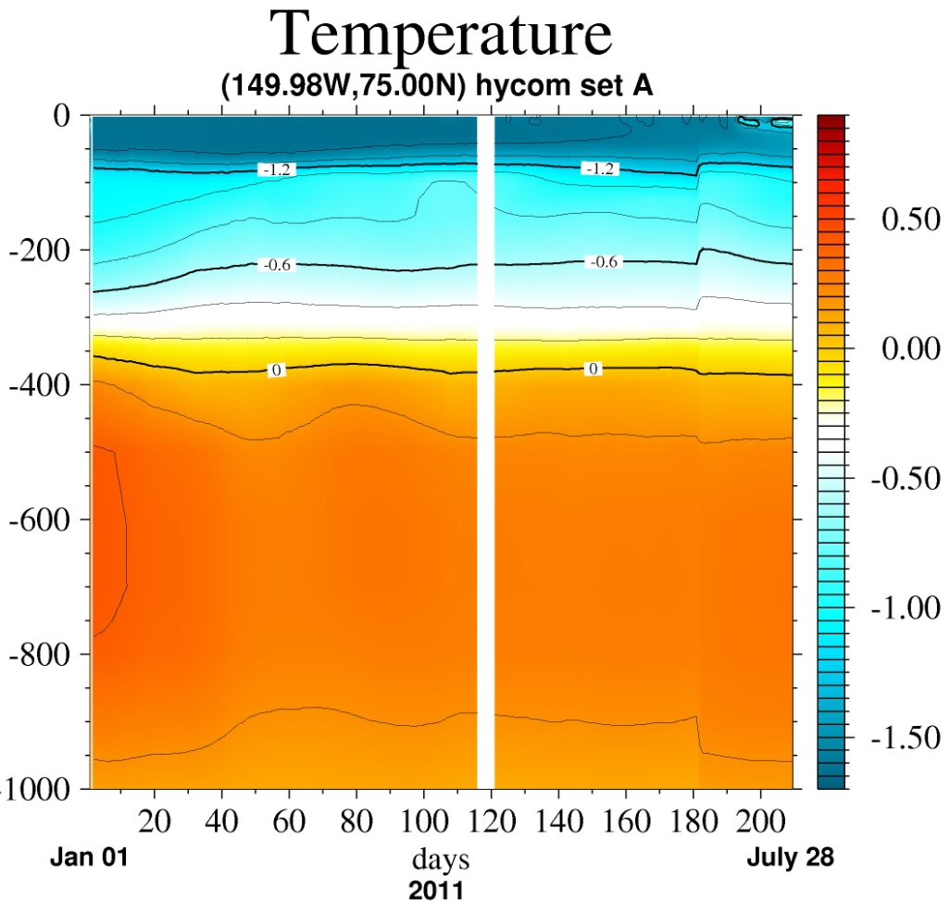
MMP vs. ACNFS Temp 2011
MMP
HYCOM

Slide 19
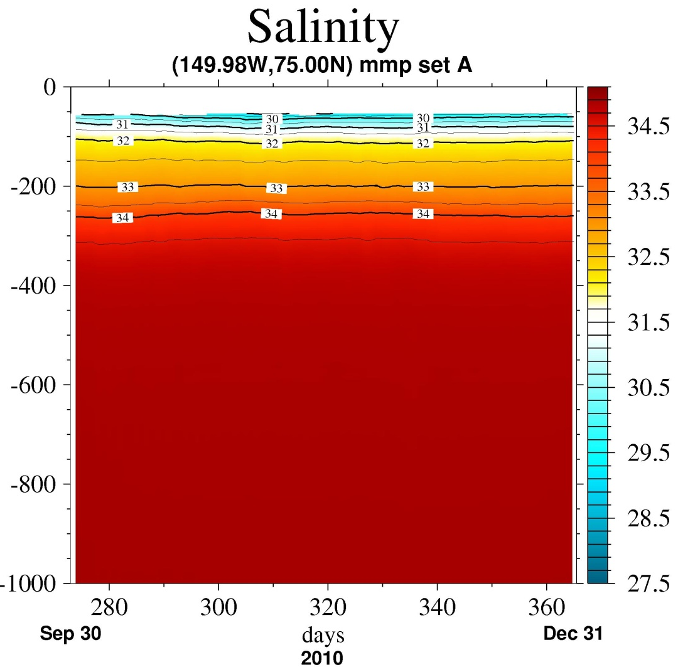
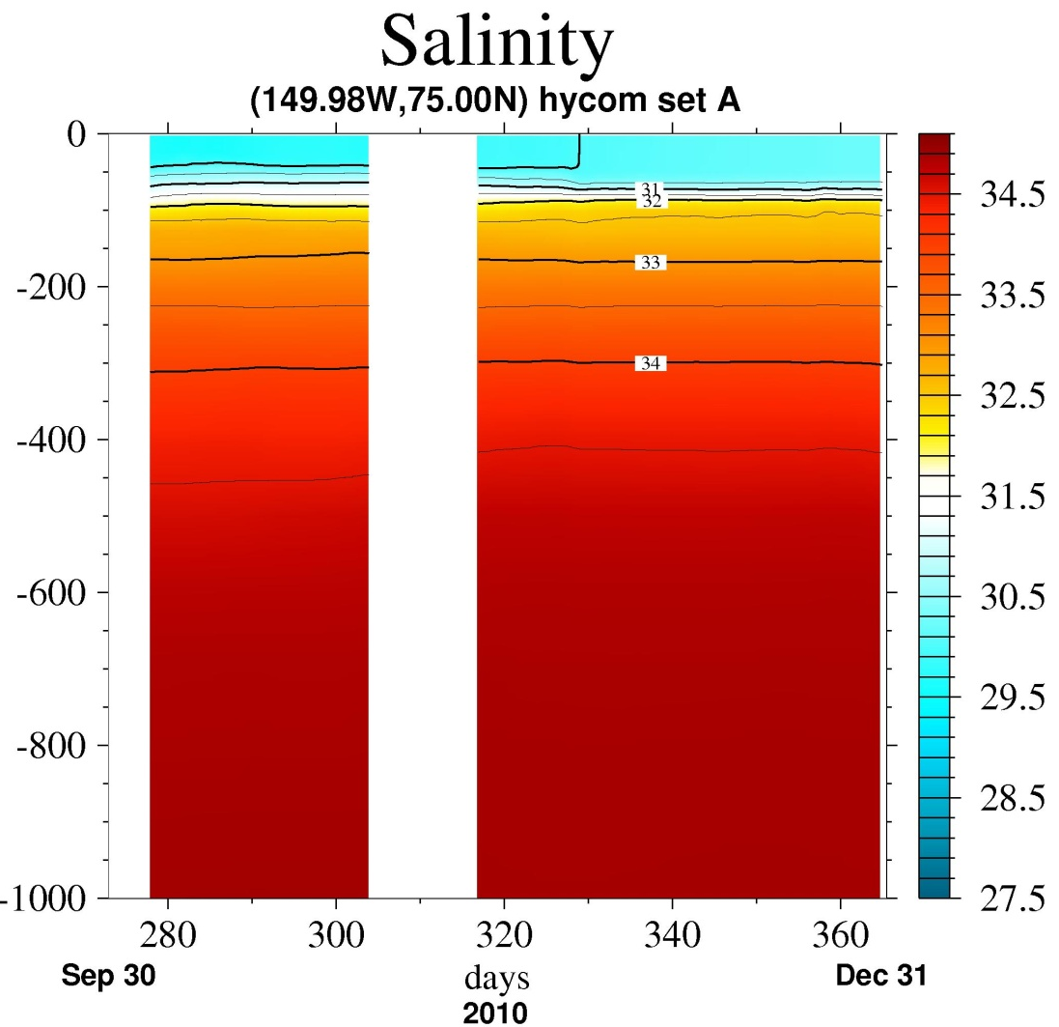
MMP vs. ACNFS Salinity 2010

Slide 20
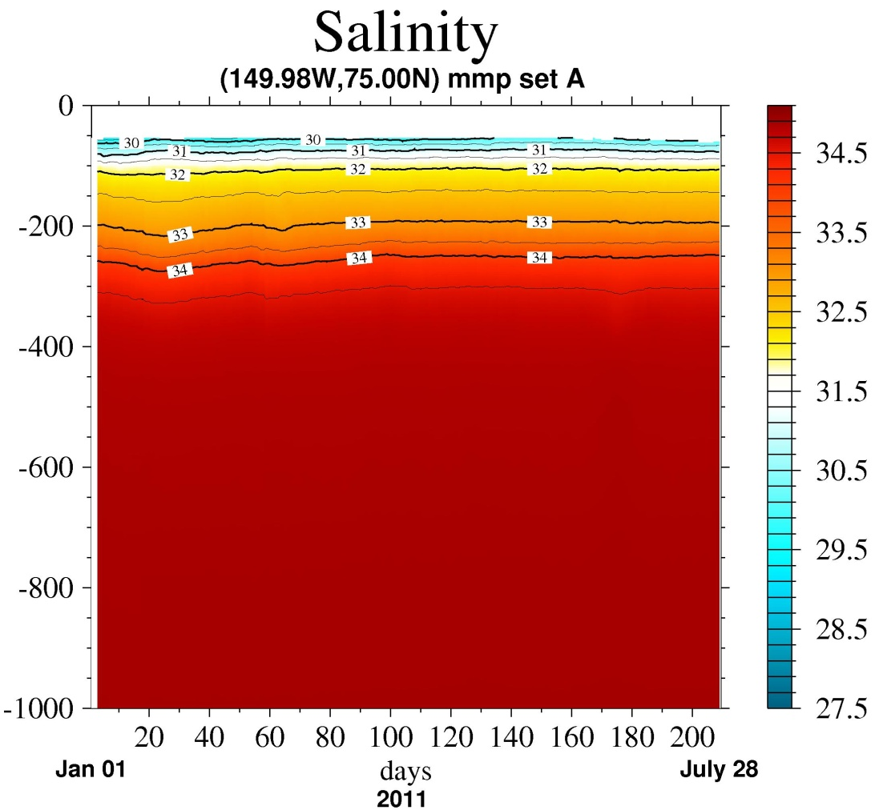
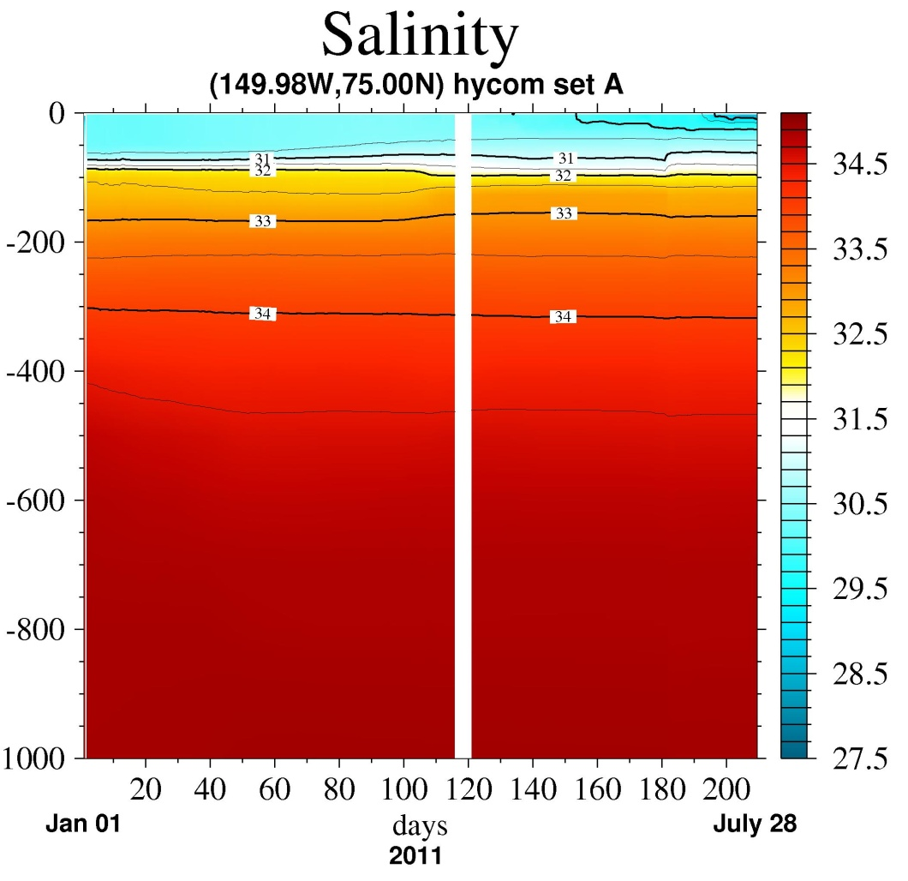
MMP vs. ACNFS Salinity 2011
MMP
HYCOM

Slide 21
GDEM - ACNFS - MMP T
Winter
Summer
GDEM4
MMP
ACNFS
2011-02-15
2011-08-15
Notes:
Both GDEM and HYCOM too cold. Upper 100m
Thermocline much different: MMP cools to 200m. GDEM isothermal layer. ACNFS thermocline starting at 50m

Slide 22
GDEM - ACNFS - MMP S
Winter
Summer
GDEM4
MMP
ACNFS
2011-02-15
2011-08-15
Notes:
MMP appears to be fresher at 50m
Both GDEM and ACNFS have Halocline uper layer; ACNFS fresher than GDEM.

Slide 23
ITP41 – WHOI

Slide 24
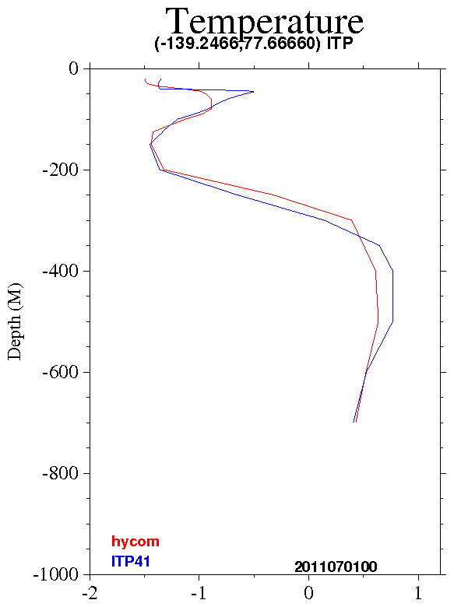
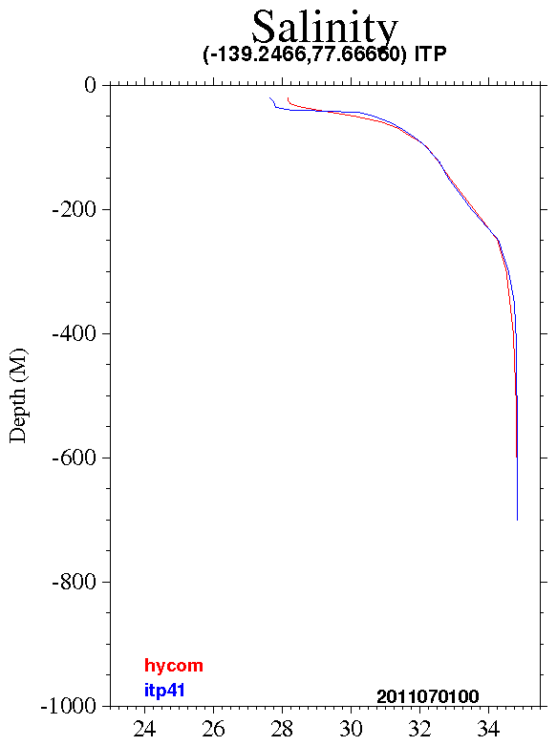
ITP41- WHOI
Weaker upper warm layer
Model too saline at surface
Cooler at depth

Slide 25
Summary
Many observations used to compare with ACNFS
ITP, IMBB, MMP, ULS, Ice Bridge
ACNFS too thick compared with Ice Bridge
Especially in Canadian Archipelago
Ice growth rate good during freezing season
Do not melt ice fast enough
Parameter tuning for albedo, melt ponds?
Ocean Mixed Layer?

Slide 26
Summary
In Beaufort ACNFS has too strong upper ocean velocity
ACNFS smooth upper ocean temp profile
Vertical resolution?
ACNFS salinity good at depth, too saline at surface
Not enough fresh water flux from ice melt?
Brine rejection parameterization? (New start project this year)

Slide 27
MMP Mooring D – 4 seasons

Slide 28
Temp MMP, ACNFS, GDEM4
Cast
ACNFS GDEM4

Slide 29
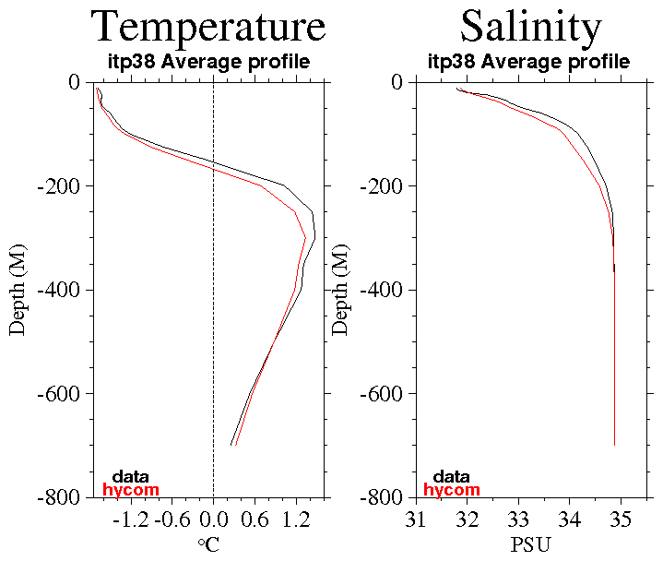
Assimilated T/S

Slide 30
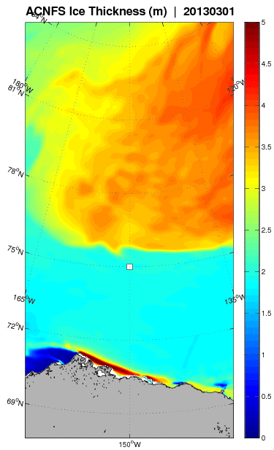
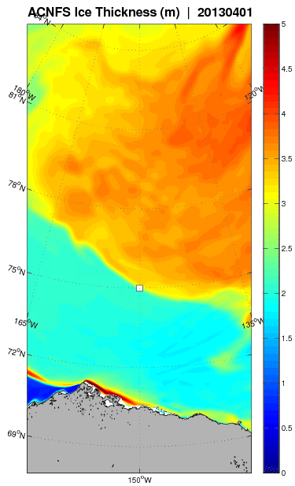
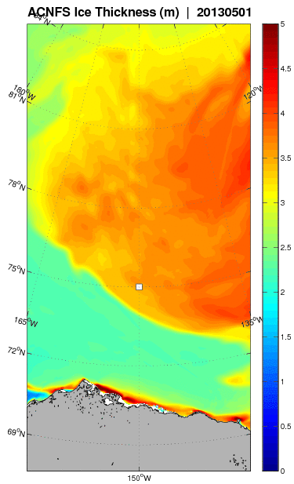
Ice Thickness 2013
March 1, 2013
April 1, 2013
May 1, 2013

